Slide 1
Dr.A Zandi
general sergeon and laparoscopic
Mainly based in Atieh Hospital Tehran
27/09/1393

Slide 2
CEO
Internationally accredited Bariatric Surgery Centre of Excellence

Slide 3
IFSO
International Federation for the Surgery of Obesity and Metabolic Disorders

Slide 4
WHY COE?

Slide 5
MORTALITEY .7 TO 1.2 % IN COE IN OTHER CENTER TILL 70% 70 TIME MORE

Slide 6
surgeons and allied health professionals, such as nurse practitioners, dieticians, nutritionists, psychologists and anaesthetists, involved in the treatment of patients with morbid obesity. The main goal of IFSO is to optimise the results of the treatment of patients with obesity.

Slide 7
1-All surgeons have a commitment to post-operative life-time follow up
2-All surgeons perform at least 50 cases per year including open and laparoscopic revision operations
3-All surgeons are involved in the training of less-experienced bariatric surgeons

Slide 8
The hospital has to be able to provide each patient with:
Specialised nursing care, dietary instruction and counselling
Psychological assessment (if and when needed)
Anaesthetists with a high level of experience of bariatric patients
Experienced interventional radiologists
On site critical care
Blood tests available 24hrs a day
Supervised support group meetings
At least five years experience of treating bariatric patients

Slide 9
The hospital has to have equipment and furniture throughout the hospital specifically designed for the care and comfort of our bariatric patients. When providing care and support to our bariatric patients maintaining our patients’ dignity is of the upmost importance

Slide 10
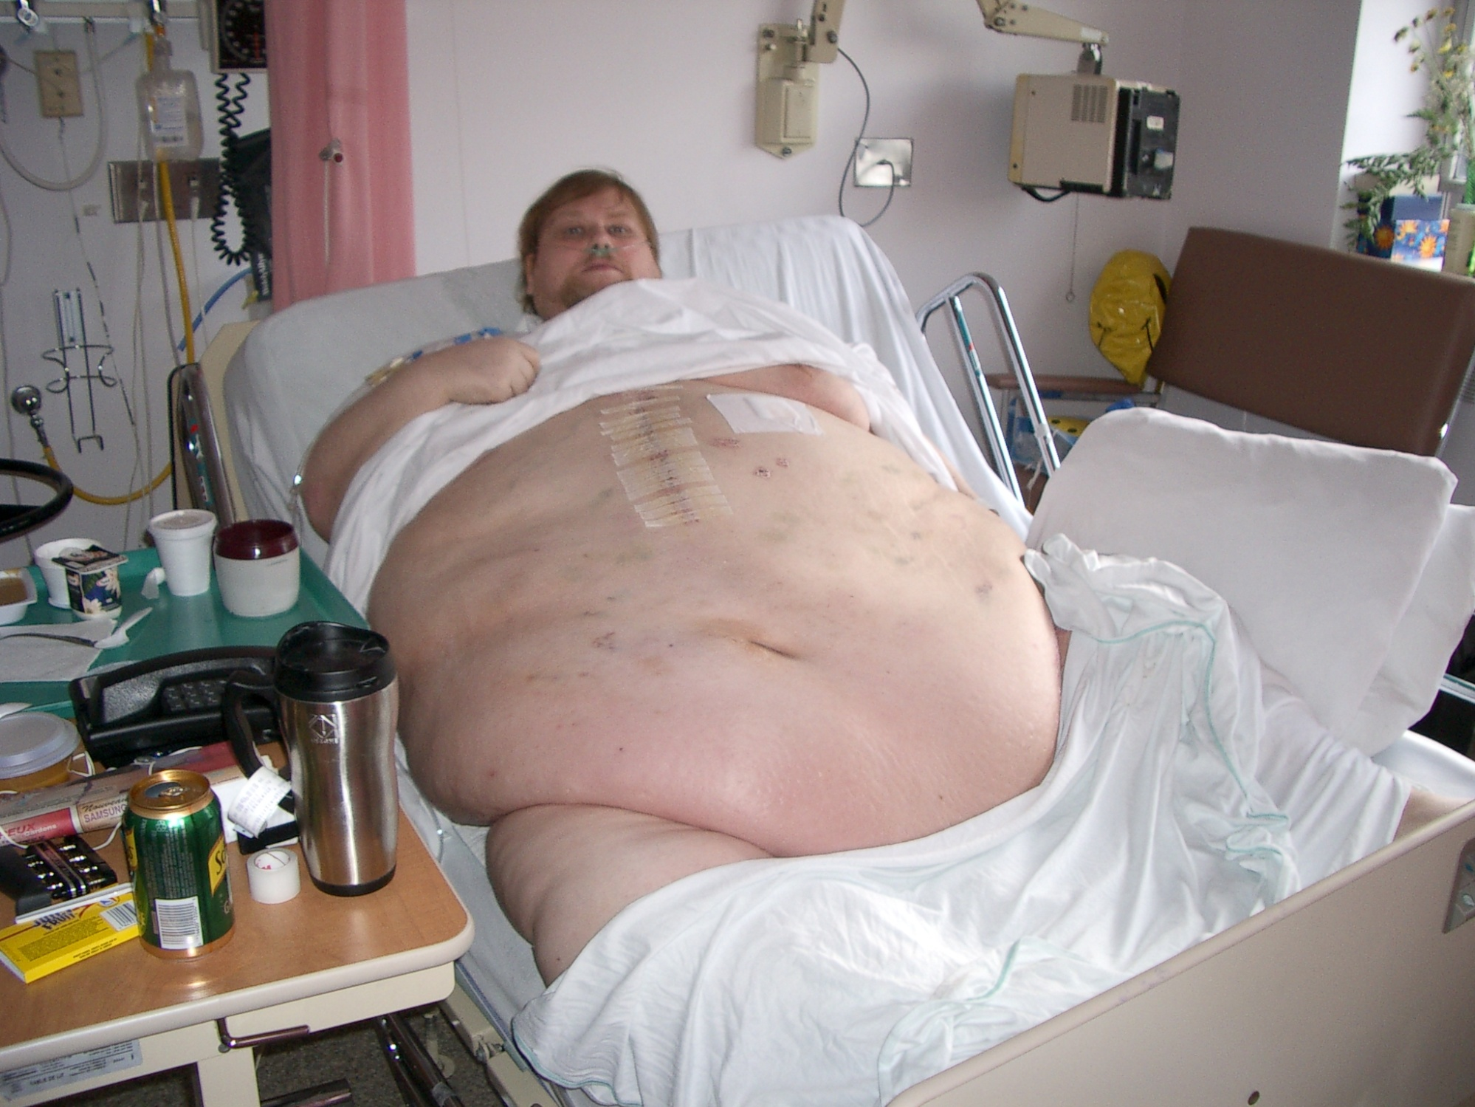

Slide 11
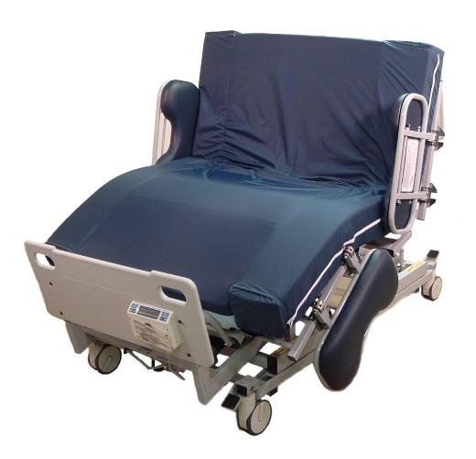

Slide 12
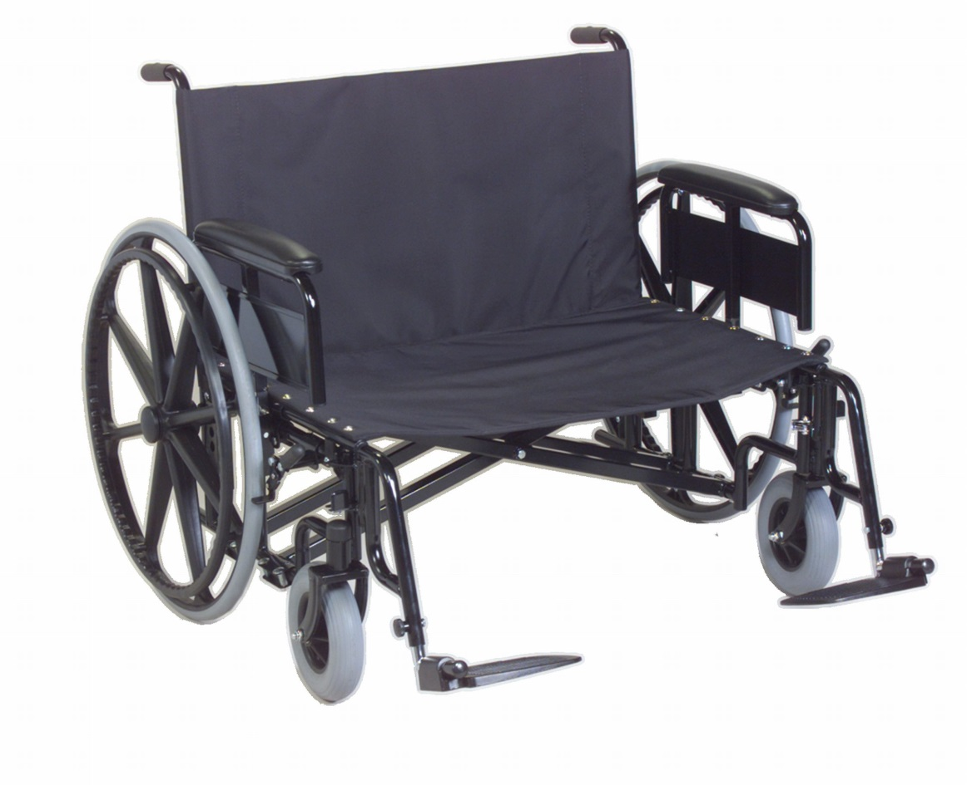

Slide 13
