Slide 1
Hypertriglyceridemia

Slide 2
HTG : fasting plasma TG concentration >95th percentile for age and gender in a population
The polygenic nature of hypertriglyceridaemia: implications for defi nition, diagnosis, and management Robert A Hegele etal, Lancet Diabetes Endocrinol.2014;2:655-656

Slide 3
Essentials of TRL metabolism
Most TG is transported in the plasma by TG-rich lipoproteins (TRL, which includes hepatically-derived VLDL and intestinally-derived chylomicrons), with measurable but quantitatively insignificant TG transported in LDL, lipoprotein(a) and HDL particles.
In fasting conditions, TG is predominantly carried in VLDL particles and their remnants, with chylomicrons absent from the plasma of a normolipidemic individual after a 14hour fast. In the postprandial state, TG is additionally carried in chylomicrons and their remnants.
Hypertriglyceridemia in the Genomic Era: a New Paradigm Gary F. Endocrine Reviews 2014: 10.1210/er -1062

Slide 4
Fasting TG concentration rises due to an accumulation of VLDL particles.
At a certain point that varies from individual to individual (when plasma TG rises to> 500 to 1000 mg/dL) chylomicrons will also begin to accumulate in fasting plasma.
Hypertriglyceridemia in the Genomic Era: a New Paradigm Gary F. Endocrine Reviews 2014: 10.1210/er -1062

Slide 6
Hypertriglyceridemia in the Genomic Era: a New Paradigm Gary F. Endocrine Reviews 2014: 10.1210/er -1062

Slide 7
HTG has generally been classified as ‘primary’ when a definite familial or inherited basis is suspected, while ‘secondary’ HTG refers to cases where there coexist one or more identifiable secondary conditions such as metabolic syndrome, T2D, alcohol consumption, various medications, renal insufficiency and pregnancy, etc.,
Although monogenic forms of HTG such as autosomal recessive lipoprotein lipase (LPL) deficiency do exist as the sole cause of HTG, they are relatively rare.
Most cases of HTG are felt to be polygenic, with strong influence by environmental factors.
Furthermore, some of the important ‘secondary’ factors, such as insulin resistance, are also strongly genetically determined conditions.
Hypertriglyceridemia in the Genomic Era: a New Paradigm Gary F. Endocrine Reviews 2014: 10.1210/er -1062

Slide 8
Familial should not be thought of as synonymous with monogenic; most cases of hypertriglyceridaemia are familial or inherited, but they are not monogenic.
Hypertriglyceridemia in the Genomic Era: a New Paradigm Gary F. Endocrine Reviews 2014: 10.1210/er -1062

Slide 9
Mild-to-moderate hypertriglyceridaemia is often viewed as a marker of cardiovascular disease risk, whereas severe hypertriglyceridaemia remains a well known risk factor for acute pancreatitis.
Although the need to intervene in an individual with severe hypertriglyceridaemia is un disputed, the appropriate response for mild-to-moderate hypertriglyceridaemia is less clear.
The polygenic nature of hypertriglyceridaemia: implications for defi nition, diagnosis, and management Robert A Hegele etal, Lancet Diabetes Endocrinol.2014;2:655-656

Slide 10
This paradox was accounted for by the fact that at greatly elevated concentrations (triglycerides >50 mmol/L), triglyceride lipoproteins are too large to enter into the arterial intima and therefore cannot lead to development of atherosclerosis.
By contrast, at mild–to–moderately raised triglyceride concentrations (2–10 mmol/L), lipoproteins are small enough to enter into the arterial wall and thus have the potential to accumulate and cause atherosclerosis.
.Lipids and cardiovascular disease 3 Triglycerides and cardiovascular disease
Lancet 2014; 384: 626–635.Bّrge G Nordestgaard, Anette Varbo

Slide 11
The polygenic nature of hypertriglyceridaemia: implications for definition, diagnosis, and management Robert A Hegele etal, Lancet Diabetes Endocrinol.2014;2:655-656

Slide 12
The polygenic nature of hypertriglyceridaemia: implications for definition, diagnosis, and management Robert A Hegele etal, Lancet Diabetes Endocrinol.2014;2:655-656

Slide 13
Hypertriglyceridemia: its etiology, effects and treatment,George Yuan. CMAJ . April 10, 2007 :176(8)

Slide 14
Plasma TG level as a function of production and clearance
PR=production rate and fractional clearance rate (FCR).
Hypertriglyceridemia in the Genomic Era: a New Paradigm Gary F. Endocrine Reviews 2014: 10.1210/er -1062

Slide 15
monogenic TG phenotypes
Homozygous or compound heterozygous mutations, which tend to occur in certain key genes, can compromise lipolysis and underlie clinical expression of a monogenic phenotype.
monogenic HTG is caused by mutations in genes that encode proteins needed for the efficient metabolism of TRL, including
LPL
APOC2
APOA5
LMF1
GPIHBP1
Hypertriglyceridemia in the Genomic Era: a New Paradigm Gary F. Endocrine Reviews 2014: 10.1210/er -1062

Slide 16
Hypertriglyceridemia in the Genomic Era: a New Paradigm Gary F. Endocrine Reviews 2014: 10.1210/er -1062

Slide 17
familial chylomicronemia syndrome
A rare autosomal recessive disease characterized by the buildup in the blood of fat particles called chylomicrons (chylomicronemia), severe hypertriglyceridemia, and the risk of recurrent and potentially fatal pancreatitis and other complications It is caused by mutations in the gene encoding LPL or, less frequently, by mutations in genes encoding other proteins necessary for LPL function.
Heterozygotes may show slight hyperlipemia and reduced PHLA.
Targeting APOC3 in the Familial Chylomicronemia Syndrome .nejm.371;23 . december 4, 2014

Slide 18
Patients with this syndrome have plasma triglyceride levels ranging from 10 to 100 times the normal value (1500 to 15,000 mg per deciliter [17 to 170 mmol per liter]), the plasma to have a milky ("lactescent" or "lipemic") appearance.
eruptive xanthomas
Arthralgias
neurologic symptoms
lipemia retinalis
hepatosplenomegaly
risk for artifactual alterations in laboratory analyses.

Slide 19
Patients with monogenic disorders have substantially increased fasting concentrations of chylomicrons, but usually do not develop premature atherosclerosis, probably because of size exclusion that limits the ability of chylomicrons to traverse the vascular endothelial barrier.
Hypertriglyceridemia in the Genomic Era: a New Paradigm Gary F. Endocrine Reviews 2014: 10.1210/er -1062

Slide 20
Nearly all patients have recurrent episodes of severe abdominal pain, with or without pancreatitis, that interfere with normal life and result in frequent hospitalizations.
These episodes can result in chronic pancreatitis and symptoms of exocrine or endocrine insufficiency, including diabetes and even fatal events.
Hypertriglyceridemia in the Genomic Era: a New Paradigm Gary F. Endocrine Reviews 2014: 10.1210/er -1062

Slide 21
Familial LPL deficiency usually manifests by 10 years of age, and in 25% occurs during infancy.
Sometimes this condition is silent and the initial clue to the diagnosis is the presence of lipemic plasma.
FAMILIAL CHYLOMICRONEMIA SYNDROME .Pediatric Dermatology Vol. 24 No. 3 May⁄ June 2007

Slide 22
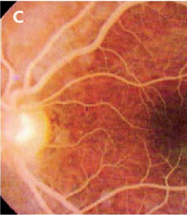
Hypertriglyceridemia: its etiology, effects and treatment,George Yuan. CMAJ . April 10, 2007 :176(8)

Slide 23
Pregnancy
Plasma lipid levels are altered during pregnancy, within the hormonal milieu.
Plasma TG concentrations are similar to nonpregnant levels in the first trimester and normally increase 2- to 4-fold in the second and third trimesters.
The concentration of all lipoprotein fractions increases during pregnancy.
VLDL cholesterol and TG increase 2.5-fold over prepregnancy levels and LDL cholesterol increases 1.6-fold, all with peak levels at term.
HDL cholesterol is maximally increased in midgestation by 1.45-fold and subsequently declines to 1.15-fold at term.
In the third trimester, VLDL production is increased, while TG clearance by LPL is reduced.
Hypertriglyceridemia in the Genomic Era: a New Paradigm Gary F. Endocrine Reviews 2014: 10.1210/er -1062

Slide 24
For most women with normal baseline TG levels and no compromise in metabolic pathways, such increases are well tolerated without clinically significant HTG.
However, in the presence of endogenous tendency towards increased TRL production or compromised catabolic pathways, plasma TG may rise above the 95th percentile for age and severe HTG can develop, especially in later pregnancy.
While it may be possible that significant pregnancy-induced HTG develops in the setting of no obvious underlying genetic susceptibility, most cases very likely occur on a background of genetic susceptibility factors, for instance, homozygous or compound heterozygous mutations in the LPL gene causing LPL deficiency .
Even heterozygous mutations in the LPL gene that do not result in hypertriglyceridemia in the nonpregnant state may result in marked HTG during pregnancy.
Hypertriglyceridemia in the Genomic Era: a New Paradigm Gary F. Endocrine Reviews 2014: 10.1210/er -1062

Slide 25
Hypertriglyceridemia in the Genomic Era: a New Paradigm Gary F. Endocrine Reviews 2014: 10.1210/er -1062

Slide 26
Diagnosis
More than 100 mutations of the LPL gene have been described and for this reason biochemical rather than genetic evaluation is still performed.
Fasting patients are given an intravenous injection of 60 units/kg of heparin, which releases LPL into the bloodstream.
Ten minutes later, a sample of postheparin blood is obtained and stored on ice, after which the plasma is frozen and sent to a lipid specialty laboratory for analysis.
Heparin species are calibrated by their anticoagulant activity and their ability to release LPL into the plasma varies, so a normal control postheparin plasma obtained with use of the same heparin is needed.

Slide 27
Hepatic lipase is also routinely measured in these samples.
Postheparin samples should not clot. If they do, it may be an indicator of a defective injection or antibodies to heparin (e.g., in the case of a patient with an autoimmune disease).
Postheparin plasma is not usually obtained during an acute episode of pancreatitis.
Patients with a history of bleeding disorders or recent use of anticoagulant or anti-platelet drugs should be studied with caution, if at all.
Deficiency of apoCII, the LPL activator, and inhibitors of LPL such as antibodies can be detected by mixing the patient's serum with a standard human or bovine source of LPL and then assessing activity.

Slide 28
At present, the diagnosis can be made by DNA sequence analysis, which shows mutations in both LPL alleles causing complete LPL deficiency; mutations in the other genes can also be detected by resequencing.

Slide 29
TREATMENT
Currently available triglyceride-lowering agents are not completely effective in controlling chylomicronemia in these patients
The only therapeutic approach that effectively maintains triglyceride levels below 880 mg per deciliter (10 mmol per liter), a value that greatly reduces the risk of pancreatitis, is severe dietary fat restriction low simple sugars, fructose avoidance of alcohol and certain medications
Lifetime compliance with these requirements is difficult, and episodes of chylomicronemia, abdominal pain, and recurrent pancreatitis are common.
The polygenic nature of hypertriglyceridaemia: implications for definition, diagnosis, and management Robert A Hegele etal, Lancet Diabetes Endocrinol.2014;2:655-656

Slide 30
John D. Brunzell. Hypertriglyceridemia .N Engl J Med 2007;357:1009-17

Slide 31
Dietary modification plays a key role in the management of this disease
recommended fat intake is restricted to 10%–15% of total energy intake (about 15–20 g/d), with reductions in saturated, unsaturated and trans fats with supplementation with fat soluble vitamins
Consultation with a dietician can be very helpful.
Plasma triglyceride response to diet and weight loss is about 25%, with marked variation among patients.
The polygenic nature of hypertriglyceridaemia: implications for definition, diagnosis, and management Robert A Hegele etal, Lancet Diabetes Endocrinol.2014;2:655-656

Slide 32
Medium-chain triglycerides are the preferred source of dietary fat.
Familial apolipoprotein-CII deficiency is also treated with fat restricted diet and by plasma or synthetic apolipoprotein-CII infusion .
FAMILIAL CHYLOMICRONEMIA SYNDROME .Pediatric Dermatology Vol. 24 No. 3 May⁄ June 2007

Slide 33
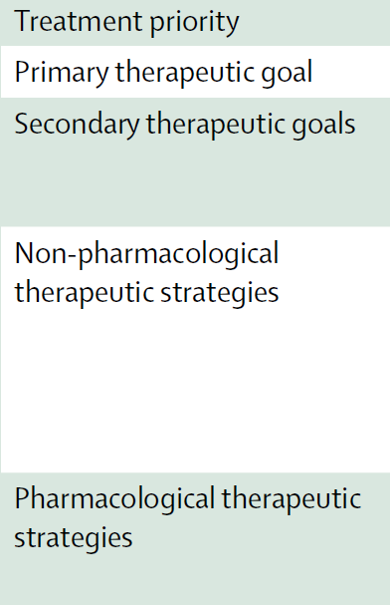
The polygenic nature of hypertriglyceridaemia: implications for definition, diagnosis, and management.Robert A Hegele etal, Lancet Diabetes Endocrinol.2014;2:655-656

Slide 34
Hypertriglyceridemia: its etiology, effects and treatment,George Yuan. CMAJ . April 10, 2007 :176(8)

Slide 35
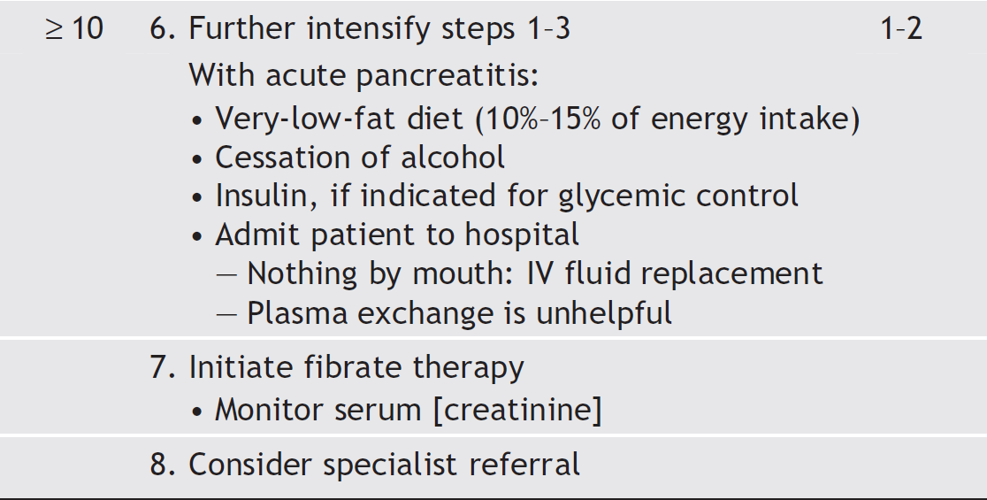
Hypertriglyceridemia: its etiology, effects and treatment,George Yuan. CMAJ . April 10, 2007 :176(8)

Slide 36
Fibrates
triglyceride-lowering effect of 40%, dependent on baseline triglyceride concentrations
fibrates are the firstline treatment to decrease risk of pancreatitis for patients with triglyceride concentrations of more than 10 mmol/L.
Nicotinic acid
Treatment with nicotinic acid (also known as niacin) at a dose of 2–3 g/day is associated with up to 30% reduction in triglyceride concentration, 20% increase in HDL cholesterol concentration, up to 20% lowering of LDL cholesterol concentration, and up to 25% reduction in lipoprotein(a) concentration.
The polygenic nature of hypertriglyceridaemia: implications for definition, diagnosis, and management.Robert A Hegele etal, Lancet Diabetes Endocrinol.2014;2:655-656

Slide 37
Omega-3 fatty acids
Omega-3 fatty acids (e.g., eicosapentaenoic and docosahexaenoic acid) are components of both the Mediterranean diet and of fish oils
Omega-3 polyunsaturated fatty acids at doses of up to 4 g daily reduce triglyceride concentrations by up to 30%, dependent on baseline concentrations, and might therefore be useful for prevention of pancreatitis.
However, omega-3 fatty acids are rarely effective when
used as the sole triglyceride-lowering therapy.
The polygenic nature of hypertriglyceridaemia: implications for definition, diagnosis, and management.Robert A Hegele etal, Lancet Diabetes Endocrinol.2014;2:655-656

Slide 38
Hypertriglyceridemia and pancreatitis
Although a few patients can develop pancreatitis when their fasting triglyceride concentration is 5–10 mmol/L, its risk becomes clinically significant when fasting measurements exceed 10 mmol/L, a level at which chylomicrons are present.
A threshold value of 1000 mg/dL (about 11.3 mmol/L) is often cited, but the clinical relevance and implications of a rounded threshold of 10 mmol/L for “very high” triglycerides are comparable.
Hypertriglyceridemia: its etiology, effects and treatment,George Yuan. CMAJ . April 10, 2007 :176(8)

Slide 39
Triglyceride- induced pancreatitis can be preceded by episodic nausea and epigastric pain, during which serum amylase may not exceed common diagnostic cutoffs.
The onset of full-blown acute pancreatitis can be prevented by restriction of dietary fat or the use of fibrates.
Treatment of acute cases includes hemodynamic stabilization, cessation of all oral intake, placement of a nasogastric tube and control of metabolic disturbances.
Restricted energy intake is associated with a brisk decrease in plasma triglyceride levels.
Plasmapheresis has been attempted in extreme cases, but the benefit was transient.
The threshold for developing pancreatitis can vary widely; some asymptomatic people live with triglyceride levels chronically in excess of 40 mmol/L.
Hypertriglyceridemia: its etiology, effects and treatment,George Yuan. CMAJ . April 10, 2007 :176(8)

Slide 40
Feoli-Fonseca et al. (1998): chylomicronemia responded rapidly to dietary fat restriction, and it was possible to maintain satisfactory metabolic control for a prolonged period of time. Only 1 adolescent girl had an episode of pancreatitis associated with the use of oral contraceptives. Heaney et al. (1999) :reported a dramatic response to antioxidant therapy (Antox, 1 tablet 4 times daily) in 3 patients with familial lipoprotein lipase deficiency complicated by frequent severe episodes of pancreatitis. Because these patients failed to respond to other dietary and pharmacologic measures, the authors concluded that antioxidant therapy may be an important advance in the management of this type of patient.

Slide 41
APOC3 is known to inhibit LPL, although there is also evidence that APOC3 increases the level of plasma triglycerides through an LPL-independent mechanism.
Gaudet et al. (2014): administered an inhibitor of APOC3 mRNA, called ISIS 304801(ISIS 304801 is a second-generation 2′-O-(2- methoxyethyl)–modified antisense inhibitor of APOC3 synthesis) to treat 3 patients with familial chylomicronemiasyndrome due to LPL deficiency and triglyceride levels ranging from 1,406 to 2,083 mg/dl (15.9-23.5 mM/l).
After 13 weeks of study drug administration, plasma APOC3 levels were reduced by 71 to 90% and triglyceride levels by 56 to 86%. During the study, all patients had a triglyceride level of less than 500 mg/dl (5.7 mM/l) with treatment.
Gaudet et al. (2014) concluded that these data supported the role of APOC3 as a key regulator of LPL-independent pathways of triglyceride metabolism.

Slide 43
Thank you

