Slide 1



Overcoming Limitations of Dieting by Focusing on Brain, Mood and Food Intake in Obesogenic Environment
Ladan Giahi ( PhD)
Dietitian & Immunonutritionist
Avicenna Research Institute

Slide 2

Main Goal: Optimizing Obesity Management
Scientific advances:
Energy hemostasis….. Set points
Neural circuits in hypothalamus and hindbrain… leptin discovery
Systemic molecular and cellular homeostatic dysfunction rather than limited to fat accumulation
Complex metabolic misbalances in key cell types including adipocytes, hepatocytes and myocytes with a different etiologies
  Genetics
  Epigenetic
  biological stress
  Chronic unhealthy diet
Changing environment & lifestyle are the primary engines of the obesity epidemic.

Slide 3
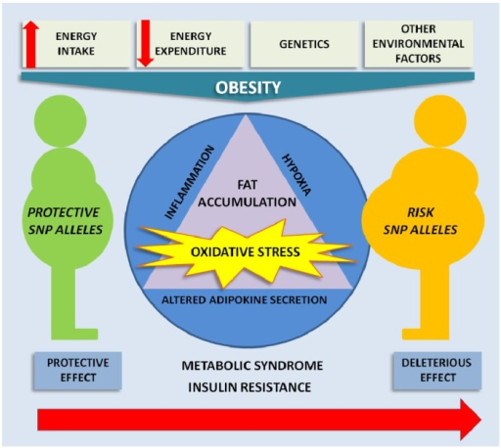
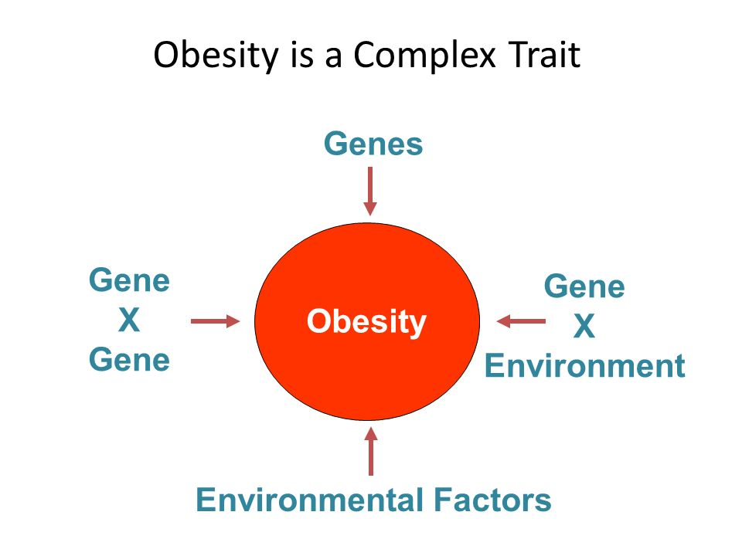
Energy balance required to maintain fat mass varies among individuals due to differences: metabolism and lipostatic set point
Genetic : 30-40%
Environment: 60- 70 %
longitudinal interaction may be important for intervention strategies

Slide 4
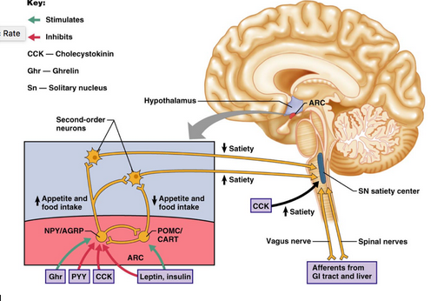
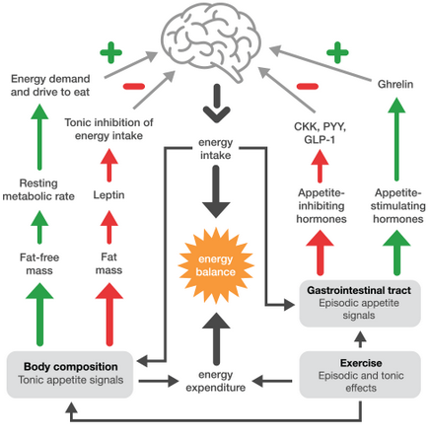
Neural Systems Controlling the Drive to Eat
                Metabolic Brain
post-leptin discovery era have mainly focused on the metabolic brain crucial neural circuits in hypothalamus and hindbrain

Slide 5
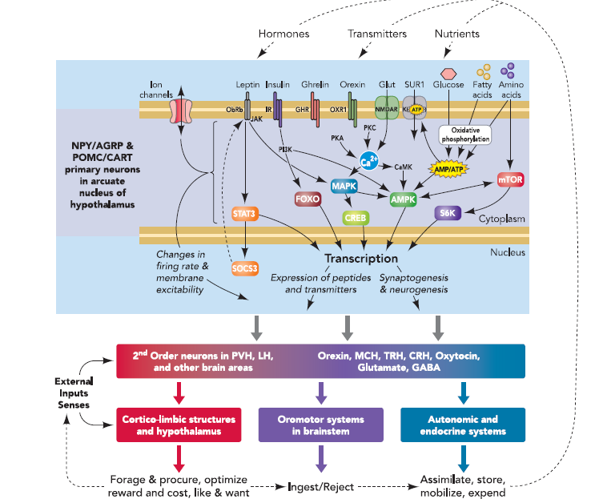
Hypothalamic regulator of energy balance
www.physiology.org/journal/physiologyonline (093.117.182.243

Slide 6
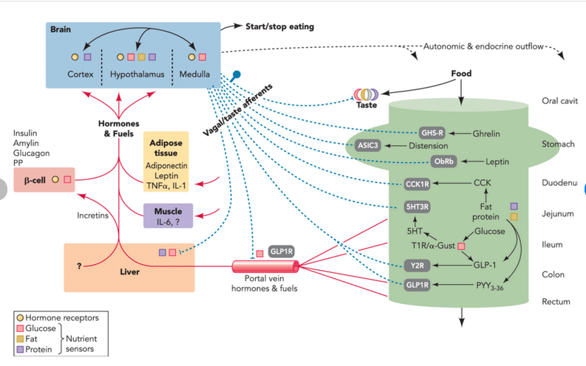
Nutrient sensing by the brain : orchestrating survival and handling abundance
www.physiology.org/journal/physiologyonline (093.117.182.243

Slide 7
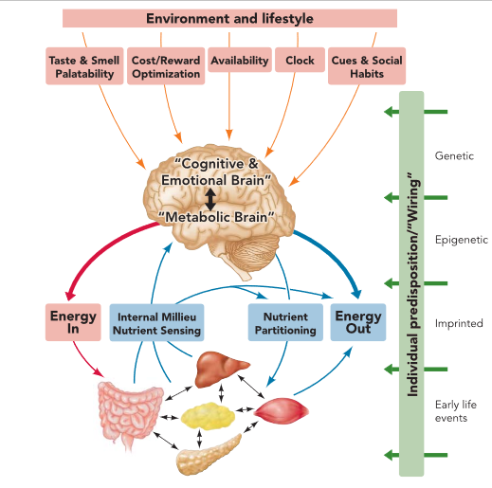
Neural Systems Controlling the Drive to Eat: Mind Versus Metabolism
www.physiology.org/journal/physiologyonline (093.117.182.243

Slide 8
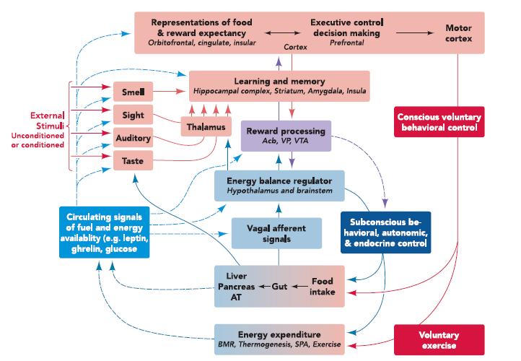
Neural integration of internal and external information in the control of appetite and energy expenditure
www.physiology.org/journal/physiologyonline (093.117.182.243

Slide 9

Neural Systems Controlling the Drive to Eat: Mind Versus Metabolism
Metabolic need is translated into strong behavioral actions that successfully compete with other motivated behavior, the role of the “cognitive and emotional brain” cannot be neglected

Slide 10
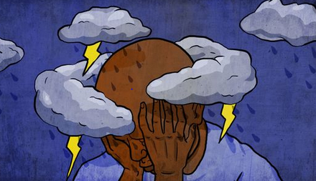
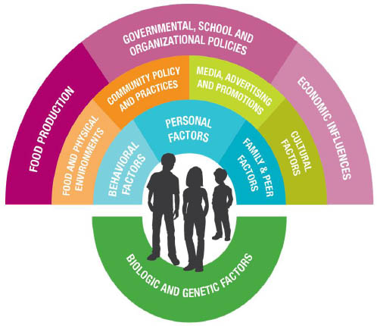
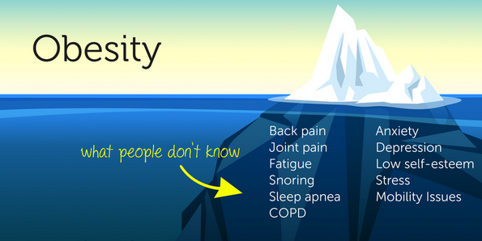
Coexistence of obesity and depression ~43%
Our world is becoming more depressed more obese
It is unlikely that mono-therapies, only acting on one single step in one pathway, will be sucessful in fighting the obesity war.

Slide 11
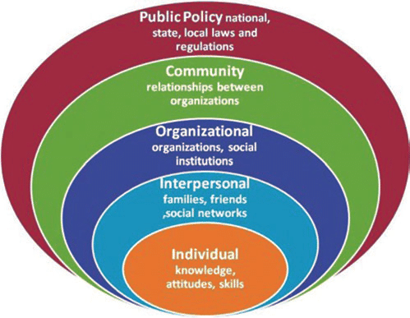
Food choice complexity
individual
family : strong correlation between the eating patterns of mothers and children
Physical environment
Social environment
Social policy: ways that governments support farmers
Our food systems are making people sick
  taxing unhealthful foods and drinks
  curbing junk food marketing to all groups (not just children),
  realigning agricultural subsidies with health

Slide 12
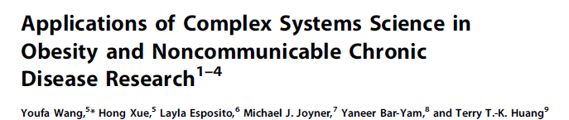
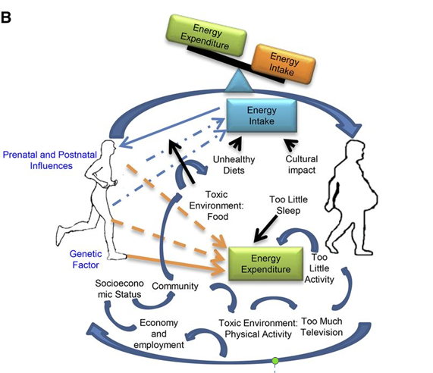

Slide 13
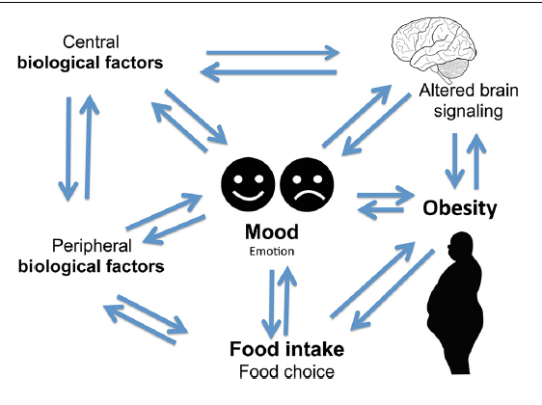
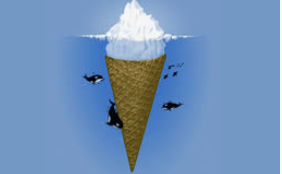
MOOD, FOOD & Obesity

Slide 14
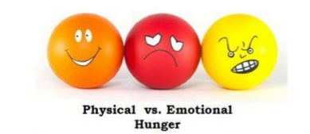
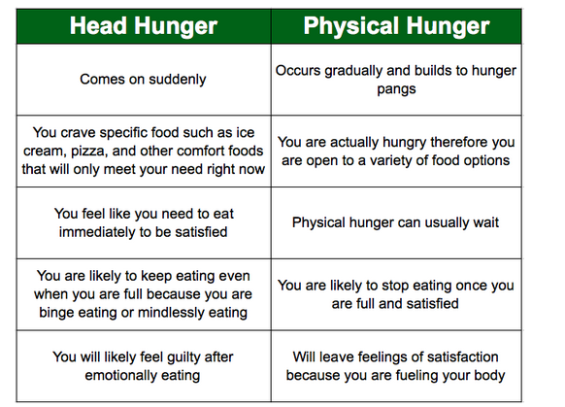
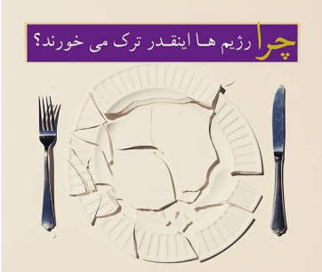

Slide 15

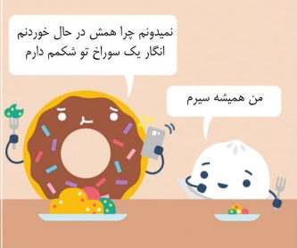
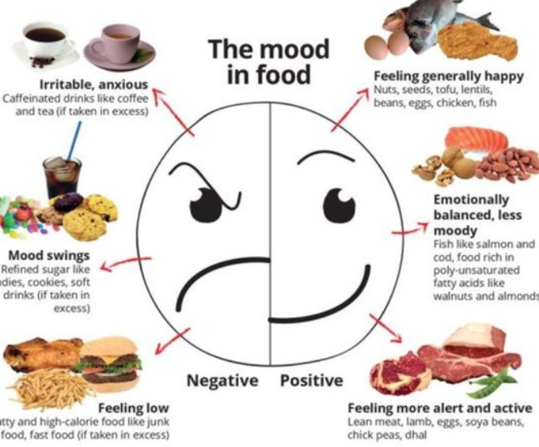

Slide 16

A Common Example:
Women with PCOS are six times more likely to suffer from eating disorders
One-third of women with PCOS suffer from binge eating disorder.
Every woman with PCOS has unique nutritional concerns – some unique to PCOS & some unique to her

Slide 17
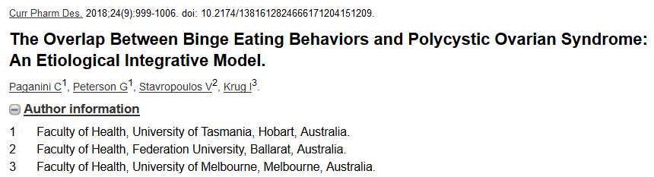
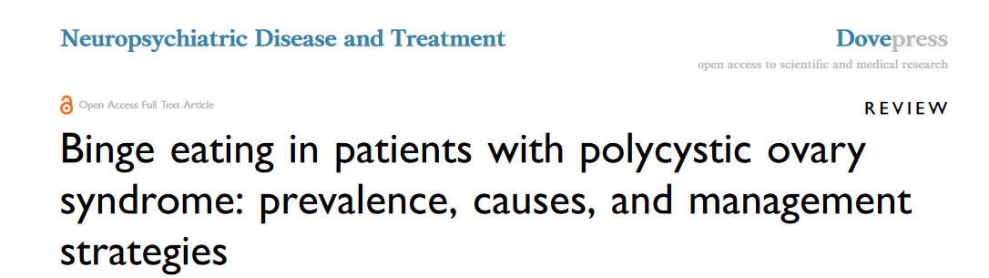
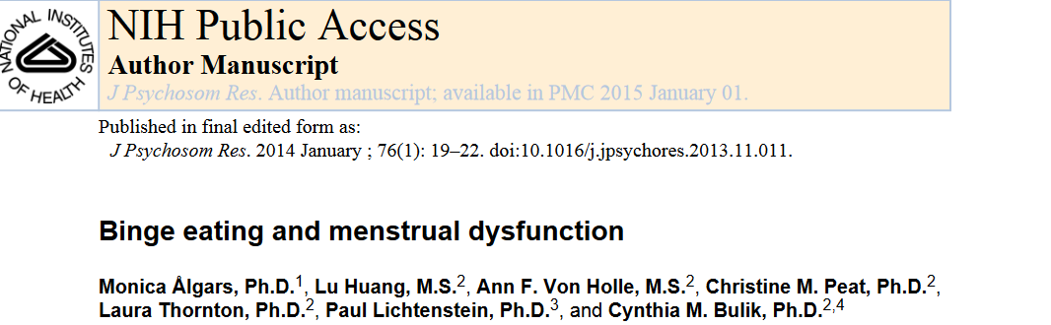

Slide 18
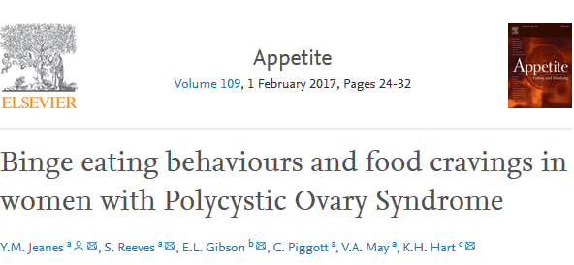
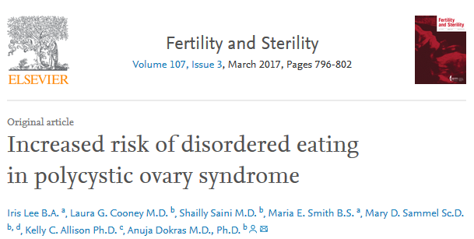

Slide 19
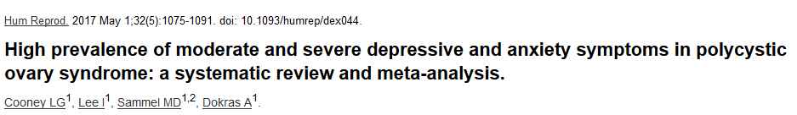
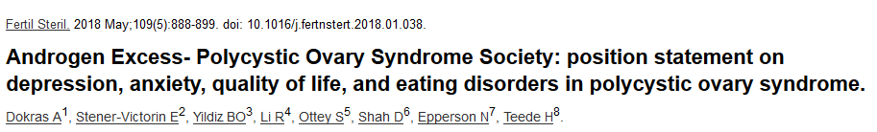

Slide 20
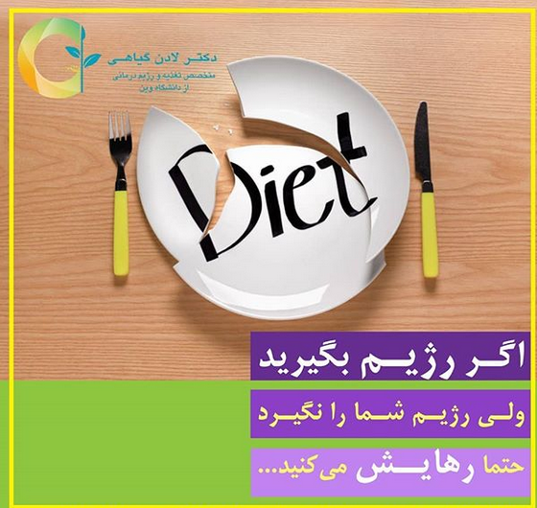
Dieting Make people Fat
Improper goal setting
Diet plan makes an enemy of food
Don’t look at food in the sense of a source of nourishment and health.
BMI is not accurate to characterize obesity at the individual level nor a body fat measure
simple to measure and with almost no cost
Provide limited clinical and biological information
obesity-related health disorders are lipid accumulation and distribution, rather than body weight

Slide 21
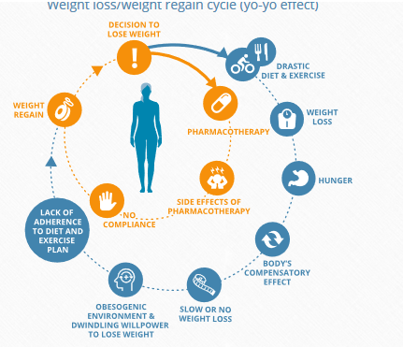
Weight loss/weight regain is a vicious cycle that is fueled by environmental, dietary, and treatment-related realities
  Diet therapy and nutrition counseling is beyond calorie restriction, beyond pharmacotherapy

Slide 22
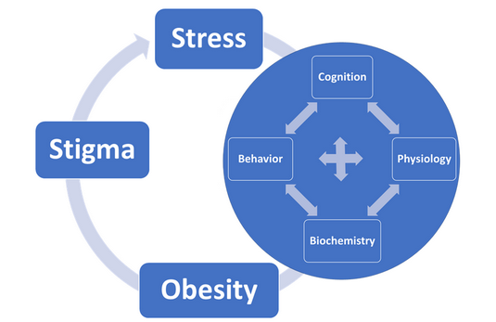
Multiple level Assessment

Slide 23
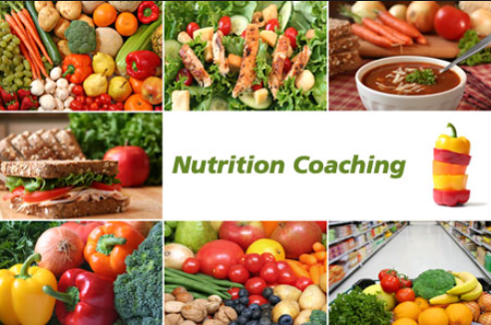
Eating to regulate better endocrine response has to be personalized based on comprehensive multiple level assessment

Slide 24
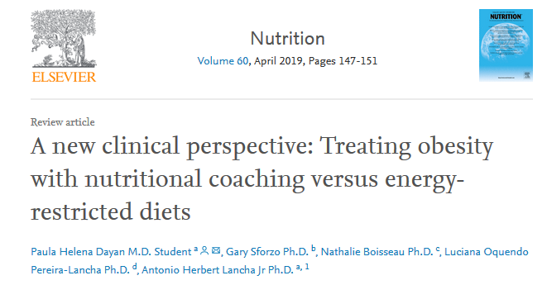
Nutritional coaching
promising strategy and potentially highly effective approach for weight loss in short-term, long-term maintenance and healthy behavior change.

Slide 25
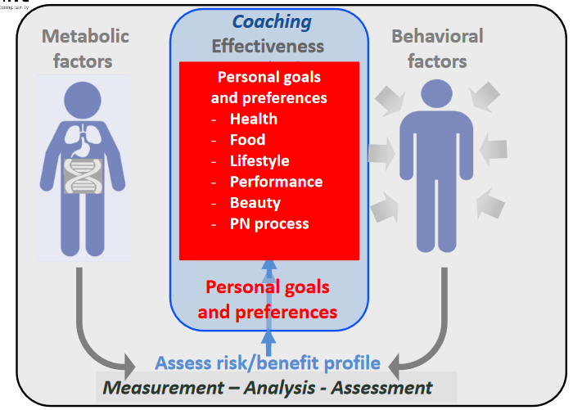
The Essence of Nutrition coaching

Slide 26
Nutrition coaching is:
Far beyond anthropometric assessment
Far beyond calorie, balance, variety
Far beyond diet planning
Why??
Fous on:
non-dietary aspects of a person’s life, in order to improve clients overall, holistic wellbeing

Slide 27
Nutrition Coaching
Aim to:
empowerment : mobilize internal strengths and external resources ….
Skill
Confidence…. to feel confident about cooking and eating healthy, whether at home or on-the-go.
Highly motivated

Slide 28
Personalized Nutrition Assessment
Review all aspects of your lifestyle to get a good picture of what one has been through on her health status journey and where she is now
Deep one hour long assessment …..reflective listening
Detailed nutrition assessment of eating habits and food choices
Assessment and education around nutrition for health condition so patient really understand what’s happening to her body
clear up false information and odd expectations

Slide 29
Nutrition Coaching
End the yo-yo dieting cycle
• Learn how food affects your insulin levels and metabolism
• Learn which nutritional supplements are best
• Decrease clinical risk outcome
• Overcome binge eating
• Improve your body image
• Have more energy
• Overcome resistance to exercise
• Develop individualized meal plans
• Provide cooking and shopping advice
• Learn how to read food labels …and more!

Slide 30
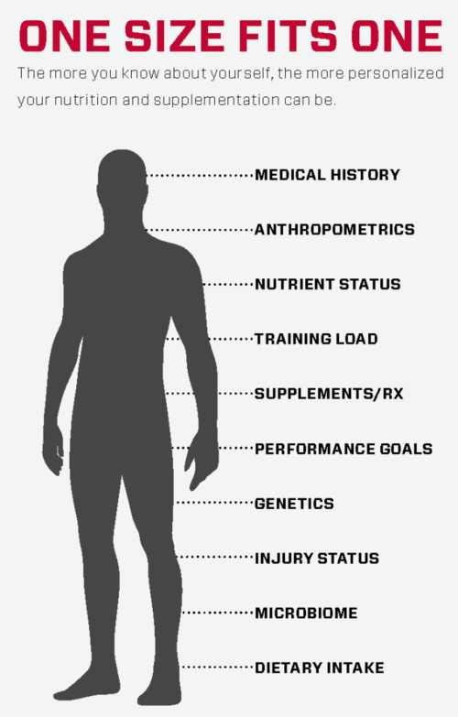
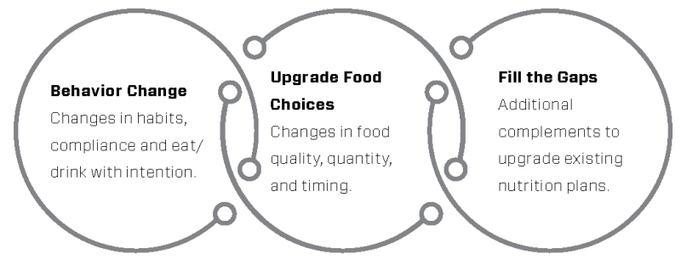
Follow up nutrition coaching sessions
Individualized intervals 2 to 4weeks
Discuss the challenges
  Struggling with strong cravings
  Eating for emotional reasons
  Difficulty planning meals

Slide 31


Thanks For Your Attention
Dr.lgiahi@gmail.com
Dr.ladangiahi

