Slide 1
PATIENT-CENTERED COLLABORATIVE CARE
Hormoz Kaykhanzadeh M.B.A
Sara Sedaghat, M.D.
Gabric Diabetes Education Association
August 2019

Slide 2
Facts
Our diabetes toolbox has grown, but A1C in the united states has remained flat
The overall proportion of patients in very poor control, defined as an A1C >9%, has actually increased.
Edelman, S. V. (2017). Taking Control Of Your Diabetes: An Innovative Approach to Improving Diabetes Care Through Educating, Motivating, and Making the Connection Between Patients and Health Care Providers. Clinical Diabetes, 35(5), 333-339.

Slide 3
What is the miracle cure?
Patient-centered Collaborative Care
Edelman, S. V. (2017). Taking Control Of Your Diabetes: An Innovative Approach to Improving Diabetes Care Through Educating, Motivating, and Making the Connection Between Patients and Health Care Providers. Clinical Diabetes, 35(5), 333-339. doi:10.2337/cd17-0090
Notes:
A miracle cure on TV, on the internet, or in vitamin stores and are grabbing on to the unproven or outright false claims that accompany such products. The sale of over-the-counter supplements that are not regulated by the U.S. Food and drug administration and have no proven benefits is a multibillion-dollar industry

Slide 4
Successful Medical Evaluation
A successful medical evaluation depends on beneficial interactions between the patient and the care team.
Patient-centered Collaborative Care
Comprehensive Medical Evaluation and Assessment of Comorbidities: Standards of Medical Care in Diabetes—2019. (2019).

Slide 5
Patient-Centered Care
Comprehensive Medical Evaluation and Assessment of Comorbidities: Standards of Medical Care in Diabetes—2019. (2019).

Slide 6
Case 1: A 62 y/o man with 11 yrs history of T2DM
Drugs:
Medical History
Metformin/ sitagliptin 1000/50 mg (bd)
Gliclazide MR 60 mg
Atorvastatin: 20 mg
Aspirin 80 mg
Severe Non-proliferative Diabetic Retinopathy
Distal polyneuropathy
Previous Acute MI: 3 years ago

Slide 7
Case 1: A 62 y/o man with 11 yrs history of T2DM
Lab Data
Vital signs
FBS: 220 mg/dL
Last 3 HbA1c results: 11.6%, 10.9%, 11.4%
Cr: 1.1
HDL: 30 mg/dL
LDL: 160 mg/dL
TG: 240 mg/dL
BP: 155/100 mmHg
HR: 90 bpm
Wt: 110
Ht: 180 cm
BMI: 36

Slide 8
Your plan?

Slide 9
“The patient will never care how much you know, until they know how much you care.”
Tongue J. R., Epps H. R., Forese L. L. Communication skills for patient-centered care: research-based, easily learned techniques for medical interviews that benefit orthopaedic surgeons and their patients. J Bone Joint Surg Am. 2005;87:652–658

Slide 10
Recommended Sequence for Patient-Centered Medical Interviewing
Introduce and build rapport
Elicit the patient’s agenda
List all of the patient’s agenda items
Negotiate the agenda
Start discussing the patient’s concerns with open-ended questions
Ask direct questions to elicit details about the chief concern, and perform a review of systems
Elicit the patient’s perspective
Empathize
Summarize
Transition
Additional data
https://www.aafp.org/afp/2017/0101/p29.html

Slide 11
Collaborative Relationship
The goal of provider-patient communication:
Establish a collaborative relationship
Assess and address self-management barriers
Not blaming patients for “noncompliance” or “nonadherence” when the outcomes of self-management are not optimal
Comprehensive Medical Evaluation and Assessment of Comorbidities: Standards of Medical Care in Diabetes—2019. (2019).

Slide 12
Language matters!
Language has a strong impact on perceptions and behavior.
Person-first, strengths-based, empowering language can improve communication and enhance the motivation, health, and well-being of people with diabetes
Dickinson JK, et al et al. The Use of Language in Diabetes Care and Education. Diabetes Care. 2017.
Comprehensive Medical Evaluation and Assessment of Comorbidities: Standards of Medical Care in Diabetes—2019. (2019).
Notes:
Language has a strong impact on perceptions and behavior.
The use of empowering language in diabetes care and education can help to inform and motivate people, yet language that shames and judges may undermine this effort. The American Diabetes Association (ADA) and American Association of Diabetes Educators consensus report, “The Use of Language in Diabetes Care and Education,” provides the authors’ expert opinion regarding the use of language by health care professionals when speaking or writing about diabetes for people with diabetes or for professional audiences (14). Although further research is needed to address the impact of language on diabetes outcomes, the report includes five key consensus
recommendations for language use:
○ Use language that is neutral, nonjudgmental, and based on facts, actions, or physiology/biology.
○ Use language that is free from stigma.
○ Use language that is strength based, respectful, and inclusive and that imparts hope.
Use language that fosters collaboration between patients and providers.
○ Use language that is person centered (e.g., “person with diabetes” is preferred over “diabetic”)

Slide 13
Language matters!
Recommendations for language use:
Use language that is neutral, nonjudgmental, and based on facts, actions, or physiology/biology.
Use language that is free from stigma.
Use language that is strength based, respectful, and inclusive and that imparts hope.
Use language that fosters collaboration between patients and providers.
Use language that is person centered (e.G., “Person with diabetes” is preferred over “diabetic”)
Dickinson JK, et al et al. The Use of Language in Diabetes Care and Education. Diabetes Care. 2017.
Notes:
Language has a strong impact on perceptions and behavior.
The use of empowering language in diabetes care and education can help to inform and motivate people, yet language that shames and judges may undermine this effort. The American Diabetes Association (ADA) and American Association of Diabetes Educators consensus report, “The Use of Language in Diabetes Care and Education,” provides the authors’ expert opinion regarding the use of language by health care professionals when speaking or writing about diabetes for people with diabetes or for professional audiences (14). Although further research is needed to address the impact of language on diabetes outcomes, the report includes five key consensus
recommendations for language use:
○ Use language that is neutral, nonjudgmental, and based on facts, actions, or physiology/biology.
○ Use language that is free from stigma.
○ Use language that is strength based, respectful, and inclusive and that imparts hope.
Use language that fosters collaboration between patients and providers.
○ Use language that is person centered (e.g., “person with diabetes” is preferred over “diabetic”)

Slide 14
The use of language

Slide 15
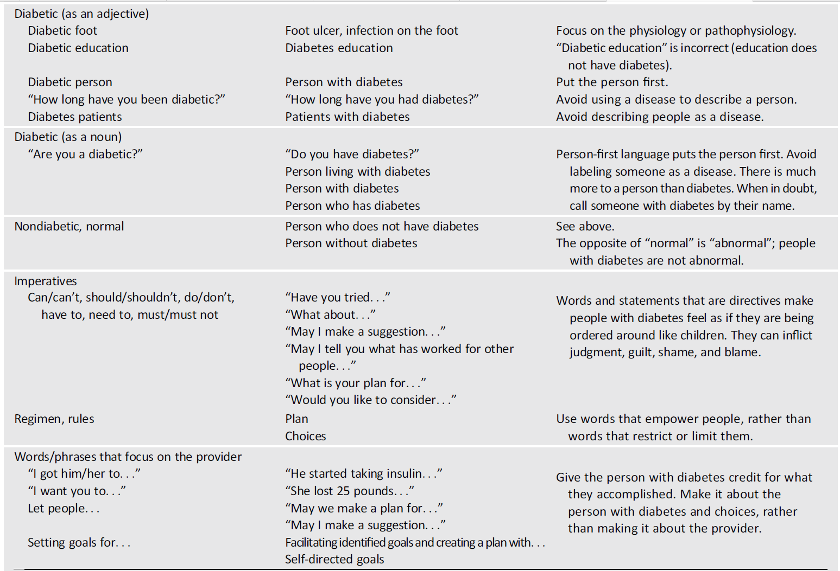
Dickinson JK, et al et al. The Use of Language in Diabetes Care and Education. Diabetes Care. 2017.

Slide 16
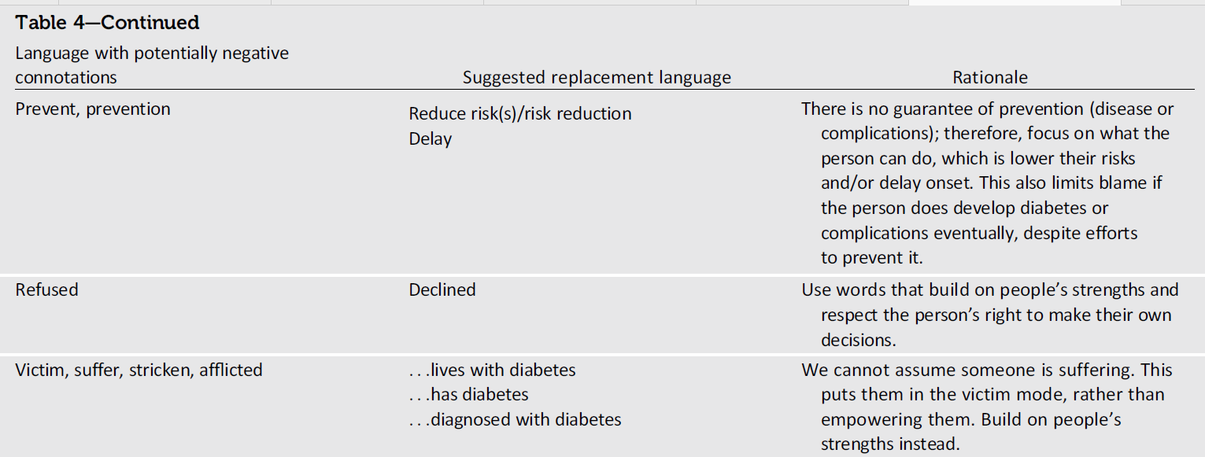
Dickinson JK, et al et al. The Use of Language in Diabetes Care and Education. Diabetes Care. 2017.

Slide 17
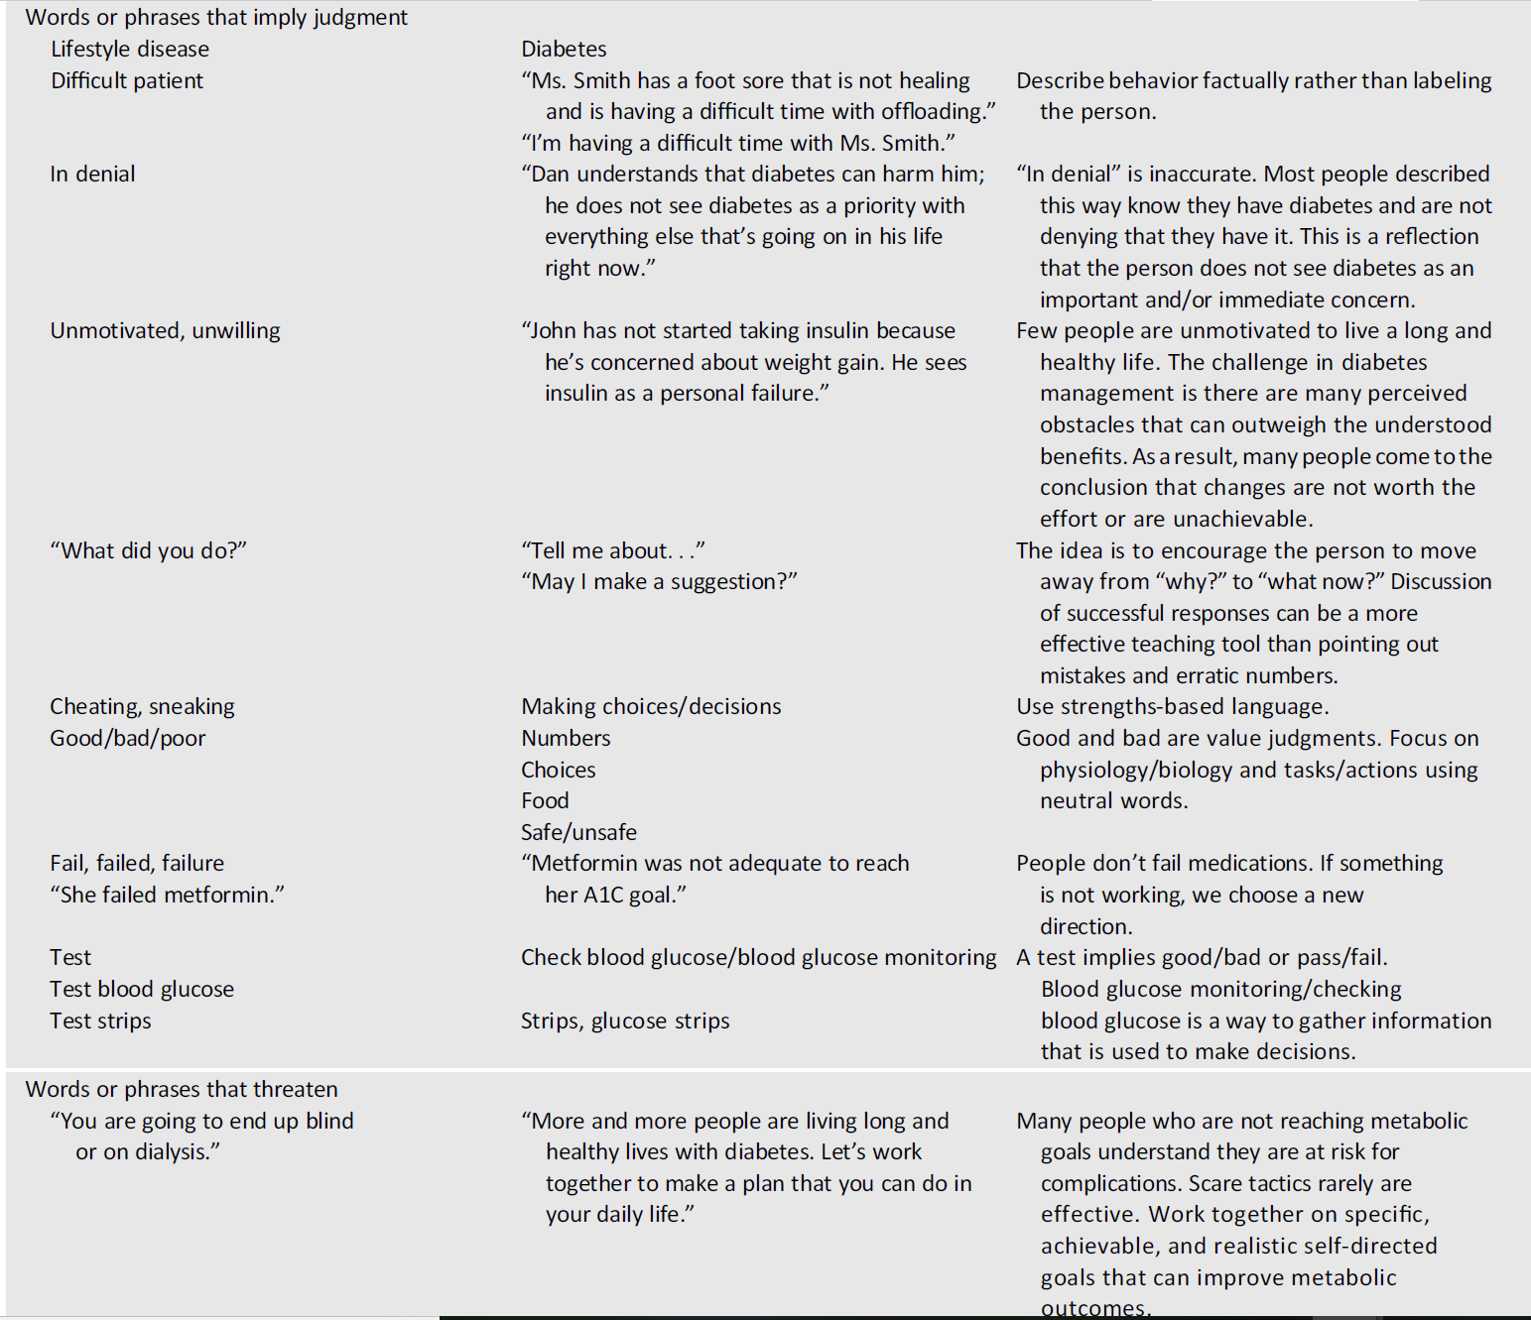
Dickinson JK, et al et al. The Use of Language in Diabetes Care and Education. Diabetes Care. 2017.

Slide 18
Compliance and adherence are dysfunctional concepts in diabetes care
Anderson, R. M., & Funnell, M. M. (2000). Compliance and adherence are dysfunctional concepts in diabetes care. The Diabetes Educator, 26(4), 597-604.

Slide 19
Communication Style
Empathizing
Using active listening techniques
Open-ended questions
Reflective statements
Summarizing what the patient said
Comprehensive Medical Evaluation and Assessment of Comorbidities: Standards of Medical Care in Diabetes—2019. (2019).

Slide 20
فرق این دو پزشک در چیست؟
بیماران او را پزشکی معمولی با مطبی شلوغ توصیف می کنند.
بیماران او را پزشکی حاذق و بسیار دوست داشتنی توصیف می کنند.

Slide 21
Empathy
A key aspect of the physician–patient relationship
Derksen, F., et al.(2013). Effectiveness of empathy in general practice: a systematic review. Br J Gen Pract, 63(606), e76-e84.
Kelm, Z., et al. (2014). Interventions to cultivate physician empathy: a systematic review. BMC medical education, 14(1), 219.

Slide 22
Neurobiological Basis: ‘soft’ concept of empathy into ‘hard’ science
Mirror Neuron System (MNS)
Derksen, F., et al (2013). Effectiveness of empathy in general practice: a systematic review. Br J Gen Pract, 63(606), e76-e84.

Slide 23
Empathy
Three dimensions:
An attitude (affective)
A competency (cognitive)
A behaviour
The competence of a physician:
To understand the patient’s situation, perspective, and feelings.
To communicate that understanding and check its accuracy.
To act on that understanding in a helpful therapeutic way.
Derksen, F., et al (2013). Effectiveness of empathy in general practice: a systematic review. Br J Gen Pract, 63(606), e76-e84.

Slide 24
Empathy and social interactions
Deep in our architecture and biological makeup, we are meant to be together, and socially interact.

Slide 25
Empathy & Outcomes
Patient’s point of view:
Patient satisfaction and adherence
Decreasing patients’ anxiety and distress
Better diagnostic and clinical outcomes
Strengthening patient enablement
Physician’s point of view:
Fewer cases of compassion fatigue or burn out.
Derksen, F., et al (2013). Effectiveness of empathy in general practice: a systematic review. Br J Gen Pract, 63(606), e76-e84.

Slide 26
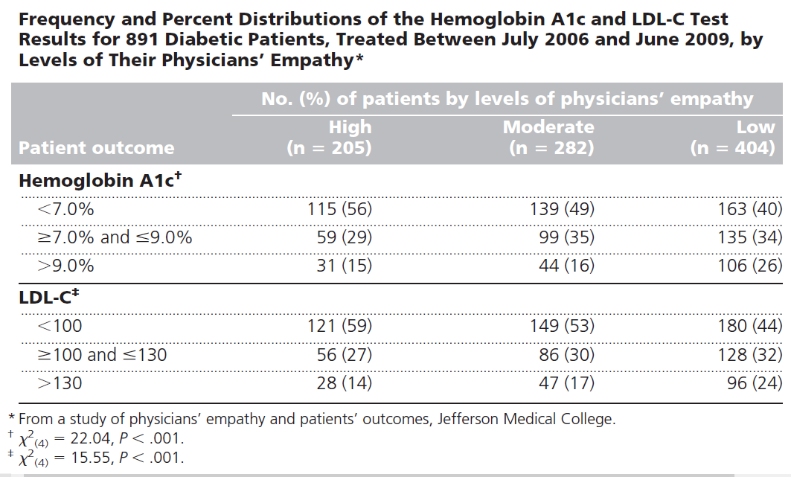
Empathy & Clinical Outcomes in diabetes
Empathy is an important factor associated with clinical competence and patient outcomes.
Hojat, M.,et al (2011). Physicians' Empathy and Clinical Outcomes for Diabetic Patients. Academic Medicine, 86(3), 359-364.

Slide 27
Empathy and clinical outcomes in Diabetes
RESULTS:
higher empathy scores were associated with a lower risk of CVD events and a lower risk of all-cause mortality (HRs for the middle and highest tertiles, respectively: 0.49; 95% CI, 0.27-0.88, P = .01 and 0.60; 95% CI, 0.35-1.04, P = .05).
CONCLUSIONS Positive patient experiences of practitioner empathy in the year
after diagnosis of type 2 diabetes may be associated with beneficial long-term
clinical outcomes..
Ann Fam Med 2019;17:311-318.
Notes:
RESULTS Of the 628 participants with a completed CARE score, 120 (19%)
experienced a CVD event, and 132 (21%) died during follow up. In the multivariable
model, compared with the lowest tertile, higher empathy scores were
associated with a lower risk of CVD events (although this did not achieve statistical
significance) and a lower risk of all-cause mortality (HRs for the middle and
highest tertiles, respectively: 0.49; 95% CI, 0.27-0.88, P = .01 and 0.60; 95%
CI, 0.35-1.04, P = .05).
CONCLUSIONS Positive patient experiences of practitioner empathy in the year
after diagnosis of type 2 diabetes may be associated with beneficial long-term
clinical outcomes. Further work is needed to understand which aspects of patient
perceptions of empathy might influence health outcomes and how to incorporate
this understanding into the education and training of practitioners.

Slide 28
https://www.aafp.org/afp/2017/0101/p29.html

Slide 29
مدیر رهبر
مدیر رئیس
اشتیاق و انگیزه میدهد | ترس ایجاد می کند
می گوید بیایید برویم! | میگوید بروید!
روی نقاط مثبت و تواناییها تمرکز می کند | بر کمبودها تمرکز می کنند
به دیگران اعتبار میدهند! | از اعتبار دیگران استفاده می کند!
به دنبال راه حل و حل مساله هستند! | دیگران را سرزنش می کند و به دنبال مقصر است!
پیروان را پرورش میدهد! | از پیروان استفاده می کند!
می گوید ما! | می گوید من!
قدرت به واسطه جاذبه شخصیتی و باور به او | قدرت به واسطه سلسله مراتب سازمانی
او را همکار و دوست خود می دانند | او را رئیس خود می دانند
تفویض اختیار | تمرکز روی تک تک کارهای ریز و جزئی
نگاه مهربانانه به کارکنان به عنوان انسان | نگاه ابزاری به کارکنان مانند ماشین
سوال و همفکری می کند! | دستور می دهد.
همواره به دنبال یادگیری است، حتی به قیمت پذیرش اشتباهات و ضعفهای خود | من کامل هستم و نیازی به تغییر و یادگیری ندارم
مثبت اندیش هستند و انرژی مثبت میدهند | منفی باف و بد بین هستند

Slide 30
Case 1: A 62 y/o man with 11 yrs history of T2DM
Drugs:
Medical History
Metformin/ sitagliptin 1000/50 mg (bd)
Gliclazide MR 60 mg
Atorvastatin: 20 mg
Aspirin 80 mg
Severe Non-proliferative Diabetic Retinopathy
Distal polyneuropathy
Previous Acute MI: 3 years ago

Slide 31
Case 1: A 62 y/o man with 11 yrs history of T2DM
Lab Data
Vital signs
FBS: 220 mg/dL
Last 3 HbA1c results: 11.6%, 10.9%, 11.4%
Cr: 1.1
HDL: 30 mg/dL
LDL: 160 mg/dL
TG: 240 mg/dL
BP: 155/100 mmHg
HR: 90 bpm
Wt: 110
Ht: 180 cm
BMI: 36

Slide 32
OUR plan?

Slide 33
Limiting factors
Time pressure
Heavy workload
A cynical view on the effectiveness of empathy
Lack of skill

Slide 34
This is the “Art of Medicine”

Slide 35
Thanks for your attention
August 2019

Slide 36
Communication Style
Empathizing
Using active listening techniques
Open-ended questions
Reflective statements
Summarizing what the patient said
3. Comprehensive Medical Evaluation and Assessment of Comorbidities: Standards of Medical Care in Diabetes—2018. (2018). Diabetes care, 41(Supplement 1), S28-S37. doi:10.2337/dc18-S003

Slide 37
Skills
(1) Active listening
Asking open-ended questions.
Making reflections
(2) Building motivation
Rolling with resistance
Clarifying personal values
Eliciting “change talk”
(3) Facilitating behavior change
5-step goal-setting process.
Making an I-SMART diabetes action plan.
Problem-solving

Slide 38
Active Listening Steps:
1. Look at the person, and stop other things you are doing
2. Be sincerely interested in what the other person is talking about
3. Focus on feelings and emotions
4. Ask open-ended questions
5. Make reflections (feelings and emotions)
6. Be empathic and non-judgmental
7. Be aware of your own feelings and strong opinions, but avoid conveying them

Slide 39
Open vs Close Questions:
Close-ended question:
Open-ended question:
Do you inspect your feet every day?
Tell me about your foot care

Slide 40
Making Reflections:
Participant:
You:
Every time I leave the house, I have to remember to bring my insulin pen, my meter, and some hard candy just in case I have a low. Having diabetes is a full-time job.
It sounds like you are feeling overwhelmed with all the responsibilities you have because of your diabetes.

Slide 41
Rolling with resistance
Participant
You
My doctor wants me to start insulin, but there is no way I am going to give myself shots everyday.
Going on insulin is a hard transition for people. Maybe you just are not ready to make that change.

Slide 42
Change Talk
On a scale of 1 to 10 (with 10 being the highest), how motivated or interested are you in [insert behavior change]?
On a scale of 1 to 10 (with 10 being the highest), assuming you want to, how confident are you that you can [insert behavior change]?
Follow-up probes:
Why did you not choose a lower number (to elicit positive statements)? Why did you not choose a higher number 8 (to elicit barriers)? What would it take for you to move to a 9 or 10?

Slide 43
5 Step Behavioral Goal Setting
Step I: Exploring the problem or issue
What is the one thing you would like to change about yourself?
Can you think of some specific examples?
Please tell me more about that.

Slide 44
5 Step Behavioral Goal Setting
Step 2: Clarifying feelings and meaning
What are your thoughts about this?
Are you feeling (insert feeling) because (insert meaning) ?
How will you feel if this doesn’t change?

Slide 45
5 Step Behavioral Goal Setting
Step 3: Developing a long-term goal

Slide 46
5 Step Behavioral Goal Setting
Step 4: I-SMART

Slide 47
5 Step Behavioral Goal Setting
How did it go this week with the experiment you chose?
What did you learn from the experience
Step 5: Evaluation

Slide 48
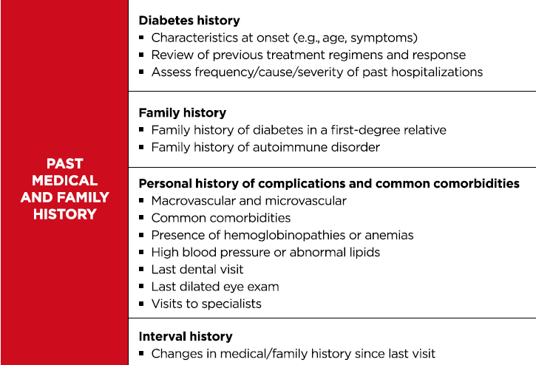
Comprehensive Diabetes Medical Evaluation
3. Comprehensive Medical Evaluation and Assessment of Comorbidities: Standards of Medical Care in Diabetes—2018. (2018). Diabetes care, 41(Supplement 1), S28-S37. doi:10.2337/dc18-S003

Slide 49
Comprehensive Diabetes Medical Evaluation
3. Comprehensive Medical Evaluation and Assessment of Comorbidities: Standards of Medical Care in Diabetes—2018. (2018). Diabetes care, 41(Supplement 1), S28-S37. doi:10.2337/dc18-S003

Slide 50
Comprehensive Diabetes Medical Evaluation
3. Comprehensive Medical Evaluation and Assessment of Comorbidities: Standards of Medical Care in Diabetes—2018. (2018). Diabetes care, 41(Supplement 1), S28-S37. doi:10.2337/dc18-S003

Slide 51
Comprehensive Diabetes Medical Evaluation
3. Comprehensive Medical Evaluation and Assessment of Comorbidities: Standards of Medical Care in Diabetes—2018. (2018). Diabetes care, 41(Supplement 1), S28-S37. doi:10.2337/dc18-S003

Slide 52
Comprehensive Diabetes Medical Evaluation
3. Comprehensive Medical Evaluation and Assessment of Comorbidities: Standards of Medical Care in Diabetes—2018. (2018). Diabetes care, 41(Supplement 1), S28-S37. doi:10.2337/dc18-S003

Slide 53
Comprehensive Diabetes Medical Evaluation

Slide 54
Rule of Halves
https://www.novonordisk.com/about-novo-nordisk/novo-nordisk-in-brief/stories/leadership/rule-of-halves.html

Slide 55
DAWN2 Study Results
Provision of quality team-based and individualized diabetes care
Only about one-third of people with diabetes felt that they are provided with person-centered care
Over 50% of healthcare professionals, on the other hand, rated themselves as being person-centered in their approach
Nicolucci, A., et al. (2013). Diabetes Attitudes, Wishes and Needs second study (DAWN2™): Cross‐national benchmarking of diabetes‐related psychosocial outcomes for people with diabetes. Diabetic Medicine, 30(7), 767-777.

Slide 56
Taking Control Of Your Diabetes
An Innovative Approach to Improving Diabetes Care Through Educating, Motivating, and Making the Connection Between Patients and Health Care Providers
Edelman, S. V. (2017). Taking Control Of Your Diabetes: An Innovative Approach to Improving Diabetes Care Through Educating, Motivating, and Making the Connection Between Patients and Health Care Providers. Clinical Diabetes, 35(5), 333-339. doi:10.2337/cd17-0090

Slide 57
Case 2:
An 18 years old girl
T1DM History: 2 yrs
On MDI:
Glargine U-300: 26 units 10 P.M.
Aspart: 5-7 units
Latest HbA1c: 7.3
Expressing concern to her health care team about repeated episodes of hypoglycemia during her aerobic workout (cycling and training on an elliptical machine).

Slide 58
Case
She begins exercising 4 hours after her mealtime injection and still cannot control for hypoglycemia.
Her mid-afternoon exercise routine consists of 60 minutes of stationary cycling, followed by 20 minutes of elliptical work at a moderate to high intensity, three to four times per week.

Slide 59
SMBG Report:
FBS | Pre-prandial Lunch BG | Pre-exercise BG | During exercise BG | Pre-prandial Dinner BG | Bed time BG
140 | 90 | 85 | 60 | 160 | 150
110 | 155 |  |  | 125 | 160
118 | 100 | 100 | 70 | 101 | 170
98 | 125 |  |  | 85 | 200
85 | 120 | 95 | 65 | 150 | 140
160 | 101 | 80 | 50 | 130 | 190
120 | 85 |  |  | 100 | 180

Slide 60
Problem
The health care team must determine whether hypoglycemia is occurring because of:
The type of exercise?
Too much on-board (active) insulin remaining from her previous mealtime injection?
Excessive basal insulin for exercise?
too few extra carbs?

Slide 61
Case
A 18 years old girl
T1DM History: 2 yr
On MDI:
Glargine U-300: 26 units 10 P.M.
Glulisine: 6-8 units
Exercise starts 4 hours after her mealtime injection in mid-afternoon for 3-4 times per week
60 min stationary cycling
20 min elliptical work (moderate to high intensity)
Problem:
Repeated episodes of hypoglycemia during her aerobic workout.
Solution:
Option 1: Add Extra Carbs
Option 2: Insulin Adjustment
Option 3: exercise planning recommendation

Slide 62
MNS Function

