Slide 1
IN THE NAME OF GOD
RRA USAGE IN
LOW & INTERMEDIATE –RISK
DTC
Dr. Anahita-Zakeri
1400/1/16

Slide 2
QUESTIONS :
*Does RRA have an effect on the long-term outcome of low – risk patient?
*Does RRA (low dose vs high dose) have an effect on the outcome of low- risk patient?
*Does the use of low dose & high dose iodine affect the recurrence of low- risk patient?
*Guidelines
*Conclusions

Slide 3
INTRUDUCTION:
*-Papillary thyroid cancer, the most common endocrine malignancy, offers important public health and individualized treatment challenges to policy makers and clinicians.
*-Although most of these patients do well, the biology of papillary cancer is extremely diverse, ranging from non progressive/extremely indolent lesions to aggressive metastatic cancers.
McLeod et al Papillary Thyroid Cancer Management Endocrine Reviews, December 2019, 40(6):1481–1499
McLeod et al Papillary Thyroid Cancer Management Endocrine Reviews, December 2019, 40(6):1481–1499

Slide 4
INTRUDUCTION:
Patients at low risk of thyroid cancer death can still have important or even catastrophic morbidity (including invasion of trachea, esophagus, largecervical vessels, and recurrent laryngeal nerves) .
McLeod et al Papillary Thyroid Cancer, December 2019, 40(6):1481–1499

Slide 5
INTRUDUCTION:
-*There are perhaps few controversies more heated in the thyroid cancer field than whether radioiodine should be used routinely following total thyroidectomy for patients with low-risk & intermadiate-risk papillary thyroid cancer.
-*Part of the difficulty is perhaps the failure to distinguish between
remnant ablation and adjuvant therapy, which are both
under the rubric of “postoperative radioactive iodine therapy.”
McLeod et al Papillary Thyroid Cancer Management Endocrine Reviews, December 2019, 40(6):1481–1499

Slide 6
-Thyroid tissue has a unique ability to take up iodine from blood.Like iodine, radioiodine is taken up and concentrated in thyroid follicular cells because they have a membrane sodium-iodide transporter.
-Compared with normal thyroid follicular cells, thyroid cancer cells have reduced expression of the transporter, which may account for the low iodine-131 uptake in thyroid cancer tissue.
- 131-I causes acute thyroid cell death by emission of short path length (1 to 2 mm) beta particles.
J Clin Endocrinol Metab 2001;86:3327

Slide 7
s
GOALS :
-Remnant ablation: The primary goal is destruction of presumably benign thyroid tissue after total thyroidectomy, to facilitate initial staging and follow up :
*improve the specificity of measurements of serum Tg
as a tumor marker
*increase the specificity of 131-I scaning for detection of
recurrent or metastatic disease by eliminating uptake by residual
normal tissue
Thyroid. 2019;29(4):461.

Slide 8
-Adjuvant treatment: The primary goal is destruction of subclinical tumor deposits that may or maynot be present after surgical resection of all known primary tumor tissue& metastatic foci.
The potential benefits of 131-I adjuvant treatment could include:
*Destruction of subclinical,microscopic foci of diseas
remaining after surgery
*Decreased risk of recurrence
*Improved disease specific survival
*Improved progression free survival.
Thyroid. 2019;29(4):461

Slide 9
-Treatment of known disease: The primary goal is destruction of clinically apparent macroscopic disease(evidenced by either abnormal Tg or structural finding) :
* residual & metastatic disease
*may reduce the risk of recurrence & mortality,especially in
small volume that is radioiodine avid
Thyroid. 2019;29(4):461

Slide 11
Importance of risk stratification
The adequate risk stratification in a malignant neoplastic disease is crucial to avoid on one hand the overtreatment of low-risk patients and on the other hand the under treatment of high risk subjects.
This issue is particularly important in thyroid carcinoma, generally characterized by good outcomes with 10-year overall survival (OS) rates for patients with papillary (PTC), follicular (FTC) and medullary thyroid cancer (MTC) of 93%, 85% and 75%, respectively
Tuttle RM, et al. Thyroid. 2010; 20: 134-49

Slide 12
Tools for risk classification
*TNM for prediction of disease specific mortality
*Clinico-pathological staging system for prediction of recurrence

Slide 13
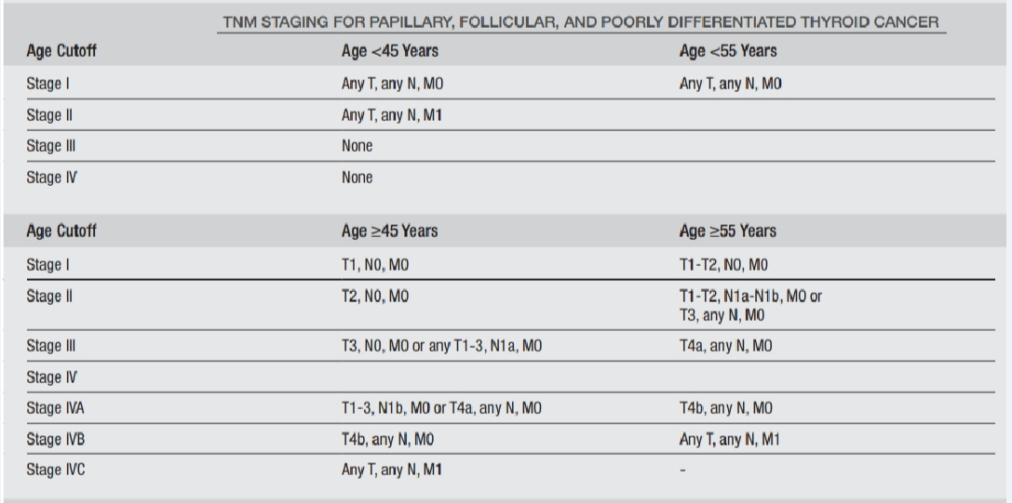

Slide 14
ATA low risk...
Papillary thyroid cancer (with all of the following):
No local or distant metastases • All macroscopic tumor has been resected • No tumor invasion of loco-regional tissues or structures • The tumor does not have aggressive histology (e.g., tall cell, hobnail variant, columnar cell carcinoma). • If ¹³¹I is given, there are no RAI-avid metastatic foci outside the thyroid bed on the first posttreatment whole-body RAI scan. • No vascular invasion • Clinical N0 or ≤5 pathologic N1 micrometastases (<0.2 cm in largest dimension).
Modified 2009 Risks

Slide 15
ATA low risk
-Intrathyroidal, encapsulated follicular variant of papillary thyroid cancer.
-Intrathyroidal, well differentiated follicular thyroid cancer with capsular invasion and no or minimal (<4 foci) vascular invasion.
-Intrathyroidal, papillary microcarcinoma, unifocal or multifocal, including BRAF^{V600E}mutated (if known).
Modified 2009 Risks

Slide 16
ATA intermediate risk
- Microscopic invasion of tumor into the peri-thyroidal soft tissues - RAI-avid metastatic foci in the neck on the first post treatment whole-body RAI scan - Aggressive histology (e.g., tall cell, hobnail variant, columnar cell carcinoma) - Papillary thyroid cancer with vascular invasion - Clinical N1 or >5 pathologic N1 with all involved lymph nodes <3 cm in largest dimension - Multifocal papillary microcarcinoma with ETE and BRAF^{V600E} mutated (if known)
Modified 2009 Risks

Slide 17
ATA high risk
- Macroscopic invasion of tumor into the peri-thyroidal soft tissues (gross ETE). - Incomplete tumor resection - Distant metastases - Postoperative serum thyroglobulin suggestive of distant metastases - Pathologic N1 with any metastatic lymph node ≥3 cm in largest dimension. - Follicular thyroid cancer with extensive vascular invasion (> 4 foci of vascular invasion) Modified 2009 Risks

Slide 18
QUESTIONS :
*Does RRA have an effect on the long-term outcome of low – risk patient?
*Does RRA (low dose vs high dose) have an effect on the outcome of low- risk patient?
*Does the use of low dose & high dose iodine affect the recurrence of low- risk patient?
*Guidelines
*Conclusions

Slide 20
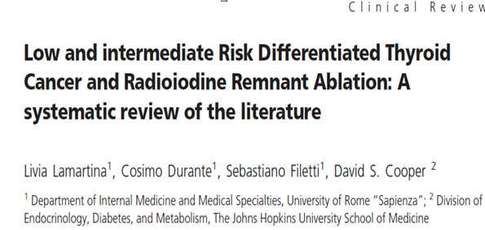
Design: Systematic Review
Main Aim: To examine the evidence of RRA benefit in staging, follow up (F/U), and DR prevention in LR and IR DTC patients. 2008-2014
-2 OP demonstrating RRA benefit on recurrence in LR
-found 11 Ops that benefit reducing recurrence retes with RRA in IR
and 13 OPs that no.
.
Clin Endocrinol Metab2015

Slide 21
QUESTIONS :
*Does RRA have an effect on the long-term outcome of low – risk patient?
*Does RRA (low dose vs high dose) have an effect on the outcome of low- risk patient?
*Does the use of low dose & high dose iodine affect the recurrence of low- risk patient?
*Guidelines
*Conclusions

Slide 22
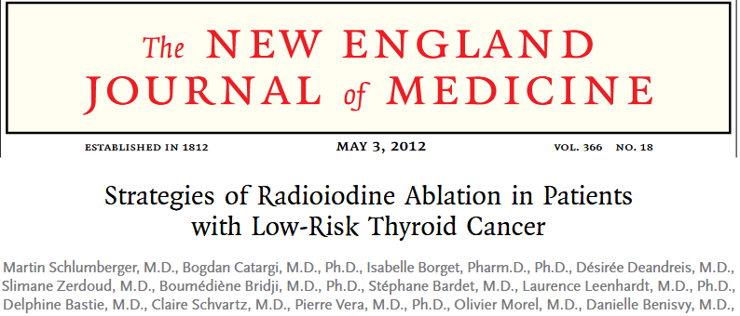
Methods: 684 patients , a follow-up between 6 and 10 months T1-T2,N0 N1 Nx , M0
Primary outcomes were : ablation was considered complete if: rh TSH Tg < 1 ng/ml & Neck sonography = normal WBS<0.5%
Secondary outcomes were symptoms of hypothyroidism, quality of life
T h e n e w e n g l a n d j o u r n a l o f m e d i c i n en engl j med 366;18nejm.orgmay 3, 2012

Slide 23
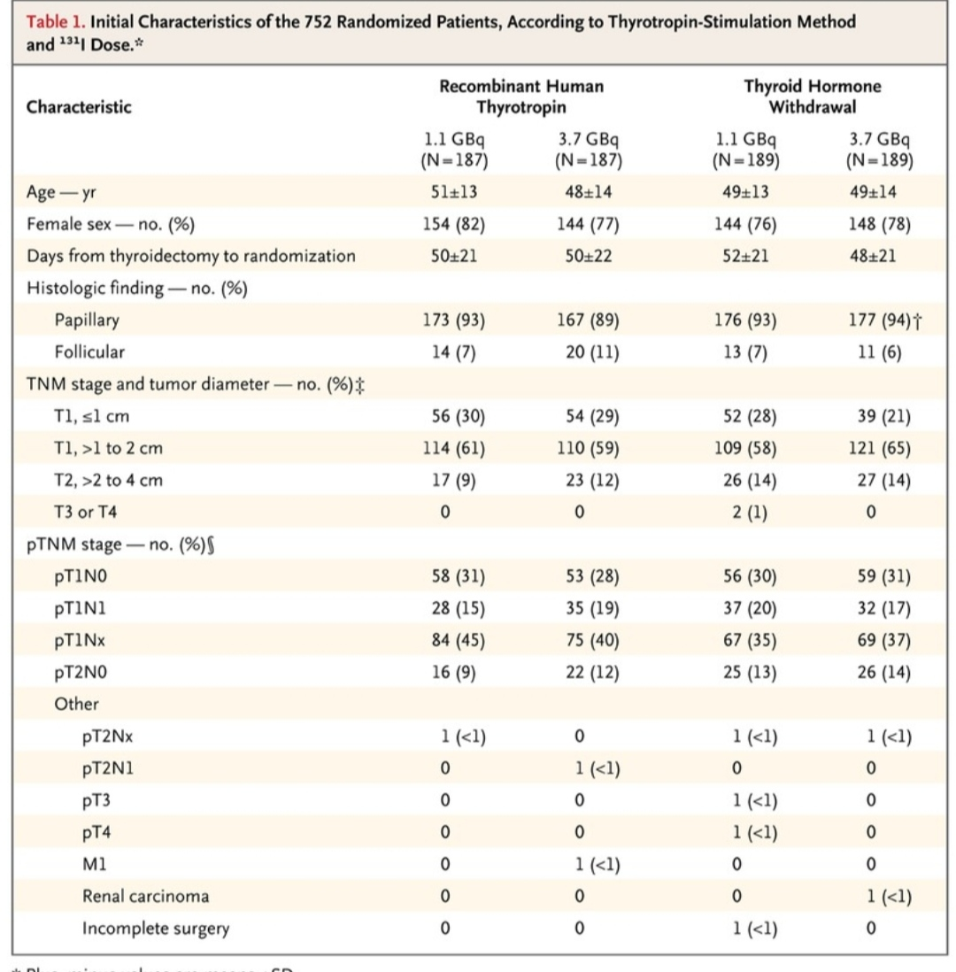

Slide 24
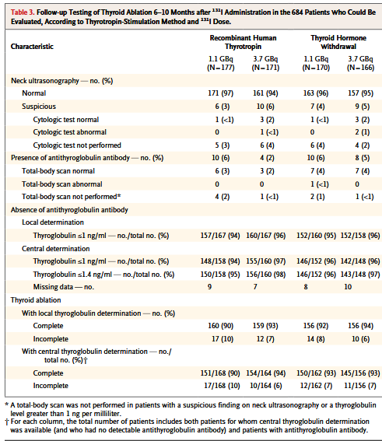

Slide 25
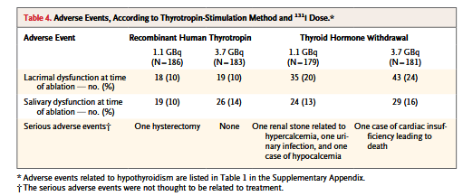
T h e n e w e n g l a n d j o u r n a l o f m e d i c i n en engl j med 366;18nejm.orgmay 3, 2012

Slide 26
Thus, the use of recombinant human thyrotropin and a low dose of 131I for postoperative radioiodine ablation represents an effective and attractive option for the management of low-risk thyroid cancer that reduces the amount of whole-body irradiation and maintains the quality of life.
T h e n e w e n g l a n d j o u r n a l o f m e d i c i n en engl j med 366;18nejm.orgmay 3, 2012

Slide 27
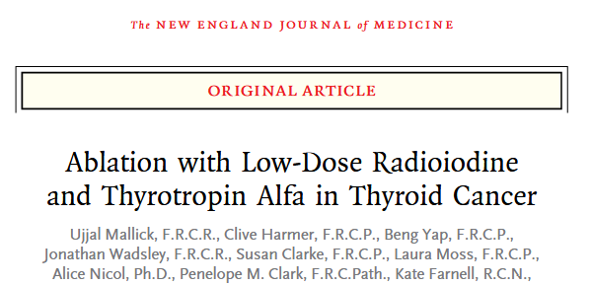
Methods: From 2007 - 2010, in 29 centers with 421 patients
Tumor stage T1 to T3 , N0, NX, N1, and M0, Tg =2 (ablation day)
primary end point was the success rate for ablation; negative scan (<0.1% uptake on the thyroid bed) and a thyroglobulin level< 2.0 ng/ml at 6 to 9 months.
Secondary end points: days of hospitalization; adverse events during ablation and 3 M after ablation, tumor recurrence; quality of life
l ow-dose R a dioiodine a nd Th y ro tropin A lfan engl j med 366;18nejm.orgmay 3, 2012

Slide 28
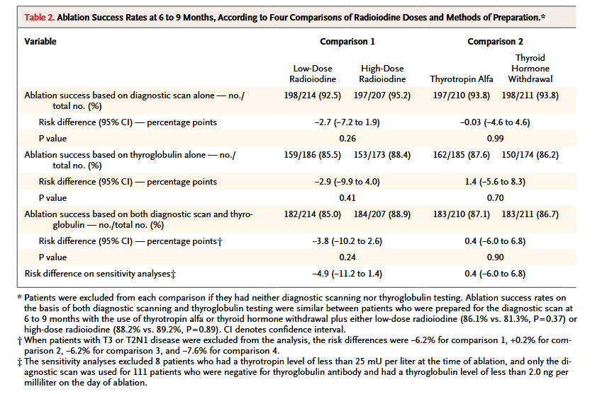

Slide 29
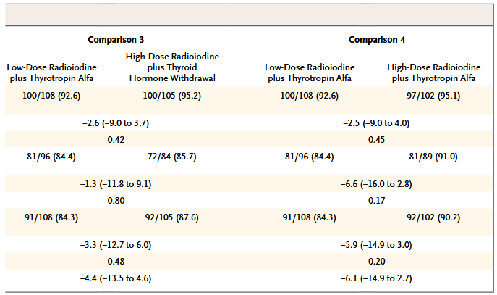

Slide 30
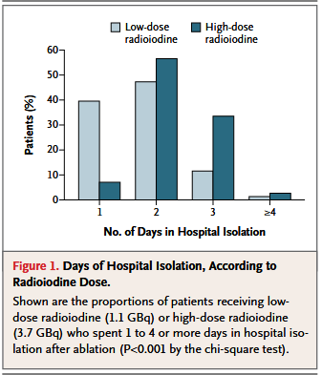
39.6% versus 7.1% requiring only 1 day in hospital isolation and 13.0% versus 36.3% requiring 3 days or more (P<0.001)
l ow-dose R a dioiodine a nd Th y ro tropin A lfan engl j med 366;18nejm.orgmay 3, 2012

Slide 31
*patients receiving low-dose radioio-dine and thyrotropin alfa had fewer early side effects, reported having a significantly better quality of life, and spent less time in hospital isolation than those receiving the high dose with either thyrotropin alfa or thyroid hormone withdrawal.
* ablation success : at 6 to 9 months and do not address future recurrences, Long-term follow-up will be required to examine recurrence rates
l ow-dose R a dioiodine a nd Th y ro tropin A lfan engl j med 366;18nejm.orgmay 3, 2012

Slide 32
6 RCT, 1809 patient
primary outcomes :asnegative (WBS) alone
secondary outcomes : adverse effects, days of hospitalisolation:
The1100-MBqactivity vs the 3700-MBq activity ,The 1850-MBqactivity vs the 3700-MBq activity
J Clin Endocrinol Metab, April 2013, 98(4):1353–1360

Slide 33
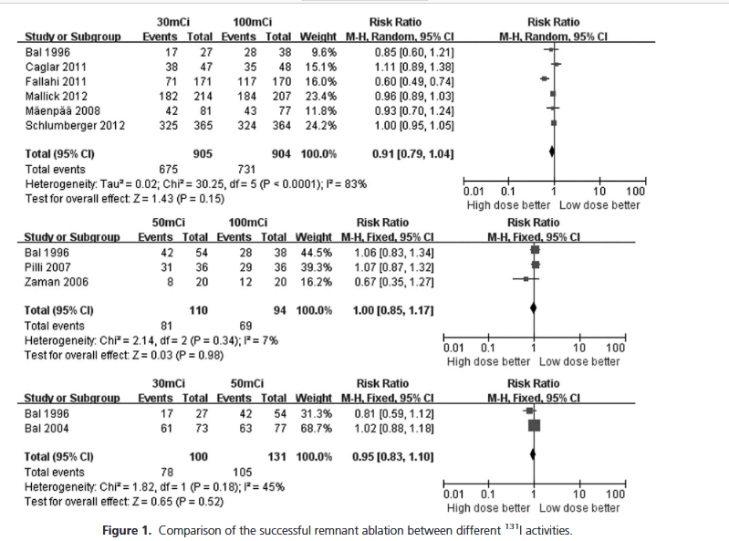

Slide 34
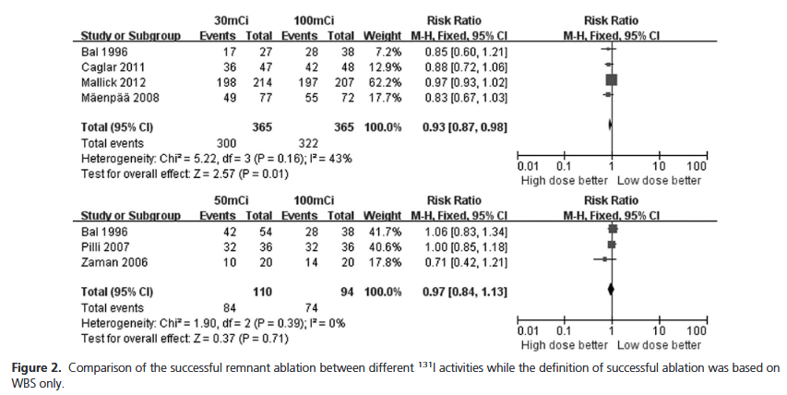

Slide 36
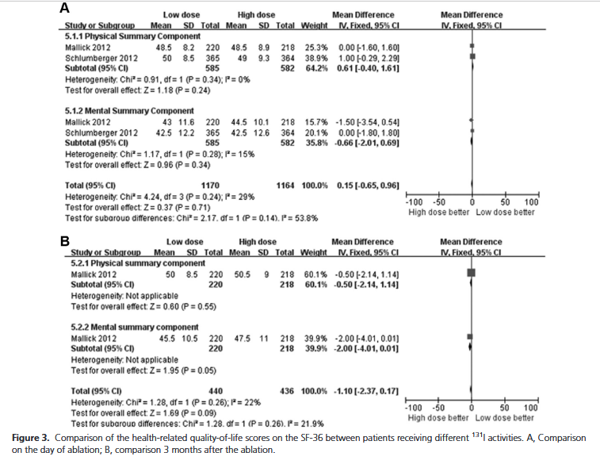

Slide 37
. *Therefore,the low-dose 131I activity(1100MBq) is sufficient for remnant ablation in DTC patients with low and intermediate risk of relapse.
*The ablation radioiodine for DTC patients was generally well tolerated, and the frequency of adverse effects decreased with time.
J Clin Endocrinol Metab, April 2013, 98(4):1353–1360

Slide 38
*-rhTSH-aided low-activity versus high-activity regimens ofradioiodine in residual ablation for differentiated thyroidcancer:
Chao Maa,*, Limin Tangb,*, Hongliang Fua,*, Jianing Liaand Hui Wang
3 RCT(637 patients OR=0.85 (95% CI 0.49-1.47 ; p=0.56)
*- High versus low radioiodine activity in patients with differented thyroid cancer : Valachis A, Nearchou A.
10 RCT(1772 patients , ( RR ) 0.94 [95% CI 0.85-1.04] ; p= 0.21

Slide 39
11 RCT , 3732 patients , untill 2014
Low dose(24 mCi) =1514
Moderate dose(39 mCi)=811
High dose (120 mCi)=1412
Assessed the successful remnant ablation at 3 to 12 months after131I admin-istration

Slide 41
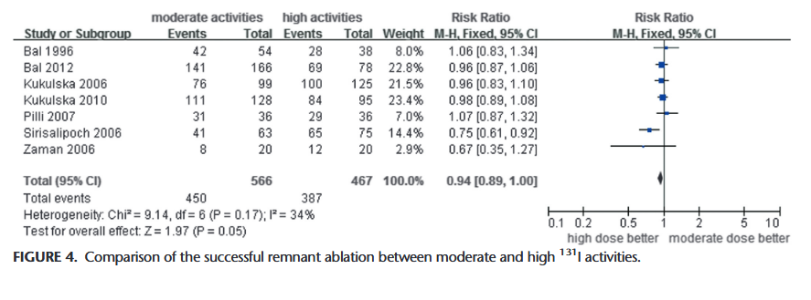

Slide 42
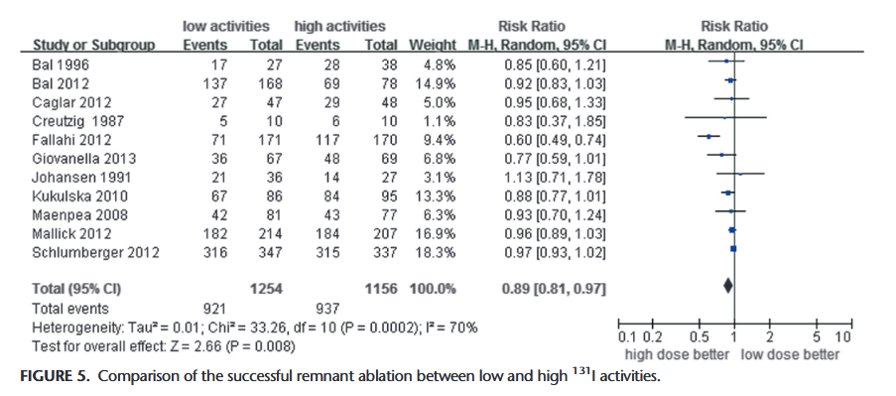

Slide 43
QUESTIONS :
*Does RRA have an effect on the long-term outcome of low – risk patient?
*Does RRA (low dose vs high dose) have an effect on the outcome of low- risk patient?
*Does the use of low dose & high dose iodine affect the recurrence of low- risk patient?
*Guidelines
*Conclusions

Slide 44
Methods :This multicentre, randomised, open-label, equivalence trial was done at 24 centres, 2007-2010, 726 patients (97% of the 752 patients 5.4 y followed up).
randomly assigned (1:1:1:1), all of patients low-risk (DTC) , age > 18y
TNM stage pT1 of 1 cm or less with N1 or Nx, pT1 of more than 1 cm with any N, or pT2 with N0 in the absence of distant metastasis
Lancet.com/diabetes-endocrinology Published online May 25, 2018

Slide 45
The primary outcomes : complete thyroid ablation 6–10 months after radioactive iodine: normal neck ultrasonography & Tg<= 1 ng/ml after rhTSH or a normal diagnostic radioactive iodine total-body scan in patients with serum thyroglobulin antibodies.
secondary outcomes :adverse events, symptoms of hypothyroidrism, and quality of life
Lancet.com/diabetes-endocrinology Published online May 25, 2018

Slide 46
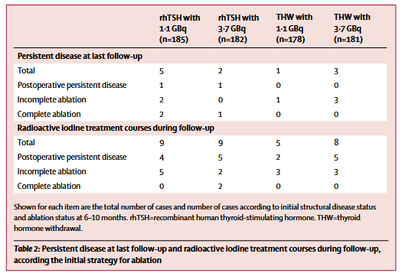

Slide 47
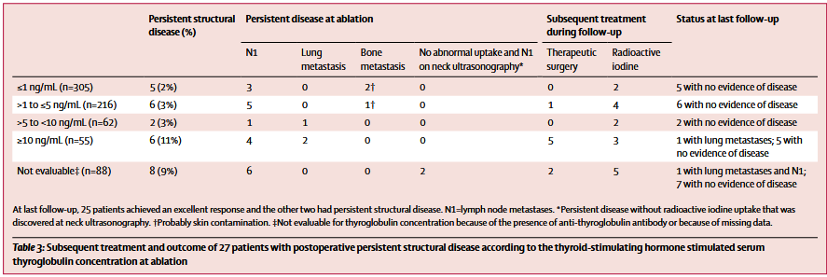

Slide 48
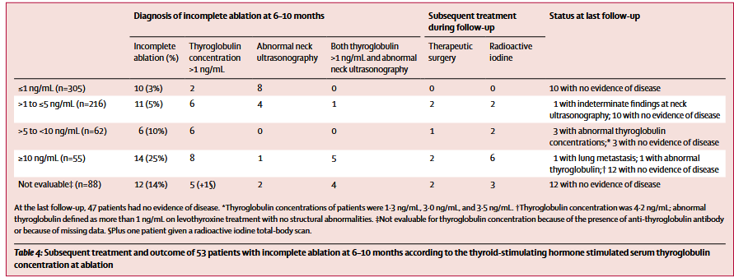

Slide 49
* thyroglobulin concentration measured at the time of ablation was prognostic for structural disease, status at ablation, ablation status at 6–10 months, and the final outcome .
Lancet.com/diabetes-endocrinology Published online May 25, 2018

Slide 50
438 Patients Between Jan 16, 2007, and July 1, 2010, median follow-up was 6·5 year
29 centre, TNM :T1-T3 N0 N1 Nx , Low & Intermediate- risk(100 )
217 in the low-dose group (1·1 GBq ) and 217 in the high-dose group (3.7GBq)
Outcomes :This report focuses on recurrence
diabetes-endocrinology Vol 7 January 2019

Slide 51
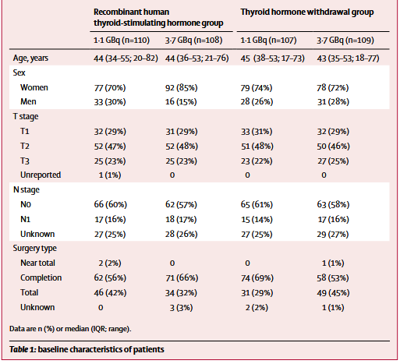

Slide 52
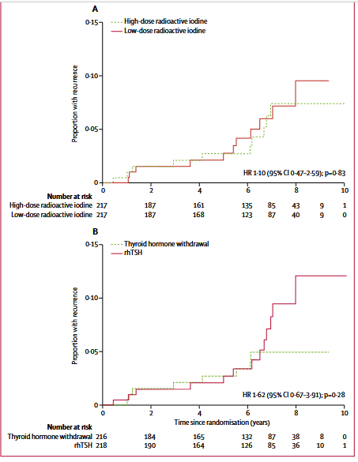

Slide 53
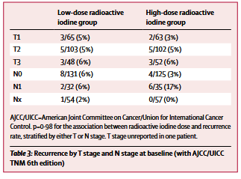
Recurrence rates : 0·5% for 1·1 GBq versus 1·1% for 3·7 GBq at 3 years
1.1% for 1.1GBq versus 1·7% for 3.7GBQ at 5 years
4·9% for 1.1GBq versus 6·3% for 3.7GBq at 7 years
(HR 1·13 [95% CI 0·43–2·92];p=0·81)

Slide 54
*Long-term follow-up data from the HiLo randomised trial show that the low radioactive iodine dose is not associated with a higher risk of recurrence than the high dose, and nor is the risk of recurrence higher with rhTSH than with thyroid hormone withdrawal.
*These results extend that low-dose radioactive iodine is non-inferior to high-dose radioactive iodine in terms of ablation success rate in selected patients with low-risk and intermediate-risk differentiated thyroid cancer.
diabetes-endocrinology Vol 7 January 2019

Slide 55
*The combination of recent large observational studies and long-term follow-up of two randomised trials (HiLo & ESTIMABL1) represents comprehensive and definitive evidence that low-dose radioactive iodine is an acceptable therapy for patients with DTC.
The next step is to show whether radioactive iodine ablation can be avoided completely in patients at very low risk.
Two large prospective trials are ongoing, the IoN trial & ESTIMABL2 , both of which involve randomly assigning selected low-risk patients to have either 1·1 GBq radioactive iodine ablation or no radioactive iodine ablation, with disease-free survival as a major endpoint.
diabetes-endocrinology Vol 7 January 2019

Slide 56
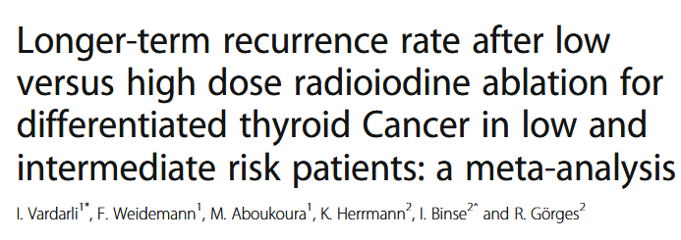
primary endpoint; recurrence rate between the low & high radioiodine activity (Recurrence was defined as pathologic findings, (FNA), (Tg), (US) diagnostic radioactive iodine scan, PET-Scan or MRI scan
secondary endpointswere: No uptake in WBS and/or Tg level < 2.0 ng/mL or < 10.0ng/mL)
4 RCT , 1501 paitents
BMC Cancer (2020) 20:550

Slide 57
The included trials showed that the longer-term recurrence rate among patients who had low activity radio-active iodine ablation was not higher than for high dose(OR 0.93 [95% CI 0.53–1.63];P= 0.79)

Slide 58
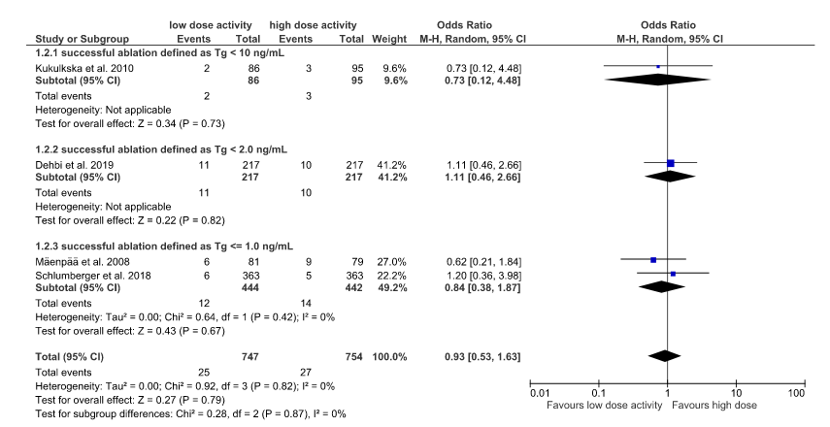
The subgroup analysis regarding the TSH stimulated thyroglobulin values(< 10 ng/mL versus < 2 ng/mL versus≤1 ng/mL) showed no influence on longer-term recurrence rate

Slide 59
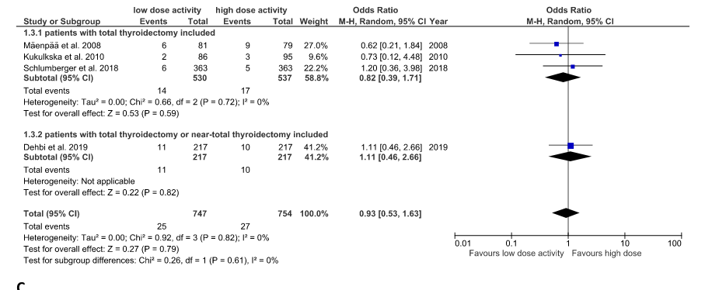
The subgroup analyses regarding the type of surgery(total thyroidectomy versus total or near-total thyroidec-tomy) ) showed no influence onthe longer-term recurrence rate

Slide 60
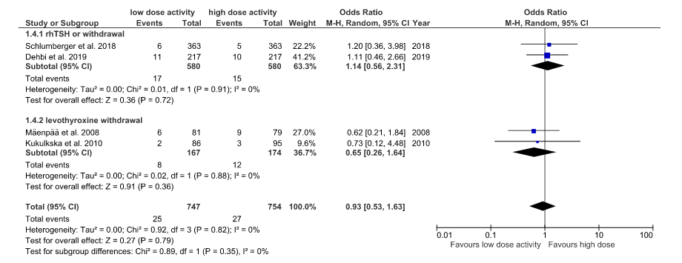
stimulation method (rhTSH ver-sus levothyroxine withdrawal) showed no influence onthe longer-term recurrence rate (

Slide 61
QUESTIONS :
*Does RRA have an effect on the long-term outcome of low – risk patient?
*Does RRA (low dose vs high dose) have an effect on the outcome of low- risk patient?
*Does the use of low dose & high dose iodine affect the recurrence of low- risk patient?
*Guidelines
*Conclusions

Slide 62
ATA Guidline for Low – Risk DTC
*RAI remnanta blation is not routinely recommended after thyroidectomy for ATA Low-risk DTC patients.
*Consideration of specific features of the individual patient that could modulate recurrence risk, disease follow up implications, and preferences are relevant to RAI decision making.
(Weak recommendation, Low-quality evidence)

Slide 63
*RAI remnant is not routinely recommended after lobectomy or total thyroidectomy for patients with unifocal PMC, in the absence of other adverse features.
(Strong recommendation, Moderate- quality evidence)
*RAI remnant ablation is not routinely recommended after thyroidectomy for patients with multifocal PMC in absence of other adverse features.
(Weak recommendation, Low- quality evidence)
*Consideration of specific features of the individual patient that could modulate recurrence risk, disease follow up implications, and preferences are relevant to RAI decision making.

Slide 64
or
*if RAI remnant ablation is performed after total total thyroidectomy for ATA Low- risk or intermediate- risk disease with lower risk features (low volume central neck nodal metastases with no other known gross residual disease or any other adverse features), a low administered activity of approximately of 30 mCi is generally favored over higher administered activities.
(Strong recommendation, High- quality evidence)

Slide 65
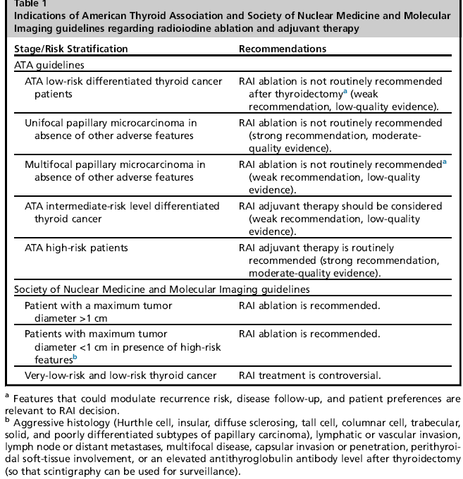

Slide 66
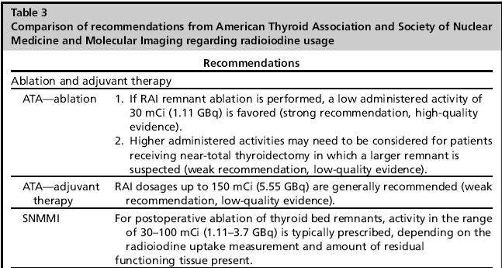

Slide 67
QUESTIONS :
*Does RRA have an effect on the long-term outcome of low – risk patient?
*Does RRA (low dose vs high dose) have an effect on the outcome of low- risk patient?
*Does the use of low dose & high dose iodine affect the recurrence of low- risk patient?
*Guidelines
*Conclusions

Slide 68
CONCLUSION:
*- when ablation is indicated in patients with low-risk & intermediate-risk thyroid cancer, low dose RAI is sufficient.
*- This preference is due to fewer common adverse effects, and a shorter stay inradiation protection unit.
*- It is better to use RAI after rhTSH injections, because with this combination the whole body irradiation is lower and quality of life is maintained.

Slide 69
*-Regarding the lack of iodine consumption and the absence of recurrence in Low-risk & intermediate-risk DTC we had to wait the result of ESTIMBLE 2 & ION

