Slide 1
Pitfalls in diagnosis Treatment of hypothyroidism
A.Amouzegar MD
Endocrine Research Center
Research Institute For Endocrine Sciences
Shahid Beheshti University ,Tehran, IRan

Slide 2
Outlines:
Screening
Definition
Local reference range
Interpretation of high serum TSH
Subclinical hypothyroidism
Treatment
Conclusion

Slide 3
Screening and aggressive case finding for hypothyroidism
Criteria for population screening include:
A condition that is prevalent and an important health problem
Early diagnosis is not usually made
Diagnosis is simple and accurate
Treatment is cost effective and safe
Endocr Pract. 2012 Nov-Dec;18(6):988-1028

Slide 4
Cont
Despite this seemingly straightforward guidance, expert panels have disagreed about TSH screening of the general population
Endocr Pract. 2012 Nov-Dec;18(6):988-1028

Slide 5
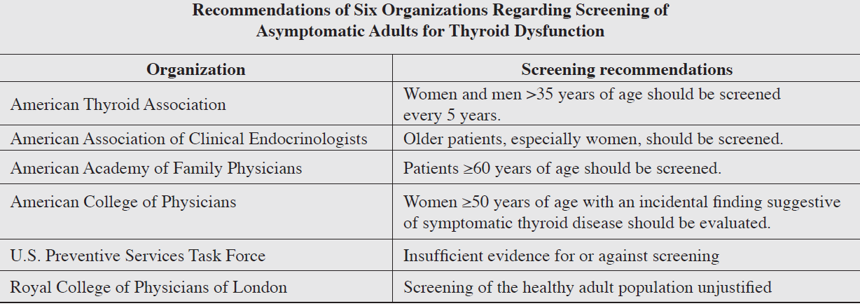
Endocr Pract. 2012 Nov-Dec;18(6):988-1028

Slide 6
Definitions
Hypothyroidism may be either subclinical or overt
SCH is characterized by a serum TSH above the upper reference limit in combination with a normal free thyroxine (T4)
An elevated TSH, usually above 10 mIU/L, in combination with a subnormal free T4 characterizes overt hypothyroidism
Thyroid. 2014 Dec;24(12):1670-751

Slide 7
Signs and symptoms of hypothyroidism
Dry skin
Cold sensitivity
Fatigue
Muscle cramps
Voice changes
Constipation
Carpal tunnel syndrome
Sleep apnea
Pituitary hyperplasia that can occur ± hyperprolactinemia
Hyponatremia

Slide 8
TSH reference range
TSH reference range should be determined in a disease-free population, which excludes those who :
Self-reported thyroid disease or goiter
Who were taking thyroid medications
Were not pregnant
Did not have laboratory evidence of hyper- or hypothyroidism
Did not have detectable TgAb or TPOAb
Were not taking estrogens, androgens, or lithium
Thyroid 2003, 13: 3-126.

Slide 10
Age influence of upper bound
For every 10-year age increase after 30-39 years, the 97.5th percentile of serum TSH increases by 0.3 mIU/L
Not all patients who have mild TSH elevations are hypothyroid
A mild TSH elevation (4.0–7.0 mU/l) in the elderly (>80 years old) should be considered as a physiological adaptation to aging
Thyroid. 2011;21:5-11
Clin Endocrinol Metab 2007; 92: 4575–4582

Slide 11
Pitfalls encountered when interpreting serum TSH levels Monitoring of treatment
TSH levels vary diurnally by up to approximately 50% of mean values , with some reports indicating up to 40% variation on specimens performed serially during the same time of day
Values tend to be lowest in the late afternoon and highest around the hour of sleep
In light of this, variations of serum TSH values within the normal range of up to 40%-50% do not necessarily reflect a change in thyroid status
JCEM . 1986;62:960-964
Thyroid. 2008;18:303-308

Slide 12
Case 1: Diagnosis Pitfall?
A 33-year-old woman presented with fatigue, weight loss, in the 8 w postpartum
At the other medical center, TFTs revealed a markedly elevated TSH with discordantly normal fT4 and fT3 levels
She was prescribed LT4 therapy
Due to unresponsiveness of TSH to almost 1 year of LT4 therapy and unexplained elevations in several other hormone tests, she was referred to our clinic
When admitted, she had no specific symptoms and was clinically euthyroid
Her PHX was normal
Her PMH was unremarkable
She had no personal or FH of thyroid disease
Thyroid autoantibodies were negative, and thyroid US was normal
J Clin Endocrinol Metab. 2015 Jun;100(6):2147-53

Slide 13
Cont
Repeated measurements revealed :
TSH :303 mIU/L (0.35– 4.94)
fT4 :1.4 ng/dL (0.7–1.48)
fT3 :3.32 pg/mL (1.71–3.71)
A retrospective analysis of the patient’s records revealed that she had normal levels of TSH :1.24 mIU/L (0.35– 4.94)
No other unusual events or medical conditions were noted starting from that point in time to her admission
J Clin Endocrinol Metab. 2015 Jun;100(6):2147-53

Slide 14
Cont
Because we suspected assay interference, we ordered several other hormone tests
Prolactin (PRL), ACTH levels were markedly high and hCG was tested positive
She had no symptoms associated with Cushing syn, and the serum cortisol levels were suppressed with the LDDST
She had regular menses, and her menstrual period started on the day when hCG was tested positive
A repeated hCG on the same day on another analytical platform was found to be negative and there was no sign of pregnancy on US
J Clin Endocrinol Metab. 2015 Jun;100(6):2147-53

Slide 15
What is your diagnosis?
A: Hypothyroidism with low drug- compliance
B: Presence of heterophil Antibody
C: TSHoma
D Resistant to thyroid hormones

Slide 16
Measurements on different analytical platforms
Results of Hormonal Assays From Different Analytical Platforms
Disconcordant results?!!!

Slide 17
Heterophile antibody analysis
When samples were reanalyzed with heterophile antibody blocking tubes, the hormone levels were measured in the normal reference range revealing the presence of heterophile Abs
Results before and after incubation in Heterophile Antibody Blocking Tubes
After | Before
1.73 | >100 | TSH (0.35– 4.94) mIU/L

Slide 18
other pitfalls
TSH levels may increase to levels above normal, but generally below 20 mIU/L during the recovery phase from nonthyroidal illness
Arch Intern Med. 1981;141:873-875
Thus, there are limitations to TSH measurements in hospitalized pts and, they should be only performed if there is an index of suspicion for thyroid dysfunction
Am J Med.. 1982;72:9-16

Slide 19
Other pitfalls
Patients with nonfunctioning pituitary adenomas, with central hypothyroidism, may have mildly elevated serum TSH levels, generally not above 6 or 7 mIU/L, due to secretion of bio - inactive isoforms of TSH
NEJM. 1985;312:1085-1090
TSH levels may also be elevated in association with elevated serum thyroid hormone levels in patients with resistance to thyroid hormone
Clin Invest. 1975;56:633-642

Slide 20
Other pitfalls
Lastly, adrenal insufficiency, as previously noted in Disorders associated with hypothyroidism, may be associated with TSH elevations that are reversed with glucocorticoid replacement
Endocr Pract. 2006;12:572
Clin Invest. 1975;56:633-642

Slide 21
Case 2: Who should be treated?
A 53 year-old lady came to us with dry skin, cold sensitivity, fatigue, muscle cramps, and constipation
Thyroid palpation showed mild goiter
Serum TSH was 8.1 mU/L that after repetition we got the same result ( TSH 8.9 mU/L)
When do you consider treatment?
A: if patient has symptoms suggestive of hypothyroidism
B: If she has positive TPOAb
C: If she has evidence of ASCVD, HF , or associated risk factors
D: All
Grade B, evidence

Slide 22
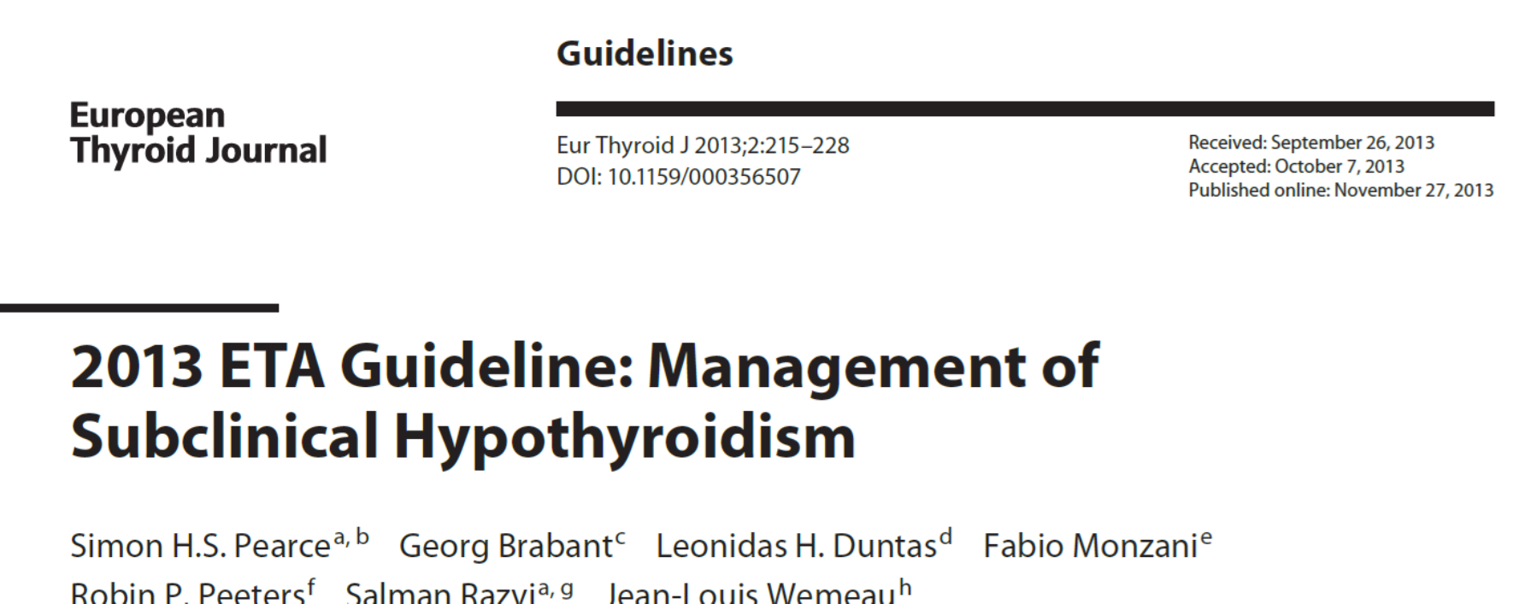
Recommendations
LT4 replacement therapy should be considered:
In younger SCH patients (<65 years; serum TSH <10 mU/L) with symptoms suggestive of hypothyroidism
Following hemithyroidectomy, persistent SCH
Patients with persistent SCH and diffuse or nodular goitre
Even in the absence of symptoms, LT4 is recommended for patients (<65 years) with serum TSH >10 mU/L

Slide 23
Which patients with TSH levels above a given laboratory’s reference range should be considered for treatment with L-thyroxine?
Patients whose serum TSH levels exceed 10 mU/L are at increased risk for heart failure and cardiovascular mortality, and should be considered for treatment with L-thyroxine Grade B
Which patients with TSH levels of 4.5-10 mU/L will benefit from treatment is less certain
The oldest old subjects (>80–85 years) with elevated serum TSH ≤ 10 mU/L should be carefully followed with a wait-and-see strategy, generally avoiding hormonal treatment
There are virtually no clinical outcome data to support treating patients with subclinical hypothyroidism with TSH levels between 2.5 and 4.5 mU/L
Pharmaceutics. 2013 Dec 13;5(4):621-33
Thyroid. 2014 Dec;24(12):1670-751
JCEM 2013 Feb;98(2):653-8

Slide 24
What are the clinical and biochemical goals for levothyroxine replacement in primary hypothyroidism?
(1) to provide resolution of the patients’ symptoms and hypothyroid signs, including biological and physiologic markers of hypothyroidism
(2) to achieve normalization of serum TSH with improvement in thyroid hormone concentrations
(3) to avoid overtreatment (iatrogenic thyrotoxicosis)
(4) All
Thyroid 2014 Dec;24(12):1670-751

Slide 25
Case 3
A 54 – year old lady referred to us with hypothyroidism. She is being treated with levothyroxine 100mcg/day. What is your goal for serum TSH level?
A : TSH < 2.5 U/mL
B: TSH < 1 U/mL
C: based on age-based upper limit of normal for TSH assay
D: TSH < 4.1 U/mL

Slide 26
What are the potential deleterious effects of excessive levothyroxine?
A: Atrial fibrillation
B: Osteoporosis
C: Hyperlipidimia
D: A & B

Slide 27
L-thyroxine treatment of hypothyroidism
Treatment of hypothyroidism is best accomplished using synthetic L-thyroxine sodium preparations
The studies related to L-thyroxine and L-triiodothyronine combination therapy have largely failed to confirm an advantage of this approach to improve outcomes in hypothyroid individuals treated with L-thyroxine alone
JCEM . 2005;90:4946-4954
JCEM. 2006;91:2592-2599

Slide 28
determine the levothyroxine dose
When deciding on a starting dose of LT4, the patient’s weight, lean body mass, etiology of hypothyroidism, degree of TSH elevation, age, and general clinical context, including the presence of cardiac disease, should all be considered
In addition, the serum TSH goal appropriate for the clinical situation should also be considered
Strong recommendation. Moderate quality evidence
Thyroid 2014 Dec;24(12):1670-751

Slide 29
Cont
With little residual thyroid function, replacement therapy requires approximately 1.6 μg/kg of L-thyroxine daily
Patients who are athyreotic and those with central hypothyroidism may require higher doses, while patients with subclinical hypothyroidism or after treatment for Graves’ disease may require less
Thyroid. 2012 Dec;22(12):1200-35
Horm Metab Res. 2008;40:50-55

Slide 30
Taking drug
Take LT4 with water between 30 and 60 minutes prior to eating breakfast or at bedtime 4 hours after the last meal on an empty stomach
L-T4 should be stored per product insert at 20-25°C, and protected from light and moisture
It should not be taken with substances or medications that interfere with its absorption or metabolism

Slide 31
Cont
Dose adjustments are guided by serum TSH determinations 4-8 weeks
Once an adequate replacement dosage has been determined most, but not all of us, are of the opinion that periodic follow-up evaluations with repeat TSH testing at 6-month and then 12-month intervals are appropriate
Endocr Pract. 2008;14:550-555

Slide 32
Conclusion:
Generalized screening is not needed in all people
Local reference ranges should be determined
Interpretation of serum TSH in a euthyroid patient should be with caution
Treatment of SCH needs to be considered individually
Having TSH level in normal reference range

