Slide 1
National and subnational mortality effects of major metabolic risk factors and smoking in Iran: an approach to priority setting in Iran’s health system
Presentation for
by
Farshad Farzadfar
October 17th , 2011

Slide 2
Outline
Epidemiologic transition and CVD
Iran’s population health
Data sources
Methodology and Analysis
Findings

Slide 3
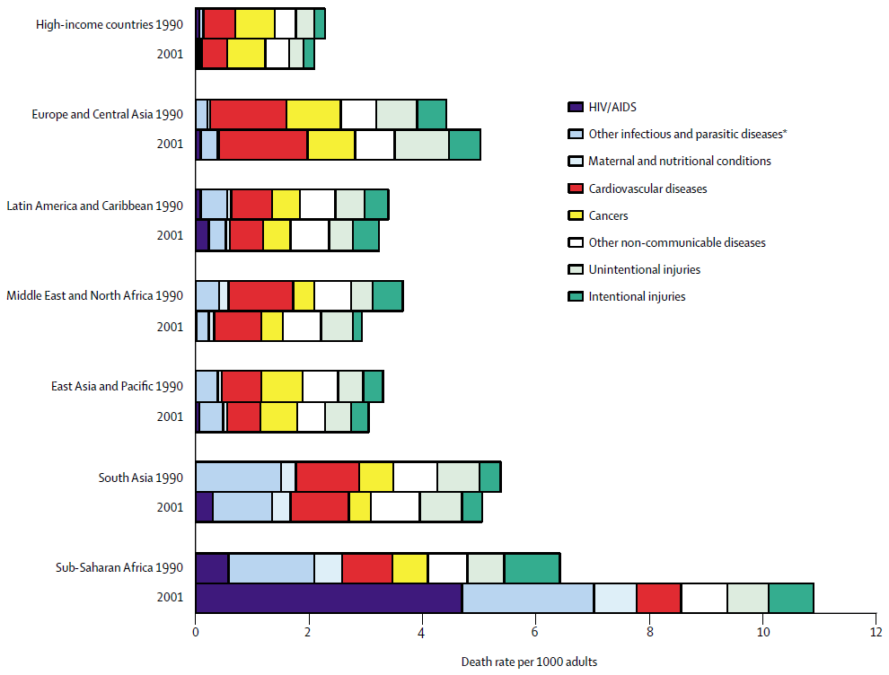
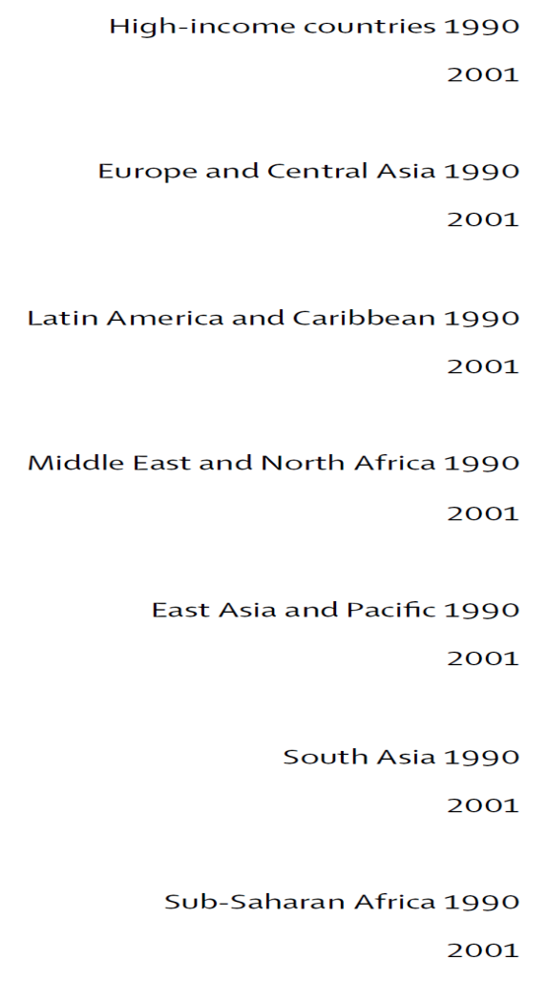
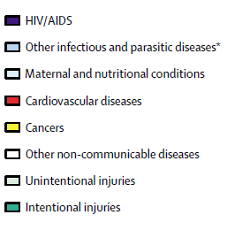
Global epidemiologic transition
Lopez et al. Lancet 2006

Slide 4
Age-standardized cardiovascular mortality trends in selected high-income countries
Male
Female
Vital registration data from WHO

Slide 5
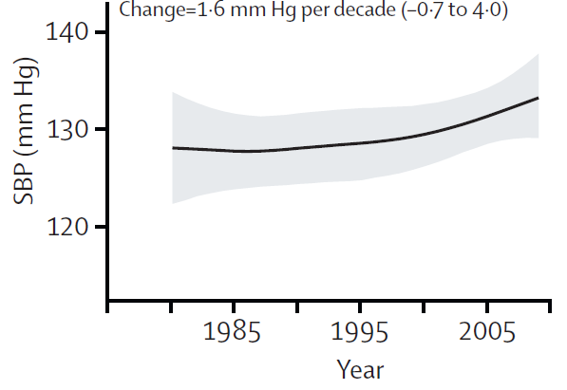
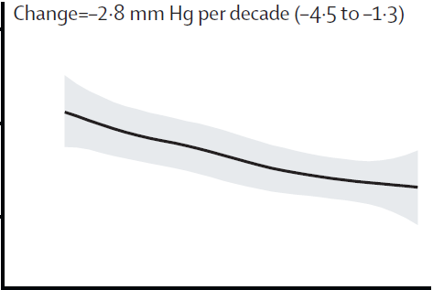
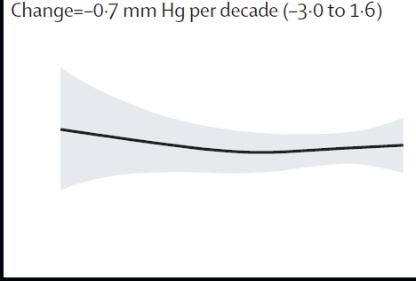
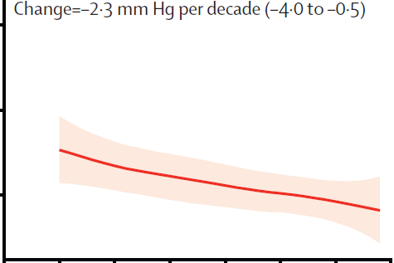
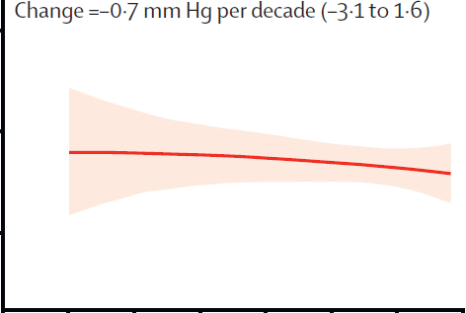
Regional SBP trends
North America
North Africa and Middle East
Male
North America
North Africa and Middle East
Female
Danaei et al. Lancet 2011

Slide 6
TC, BMI and SBP trends in Iran between 1980 and 2008
TC
BMI
SBP
Male
Female
Farzadfar et al. Lancet 2011, Finucane et al. Lancet 2011, Danaei et al. Lancet 2011

Slide 7
Risk factors in the analysis
Systolic blood pressure (SBP)
Body mass index (BMI)
Fasting plasma glucose (FPG)
Total cholesterol (TC)
Smoking

Slide 8
Data sources
Risk factor exposure:
Non-communicable diseases surveillance survey (2005)
Relative risk:
    US CRA (Danaei et al 2009)
    Law 2003
    PSC 2007
Mortality :
    Iranian death registration system (2005 and 2006)
    Demographic and Health Survey (2000)
    Census data (2006)
    Review of hospital medical records (2005)
8

Slide 9
Non-communicable diseases surveillance Survey
Adults aged 15-64 years (25-64 for blood samples)
Multilevel systematic cluster sampling
Questionnaire, physical measurements, lab measurements
A sample of 89,400 individuals (50,200 samples for lab data)

Slide 10
Analytical framework
Relative risks
Risk factor
exposure
Optimal exposure
level
Population attributable
fraction
Disease-specific
attributable
deaths
Disease-specific deaths
Correction for
incompleteness
Redistribution of
deaths with
unspecified cause

Slide 12
Analyses
Risk factor exposure:
    Missing exposure data in older age groups
    SIR for smoking
Disease-specific deaths:
Incompleteness of death registration system
Redistribution of deaths with unspecified cause
Uncertainty in estimates:
Sampling uncertainty
Etiological effects uncertainty
Uncertainty in the model for missing older age groups
Completeness estimation uncertainty
Uncertainty in proportional redistribution of deaths with unspecified cause

Slide 15
Analyses
Risk factor exposure:
    Missing exposure data in older age groups
    SIR for smoking
Disease-specific deaths:
Incompleteness of death registration system
Redistribution of deaths with unspecified cause
Uncertainty in estimates:
Sampling uncertainty
Etiological effects uncertainty
Uncertainty in the model for missing older age groups
Completeness estimation uncertainty
Uncertainty in proportional redistribution of deaths with unspecified cause

Slide 17
Smoking Impact Ratio
The accumulated hazards of smoking depend:
  the age at which smoking began
  number of cigarettes smoked per day
  and cigarette type
These data are extremely rare.
Estimation of Disease Burden
CLC= Age-sex specific lung cancer mortality rate in a population
NLC= Age-sex specific lung cancer mortality rate of never-smokers in the
same population
S*LC and N*LC = Age-sex specific lung cancer mortality rates for
smokers and never-smokers in a reference population (Cancer Prevention Study II (CPS-II) )
Notes:
17

Slide 18
Analyses
Risk factor exposure:
    Missing exposure data in older age groups
    SIR for smoking
Disease-specific deaths:
Incompleteness of death registration system
Redistribution of deaths with unspecified cause
Uncertainty in estimates:
Sampling uncertainty
Etiological effects uncertainty
Uncertainty in the model for missing older age groups
Completeness estimation uncertainty
Uncertainty in proportional redistribution of deaths with unspecified cause

Slide 20
Analyses
Risk factor exposure:
    Missing exposure data in older age groups
    SIR for smoking
Disease-specific deaths:
Incompleteness of death registration system
Redistribution of deaths with unspecified cause
Uncertainty in estimates:
Sampling uncertainty
Etiological effects uncertainty
Uncertainty in the model for missing older age groups
Completeness estimation uncertainty
Uncertainty in proportional redistribution of deaths with unspecified cause

Slide 21
Analysis regions

Slide 22
Exposure to selected risk factors in 2005, by region and sex
SBP (mmHg)
Southeast
North-Northeast
West
Central
National
FPG (mmol/L)
Southeast
North-Northeast
West
Central
National
BMI (Kg/m^2)
Southeast
North-Northeast
West
Central
National

Slide 23
The geographical distribution of the estimated mortality rates (deaths/100,000 population) attributable to the cardiometabolic and lifestyle risk factors in Iranian population in 2005, by sex

Slide 24
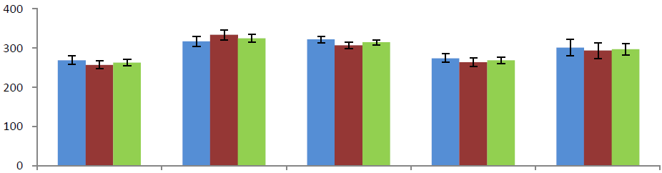
Age-standardized mortality rates attributable to selected risk factors in 2005, by region and sex
SBP
Age-standardized mortality
(deaths/100,000)
Southeast
North-Northeast
West
Central
National
FPG
Age-standardized mortality
(deaths/100,000)
Southeast
North-Northeast
West
Central
National
BMI
Age-standardized mortality
(deaths/100,000)
Southeast
North-Northeast
West
Central
National

Slide 25
The effects of risk factors on life expectancy in 2005, by region
Male
Life expectancy
Southeast
North-Northeast
West
Central
National
Female
Life expectancy
Southeast
North-Northeast
West
Central
National

Slide 26
Policy implications and future directions
Risk factors with large burden but no current program to control
Subnational level policy making
Trend of metabolic risk factors at subnational level
Experimental randomization studies by introducing stepwise health interventions

Slide 27
Acknowledgement
Doctoral committee members:
    Dr. Majid Ezzati
    Dr. Christopher Murray
    Dr. Thomas Bossert
Others:
    Goodarz Danaei
    Hengameh Namdaritabar
    Julie Knoll Rajaratnam
    Jacob Marcus
    Ardeshir Khosravi
    Siamak Alikhani
    Jalal Hosseini
    Kathie Dionisio

Slide 28
Questions/ Comments
28

