Slide 1

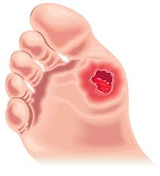
Diabetic Foot Managment
Dr. Amir Sabbaghzadeh Irani
Akhtar hospital
Assistant professor
SBMU
2017

Slide 2

Epidemiology
175 million people worldwide with diabetes mellitus
by 2030 the projected number is 360 million
foot disorders are the most common complication
The major cause of hospitalization

Slide 3
Diabetic foot ulcer (DFU) is the most costly and devastating complication
Affects 15% of diabetic patients during their lifetime
Proper management can greatly reduce, delay or prevent
Infection
Gangrene
Amputation
Death

Slide 4

Diabetes is a multi-organ systemic disease
All comorbidities that affect wound healing must be managed
So you need a multidisciplinary team

Slide 5

The Role of orthopedic surgeon?

Slide 6
Treatment approaches
Patient education
Blood glucose control
Neuropathy
Vasculopathy

Slide 7
Wound/Ulcer Management

Slide 8

Three Main Questions
Extent of the lesion
Vascularity
Infection

Slide 9
First step is to classify(extent and ischemia)
Wagner
University of Texas ulcer classification

Slide 10
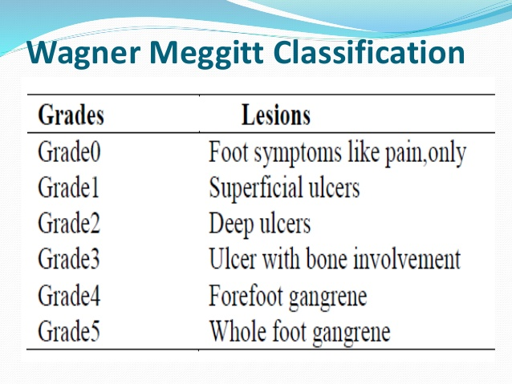

Slide 11
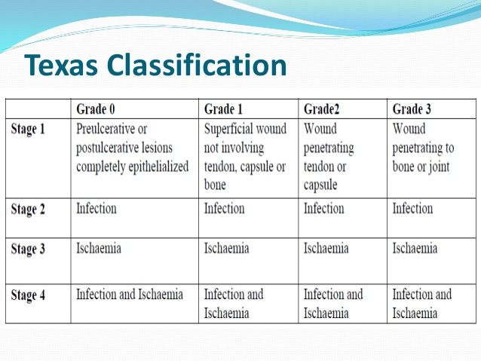

Slide 12
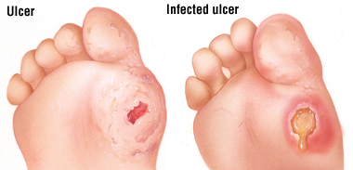
Infection
All ulcers are colonized at least superficially
Characteristics
Discharge
Deep(greater than grade 1)
Surrounding erythema
Cellulitis
Edema and lymphangitis

Slide 13
Principles of care for diabetic foot

Slide 14
Most grade 1 ulcers can be treated outpatient and non-operatively
Deeper than grade 1 usually require inpatient or surgery

Slide 15
Infected?
Dysvascular?
Doppler screening
Infected and not dysvascular
Dysvascular with or without infection
MRI or CT
abcess
Osteomylitis
cellulitis
Vascular consultation
Reconstructable
Not reconstructable

Slide 16
Osteomylitis
Intravenous antibiotics
cellulitis
Abcess
Excision of infected bone
Toe , ray , TM amputation or partial foot amputation
Drain or debride
Partial amputation sometimes necessary

Slide 17
dysvascular
Reconstructable
Not reconstructable
Ballon angioplasty , bypass , proximal large vessel reconstruction
Appropriate amputation
Not infected
Infected
amputation
debridment
As vascular and infected

Slide 18
Operative or Non-operative
Off-Loading

Slide 19
Non-operative Off-Loading

Slide 20

Relief of Pressure
Options for modification of weight bearing pressure
Activity modification
Specialized footwear
Total contact casting
Brace

Slide 21
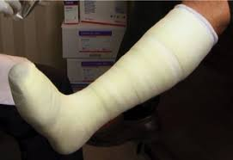
Total Contact Casting(TCC)
The best and most widely used method
Specially in plantar grade 1 ulcers

Slide 22
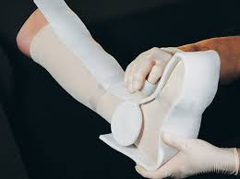
Principles of TCCs
The cast must not be over padded
The cast must limit toe motions
The bony prominences should be padded with foam
Tibia crest
Malleoli
Dorsum of toes
Protuberance of charcot joint

Slide 23
Foot and ankle should be positioned in a neutral planti-grade position(Equinus the most common error)
First cast should be changed within 5-10 days
The rest every 2 to 4 weeks

Slide 24
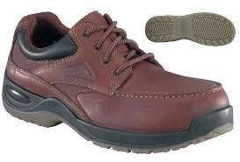
Footwear and shoe insoles
The goal is to relief pressure
Fitting around the foot
High toe box
Soft leather
Adjustable closure
Checking the skin in first few days

Slide 25

Activity modification
Unloading the foot with crutch or walker
Providing balance
Non weight bearing alone is not recommended

Slide 26
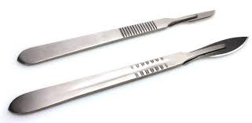
Surgical treatment
When ulcers fail to heal or recur
Excessive internal bone pressure

Slide 27


Principles of surgical treatment
Having adequate vascularity
Incision is usually made away from ulcer
Better to put the incision medially laterally or dorsally
Avoid excision of bone from ulcer
In presence of infection leave the incision open

Slide 28
Surgical Off-Loading

Slide 29
Three techniques for Off-Loading
Bone resection(most direct most effective)
Realignment
Reconstruction in proximal

Slide 30
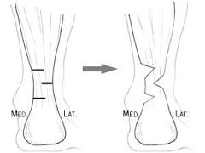
Achilles tendon lengthening
Recurrent plantar forefoot ulcers
Achilles tightness causes excessive
forefoot pressure
Can be coupled with TCC
Risks in neuropathic patients:
Complete rupture and new ulceration under heel

Slide 31
A, A gastrocnemius recession performed to augment
healing of a plantar forefoot ulceration.
B, An image taken 2 years
postoperatively demonstrates long-term ulcer healing

Slide 32
Heel Ulcers
Most defecult to manage
Respond poorly to pressure relief
They are characterized by ischemia(occlusion of medial branch of the posterior tibial artery to heel pad)

Slide 33
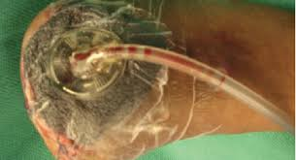
Heel ulcers require debridement of both soft tissue and bone
Negative-pressure therapy
PDGF to promote healing
Sometimes require amputation

Slide 34
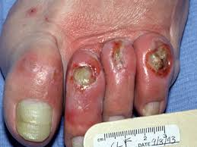
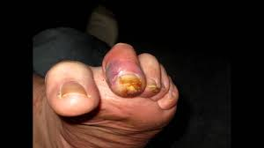
Lesser toe ulceration
Pressure over PIP or tip of toe due to hammer toe or claw toe
Percutaneous flexor tenotomy
Resection arthroplasty will off load the area

Slide 35
Distal tip ulcers, in a flexible hammer toe
flexor digitorum longus tenotomy

Slide 36
Flexor tenotomy
A blade or 18-gauge needle is introduced 1 cm proximal to proximal plantar flexural crease of the toe

Slide 37
Ankle is held in a dorsiflexed position
Actively holding all toes in a flexed position
Toe is manually straightened
The blade is moved across the taught tendon

Slide 38
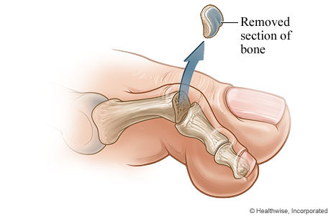
Distal tip ulcers, in a rigid hammer toe
Resection arthroplasty at the level of the proximal interphalangeal joint

Slide 39
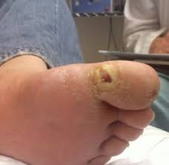
Ulceration of hallux interphalangeal joint
Plantar medial surface
Pressure accentuated by pronation or pes planus

Slide 40
Three Options
Resection of the medial condyles of the proximal and distal phalanges
Dorsiflexion Close wedge osteotomy of base of proximal phalanx
Modified Keller resection

Slide 41
Arthroplasty of the hallux for surgical off-loading of a chronic hallux ulceration
The head of the phalanx is removed
The long extensor Tendon is repaired
The wound closed primarily
Early ambulation is possible with a postoperative shoe

Slide 42
Keller resection arthroplasty

Slide 43
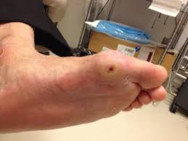
First MTP Ulcer
Very common
Weight bearing surface of sesamoid
Aggressive intervention is warranted to prevent progression to grade 3

Slide 44
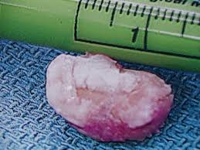
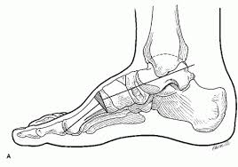
Two options
Partial or complete sesamoidectomy
Dorsiflexion osteotomy at the base of first metatarsal

Slide 45
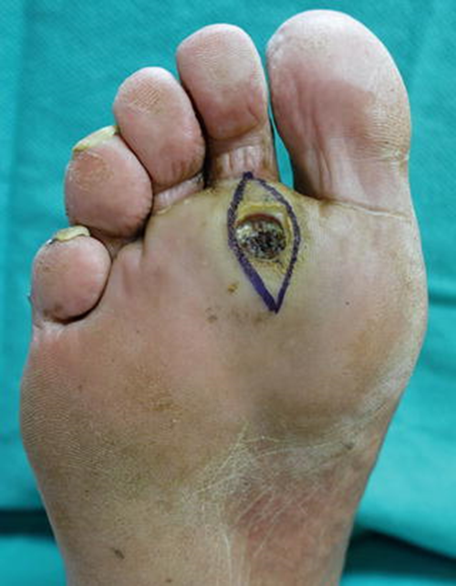
Ulceration under lesser metatarsal head
Often associated with hammer toe
Correction of toe deformity helps healing

Slide 46
Three options
Metatarsal head resection
Metatarsal condylectomy
Dorsiflexion osteotomy (off loads planar aspect of metatarsal head)

Slide 47
lesser metatarsal head resections
peroneus longus-to-brevis tendon transfer(ulceration under 1st MTP)
gastrocnemius recession(ulceration under 5st MTP)

Slide 48

Thanks

