Slide 1
Presented by: Dr Batoul Birjandi
Department of Obstetrics and Gynecology, University of Oklahoma,2018

Slide 2
Agenda
Introduction
Cares (Preconception/during pregnancy/ post partum)
Insulin
Metformin
Glyburide
Glyburide versus metformin
Alternate oral agents
Conclusions

Slide 3
Agenda
Introduction
Cares (Preconception/during pregnancy/ post partum)
Insulin
Metformin
Glyburide
Glyburide versus metformin
Alternate oral agents
Conclusions

Slide 4
Introduction
Diabetes affects 6-9% of pregnancies with approximately 99% of women having gestational diabetes, 0.5% having type 2 diabetes, and 0.3% having type 1 diabetes.
Physiologic changes of pregnancy include progressive increases in insulin resistance, weight gain, and changes in body composition, and each of these changes may affect the pharmacologic properties of diabetes treatment
The goal of diabetes treatment in pregnancy is to minimize maternal and fetal adverse events related to hyperglycemia.

Slide 5
Agenda
Introduction
Cares (Preconception/during pregnancy/ post partum)
Insulin
Metformin
Glyburide
Glyburide versus metformin
Alternate oral agents
Conclusions

Slide 6
Preconception care/ early gestation in pregestational diabetes

Slide 7
Preconception care in gestational diabetes

Slide 8
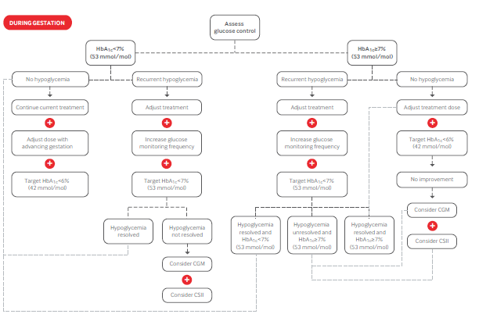
pregestation
Assess
Glucose control
HbA1c<7
HbA1c≥7
No hypoglycemia
Recurrent hypoglycemia
Recurrent hypoglycemia
No hypoglycemia
Con current treatment
Adj treatment
Adj treatment
Adj treatment
Adj dose with advancing gestation
Increase G. monitoring frequency
Increase G. monitoring frequency
Target HbA1c<6%
Target HbA1c<6%
Target HbA1c<7%
Target HbA1c<7%
No improvement
Consider CGM
Hypoglycemia resolved
Not resolved
Hypoglycemia resolved
HbA1c<7%
Not Resolved
HbA1c≥7
Hypoglycemia resolved
HbA1c≥7
Consider CSII
Consider CGM
Consider CSII

Slide 9
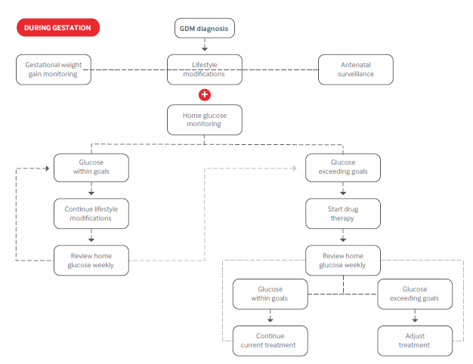
GDM
Gestational weight gain monitoring
Lifestyle modification
Antenatal surviellance
Home glucose monitoring
Glucose within goals
Glucose exceeding goals
continue Lifestyle modification
Start drug thrapy
Review home glucose weekly
Review home glucose weekly
Glucose within goals
Glucose exceeding goals
Con current treatment
Adj treatment

Slide 10
Pregestational
Gestational

Slide 11
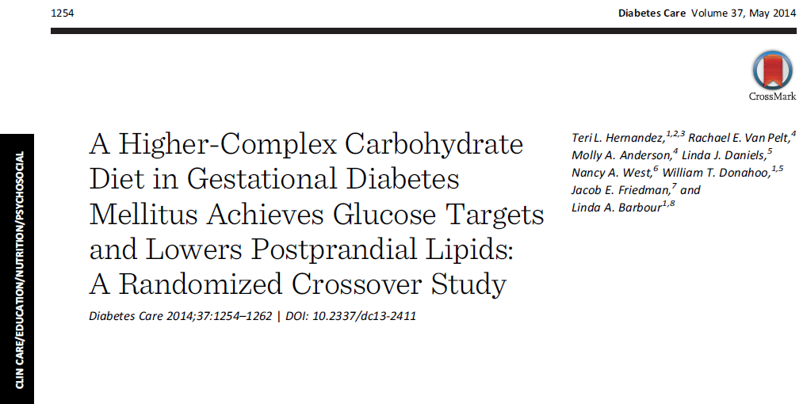
Lifestyle modifications

Slide 12
protocol
16 GDM women (BMI 34 ±1 kg/m2)
two 3-day isocaloric diets at 31 ± 0.5 weeks (washout between diets)
On day 4 of each diet, determined postprandial (5 h) glucose, insulin, triglycerides (TGs), and free fatty acids (FFAs)
Diets:
washout/control diet :50% carbohydrate/35% fat/15% protein.
lower-carbohydrate/HF diet (40% carbohydrate/45% fat/15% protein)
higher-complex carbohydrate (HCC)/lower-fat (LF) Choosing Healthy Options in Carbohydrate Energy (CHOICE) diet (60/25/15%)
“complex carbohydrate” as polysaccharides and starches primarily derived from grains, vegetables, and fruits that tend to attenuate a sharp postprandial rise in plasma glucose.

Slide 13
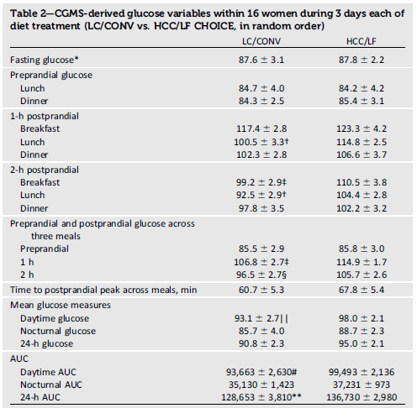

Slide 14
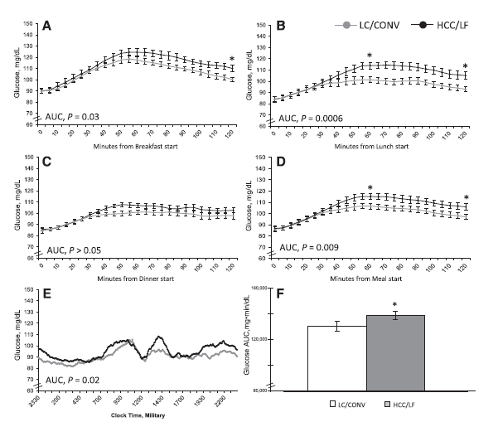

Slide 15
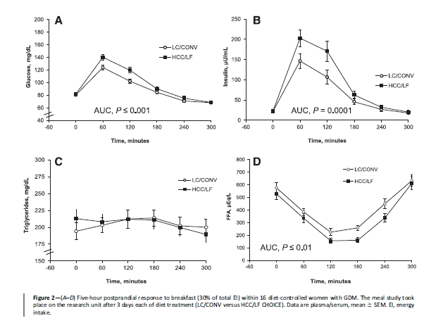

Slide 16
CONCLUSIONS
This highly controlled study randomizing isocaloric diets and using a CGMS is the first to show that liberalizing complex carbohydrates and reducing fat still achieved glycemia below current treatment targets and lower postprandial FFAs.

Slide 17
Glucose monitoring
Fasting and postprandial :all type of diabetes
preprandial :for pregnant women with pre-existing diabetes who are using insulin pumps or basal-bolus therapy
HbA1c : fall during normal pregnancy owing to red blood cell turnover and HbA1c does not reflect variability in glucose concentration
CGM
FGM

Slide 18
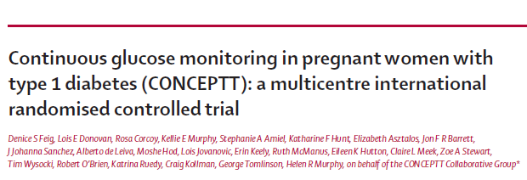
Pregnant women aged 18–40 years with type 1 diabetes for a minimum of 12 months who were receiving intensive insulin therapy
325 Participants were pregnant (≤13 weeks and 6 days’ gestation) or planning pregnancy from 31 hospitals
participants were randomly assigned to either CGM in addition to capillary glucose monitoring or capillary glucose monitoring alone

Slide 19
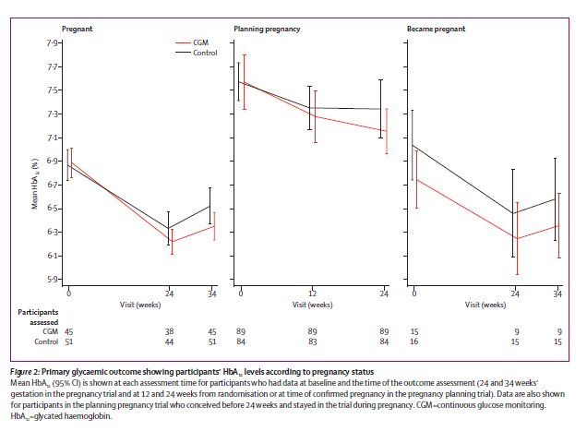

Slide 20
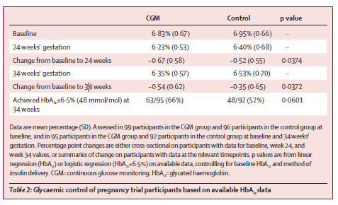

Slide 21
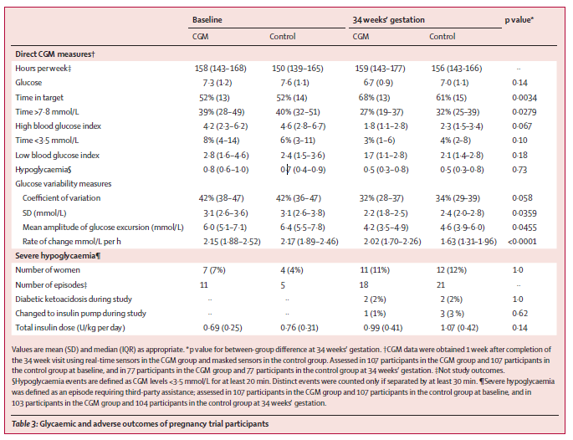
(140)

Slide 22
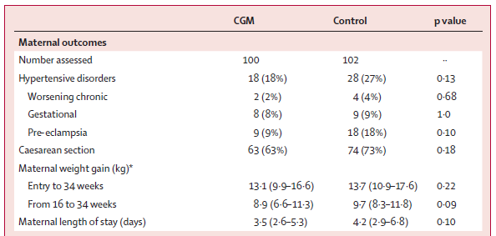

Slide 23
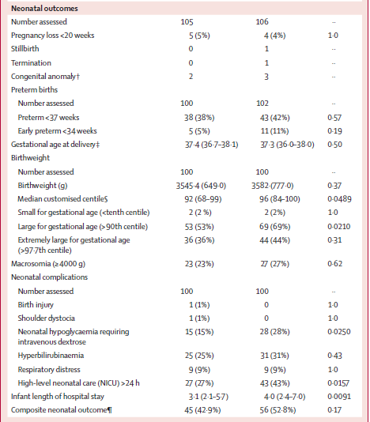
CGM
control
P value

Slide 24
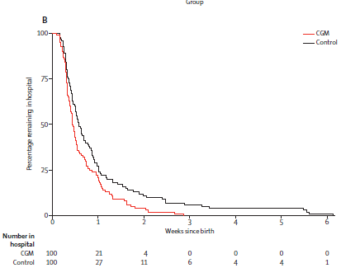

Slide 25
Interpretation :
Use of CGM during pregnancy in patients with type 1 diabetes is associated with improved neonatal outcomes, which are likely to be attributed to reduced exposure to maternal hyperglycaemia.
CGM should be offered to all pregnant women with type 1 diabetes using intensive insulin therapy.

Slide 26
300 pregnant women with type 1 diabetes, or type 2 diabetes on insulin therapy with gestational age <16 weeks, or insulin treated GDM with gestational age <30 weeks(2011-2015)
Primary outcome was macrosomia, defined as birth weight above the 90th percentile. Secondary outcomes were glycaemic control, maternal and neonatal complications.

Slide 27
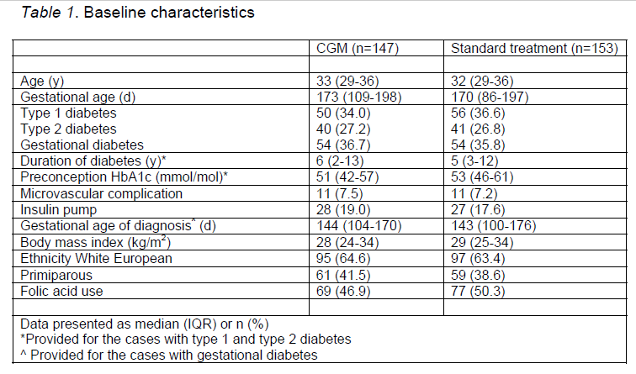

Slide 28
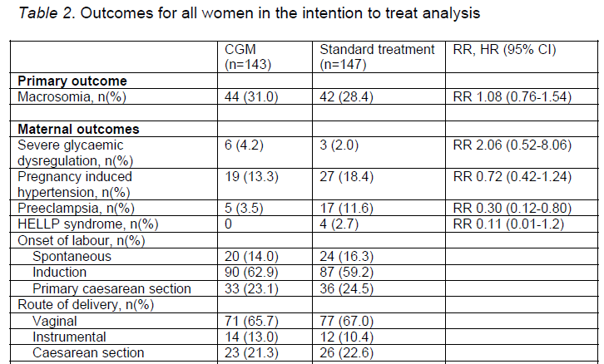

Slide 30
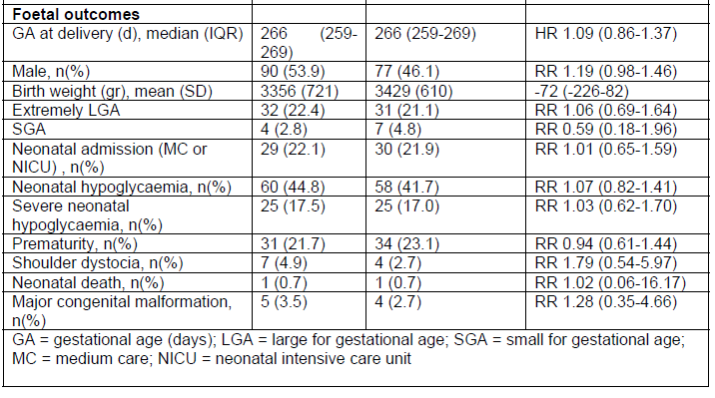
CGM
NO CGM
RR

Slide 31
Conclusions
In diabetic pregnancy, intermittent retrospective CGM use did not reduce the risk of macrosomia.
CGM use provides detailed information about glycaemic fluctuations but as a treatment strategy does not translate into improved pregnancy outcome.

Slide 32
flash glucose monitoring (FGM)
users can obtain glucose measurements instantly by scanning the glucose sensor with the reader, producing real time data

Slide 33
74 participants, with type 1 (T1D, n = 24), type 2 (T2D, n = 11), or GDM (n = 39)
enrolled across 13 sites (9 in United Kingdom, 4 in Austria)
Average gestation was 26.6 ± 6.8 weeks
Sensor glucose values (masked) were compared with capillary SMBG values (made at least 4 times/day).

Slide 34
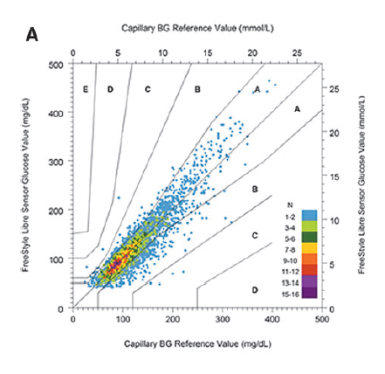
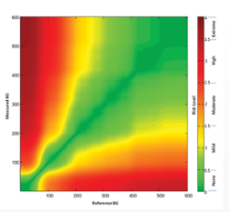
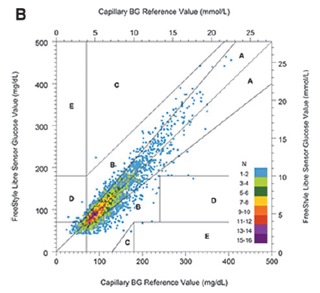
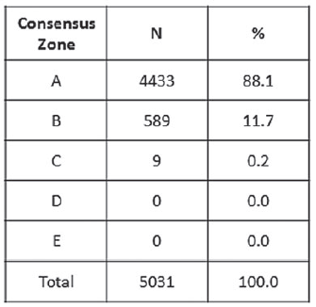
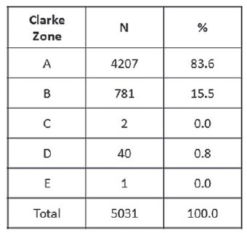
A: Clinically correct decisions
B: Clinically uncritical decisions
C: Overcorrection
D: Skip a necessary correction
E: Performing the opposite/wrong“correction

Slide 35
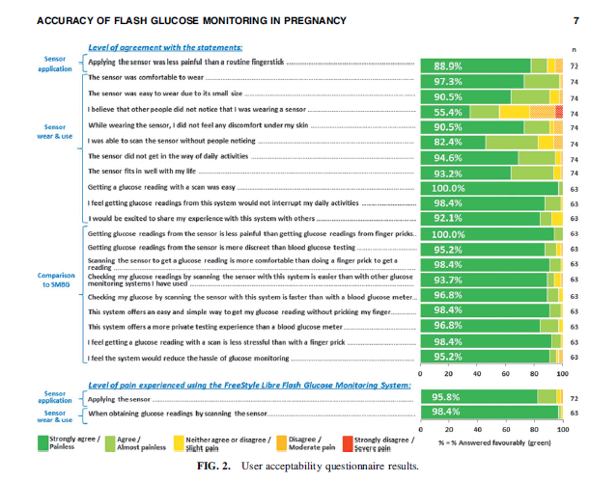

Slide 36
Conclusion:
Good agreement was demonstrated between the FreeStyle Libre System and SMBG.

Slide 37
What is the optimal glycemic targets in pregnancy?
Fetal adiposity is strongly associated with elevated maternal glucose, and approximately 15-20% of pregnant women with diabetes whose glucose targets are within current clinical targets still deliver macrosomic infants who are at increased risk for long term metabolic dysfunction.
current pregnancy glycemic targets have not been rigorously defined or tested in RCTs .

Slide 38
Retrospective cohort study
1,344 women with GDM
Delivered between 2009 - 2012
Demographic data, blood sugar values, gestational weight gain, and maternal and neonatal outcome
data were abstracted from the medical record and compared among normal-weight, overweight, and obese women.

Slide 39
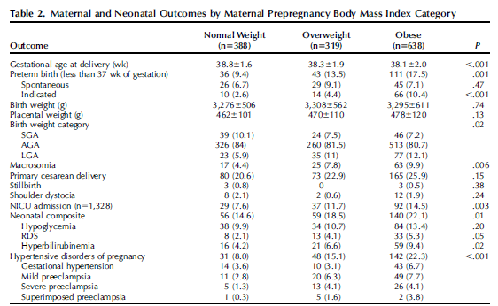

Slide 40
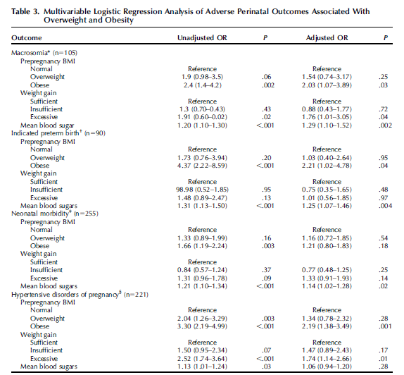

Slide 41
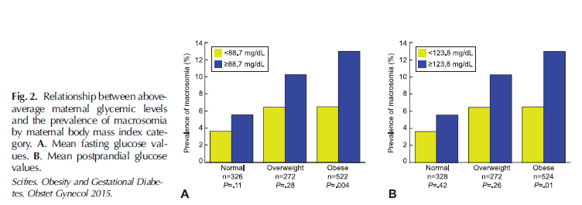

Slide 43
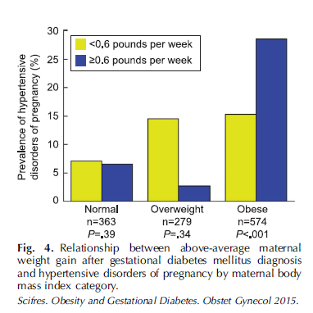

Slide 44
CONCLUSIONS:
Obese women with GDM represent a large, uniquely high-risk population, and ongoing efforts are needed to prevent the development of GDM in these women. However, our results highlight the urgent need for studies to evaluate whether more aggressive treatment protocols among obese women
with GDM can reduce the risk for adverse outcomes.

Slide 45
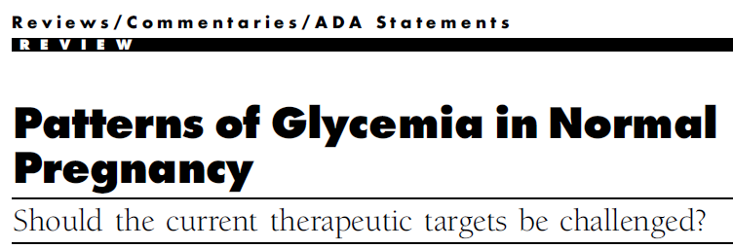
12 observational studies(between 1975 and 2008 )
255 pregnant women with normal weight and glucose tolerance
Glycemic Patterns : hospital admission with frequent blood sampling, SMBG, CGMS.

Slide 46
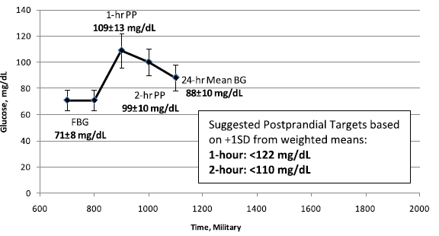
The current therapeutic targets :
≤95 mg/dL for FBG,
140 mg/dL for 1-h PP glucose, and 120 mg/dL for 2-hPP glucose

Slide 47
CONCLUSIONS:
The results of 45 years of data characterizing glycemia in normal pregnancy strongly support the need for future prospective studies that specifically test lower therapeutic PP glycemic targets for gestational diabetes, and possibly obese patients, to potentially limit a looming epidemic of fetal macrosomia.

Slide 48
This is the basis for ongoing studies such as the GDM-MOMS study, which is randomizing overweight and obese women with gestational diabetes to either standard glycemic targets (fasting <95 mg/dL (5.3 mmol/L), one hour postprandial <140 mg/dL (7.8 mmol/L)) or more intensive glycemic control (fasting <90 mg/dL (5 mmol/L), one hour postprandial <120 mg/dL (6.9 mmol/L))

Slide 49
Agenda
Introduction
Cares (Preconception/during pregnancy/ post partum)
Insulin
Metformin
Glyburide
Glyburide versus metformin
Alternate oral agents
Conclusions

Slide 50
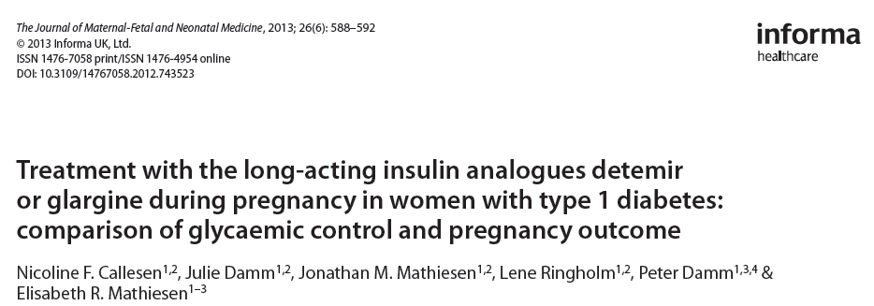
Copenhagen, Denmark
Retrospective study of singleton pregnancies from 2007 to 2011 in women with type 1 diabetes with a single living fetus at 22 weeks using either insulin detemir (n = 67) or glargine (n = 46) from conception.

Slide 51
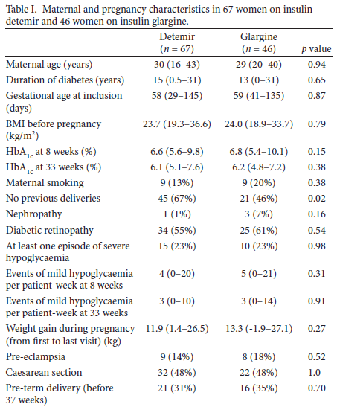
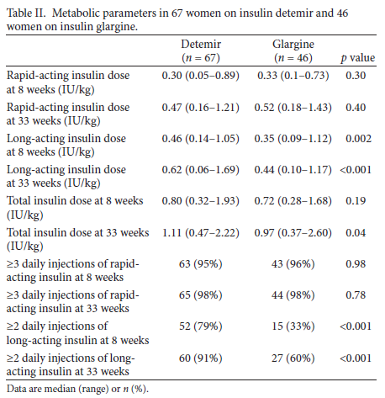

Slide 52
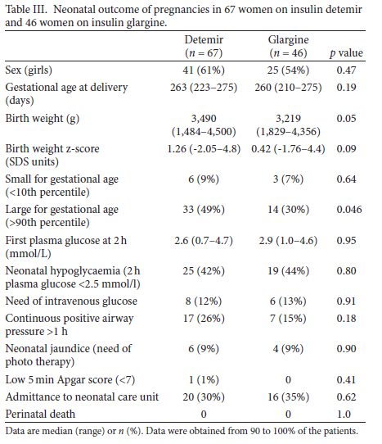

Slide 53
Conclusion
Glycaemic control and pregnancy outcome were comparable in women using insulin detemir or glargine with a low rate of severe complications. However, a lower prevalence of large for gestational age infants in women on glargine was seen.
The increasing use of both long-acting insulin analogues during pregnancy seems safe.

Slide 54
two type 1 diabetic women who continued pre-conception degludec treatment during embryogenesis

Slide 55
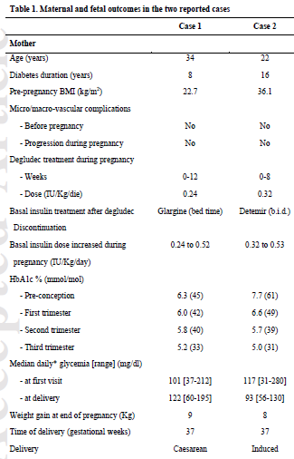
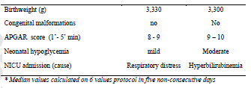
Case1
Case 2

Slide 56
first report on degludec treatment in pregnant women
No complications or adverse events were observed for degludec treatment in the first trimester and also during the following period of pregnancy. (4m & 13m)
Animal reproduction studies have found no difference between degludec and human insulin for embryotoxicity

Slide 57
2016

Slide 58
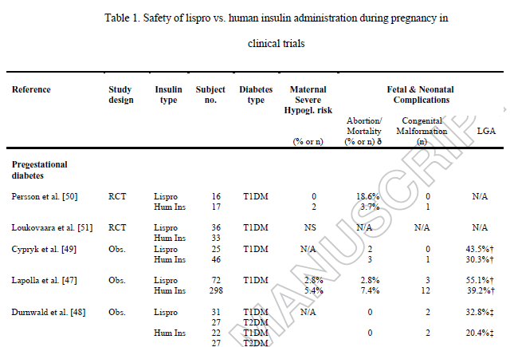
2002
2003
2004
2008
2008

Slide 59
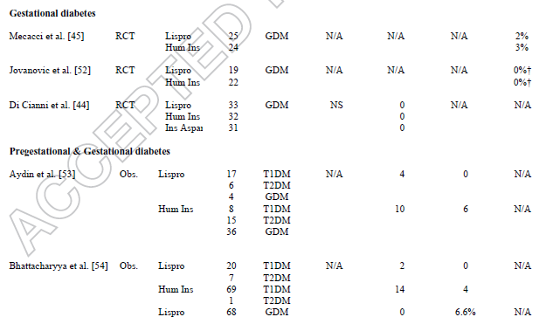
2003
1999
2007
2008
2001
2002

Slide 60
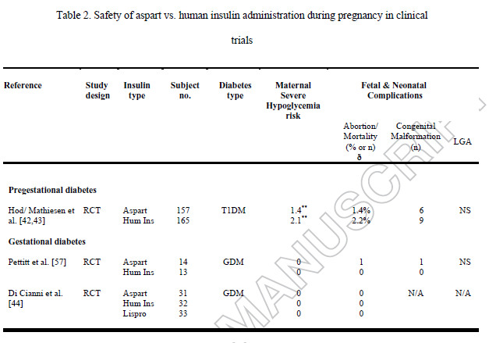
2007-8
2007
2007

Slide 61
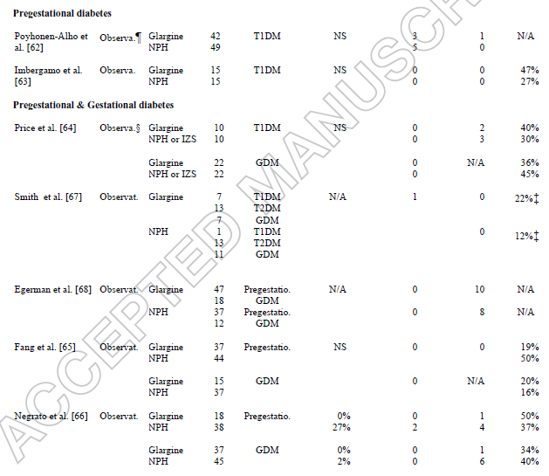
2007
2008
2007
2009
2009
2009
2010

Slide 62
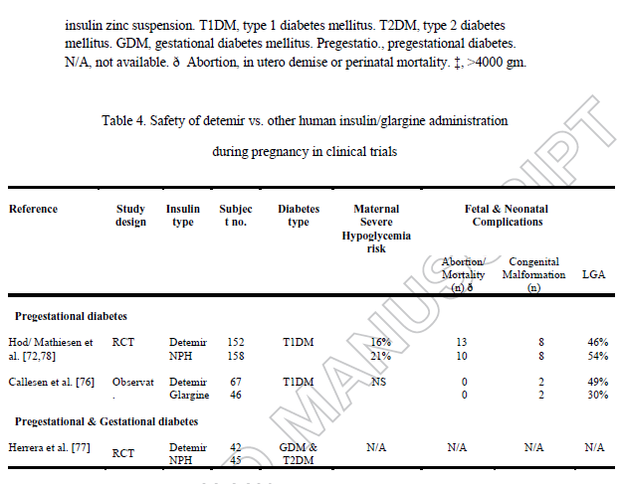
2012
2014
2013
2015

Slide 63
Expert opinion:
Insulin analogues are viable therapeutic options for diabetes in pregnancy, specifically lispro, aspart and detemir.
Though data in limited, their safety and efficacy are comparable with human insulin.
The analogues are superior to human insulin regarding hypoglycaemia risk.
More data, specifically for their use in pregnancies complicated by gestational diabetes or type 2 diabetes, is needed.

Slide 64
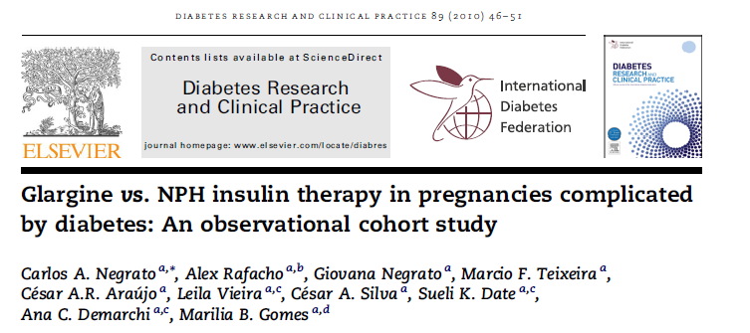
56 women with pregestational and 82 with gestational diabetes

Slide 65
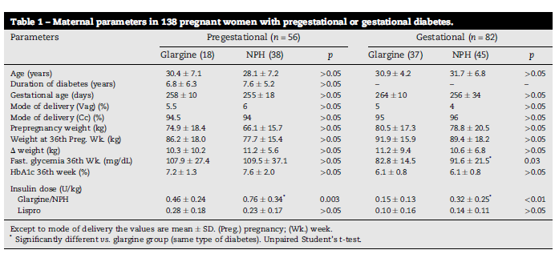

Slide 66
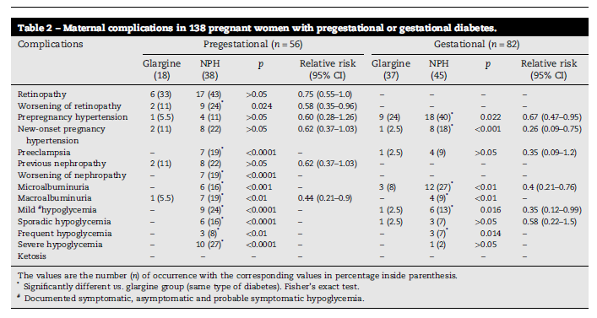

Slide 67
*cranial (CC) and thoracic circumferences (TC)
CC/TC < 1 : indicates a disproportional body composition

Slide 68
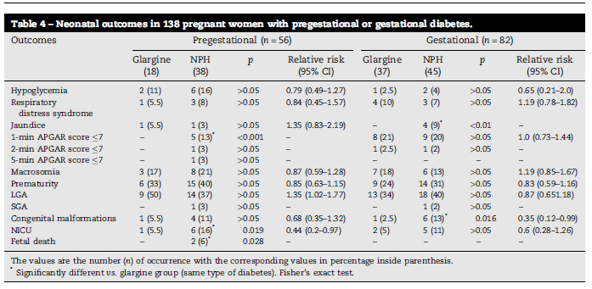

Slide 69
Adverse outcomes for both the mother and the newborn were less frequently found in pregnant women with any type of diabetes treated with glargine when compared with those treated with NPH insulin.
We propose that women with pregestational diabetes may remain on glargine throughout their pregnancy if they are already using it; those with gestational diabetes can also start its use, from diagnosis onwards. Insulin glargine may be considered a new tool and alternative long-acting insulin for the treatment of diabetes in pregnancy.

Slide 70
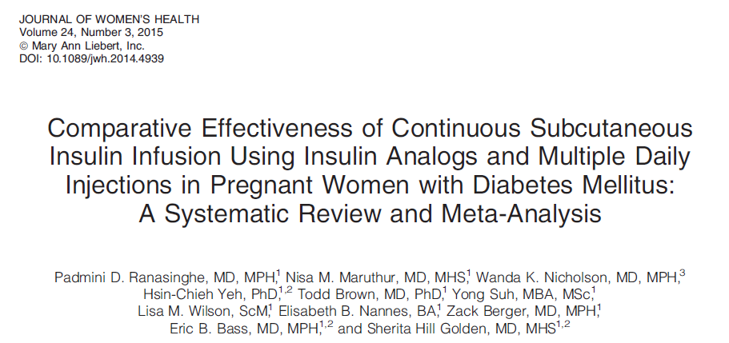
systematic review
Medline, Embase, and the Cochrane Central Register of Controlled Trials through May 2013
comparing CSII with MDI in pregnant women with diabetes mellitus

Slide 71
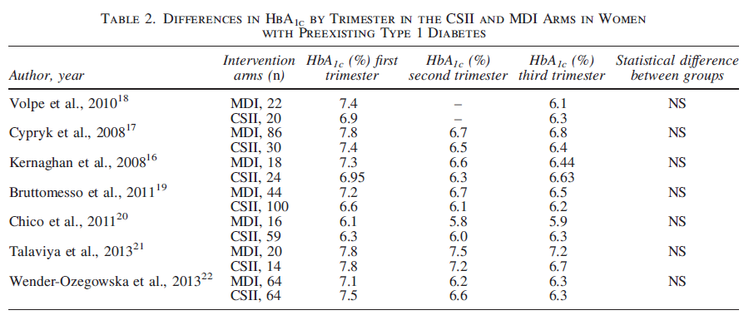

Slide 72
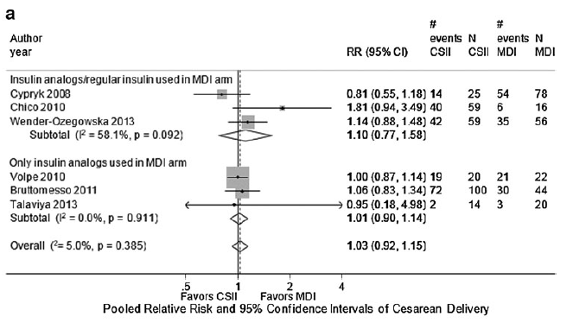
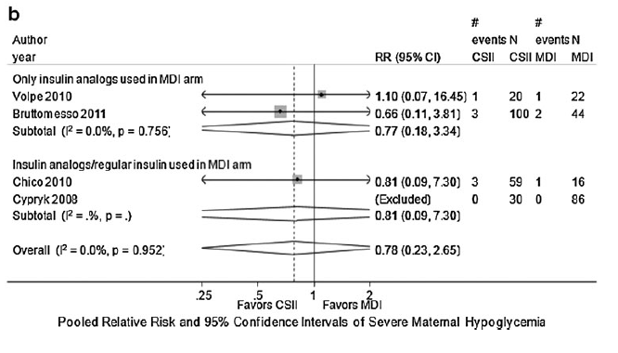
Combined relative risk of maternal outcomes in MDI versus CSII interventions among pregnant women with preexisting type 1 diabetes.(a) Combined relative risk of cesarean delivery in MDI versus CSII interventions among pregnant women with preexisting type 1 diabetes. (b) Combined relative risk of severe maternal hypoglycemia in MDI versus CSII interventions among pregnant women with preexisting type 1 diabetes.

Slide 73
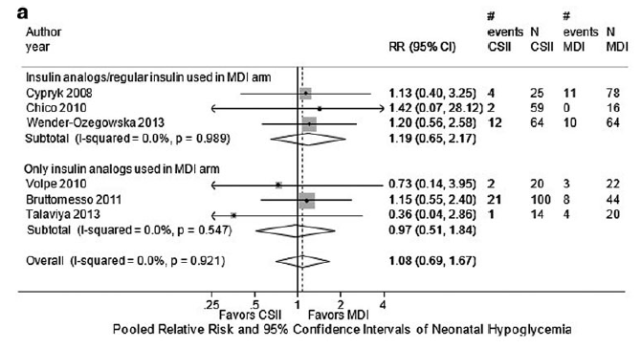
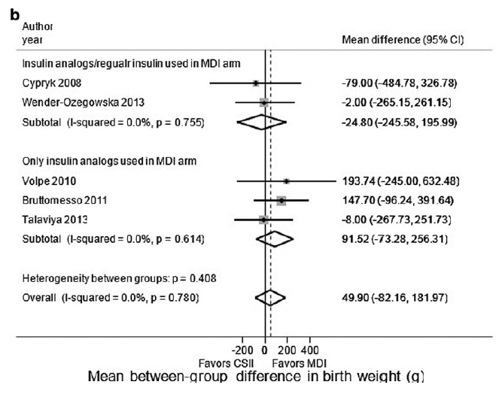
Combined relative risk of neonatal outcomes in MDI versus CSII interventions among pregnant women with preexisting type 1 diabetes. (a) Combined relative risk of neonatal hypoglycemia comparing CSII with MDI among pregnant women with preexisting diabetes. (b) Combined mean betweengroup difference between MDI and CSII in birth weight among infants born to women with preexisting type 1 diabetes.

Slide 74
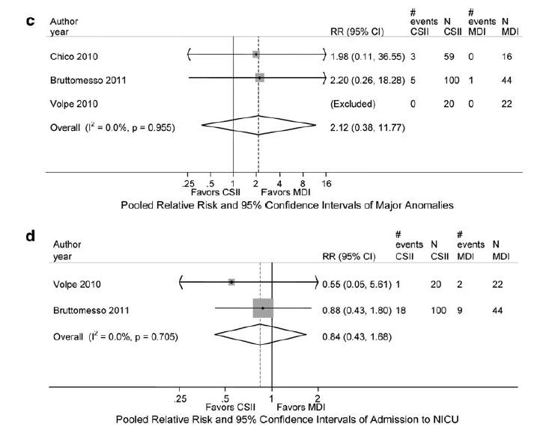
(c) Combined relative risk of major congenital anomalies in MDI versus CSII interventions among infants born to women with preexisting type 1 diabetes. (d). Combined relative risk of neonatal intensive care unit admission in MDI versus CSII interventions among infants born to women with preexisting type 1 diabetes. (e) Combined relative risk of preterm delivery in MDI versus CSII interventions among pregnant women with preexisting type 1 diabetes.

Slide 75
Conclusion
similar improvements in HbA1c with CSII and MDI during pregnancy, but evidence was insufficient to rule out possible important differences between CSII and MDI for maternal and fetal outcomes.

Slide 76
Agenda
Introduction
Cares (Preconception/during pregnancy/ post partum)
Insulin
Metformin
Glyburide
Glyburide versus metformin
Alternate oral agents
Conclusions

Slide 78
16 study (n = 2165)
Eligible studies were randomized control trials (RCTs) or follow-up of an RCT that:
(1) compared metformin with insulin in pregnancy in women with gestational diabetes mellitus or Type 2 diabetes; and
(2) reported maternal or fetal outcomes of interest

Slide 85
Conclusions
Metformin had no short-term adverse effects on pregnancy

Slide 86
Randomized, open label study
206 patients( type 2 diabetes)
Insulin was added to metformin treatment when required, to maintain the target glycemic control

Slide 92
Conclusion
Metformin is an effective treatment option for women with type 2 diabetes in pregnancy with or without add-on insulin .
Metformin has advantages over insulin such as less maternal weight gain, no maternal hypoglycemia, being cheap, being oral therapy, and requiring no vigorous monitoring and frequent hospital admissions with good compliance and acceptability.
Metformin treatment when compared with insulin treatment showed less maternal hypertensive complications and less risk of neonatal hypoglycemia with few neonatal intensive care admissions.
Metformin treatment is suitable for non obese type 2 diabetes patients in pregnancy without complications.
Metformin treatment in type 2 diabetes in pregnancy required lower dose of add-on insulin, at a later gestational age for maintaining glycemic control when compared with insulin treatment.

Slide 93
RCT
Routine visits to child welfare clinics at the ages of 6, 12, and 18 months, including weight and height measurements, and assessment of motor, social, and linguistic development.
Sample: The children of mothers with GDM randomized to metformin (n = 47) or
insulin (n = 50) treatment during pregnancy.

Slide 96
Conclusion:
The study found no adverse influence of prenatal metformin exposure on motor, linguistic, or social development of the offspring during the first 18 months of life, as compared with insulin exposure.
The relevance of the finding that infants exposed to metformin were heavier at the age of 12 months and both taller and heavier at 18 months needs to be settled in long-term studies.

Slide 97
Agenda
Introduction
Cares (Preconception/during pregnancy/ post partum)
Insulin
Metformin
Glyburide
Glyburide versus metformin
Alternate oral agents
Conclusions

Slide 99
JAMA Pediatr. 2015
Retrospective cohort study of a population-based cohort from a nationwide US employer-based insurance claims database from January 1, 2000, to December 31, 2011
Among 110 879 women with GDM, 9173 women (8.3%) were treated with glyburide (n = 4982) or insulin (n = 4191)

Slide 102
Conclusions
There is association between glyburide (compared with insulin) and elevated risk of NICU admission, neonatal hypoglycemia, respiratory distress, birth injury, and large for gestational age in women with GDM.

Slide 103
Agenda
Introduction
Cares (Preconception/during pregnancy/ post partum)
Insulin
Metformin
Glyburide
Glyburide versus metformin
Alternate oral agents
Conclusions

Slide 104
© 2017 by the American Diabetes Association.
prospective randomized controlled study
GDM at 13–33 weeks gestation
Glyburide in 53 patients and metformin in 51.

Slide 109
CONCLUSIONS:
In this randomized controlled trial, both treatments were similar in their efficacy and safety.

Slide 110
Agenda
Introduction
Cares (Preconception/during pregnancy/ post partum)
Insulin
Metformin
Glyburide
Glyburide versus metformin
Alternate oral agents
Conclusions

Slide 111
Obstetrics Department, Federal University of Sa˜ o Paulo, Brazil
RCT
To compare neonatal results from patients with gestational diabetes mellitus (GDM) who were treated with insulin, glyburide and acarbose.
3 groups: insulin therapy (ns27), glyburide therapy (ns24) and acarbose therapy (ns19).

Slide 114
In our study, changing therapy to insulin was required in 8 patients using acarbose (42.1%) and in only 5 patients from the glyburide (20.8%) group, thus corroborating the view that acarbose is less effective than glyburide for glycemic control.

Slide 115
Conclusion:
We believe that glyburide and acarbose can be promising alternative therapies for the treatment of GDM. Glyburide controlled glucose levels in most patients and it was more efficient than acarbose.
Glyburide showed a higher rate of macrosomia and neonatal hypoglycemia as compared to other therapies.

Slide 116
Guidelines

Slide 117
Agenda
Introduction
Cares (Preconception/during pregnancy/ post partum)
Insulin
Metformin
Glyburide
Glyburide versus metformin
Alternate oral agents
Conclusions

Slide 118
Conclusions
Data on continuous subcutaneous insulin infusion suggest that this technology may improve outcomes in women with type 1 diabetes, and future studies are needed to assess whether it can improve outcomes in women with type 2 diabetes and even difficult to control gestational diabetes
insulin is first line treatment for gestational diabetes and ongoing studies will clarify a potential role for metformin in the treatment of gestational diabetes and as an adjuvant to insulin in women with type 2 diabetes.
future studies should engage patients to ensure access to novel therapies and understand their preferences regarding various treatment strategies.

