Slide 1
In the name of God clinical assessment and management of nonalcoholic fatty liver disease Hamid Rafie sadr, MD
RESEARCH INSTITUTE FOR ENDOCRINE SCIENCES SHAHID BEHESHTI UNIVERSITY OF MEDICAL SCIENCES
1 july-2024

Slide 2
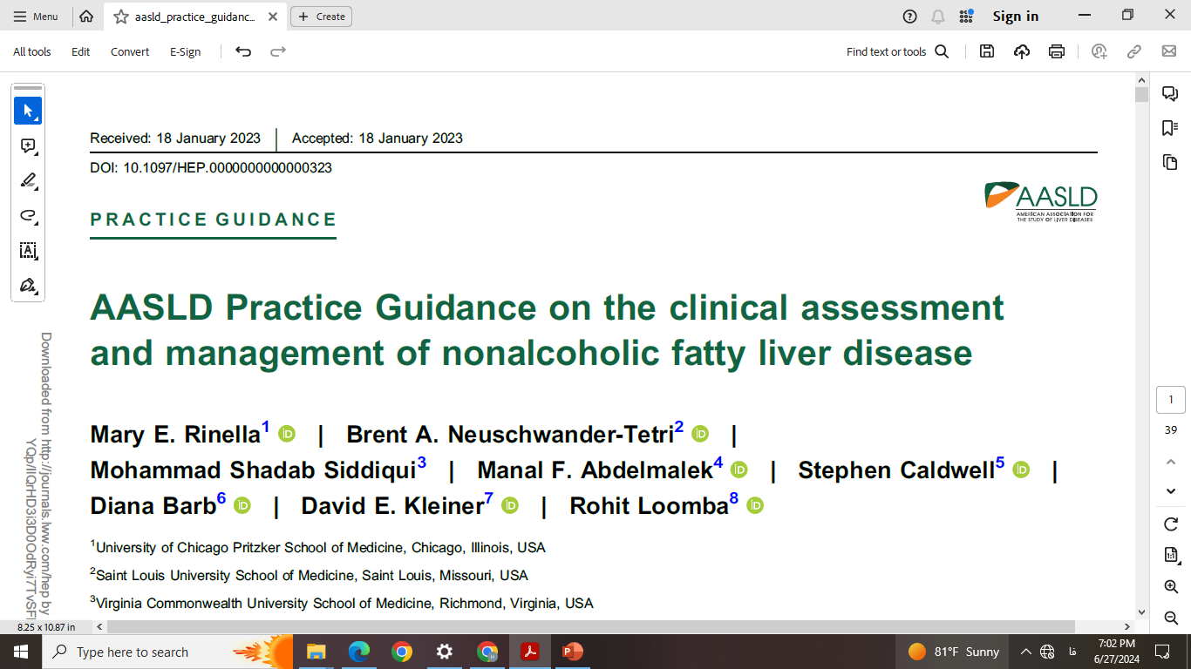

Slide 3
Agenda
DEFINITIONS
UPDATE ON EPIDEMIOLOGY AND NATURAL HISTORY
MOLECULAR AND CELLULAR PATHOGENESIS
COMORBID CONDITIONS ASSOCIATED WITH NAFLD
INITIAL EVALUATION OF A PATIENT WITH NAFLD
ASSOCIATED ENDOCRINE DISORDERS
WHICH PATIENTS SHOULD BE SCREENED
TREATMENT

Slide 4
Case study
What is the most important next step in a 59-year-old diabetic male patient being treated with metformin and gliclazide with a history of cirrhosis in his wife in the field of NASH with the following tests and a normal liver ultrasound?
HBA1C:7.4 AST;36 ALT:38 PLT:190 BMI:28 FIB-4:1.81
A-START PIOGLITASONE
B- REPEAT liver sonography at 6 mouth
C-Fibroscan
D-Continue the same treatment

Slide 5
A “Guidance” differs from a “Guideline” in that it is not bound by the Grading of Recommendations, Assessment Development and Evaluation system.
Thus, actionable statements rather than formal recommendations are provided herein.
The highest available level of evidence was used to develop these statements, and , where high-level evidence was not available, expert opinion was used to develop guidance statements to inform clinical practice

Slide 6
The most profound advances in NAFLD relevant to clinical practice are in biomarkers and therapeutics.
Biomarkers and noninvasive tests (NITs) can be used clinically to either exclude advanced diseases or identify those with a high probability of cirrhosis.
Identifying patients with “at-risk” NASH (biopsy-proven NASH with stage 2 or higher fibrosis) is a more recent area of interest.
Although the definitive diagnosis and staging of NASH remain linked to histology, noninvasive tools can now be used to assess the likelihood of
significant fibrosis, predict risk of disease progression and decompensation, make management decisions, and, to some degree, assess response to treatment

Slide 7
DEFINITIONS
NAFLD is an overarching term that includes all disease grades
and stages and refers to a population in which ≥5% of
hepatocytes display macrovesicular steatosis in the absence of
a readily identified alternative cause of steatosis (eg,
medications, starvation, monogenic disorders) in individuals who
drink little or no alcohol (defined as < 20 g/d for women and <30
g/d for men).

Slide 8
NAFL, characterized by macrovesicular hepatic steatosis that may be
accompanied by mild inflammation,
NASH, which is additionally characterized by the presence of inflammation and cellular injury (ballooning), with or without fibrosis,
cirrhosis, which is characterized by bands of fibrous septa leading to the formation of cirrhotic nodules, in which the earlier features of NASH may no longer be fully appreciated on a liver biopsy.

Slide 9
The prevalence of NAFLD and NASH is rising worldwide in parallel with increases in the prevalence of obesity and metabolic comorbid disease (insulin resistance, dyslipidemia, central obesity, and hypertension).
prevalence of NAFLD in adults is estimated to be 25%–30% in the general population and varies with the clinical setting, race/ethnicity, and geographic
NASH was identified in 14% of asymptomatic patients undergoing colon cancer screening
the prevalence of clinically significant fibrosis (stage 2 or higher fibrosis) has increased >2-fold, As such, the incidence of hepatic decompensation, HCC, and death related to NASH cirrhosis are likewise expected to increase 2- to 3-fold by 2030

Slide 10
Association between disease stage and adverse outcomes
Although fibrosis is the primary determinant of adverse outcomes, increased liver-related morbidity and mortality and nonhaptic malignancy are observed in patients with NAFLD even in the absence of fibrosis on initial biopsy.
patients with NASH and at least stage 2 fibrosis (F2), referred to as “at-risk” NASH, have a demonstrably higher risk of liver-related morbidity and mortality

Slide 11
Fibrosis progression is influenced by many factors such as the presence and severity of comorbid disease, genomic profile, and environmental factors.
A meta-analysis of placebo-treated patients in 35 NASH trials found minimal progression, suggesting that nonpharmacologic factors (frequent visits/monitoring, dietary or lifestyle counseling, or changes) may reduce progression.
An earlier meta analysis of cohorts with longitudinal paired biopsies demonstrated a NAFLD fibrosis progression rate of one stage per 7 years in those with NASH versus 14 years for those with NAFL.
Those with cirrhosis require biannual screening for HCC as well as screening for varices and monitoring for signs or symptoms of decompensation. Among patients with cirrhosis, progression to clinical decompensation ranges from 3% to 20% per year

Slide 12
Association between disease stage and adverse outcomes
The most common causes of death in patients with NAFLD overall are cardiovascular disease (CVD) and nonhepatic malignancy, followed by liver disease.
The amount of liver fibrosis identified histologically in patients with NAFLD has been strongly linked to the development of liver-related outcomes and death
In a prospective study of 1773 patients, all cause mortality in those with fibrosis stages 0–2 was 0.32 per 100 person-years,
compared with 0.89 per 100 person years in those with bridging fibrosis
and 1.76 per 100 person-years in those with cirrhosis

Slide 13
Key points:
Patients with NASH and F2–4 fibrosis are at higher risk for liver-related events and mortality and are considered to have “at-risk” NASH.
The rates of fibrosis progression and hepatic decompensation vary depending on baseline disease severity, genetic, individual environmental, and comorbid disease determinants.
CVD and non hepatic malignancies are the most common causes of mortality in patients with NAFLD without advanced fibrosis; death from liver disease predominates in patients with advanced fibrosis.

Slide 14
MOLECULAR AND CELLULAR PATHOGENESIS
When energy intake exceeds metabolic needs and disposal capacity, carbohydrates, in the form of dietary sugars (eg, fructose, sucrose, and glucose), drive the formation and accumulation of intrahepatic fat from de novo lipogenesis (DNL)
Interindividual heterogeneity in the role of DNL among patients with NAFLD.
the type of fat consumed plays a role in the development of NASH, with a higher risk associated with saturated versus unsaturated fat consumption
Insulin resistance is nearly universal in patients with NAFLD and is present in the liver, adipose tissue, and muscle.

Slide 15
MOLECULAR AND CELLULAR PATHOGENESIS
Adipose tissue insulin resistance is characterized by increased release of free fatty acids from adipocytes (lipolysis)
Although in some patients, the development and progression of NASH are driven by substrate overload and insulin resistance, in other patients, disease progression is heavily influenced by genetic factors impacting hepatocyte lipid handling.
The I148M polymorphism of PNPLA3 impairs lipolysis of triglyceride in lipid droplets
polymorphisms in transmembrane 6 superfamily member 2 (TM6SF2), and MBOAT7
Rare loss-of function mutations in CIDEB, a protein needed for activation of DNL
Although markers of oxidative stress have been a consistent finding in NASH, its role in the pathogenesis of NASH in humans remains uncertain

Slide 17
COMORBID CONDITIONS ASSOCIATED WITH NAFLD
Obesity
The presence and severity of obesity are associated with NAFLD and disease progression.
Body fat distribution is an important determinant of the contributory role of
obesity in NAFLD
Android body fat distribution, characterized by increased truncal subcutaneous fat and visceral fat confers a higher risk of insulin resistance, CVD, and hepatic fibrosis, irrespective of body mass index(BMI)
gynoid body fat distribution, characterized by increased subcutaneous body fat
predominantly in the hips or buttocks, appears to be protective against NAFLD.
Visceral fat, which is more metabolically active and inflammatory than subcutaneous fat, mediates the majority of this risk

Slide 18
COMORBID CONDITIONS ASSOCIATED WITH NAFLD
Type 2 diabetes mellitus (T2DM)
T2DM is the most impactful risk factor for the development of NAFLD, fibrosis progression, and HCC.
patients with T2DM have a higher prevalence of NAFLD (ranging from 30% to 75%) and a higher risk of developing NASH with fibrosis
The relationship between NAFLD and T2DM is bidirectional
The presence of NAFLD is associated with a 2- to 5-fold risk of incident diabetes
NAFLD is associated with a reduction in insulin sensitivity, even in the absence of overt diabetes.
as liver disease progresses, so does insulin resistance and beta cell failure, making diabetes more challenging to manage
The role of glycemic control in the progression of NAFLD/NASH remains controversial

Slide 19
COMORBID CONDITIONS ASSOCIATED WITH NAFLD
Hypertension
There is a higher incidence of hypertension in those with NAFLD across the disease spectrum, with incidence rates of 6.5 per 100 person-years in early disease to 14.5 per 100 person-years in those with cirrhosis
The presence of hypertension is clearly additive to other metabolic comorbidities with respect to NASH the epidemiological risk of and has been associated with fibrosis progression.

Slide 20
COMORBID CONDITIONS ASSOCIATED WITH NAFLD
Dyslipidemia
Patients with NAFLD are twice as likely to exhibit plasma lipid abnormalities as those without NAFLD and the serum lipid subfractions are more atherogenic in patients with NAFLD.
Management of dyslipidemia in NAFLD should include the use of moderate-intensity to high-intensity statins as first-line therapy based on lipid risk levels and atherosclerotic CVD risk scores.
Combination therapies of statins with other hypolipemic agents, such as ezetimibe, PCSK-9 inhibitors, inclisiran, bempedoic acid, fibrates, omega 3 fatty acids, or icosapent ethyl, should be considered when monotherapy with a statin does not achieve therapeutic goals
Statins are also considered safe in the context of compensated cirrhosis and may have beneficial effects on future decompensation and HCC risk

Slide 21
In patients with NAFLD and severely elevated triglycerides levels (eg, > 500 mg/dL), fibrates, or a combination of fibrates with prescription grade omega-3 fatty acids or icosapent ethyl, should be used to reduce the risk of pancreatitis.
Fibrates may also improve atherosclerotic CVD outcomes when triglyceride concentrations are ≥ 200 mg/dL and HDL-C concentrations are <40 mg/dL.
Pioglitazone can be considered for optimization of glycemic control due to its concomitant benefits on lipid profile

Slide 22
COMORBID CONDITIONS ASSOCIATED WITH NAFLD
Obstructive sleep apnea (OSA)
OSA is associated with NAFLD, and several studies suggest OSA is also associated with more advanced NAFLD/NASH histology
Intermittent hypoxia, a critical consequence of OSA, has been linked to mitochondrial dysfunction, dysregulation of glucose and lipid metabolism worse insulin resistance, and increased hepatic DNL.
patients with NAFLD who are overweight or obese should be screened for OSA, and polysomnography or other sleep studies should be considered for those at high risk.

Slide 23
COMORBID CONDITIONS ASSOCIATED WITH NAFLD
CVD
CVD is an important cause of death in patients with NAFLD
A strong association exists between NAFLD and atherosclerotic heart disease, heart failure, and arrhythmias, particularly atrial fibrillation
Aggressively treating comorbid conditions such as hypertension, dyslipidemia, and hyperglycemia and promoting smoking cessation is recommended to decrease CVD in those at risk

Slide 24
COMORBID CONDITIONS ASSOCIATED WITH NAFLD
Chronic kidney disease (CKD)
A meta-analysis of 20 cross-sectional studies found that NAFLD was associated with a 2-fold increased prevalence of CKD.
NAFLD overall, and NASH specifically, are also associated with microvascular diabetic complications, especially CKD

Slide 27
INITIAL EVALUATION OF A PATIENT WITH NAFLD
Initial evaluation of such patients should include screening for metabolic comorbidities,
assessment of alcohol intake, and exclusion of other causes of liver disease as well as
physical examination to identify signs of insulin resistance and advanced liver disease
It is important to note that normal values provided by most laboratories are higher than what should be considered normal in NAFLD, in which a true normal alanine aminotransferase (ALT) ranges from 29 to 33 U/L in men and from 19 to 25 U/L in women
When the clinical profile is atypical (eg, not associated with metabolic comorbidities) or accompanied by additional signs or symptoms suggesting additional/alternate etiologies, less common causes of steatosis or steatohepatitis should be excluded

Slide 28
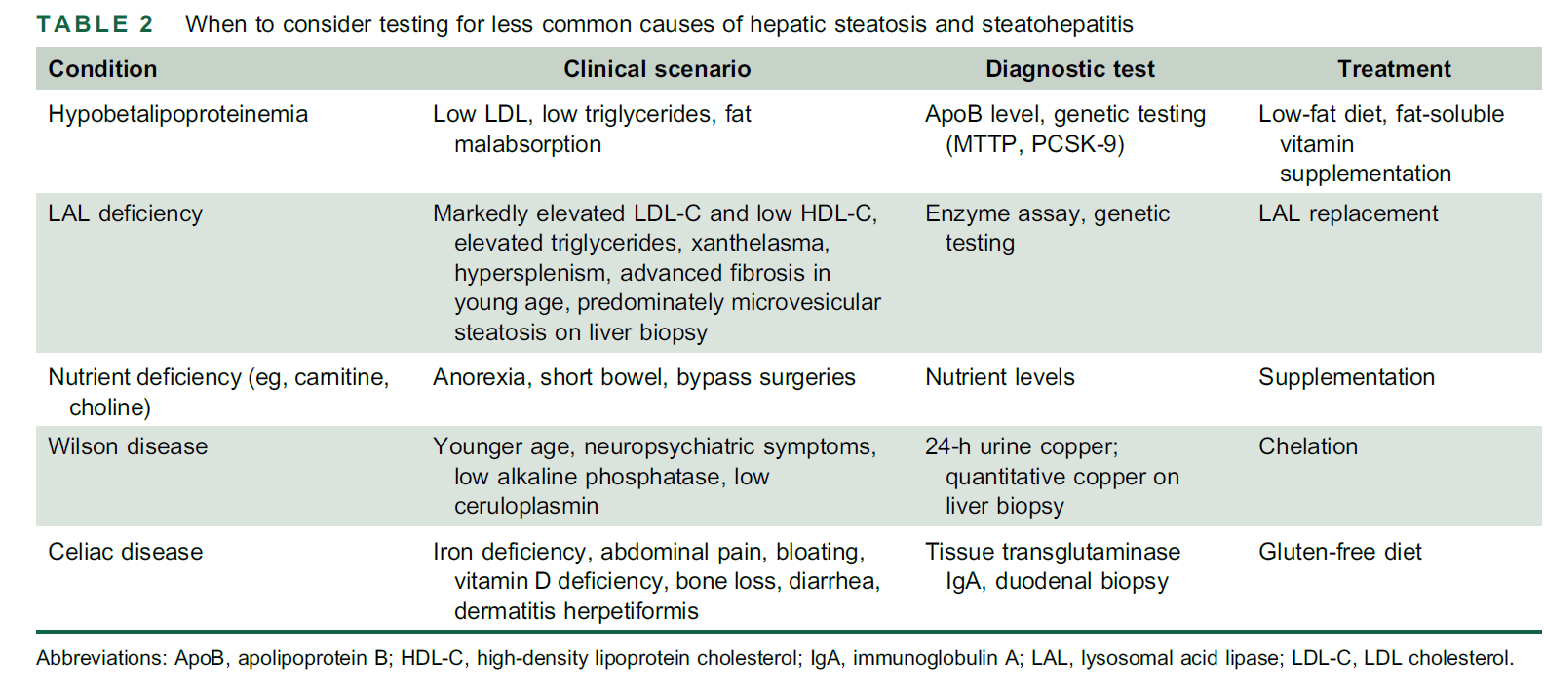

Slide 29
Several drugs can also lead to hepatic steatosis or steatohepatitis or exacerbate disease in those with underlying NAFLD and should be identified during initial evaluation

Slide 30
Role of alcohol consumption
Alcohol use can be an important contributor to fatty liver disease progression and should be quantified in all patients.
Alcohol intake can be broadly classified as mild moderate and or heavy
Moderate alcohol use increases the probability of advanced fibrosis particularly in patients with obesity or T2DM, indicating synergistic effects
Heavy alcohol consumption accelerates liver injury and fibrosis progression and should be avoided in patients with NAFLD/NASH.
In addition, daily alcohol may increase the risk for extrahepatic malignancies and HCC.

Slide 32
ASSOCIATED ENDOCRINE DISORDERS
higher rates of NAFLD have been reported in patients with hypothyroidism, hypogonadism, growth hormone (GH) deficiency, and polycystic ovarian syndrome (PCOS).
Hypothyroidism
No significant association between NAFLD and hypothyroidism (subclinical or overt) was observed in a large meta-analysis; however, a cohort study of nearly 9500 patients followed for a mean of 10 years found hypothyroidism was associated with a 24% higher chance of NAFLD

Slide 33
ASSOCIATED ENDOCRINE DISORDERS
GH deficiency
GH deficiency is associated with body fat redistribution and increased visceral adipose tissue mass and can result in insulin resistance, hyperglycemia, hyperlipidemia, and NAFLD.
the association between a disturbance in the GH axis and NAFLD is strongly linked to changes in visceral fat and insulin resistance, but screening is not recommended for all patients

Slide 34
ASSOCIATED ENDOCRINE DISORDERS
Hypogonadism
low testosterone levels can also negatively affect body composition, worsen insulin resistance, and thus contribute to the development of hepatic steatosis
In women, hypogonadism is associated with increased liver enzymes as well as a higher prevalence of NAFLD and advanced fibrosis
PCOS
In PCOS, hyperinsulinemia promotes hypothalamic luteinizing hormone stimulation of ovarian theca cells resulting in excessive androgen production
a 2- to 4-fold increase in the prevalence of NAFLD and an increased risk of T2DM among women with PCOS, suggesting that insulin resistance is the main driver of disease in PCOS

Slide 36
NAFLD IN LEAN INDIVIDUALS
NAFLD can also occur in nonoverweight (BMI <25 kg/m2 or<23 kg/m2 in Asian individuals) patients
histological findings are milder compared with overweight patients
Prevalence of NAFLD in lean individuals varies from 4.1% in the US to as high as 19% in Asia
Alcohol use and alterations in the gut microbiome may also contribute to NAFLD in lean individuals. Genetic factors likely play a significant role in this population (PNPLA3 I148M polymorphism, TM6SF2 gene)
Uncommon genetic conditions (e.g., lipodystrophy, lysosomal acid lipase deficiency, hypobetalipoproteinemia) and should be considered
Management of NAFLD in patients without obesity:dietary modifications and exercise

Slide 38
WHICH PATIENTS SHOULD BE SCREENED FOR THE PRESENCE OF CLINICALLY SIGNIFICANT FIBROSIS?

Slide 39
WHICH PATIENTS SHOULD BE SCREENED FOR THE PRESENCE OF CLINICALLY SIGNIFICANT FIBROSIS?
first-degree relatives of probands with NASH cirrhosis have a 12-fold higher risk of advanced fibrosis
the risk of NAFLD and advanced fibrosis may be increased, even among nonrelated household members, likely because of related similar environmental risk factors, lifestyle patterns, and gut microbiota

Slide 40
How should NAFLD be managed in primary care and endocrinology practice settings?
Patients suspected to have NAFLD on the basis of
metabolic risk factors or incidentally identified as having
fatty liver by imaging in the absence of other etiologies of
hepatic steatosis (ie, Wilson disease, celiac disease, HCV,
alcohol use, etc.) should undergo primary risk assessment

Slide 42
12. In patients with pre-DM, T2DM, or 2 or more metabolic risk factors (or imaging evidence of hepatic steatosis), primary risk assessment with FIB-4 should be repeated every 1–2 years. 13. Patients with NASH cirrhosis are at the highest risk for liver-related outcomes and require routine surveillance for HCC, esophageal varices, and monitoring for decompensation. 14. Patients with suspected advanced NASH or discordant NITs should be referred to a specialist for evaluation, management, and/or further diagnostic evaluation. 15. Aminotransferase levels are frequently normal in patients with advanced liver disease due to NASH and should not be used in isolation to exclude the presence of NASH with clinically significant fibrosis. 16. First-degree relatives of patients with NASH cirrhosis should be counseled regarding their increased individual risk and offered screening for advanced hepatic fibrosis. Key points: Patients with “at-risk” NASH (NASH with at least stage 2 fibrosis) are at increased risk of developing cirrhosis and liver-related complications.

Slide 43
Guidance statements: 17. Although standard ultrasound can detect hepatic steatosis, it is not recommended as a tool to identify hepatic steatosis due to low sensitivity across the NAFLD spectrum. 18. CAP as a point-of-care technique may be used to identify steatosis. MRI-PDFF can additionally quantify steatosis. 19. If FIB-4 is ≥ 1.3, VCTE, MRE, or ELF may be used to exclude advanced fibrosis. Key points: Highly elevated liver stiffness, FIB-4, and ELF scores can predict an increased risk of hepatic decompensation and mortality.

Slide 44
TREATMENT
A healthy diet and regular exercise form the foundation of treatment for the vast majority of those with NAFLD.
Weight loss
Even modest amounts of weight loss can be impactful, especially in those with milder disease. Weight loss of 3%–5% improves steatosis, but greater weight loss(>10%) is generally required to improve NASH and fibrosis.
Unfortunately, reducing caloric intake can also be associated with counterproductive reductions in metabolic energy disposal
A diet containing excess calories, particularly excess saturated fats, refined carbohydrates, and sugar-sweetened beverages, is associated with obesity and NAFLD
Excessive fructose consumption in particular increases the risk of NAFLD, NASH, and advanced fibrosis independent of calorie intake
The Mediterranean diet is often recommended to patients with NAFLD based on its associated improvement in cardiovascular health and reduction in liver fat
Coffee consumption, independent of caffeine content , may also be beneficial. Drinking 3 or more cups per day could be recommended in the absence of contraindications based on the reduced risk for NAFLD and liver fibrosis

Slide 45
Impact of exercise
Exercise, independently has hepatic and cardiometabolic benefit
moderate exercise at least 5 times per week for a total of 150 minutes per week can prevent or improve NAFLD
more vigorous exercise is needed to improve NASH histology, with even higher intensity exercise needed to reduce fibrosis.
Studies combining diet with exercise consistently demonstrate reductions in liver fat proportional to the intensity of the intervention.
Patients with cirrhosis require a slightly different approach that prioritizes protein intake and recognizes potential physical limitations.
Exercise can also improve frailty, sarcopenia, and quality of life in patients with chronic liver disease

Slide 46
Guidance statements: 20. Patients with NAFLD who are overweight or obese should be prescribed a diet that leads to a caloric deficit. When possible, diets with limited carbohydrates and saturated fat and enriched with high fiber and unsaturated fats (e.g., Mediterranean diet) should be encouraged due to their additional cardiovascular benefits. 21. Patients with NAFLD should be strongly encouraged to increase their activity level to the extent possible. Individualized prescriptive exercise recommendations may increase sustainability and have benefits independent of weight loss. Key points: Weight loss improves hepatic steatosis, NASH, and hepatic fibrosis in a dose-dependent manner. The necessary support to manage comorbid disease and foster the adoption of liver protective health behaviors is best achieved using a multidisciplinary approach. Coffee consumption (caffeinated or not) of at least 3 cups daily is associated with less advanced liver disease.

Slide 47
Bariatric surgery
Although currently accepted criteria for bariatric surgery are BMI ≥40 kg/m2 irrespective of metabolic comorbid disease or BMI ≥ 35 kg/m2 with comorbidities (T2DM or pre-DM, uncontrolled hypertension, osteoarthritis of hip or knee, urinary incontinence
NAFLD/NASH is increasingly accepted as a comorbid condition benefitting from bariatric surgery
Bariatric surgery can resolve NASH, improve hepatic fibrosis, induce sustained weight loss of up to 30%, cure diabetes, and decrease all-cause morbidity and mortality.
resolution of NASH without worsening of fibrosis occurred in 80%of patients 1 year following bariatric surgery ,which was maintained at 5 years.
Restrictive surgical procedures result in substantially less weight loss than malabsorptive procedures and are more likely to be associated with persistent NASH
for the treatment of compensated NASH cirrhosis >>> bariatric surgery currently cannot be considered a primary therapy however, it seems to be safe in carefully selected patients
Bariatric surgery in the setting of decompensated cirrhosis or clinically significant portal hypertension is associated with an increased risk of postoperative mortality and should only be considered at high volume centers

Slide 48
Guidance statements: 22. Bariatric surgery should be considered as a therapeutic option in patients who meet criteria for metabolic weight loss surgery, as it effectively resolves NAFLD or NASH in the majority of patients without cirrhosis and reduces mortality from CVD and malignancy. Key points: The type, safety, and efficacy of bariatric surgery in patients with well-compensated NASH cirrhosis is not established and requires a careful benefit–risk assessment by a multidisciplinary team of experts that includes a hepatologist. Decompensated cirrhosis should be considered an absolute contraindication for bariatric surgery due to increased risk and unproven liver-related benefit, unless performed in conjunction with liver transplantation at experienced centers.

Slide 49
USE of available medications
there are no FDA-approved drugs for the treatment of NASH at any disease stage,
there are medications approved for other indications that have shown benefits for NASH
Vitamin E
vitamin E improved serum aminotransferases in addition to steatosis, inflammation, and cellular ballooning on biopsy
A reduction in serum ALT to ≤40 U/L and by ≥30% of baseline value after initiation of vitamin E is associated with improvement in histological parameters
vitamin E use was associated with lower rates of hepatic decompensation (37% vs. 62%, p=0.04) and higher transplant free survival (78% vs. 49%, p<0.01).
Concern about the risks of vitamin E on bleeding and specifically hemorrhagic stroke
data demonstrating a relationship between vitamin E and prostate cancer

Slide 50
USE of available medications
Thiazolidinediones
In patients with NASH with or without pre-DM or T2DM, treatment with pioglitazone improves histology and insulin resistance
in an 18-month study of patients with either preDM or T2DM and NASH, pioglitazone treatment led to a ≥2-point reduction in NAS and a trend toward fibrosis improvement
Potential side effects :weight gain, osteoporosis in postmenopausal women, a debated risk of bladder cancer, and potential risk for worsening heart failure

Slide 51
USE of available medications
GLP-1RAs
none has been approved for treatment of NASH.
In a small study of patients with NASH, liraglutide improved steatosis, resolved NASH, and reduced fibrosis progression compared with placebo
Semaglutide : NASH resolution was dose dependent and occurred in 59% in the treatment group versus 17% in the placebo group (p<0.001)
Tirzepatide : an absolute reduction in liver fat content of 8.1%, suggesting a possible benefit in NASH
SGLT-2i
data suggest SGLT-2i improve hepatic steatosis; however, the therapeutic impact of SGLT-2i on liver histology needs to be better defined

Slide 53
available agents without evidence of histological benefits in NASH
Metformin has been extensively evaluated in patients with NASH but it does not improve histology
ursodeoxycholic acid failed to demonstrate any histological benefit
dipeptidyl peptidase-4 inhibitors have not proven efficacious to treat NAFLD
The effect of silymarin (milk thistle) in patients with NASH remains inconclusive

Slide 54
guidance statements: 23. There are currently no FDA-approved medications for the treatment of NAFLD, but drugs approved to treat associated comorbidities with potential benefit in NAFLD maybe considered in the appropriate clinical setting. 24. Semaglutide can be considered for its approved indications (T2DM/obesity) in patients with NASH, as it confers a cardiovascular benefit and improves NASH. 25. Pioglitazone improves NASH and can be considered for patients with NASH in the context of patients with T2DM . 26. Vitamin E can be considered in select individuals as it improves NASH in some patients without diabetes. 27. Available data on semaglutide, pioglitazone, and vitamin E do not demonstrate an antifibrotic benefit, and none has been carefully studied in patients with cirrhosis. 28. Metformin, ursodeoxycholic acid, dipeptidylpeptidase-4, statins, and silymarin are well studied in NASH and should not be used as a treatment for NASH as they do not offer a meaningful histological benefit.

Slide 56
Resmetirom, the First Drug Approved by the U.S. FDA for Treating Patients with Nonalcoholic Steatohepatitis
nearly 1000 patients with biopsy-proven NASH (fibrosis stages 2 or 3) received resmetirom or placebo, taken orally once daily; participants also received periodic counseling on nutrition and exercise. On repeat biopsies at 12 months, resmetirom recipients were more likely than placebo recipients to have resolution of NASH (28% vs. 10%) and improvement in fibrosis (25% vs. 14%). The most common side effects were nausea and diarrhea

Slide 57
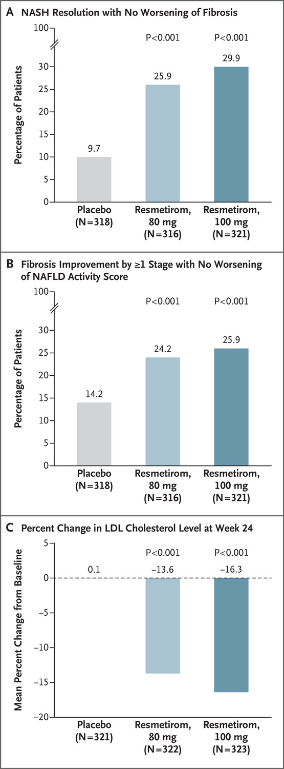

Slide 58
SURROGATE MARKERS OF HISTOLOGICAL TREATMENT RESPONSE
ALT reduction correlates with histological improvement and ALT normalization can predict NASH resolution in response to lifestyle modification as well as various therapeutic intervention
in addition to improvements in ALT, improvement in FIB-4, FAST, ELF, VCTE, and other markers correlated with histological fibrosis reduction, suggesting that histological response may be tracked using NITs
≥ 30% decline in MRI-PDFF is associated with 5-fold improved odds of NASH resolution
Improvements in FIB-4 or serum biomarkers such as ELF, liver stiffness, or combination parameters (Table 5) have been associated with histological response, but the exact thresholds of improvement remain to be validated in large multicenter studies within this context of use

Slide 59
Guidance statements: 29. Improvement in ALT or reduction in liver fat content by imaging in response to an intervention can be used as a surrogate for histological improvement in disease activity. Key points: ALT reduction of ≥17 U/L is associated with histological improvement; however, thresholds may differ for type of histological response (eg, NASH resolution or fibrosis improvement) and may be mechanism of action specific.

Slide 60
Case study
What is the most important next step in a 59-year-old diabetic male patient being treated with metformin and gliclazide with a history of cirrhosis in his wife in the field of NASH with the following tests and a normal liver ultrasound?
HBA1C:7.4 AST;36 ALT:38 PLT:190 BMI:28 FIB-4:1.81
A-START PIOGLITASONE
B- REPEAT liver sonography at 6 mouth
C-Fibroscan
D-Continue the same treatment

