Slide 1
The Role of Dopamine Agonists in Pituitary Adenomas
L.Mahmoudieh MD

Slide 2
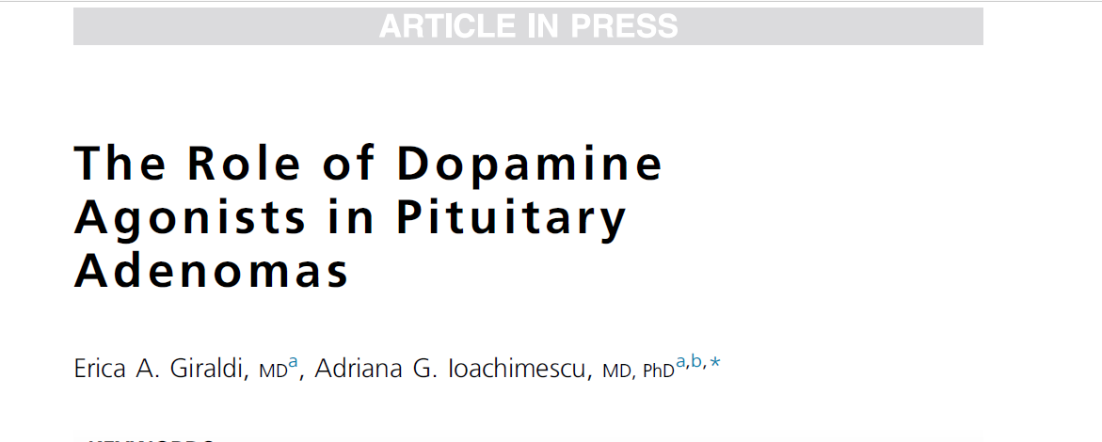

Slide 3
Agenda
Introduction
Dopamine agonists in prolactinoma
Dopamine agonists in acromegaly
Dopamine agonists in cushing disease
Dopamine agonists in non functioning adenoma

Slide 4
Agenda
Introduction
Dopamine agonists in prolactinoma
Dopamine agonists in acromegaly
Dopamine agonists in cushing syndrome
Dopamine agonists in non functioning adenoma

Slide 5
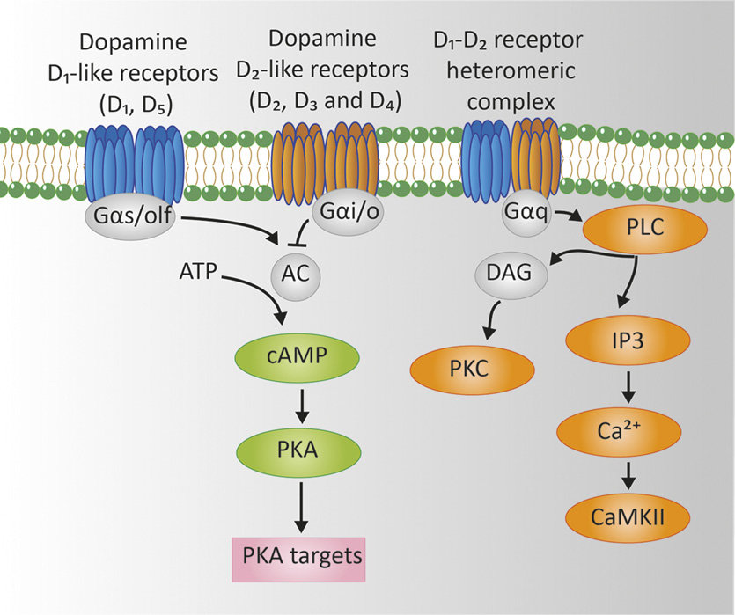
Lactotroph, somatotroph, corticotroph, and nonfunctioning adenomas
have variable expression of D2R receptors

Slide 6
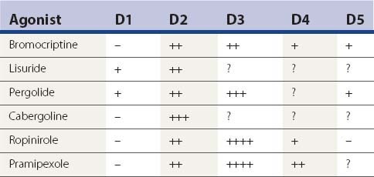
Notes:
cabergoline are most commonly used, the latter with higher D2R selectivity/affinity and longer half-life.

Slide 7
The side effects include:
  nausea and vomiting
  postural hypotension
  headache, dizziness
  mood changes including: impulse control disorders
  cerebrospinal fluid leak and pituitary apoplexy(rarely)
They typically resolved after medication discontinuation.

Slide 8
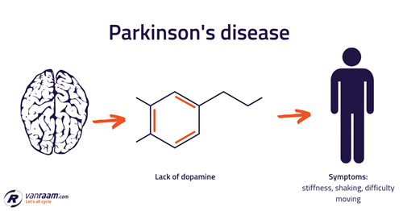
In patients with Parkinson disease, high-dose cabergoline was associated with an increased risk of valvulopathy.

Slide 9
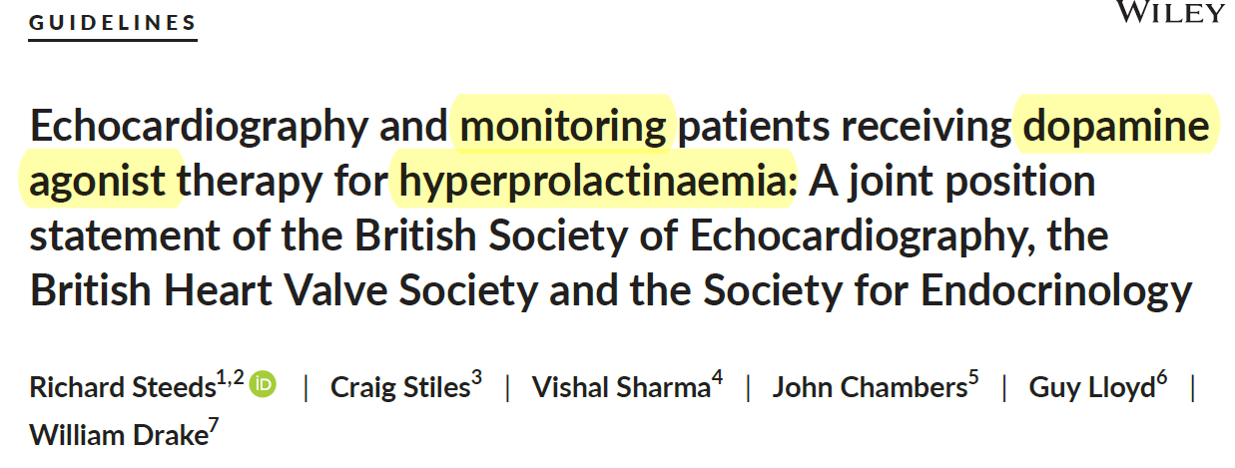
Clinical Endocrinology. 2019;90:662–669.

Slide 10
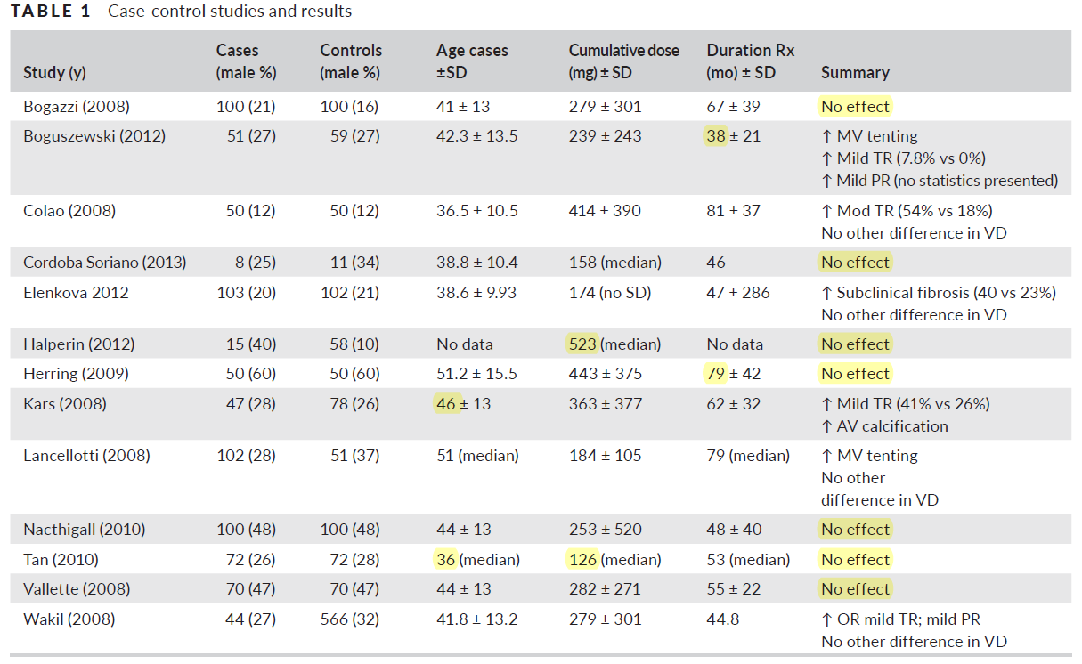

Slide 11
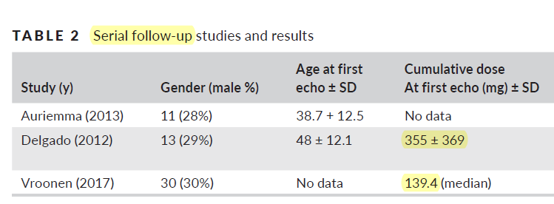
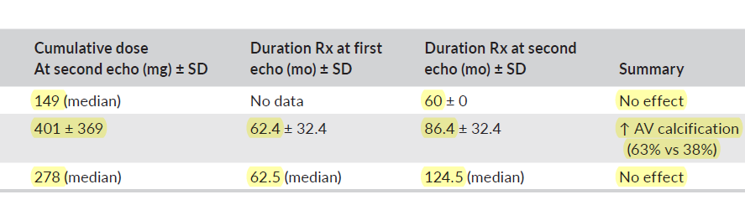

Slide 12
In summary:
  case‐control studies investigating DA‐agonist valvulopathy in hyperprolactinaemia have provided poor quality data, using different diagnostic criteria, multiple testing in small groups and lack of standardised assessment of valve morphology.

Slide 13
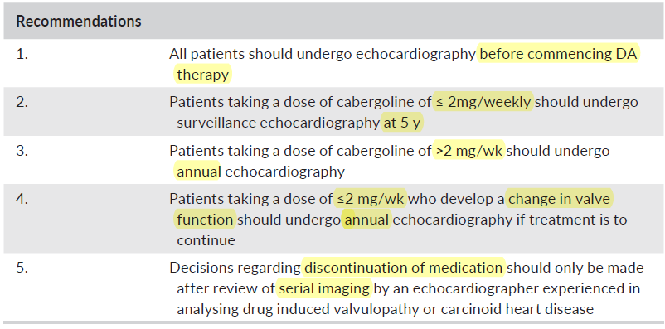
Clinical Endocrinology. 2019;90:662–669.

Slide 14
Agenda
Introduction
Dopamine agonists in prolactinoma
Dopamine agonists in acromegaly
Dopamine agonists in cushing syndrome
Dopamine agonists in non functioning adenoma

Slide 15
Prolactinomas represent 40% to 57% of pituitary adenomas.
Premenopausal women clinically present with:
  Amenorrhea
  Galactorrhea
  Infertility
  mostly microadenomas
Men present with:
  Hypogonadism
  Gynecomastia
  Headaches
  Vision changes
  Higher prevalence of macroadenomas.

Slide 16

DAs represent the first-line therapy for macroprolactinomas or symptomatic microprolactinomas
aiming for:
  prolactin normalization
  tumor control
  gonadal function restoration
The 2011 Endocrine Society guidelines

Slide 17
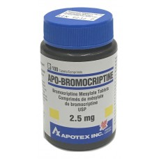
  Bromocriptine :
    Drug dosage:
      2.5 to 15 mg/d
    A systematic review of 7 studies (1978–2011) indicated that most patients responded with:
      galactorrhea (86%)
      amenorrhea (78%)
      normoprolactinemia (68%)
      resolution of visual defects (67%)
      sexual dysfunction (67%)
      tumor reduction (62%)
      infertility (53%)
Notes:
Williams : (2.5–7.5 mg/day)

Slide 18
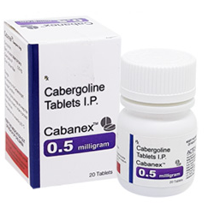
  Cabergoline:
    0.25 to 3 mg/wk
    A meta-analysis of 7 studies indicated:
      normoprolactinemia in 50% to 100%
      tumor reduction in 47% to 97%

Slide 19
Bromocriptine was less effective than cabergoline in:
  reducing the risk of persistent hyperprolactinemia
  amenorrhea/oligomenorrhea
  galactorrhea
There were no significant differences between the two drugs in terms of overall change in prolactin level or other patient important outcomes.

Slide 20
predicting long-term outcomes of DA therapy:
  Baseline biochemical and radiological measurements
  Response after 3 to 6 months of DA therapy
  Requiring smaller dosages

Slide 21
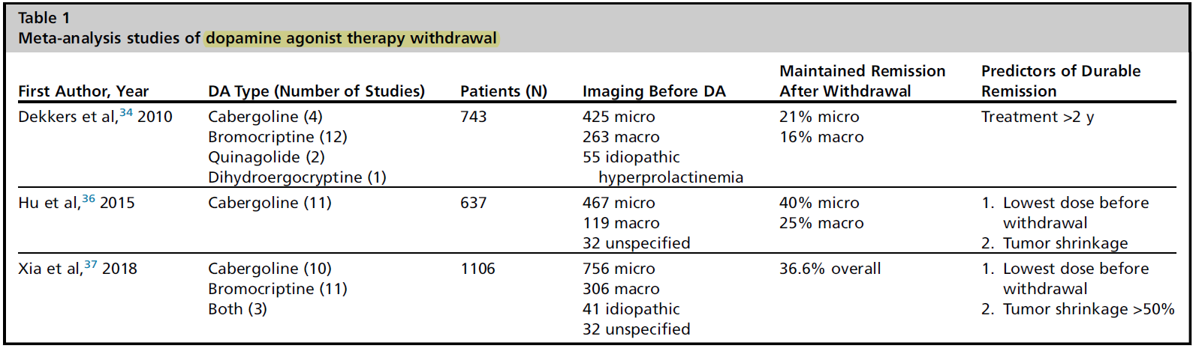
Dopamine Agonist Withdrawal
Per Endocrine Society guidelines, patients treated for more than 2 years can be considered for DA discontinuation if:
  prolactin is normal
  tumor no longer visible on imaging.
For patients with large tumors, surgery and medical treatment may be needed.
The 2011 Endocrine Society guidelines
Endocrinol Metab Clin N Am - (2020) -–
Notes:
Treatment duration 3-62 mo.

Slide 22
The risk of recurrence after withdrawal ranges from 26 to 69%.
All studies have shown that recurrence is predicted by prolactin levels at diagnosis and by tumor size.
Recurrences are most likely to occur in the year after withdrawal.
The 2011 Endocrine Society guidelines

Slide 23
Agenda
Introduction
Dopamine agonists in prolactinoma
Dopamine agonists in acromegaly
Dopamine agonists in cushing syndrome
Dopamine agonists in non functioning adenoma

Slide 24
Active acromegaly is associated with high morbidity and increases mortality by about 1.7-fold compared with the general population.
However, its effective treatment, aimed at achieving age-normalized serum IGF-I levels and random serum GH levels lower than 1.0 μg/L, allows normalization of mortality rates.

Slide 25

Pituitary surgery is first-line therapy in acromegaly management, with initial disease remission rates of 85 % in patients with a microadenoma, and 40–50 % in patients with a macroadenoma.
Apart from selected cases where it is used as primary treatment, medical therapy is usually initiated for persistent disease after surgery.
Radiotherapy is usually considered a third-line treatment option.
The role of combination medical therapy in the treatment of acromegaly

Slide 26
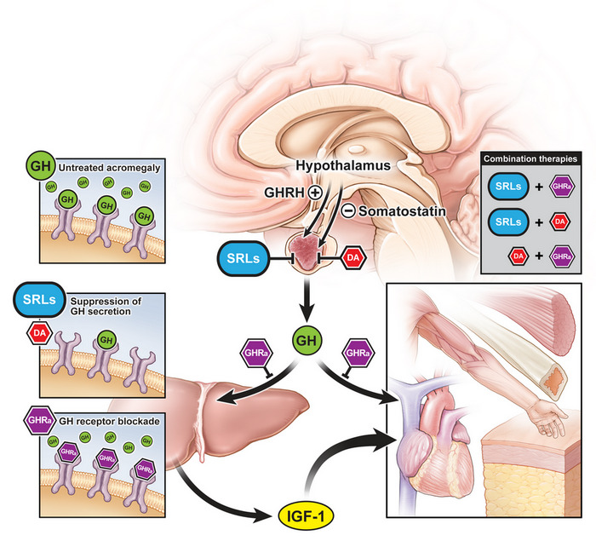
There are three drug classes available in the therapeutic arsenal for acromegaly treatment:
  somatostatin receptor ligands (SRLs)
  dopamine agonists (DAs)
  GH receptor antagonists (pegvisomant)
SRLs and pegvisomant are FDA approved for acromegaly, whereas DAs are used off label.

Slide 27
Acromegaly: An Endocrine Society Clinical Practice Guideline
Recommend medical therapy in a patient with:
  persistent disease following surgery
  In a patient with significant disease (ie, with moderate-to-severe signs and symptoms of GH excess and without local mass effects), we suggest use of either a SRL or pegvisomant as the initial adjuvant medical therapy.
J Clin Endocrinol Metab, November 2014, 99(11):3933–3951

Slide 28
Acromegaly: An Endocrine Society Clinical Practice Guideline
Recommend medical therapy in a patient with (cont.) :
  In a patient with only modest elevations of serum IGF-1 and mild signs and symptoms of GH excess, we suggest a trial of a dopamine agonist, usually cabergoline, as the initial adjuvant medical therapy.
  We suggest use of an SRL as primary therapy in a patient who is a poor surgical candidate.
J Clin Endocrinol Metab, November 2014, 99(11):3933–3951

Slide 29
Dopamine agonist monotherapy for acromegaly
Bromocriptine Monotherapy:
  In a more recent retrospective study in 133 patients, biochemical response was 18.8%.

Slide 30
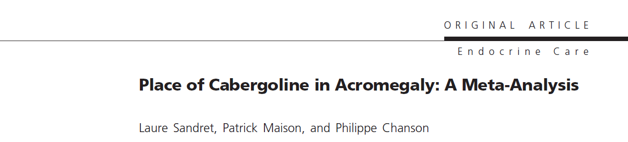
Mean age was 50 (12)yr.
Of the 107 patients, 75 and 35 patients, respectively, had previously been operated on and/or irradiated.
Forty-six (38%) patients also had increased baseline prolactin levels. The mean prolactin level was 62 (216) ng/ml.
Among those patients who had been surgically treated, 30.5% had positive prolactin immunostaining.
53 patients had macro and 57 had microadnoma.
The cabergoline doses ranged widely from 0.3 to 7 mg/wk.
The mean (SD) duration of treatment was 10.8 ± (8.2) months (range, 1–45).

Slide 31
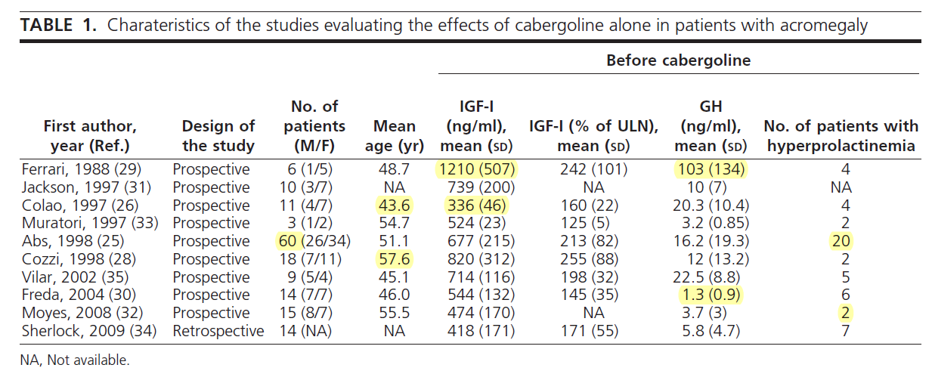
634±279
16±34
Notes:
At baseline, mean IGF-I and GH levels were 634 (279) and 16 (34) ng/ml

Slide 32
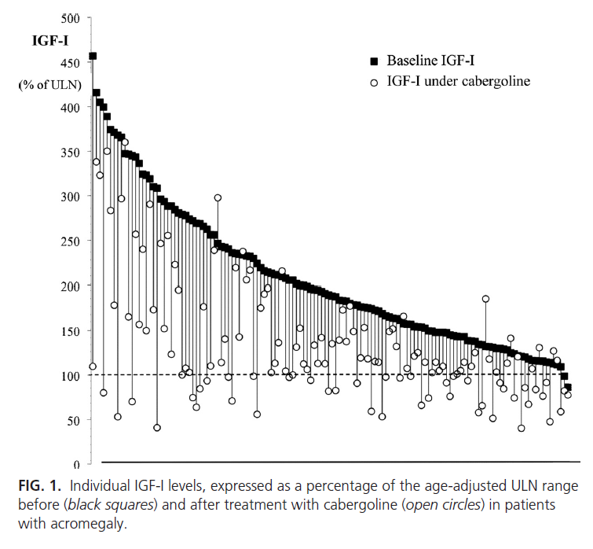
Cabergoline treatment was associated with significant reductions in IGF-I and GH levels of 33 and 47%, respectively (both P < 0.001)
34% patients achieved age-adjusted normal IGF-I levels.
GH levels were below 2.5 ng/ml in 48% of patients.

Slide 33
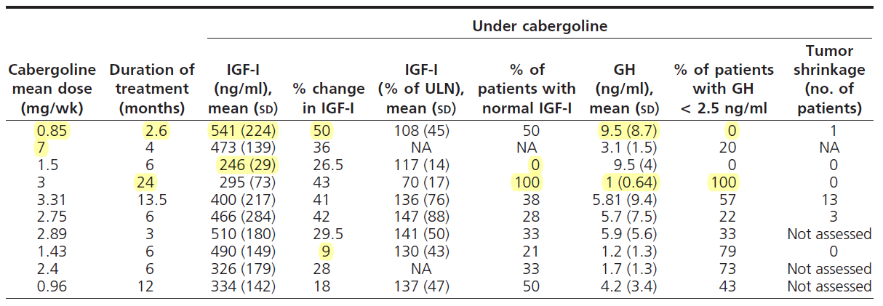
634±279
409± (215)
16±34
5.2 ± (16.3)

Slide 34
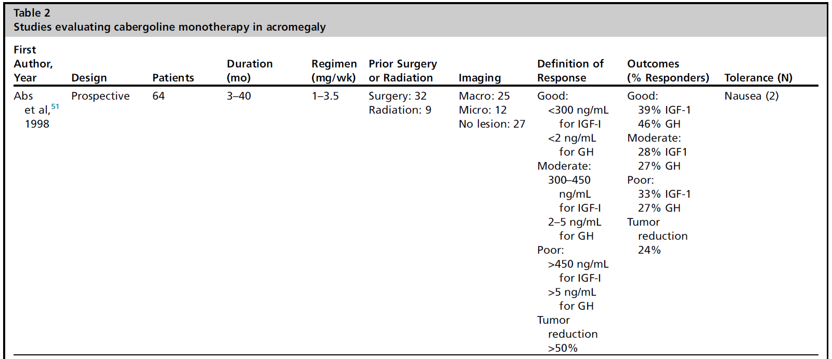

Slide 35
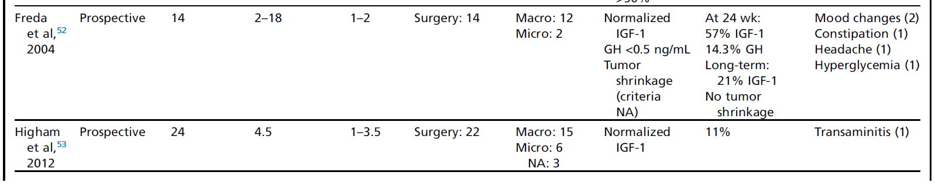
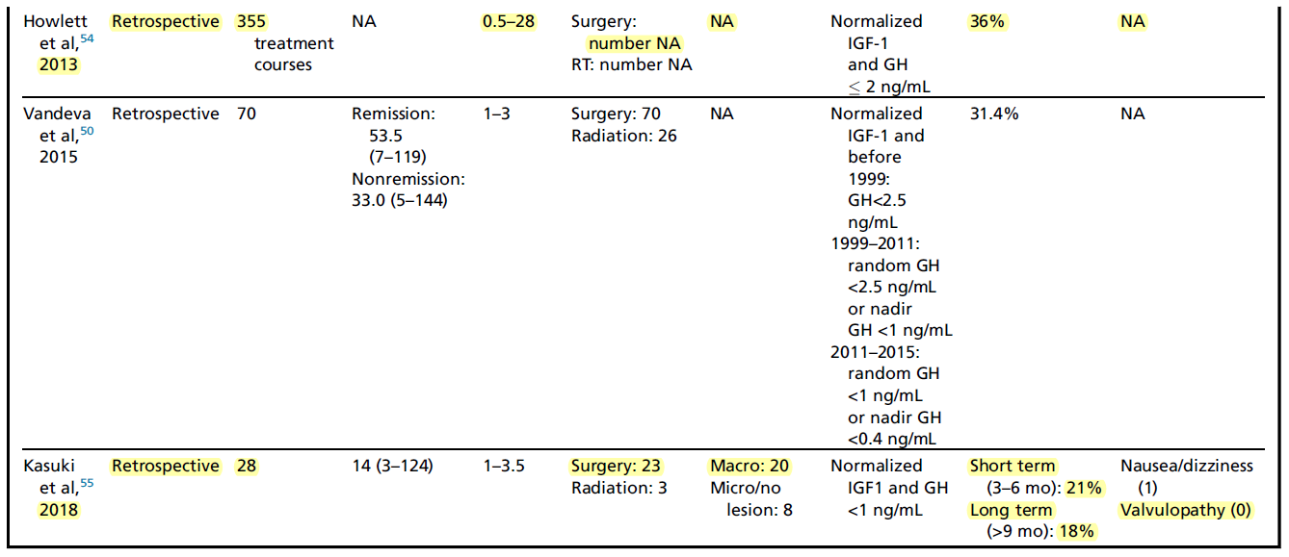

Slide 36

Predictors of response:
  prolactin cosecretion
  higher baseline prolactin levels
  lower pretreatment IGF-1 levels.
  Longer treatment duration

Slide 37

  In a patient with only modest elevations of serum IGF-1 and mild signs and symptoms of GH excess, we suggest a trial of a dopamine agonist, usually cabergoline, as the initial adjuvant medical therapy.

Slide 38
Mean age was 48.2 (14) yr.
Previous treatments consisted of surgery in 54 patients (70%) and/or radiotherapy in 22 patients (29%).
Twenty-one patients (27%) had high serum prolactin levels at baseline.
Among the 46 patients in whom immunostaining of the excised tumor was available, 21 (47%) had a mixed GH-prolactin adenoma.
The cabergoline dose ranged between 1 and 7 mg/wk.
The mean duration of combined treatment was 6.6 (4.1) months (range, 2–20)
Notes:
63 patients

Slide 39
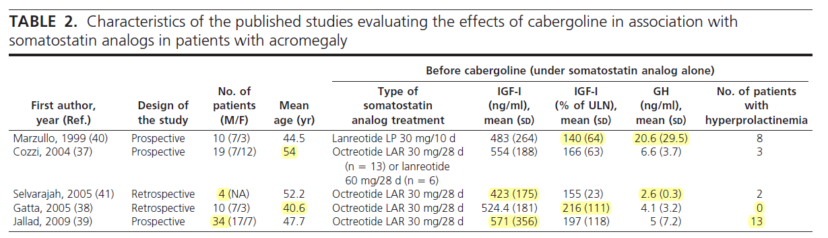
Dopamine agonist combination therapy with SRL
542 (280)
7.4 (12.5)
Notes:
In five studies, cabergoline was added to ongoing treatment with a somatostatin analog that had failed to normalize IGF-I

Slide 40
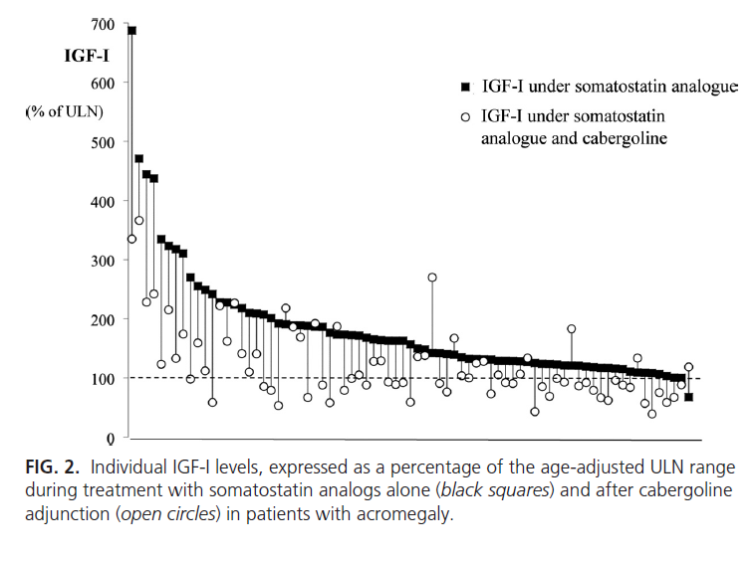
The mean IGF-I concentration fell significantly from 542 (280) ng/ml to 358 (201) ng/ml (P 0.001).
The mean GH concentration fell significantly from 7.4 (12.5) ng/ml to 3.6 (3.8) ng/ml (P 0.001).
In cabergoline/SRL combination therapy lower pretreatment IGF-1 and GH levels seem to predict the response.
Notes:
Tumor shrinkage The sample was too small for multivariate analysis.

Slide 41
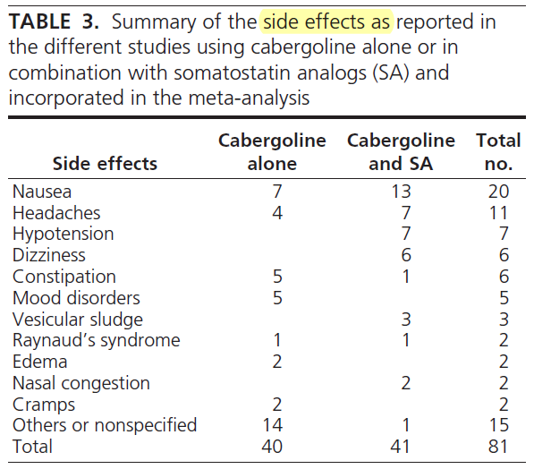

Slide 42
The Endocrine Society guidelines suggest adding cabergoline or pegvisomant in patients with inadequate response to SRL postoperatively.

Slide 43
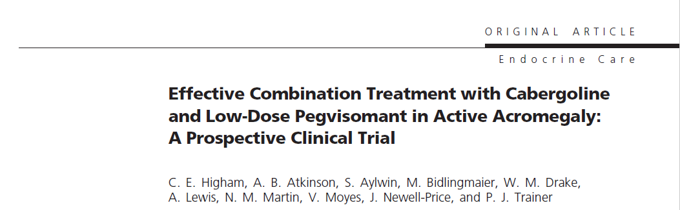


Slide 44
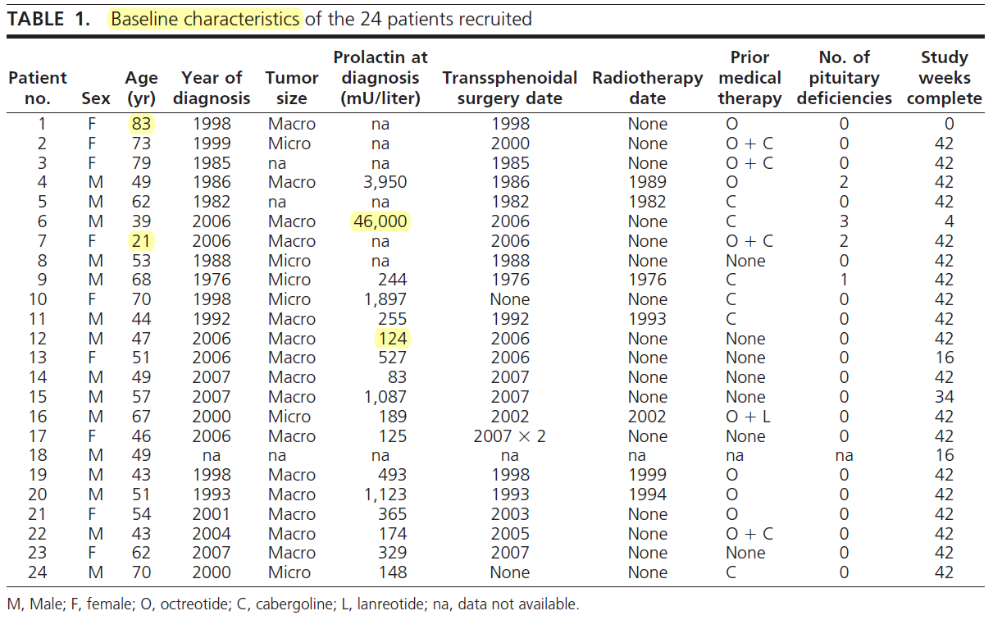

Slide 45
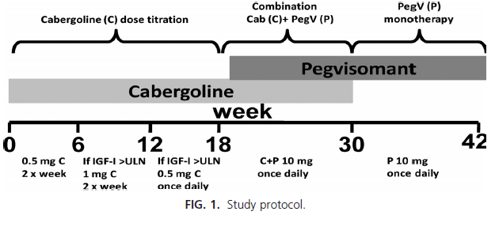
A prospective study assessed 24 patients at 5 centers :
only 11% achieved normal IGF-1 levels.
68% had normal IGF-1 levels
only 24% maintained normal IGF-1

Slide 46
Predictors of response included:
  baseline IGF-1 levels less than 160% of UNL
  female gender
  lower body weight
  higher prolactin levels

Slide 47
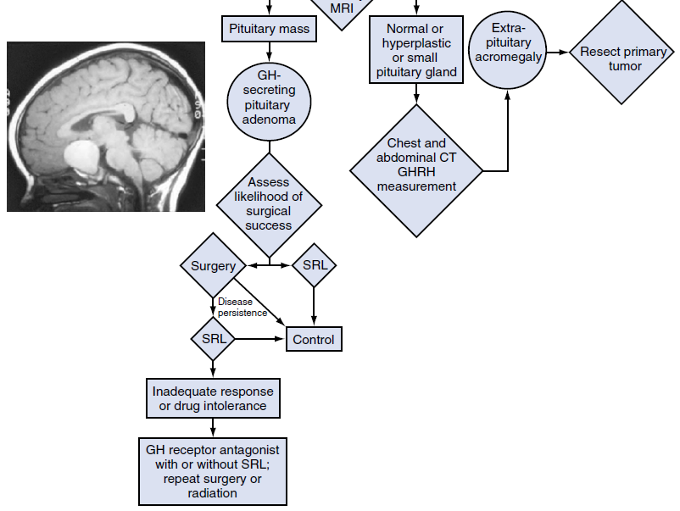
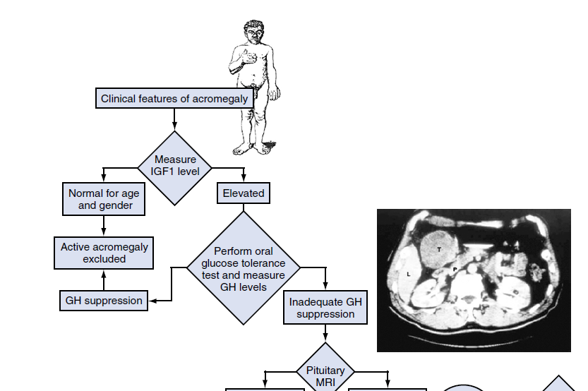
williams textbook of endocrinology 14th edition
Williams textbook of endocrinology 14th edition

Slide 48
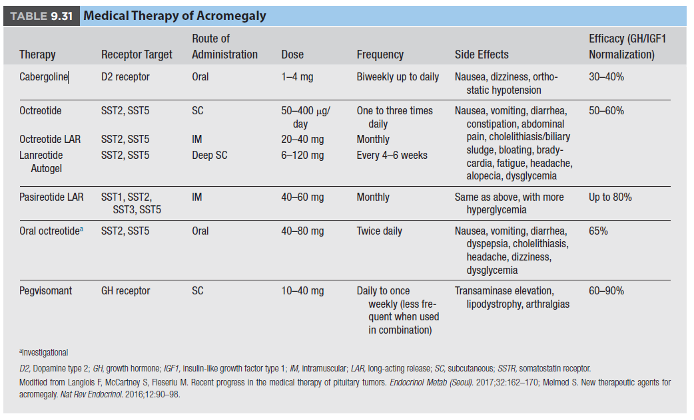

Slide 49
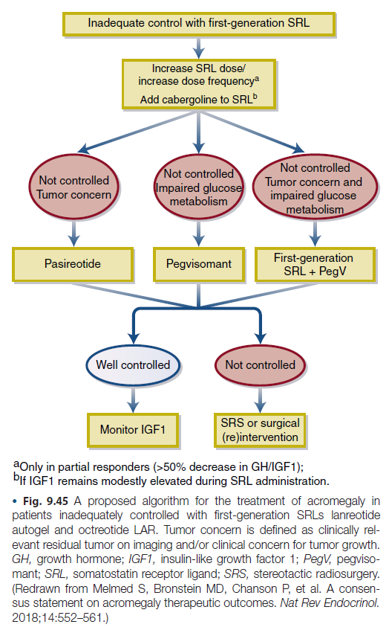

Slide 50
Agenda
Introduction
Dopamine agonists in prolactinoma
Dopamine agonists in acromegaly
Dopamine agonists in cushing disease
Dopamine agonists in non functioning adenoma

Slide 51
The first-line treatment of Cushing disease (CD) is surgery, with remission rates of 65% to 90%; however, recurrence affects approximately 30% of patients.
Management of persistent or recurrent hypercortisolism is challenging and entails:
  pituitary reoperation
  Radiation
  bilateral adrenalectomy
  medical treatment

Slide 52
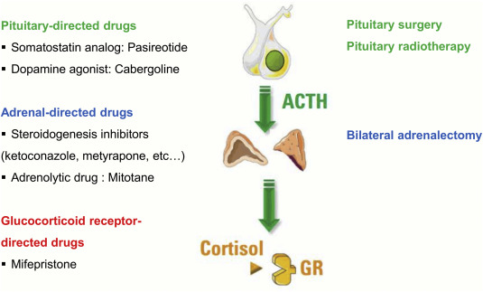
Notes:
The only approved tumor-targeting therapy is pasireotide, which normalizes the urine free cortisol (UFC) in a third and causes hyperglycemia in most patients.

Slide 53
A study in 20 corticotroph adenomas identified D2R in 75% of tumors by IHC and 83% by PCR.
DR2 expression correlated with the in vitro adrenocorticotropic hormone (ACTH) secretion inhibition in the cultured adenoma cells.

Slide 54
Bromocriptine Monotherapy
  In the 1980s, 6 studies (49 patients) investigated bromocriptine therapy for 1 to 36 months in CD. UFC decreased in 23% to 66%, and plasma ACTH level in 33% to 80% of patients.
  One study showed no change in UFC or ACTH levels.

Slide 55
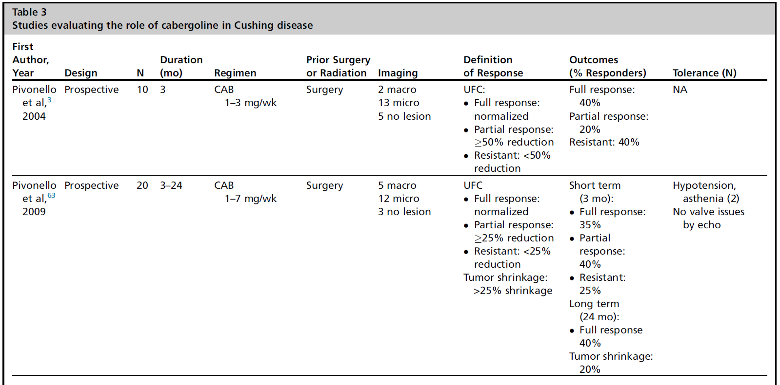
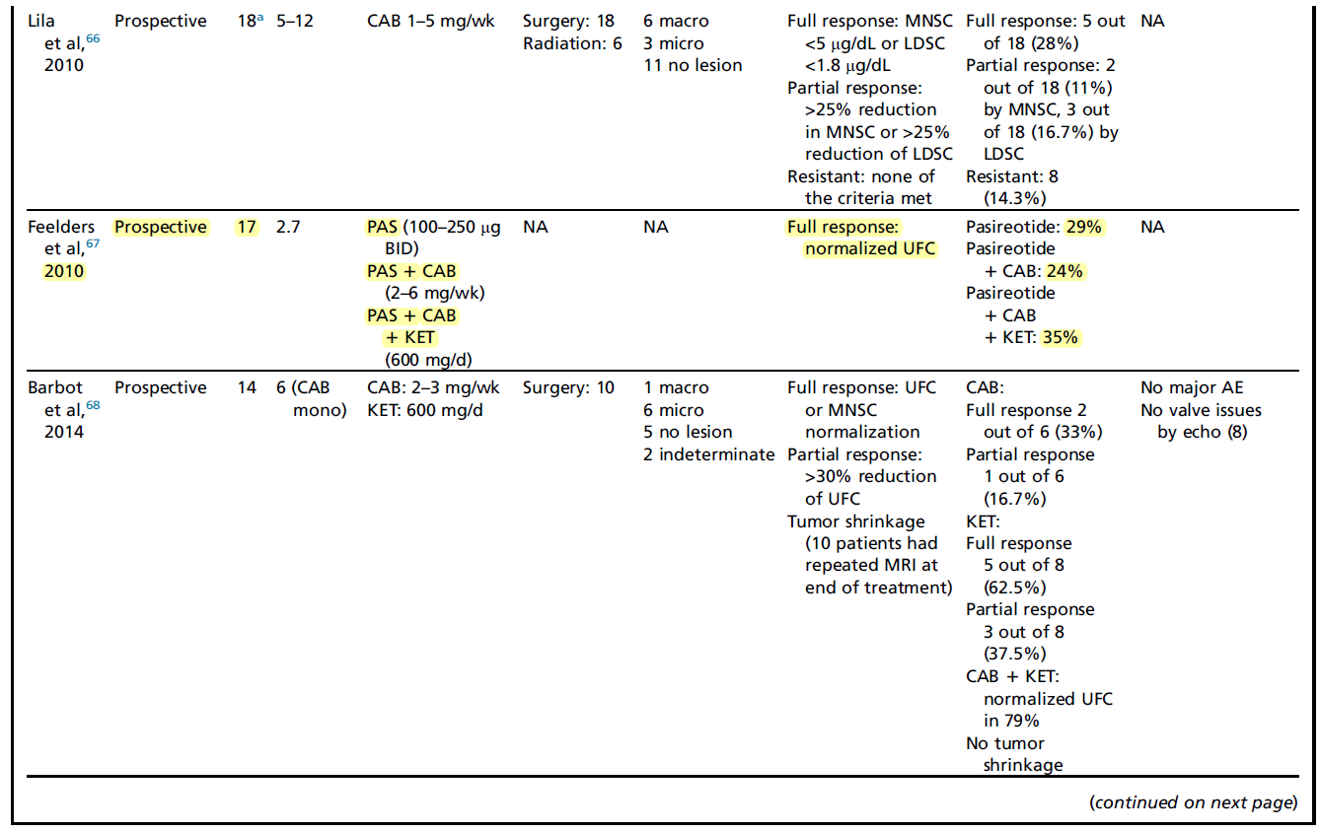

Slide 56
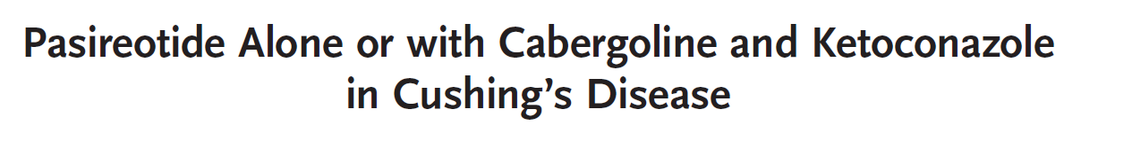

Seventeen patients with Cushing’s disease (mean age, 45.7 years; 13 women) were included in an 80-day trial with normalization of levels of UFC as the main outcome measure.

Slide 57
All patients began treatment with 100 μg of pasireotide subcutaneously three times daily; this dose was increased to 250 μg subcutaneously three times daily at day 15 if the level of urinary free cortisol had not normalized.
At day 28, cabergoline was added to pasireotide at a dose of 0.5 mg every other day (this dose was increased to 1.0 mg every other day after 5 days and 1.5 mg every other day after 10 days) if the level of urinary free cortisol remained elevated.
If the level of urinary free cortisol had not normalized at day 60, ketoconazole was added at a dose of 200 mg thrice daily.
Th e new england journal o f medicine

Slide 58
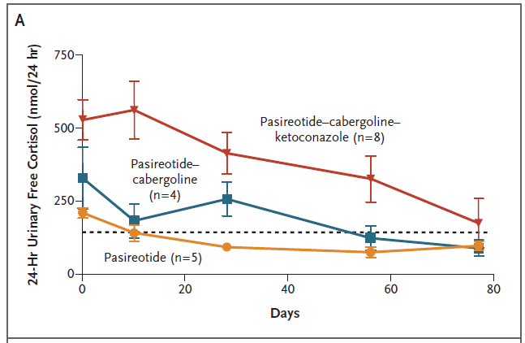
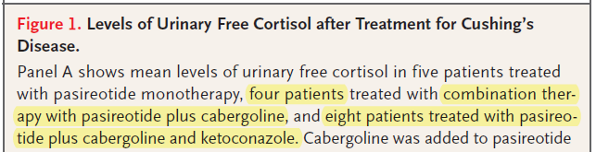
Th e new england journal o f medicine

Slide 59
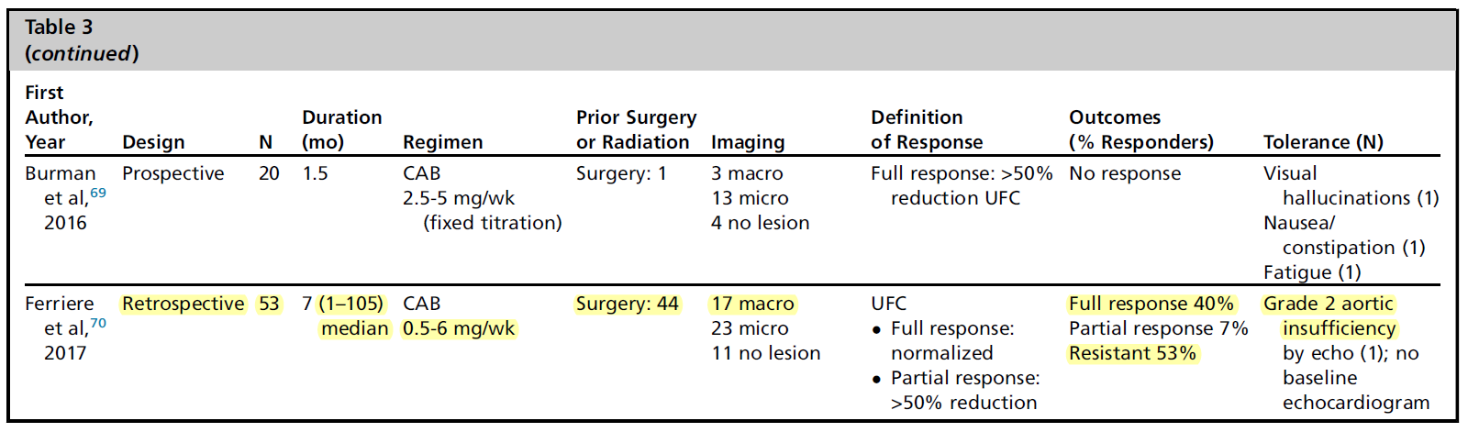

Slide 60
Treatment of Cushing’s Syndrome: An Endocrine Society Clinical Practice Guideline
In small studies, 30–40% of patients responded and continued to have normal UFC levels after 2–3 years of cabergoline treatment.
The cortisol lowering effect did not last in 29% of initial responders.
Tumor volume decreased or remained stable in the small number of reported patients.
J Clin Endocrinol Metab, August 2015, 100(8):2807–2831

Slide 61
Agenda
Introduction
Dopamine agonists in prolactinoma
Dopamine agonists in acromegaly
Dopamine agonists in cushing syndrome
Dopamine agonists in non functioning adenoma

Slide 62
  NFPAs are the second most common type of pituitary adenomas treated primarily by surgery.
  Complete tumor resection is achieved in 40% to 90% of cases.
  Strategies for management of the residual or recurrent tumor include observation, reoperation, and radiation.
  There is currently no consensus on pharmacologic therapy for NFPA.
  The lack of biochemical markers makes evaluation of medical treatment of NFPA difficult.

Slide 63
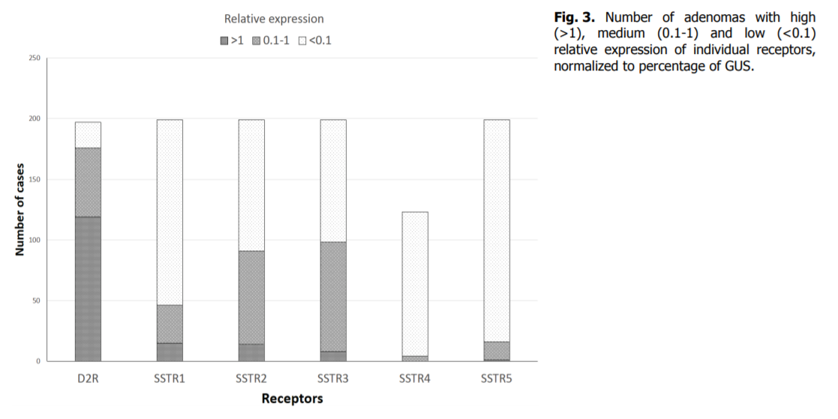
A study of 198 adenomas found high D2R messenger RNA expression in 60% of samples, and much lower somatostatin receptor expression (<8%).
Physiol. Res. 64: 369-377, 2015
Dopamine 2 and Somatostatin 1-5 Receptors Coexpression in Clinically Non-Functioning Pituitary Adenomas

Slide 64
Most bromocriptine studies did not show reduction in tumor size. Notably, bromocriptine was used as primary therapy before surgery.
Cabergoline studies included 13 to 79 patients, most having had prior surgery. Tumor shrinkage by greater than 25% was encountered in 28% to 67% of patients.

Slide 65
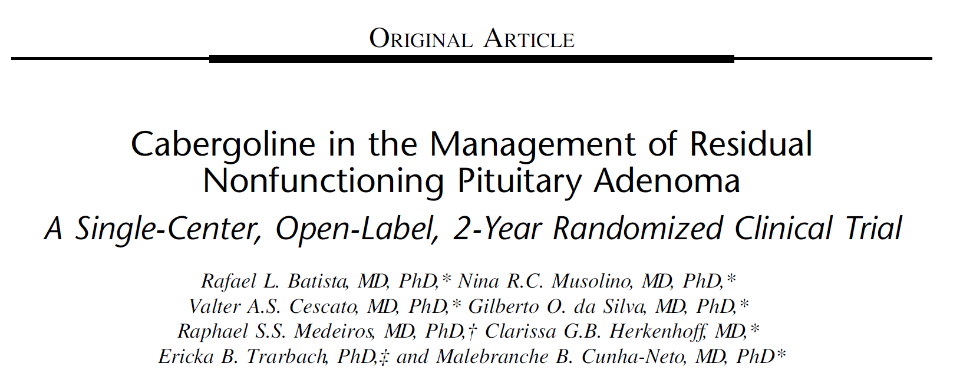
Design:
--We conducted a randomized, parallel, open-label clinical trial that compared cabergoline
with nonintervention in patients with residual NFPA after transsphenoidal surgery
over 2 years.
-- The outcome was clinical efficacy (tumor reduction).
-- Tumor measurements and clinical evaluations were performed every 6 months.

Slide 66
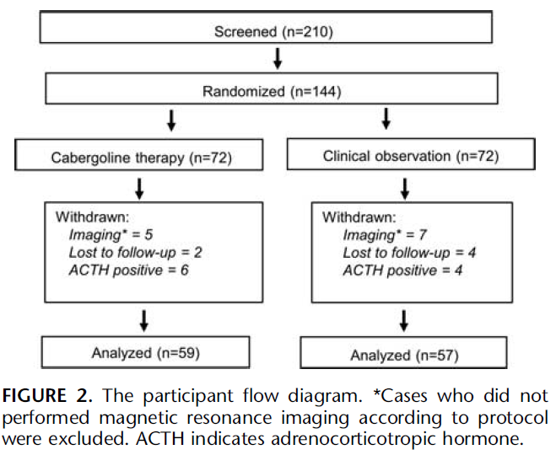
Notes:
prospective, randomized, open-label, singlecenter trial conducted at the clinical hospital of Sao Paulo University over 30 months.
was delineated to test the clinical efficacy of a specific DA, cabergoline, in NFPA patients with a residual tumor after primary neurosurgery.
open-label manner
Cabergoline was initiated (T0) at 0.5mg 3 times a week titrated up to a daily dose of 0.5mg. In all cases, the target dose of 3.5 mg a week was achieved within 15 days and maintained until the end of the study.

Slide 67
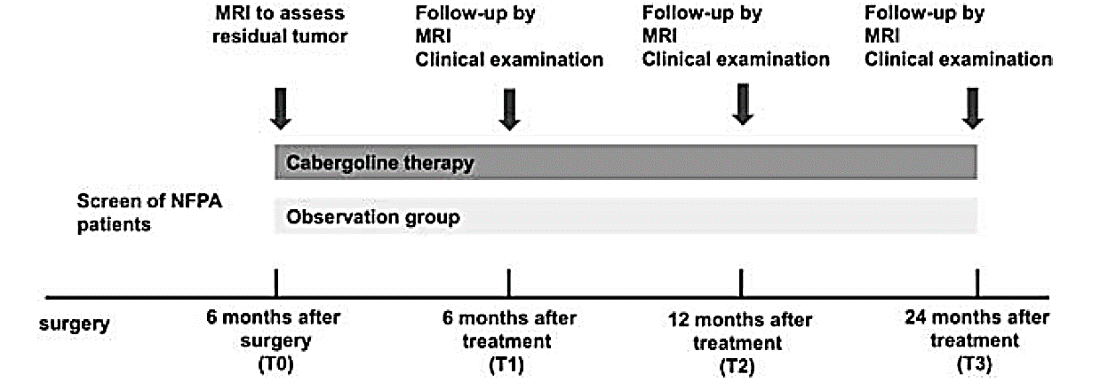

Slide 68
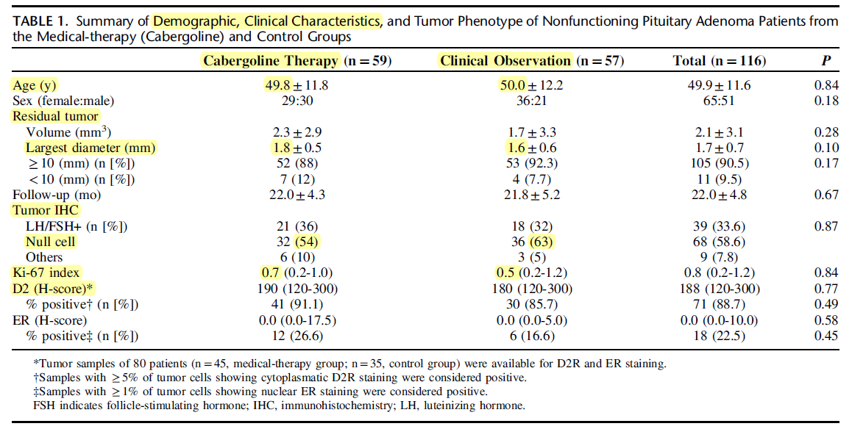

Slide 69
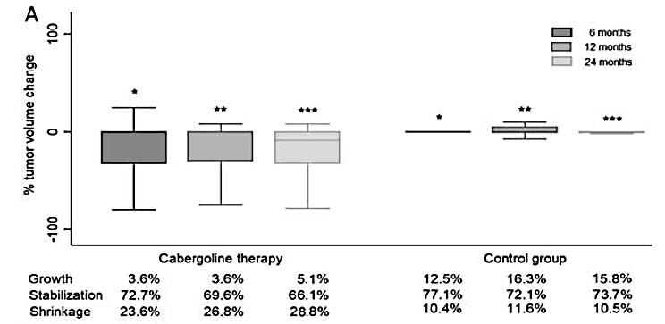
Percentage of change in tumor volume at 6, 12, and 24 months in the medical-therapy (cabergoline) and in control groups *P=0.07, **P= 0.02, ***P= 0.01.

Slide 70
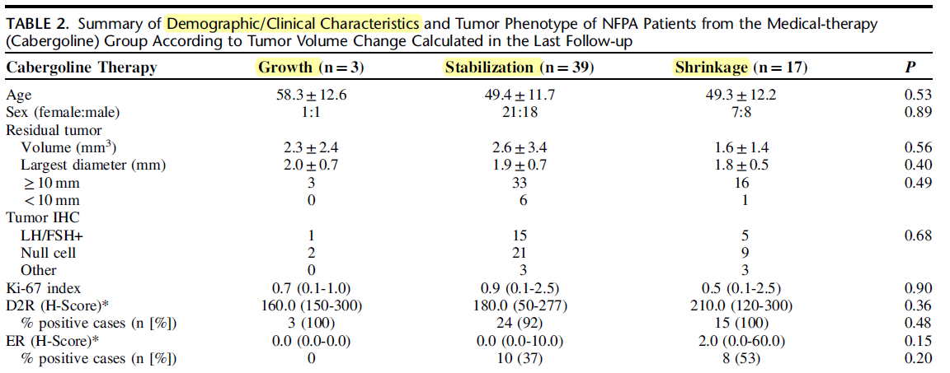

Slide 71


In summary:
  In prolactinomas cabergoline seems superior to bromocriptine regarding clinical, biochemical, and radiographic effects.
  In acromegaly cabergoline/pegvisomant combination seems more effective than monotherapy and allows smaller drug doses.
  In cushing disease cabergoline was associated with improved biochemical parameters in up to 40% of patients as monotherapy and up to 80% in combination with ketoconazole and pasireotide.
  In NFPA, there is no sufficient evidence to support bromocriptine treatment.
More studies with larger sample size and longer follow up is needed for decision making.

Slide 72

Thank you for your attention

