Slide 1
Hypertriglyceridemia and cardiovascular outcomes
F. Hosseinpanah
Obesity Research Center
Research Institute for Endocrine sciences
Shahid Beheshti University
of Medical Sciences
August19, 2016
Tehran

Slide 2
Agenda
Overview of pathophysiology
Role of triglycerides as a CHD risk factor (observational studies)
Residual risk after statins
Effect of triglyceride reduction on cardiovascular outcomes (clinical trials)
Guidelines
Conclusions

Slide 3
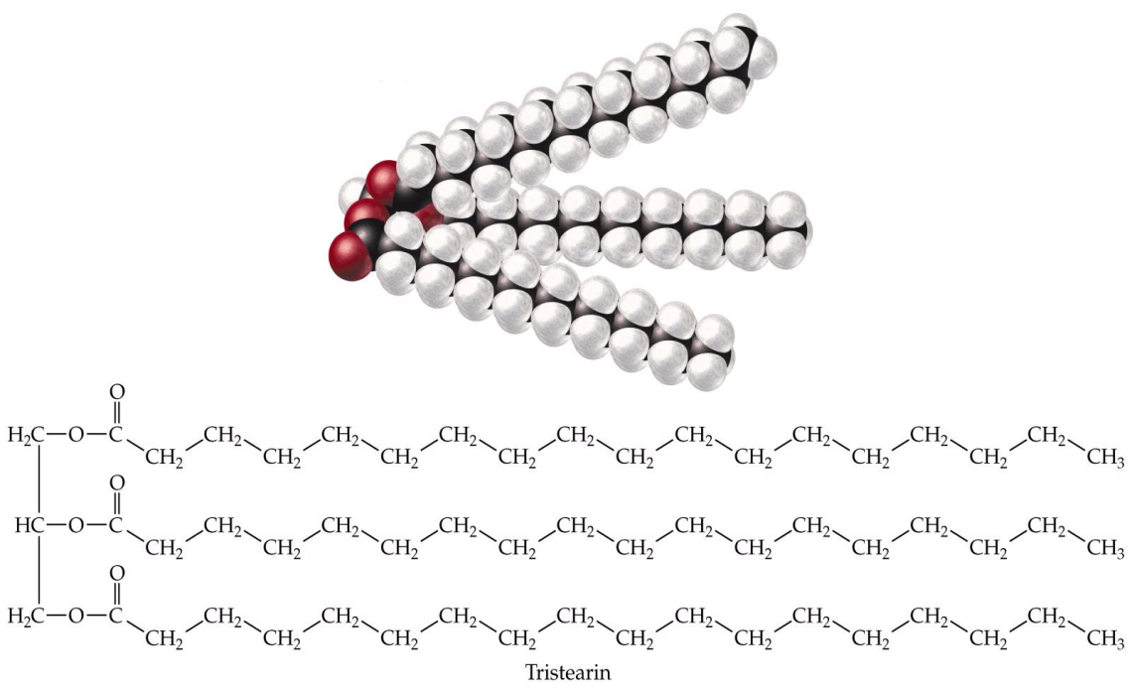
What are Triglycerides?
Chylo
Three
Fatty
Acids
Glycerol
VLDL
Chylo
Remnant
VLDL
Remnant
IDL
TG Rich LP

Slide 4
Hypertriglyceridemia
Hypertriglyceridemia the accumulation of triglyceride-rich lipoproteins(Remnant cholesterol)
Remnant cholesterol is the cholesterol content of triglyceride-rich lipoproteins
Since triglyceride-rich lipoproteins also transport cholesterol, hypercholesterolemia of varying severity often accompanies hypertriglyceridemia

Slide 5
Remnant cholesterol = non-fasting total cholesterol - HDL cholesterol - LDL cholesterol

Slide 6
Because triglycerides can be degraded by most cells, but cholesterol cannot be degraded by any, the cholesterol content of triglyceride-rich lipoproteins (remnant cholesterol) is more likely to be the cause of atherosclerosis and cardiovascular disease rather than raised triglycerides per se

Slide 7
Triglycerides and Atherogenesis
Simplest chain of events is that high triglyceride concentrations are a marker for raised remnants rich in cholesterol, which, upon entrance into the intima, leads to low-grade infl ammation, foam cell formation, atherosclerotic plaques, and ultimately cardiovascular disease
Current Opinion in Cardiology 2009,24:345–350

Slide 8
Atherogenic Particles
Small,
dense LDL
VLDL
VLDL_{R}
IDL
LDL
TG-rich lipoproteins
Notes:
Atherogenic particles
Not only is LDL-C a risk factor for cardiovascular disease, but triglyceride-rich lipoproteins—very low density lipoprotein (VLDL), VLDL remnants, and intermediate-density lipoprotein (IDL)—may also increase the risk of heart disease. The NCEP ATP III uses non-HDL-C principally as a surrogate for these atherogenic particles.

Slide 9
Associated Abnormalities
Low levels of HDL-C
The presence of small, dense LDL particles
The presence of atherogenic triglyceride-rich lipoprotein remnants
Insulin resistance
Increases in coagulability and viscosity

Slide 11
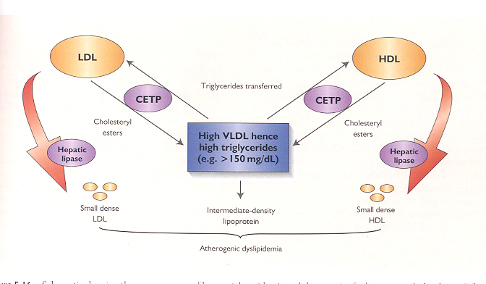

Slide 12
Why High TG causes Low HDL and High small dense LDL ?
High levels of VLDL
  VLDL exchanges its TG for Chol from HDL (by CETP)
    Chol rich VLDL- is very iatherogenic
    Chol depleted HDL-can easily dissociate from apo A-1 and be cleared
  VLDL exchanges its TG for Chol from LDL (by CETP)
    LDL gets denser and smaller-Very atherogenic

Slide 13
Two important questions
Is TG as an independent risk factor for CVD?
Dose treating elevated triglyceride levels lower the risk for CHD?

Slide 14
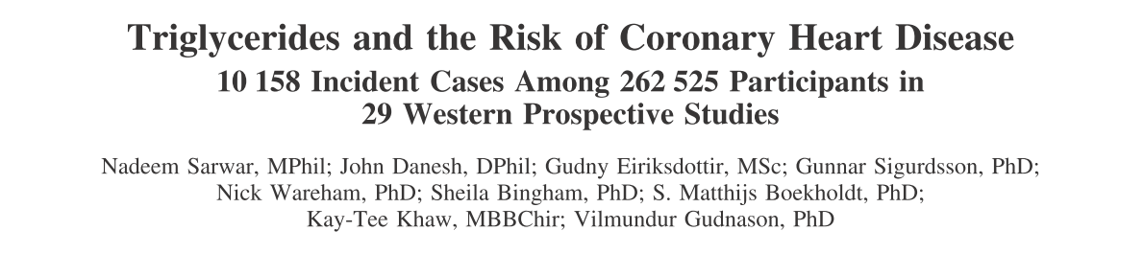
In the largest and most comprehensive study primary data from the Reykjavik Study and European Prospective Investigation of Cancer Norfolk Study were incorporated into an updated meta-analysis of 27 additional prospective studies in western populations comprising 262 525 participants, including 10 158 CHD cases.
Circulation. 2007;115:450-458

Slide 15
TG Level Is Significant CVD Risk Factor: Meta-Analysis of 29 Studies
Groups CHD Cases
N = 262,525
Duration of follow-up
≥10 years 5902
<10 years 4256
Sex
Male 7728
Female 1994
Fasting status
Fasting 7484
Nonfasting 2674
Adjusted for HDL
Yes 4469
No 5689
1.72 (1.56-1.90)
*Individuals in top vs bottom third
of usual log-TG values; adjusted for at least age, sex, smoking status, and lipid concentrations; also adjusted for BP (in most studies).
1
2
CHD Risk Ratio* (95% CI)
Sarwar N, et al. Circulation. 2007;115:450-458.
Notes:
Triglyceride Level Is Significant CVD Risk Fact: Recent Meta-Analysis of 29 Studies.
A recent meta-analysis by Sarwar et al¹ included 29 prospective studies and was the largest and most comprehensive epidemiological assessment of the association between triglyceride values and CHD risk in Western populations (262 525 participants; 10,158 CHD cases). A combined analysis of the 29 studies yielded an adjusted odds ratio of 1.72 (95% CI, 1.56-1.90) in a comparison of extreme thirds of usual triglyceride values (ie, individuals with usual log-triglyceride values in the top third of the population compared with those in the bottom third). This odds ratio was adjusted in all but one study for at least age, sex, smoking status, lipid concentrations, and most studies also adjusted for blood pressure. The above figure shows the CHD risk ratio adjusted for several established risk factors and grouped according to several study characteristics (ie, duration of follow-up, sex, fasting status, and adjusted for HDL-cholesterol). The data indicate that the impact of triglycerides on CHD risk is similar in women and men and also regardless of duration of follow up. The data suggest no important differences in the strength of associations between triglycerides and CHD in studies of fasting participants compared with studies of nonfasting participants. Finally, adjustment for HDL-cholesterol attenuated the magnitude of the association between triglyceride level and CHD risk. The conclusion of the study is that there is a strong and highly significant association between triglyceride value and CHD risk.
Reference
1. Sarwar N, et al. Circulation. 2007;115:450-458.

Slide 16
Key messages
Available prospective studies in Western populations consistently indicate moderate and highly significant associations between triglyceride values and coronary heart disease risk.
Although there is consistent evidence that raised circulating triglyceride levels are associated with increased CHD risk, adjustment for established coronary risk factors, especially HDL cholesterol, substantially attenuated the magnitude of this association, but still remained significant
impact of triglycerides on CHD risk is similar in men and women

Slide 17
JAMA 2009;302: 1993–2000

Slide 19
The Emerging Risk Factors Collaboration
An increased risk of coronary heart disease up to mean raised fasting triglyceride concentrations of around 2·8 mmol/L and increased risk of ischemic stroke up to around 2·2 mmol/L.

Slide 20
Non fasting TG
Copenhagen City Heart
Study and the Copenhagen General Population
Study

Slide 21
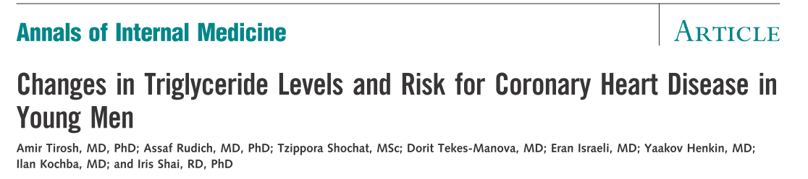
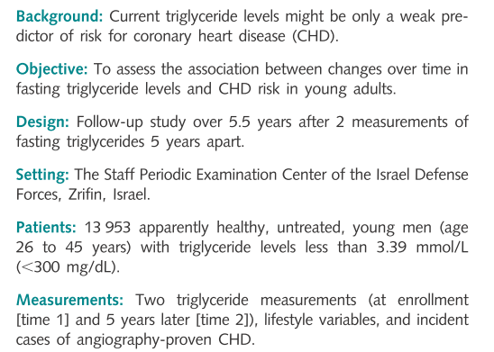
Ann Intern Med. 2007;147:377-385

Slide 22
Triglycerides were strongly and independently associated with CHD risk when comparing those in the highest quintile to those in the lowest ( HR ,4.1)

Slide 25
Key messages
Two triglyceride measurements obtained 5 years apart may assist in assessing CHD risk in young men.
A decrease in initially elevated triglyceride levels is associated with a decrease in CHD risk compared with stable high triglyceride levels.
However, this risk remains higher than in those with persistently low triglyceride levels.

Slide 26
Residual Cardiovascular Risk Remaining After Statin Treatment

Slide 27
Residual Cardiovascular Risk in Major Statin Trials
75%
75%
73%
69%
62%
62%
Patients Experiencing
Major Coronary Events (%)
4S
LIPID
CARE
HPS
WOS
AFCAPS/
TexCAPS
4444
20 536
N
9014
4159
6595
6605
-36%
ΔLDL
-25%
-28%
-29%
-26%
-27%
4S=Scandinavian Simvastatin Survival Study; LIPID=Long-Term Intervention with Pravastatin in Ischaemic Disease; CARE=Cholesterol and Recurrent Events; HPS=Heart Protection Study; WOS=West of Scotland Coronary Prevention Study; AFCAPS/TexCAPS=Air Force/Texas Coronary Atherosclerosis Prevention Study.
Libby PJ et al. J Am Coll Cardiol. 2005;46(7):1225-1228.

Slide 28
Residual risk ?
Elevated Triglyceride level
Role of TG rich lipoproteines
Beyond LDL,non HDL may be a better predictor

Slide 29
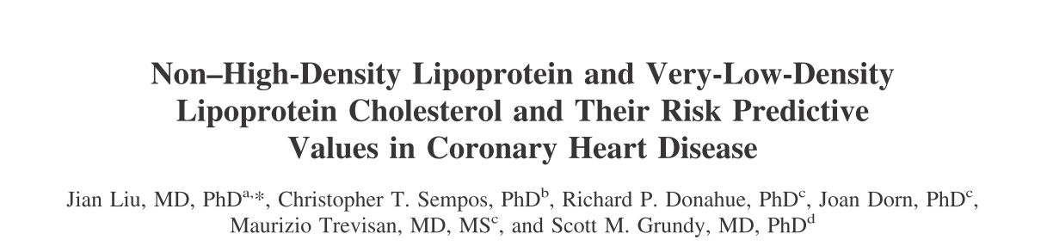
To determine if non-HDL cholesterol is a more useful predictor of coronary heart disease (CHD) risk than LDL cholesterol and if VLDL cholesterol is an independent predictor of CHD risk
All subjects aged >30 years and free of CHD at baseline, followed for incident CHD (618 men, 372 women)
Am J Cardiol 2006;98:1363–1368

Slide 30
Non–HDL-C Is Superior to LDL-C in Predicting CHD Risk
Within non–HDL-C levels, no association was found between LDL-C and the risk for CHD
In contrast, a strong positive and graded association between non–HDL-C and risk for CHD occurred within every level of LDL
Relative CHD Risk
≥190
160-189
<130
130-159
≥160
<160
LDL-C,
mg/dL
Non–HDL-C,
mg/dL
.
Notes:
Non HDL-C and VLDL-C and Their Risk Predictive Values in CHD.
Senior author Scott M. Grundy, chairman of the NCEP ATP III, published this study that analyzed data from the Framingham Heart Study (2693 men and 3101 women) in order to determine if non–HDL-C is a more useful predictor of CHD risk than LDL-C and if VLDL-C is an independent predictor of CHD risk. All subjects were aged ≥30 years of age and free of CHD at baseline, and incident CHD was the end point (618 men and 372 women). After multivariate adjustment, within non–HDL-C, no association was found between LDL-C and the risk for incident CHD. In contrast, a strong positive and graded association between non–HDL-C and risk for CHD was observed within every level of LDL-C. These results suggest that non–HDL-C is a stronger predictor of CHD risk than LDL-C and that VLDL-C may play a critical role in the development of CHD.¹
These analyses were repeated within triglyceride levels <200 mg/dL and ≥200 mg/dL (data not shown here). Overall, the association with CHD incidence was stronger for non–HDL-C within every level of LDL-C than that for LDL-C within each level of non–HDL-C, regardless of whether triglyceride levels were <200 mg/dL or ≥200 mg/dL.¹
Reference
1. Liu J, et al. Am J Cardiol. 2006;98:1363-1368.

Slide 31
When the analysis was repeated within triglyceride levels (<200 vs>200 mg/dl), the risk pattern did not change signiﬁcantly

Slide 33
Key message
The results from this study support the conclusions that VLDL cholesterol is an independent predictor of CHD risk and that non-HDL cholesterol overall appears to be a better predictor of CHD risk than LDL cholesterol.
These conclusions appear to be valid for the entire population and when TG levels are either ≥200 or< 200 mg/dl.

Slide 34
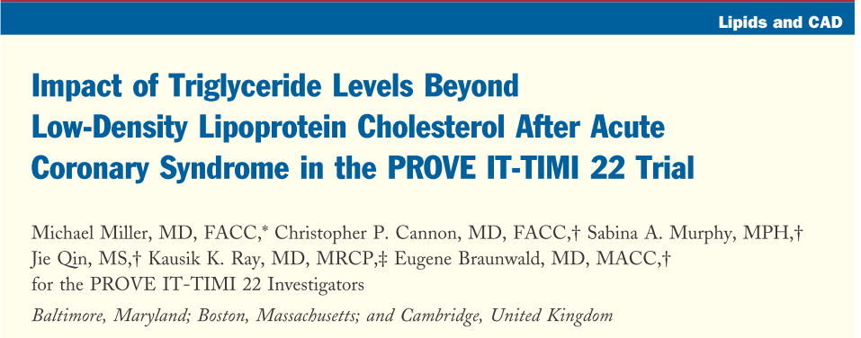
The PROVE IT-TIMI 22 trial demonstrated that low-density lipoprotein cholesterol (LDL-C)< 70 mg/dl was associated with greater CHD event reduction than LDL-C <100 mg/dl after ACS. However, the impact of low on-treatment TG on CHD risk beyond LDL-C <70 mg/dl has not been explored.
Purpose : to assess the impact of on treatment triglycerides (TG) on coronary heart disease (CHD) risk after an acute coronary syndrome (ACS)
Sample size: 4,162 patients hospitalized for ACS
Intervention : Atorvastatin 80 mg VS pravastatin 40 mg daily
Length of F/U: 2years

Slide 35
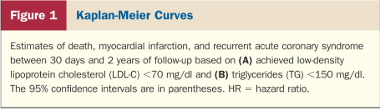
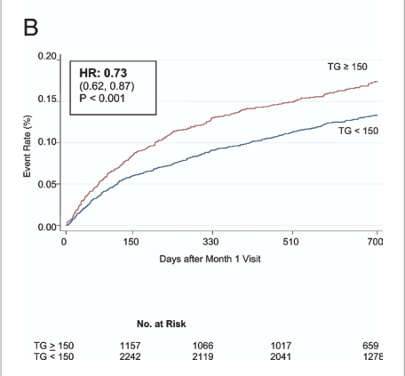
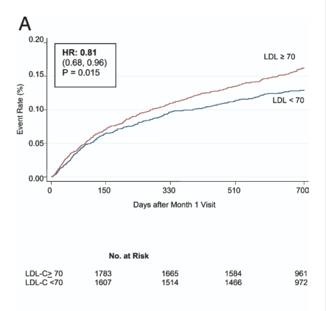

Slide 36
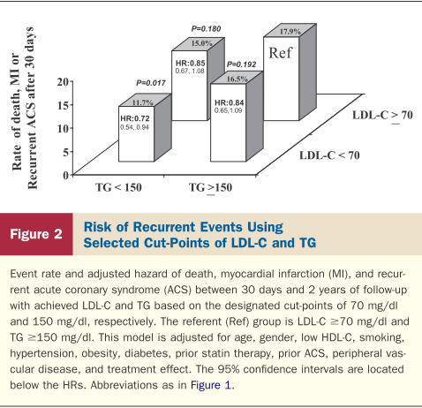
Compared with LDL-C ≥70 mg/dl and TG ≥150 mg/dl (referent), lower CHD risk was observed with low on- treatment TG (<150 mg/dl) and LDL-C (<70 mg/dl)
(HR 0.72, 95% CI 0.54 to 0.94; p = 0.017)

Slide 37
Key messages
In this analysis , the most noteworthy ﬁnding was the reduced risk of CHD with low on-treatment TG (<150 mg/dl) that was independent of the level of LDL-C.
For each 10-mg/dl decline in on-treatment TG, we observed a 1.6% lower risk of the composite end point (p <0.001) after adjustment for LDL-C and other covariates.
Moreover, the combination of low LDL-C (<70 mg/dl) and low TG (<150 mg/dl) was associated with the lowest event rates compared with higher LDL-C, higher TG, or both.

Slide 38
Two important questions
Is TG as an independent risk factor for CVD?
Dose treating elevated triglyceride levels lower the risk for CHD?

Slide 39
Effect of triglyceride reduction on cardiovascular outcomes (clinical trials)

Slide 40
Important point
No large-scale randomised trial has examined the effect of reducing triglycerides on cardiovascular disease risk in people with raised triglycerides.
Conversely, most trials have excluded participants with triglyceride concentrations that are greater than 4·5 mmol/L

Slide 41
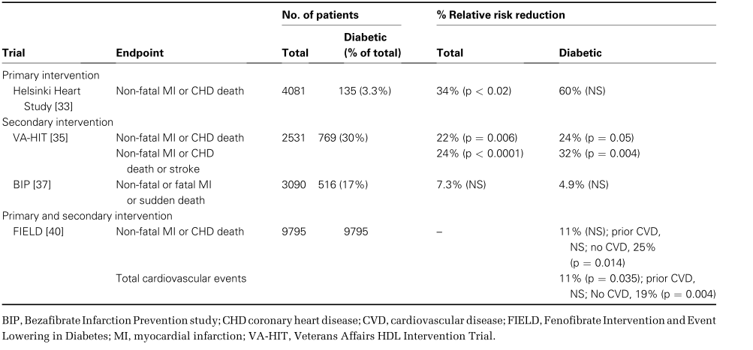
Fibrates Trials

Slide 42
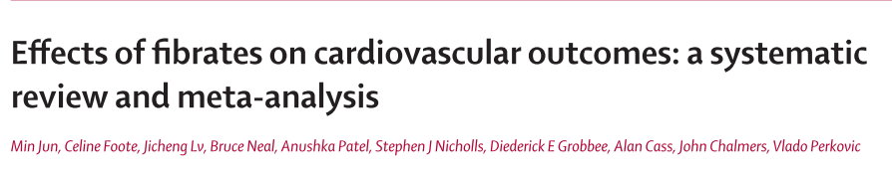
Eighteen trials providing data for 45 058 participants, including 2870 major cardiovascular events, 4552 coronary events, and 3880 deaths were pooled
Outcomes : major cardiovascular events, coronary events, stroke, heart failure, coronary revascularisation, all-cause mortality cardiovascular death, non-vascular death, sudden death, new onset albuminuria, and drug-related adverse events.
Lancet 2010; 375: 1875–84

Slide 43
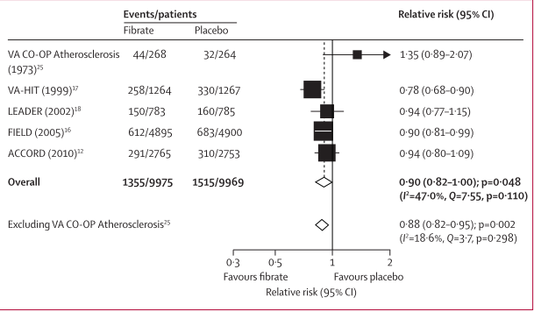
Effect of ﬁbrates on risk of major cardiovascular outcomes

Slide 44
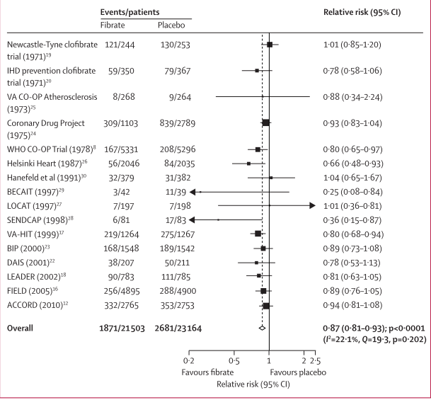
Effect of ﬁbrates on the risk of coronary events

Slide 45
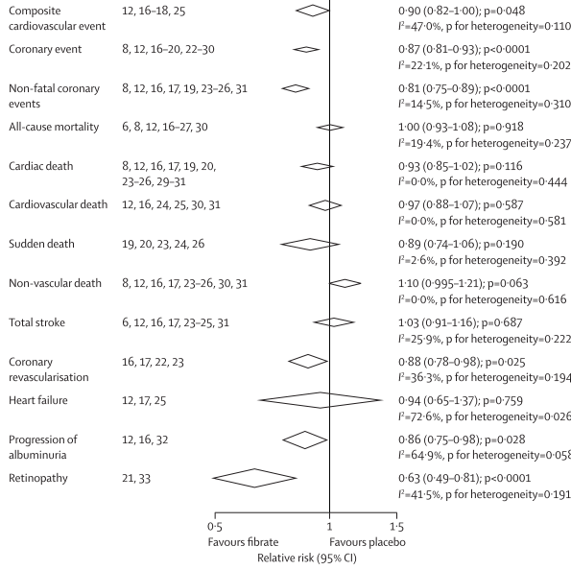
Summary of the relative risks of all outcomes assessed

Slide 46
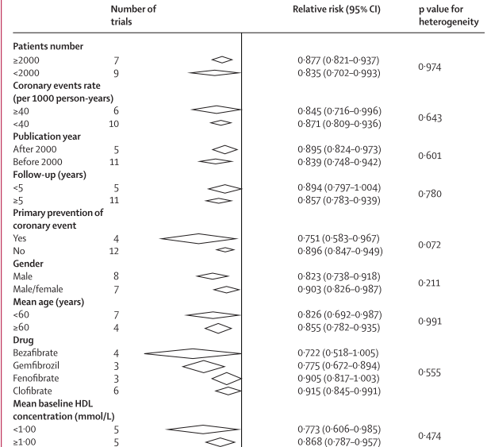
Subgroup analysis

Slide 47
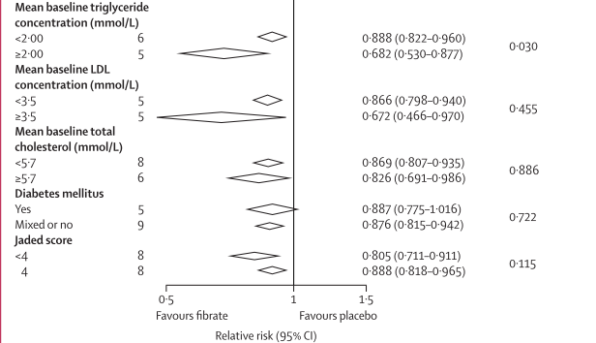
Subgroup analysis
Trials including individuals with high average baseline triglyceride concentrations reported signiﬁcantly greater proportional risk reductions

Slide 48
Conclusion
This large quantitative review, including more than 45 000 individuals with a broad range of baseline characteristics, suggests that therapy with ﬁbrates could reduce the risk of major cardiovascular events, mainly as a consequence of a favorable eﬀect on the risk of coronary events.

Slide 49
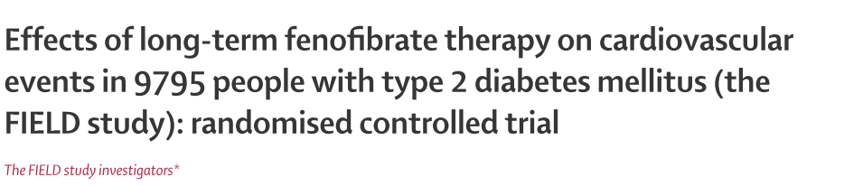
Sample size: 9795 Type 2 diabetic participants aged 50–75 years
Primary outcome: coronary events (coronary heart disease death or non-fatal myocardial infarction)
Prespeciﬁed subgroup analyses : total cardiovascular events (the composite of cardiovascular death, myocardial infarction, stroke, and coronary and carotid revascularisation)
Length of F/U: 5 years
Lipids to qualify for the study were: cholesterol 116–251 mg/dl, and chol/HDL>4.0 or TG 89–444 mg/dl.
Lancet 2005; 366: 1849–61

Slide 50
Lipid changes
 | TG | LDL | HDL | TOTAL-C
FENOFIBRATE | -23.5 | -24.7 | +1.1 | -31.1
PLACEBO | +11.9 | -18.1 | + 0.7 | -18.3

Slide 51
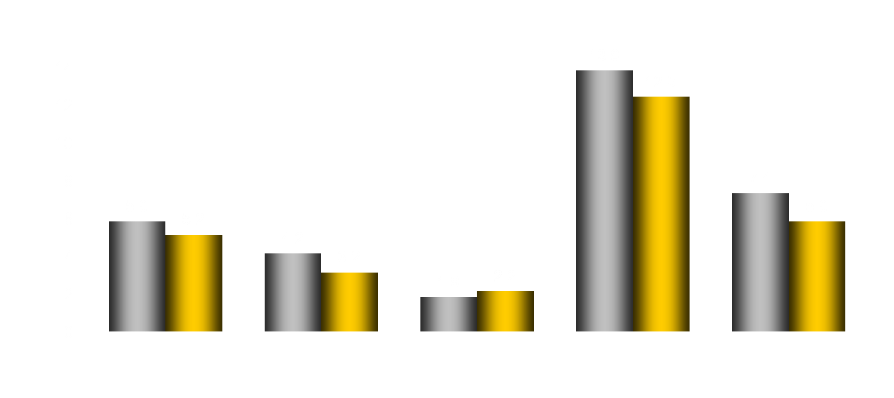
FIELD: Primary and
Secondary End Points
11% Reduction
P = .035
Placebo
Fenofibrate
21% Reduction
P = .003
11% Reduction
P = .16
24% Reduction
P = .01
Event Rate (%)
19% Increase
P = .22
CHD Events*
(Primary
End Point)
Nonfatal MI
CHD Death
Total CVD
Events†
(Secondary
End Point)
Coronary
Revascularization
*Nonfatal MI and CHD death. †CHD events, stroke, CVD death, revascularizations.
Keech A, et al. Lancet. 2005;366:1849-1861.
Notes:
FIELD: Primary and Secondary End Points.
Fenofibrate provided a nonsignificant 11% reduction in the incidence of the primary end point of CHD events (nonfatal MI and CHD death). A closer look at the individual components of the primary end point revealed that fenofibrate significantly reduced the incidence of nonfatal MI by 24% (P=.01) but had no significant effect on CHD death. Fenofibrate reduced the incidence of the secondary end point of total CVD events (CHD events, stroke, CVD death, and revascularizations) by 11% (P=.035). Fenofibrate reduced coronary revascularizations by 21% (P=.003).¹
Reference
1. Keech A, et al. Lancet. 2005;366:1849-1861.

Slide 52
Post hoc subgroup analysis in patients without CVD
CHD Events
Total CVD
(n = 7664)
(n = 7664)
0
-5
-10
Risk Reduction (%)
-15
-20
-19
P = .004
-25
Secondary End Point
-25
-30
P = .014
Primary End Point
Keech A, et al. Lancet. 2005;366:1849-1861.
Notes:
FIELD: End Points in Patients With No Prior CVD.
Fenofibrate treatment had a particularly beneficial effect in patients that had no prior CVD. In this primary prevention population (78% of the total population, n = 7664), fenofibrate reduced the incidence of the primary end point (CHD events) by 25% (P=.014) and the incidence of total CVD events by 19% (P=.004).¹
Reference
1. Keech A, et al. Lancet. 2005;366:1849-1861.

Slide 53
Key messages
Fenoﬁbrate did not signiﬁcantly reduce the risk of the primary outcome of coronary events. It did reduce total cardiovascular events, mainly due to fewer non-fatal myocardial infarctions and revascularisations.
The higher rate of starting statin therapy in patients allocated placebo might have masked a moderately larger treatment benefit.

Slide 54
Randomized, placebo-controlled, double-blind clinical trial conducted in 77 clinical sites in the U.S. and Canada
Sample size: 5518 patients with type 2 diabetes
Mean follow-up : 4.7 years.
N Engl J Med 2010; 362: 1563–74.

Slide 55
Baseline characteristics

Slide 56
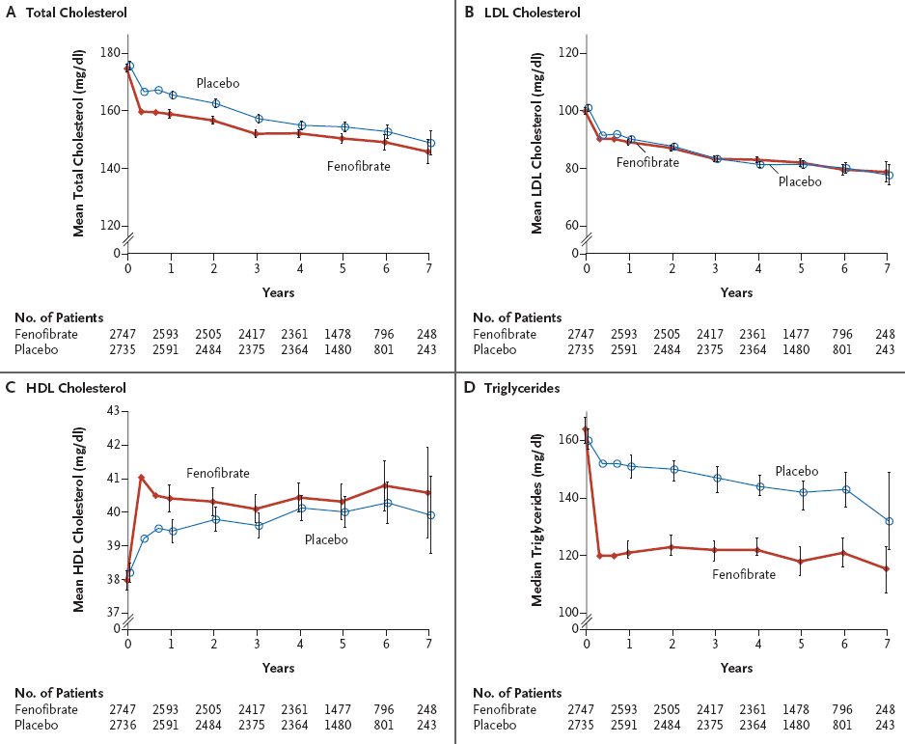
Lipid Values
Notes:
Lipid Values.
Shown are mean plasma levels of total cholesterol (Panel A), low-density lipoprotein (LDL) cholesterol (Panel B), and high-density lipoprotein (HDL) cholesterol (Panel C) and median levels of triglycerides (Panel D) at baseline, 4 months, 8 months, 1 year, and annually thereafter. Nominal P values for differences between the study groups at 4 months and at the end of the study were, respectively: total cholesterol, P<0.001 and P = 0.02; LDL cholesterol, P = 0.11 and P = 0.16; HDL cholesterol, P<0.001 and P=0.01; and triglycerides, P<0.001 for both comparisons with the use of nonparametric tests. End-of-study visits were those that occurred in early 2009 and included follow- up at years 4, 5, 6, and 7. The I bars represent 95% confidence intervals. To convert the values for cholesterol to millimoles per liter, multiply by 0.02586. To convert the values for triglycerides to millimoles per liter, multiply by 0.01129.

Slide 57
Primary outcome
Fenofibrate
Placebo
(N=2765)
(N=2753)
N of
Rate
N of
Rate
Events
(%/yr)
Events
(%/yr)
HR (95% CI)
P Value
Primary Outcome:
Major Fatal or Nonfatal
291
2.24
310
2.41
0.92
(0.79 - 1.08)
0.32
Cardiovascular Event

Slide 58
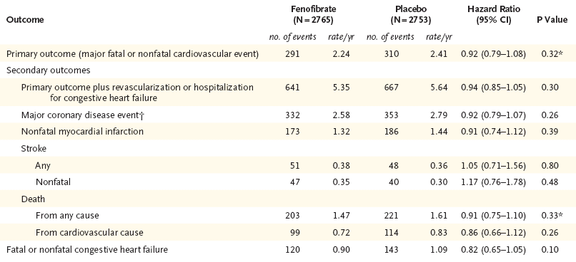
Prespecified Primary and Secondary Outcomes

Slide 59
Subgroup analysis

Slide 60
Subgroup analysis

Slide 61
Key message
ACCORD Lipid trial does not support use of the combination of fenofibrate and simvastatin, compared to simvastatin alone, to reduce CVD events in the majority of patients with T2DM who are at high risk for CVD.

Slide 62
Prescription Omega-3 Fatty Acid Product Information and Associated Trials

Slide 63
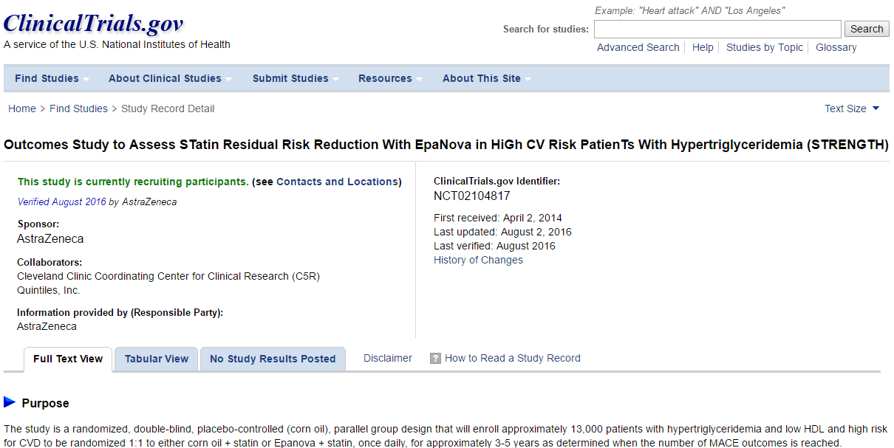

Slide 64
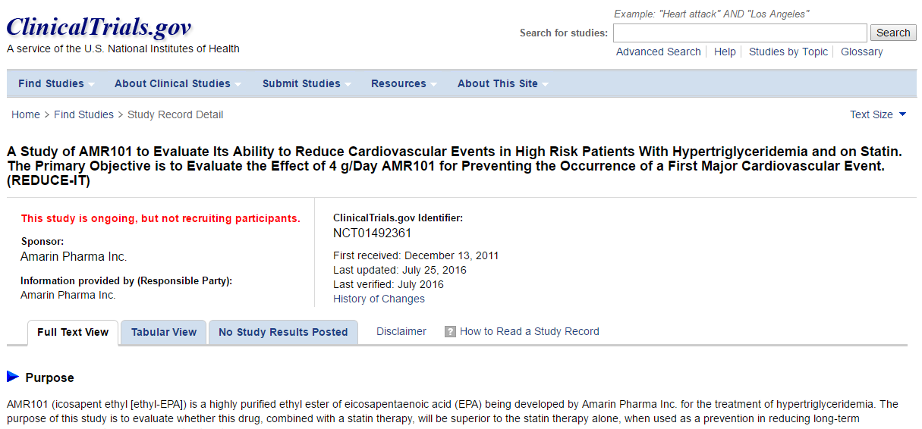

Slide 65
ATP III Classification of Hypertriglyceridemia
TG (mg/dL) |  | Primary concern
<150 | Normal
150–199 | Borderline high | Metabolic syndrome
200–499 | High | CHD risk
≥500 | Very high | Pancreatitis
Expert Panel on Detection, Evaluation, and Treatment of High Blood Cholesterol in Adults. JAMA 2001;285:2486-2497.
Notes:
ATP III Classification of Hypertriglyceridemia
The ATP III guidelines define normal TG levels as <150 mg/dL. The patient in this case has very high TG as categorized by the ATP III guidelines and is at risk for pancreatitis.
Reference:
Expert Panel on Detection, Evaluation, and Treatment of High Blood Cholesterol in Adults. Executive summary of the third report of the National Cholesterol Education Program (NCEP) Expert Panel on Detection, Evaluation, and Treatment of High Blood Cholesterol in Adults (Adult Treatment Panel III). JAMA 2001;285:2486-2497.

Slide 66
The NCEP Guidelines Identify TG as an Important Parameter for Lipid Management
Treatment Objectives for Elevated TGs
    Primary objective: TG reduction
    Secondary objective: LDL-C reduction and
    non-HDL-C reduction
    Primary objective: LDL-C reduction
    Secondary objective: non HDL-C reduction (VLDL and LDL)
TG ≥ 500
mg/dL
TG 200-499 mg/dL
Third Report of the National Cholesterol Education Panel (NCEP) on Detection, Evaluation, and Treatment of High Blood Cholesterol in Adults
(Adult Treatment Panel III) National Institutes of Health. September 2002.

Slide 67
Treating Beyond LDL-C:
Other Targets of Lipid-Lowering Therapy
Lipoprotein species other than LDL are involved in atherogenesis (ie, VLDL, IDL, HDL)¹
NCEP ATP III concluded on the basis of several types of data that an elevated non–HDL-C in patients with hypertriglyceridemia will impart increased risk even after the goal of LDL-C has been reached¹
NCEP ATP III 2004 update: “For those high risk patients who have elevated triglycerides or low HDL-C levels, addition of a fibrate or nicotinic acid to LDL-lowering therapy can be considered.^{”2}
¹Grundy SM. Circulation. 2002;106:2526-2529.
²Grundy SM, et al. Circulation. 2004;110:227-239.
Notes:
Treating Beyond LDL: Other Targets of Lipid-Lowering Therapy.
According to the National Cholesterol Education Program Adult Treatment Panel III (NCEP ATP III) guidelines, LDL-C is the primary therapeutic target for intervention.¹ However, elevated triglycerides and low HDL-C also contribute to atherogenesis increased CVD risk even after the LDL-C goals have been reached. For this reason, non–HDL-C is considered a secondary therapeutic target that should be addressed after achieving the LDL-C goal. This treatment approach may provide additional CHD risk reduction.² This quote from the 2004 update to the NCEP ATP III guidelines emphasizes the increased evidence base for the benefits of combination therapy compared with monotherapy.³
References
1. National Cholesterol Education Program. Adult Treatment Panel III. NIH Publication 02-2515, 2002.
2. Grundy SM. Circulation. 2002;106:2526-2529.
3. Grundy SM, et al. Circulation. 2004;110:227-239.

Slide 68
The 2013 ACC/AHA guidelines on the treatment of cholesterol to reduce atherosclerotic cardiovascular risk in adults provide no evidence-based recommendations for the evaluation or treatment of hypertriglyceridemia to reduce of CVD risk .
Circulation 2014;129(Suppl. 2):S1–S45

Slide 69
J Clin Endocrinol Metab 97: 2969–2989, 2012

Slide 71
ADA 2016
Triglyceride Lowering And HDL Raising in Type 2 Diabetes Mellitus

Slide 72
High TG , Low HDL
Low levels of HDL cholesterol, often associated with elevated triglyceride levels, are the most prevalent pattern of dyslipidemia in individuals with type 2 diabetes.
However, the evidence for the use of drugs that target these lipid fractions is substantially less robust than that for statin therapy

Slide 73
TG and pancreatitis

Slide 74
TG and CVD Reduction

Slide 75
Statin/niacin combination

Slide 76
Conclusion
Large and comprehensive epidemiological analysis show moderate independent association between TG and CHD
There are fewer well designed clinical trials with fibrates than statins
Fibrates can reduce the risk of major cardiovascular events, mainly as a consequence of a favorable effect on the risk of coronary events, especially in those without prior cardiovascular disease
In contrast to statins , fibrates do not seem to greatly affect all-cause mortality.
Recent data do not support routine use of combination therapy to reduce cardiovascular risk

