Slide 1


Slide 2
Recent Advances on Subclinical Hypercortisolism
Guido Zavatta, MD, Guido Di Dalmazi, MD*
Endocrinol Metab Clin N Am – 2018

Slide 3
Main Questions:
What is the definition of Subclinical Hypercortisolism(SH)?
How much is the prevalence of SH?
What about biochemical diagnostic tools and their cut offs?
How to distinguish between different types of adrenal masses and their functional status with radiologic diagnostic tools?
How is the outcome in SH patients?
the medical, conservative, and or surgical treatment are recommended?

Slide 4
Main Questions:
What is the definition of Subclinical Hypercortisolism(SH)?
How much is the prevalence of SH?
What about biochemical diagnostic tools and their cut offs?
How to distinguish between different types of adrenal masses and their functional status with radiologic diagnostic tools?
How is the outcome in SH patients?
the medical, conservative, and or surgical treatment are recommended?

Slide 5
INTRODUCTION
SH is a pathologic condition defined as biochemical evidence of hypercortisolism in patients without typical signs or symptoms of Cushing syndrome.

Slide 6
Main Questions:
What is the definition of Subclinical Hypercortisolism(SH)?
How much is the prevalence of SH?
What about biochemical diagnostic tools and their cut offs?
How to distinguish between different types of adrenal masses and their functional status with radiologic diagnostic tools?
How is the outcome in SH patients?
the medical, conservative, and or surgical treatment are recommended?

Slide 7
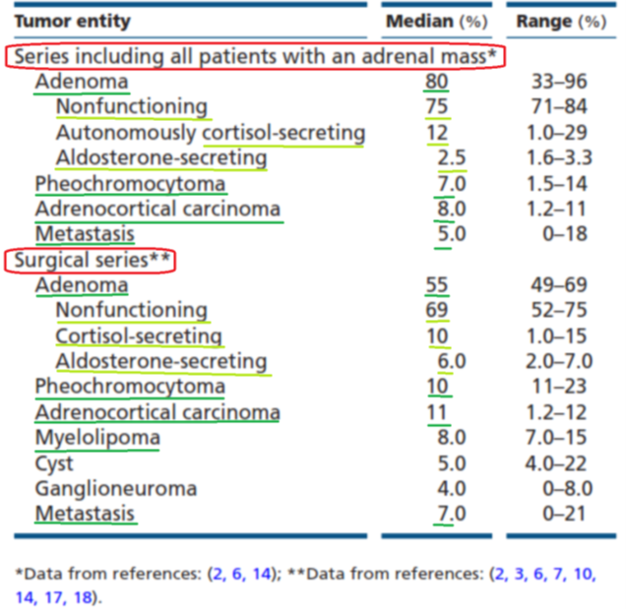
Management of adrenal incidentalomas: European Society of Endocrinology Clinical Practice Guideline in collaboration with the European Network for the Study of Adrenal Tumors
Martin Fassnacht1,2, Wiebke Arlt3,4, Irina Bancos3,4,5, Henning Dralle6,John Newell-Price7,8, Anju Sahdev9, Antoine Tabarin10, Massimo Terzolo11, Stylianos Tsagarakis12 and Olaf M Dekkers13,14
European Journal of Endocrinology(2016) 175, G1–G34

Slide 8
Even though most adrenal incidentalomas do not show biochemical evidence of hormonal excess, up to 30% of those tumors are associated with subclinical hypercortisolism (SH).
Recent Advances on Subclinical Hypercortisolism, Endocrinol Metab Clin N Am – 2018

Slide 9
Main Questions:
What is the definition of Subclinical Hypercortisolism(SH)?
How much is the prevalence of SH?
What about biochemical diagnostic tools and their cut offs?
How to distinguish between different types of adrenal masses and their functional status with radiologic diagnostic tools?
How is the outcome in SH patients?
the medical, conservative, and or surgical treatment are recommended?

Slide 10
First-line screening tests for Cushing’s syndrome in patients with adrenal incidentaloma: the role of urinary free cortisol measured by LC-MS/MS
F. Ceccato1 · G. Antonelli2 · A. C. Frigo3 · D. Regazzo1 · M. Plebani2 · M. Boscaro1 · C. Scaroni1
Italian Society of Endocrinology (SIE) 2017
164 consecutive patients with adrenal incidentaloma
Endocrinology unit of Padua University Hospital,
including 92 females and 72 males,
mean age of 63 ± 11 years;
34 patients (21%) had bilateral adenomas

Slide 11
Patients Excluded with:
Active malignancies
clear signs/symptoms of overt hypercortisolism
Primary aldosteronism and pheochromocytoma
ACTH-dependent CS
diagnosed SH in those patients with:
adrenal incidentaloma who did not suppress serum cortisol<138 nmol/L after DST, or
whose serum cortisol after DST was 50–138 nmol/L and presented at least another impaired test of HPA axis (ACTH levels <10 ng/L, high LNSC, or UFC levels)
First-line screening tests for Cushing’s syndrome, Italian Society of Endocrinology (SIE) 2017

Slide 12
First-line screening tests for Cushing’s syndrome, Italian Society of Endocrinology (SIE) 2017

Slide 13
LOW DHEAS: A SENSITIVE AND SPECIFIC TEST FOR THEDETECTION OF SUBCLINICAL HYPERCORTISOLISM IN ADRENAL INCIDENTALOMA
S.M Conall Dennedy, Anand K Annamalai, Olivia Prankerd-Smith, Natalie Freeman, Kuhan Vengopal, Johann Graggaber, Olympia Koulouri, Andrew S Powlson, Ashley Shaw, David J Halsall, Mark Gurnell
JCEM 2016
185 consecutive patients with adrenal incidentalomas
Cambridge University
between January2006 and April 2013 were reviewed.
All patients had undergone standardized clinical, biochemical and radiological assessments
retrospective analysis

Slide 14
LOW DHEAS, JCEM 2016

Slide 15
DHEAS levels are frequently reduced in patients with hypercortisolism.
A large retrospective study showed that DHEAS levels less than 40 µg/dL had a specificity of 75% and a sensitivity of 68% in identifying SH.
DHEAS offered comparable sensitivity and greater specificity to the 1-mg DST for the detection of SH.
Recent Advances on Subclinical Hypercortisolism, Endocrinol Metab Clin N Am – 2018

Slide 16
The role of salivary cortisol measured by liquid chromatography–tandem mass spectrometry in the diagnosis of subclinical hypercortisolism
S Palmieri, V Morelli, E Polledri, S Fustinoni, R Mercadante, L Olgiati, C Eller Vainicher, E Cairoli, V V Zhukouskaya, P Beck-Peccoz and I Chiodini
European Journal of Endocrinology (2013) 168 289–296
70 consecutive patients with adrenal incidentalomas (AI), diagnosed SH in the presence of at least two of the following:
cortisol after 1 mg DST>83 nmol/l
UFC >193 nmol/24 h
morning ACTH < 2.2 pmol/l
LNSalC levels and hypertension, type 2 diabetes mellitus (T2DM), and osteoporosis (OP) were assessed.

Slide 17
The role of salivary cortisol, European Journal of Endocrinology (2013)

Slide 18
Late-night salivary cortisol (LNSC) as a single hormonal parameter is not sufficient to make the diagnosis of SH.15,16
However, LNSC combined with cortisol after 1-mg DST greater than 1.8 mg/dL has 89% sensitivity and 85% specificity for detection of SH.
Recent Advances on Subclinical Hypercortisolism, Endocrinol Metab Clin N Am – 2018

Slide 19
the analysis of daily salivary cortisol rhythm measured by mass spectrometry showed that patients with 1-mg DST cortisol levels greater than 1.8 mg/dL had higher cortisol levels in the morning, and no significant impairment of cortisol circadian rhythm.18
Recent Advances on Subclinical Hypercortisolism, Endocrinol Metab Clin N Am – 2018

Slide 20
Additional tests for patients with abnormal DST include:
basal adrenocorticotropic hormone (ACTH) levels (helpful in diagnosing ACTH-independent hypercortisolism when suppressed <10 pg/mL).
ACTH in adrenal incidentalomas is sometimes detectable in patients with ACTH-independent Cushing syndrome.
ACTH immunoassays are vulnerable to interference of endogenous antibodies.
Recent Advances on Subclinical Hypercortisolism, Endocrinol Metab Clin N Am – 2018

Slide 21
Unlike overt Cushing syndrome, SH patients do not benefit much from urinary free cortisol (UFC) measurement,8 mainly because of the low sensitivity in detecting mild cortisol excess.
a recent study showed that high UFC levels measured by mass spectrometry might be a biomarker of cardiovascular risk in patients with SH.
Recent Advances on Subclinical Hypercortisolism, Endocrinol Metab Clin N Am – 2018

Slide 22
MASS SPECTROMETRY–BASED METABOLOMIC PROFILING IN SUBCLINICALHYPERCORTISOLISM
Adrenal tumors associated with SH have been found to cosecrete other steroids, defined as “minor” in the past.
A recent study by the authors' group analyzed a panel of 10 steroids in adrenal incidentalomas and controls, by means of liquid chromatography-tandem mass spectrometry (LC-MS/MS).
Recent Advances on Subclinical Hypercortisolism, Endocrinol Metab Clin N Am – 2018

Slide 23
Androgen reduction (DHEA, androstenedione, and testosterone) resulted as a marker of SH.
higher levels of corticosterone, 11-deoxycorticosterone, and 21-deoxycortisol were also found in SH than in nonsecreting adenomas, which may implicate these steroids with glucocorticoid and mineralocorticoid activity in the pathogenesis of cardiovascular diseases encountered in patients with SH.
Recent Advances on Subclinical Hypercortisolism, Endocrinol Metab Clin N Am – 2018

Slide 24
Main Questions:
What is the definition of Subclinical Hypercortisolism(SH)?
How much is the prevalence of SH?
What about biochemical diagnostic tools and their cut offs?
How to distinguish between different types of adrenal masses and their functional status with radiologic diagnostic tools?
How is the outcome in SH patients?
the medical, conservative, and or surgical treatment are recommended?

Slide 25
RADIOLOGICAL DIAGNOSIS
The size of a normal adrenal gland has been systematically defined in:
a cohort of 55 patients more than 20 years ago.
showed that the thick-ness of normal adrenal limbs was ≤ 5 mm.
the median width of right and left adrenal lateral limb in 105 patients was 4.0 mm and 4.6 mm, respectively.
the ESE guidelines suggest performing additional diagnostic workup only for lesions ≥1 cm.
unless there is clinical evidence of hormone excess.
Recent Advances on Subclinical Hypercortisolism, Endocrinol Metab Clin N Am – 2018

Slide 26
it may be challenging to distinguish those conditions by performing standard radiological imaging techniques.
A retrospective study by Park and colleagues analyzed CT densitometry and percentage washout in 424 histologically confirmed adrenal tumors.
a larger tumor size was suggestive of adenoma and
the presence of ≥ 3 nodules increased the likelihood of hyperplasia.
Recent Advances on Subclinical Hypercortisolism, Endocrinol Metab Clin N Am – 2018

Slide 27
In a multicentric study, Olsen and colleagues found that SH was positively associated with the size of adenoma and inversely correlated to unenhanced CT attenuation.
In contrast, a recent study showed that unenhanced CT attenuation was positively associated with cortisol hypersecretion.
Recent Advances on Subclinical Hypercortisolism, Endocrinol Metab Clin N Am – 2018

Slide 28
CT scan may be used to characterize the functional status of an adrenal tumor.
The authors’ group first presented a score calculated by using several radiological parameters to differentiate nonsecreting adrenal adenomas from those associated with SH.
The diagnostic accuracy in classifying patients with abnormal cortisol suppression to DST (>1.8 µg/dL) was 85%, with sensitivity and specificity of 81% and 87%, respectively.
Recent Advances on Subclinical Hypercortisolism, Endocrinol Metab Clin N Am – 2018

Slide 29
Can Imaging Predict Subclinical Cortisol Secretion in Patients with adrenal Adenomas? A CT Predictive Score
Mosconi C, et al.
AJR J Roentgenol. 2017
A retrospective study of 55 Pts with Adrenal Incidentalomas
CT with Adrenal protocol
Assessing diameters and attenuation values
On the unenhanced and contrast-enhanced phases
Cortisol after 1 mg DST >50 nmol/l identified SH
The formula of the radiologic score :
(0.1914*minimum diameter)+(0.0308*enhanced attenuation)

Slide 30
The ESE guidelines recommend that all patients should undergo a noncontrast Ctscan.
In those cases of lipid-rich adenomas (ie, homogeneous lesions with unenhanced CT attenuation ≤10 HU)
that are smaller than 4 cm,
no further imaging isrequired.
this recommendation has a very low quality of evidence .
Recent Advances on Subclinical Hypercortisolism, Endocrinol Metab Clin N Am – 2018

Slide 31
Main Questions:
What is the definition of Subclinical Hypercortisolism(SH)?
How much is the prevalence of SH?
What about biochemical diagnostic tools and their cut offs?
How to distinguish between different types of adrenal masses and their functional status with radiologic diagnostic tools?
How is the outcome in SH patients?
the medical, conservative, and or surgical treatment are recommended?

Slide 32
Cardiovascular events and mortality in patients with adrenal incidentalomas that are either non-secreting or associated with intermediate phenotype or subclinical Cushing’s syndrome: a 15-year retrospective study
Guido Di Dalmazi, Valentina Vicennati, Silvia Garelli, Elena Casadio, Eleonora Rinaldi, Emanuela Giampalma, Cristina Mosconi, Rita Golﬁeri, Alexandro Paccapelo, Uberto Pagotto, Renato Pasquali
Lancet Diabetes Endocrinol, 2014; 2: 396–405
From January, 1995, to September, 2010
198 outpatients with adrenal incidentalomas
Orsola-Malpighi Hospital, Bologna, Italy
Individuals were assessed every 18–30 months for the ﬁrst 5 years Cortisol concentrations after the 1 mg dexamethasone suppression test (DST) were used to deﬁne:
non-secreting (<50 nmol/L)
intermediate phenotype (50–138 nmol/L)
subclinical Cushing’s syndrome (>138 nmol/L).

Slide 33
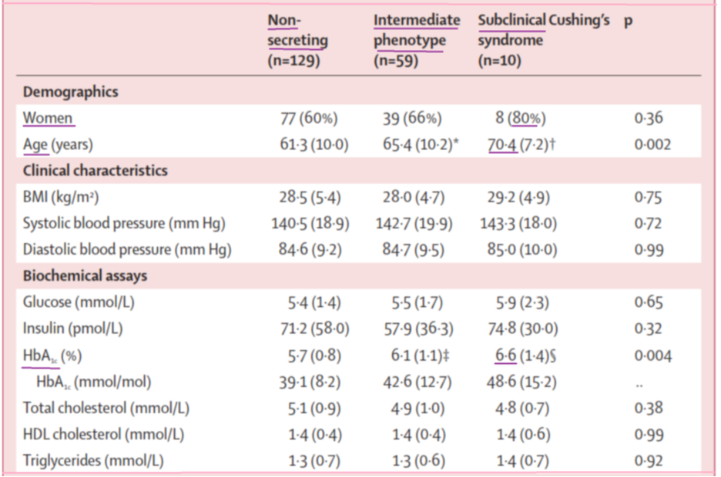
Cardiovascular events and mortality in patients with adrenal incidentalomas, Lancet Diabetes Endocrinol, 2014

Slide 34
Cardiovascular events and mortality in patients with adrenal incidentalomas, Lancet Diabetes Endocrinol, 2014

Slide 35
Cardiovascular events and mortality in patients with adrenal incidentalomas, Lancet Diabetes Endocrinol, 2014

Slide 36
Cardiovascular events and mortality in patients with adrenal incidentalomas, Lancet Diabetes Endocrinol, 2014

Slide 37
Patients with cortisol levels greater than 1.8 mg/dL are at increased risk for cardiovascular diseases.
Moreover, patients with SH had a lower survival, because of :
cardiovascular events and infectious complications.
Recent Advances on Subclinical Hypercortisolism, Endocrinol Metab Clin N Am – 2018

Slide 38
ESE experts’ panel recommended that:
cortisol levels after DST should be considered a continuous rather than a categorical variable, supporting the concept of a continuum of progression of hypercortisolism over time.
Recent Advances on Subclinical Hypercortisolism, Endocrinol Metab Clin N Am – 2018

Slide 39
The long-term retrospective data on the natural history of SH provide insights regarding what patients are at risk of developing cardiovascular diseases:
previous cardiovascular events
hypertension
increasing cortisol levels after 1-mg DST
the higher the cortisol after 1-mg DST, the higher the mortality of patients with SH.
SH should be considered a cardiovascular risk factor.
Recent Advances on Subclinical Hypercortisolism, Endocrinol Metab Clin N Am – 2018

Slide 40
in patients with cortisol suppression between 1.8 and 5 µg/dL, the presence of comorbidities related to hypercortisolism should be carefully considered. include:
diabetes mellitus
Hypertension
cardiovascular disease.
Recent Advances on Subclinical Hypercortisolism, Endocrinol Metab Clin N Am – 2018

Slide 41
Main Questions:
What is the definition of Subclinical Hypercortisolism(SH)?
How much is the prevalence of SH?
What about biochemical diagnostic tools and their cut offs?
How to distinguish between different types of adrenal masses and their functional status with radiologic diagnostic tools?
How is the outcome in SH patients?
the medical, conservative, and or surgical treatment are recommended?

Slide 42
TREATMENT OF SUBCLINICAL HYPERCORTISOLISM
The ESE guidelines suggest that adrenalectomy may be performed in patients with unilateral adenomas with lack of suppression to DST (cortisol >5 µg/dL) and at least 2 comorbidities potentially related to hypercortisolism.
no agreement has been reached for surgical indication in the remaining cases, and a personalized approach has been suggested.
the quality of evidence supporting adrenalectomy in SH was very low.
Recent Advances on Subclinical Hypercortisolism, Endocrinol Metab Clin N Am – 2018

Slide 43
a recent meta-analysis has shown an over-all improvement of cardiovascular risk factors, such as hypertension and diabetes mellitus, in surgically treated patients versus those undergoing conservative management.
To date, only one randomized controlled trial (RCT) has been performed, high- lighting normalization or improvement of diabetes and hypertension in 63% and 67% of the patients, respectively, in patients undergoing surgery.40
Recent Advances on Subclinical Hypercortisolism, Endocrinol Metab Clin N Am – 2018

Slide 44
Unilateral adrenalectomy has been proposed for patients with BMAH associated with SH to avoid life-long adrenal insufficiency induced by bilateral adrenalectomy.
when unilateral approach is preferred, difficulties come from the lateralization of the source of cortisol hypersecretion.
To this scope, adrenal scintigraphy with radiolabeled norcholesterol has been proposed as a promising technique.
Adrenal vein sampling has also been considered a useful alternative, this technique has not gained popularity so far because of the well-known technical difficulties.
Recent Advances on Subclinical Hypercortisolism, Endocrinol Metab Clin N Am – 2018

Slide 45
Adrenal steroidogenesis inhibitors:
ketoconazole
metyrapone
etomidate
for the treatment of overt hypercortisolism.
Osilodrostat (LCI699) is a potent and selective inhibitor of CYP11B2 and CYP11B1.
Considering the double action of this compound, it may be a promising treatment in patients with aldosterone and cortisol cosecretion.
Recent Advances on Subclinical Hypercortisolism, Endocrinol Metab Clin N Am – 2018

Slide 46
The glucocorticoid receptor antagonism mifepristone has been used in patients with overt Cushing syndrome and hyperglycemia and is currently under evaluation in patients with SH .
Recent Advances on Subclinical Hypercortisolism, Endocrinol Metab Clin N Am – 2018

Slide 47
KEY POINTS…
The most recent guidelines suggest the use of 1-mg dexamethasone suppression test in all patients with adrenal incidentalomas.
Mass spectrometry–based steroid profiling is useful in evaluation of subclinical hypercortisolism.
Adrenal protocol computed tomography scan provides morphologic information that may be predictive of cortisol hypersecretion.
Recent Advances on Subclinical Hypercortisolism, Endocrinol Metab Clin N Am – 2018

Slide 48
KEY POINTS…
Subclinical hypercortisolism is associated with increased incidence of cardiovascular diseases and increased mortality from cardiovascular events and infections.
Adrenalectomy in patients with subclinical hypercortisolism and unilateral adenomas has some beneficial effects on associated comorbidities, as shown by retrospective studies.
Recent Advances on Subclinical Hypercortisolism, Endocrinol Metab Clin N Am – 2018

Slide 49
Diagnostic testing for subclinical hypercortisolism
All patients with adrenal incidentalomas should undergo a 1-mg DST.
Cortisol suppression less than 1.8 µg/dL indicates a normal greater than 5 µg/dL define subclinical hypercortisolism.
between 1.8 and 5 µg/dL, additional tests include late-night salivary cortisol and DHEAS, whereas ACTH and UFC levels seem less helpful.
Reduced levels of adrenal androgens measured by mass spectrometry may be used as markers of SH.
Recent Advances on Subclinical Hypercortisolism, Endocrinol Metab Clin N Am – 2018

Slide 50
Radiological diagnosis of adrenal incidentalomas
Adrenal incidentaloma definition refers to lesions that are larger than 1 cm in diameter.
CT should be used as a first-line imaging technique.
The region of interest for measurement of CT attenuation should include at least 75% of the lesion and precontrast HU ≤ 10 in a homogeneous mass define a lipid-rich adenoma.
Tumors with precontrast HU >10 should undergo CT scan with delayed contrast washout at10 or 15 minutes to calculate absolute washout (AWO) and relative washout (RWO).
AWO greater than 60% and/or RWO greater than 40% suggest a benign adrenal mass.
Recent Advances on Subclinical Hypercortisolism, Endocrinol Metab Clin N Am – 2018

Slide 51
Thank You For Your Attention

