Slide 1
Management of hyperglycemia in type 2 diabetes
October 17,2022
Mahsa Abbaszadeh, MD
Research Institute for Endocrine Sciences, Shahid Beheshti University of Medical Sciences

Slide 4
Outline:
Principles of care:
Individualised and personalized approach
Diabetes self-management education and support (DSMES)
Healthy lifestyle behaviors
MNT, dietary quality and energy restriction, Physical activity, Sleep, psychological support, tobacco/substance abuse counselling
Glucose monitoring:
Regular blood glucose monitoring (BGM), Continuous glucose monitoring (CGM)
Weight reduction
Avoid complication

Slide 5
Outline:
Therapeutic options:
Pharmacotherapy for control of hyperglycemia
Weight management beyond lifestyle interventions
Cardiorenal protection

Slide 6
Comprehensive diabetes care
Blood Glucose levels
Weight
Cardiovascular risk factors
Comorbidities
Complications

Slide 7
Time in range
Time in range is defined as the percentage of time that CGM readings are in the range 70–180 mg/dl.
Useful variables for the evaluation of treatment regimens.
A goal parallel to an HbA1c level of <7% for many is:
time in range of >70%
time below range of <4%
time at <54 mg/dl of <1%.
Glycemic targets: standards of medical care in diabetes – 2022. Diabetes Care 45(Suppl 1):S83–S96.

Slide 8
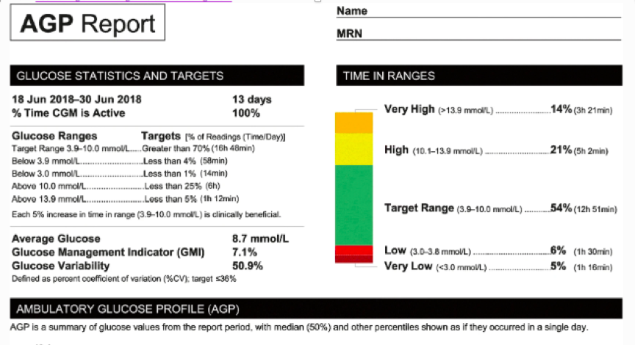

Slide 9
Sleep
The quantity of sleep is known to be associated in a ‘U’ shaped manner with health outcomes (e.g. obesity and HbA1c)
Both long (>8 h) and short (<6 h) sleep durations having negative impacts.
’Catch-up’ weekend sleep alone is not enough to reverse the impact of insufficient sleep
Sleep Med Rev 31:91–101

Slide 11
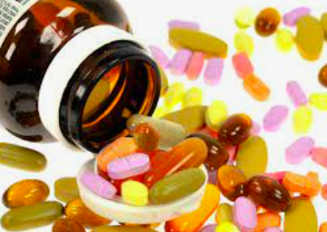
Medications for lowering glucose

Slide 12
Medications for lowering glucose
The profile of the person with diabetes
(younger age, life expectancy, cognitive impairment).
Risk factors for medication adverse events (hypoglycaemia, volume depletion, genital infections, history of pancreatitis).
Prioritise the use of organ-protective medications Cardiorenal disease or NASH.
(GLP-1 RA, SGLT2i, TZD)
Relevant comorbidities
(Obesity, CVD, HF, CKD, NAFLD).

Slide 13
Monotherapy or combination therapy:
Traditionally, a stepwise approach was advocated, in which a new agent is added to the existing regimen.
Evidence is growing to support a more proactive approach in many, by combining glucose-lowering agents from initial diagnosis.
Benefits of combination therapy:
Simultaneous targeting of the multiple pathophysiological processes
Increased durability of the glycaemic effect
Complementary clinical benefits (Tighter glucose control, weight and cardiovascular risk profiles)
Diabetologia 2020, 63(2): 221–228.

Slide 14
Consensus recommendations
Consider initial combination therapy with glucose-lowering agents, especially in those:
With high HbA1c at diagnosis (HbA1c levels >1.5% above their target at diagnosis (≥8.5% in most)).
In younger people with type 2 diabetes (regardless of HbA1c)
In whom a stepwise approach would delay access to agents that provide cardiorenal protection beyond their glucose-lowering effects.

Slide 16
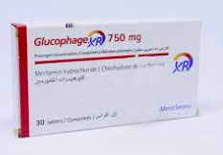
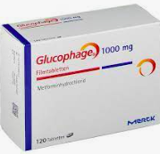
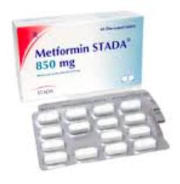
Metformin

Slide 17
Metformin
Metformin has traditionally been recommended as first-line glucose-lowering therapy for the management of type 2 diabetes.
There is ongoing acceptance that other approaches may be appropriate.
Efficacy | Hypoglycemia | Weight Change | Oral/SQ | Cost
High | No | Neutral (potential for modest loss) | Oral | Low

Slide 18
Metformin
The benefits of GLP-1 RA and SGLT2i for cardiovascular and renal outcomes have been found to be independent of metformin use.
These agents should be considered in people with established or high risk of CVD, HF or CKD, independent of metformin use.

Slide 19
ADA 2022

Slide 20
Crowley MJ, McGuire DK, Alexopoulos AS et al (2020) Effects of liraglutide on cardiovascular outcomes in type 2 diabetes patients with and without baseline metformin use: post hoc analyses of the LEADER trial. Diabetes Care 43(9):e108–e110.

Slide 21
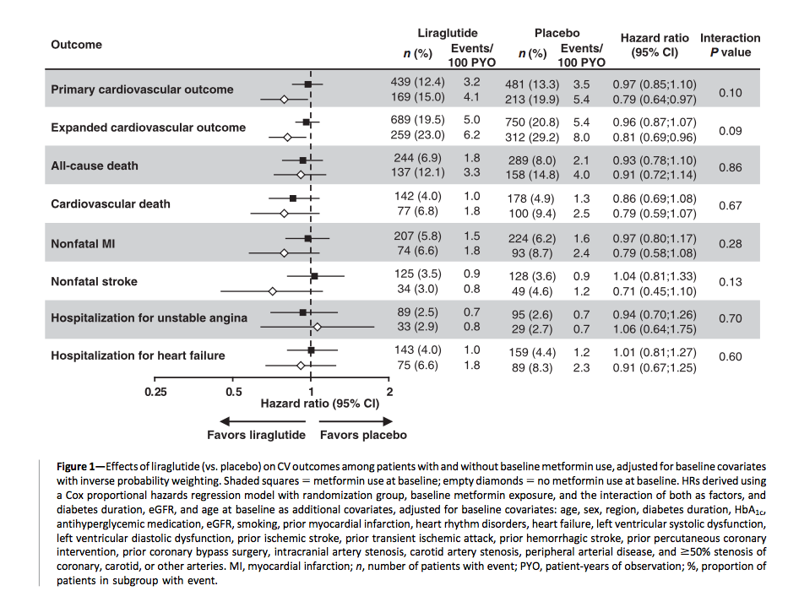

Slide 22
The effects of liraglutide appeared greater in the subgroup without baseline metformin treatment
our main analyses did not show statistically significant interactions between liraglutide treatment and metformin use.
These findings may indicate that the CV benefits of liraglutide do not rely upon prior metformin treatment.

Slide 23
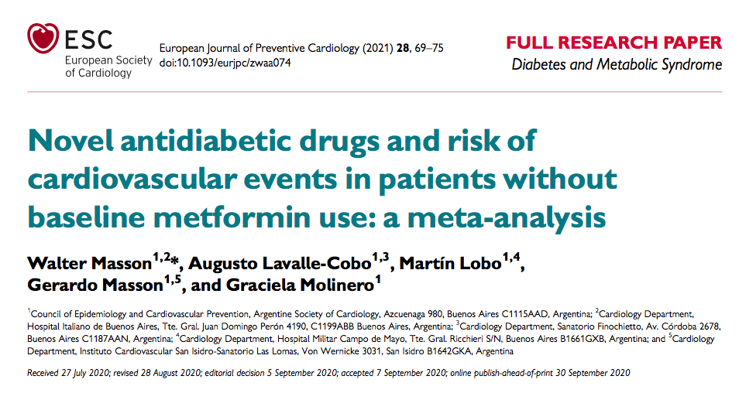

Slide 24
Six eligible trials (three studies of SGLT-2 inhibitors and three trials of GLP-1RAs)
including 13 049 patients
Endpoint:
The primary endpoint: MACE.
The secondary endpoint: cardiovascular death or hospitalization for heart failure.
Crowley MJ, McGuire DK, Alexopoulos AS et al (2020) Effects of liraglutide on cardiovascular outcomes in type 2 diabetes patients with and without baseline metformin use: post hoc anal- yses of the LEADER trial. Diabetes Care 43(9):e108–e110.

Slide 25
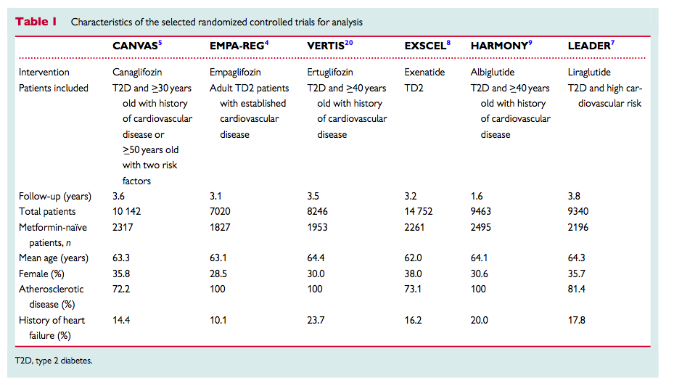

Slide 26
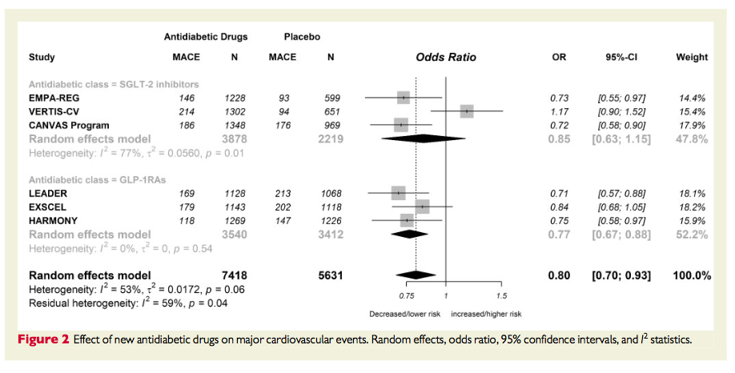
The new antidiabetic drugs were associated with a significant reduction in MACE [odds ratio (OR): 0.80, 95% confidence interval: 0.70–0.93; I²: 53%.

Slide 27
The new antidiabetic drugs were associated with a significant reduction in MACE [odds ratio (OR): 0.80, 95% confidence interval: 0.70–0.93; I2: 53%].
The subgroup analysis showed the following findings:
GLP-1RAs group, OR: 0.77 (95% confidence interval 0.67–0.88);
SGLT-2 inhibitors, OR: 0.85 (95% confidence interval 0.63–1.15).

Slide 28
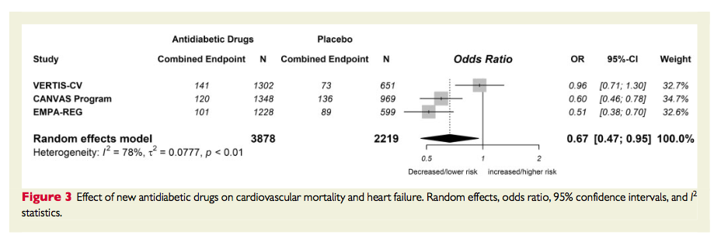
SGLT-2 inhibitors were associated with a significant reduction in hospitalization for heart failure or cardiovascular mortality incidence (OR: 0.67, 95% confidence interval: 0.47–0.95; I2: 78%).

Slide 29
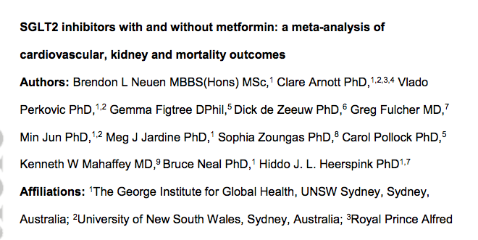
Neuen BL, Arnott C, Perkovic V et al (2021) Sodium-glucose co- transporter-2 inhibitors with and without metformin: a meta- analysis of cardiovascular, kidney and mortality outcomes. Diabetes Obes Metab 23(2):382–390.

Slide 30
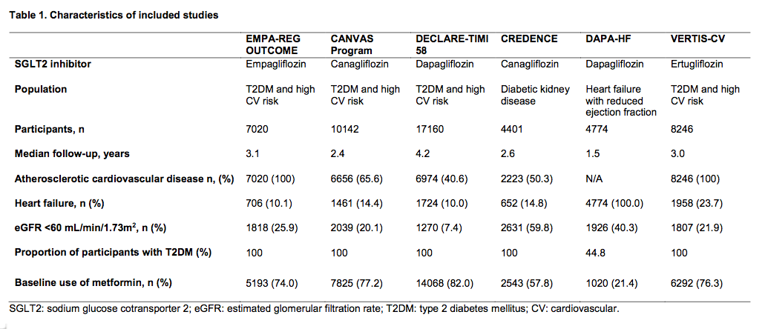

Slide 31
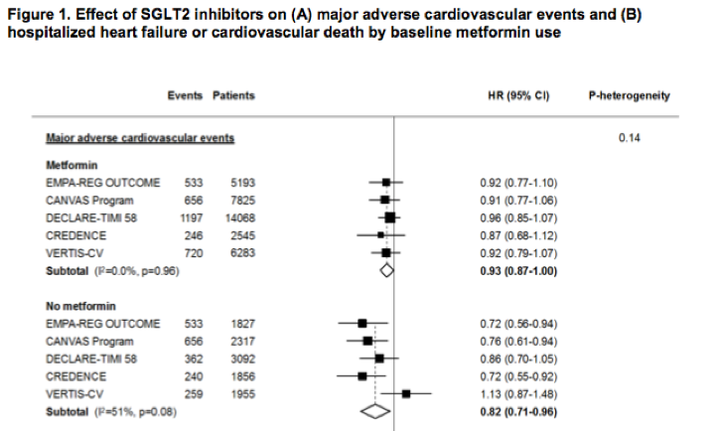

Slide 32
Side effects
Gl side effects
Common
to mitigate Gl side effects, consider
Slow dose titration,
Extended release formulations
Administration with food
Potential for vitamin B12 deficiency; monitor at regular intervals
..

Slide 33
Cardiorenal-protective glucose-lowering medications
Sodium–glucose cotransporter-2 inhibitors
Glucagon-like peptide-1 receptor agonists
..

Slide 34
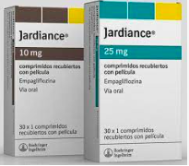
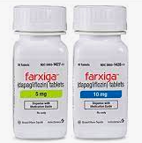
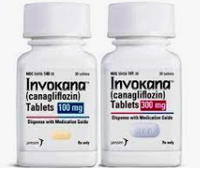
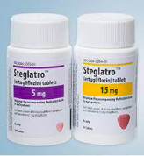
SGLT2 inhibitors
Empagliflozin Dapagliflozin Canagliflozin Ertugliflozin
..

Slide 35
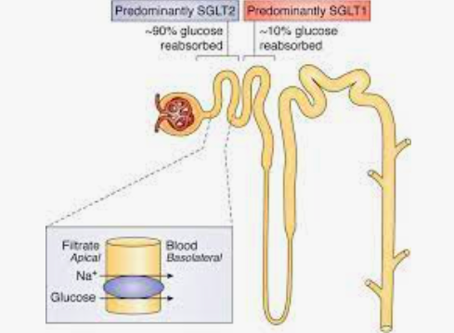
SGLT2 inhibitors
Mechanism: Reduce plasma glucose by enhancing urinary excretion of glucose.
Efficacy | Hypoglycemia | Weight Change | Oral/SQ | Cost
Intermediate to high | No | Loss (intermediate) | Oral | High

Slide 36
Cardiorenal protection
Cardiorenal outcomes trials have demonstrated their efficacy in:
reducing the risk of
Composite major adverse cardiovascular events (MACE),
Cardiovascular death,
Myocardial infarction,
Hospitalization for heart failure (HHF)
All-cause mortality
improving renal outcomes in individuals with type 2 diabetes with an established/high risk of CVD.
(2021) Association of SGLT2 inhibitors with cardiovascular and kidney outcomes in patients with type 2 diabetes: a meta-analysis. JAMA Cardiol 6(2):148–158.

Slide 38
CREDENCE
The Canagliflozin and Renal Endpoints in Diabetes with Established Nephropathy Clinical Evaluation (CREDENCE)
Included adults with type 2 diabetes with an eGFR from 30-90 ml/min/1.73m² and albuminuria (300–5000 mg/g creatinine)
Canagliflozin treatment significantly reduced:
the risk of a composite primary outcome of progression to renal replacement therapy,
eGFR of <15 ml/min per 1.73 m2,
A doubling of serum creatinine level
death from cardiovascular or kidney causes.
Perkovic V, Jardine MJ, Neal B et al (2019) Canagliflozin and renal outcomes in type 2 diabetes and nephropathy. N Engl J Med 380:2295–2306.

Slide 39
DAPA- CKD
The Dapagliflozin And Prevention of Adverse outcomes in Chronic Kidney Disease (DAPA- CKD)
Participants with (68%) and without type 2 diabetes with an eGFR of 25–75 ml/min /1.73 m2 and a UACR of 200–5000 mg/g
A clear benefit of dapagliflozin on
a composite kidney outcome,
on individual kidney-specific outcomes
on cardiovascular death or HHF,
[153]. ..

Slide 40
VERTIS CV
Evaluation of Ertugliflozin Efficacy and Safety CVOT (VERTIS CV)
Exclusively people with established CVD and type 2 diabetes
Ertugliflozin was similar to placebo:
with respect to the primary MACE outcome
all key secondary outcomes (including a composite kidney outcome)
except for HHF.
Cannon CP, Pratley R, Dagogo-Jack S et al (2020) Cardiovascular outcomes with ertugliflozin in type 2 diabetes. N Engl J Med 383(15):1425–1435.

Slide 41
SGLT2 inh
CV effects |  | Renal effects
Effect on MACE | HF | Progression of DKD | Dosing/ Dose consideration
Benefit: Canagliflozin, Empagliflozin | Benefit: Canagliflozin, Dapagliflozin, Empagliflozin, Ertugliflozin | Benefit: Canagliflozin, Dapagliflozin, Empagliflozin, | See labels for renal dose considerations Glucose-lowering effect is lower for SGLT2 inhibitors at lower eGFR

Slide 42
Safety
Recent data have increased confidence in the safety of the SGLT2i drug class.
Early studies brought attention to several safety areas of interest
Acute kidney injury, Dehydration, Orthostatic hypotension
Amputation, Fractures
longer-term studies prospectively assessed and monitored these events have not seen a significant imbalance in risks.
JAMA Cardiol 6(2):148–158
Osteoporos Int 31(12):2313–2320.

Slide 43
SGLT2 inhibitors Safety
Increased risk for mycotic genital infections: typically mild and treatable.
Increase the risk of diabetic ketoacidosis (DKA):
the incidence is low (DKA rates of 0.1–0.6% compared with rates of <0.1–0.3% with placebo)
Risk can be mitigated with education and guidance, discontinuation of the medication:
preoperatively, i.e. 3-4 days prior to surgery
during critical illness
during prolonged fasting
N Engl J Med 380(4):347–357. (2019)

Slide 44
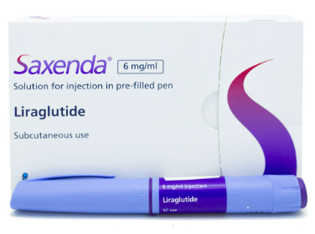
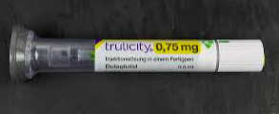
GLP1 RA
Liraglutide Semaglutide Dulaglutide Exenatide

Slide 45
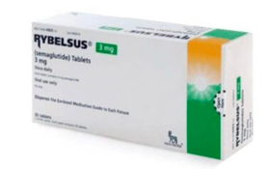
Dosage Forms: US
Solution Auto-injector, Wegovy, Subcutaneous:
0.25 mg (0.5 mL), 0.5 mg (0.5 mL), 1 mg (0.5 mL); 1.7 mg (0.75 mL); 2.4 mg (0.75 mL)
Solution Pen-injector, Ozempic, Subcutaneous:
0.25 mg or 0.5 mg per dose [2 mg/1.5 mL]
1 mg per dose [2 mg/1.5 mL] , 1 mg per dose [4 mg/3 mL]
Tablet, Oral, Rybelsus: 3 mg, 7 mg, 14 mg

Slide 46
GLP1 RA
Efficacy | Hypoglycemia | Weight Change | Oral/SQ | Cost
High to very high | No | Loss (intermediate to very high) | SQ, Oral | High
Mechanism:
Augment glucose-dependent insulin secretion
Glucagon suppression
Decelerate gastric emptying
Reduce appetite, energy intake and body weight.

Slide 47
Benefits:
Improving HbA1c
Reducing risk of MACE in adults with type 2 diabetes with established CVD
Chronic weight management (subcutaneous liraglutide titrated to 3.0 mg once daily; subcutaneous semaglutide titrated to 2.4 mg once weekly).
Renal: driven by albuminuria outcomes
NASH?
The recent higher dose GLP-1 RA studies have indicated incremental benefits for glucose and weight at higher doses of GLP-1 RA.
Diabetes Care 44(3): 765–773.

Slide 48
Semaglutide STEP2
People with Obesity and diabetes (STEP2 trial)
More than two thirds of participants in the semaglutide 2.4 mg arm achieved an HbA1c level of ≤6.5%.
weight loss:
Semaglutide 2.4 mg once a week: 9.6%
Semaglutide 1.0 mg: 6.9%
Placebo: 3.4%
Wilding JPH, Batterham RL, Calanna S et al (2021) Once-weekly semaglutide in adults with overweight or obesity. N Engl J Med 384(11):989–1002

Slide 49
GLP1 RA
CV effects |  | Renal effects
Effect on MACE | HF | Progression of DKD | Dosing/ Dose consideration
Benefit: Liraglutide, dulaglutide Semaglutide (SQ) Neutral: Exenitide, Lixisenatide | Neutral | Benefit for renal endpoints in CVOTs driven by albuminuria outcomes: Liraglutide, dulaglutide Semaglutide (SQ) | See labels for renal dose considerations No dose adjustment for dulaglutide, liraglutide, semaglutide Monitor renal function when initiating or escalating doses in patients with renal impairment reporting severe adverse Gl reactions

Slide 50
Side effects:
Gastrointestinal:
Nausea, vomiting and diarrhea
distinguish between nausea and satiety
Tend to occur during initiation and dose escalation and diminish over time.
Gradual up-titration is recommended
Pancreatitis, pancreatic cancer:
Data from CVOTs indicate that there is no increase in these risks with GLP-1 RA.
Pancreatitis has been reported in clinical trials but causality has not been established.
Discontinue if pancreatitis is suspected.
Postgrad Med 134(1):14– 19.
Lancet Diabetes Endocrinol 9(9):563–574

Slide 51
Side effects:
Medullary thyroid cancer:
Data from CVOTs indicate that there is no increase in these risks with GLP-1 RA.
Seen in rodents in preclinical studies.
GLP-1 RA are contraindicated in people at risk of the rare medullary thyroid cancer.
Increased retinopathy complications
seen in the SUSTAIN 6 CVOT
appear attributable to the rapidity of HbA1c reductions in individuals with preexisting diabetic retinopathy and high glycaemic levels
Associated with higher risks of gallbladder and biliary diseases.
Mol Metab 46:101102.
Diabetes Care 44(1):290– 296.

Slide 52
Comparative effectiveness data
A large population-based cohort study in the USA,
showed that:
SGLT2i reduced HHF compared with GLP-1 RA in people both with CVD (HR 0.71; 95% CI 0.64, 0.79) and without CVD (HR 0.69; 95% CI 0.56, 0.81).
Differences between the two drug classes with regard to mortality rates and other cardiovascular outcomes were not clinically important.
Patorno E, Htoo PT, Glynn RJ et al (2021) Sodium-Glucose Cotransporter-2 Inhibitors Versus Glucagon-like Peptide-1 Receptor Agonists and the Risk for Cardiovascular Outcomes in Routine Care Patients With Diabetes Across Categories of Cardiovascular Disease. Ann Intern Med 174(11):1528–1541. .

Slide 53
Pooled analysis of SUSTAIN 6 and LEADER
Regarding GLP-1 RA, a metaanalysis of relevant CVOTs demonstrated the favourable effect of GLP-1 RA vs placebo on MACE and its individual components including stroke, HHF and a composite kidney outcome including severe albuminuria.
the overall effect estimate for the composite kidney outcome was most likely driven by the effect of GLP-1 RA on severe albuminuria only and not on hard kidney endpoints.
Shaman AM, Bain SC, Bakris GL et al (2022) Effect of the glucagon-like peptide-1 receptor agonists semaglutide and liraglutide on kidney outcomes in patients with type 2 diabetes: pooled analysis of SUSTAIN 6 and LEADER. Circulation 145(8):575– 585

Slide 54
Comparative effectiveness data
The comparative effectiveness of the two drug classes has been assessed in three recent network meta-analyses
Found that:
in people with type 2 diabetes, SGLT2i were superior to GLP-1 RA in reducing HHF and a composite kidney outcome,
GLP-1 RA seemed more efficacious in reducing the risk of stroke.
No important differences between the two drug classes were evident in terms of mortality rates and other cardiovascular outcomes.
BMJ 372:m4573. , Lancet Diabetes Endocrinol 9(10): 653–662. , Diabetologia 64(12):2676–2686.

Slide 55
Conclusion:
In people with established CVD or with a high risk for CVD, GLP-1 RA were prioritised over SGLT2i.
GLP-1 RA reduced all three outcomes of MACE, with a more pronounced effect on stroke followed by cardiovascular death and myocardial infarction .
SGLT2i, albeit reducing cardiovascular death, had a neutral effect on stroke.
Given their favourable drug class effect in reducing HHF and progression of CKD, SGLT2i were prioritised in people with HF, particularly those with a reduced ejection fraction, or CKD.
Lancet Diabetes Endocrinol 9(10): 653–662.

Slide 56
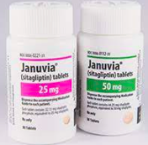
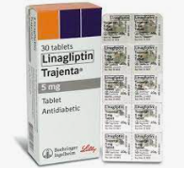
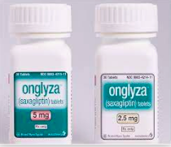
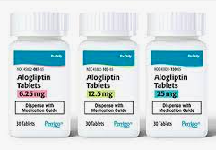
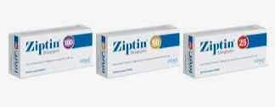
Dipeptidyl peptidase-4 inhibitors
Sitagliptin Linagliptin Saxagliptin Alogliptin
..

Slide 57
DPP4 inh
Efficacy | Hypoglycemia | Weight Change | Oral/SQ | Cost
Intermediate | No | Neutral | Oral | High
Inhibit the enzymatic inactivation of endogenous incretin hormones,
Resulting in glucose-dependent insulin release
A decrease in glucagon secretion.

Slide 58
Dipeptidyl peptidase-4 inhibitors
CVOTs have demonstrated the cardiovascular safety without cardiovascular risk reduction of four DPP-4i (saxagliptin, alogliptin, sitagliptin and linagliptin).
Reductions in risk of albuminuria progression were noted with linagliptin in the Cardiovascular and Renal Microvascular Outcome Study With Linagliptin (CARMELINA) trial.
Perkovic V, Toto R, Cooper ME et al (2020) Effects of linagliptin on cardiovascular and kidney outcomes in people with normal and reduced kidney function: secondary analysis of the CARMELINA randomized trial. Diabetes Care 43(8):1803–1812

Slide 59
DPP4 inh
CV effects |  | Renal effects
Effect on MACE | HF | Progression of DKD | Dosing/ Dose consideration
Neutral | Neutral (potential risk: Saxagliptin) | Neutral | Can be used in renal impairement No dose adjustment: Linagliptin Renal dose adjustment required: Others

Slide 60
Side effects
Pancreatitis has been reported in clinical trials but causality has not been established. Discontinue if pancreatitis is suspected
Bullous pemphigoid (postmarketing): discontinue if suspected
there have been rare reports of arthralgia and hypersensitivity reactions with the DPP-4i class.
..

Slide 61
Glucose-dependent insulinotropic polypeptide and glucagon-like peptide-1 receptor agonist
Efficacy | Hypoglycemia | Weight Change | Oral/SQ | Cost
very high | No | Loss (very high) | SQ | High

Slide 62
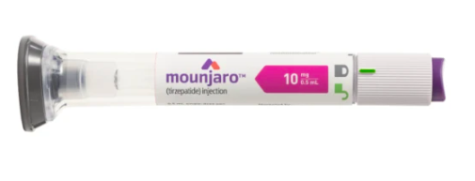
Tirzepatide
Dual GLP-1 / GIP (Glucose-dependent insulinotropic polypeptide) RA
Glycemic control: Tirzepatide was FDA-approved for the treatment of type 2 diabetes in May 2022 and is now commercially available for that use.
Weight reductions: Currently, tirzepatide is not FDA-approved as an anti-obesity medication for the treatment of obesity.
NASH: Improvements in liver fat content, Reduced visceral and subcutaneous abdominal adipose tissue volume
Endocrine Practice 28 (2022) 528e562

Slide 63
Glycemic control
For HbA1c, placebo-adjusted reductions of 1.91%, 1.93% and 2.11% were demonstrated with tirzepatide 5, 10 and 15 mg weekly.
In the Phase III clinical trial programme, tirzepatide demonstrated superior glycaemic efficacy to placebo, subcutaneous semaglutide 1.0 mg weekly, insulin degludec and insulin glargine.
Lancet 398(10295):143–155, JAMA 327(6):534–545. , N Engl J Med 385(6):503–515., Lancet 398(10300):583–598. , Lancet 398(10313):1811–1824.

Slide 64
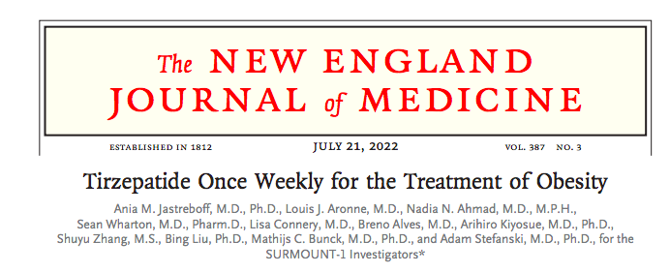
Phase 3 double-blind, RCT, 2539 adults
BMI of 30 or more, or 27 or more and at least one weight-related complication
Once-weekly, subcutaneous tirzepatide (5 mg, 10 mg, or 15 mg) or placebo
For 72 weeks
n engl j med 387;3 nejm.org July 21, 2022.

Slide 65
−20.9% (95% CI, −21.8 to −19.9) with 15-mg doses
n engl j med 387;3 nejm.org July 21, 2022.

Slide 66
Side effects
Gastrointestinal, most were mild to moderate in severity,
Occurring primarily during dose escalation.
Adverse events caused treatment discontinuation in 4.3%, 7.1%, 6.2%, and 2.6% of participants receiving 5-mg, 10-mg, and 15-mg tirzepatide doses and placebo, respectively.
New engl j med 387;3 nejm.org July 21, 2022.

Slide 67
Side effects
Risk of thyroid C-cell tumours in rodents; human relevance not determined
Pancreatitis has been reported in clinical trials but causality has not been established. Discontinue if pancreatitis is suspected
Gallbladder disease
..

Slide 68
GIP and GLP1 RA
CV effects |  | Renal effects
Effect on MACE | HF | Progression of DKD | Dosing/ Dose consideration
Under investigation | Under investigation | Under investigation | See label for renal dose considerations No dose adjustment Monitor renal function when initiating or escalating doses in patients with renal impairment reporting severe adverse Gl reactions

Slide 69
Sulfonylurea
Efficacy | Hypoglycemia | Weight Change | Oral/SQ | Cost
High | Yes | Gain | Oral | Low
CV effects |  | Renal effects
Effect on MACE | HF | Progression of DKD | Dosing/ Dose consideration
Neutral | Neutral | Neutral | Glyburide: generally not recommendet in chronic kidney disease Glipizide and glimepiride: initiate conservatively to avoid hypoglycaemia

Slide 70
TZDs increase insulin sensitivity
Efficacy | Hypoglycemia | Weight Change | Oral/SQ | Cost
High | No | Gain | Oral | Low
CV effects |  | Renal effects
Effect on MACE | HF | Progression of DKD | Dosing/ Dose consideration
Potential Benefit: Pioglitazone | Increased risk | Neutral | No dose adjustment required Generally not recommended in renal impairment due to potential for fluid retention

Slide 71
Insulin
Efficacy | Hypoglycemia | Weight Change | Oral/SQ | Cost
High to very high | Yes | Gain | SQ, inhaled | Low/ High
CV effects |  | Renal effects
Effect on MACE | HF | Progression of DKD | Dosing/ Dose consideration
Neutral | Neutral | Neutral | Lower insulin doses required with a decrease in eGFR; titrate per clinical response

Slide 72
Less commonly used medications
Alpha- glucosidase inhibitors ,
Meglitinides,
Colesevelam,
Quick-release bromocriptine
Pramlintide
Are not commonly used in the USA and most are not licensed in Europe
..

Slide 73
Comparative efficacy of glucose-lowering agents
..

Slide 74
 | Efficacy | Hypoglycemia | Weight Change | Oral/SQ | Cost
Metformin | High | No | Neutral (potential for modest loss) | Oral | Low
SGLT2 inh | Intermediate to high | No | Loss (intermediate) | Oral | High
GLP1 RA | High to very high | No | Loss (intermediate to very high) | SQ, Oral | High
GIP and GLP1 RA | very high | No | Loss (very high) | SQ | High
DPP4 inh | Intermediate | No | Neutral | Oral | High
TZDs | High | No | Gain | Oral | Low
Sulfonylurea | High | Yes | Gain | Oral | Low
insulin | High to very high | Yes | Gain | SQ, inhaled | Low/ High

Slide 75
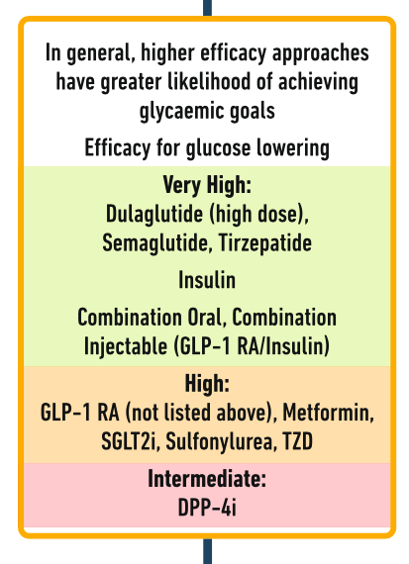
 | Efficacy
Metformin | High
SGLT2 inh | Intermediate to high
GLP1 RA | High to very high
GIP and GLP1 RA | Very high
DPP4 inh | Intermediate
TZDs | High
Sulfonylurea | High
insulin | High to very high

Slide 76
 | Efficacy | Hypoglycemia | Weight Change | Oral/SQ | Cost
Metformin | High | No | Neutral (potential for modest loss) | Oral | Low
SGLT2 inh | Intermediate to high | No | Loss (intermediate) | Oral | High
GLP1 RA | High to very high | No | Loss (intermediate to very high) | SQ, Oral | High
GIP and GLP1 RA | very high | No | Loss (very high) | SQ | High
DPP4 inh | Intermediate | No | Neutral | Oral | High
TZDs | High | No | Gain | Oral | Low
Sulfonylurea | High | Yes | Gain | Oral | Low
insulin | High to very high | Yes | Gain | SQ, inhaled | Low/ High

Slide 77
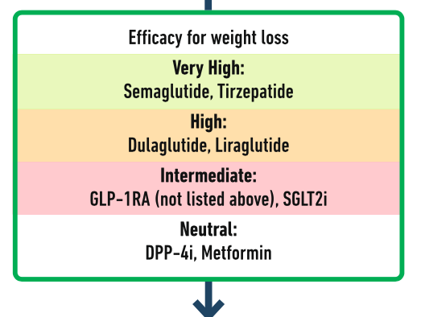
 | Weight Change
Metformin | Neutral (potential for modest loss)
SGLT2 inh | Loss (intermediate)
GLP1 RA | Loss (intermediate to very high)
GIP and GLP1 RA | Loss (very high)
DPP4 inh | Neutral
TZDs | Gain
Sulfonylurea | Gain
insulin | Gain

Slide 78
Personalized approach

Slide 79
..

Slide 82
 | CV effects |  | Renal effects
 | Effect on MACE | HF | Progression of DKD | Dosing/ Dose consideration
Metformin | Potential Benefit | Neutral | Neutral | eGFR≧30 ml/min/1.73 m²
SGLT2 inh | Benefit: Canagliflozin, Empagliflozin | Benefit: Canagliflozin, Empagliflozin, dapagliflozin, ertugliflozin | Benefit: Canagliflozin, Empagliflozin, dapagliflozin | See labels for renal dose considerations Glucose-lowering effect is lower for SGLT2 inhibitors at lower eGFR
GLP1 RA | Benefit: Liraglutide, dulaglutide Semaglutide (SQ) | Neutral | Benefit for renal endpoints in CVOTs driven by albuminuria outcomes: Liraglutide, dulaglutide Semaglutide (SQ) | No dose adjustment
GIP and GLP1 RA | Under investigation | Under investigation | Under investigation | No dose adjustment
DPP4 inh | Neutral | Neutral (potential risk: Saxagliptin) | Neutral | No dose adjustment: Linagliptin Renal dose adjustment required: Others
TZDs | Potential Benefit: Pioglitazone | Increased risk | Neutral | No dose adjustment Generally not recommended
Sulfonylurea | Neutral | Neutral | Neutral | Glyburide: Generally not recommended
insulin | Neutral | Neutral | Neutral | Lower ins doses required with a decrease in eGFR

Slide 83
 | Effect on MACE
Metformin | Potential Benefit
SGLT2 inh | Benefit: Canagliflozin, Empagliflozin
GLP1 RA | Benefit: Liraglutide, dulaglutide Semaglutide (SQ)
GIP and GLP1 RA | Under investigation
DPP4 inh | Neutral
TZDs | Potential Benefit: Pioglitazone
Sulfonylurea | Neutral
insulin | Neutral

Slide 84
Consensus recommendations
In individuals without established CVD but with multiple cardiovascular risk factors (such as age ≥55 years, obesity, hypertension, smoking, dyslipidaemia or albuminuria):
A GLP-1 RA with proven benefit could be used to reduce MACE,
Or an SGLT2i with proven benefit could be used to reduce MACE and HF and improve kidney outcomes.
..

Slide 85
 | HF
Metformin | Neutral
SGLT2 inh | Benefit: Canagliflozin, Empagliflozin, dapagliflozin, ertugliflozin
GLP1 RA | Neutral
GIP and GLP1 RA | Under investigation
DPP4 inh | Neutral (potential risk: Saxagliptin)
TZDs | Increased risk
Sulfonylurea | Neutral
insulin | Neutral

Slide 86
Consensus recommendations
In people with HF, SGLT2i should be used because they improve HF and kidney outcomes.
..

Slide 87
 | Renal effects
 | Progression of DKD | Dosing/ Dose consideration
Metformin | Neutral | eGFR≧30 ml/min/1.73 m²
SGLT2 inh | Benefit: Canagliflozin, Empagliflozin, dapagliflozin | Empagliflozin eGFR≧30 ml/min/1.73 m² (glycemic control) eGFR≧20 ml/min/1.73 m² ( HF, DKD)
GLP1 RA | Benefit for renal endpoints in CVOTs driven by albuminuria outcomes: Liraglutide, dulaglutide Semaglutide (SQ) | No dose adjustment t for dulaglutide, liraglutide, semaglutide Eenitide, lixisenatide
GIP and GLP1 RA | Under investigation | No dose adjustment
DPP4 inh | Neutral | No dose adjustment: Linagliptin Renal dose adjustment required: Others
TZDs | Neutral | No dose adjustment Generally not recommended
Sulfonylurea | Neutral | Glyburide: Generally not recommended
insulin | Neutral | Lower ins doses required with a decrease in eGFR

Slide 88
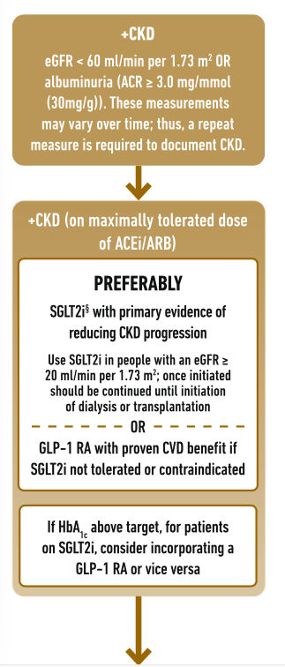

Slide 89
Consensus recommendations
In people with CKD and an eGFR ≥20 ml/min/1.73 m2 or UACR >30 mg/g
An SGLT2i with proven benefit should be initiated to reduce MACE and HF and improve kidney outcomes.
Indications and eGFR thresholds may vary by region.
If such treatment is not tolerated or is contraindicated, a GLP-1 RA with proven cardiovascular outcomes benefit could be considered to reduce MACE and should be continued until kidney replacement therapy is indicated.
..

Slide 90
Consensus recommendations
In people with HF, CKD, established CVD or multiple risk factors for CVD, the decision to use a GLP-1 RA or SGLT2i with proven benefit should be independent of background use of metformin.
In people with HF, CKD, established CVD or multiple risk factors for CVD, the decision to use a GLP-1 RA or an SGLT2i with proven benefit should be independent of baseline HbA1c or target HbA1c level.
..

Slide 93
..

Slide 94
Place of insulin in type 2 diabetes
GLP-1 RA should be considered in all before initiation of insulin:
Allow lower glycemic targets to be reached
Lower risk of hypoglycemia
Weight loss
..

Slide 95
Place of insulin in type 2 diabetes
Insulin may be the preferred agent:
In the setting of severe hyperglycaemia (HbA1c >10%)
When associated with weight loss or ketonuria/ketosis
With acute glycaemic dysregulation (e.g. during hospitalisation, surgery or acute illness)
In underweight people
When the diagnosis of type 1 diabetes is suspected.
..

Slide 96
..

Slide 99
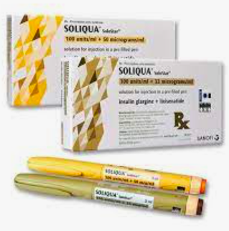
Combination glucagon-like peptide-1/insulin therapy
Two fixed-ratio combinations of GLP-1 RA with basal insulin analogues:
insulin degludec plus liraglutide (IDegLira)
insulin glargine plus lixisenatide (iGlarLixi).
..

Slide 100
Combination glucagon-like peptide-1/insulin therapy
Results in:
Greater glycemic lowering efficacy than the mono-components
Less weight gain
Lower rates of hypoglycemia than with intensified insulin regimens,
Better gastrointestinal tolerability than with GLP-1 RA alone.
..

Slide 102
Metformin
CV effects |  | Renal effects
Effect on MACE | HF | Progression of DKD | Dosing/ Dose consideration
Potential Benefit | Neutral | Neutral | Contraindicated with eGFR <30 ml/min/1.73 m2 Dose reduction should be considered when the eGFR is <45 ml/min/1.73 m2.

Slide 103
Metabolic surgery
..

Slide 104
Consensus recommendations
Adults with type 2 diabetes who are appropriate surgical candidates
with a BMI ≥40.0 kg/m2
or a BMI of 35.0–39.9 kg/m2 who do not achieve durable weight loss and improvement in comorbidities (including hyperglycaemia) with non- surgical methods.
..

Slide 105
Metabolic surgery
One mixed-effects meta-analysis model has estimated a 43% diabetes remission rate (95% CI 34%, 53%) following metabolic surgery in people with type 2 diabetes and a BMI <30 kg/m2 [136], significantly higher than that achieved with traditional medical management [137].
..

Slide 106
Metabolic surgery
postoperative diabetes remission :
duration of diabetes: the likeli- hood of remission decreases significantly with duration of diabetes longer than about 5–8 years
Even in people with diabetes who do not achieve postoperative diabetes remission, or relapse after initial remission, metabolic surgery is associated with better metabolic control than medical management [137, 139].
..

Slide 107
EMPEROR-Reduced EMPEROR-Preserved (>40%)
Empagliflozin Outcome Trials
Patients With CHF-rEF or CHF-pEF
irrespective of the presence of type 2 diabetes (50%)
Reduced:
the primary composite endpoint of cardiovascular mortality or HHF
N Engl J Med 383(15):1413–1424.
N Engl J Med 385(16):1451–1461.

Slide 108
Regarding GLP-1 RA, a subgroup meta-analysis found that their effect on MACE:
did not significantly differ between people with an eGFR <60 ml/min/1.73m2 and those with an eGFR ≥60 ml/min/1.73 m2.
did not appear to differ between people with lower and higher HbA1c at baseline.
Sattar N, Lee MMY, Kristensen SL et al (2021) Cardiovascular, mortality, and kidney outcomes with GLP-1 receptor agonists in patients with type 2 diabetes: a systematic review and meta- analysis of randomised trials. Lancet Diabetes Endocrinol 9(10): 653–662.

Slide 109
AWARD-11 trial
RCT
Weekly Administration of dulaglutide in Diabetes
Evaluated higher doses of dulaglutide (3.0 mg and 4.5 mg weekly) compared with 1.5 mg weekly
36 weeks
Demonstrating superior HbA1c reductions [−1.77 vs −1.54%], estimated treatment difference [ETD: −0.23%])
Weight loss (−4.6 vs −3.0 kg, ETD −1.6 kg)
Frias JP, Bonora E, Nevarez Ruiz L et al (2021) Efficacy and safety of dulaglutide 3.0 mg and 4.5 mg versus dulaglutide 1.5 mg in metformin-treated patients with type 2 diabetes in a randomized controlled trial (AWARD-11). Diabetes Care 44(3): 765–773.

Slide 110
Conclusion:
Pairwise meta-analyses of SGLT2i CVOTs verified that SGLT2i reduced MACE, HHF and a composite kidney outcome in the overall population vs placebo [142, 249].
Regarding GLP-1 RA, a meta- analysis of relevant CVOTs demonstrated the favourable effect of GLP-1 RA vs placebo on MACE and its individual components including stroke, HHF and a composite kidney outcome including severe albuminuria.
the overall effect estimate for HHF seems to have been driven by CVOTs of albiglutide and efpeglenatide, (are not available for clinical use)
the overall effect estimate for the composite kidney outcome was most likely driven by the effect of GLP-1 RA on severe albuminuria only and not on hard kidney endpoints. Of note, the beneficial kidney effects of canagliflozin, dapagliflozin and empagliflozin were also evident for hard kidney outcomes including chronic dialysis and kidney transplantation.
Shaman AM, Bain SC, Bakris GL et al (2022) Effect of the glucagon-like peptide-1 receptor agonists semaglutide and lirag- lutide on kidney outcomes in patients with type 2 diabetes: pooled analysis of SUSTAIN 6 and LEADER. Circulation 145(8):575– 585

Slide 111
PROactive
In the PROspective pioglitAzone Clinical Trial In macroVascular Events (PROactive)
in adults with type 2 diabetes and macrovascular disease
A reduction in secondary cardiovascular endpoints was seen,
Although significance was not achieved for the primary outcome.
Dormandy JA, Charbonnel B, Eckland DJA et al (2005) Secondary prevention of macrovascular events in patients with type 2 diabetes in the PROactive Study (PROspective pioglitAzone Clinical Trial In macroVascular Events): a randomised controlled trial. Lancet 366(9493):1279–1289.

Slide 112
Thiazolidinediones
Beneficial effects on non-alcoholic fatty liver disease (NAFLD) and non-alcoholic steatohepatitis (NASH) have been seen with pioglitazone.
Ann Intern Med 165(5):305–315.

Slide 113
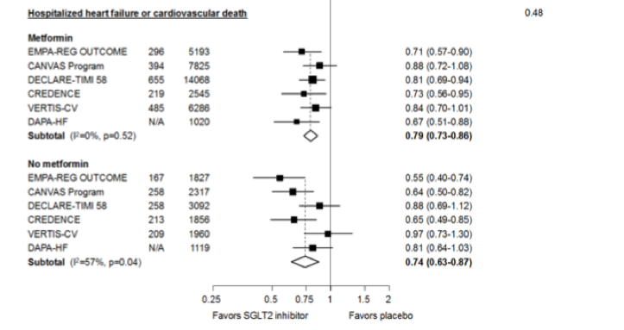

Slide 114
