Slide 1
In The Name Of GOD

Slide 2
Biochemical persistent MTC
Soheila sadeghi

Slide 3
What we should do before MTC surgery?
What the surgeon should do during MTC surgery?
what is the significance of calcitonin level after surgery?
What is the best imaging for MTC metastases diagnosis?
And about our patient

Slide 5
What we should do before MTC surgery?

Slide 6
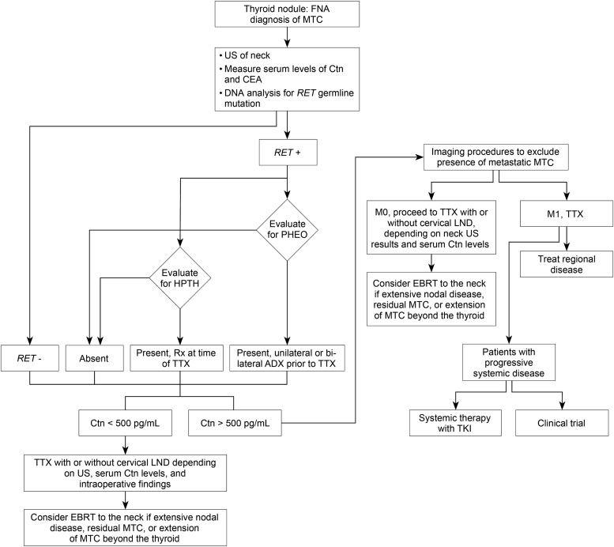

Slide 7
RECOMMENDATION 21:
Patients presenting with a thyroid nodule and a cytological or histological diagnosis of MTC should have a physical examination, determination of serum levels of Ctn and
CEA, and genetic testing for a RET germline mutation. The presence of a PHEO and HPTH should be excluded in patients with hereditary MTC. Grade B Recommendation
RECOMMENDATION 22:
Ultrasound examination of the neck should be performed in all patients with MTC .Contrast-enhanced CT of the neck and chest, three-phase contrast-enhanced multi-detector liver CT, or contrast-enhanced MRI of the liver, and axial MRI and bone scintigraphy are recommended in patients with extensive neck disease and signs or symptoms of regional or distant metastases, and in all patients with a serum Ctn level greater than 500 pg/mL. Grade C Recommendation
RECOMMENDATION 23:
Neither FDG-PET/CT nor F-DOPA-PET/CT is recommended to detect the presence of distant metastases. Grade E Recommendation

Slide 8
What the surgeon should do during MTC surgery?

Slide 9
The initial surgical treatment of patients with MTC
Total thyroidectomy and dissection of cervical lymph node compartments, depending on serum Ctn levels and US findings, is standard treatment for patients with sporadic or hereditary MTC.

Slide 10
The preoperative basal serum Ctn level is also useful in determining the extent of lymph node metastases
Some endocrinologists and surgeons consider preoperative US of primary importance in detecting lymph node metastases and do not advocate compartment dissection if US of the neck is negative. Others argue that elective dissection of US-normal ipsilateral central and ipsilateral lateral neck compartments is indicated in patients with basal serum Ctn levels above 20 pg/mL. Also, elective dissection of an US-normal contralateral lateral neck compartment is indicated when the basal serum Ctn level is greater than 200 pg/mL

Slide 11
RECOMMENDATION 24:
Patients with MTC and no evidence of neck lymph node metastases by US examination and no evidence of distant metastases should have a total thyroidectomy and dissection of the lymph nodes in the central compartment (level VI). Grade B Recommendation
RECOMMENDATION 25:
In patients with MTC and no evidence of neck metastases on US, and no distant metastases, dissection of lymph nodes in the lateral compartments (levels II–V) may be considered based on serum Ctn levels. The Task Force did not achieve consensus on this recommendation. Grade I Recommendation

Slide 12
RECOMMENDATION 26:
Patients with MTC confined to the neck and cervical lymph nodes should have a total thyroidectomy, dissection of the central lymph node compartment (level VI), and dissection of the involved lateral neck compartments (levels II–V). When preoperative imaging is positive in the ipsilateral lateral neck compartment but negative in the contralateral neck compartment, contralateral neck dissection should be considered if the basal serum calcitonin level is greater than 200 pg/mL. Grade C Recommendation

Slide 13
RECOMMENDATION 28:
Following unilateral thyroidectomy for presumed sporadic MTC completion thyroidectomy is recommended in patients with a RET germline mutation, an elevated postoperative serum Ctn level, or imaging studies indicating residual MTC. The presence of an enlarged lymph node in association with a normal serum Ctn level is not an indication for repeat surgery. Grade B Recommendation
RECOMMENDATION 29:
In patients having an inadequate lymph node dissection at the initial thyroidectomy a repeat operation, including compartment oriented lymph node dissection, should be considered if the preoperative basal serum CTN level is less than 1000 pg/mL and five or fewer metastatic lymph nodes were removed at the initial surgery. Grade C Recommendation

Slide 14
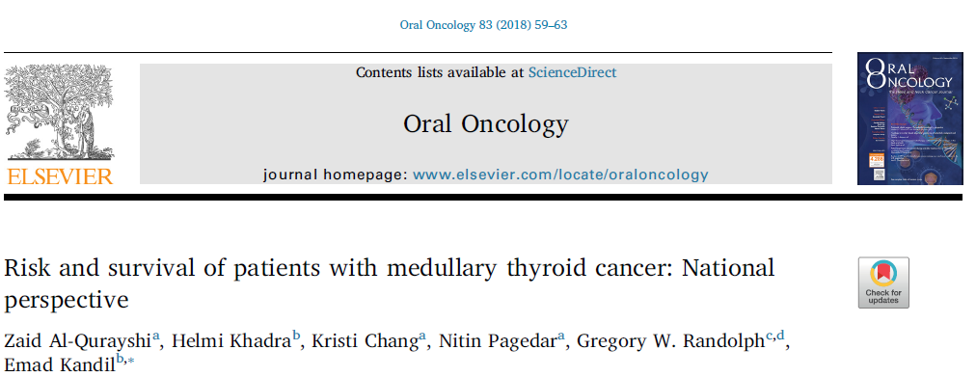

Slide 15
Background:
Medullary thyroid carcinoma (MTC) is a neuroendocrine tumor account for 1–2% of thyroid cancer.In this study, we aim to examine the characteristics and survival of patients with MTC.
Methods:
A retrospective cohort study utilizing the National Cancer Data Base, 2004–2014. The study population included adults with either MTC (cases) or with differentiated thyroid cancer (DTC) (controls).
Results:
A total of 2,776 MTC and 171,631 DTC patients were included. The median follow-up time for MTC was 55.5 months (interquartile range: 31.2–84.6 months). As compared to DTC, patients with MTC were more likely to be≥45-year old, male, and Black (p < 0.001). Neck dissection improved survival in patients with stage III [HR: 0.26, 95%CI: (0.10, 0.64), p=0.004]. In patients with stages I and II, neck dissections did not add significant survival benefit to thyroidectomy [stage I, HR: 1.00, 95%CI: (0.54, 1.86), p=0.99],[stage 2, HR: 0.72, 95%CI: (0.40, 1.29), p=0.27]. However, neck dissections upgraded staging to N1A and N1B in 17.7% and 14.3% of patients with clinically N0 neck, respectively. In stage IV, thyroidectomy with neck dissection had the highest 5-year survival (84.9%), but this was not significantly different from thyroidectomy alone (84.1%); Patients who had thyroidectomy and EBRT with or without neck dissection had a lower survival than thyroidectomy alone (p < 0.01).
Conclusions:
Neck dissection performed on patients with clinically N0 neck, is important for accurate staging and associate with improved survival in advanced stages. Thyroidectomy and neck dissection in stage IV not only have palliative role but also add survival advantage.

Slide 16
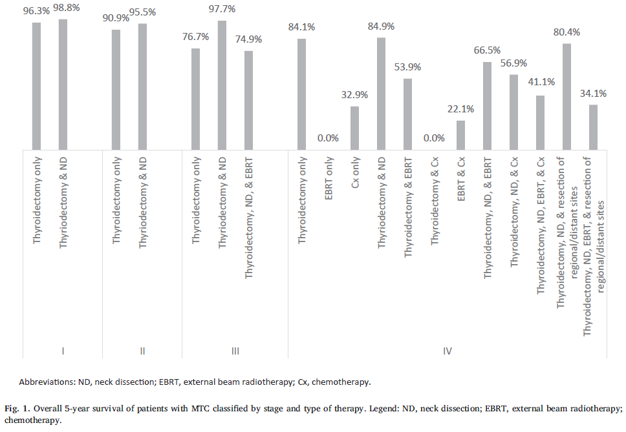

Slide 18
Total thyroidectomy with central lymph node dissection is recommended in patients with medullary thyroid cancer (MTC). However, the relationship between disease severity and extent of resection on overall survival remains unknown.
Objective: The aim of the study was to identify the effect of surgery on overall survival in MTC patients.
Methods:
Using data from 2968 patients with MTC diagnosed between 1998 and 2005 from the National Cancer Database, we determined the relationship between the number of cervical lymph node metastases, tumor size, distant metastases, and extent of surgery on overall survival in patients with MTC.
Results:
Older patient age (5.69 [95% CI, 3.34–9.72]), larger tumor size (2.89 [95% CI, 2.14–3.90]), presence of distant metastases (5.68[95%CI, 4.61–6.99]),and number of positive regional lymph nodes (for 16 lymph nodes, 3.40 [95% CI, 2.41–4.79]) were independently associated with decreased survival. Overall survival rate for patients with cervical lymph nodes resected and negative, cervical lymph nodes not resected, and 1–5, 6–10, 11–16, and16 cervical lymph node metastases was 90, 76, 74, 61,69,and55%,respectively. There was no difference in survival based on surgical intervention in patients with tumor size2 cm without distant metastases. In patients with tumor size2.0cmand no distant metastases, all surgical treatments resulted in a significant improvement in survival compared to no surgery (P .001). In patients with distant metastases, only total thyroidectomy with regional lymph node resection resulted in a significant improvement in survival (P .001).
Conclusions:
The number of lymph node metastases should be incorporated into MTC staging. The extent of surgery in patients with MTC should be tailored to tumor size and distant metastases.

Slide 20
RECOMMENDATION 31:
Serum TSH should be measured within 4–6 weeks postoperatively. Replacement therapy with levothyroxine should be administered with the goal of maintaining serum TSH levels in the euthyroid range. Grade B Recommendation
Also, patients need to be monitored for hypocalcemia, which is almost always transient; however, treatment with oral calcium and calcitriol is indicated if patients become symptomatic or have persistently prolonged hypocalcemia. Withdrawal of replacement therapy is guided by serial measurements of serum calcium
RECOMMENDATION 32:
Serum calcium levels should be monitored postoperatively. Oral calcium and vitamin D should be administered to patients who develop symptomatic hypocalcemia. Chronic replacement therapy is indicated in patients who cannot be weaned from medication. Grade B Recommendation

Slide 21
what is the significance of calcitonin level after surgery?

Slide 22
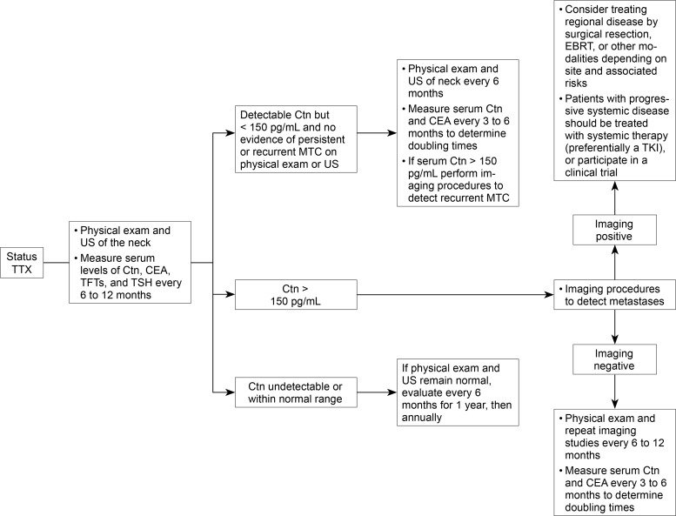

Slide 23
RECOMMENDATION 45:
Clinicians should consider TNM classification, the number of lymph node metastases, and postoperative serum Ctn levels in predicting outcome and planning long-term
follow-up of patients treated by thyroidectomy for MTC. Grade C recommendation
RECOMMENDATION 46:
Serum levels of Ctn and CEA, should be measured 3 months postoperatively, and if undetectable or within the normal range, they should be measured every 6
months for 1 year, and then yearly thereafter. Grade C Recommendation
RECOMMENDATION 47:
Patients with elevated postoperative serum Ctn levels less than 150 pg/mL should have a physical examination and US of the neck. If these studies are negative the patients should be followed with physical examinations, measurement of serum levels of Ctn and CEA, and US every 6 months. Grade C Recommendation

Slide 24
RECOMMENDATION 48:
If the postoperative serum Ctn level exceeds 150 pg/mL patients should be evaluated by imaging procedures, including neck US, chest CT, contrast-enhanced MRI or
three-phase contrast-enhanced CT of the liver, and bone scintigraphy and MRI of the pelvis and axial skeleton. Grade C Recommendation
RECOMMENDATION 50:
Surgical resection of persistent or recurrent loco-regional MTC in patients without distant metastases should include compartmental dissection of image-positive or biopsy positive disease in the central (level VI) or lateral (levels II–V) neck compartments. Limited operative procedures, such as resection of only grossly metastatic lymph nodes, should be avoided unless there has been prior extensive
surgery in a compartment. Grade C Recommendation

Slide 25
RECOMMENDATION 53
Systemic therapy should not be administered to patients who have increasing serum Ctn and CEA levels but no documented metastatic disease. Nor should systemic therapy be administered to patients with stable low-volume metastatic disease, as determined by imaging studies and serum Ctn and CEA doubling times greater than 2 years.
Grade C Recommendation

Slide 26
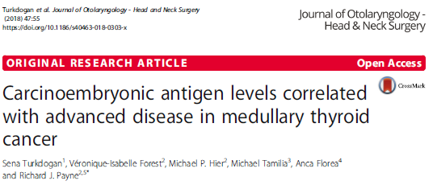

Slide 27
Background:
Medullary thyroid cancer (MTC) cells are capable of secreting various tumor markers including calcitonin and carcinoembyronic antigen (CEA). The purpose of this study is to determine whether abnormal CEA levels may be used as a tumor marker to predict the severity of disease in MTC.
Methods:
A retrospective analysis was completed for 33 patients with MTC who had preoperative serum CEA levels. Univariate and multivariate analyses were used to quantify the relationship between serum CEA levels and tumor stage and prognosis. Our study is an analysis of MTC patients who underwent a total thyroidectomy with or without a selective or radical neck dissection at two tertiary surgical centers in Montreal, including the Jewish General Hospital and the Royal Victoria Hospital between the years of 2003–2016. The inclusion criteria included all MTC patients who had pre-operative and post-operative calcitonin and CEA levels, bloodwork which has become part of a routine workup in our institutions.

Slide 28
Results:
On multivariate analysis, elevated preoperative CEA levels were significantly associated with the size and stage of tumor, distant metastasis, decreased biochemical cure, and mortality. There was a significant association between tumor size greater than 37 mm and elevated CEA levels (> 271 ng/ml). There was also a positive correlation with increased cancer stage (> 377 ng/ml), distant metastasis (> 405 ng/ml), and contralateral compartment location of lymph node metastasis (> 162 ng/ml). When pre-operative CEA levels are > 500 ng/ml, patient mortality was 67%.
Conclusion:
In this study, both pre-operative calcitonin and CEA levels were significantly correlated with the extent of disease in MTC. While calcitonin has a linear relationship with disease progression, abnormal CEA levels were a better indicator of advanced disease suggesting that it also may be a predictor of tumor size, central lymph node metastasis, and mortality. CEA levels > 271 ng/ml are significant for advanced tumor size and staging, metastasis to the central compartment, and decreased chance of biochemical cure. CEA levels greater than 500 ng/ml are associated with significant patient mortality.

Slide 29
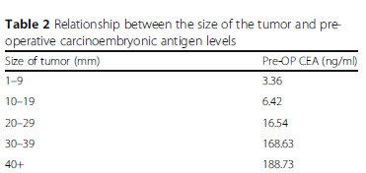

Slide 30
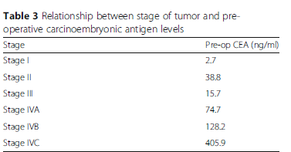

Slide 31
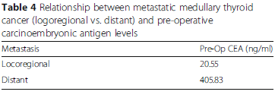

Slide 32
What is the best imaging for MTC metastases diagnosis?

Slide 34
Patients and Methods:
Fifty-five consecutive elevated calcitonin level MTC patients were enrolled to undergo neck and abdomenultrasonography (US); neck, chest, and abdomen spiral computed tomography (CT); liver and whole-body magnetic resonance imaging (MRI); bone scintigraphy; and 2-[fluorine-18]fluoro-2-deoxy-D-glucose(FDG) positron emission tomography (PET)/CT scan (PET).
Results:
Fifty patients underwent neck US, CT, and PET, and neck recurrence was demonstrated in 56, 42, and 32%, respectively. Lung and mediastinum lymph node metastases in the 55 patients were demonstrated in 35 and 31% by CT and in 15 and 20% by PET. Liver imaging with MRI, CT, US, and PET in 41 patients showed liver in 49, 44, 41, and 27% patients, respectively. Bone metastases in 55 patients were demonstrated in 35% by PET, 40% by bone scintigraphy, and 40% by MRI; bone scintigraphy was complementary with MRI for axial lesions but superior for the detection of peripheral lesions. Ten patients had no imaged tumor site despite elevated calcitonin level (median 196 pg/ml; range 39–816). FDG uptake in neoplastic foci was higher in progressive patients but with a considerable overlap with stable ones.
Conclusion:
The most efficient imaging work-up for depicting MTC tumor sites would consist of a neck US, chest CT, liver MRI, bone scintigraphy, and axial skeleton MRI. FDG PET scan appeared to be less sensitive and of low prognostic value

Slide 36
And about our patient
Axial and pelvic MRI
Bone scintigraphy
At the end repeat surgery for LN dissection

