Slide 1
1
Incretin Based Therapy in T₂DM
Workshop & Case Study
RIES 28 Oct 2015 Tehran, IRAN

Slide 2
ADA/EASD position statement 2015
Healthy eating, weight control, increased physical activity
Initial monotherapy
MET
Not at target HbA_{1c} after ~3 months
SU
TZD
DPP-4i
SGLT-2i
GLP-1RA
Insulin
Two-drug combinations
Not at target HbA_{1c} after ~3 months
Three-drug combinations
TZD DPP-4i GLP-1RA Insulin
SGLT-2i
SU DPP-4i GLP-1RA Insulin
SGLT-2i
SU TZD Insulin
SGLT-2i
SU TZD
GLP-1RA Insulin
SU TZD Insulin
TZD DPP-4i GLP-1RA
SGLT-2i
Not at target HbA_{1c} after 3-6 months combination therapy with insulin
More complex strategies
Basal Insulin + GLP-1 RA or Prandial Insulin
Inzucchi et al. Diabetes Care 2015;38:140-149
Notes:
ADA/EASD position statement now recommends GLP-1RAs as second line agents

Slide 3
CASE 1
A 48 y/o woman, known case of T2DM since 3 yrs ago, presents with polyuria, polydipsia, bloating & mild to moderate episodes of hypoglycemia during the past 2 months.
HbA1c= 8.06 %
FBS= 149 mg/dL
2hpp BG= 208 mg/dL
Cr= 1.12 mg/dL
HDL= 30 mg/dL
LDL= 105 mg/dL
TG= 266 mg/dL
BP= 135/75 mmHg
W= 84.6 kg
BMI= 29.9 kg/m2
Current medications:
Metformin: 2500mg/d
Atorvastatin: 20 mg/d
Repaglinide: 4mg TDS

Slide 4
CASE 1
Which of the following is the most appropriate intervention that should be initiated as 3rd step in treating of hyperglycemia?
1- Glargine + Metformin + Repaglinide
2- Increasing dose of Metformin
3- Increasing dose of Metformin & glinide
4- Metformin + Repaglinide + Pioglitazone
5- Metformin + Repaglinide + Acarbose
6- Metformin + Repaglinide + Sitagliptin
7- Metformin + Repaglinide + Liraglutide

Slide 5
CASE 2
A 35 y/o woman with newly diagnosed T2DM has been on the maximum tolerated dose of Metformin (2000 mg/d) since 11 months ago.
Over the past 7 months, her postprandial BG levels rose to 200 ̶ 250 mg/dL.
She has been compliant with her medications.
She follows a diet that has resulted in the loss of 6 kg since Dx.
HbA1c = 7.92 %.
BMI= 30.7

Slide 6
CASE 2
Which of the following is the next most appropriate intervention for her to help achieve glycemic control?
1- Add Liraglutide
2- Add Glibenclamide/Gliclazide
3- Add Pioglitazone
4- Add Sitagliptin
5- Add basal insulin
6- Add Acarbose
7- Add Repaglinide

Slide 7
A 56 y/o man with T2DM without any evidence of retinopathy, neuropathy & CVD PMH: 5 yrs Hx. of T2DM 8 yrs Hx. of HTN Ph/Ex: BP: 145/85 mmHg 1+ ankle edema Wt: 90 kg BMI: 31.5 kg/m2
CASE 3
Lab. Results:
HbA1c: 7.86 %
FPG: 126 mg/dL
LDL-C: 96 mg/dL HDL-C: 34 mg/dL TG: 240 mg/dL
Creatinine: 1.38/ mg/dL
U Alb.: 53 mg/24 hrs
Current medications:
Metformin: 2500/d
Gliclazide: 320 mg/dL
HCTZ: 25 mg/d
Valsartan: 160 mg/d
Atorvastatin: 20 mg/d
7
Notes:
7

Slide 8
CASE 3
Which of the followings is more appropriate intervention for him to help achieve glycemic control?
1- Add Liraglutide
2- Add Pioglitazone
3- Add Sitagliptin
4- Add basal insulin
5- Add Acarbose

Slide 9
CASE 4
A 52 y/o man with T2DM & HTN X 7 yrs.
Current medications:
Metformin 1500 mg BID, Repaglinide 5 mg TDS & Pioglitazone: 45 mg/d, Lisinopril, Atorvastatin, Allopurinol, ASA, Metoral
He is an active businessman and travels regularly.
Current concerns:
GI upset (intermittent diarrhea, bloating, epigastric burning pain)
Frequent episodes of hypoglycemia

Slide 10
CASE 4
Medical Hx.:
– Gout, HTN, DLP, NASH, NAFLDIII,
DM complications: Very mild NPDR
Ph/Ex: BMI = 37.65 kg/m2, BP =135/90 mmHg, 1+ bilateral pedal edema
Lab. results:
HbA1C= 8.84 %, LDL-C= 94, eGFR >60,
TG= 308 mg/dL, FPG=133 mg/dL,
2hppBG = 312 mg/dL,
Urine microalbumin = 36 mg/24 hrs.

Slide 11
CASE 4
A1C goal is < 7%?
Liraglutide?
Metformin?
TZD?
SUs/Glinide?
Basal insulin?
Basal/Plus insulin? / Premixed insulin?
Sitagliptin?
Acarbose
Weight loss medications?
Bariatric surgery?

Slide 12
Case Study: Case 1
Mr Ali A.F.

Slide 13
Demographic characterestic of Case 1 1st visit: 12/2/1390
Age: 36 y/o ♂
Diabetes duration: 1 yr
Obesity since puberty
HLP (TG): 4 yrs
Active smoker: 7 P/Y
Weight: 105 kg Height: 166 cm BMI: 38 kg/m²
P/E: BP 120/80 mmHg
DM complications: not yet assessed

Slide 14
Lab. Results
Basal data at presentation, before treatment, 8-1389:
FBS: 209 mg/dl, BS: 374 mg/dl
HbA1c: 8.4%
He stated his SMBG as quite good, but had no recent data at that time.
Fatty liver, G2, in sonography

Slide 15
Current Treatment – 12/2/1390
Glibenclamide: 2.5 mg HS
Metformin: 500 mg TSD
Gemfibrozil: 450 mg BD
Education
Weight loss
Quit smoking
Glibenclamide D/C
Metformin 1000 mg Bid
Evaluation of complications

Slide 16
2nd visit: 1390/4/5
W: 103.2 kg
BP: 130/80 mmHg
He has taken part in diabetes educational classes & tries to have better life style.
FBS: 108 mg/dL, HbA1c : 5.4%
Cr: 1 mg/dL
LDL: 114 mg/dL, TG: 623 mg/dL
Uric Acid: 7.4 mg/dL
Na, K, U/A: normal
TSH: 8.1
Urine microalbumin: 11.7 mg/24 hrs
Continue weight loss
Quit smoking
Atorvastatin: 10 mg/d
Gemfibrozil: 1200 mg/d
Levothyroxine: 600 µg/wk
Alluporinol: 100 mg/d
Amp D3: 2 monthly

Slide 17
3rd visit: 1390/7/9
W: 101.5 kg
BP: 145/92 mmHg
No diabetic retinopathy
FBS: 111 mg/dL, HbA1c : 5.7 %
Cr: 1 mg/dL
LDL: 68 mg/dL, TG: 378 mg/dL
ALT: 115, Uric Acid: 5.9 mg/dL
Na, K, U/A: normal
TSH: 2.1
Continue weight loss
Quit smoking
ASA: 80 mg/daily
Losartan: 12.5 mg BD
Referred to cardiologist

Slide 18
4th visit: 1390/10/21
W: 101 kg
BP: 128/82 mmHg
Normal ETT
FBS: 105 mg/dL, HbA1c : 4.6 %
TG: 384 mg/dL
ALT: 107
Uric Acid: 4.5 mg/dL
Continue weight loss
Bariatric surgery was discussed

Slide 19
8th visit: 1392/5/6
W: 98.2 kg
BP: 140/95 mmHg
He reported weight of 93 kg on 3-92, coming back from a trip.
SMBP: occasional rise in DBP
He complains of poly-pharmacy
FBS: 110 mg/dL, HbA1c : 5.2 %
LDL: 56 mg/dL, TG: 526 mg/dL
ALT: 62
Urine microalbumin: 26 mg/24 hrs
weight loss
Losartan D/C
Valsartan 160 mg/d
Gemfibrozil D/C
Fenofibrate 200 mg/d
Victoza was introduced.
Bariatric surgery was discussed again.

Slide 20
10th visit: 1393/2/14
W: 99.1 kg
SMBP: OK
SMBG: occasional rise and flactuation
FBS: 126 mg/dL, HbA1c: 5.8 %
LDL: 87 mg/dL, TG: 410 mg/dL
ALT: 51
Cr: 1.1
25(OH)D: 23 ng/ml
weight loss
Victoza was advised

Slide 21
11th visit: 1393/8/14
W: 101.2 kg
SMBG & SMBP: OK
No diabetic complication yet.
Metformin: 1000 mg BD
ASA: 80 mg/d
Valsartan: 160 mg/d
Atorvastatin: 20 mg/d
Fenofibrate 200 mg/d
Alluporinol: 100 mg/d
LT4: 600 µg/w
Pearl D: monthly, B12
FBS: 111 mg/dL, HbA1c : 5.7 %
Cr: 1 mg/dL
LDL: 68 mg/dL, TG: 403 mg/dL
ALT: 71, Uric Acid: 4.6 mg/dL
TSH: 5.1
Urine microalbumin: 3.8 mg/24 hrs
Victoza 0.6 mg/d was started
LT4 0.1 mg/daily

Slide 22
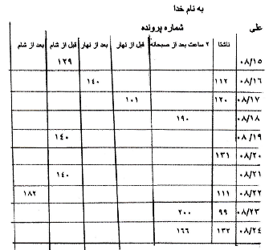
12th visit: 1393/9/23
SMBG
W: 102.2 kg
Poor life style in the last month!
Not any side effects by Victoza
Victoza was increased to 1.2 mg/d

Slide 23
13th visit: 1393/10/20
Date | FPG | PP breakfast | Before lunch | PPG lunch | Before dinner | PPG dinner | Others
14-10-93 | 92 | 139
15-10-93 | 106 |  |  |  | 115
17-10-93 |  | 143 |  |  |  | 151
18-10-93 |  |  |  | 158
19-10-93 | 115 |  | 122
W: 100.7 kg
SMBG: quite good
Proper life style
Not any side effects by Victoza
FBS: 120 mg/dL, HbA1c: 5.8 %
Cr: 1.1 mg/dL, TG: 359 mg/dL
ALT: 84, Uric Acid: 4.6 mg/dL
25(OH)D: 34 ng/ml
Continue Victoza by 1.2 mg/d

Slide 24
14th visit: 1393/11/6
W: 98 kg
SMBG: quite good
Proper life style
Not any side effects by Victoza
Continue Victoza by 1.2 mg/d

Slide 25
ADA/EASD position statement 2015
Healthy eating, weight control, increased physical activity
Initial monotherapy
MET
Not at target HbA_{1c} after ~3 months
SU
TZD
DPP-4i
SGLT-2i
GLP-1RA
Insulin
Two-drug combinations
Not at target HbA_{1c} after ~3 months
Three-drug combinations
TZD DPP-4i GLP-1RA Insulin
SGLT-2i
SU DPP-4i GLP-1RA Insulin
SGLT-2i
SU TZD Insulin
SGLT-2i
SU TZD
GLP-1RA Insulin
SU TZD Insulin
TZD DPP-4i GLP-1RA
SGLT-2i
Not at target HbA_{1c} after 3-6 months combination therapy with insulin
More complex strategies
Basal Insulin + GLP-1 RA or Prandial Insulin
Inzucchi et al. Diabetes Care 2015;38:140-149
Notes:
ADA/EASD position statement now recommends GLP-1RAs as second line agents
25

Slide 26
Case Study: Case 2
Mr Ahmad M.S.

Slide 27
Demographic characterestic of Case 2 – 17/2/93
Age: 44 y/o ♂
Diabetes Duration: 5 years
Obesity since childhood / F Hx.: obesity in mother’s family
HTN: 3 yrs
Weight: 121 kg Height: 185 cm BMI: 35.3
P/E: BP 140/100 mmHg – Axillary Acanthosis nigricans
DM Complications: no

Slide 28
Lab. Results - 1393/2/17
FBS: 377 mg/dL, BS: 324 mg/dL, HbA1c: 10.4%
Cr: 1 mg/dL, Na: 137 meq/L, K: 4.8 meq/L, Uric Acid: 8.9 mg/dL
TG: 419 mg/dL, LDL: 111 mg/dL, HDL: 38 mg/dL,
U/A: +2 glucose

Slide 29
Current Treatment – 1393/2/17
Glibenclamide: 10 mg Bid
Metformin: 2500 mg/ day
Acarbose: 300 mg/ day
Venostat: 120 mg daily till 3m. ago
Atorvastatin: 10 mg daily
Refused Insulin!
Refused Bariatric Surgery
Pioglitazon 30 mg daily
Losartan 12.5 mg Bid
Atorvastatin 20 mg daily
Nutritionist consult

Slide 30
Next visit - 1393/4/9
BP: 130/80 mmHg - Wt.: 126 kg
He discontinued venostat by himself
Acarbose D/C
Metformin 1000 mg Bid
Sitagliptin 50 mg daily
FBS: 114 mg/dL, BS: 181 mg/dL,
HbA1c: 8%
U/A: nl,
Urine 24 hr albumin: 29 mg/day

Slide 31
Next visit - 1393/6/20
BP: 110/85 mmHg - Wt.: 130 kg
No new lab. Data
No GI problem
Sitagliptin 100 mg daily

Slide 32
Next visit - 1393/9/10
BP: 140/90 mmHg - Wt.: 130 kg - thyroid exam: nl
FBS: 202 mg/dL, BS: 245 mg/dL, HbA1c: 8.7%
ALT: 26 IU/L, AST: 17 IU/L, Uric Acid: 6.8 mg/dL
TG: 165 mg/dL, LDL: 54 mg/dL, HDL: 39 mg/dL,
U/A: nl

Slide 33
Current Treatment – 1393/9/10
Glibenclamide: 10 mg Bid
Metformin: 2000 mg/day
Pioglitazon: 30 mg/day
Sitagliptin: 100 mg/day
Losartan: 12.5 mg Bid
Atorvastatin: 20 mg/day
Refused bariatric surgery
Sitagliptin D/C
Pioglitazon D/C
Losartan 25 mg Bid
Victoza 0.6 mg daily

Slide 34
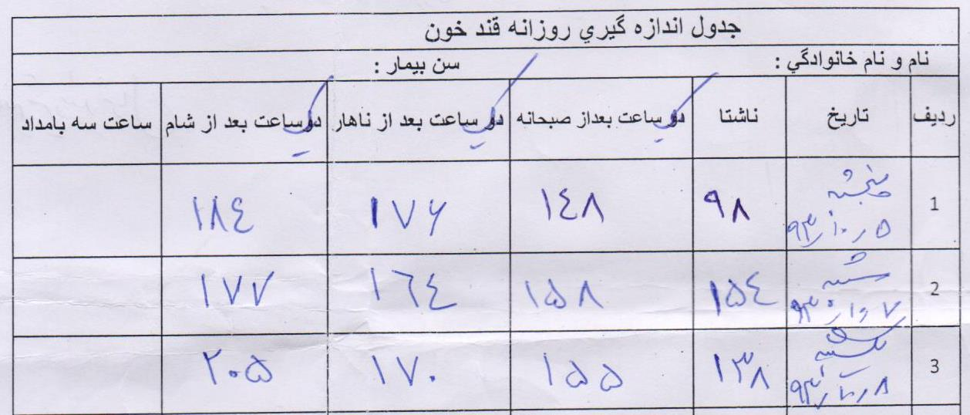
Next visit - 1393/10/9 SMBG

Slide 35
Next visit - 1393/10/9
BP: 150/90 mmHg - Wt.: 129 kg
No abdominal pain or nausea
FBS: 132 mg/dL, BS: 139 mg/dL
Cr: 1 mg/dL, K: 5.1 meq/L,
ALT: 22 IU/L, AST: 44 IU/L,
U/A: nl,
Victoza 1.2 mg daily
Glibenclamide 15 mg daily
Losartan 75 mg daily

Slide 36
ADA/EASD position statement 2015
Healthy eating, weight control, increased physical activity
Initial monotherapy
MET
Not at target HbA_{1c} after ~3 months
SU
TZD
DPP-4i
SGLT-2i
GLP-1RA
Insulin
Two-drug combinations
Not at target HbA_{1c} after ~3 months
Three-drug combinations
TZD DPP-4i GLP-1RA Insulin
SGLT-2i
SU DPP-4i GLP-1RA Insulin
SGLT-2i
SU TZD Insulin
SGLT-2i
SU TZD
GLP-1RA Insulin
SU TZD Insulin
TZD DPP-4i GLP-1RA
SGLT-2i
Not at target HbA_{1c} after 3-6 months combination therapy with insulin
More complex strategies
Basal Insulin + GLP-1 RA or Prandial Insulin
Inzucchi et al. Diabetes Care 2015;38:140-149
Notes:
ADA/EASD position statement now recommends GLP-1RAs as second line agents
36

Slide 37
Case Study: Case 3
Mrs Elaheh O.V.

Slide 38
Demographic characterestic of Case 3 1st visit: 1386/10/19
Age: 48 y/o ♀
Diabetes Duration: 8 yrs
PMH: - nonsmoker
FH: of breast CA in her sister
Weight: 66 kg Height: 159 cm BMI: 26.3 kg/m²
P/E: BP 120/80 mmHg
DM Complications:
Diabetic retinopathy: Negative
ECG: Normal
Distal pulses: Normal
Has been educated for diabetes

Slide 39
Lab. Results - 1386/10/19
SMBG:
FBS: 130-160 mg/dL
BS: 140-220 mg/dL
Cr: 0.7 mg/dL
LDL: 37 mg/dL, TG: 62mg/dL, HDL: 55 mg/dL
Ferritin: 7.9 ng/ml
Na/K, Uric Acid, ESR, U/A: Normal

Slide 40
Current Treatment – 1386/10/19
Weight loss
Pioglitazone 15 mg/d
Atorvastatin 5 mg/d
Fefol BD
ASA: 80 mg HS
Metformin: 1000 mg BD
Atorvastatin: 10 mg/d

Slide 41
2nd visit: 1387/3/4
W: 65 kg
BP: 120/80 mmHg
Hb_{A1c}: 6.3%, FBS: 140 mg/dL
SMBG:
Mean 14 days BS: 137 mg/dL
Mean 28 days BS: 143 mg/dL
Urine Microalbumin: 57 mg/12 hrs
She complaints from genital discharge & irritation.
Ob/Gyn visit
Repeat microalbuminuria after Ob/Gyn treatments

Slide 42
5th visit: 1387/12/14
W: 71 kg
Hb_{A1c}: 7.2%
SMBG:
Mean 14 days BS: 113 mg/dL
Mean 28 days BS: 121 mg/dL
LDL: 89 mg/dL, TG: 62mg/dL
Ferritin: 11.1 ng/ml
D3: 20 ng/ml
Cr, ESR, U/A: Normal
Urine Microalbumin: 7.2 µg/min
Weight loss
↑ Pioglitazone to 30 mg/d
Should take fefol regularly
Pearl D3

Slide 43
9th visit: 1389/2/26
W: 70 kg
BP: 150/85
Hb_{A1c}: 6.9%
Urine Microalbumin: 7.1 µg/min
SMBG:
OK, but FBS< 140
Weight loss
SMBP
↑ Atorvastatin to 10 mg/d
Better LSM at night

Slide 44
10th visit: 1389/6/3
Weight loss
Glargine 10 IU/HS
Pioglitazone D/C
Continue:
Metformin 2 gr/d
ASA 80 mg/d
Atorvastatin 10 mg/d
D3 & B12 & Fefol
W: 71 kg
BMI: 28.4 kg/m²
Hb_{A1c}: 7.1%
SMBP: OK
FBS: 128 mg/dl
SMBG:
FBS: 150-160
2hPP: about 150

Slide 45
11th visit: 1389/9/10
W: 70 kg
Has not used Insulin,
is on pioglitazone as before!
Hb_{A1c}: 6.9 %
SMBP: OK
FBS: 147 mg/dl
ALT: 11
SMBG:
FBS: 150-160
2hPP: about 160
Weight loss
Importance of FBS control was
discussed
↑ Pioglitazone to 45 mg/d

Slide 46
12th / 13th visit
W: 69 / 71 kg
Is on pioglitazone as before.
FBS: 127 mg/dl, Hb_{A1c}: 7 %
SMBG:
FBS: about 160
2hPP: OK
Her doctor persisted on initiation of insulin (basal), she was still worried about it!
Weight loss
Psychiatry consultation

Slide 47
14th visit: 1390/4/27
W: 70 kg
Is on pioglitazone as before!
FBS: 129 mg/dl, Hb_{A1c}: 7.2 %
LDL: 47 mg/dl
25(OH)D: 14.6 ng/ml
Urine microalbumin: 4 mg/24 hrs
SMBG:
FBS: about 160
2hPP: OK
No diabetes complication yet.
Weight loss
Pioglitazone D/C
Glargine 10 IU/HS
Continue:
Metformin 2 gr/d
ASA 80 mg/d
Atorvastatin 10 mg/d
D3 & B12 & Fefol

Slide 48
19th visit: 1392/3/22
W: 68.7 kg
During the last 2 yrs:
Has been on glargine 10-12 IU/d, with Hb_{A1c} of 6.8-7.7%
Coronary angiography: Normal (9-1390)
Metoral & losartan has been added.
FBS: 139 mg/dl, Hb_{A1c}: 7.7 %
SMBG:
FBS: OK
2hPP: OK except for after dinners of about 240 mg/dl
Acarbose 50 mg HS was added.
GI w/u was advised dyspepsia.

Slide 49
22nd visit: 1393/2/26
W: 65.6 kg
FBS: 116 mg/dl, Hb_{A1c}: 8.2 %
Ferritin: 36 ng/ml
D3: 46 ng/ml
During the last year:
Has been on glargine 12 IU/d
HbA1c of 7-8 %,
Infrequently used Acarbose
UGIE: Normal (9-1392)
SMBG:
FBS: OK
2hPP: after lunch & dinners of about 220-240 mg/dl
Acarbose 50 mg BD, for lunch & dinner, should be used regularly
Glargine 13 IU/HS

Slide 50
24th visit: 1393/9/15
W: 68.6 kg
FBS: 85 mg/dL, Hb_{A1c}: 7.2 %
Hb: 12.6 g/dl
Cr: 0.9 mg/dL
LDL: 40 mg/dL, TG: 48 mg/dL
ALT: 15
TSH: 1.8
Urine microalbumin: 14.6 mg/24 hrs
SMBG:
FBS: 80 – 110
BS: 150 - 230
No diabetic complication yet
Glargine 13 IU/HS
Metformin: 1000 mg BD
Acarbose 50 mg Bid
ASA: 80 mg/d
Losartan: 12.5 mg BD
Metoral: 25 mg BD
Atorvastatin: 10 mg/d
Pearl D: monthly, B12
Victoza 0.6 mg/d
Drug dose adjusment was done
Acarbose D/C

Slide 51
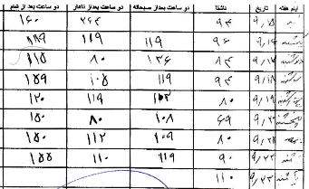
1st week of Victoza use: 1393/9/15-23
SMBG
0.6 mg Victoza
↓ ↓ appetite,
Moderate, but tolerable, nausea & flatulence
Victoza was increased to 1.2 mg/d
Drug dose adjusment was done again

Slide 52
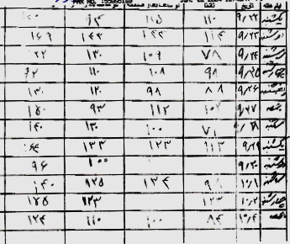
2nd & 3rd weeks of Victoza use
SMBG
1.2 mg Victoza
↓↓ appetite,
Mild & tolerable nausea & flatulence
Glargin D/C
Continue Victoza by 1.2 mg/d

Slide 53
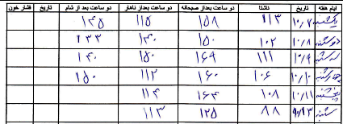
At the end of 1st month Victoza
SMBG
On 1.2 mg Victoza + 2 gr Metformin
Severe loss of appetite
GI side effects are getting better
She doesn’t want to change the treatment
Continue Victoza by 1.2 mg/d

Slide 54
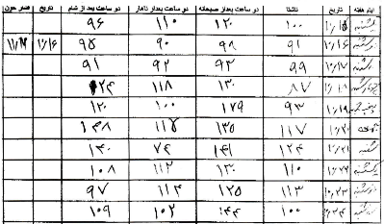
40 days after Victoza use
SMBG
1.2 mg/d Victoza + 2 gr Metformin
Moderate ↓ appetite
GI side effects has got better
She is generally satisfied from treatment
Continue Victoza by 1.2 mg/d

Slide 55
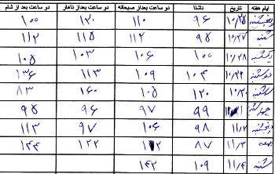
25th visit: 1393-11-4
SMBG
W: 64 Kg
1.2 mg/d Victoza + 2 g/d Metformin
Moderate ↓ appetite
No GI side effects
She is quite satisfied from treatment
Continue Victoza by 1.2 mg/d

Slide 56
ADA/EASD position statement 2015
Healthy eating, weight control, increased physical activity
Initial monotherapy
MET
Not at target HbA_{1c} after ~3 months
SU
TZD
DPP-4i
SGLT-2i
GLP-1RA
Insulin
Two-drug combinations
Not at target HbA_{1c} after ~3 months
Three-drug combinations
TZD DPP-4i GLP-1RA Insulin
SGLT-2i
SU DPP-4i GLP-1RA Insulin
SGLT-2i
SU TZD Insulin
SGLT-2i
SU TZD
GLP-1RA Insulin
SU TZD Insulin
TZD DPP-4i GLP-1RA
SGLT-2i
Not at target HbA_{1c} after 3-6 months combination therapy with insulin
More complex strategies
Basal Insulin + GLP-1 RA or Prandial Insulin
Inzucchi et al. Diabetes Care 2015;38:140-149
Notes:
ADA/EASD position statement now recommends GLP-1RAs as second line agents
56

Slide 57
Any Question?

