Slide 1
In the name of GOD
Grand 98/2/23
Meysam orangi

Slide 2
What is diagnostic W/U for patients with persistent biochemical MTC?
What is possibility bone metastasis in MTC?
What is physiopathology of diarrhea in patients with MTC?
What is prognosis in this case ?
What should be do in the case?

Slide 3
What is diagnostic W/U for patients with persistent biochemical MTC?
What is possibility bone metastasis in MTC?
Whatis physiopathology of diarrhea in patients with MTC?
What is prognosis in this case ?
What should be do in the case?

Slide 4
Total thyroidectomy + L.N compartment level VI dissection
When preoperative imaging is positive in the ipsilateral lateral neck compartment but negative in the contralateral neck compartment, contralateral neck dissection should be considered if the basal serum calcitonin level is greater than 200 pg/mL. Grade C

Slide 5
In MTC patients with extensive neck disease and signs or symptoms of regional or distant metastases, and in all patients with a serum Ctn > 500 pg/ml (preoperative) or > 150 pg/ml (postoperative)
Contrast-enhanced CT of the neck and chest
Three-phase contrast-enhanced multi-detector liver CT, or contrast-enhanced MRI of the liver
bone scintigraphy
pelvic MRI
Axial skleton MRI. (Grade C)
FDG-PET/CT nor F-DOPA-PET/CT is recommended to detect the presence of distant metastases (Grade E)

Slide 6
What is diagnostic W/U for patients with persistent biochemical MTC?
What is possibility bone metastasis in MTC?
What is physiopathology of diarrhea in patients with MTC?
What is prognosis in this case ?
What should be do in the case?

Slide 7
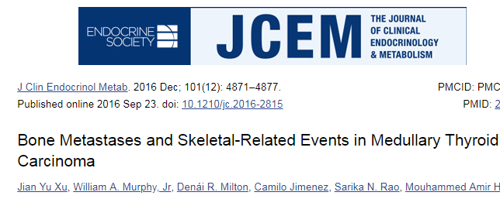
Bone metastases occur in 45% of MTC patients with local or metastatic disease.

Slide 8
Of 1008 MTC patients treated:
188 were confirmed to have bone metastasis (19%)
of whom 89% had nonosseous distant metastases.
Median time from MTC to BM diagnosis was 30.9 months.
Most patients (77%) had six or more (multifocal) lesions.
most often affecting the spine (92%) and pelvis (69%).

Slide 9
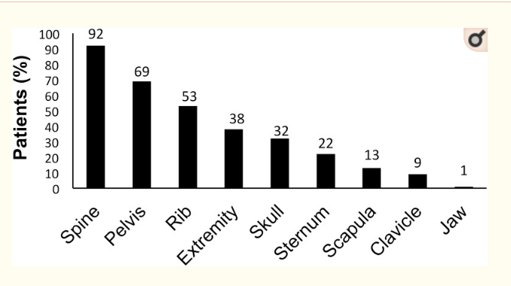

Slide 10
What is diagnostic W/U for patients with persistent biochemical MTC?
What is possibility bone metastasis in MTC?
What is physiopathology of diarrhea in patients with MTC?
What is prognosis in this case ?
What should be do in the case?

Slide 11
MTC is a rare cause of chronic diarrhea.
Diarrhoea is seen up to 30% of patients with MTC
diarrhoea in patients with MTC is usually severe, watery and w/o treatment
mortality is high
Diarrhea occurs most frequently in patients with advanced disease and
hepatic metastases.
When systemic symptoms such as diarrhea occur, distal metastasis
often exist.
The diarrhea may be hypersecretory, due to enhanced gastrointestinal motility(increase in distal ileal flow), or a combination of both.

Slide 12
There are many secretory products of MTC which cause diarrhea, Including calcitonin,
prostaglandins , VIP, CEA, chromogranin-A, dopa- carboxylase, histaminase , serotonin,
somatostatin, gastrin-releasing peptide,thyrotropin- releasing hormone, and ACTH.
The mechanism between these secretory products and diarrhea is not well known, except
calcitonin-induced secretory diarrhea.
the diarrhoea accompanying MTC is usually considered to result from a secretory process
induced by raised circulating calcitonin.
Diarrhoea is also observed in other cases such as infusion of Ctn for hypercalcemia
acute intravenous infusion of calcitonin induces jejunal and ileal secretion of water and electrolytes in normal man.

Slide 13
This mechanism may be direct activation of calcitonin receptor by
calcitonin in intestinal epithelial cells which induce Cl- secretion(Ctn
inhibit active sodium absorption and induced active chloride secretion)
The main chloride channel expressed in small intestine and colon is the
cystic fibrosis transmembrane conductance regulator (CFTR).
Activation of CFTR as a Cl- channel requires cyclic AMP, PKA and ATP.
Ctn induced chloride secretion via CFTR in a Ca2+ and cAMP-dependent
manner.
activation of CTR by Ctn induced chloride secretion across T84 monolayers via CFTR channel and the involvement of PKA- and Ca2+ dependent signalling pathways

Slide 14
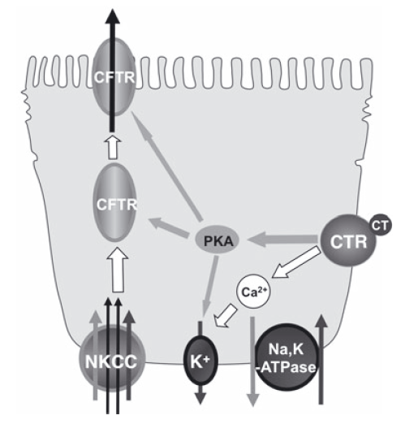

Slide 15
What is diagnostic W/U for patients with persistent biochemical MTC?
What is possibility bone metastasis in MTC?
Whatis physiopathology of diarrhea in patients with MTC?
What is prognosis in this case ?
What should be do in the case?

Slide 16
Overall, the prognosis for patients with MTC is good. The 10-year survival rate for patients with MTC is 75%–85%.
Approximately half of the patients with MTC present with disease localized to the thyroid gland, and these patients have a 10-year survival rate of 95.6%.
One third of patients present with locally invasive tumors or clinically apparent spread to the regional lymph nodes. Patients with regional disease have a 5-year overall survival rate of 75.5%.
Distant metastases are present in 13% of patients at initial diagnosis and portend a poor prognosis, with a 10-year survival rate of only 40%.

Slide 17
What is diagnostic W/U for patients with persistent biochemical MTC?
What is possibility bone metastasis in MTC?
Whatis physiopathology of diarrhea in patients with MTC?
What is prognosis in this case ?
What should be do in the case?

Slide 18
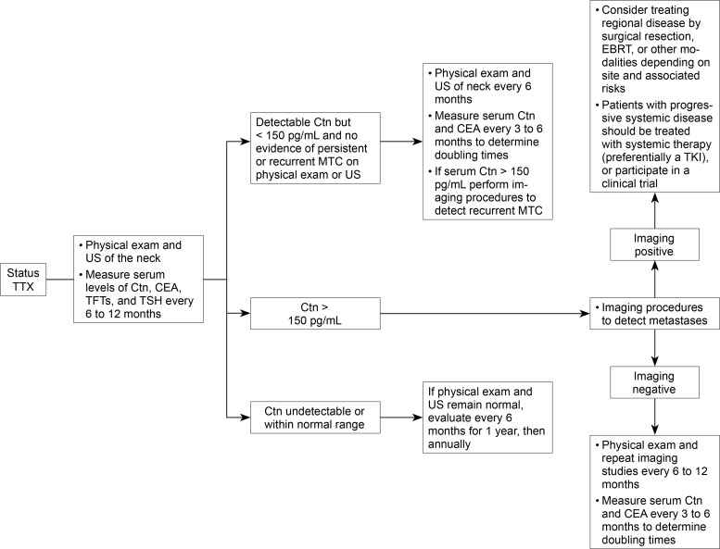

Slide 19
Patients with advanced MTC and diarrhea should be advised to avoid
alcohol intake and to maintain a diet that limits high-fiber foods.
The antimotility agents loperamide, diphenoxylate/ atropine, or
codeine have minimal side effects and should be used as first-line
therapy.
Treatment with somatostatin analogs (suppresses the levels of VIP and calcitonin) and debulking of large tumors has also been employed( with variable results, suggesting modestly improved symptoms in some patients

Slide 20
The management of patients with bone metastases includes therapies
Such as vertebroplasty, surgical excision, thermoablation
(radiofrequency or cryoablation), cement injection, and EBRT.
Treatment with either intravenous bisphosphonates (zoledronic acid or
pamidronate) or the receptor activator of nuclear factor kappa-B ligand
(RANKL) inhibitor, denosumab, in patients with thyroid cancer has been
effective in relieving pain from bony metastases and in preventing or
delaying the occurrence of other skeletal related events.

Slide 21
The use of single agent or combinatorial cytotoxic chemotherapeutic
regimens should not be administered as first-line therapy in patients
with persistent or recurrent MTC given the low response rates and
the advent of promising new treatment options.
In a study ,the degree of 111In-octreoscan tumor uptake was not
associated with treatment response or improvement in survival

Slide 22
In patients with significant tumor burden and symptomatic or
progressive metastatic disease according to RECIST treatment with TKIs
targeting both RET and VEGFR tyrosine kinases should be considered as
systemic therapy.
The TKIs vandetanib or cabozantinib can be used as single agent first-
line systemic therapy in patients with advanced progressive MTC.

Slide 23
Partial responses were observed in 45% of patients treated with
vandetanib, with a predicted median duration of response of 22
months. The improvement in quality of life, pain reduction, and
diarrhea allowed several patients in the vandetanib arm to resume a
normal social life.

Slide 24
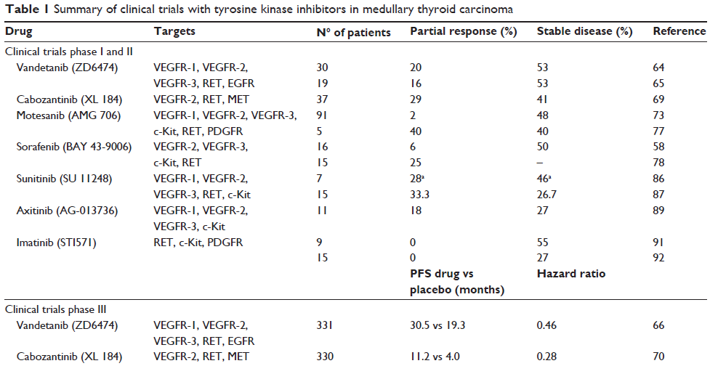

Slide 25
About the case:
Antimotility agent (loperamide)
octreoscan….octrotide
bisphosphonates/denosumab
EBRT
Chemotherapy ( TKI )

Slide 26
Thanks for your attention

