Slide 1
DM assessment in initial visit
Reference: ADA 2017
DR.Mahshid Babaei,endocrinologist
1396/5/26

Slide 2
agenda
DM complication :
Microvascular
Macrovascular
comorbidity
General health

Slide 3
خانمی 46 ساله با سابقه 7 ساله دیابت وتحت درمان روزانه 10 میلیگرم گلی بن کلامید و 500 میلیگرم متفورمین مراجعه می کند.سابقه فشارخون و درمان با لوزارتان 25 دوبارروزانه را نیز ذکر می کند.
FBS=189 BS2hpp=294
TG=305
TC=222
LDL =124
HDL=37
Cr= 0.9 U/A= glucosuria

Slide 4
Microvascular complication
Diabetic kidney disease
Screening
At least once a year, assess urinary albumin (e.g., spot urinary albumin–to–creatinine ratio) and estimated glomerular ﬁltration rate in patients with type 1 diabetes with duration of>5 years, in all patients with type 2 diabetes, and in all patients with comorbid hypertension. B

Slide 5
eGFR (mL/min/1.73 m2) | Recommended management
All patients | Yearly measurement of UACR, serum Cr, potassium

Slide 6
Cr=0.9
eGFR=?

Slide 9
eGFR (mL/min/1.73 m2) | Recommended management
45-60 | Referral to a nephrologist if possibility for nondiabetic kidney disease exists (duration of type 1 diabetes,10 years, persistent albuminuria, abnormal findings on renal ultrasound, resistant hypertension, rapid fall in eGFR, or active urinary sediment on urine microscopic examination) Consider the need for dose adjustment of medications Monitor eGFR every 6 months Monitor electrolytes, bicarbonate, hemoglobin, calcium, phosphorus, and PTH at least yearly Assure vitamin D sufficiency Vaccinate against Hep B virus Consider bone density testing Referral for dietary counseling

Slide 10
eGFR (mL/min/1.73 m2) | Recommended management
30-44 | Monitor eGFR every 3 months Monitor electrolytes, bicarbonate, calcium, phosphorus, PTH, hemoglobin, albumin, and weight every 3–6 months Consider the need for dose adjustment of medications

Slide 11
eGFR (mL/min/1.73 m2) | Recommended management
<30 | Referral to a nephrologist

Slide 12
albuminuria
UACR
urinary albumin–to–creatinine ratio (UACR) in a random spot urine collection.
Unit : mg/g
Normal < 30 mg/g sex ? Age ? Race?

Slide 13
urinary albumin excretion has an intraindividual CV of approximately 40%, multiple positive test results are required for classification.

Slide 14
Persistent albuminuria
Furthermore, because of biological variability in urinary albumin excretion, two of three specimens of UACR collected within a 3- to 6-month period should be abnormal before considering a patient to have albuminuria.

Slide 15
Exercise within 24 h
infection
fever
congestive heart failure
marked hyperglycemia
Menstruation
marked hypertension
Hematuria
may elevate UACR independently of kidney damage.

Slide 16
Urine cr = 750 mg/L
Urine albumin = 1.2 mg/dL
UACR= albumin 12 mg/L = 16 mg / g
Cr 0.750 g/L

Slide 18
retinopathy
Adults with type 1 diabetes should have an initial dilated and comprehensive eye examination by an ophthalmologist or optometrist within 5 years after the onset of diabetes. B

Slide 19
Patients with type 2 diabetes should have an initial dilated and comprehensive eye examination by an ophthalmologist or optometrist at the time of the diabetes diagnosis. B

Slide 20
If there is no evidence of retinopathy for one or more annual eye exams and glycemia is well controlled, then exams every 2 years may be considered.
If any level of diabetic retinopathy is present, subsequent dilated retinal examinations should be repeated at least annually by an ophthalmologist or optometrist. If retinopathy is progressing or sight-threatening, then examinations will be required more
frequently. B

Slide 21
neuropathy
All patients should be assessed for diabetic peripheral neuropathy starting at diagnosis of type 2 diabetes and 5 years after the diagnosis of type 1 diabetes and at least annually thereafter. B

Slide 22
neuropathy
Hx
Up to 50% of diabetic peripheral neuropathy (DPN) may be asymptomatic.
a similar number of patients with and without neuropathy answered positively on up to six questions, demonstrating that symptoms do not always indicate underlying neuropathy.

Slide 23
Assessment for distal symmetric polyneuropathy should include a careful history and assessment of either temperature or pinprick sensation (small-fiber function) and vibration sensation using a 128-Hz tuning fork (for large-fiber function).
All patients should have annual 10-g monofilament testing to identify feet at risk for ulceration and amputation. B

Slide 24
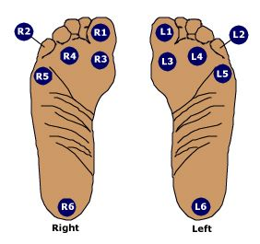
Pressure sensation

Slide 25
Pain and temperature sense
When preparing to test pain sensation, explain to the patient that you will be touching each finger with either the sharp or the dull end of a safety pin, and demonstrate each.

Slide 26
Vibration test
with a 128-Hz tuning fork applied to the bony prominence at the dorsum of the first toe, just proximal to the nail bed, twice on each great toe.

Slide 27
Symptoms and signs of autonomic neuropathy should be assessed in patients with microvascular and neuropathic complications. E

Slide 28
Cardiovascular Disease and Risk Management
Blood pressure
Blood pressure should be measured at every routine visit. Patients found to have elevated blood pressure should have blood pressure conﬁrmed on a separate day. B

Slide 29
Most patients with diabetes and hypertension should be treated to a systolic blood pressure goal of <140 mmHg and a diastolic blood pressure goal of ,<90 mmHg. A
Lower systolic and diastolic blood pressure targets, such as 130/80 mmHg, may be appropriate for individuals at high risk of cardiovascular disease, if they can be achieved without undue treatment burden. C

Slide 30
LIPID
In adults not taking statins, it is reasonable to obtain a lipid proﬁle at the time of diabetes diagnosis, at an initial medical evaluation, and every 5 years thereafter, or more frequently if indicated. E

Slide 31
Obtain a lipid proﬁle at initiation of statin therapy and periodically thereafter as it may help to monitor the response to therapy and inform adherence. E

Slide 32
A Meta-analyses demonstrate a 9% proportional reduction in all-cause mortality and 13% reduction in vascular mortality for each mmol/L (39 mg/dL) reduction in LDL cholesterol.

Slide 33
For patients of all ages with diabetes and atherosclerotic cardiovascular disease, high-intensity statin therapy should be added to life style therapy. A
For patients with diabetes aged <40 years with additional atherosclerotic cardiovascular disease risk factors, consider using moderate- intensity or high-intensity statin and lifestyle therapy. C

Slide 34
For patients with diabetes aged 40–75 years without additional atherosclerotic cardiovascular disease risk factors, consider using moderate-intensity statin and life- style therapy. A
For patients with diabetes aged 40–75 years with additional atherosclerotic cardiovascular disease risk factors, consider using high-intensity statin and lifestyle therapy. B

Slide 35
For patients with diabetes aged>75 years without additional atherosclerotic cardiovascular disease risk factors, consider using moderate-intensity statin therapy and lifestyle therapy. B
For patients with diabetes aged>75 years with additional atherosclerotic cardiovascular disease risk factors, consider using moderate-intensity or high-intensity statin therapy and lifestyle therapy. B

Slide 36
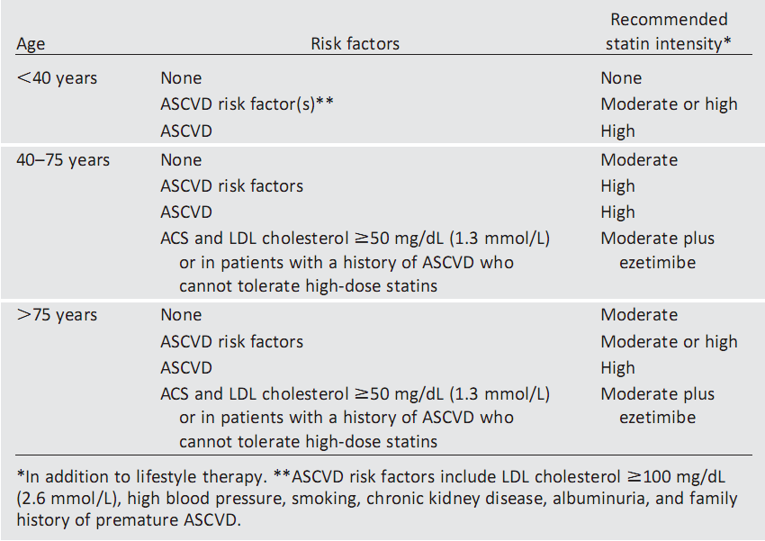
Recommendations for statin and combination treatment in diabetics

Slide 37
ANTIPLATELET AGENTS
Use aspirin therapy (75–162mg/day) as a secondary prevention strategy in those with diabetes and a history of atherosclerotic cardiovascular disease. A
For patients with atherosclerotic cardiovascular disease and documented aspirin allergy, clopidogrel (75 mg/day) should be used. B
Dual antiplatelet therapy is reasonable for up to a year after an acute coronary syndrome and may have beneﬁts beyond this period. B

Slide 38
Consider aspirin therapy (75–162 mg/day) as a primary prevention strategy in those with type 1 or type 2 diabetes who are at in- creased cardiovascular risk. This includes most men and women with diabetes aged>50 years who have at least one additional major risk factor (family history of premature atherosclerotic car- diovascular disease, hypertension, dyslipidemia, smoking, or albuminuria) and are not at increased risk of bleeding. C

Slide 39
Aspirin should not be recommended for atherosclerotic cardiovascular disease prevention for adults with diabetes at low atherosclerotic cardiovascular disease risk, such as in men or women with diabetes aged<50 years with no other major atherosclerotic cardiovascular disease risk factors, as the potential adverse effects from bleeding likely offset the potential beneﬁts. C

Slide 40
When considering aspirin therapy in patients with diabetes <50 years of age with multiple other atherosclerotic cardiovascular disease risk factors, clinical judgment is required. E

Slide 41
Low-dose aspirin (75-162 mg/d) | Reasonable for individuals with a ≥10% 10-year CVD risk and without increased bleeding risk*
Low-dose aspirin (75-162 mg/d) | Reasonable for adults with diabetes who are at intermediate CVD risk: 5-10% 10-year CVD risk†
*ACC/AHA Class IIa; level of evidence B (ADA level of evidence C) †ACC/AHA Class IIb; level of evidence C (ADA level of evidence E)

Slide 43
CAD ASSESSMENT
In asymptomatic patients, routine screening for coronary artery disease is not recommended as it does not improve outcomes as long as atherosclerotic cardiovascular disease risk factors are treated. A

Slide 44
recommendation
Consider investigations for coronary artery disease in the presence of any of the following:
atypical cardiac symptoms (e.g., unexplained dyspnea, chest discomfort);
signs or symptoms of associated vascular disease including carotid bruits, tran- sient ischemic attack, stroke, claudi- cation, or peripheral arterial disease; or electrocardiogram abnormalities (e.g., Q waves). E

Slide 45
Immunization
Provide routine vaccinations for children and adults with diabetes according to age-related recommendations. C

Slide 46
Inﬂuenza
In a case-control study, the inﬂuenza vaccine was found to reduce diabetes-related hospital admission by as much as 79%during ﬂue pidemics.
Annual vaccination against inﬂuenza is recommended for all persons with diabetes > = 6 months of age . C

Slide 47
People with diabetes may be at increased risk for the bacteremic form of pneumococcal infection and have been reported to have a high risk of nosocomial bacteremia,with a mortality rate as as high as 50% .

Slide 48
Vaccination against pneumonia is recommended for all people with diabetes 2 through 64 years of age with pneumococcal polysaccharide vaccine (PPSV23).
At age >=65 years, administer the pneumococcal conjugate vaccine (PCV13) at least 1 year after vaccination with PPSV23, followed by another dose of vaccine PPSV23 at least 1 year after PCV13 and at least 5 years after the last dose of PPSV23. C

Slide 49
Compared with the general population, people with type 1 or type 2 diabetes have higher rates of hepatitis B.
Administer 3-dose series of hepatitis B vaccine to unvaccinated adults with diabetes who are age 19–59years. C
Consider administering 3-dose series of hepatitis B vaccine to un-vaccinated adults with diabetes who are age >=60 years. C

Slide 50
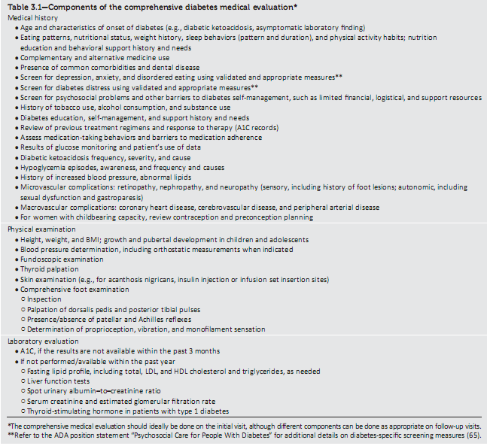

Slide 51
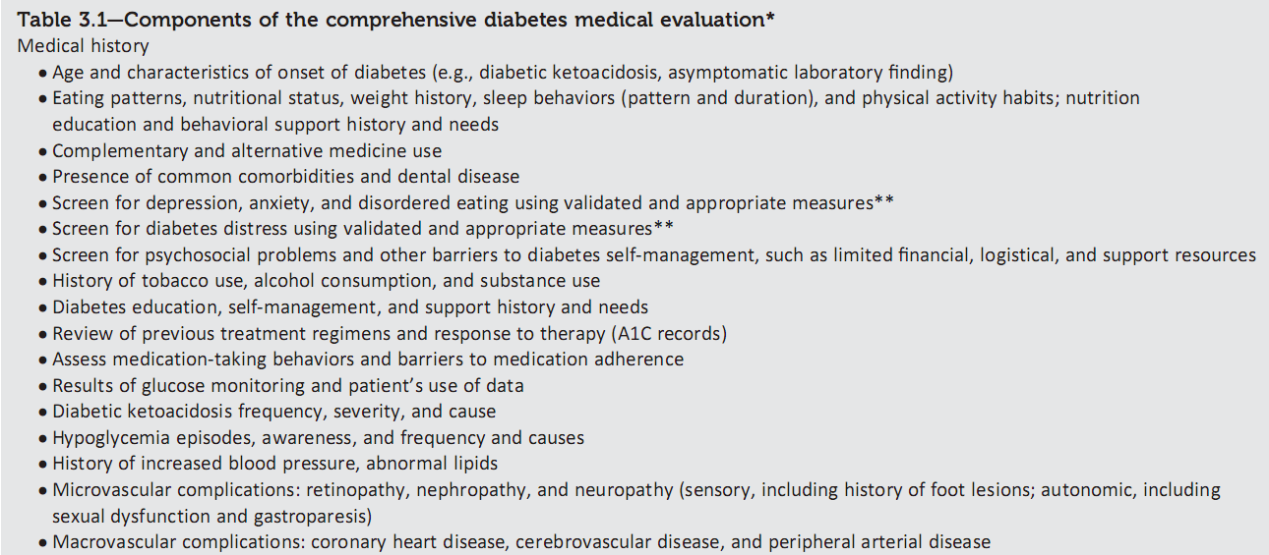

Slide 53
THANK YOU

Slide 54
خانم 44 ساله دیابتیک تحت درمان با متفورمین وسابقه فشارخون مراجعه میکند .در آزمایشات
TG=398 TC=222 HDL=38 HbA1C=8.3
دارد .چه تصمیمی در بیمار میگیرید؟
1.شروع استاتین و فنوفیبرات و کنترل قند
2. شروع استاتین و aspirin و فیبرات و کنترل قند
3.شروع استاتین وکنترل قند
4.شروع فیبرات و کنترل قند

Slide 55
آقای 38 ساله دیابتیک بدون عوارض میکرو و ماکرووسکولار مراجعه میکند .کدام مورد صحیح است؟
واکسیناسیون انفلوانزا سالانه انجام گردد.
بعد از 50 سالگی واکسیناسیون انفلوانزا سالانه انجام گردد.
در صورت داشتن ریسک فاکتور دیگری واکسیناسیون انفلوانزا سالانه انجام گردد.
واکسیناسیون نیاز ندارد.

