Slide 1
medically induced CSF leakage in pituitary adenomas
Dr. Rhim Zahedi

Slide 2
CSF rhinorrhea can be easily differentiated from allergic rhinitis or other nasal discharge conditions by biochemical analysis of fluid for sugar (usually more than 30 mg/dL) and beta-2 transferrin, which is present in CSF-containing fluid

Slide 3
Twenty-nine articles were identified from between the years 1980 and 2011, describing 52 patients with spontaneous or medically induced CSF leaks in the setting of a pituitary adenoma

Slide 4
The etiologies of spontaneous CSF leaks are numerous, and leaks have been associated with various factors, including obesity, trauma, and multiparity
There have also been several reports of development of CSF rhinorrhea following the initiation of medical treatment for pituitary adenomas
The classical description of this phenomenon has been in the setting of DA therapy for prolactin-secreting tumors

Slide 5
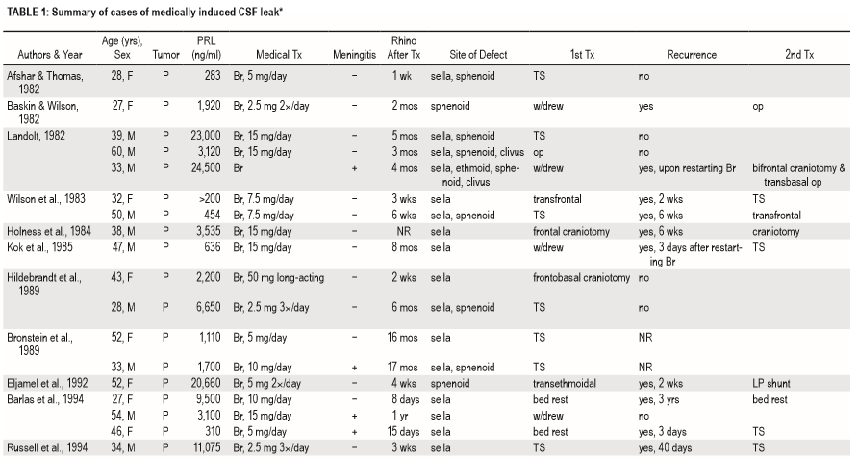

Slide 6
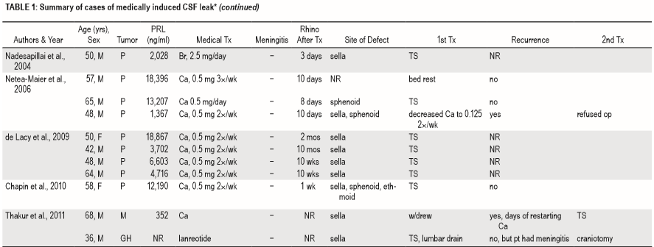

Slide 7
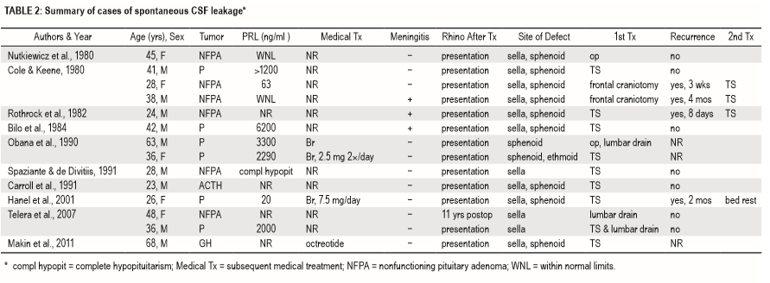

Slide 8
Results
A majority of these cases (38 patients, 73%) occurred following initiation of medical therapy
whereas the CSF leak developed as the presenting symptom of a pituitary adenoma in the remaining 14 patients (27%)
Forty-two patients (81%) had a prolactinoma
The remaining 10 patients had the following tumor subtypes: nonfunctioning pituitary adenoma (6 patients, 11%), mammosomatotroph cell adenoma (1 patient, 2%), GH-secreting adenoma (2 patients, 4%), and ACTH-secreting adenoma (1 patient, 2%)

Slide 9
36 of the 38 patients who developed CSF leaks following initiation of medical therapy had prolactinomas
whereas patients who developed spontaneous (noniatrogenic) CSF leaks had a variety of pituitary adenomas (6 prolactinomas, 6 nonfunctioning pituitary adenomas, 1 GH-secreting adenoma, and 1 ACTH-secreting adenoma)
The medical agents most closely associated with CSF leakage were DA medications in 37 patients (97%) and a somatostatin analog (lanreotide) in 1 patient (3%)

Slide 10
Of the patients who developed CSF rhinorrhea while taking DA medications, 24 were taking bromocriptine and 13 were taking cabergoline
The average time from initiation of medical therapy to onset of rhinorrhea was 3.3 months (range 3 days–17 months)
Seven patients (14%) presented with meningitis in conjunction with CSF rhinorrhea
Tumor size was reported in 9 of 52 cases (17%), with a mean maximum tumor diameter of 3.6 cm

Slide 11
. Forty-nine of 52 patients (94%) were reported to have tumors with neuroimaging evidence of extrasellar tumor invasion
Specific invasion into the sphenoid sinus, ethmoid sinus, or clivus was documented in 29 patients (56%)
In 47 patients, a discrete skull base defect could be identified on imaging studies, most frequently with thin-slice CT images in the coronal plane
The average initial prolactin level in patients with spontaneous CSF leakage was 9169 ng/ ml, compared with 4917 ng/ml in those with medically induced leakage

Slide 12
Treatment Characteristics in Patients With CSF Leaks and Underlying Pituitary Adenomas
In 4 patients, nonoperative management was successfully employed. Of these, 1 patient was successfully treated with temporary lumbar drainage and the other 3 with bed rest or withdrawal of medications
Forty-six patients (88%) ultimately underwent surgical intervention as the definitive treatment for the CSF leak
Definitive procedures for the CSF leaks included: transsphenoidal surgery (32 patients), craniotomy (5 patients), lumboperitoneal shunt (2 patients), and unknown approach (7 patients).
In 21 of 38 cases of DA-induced leak, there was no documented recurrence after the initial treatment

Slide 13
Recurrence was documented in the remaining 17 cases, and a combination of treatment approaches was employed
In 8 cases, temporary cessation of rhinorrhea occurred with treatment reduction or withdrawal, but the rhinorrhea recurred within days or weeks of restarting medical treatment
In 7 cases, rhinorrhea recurred despite initial surgical treatment
Of these cases, rhinorrhea was ultimately resolved with a transsphenoidal approach in 3 patients, a transfrontal approach in 1 patient, lumboperitoneal shunt placement in 1 patient, and craniotomy in 1 patient, and it subsided without treatment in 1 patient

Slide 14
The majority of cases of nonsurgical CSF leaks, the leaks occur in the setting of invasive pituitary tumors (typically prolactinomas) following initiation of standard medical management
In larger and more invasive pituitary adenomas, tumor expansion into the surrounding dural and bony structures is commonly observed
For instance, GH-secreting adenomas and prolactinomas are known to frequently invade the sellar floor and infrasellar space (sphenoid sinus and clivus)

Slide 15
whereas nonfunctioning macroadenomas have a tendency to invade the suprasellar space via bowing or invasion of the diaphragma sellae
In cases where the arachnoid and/or brain parenchyma have also been violated, the potential for developing a CSF fistula has been established
These communications have little clinical significance as long as the tumor occludes the opening and serves as a “plug,” thus preventing the escape of CSF

Slide 16
Any significant reduction in tumor size, however, can provide a conduit for the escape of CSF, typically resulting in CSF rhinorrhea
Rapid tumor shrinkage is frequently associated with initiation of dopamine agonist therapy for prolactin-secreting tumors
The development of meningitis should be anticipated and addressed in advance in cases of nonsurgical CSF leak.
Surgical repair is the recommended initial treatment for definitive management of DA-induced rhinorrhea, and was ultimately required in nearly 90% of patients reviewed in the literature

Slide 17
Our preferred operation in the majority of cases is the endoscopic endonasal approach, although open surgical repair via a craniotomy may be warranted in a minority of cases
Depending on the tumor subtype and growth patterns, tumor resection may be concurrently achieved prior to reconstruction of the skull base in these instances, although complete tumor resection may be limited in many of these cases as these tumors are by definition invasive into bone and dura
For smaller “weeping” CSF leaks, dural substitutes and/or fibrin glue may be used to achieve a successful repair
For larger CSF leaks, the use of autologous fat or fascia is recommended, with or without a sellar floor buttress
For extremely large or refractory CSF leaks, rotation of a pedicled nasoseptal flap may be required to definitively address the CSF fistula

Slide 18
reduction or discontinuation of medical therapy was attempted as the primary treatment in 24% of cases, we do not recommend this strategy in patients who are candidates for surgical repair
The half-life of cabergoline is 63–69 hours and that of bromocriptine is 12–14 hours, suggesting that no immediate effects from medication discontinuation will be achieved via this strategy

Slide 19
We recommend surgical repair of spontaneous or medically induced CSF leaks in the setting of pituitary adenomas, along with safe maximal tumor resection, in patients who are surgical candidates
In patients who are not surgical candidates, a more conservative approach would include temporary cessation of medical therapy and temporary insertion of a lumbar drain, but this strategy is not recommended as a first-line therapy unless deemed medically necessary

Slide 20
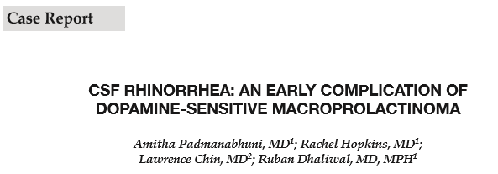
A 35-year-old obese male presented with weight gain of over 100 pounds within the last year and absent morning tumescence. Laboratory evaluation was notable for elevated total prolactin (PRL) (4,655 ng/mL) and low total testosterone (24 ng/dL

Slide 21
MRI revealed a large pituitary adenoma (4.2 × 2.5 × 3.5 cm) extending into the cavernous and sphenoid sinuses, partially eroding the sphenoid bone

Slide 22
cabergoline 250 µg twice a week was started. After two doses of cabergoline, the patient developed CSF rhinorrhea
Serum mono total PRL of 370 ng/mL. MRI pituitary revealed persistent tumor, size 4.2 × 3.5 × 2.5 cm. Cabergoline dose was increased to 500 µg twice/week

Slide 23
CSF rhinorrhea completely resolved. Concurrently, monomeric PRL decreased to 90 ng/mL, with a total PRL of 102 ng/mL.

Slide 24
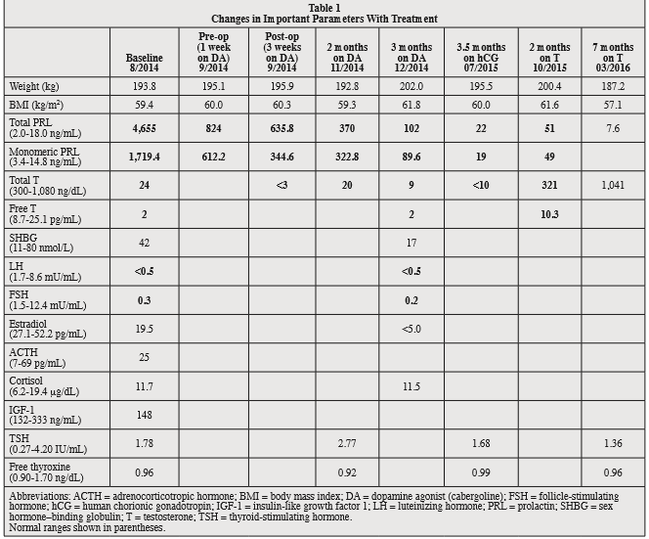

Slide 25
MRI is the modality of choice to provide multiplanar high-contrast images of the pituitary gland and its adjacent structures
(CT) is used only for supplementary purposes, i.e., to look for bony changes or to exclude or visualize calcifications

Slide 26
A standard protocol for MRI of the pituitary and parasellar region consists of thin-section (2–3 mm) sagittal and coronal T1-weighted images with and without contrast enhancement

Slide 27
They are relatively common incidental findings at autopsy (up to 30%) usually remaining asymptomatic

Slide 28
It is thought that arachnoid cysts arise from herniation of an arachnoid diverticulum through an incomplete diaphragma sellae

Slide 29
typically seen as a small nodule with characteristic high signal at the median eminence in the floor of the third ventricle

Slide 30
Cavernous sinus invasion often restricts complete surgical tumor resection

Slide 31
Intratumoral hemorrhage of macroadenomas occurs in up to 10–15% of incidental pituitary adenomas

Slide 32
Microadenomas are best seen on coronal images and usually appear hypo- or isointense relative to normal pituitary tissue on unenhanced T1-weighted images

Slide 33
if residual tumor is suspected after incomplete resection of invasive pituitary adenomas. Also in case of persisting or recurring hormone disturbances, MRI is the modality of choice to visualize residual tumor

Slide 34
Due to an en plaque growth pattern often associated with a “dural tail”, differentiation from pituitary macroadenomas usually is not a problem

Slide 35
Thank you for your attention

