Slide 1
In The Name of God
ADRENAL INCIDENTALOMA
Fatemeh zameni, MD
Fellow of Endocrinology
Research Institute of Endocrine Sciences
2016 May

Slide 2
ADRENAL INCIDENTALOMA
Adrenal incidentaloma refers to the casual detection of an adrenal lesion during imaging performed for reasons unrelated to adrenal disease.

Slide 3
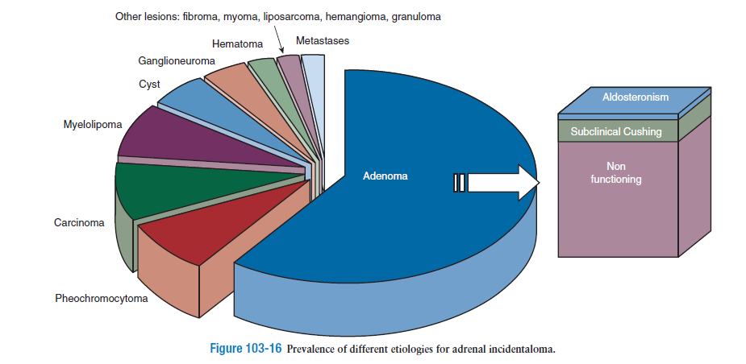
Etiology of ADRENAL INCIDENTALOMA
2015

Slide 4
Assessment of the Patient with Adrenal Incidentaloma
Imaging Studies:
1-Size
2- Hounsfield units
3-Washout
Hormonal Evaluation :
1-Pheochromocytoma
2- Primary aldosteronism
3-Cushing’s syndrome
2015

Slide 5
ARR cut-off values:

Slide 6
Our Case:
ARR = 235.5

Slide 7
Case Confirmation:
Four testing procedures: (No gold standard)
Oral sodium loading test
Saline infusion test (SIT)
Fludrocortisone suppression test
Captopril challenge test
*Choice: cost, compliance, lab routine,
local expertise

Slide 8
SIT:
Lack powerful study designs for establishing the test accuracy
Sensitivity: 83-88%
Specificity: 75-100%

Slide 9
SIT

Slide 10
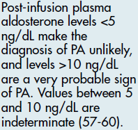
SIT:

Slide 11
Our Case:
SIT:
Start End
PAC (ng/dL) 75.8 70.9
PRA (ng/mL/h) 0.33 0.39
Cortisol (micg/dL) 5.86 5.65
Potassium (mg/dL) 3.9 3.5
PAC/Cortisol 12.9 12.5

Slide 12
Subtype Classification:
Adrenal CT scan
Adrenal venous sampling (AVS):
If surgical treatment is practicable and desired by the patient
To distinguish between unilateral and bilateral adrenal disease
Ancillary tests

Slide 13
Adrenal CT Scan:
APA: usually < 2 cm, hypodense nodule
IHA: normal-appearing or unilateral or bilateral nodular changes
Aldosterone-producing adrenal carcinomas:
almost always > 4 cm and with suspicious imaging phenotype
Sensitivity: 48-58%; Specificity: 90%
Several Limitations especially in older patients (>40 yr), thus:
AVS is essential to direct appropriate therapy

Slide 14
Our Case:
Adrenal CT scan:
A 38 mm mass with small central calcification of right adrenal.
HU in precontrast : 12
HU in portal phase : 80
HU in delay phase : 40
Absolute wash out : 66%

Slide 15
Unsuccessful or unavailable AVS:
Repeat AVS
Treat with MR antagonist
Consider surgery based on the other studies:
Adrenal CT Scan
Posture Stimulation Test
Morning Recumbent 18-OHB levels
Not available
Low accuracy

Slide 16
Posture Stimulation Test:
The absence of the significant increase (<30%) of PAC at the upright posture supports the diagnosis of APA
Test accuracy: 85%
Fontes RG, Am J Hypertens 1991;4:786-91
Young WF, Endocrinol Metab Clin North Am 1988;17:367-95
The fall in PAC during 4 h erect posture has PPV of 100% for diagnosis of unilateral lesion
Espiner EA, J Clin Endocrinol Metab 2003;88:3637-44

Slide 17
Our Case:
Posture Stimulation Test:
overnight recumbent 2 h ambulation
PAC (ng/dL) 87.0 75.8
PRA (ng/mL/h) 0.32 0.33
PAC increase: - 11.2 ng/dL ( - 12 %)

Slide 18
Summary of Diagnostic Studies:
ARR = 235.5 ng/dL per ng/mL/h
Post-SIT PAC= 70.9 ng/dL
Post-SIT PAC/Cortisol= 12.5 ng/dL per micg/dL (in favor of APA)
Positive posture stimulation test (in favor of APA)
An adenoma on CT scan

Slide 19
Diagnosis
Aldosterone-producing Adenoma

Slide 21
The Concept of Subclinical Cushing’s syndrome(SCS)
The presence of one or more abnormalities in cortisol secretion in patients who do not present features of overt Cushing’s syndrome.
Prevalence : 1% to 47%
Higher in bilateral lesions

Slide 22
Diagnosis
Cortisol level < 1.8micg/dL after 1 mg
dexamethasone clearly exclude autonomous
cortisol secretion.
Cortisol levels >5 micg/dL likely indicate SCS if no interfering conditions are present.
Cortisol level 1.8 - 5 micg/dL DST be considered as indeterminate.

Slide 23
When the results of the 1-mg DST are undefined ,SCS may be definitively demonstrated with additional work-up, i.e. measurement of ACTH, UFC or late-night salivary cortisol.
We are not using adrenal scintigraphy anymore to detect autonomous cortisol secretion because this test causes a high radiation exposure

Slide 24
What work-up should be performed for subclinical hypercortisolism?
A head-to-head comparison made did not find any advantage of the 8 mg DST compared to the 1-mg DST in the screening of SCS.
The 2-day low-dose DST has been proposed as a confirmatory test because it should be more accurate, although more time-consuming, than the overnight DST.
UFC & ACTH results is flawed by technical problems.
Late-night salivary cortisol may be more specific than the 1-mg DST, identifying patients with a more than minimal cortisol excess.
Midnight serum cortisol is a reliable method to detect a disturbance in the cortisol rhythm.

Slide 25
Summary of Diagnostic Studies:
Cortisoi over night : 2.42 mcg/dl
UFC : 17.6 mcg/24 hs
Cortisol 11 PM : 37.3 mcg/dl
Cortisol 8 AM : 16.5 mcg/dl
ACTH : 10.7 pg/ml
DHEA.S : 14.0 mcg/dl

Slide 26
Diagnosis :
Subclinical Cushing’s syndrome

Slide 27
Diagnosis :
Aldosterone-producing Adenoma
Subclinical Cushing’s syndrome

Slide 28
Management:
Recommendation of endocrine society guideline (2015):
Documented unilateral PA:
Unilateral laparoscopic adrenalectomy

Slide 29
Outcome After Adrenalectomy:
Cure of HTN (<140/90 mmHg):
50 % (range 35%–80%) of patients with APA
Improvement of BP control:
100%

Slide 30
Outcome After Adrenalectomy:
A large case-control study demonstrated a similar mortality of patients with PA treated either with adrenalectomy or with MR antagonists compared with mortality of patients with essential (primary) hypertension.
Adrenalectomy induces a significant and sustained reduction in LV mass index due to a reduction in LV diameter and volume with a reduction in LV workload (improvement in diastolic dysfunction) .
Adrenalectomy also appears to reverse the increase in carotid intima media thickness and arterial stiffness in patients with unilateral PA .
Rossi GP, Hypertension. 2013;62:62–69.
Reincke M, Hypertension. 2012;60:618–624.
Lin YHAtherosclerosis. 2012;221:154–159.

Slide 31
Outcome After Adrenalectomy:
Two prospective studies also reported the reversal of albuminuria 1 year following adrenalectomy.
Wu VC, Kuo CC, Journal of hypertension. 2011;29:1778–1786
Jacobsen NE, The Canadian journal of urology. 2003;10:1995–1999
Another study reported significant improvement
in QOL by 3 months sustained at 6 months (38).
Sukor N The Journal of clinical endocrinology and metabolism. 2010;95:1360–1364

Slide 32
Outcome After Adrenalectomy:
Predictors of complete resolution of HTN:
<=2 preoperative antihypertensive drugs**
<=1 first-degree relative with HTN**
Younger age
Shorter duration of HTN (< 6 years)
Lower BMI
Female sex
Higher preoperative ARR
Higher urinary aldosterone secretion
Positive preoperative response to Spironolactone
APA size of <= 20 mm

Slide 34
Subclinical Hypercortisolism
Sustained tissue exposure to even mildly elevated cortisol levels may lead to detrimental clinical consequences:
Obesity
Hypertension
Impaired glucose and lipid metabolism
Insulin resistance
Other features of metabolic syndrome
An increased cardiovascular risk
Up to 43% to 72% present bone mineral loss and vertebral fractures
2015

Slide 35
Patients with apparently non-functioning adrenal incidentalomas may be at increased cardiovascular risk due to excessive cortisol secretion
Ioannis I, J Clin Endocrinol Metab, 2013-4064.

Slide 36
Key message:
Patients without DM2, HTN and hyperlipidemia harboring apparently NFAI found increased CVDR assessed by biochemical markers and noninvasive imaging markers of subclinical atherosclerosis.
NFAI appear to adversely affect the endothelium both structurally and functionally, that could predict future cardiovascular events.

Slide 37
Beneficial Metabolic Effects of Prompt Surgical Treatment in Patients with an Adrenal Incidentaloma Causing Biochemical Hypercortisolism
Iacopo Chiodini, J Clin Endocrinol Metab, June 2010, 95(6):2736–2645

Slide 38
Key Message
In patients with adrenal incidentalomas, particularly if potential comorbidities are present,the surgical treatment appears to be useful, whereas the conservative approach deleterious regarding BP and FBS.
The biochemical diagnosis of SH is useful in detecting patients who better take advantage of the surgical treatment.

Slide 39
Surgical Versus Conservative Management for Subclinical Cushing Syndrome in Adrenal Incidentalomas
Antonio Toniato, Annals of Surgery • Volume 249, Number 3, March 2009

Slide 40
Key Message
Laparoscopic surgery proved a safe procedure in our SCS patients. Most of the patients with comorbidities (mainly important cardiovascular risk factors) saw improvements in their parameters after surgery.
None of the patients in the conservatively managed group progressed from subclinical to overt Cushing syndrome requiring a mandatory surgical treatment, no improvement was noted in their clinical conditions, while several patients experienced deterioration in their clinical features attributable to hypercortisolism.
Our results show that laparoscopic adrenalectomy, performed by skilled surgeons, is more beneficial than conservative management for SCS patients.

Slide 41
Long-Term Follow-Up in Adrenal Incidentalomas : An Italian Multicenter Study
Valentina Morelli,
J Clin Endocrinol Metab, March 2014, 99(3):827–834

Slide 42
Key Message
AIl patients without SH, a clinical an biochemical long-term follow-up is recommended for the risk of SH development, especially in patients with an adenoma of> 2.4 cm.
In AIl patients with SH, the increased risk of incident CVEs has to be taken into account in addressing the treatment of choice.

Slide 43
SUMMARY AND RECOMMENDATIONS
Surgery
younger patients with SCH
patients who present vascular, metabolic or bone disorders potentially linked to cortisol excess and are of:
recent onset
difficult to control
progressively deteriorating.
Not Surgery
Advanced age
long history of associated diseases with established target organ damage are factors predicting unsuccessfulness of surgery in overt Cushing’s syndrome.

Slide 44
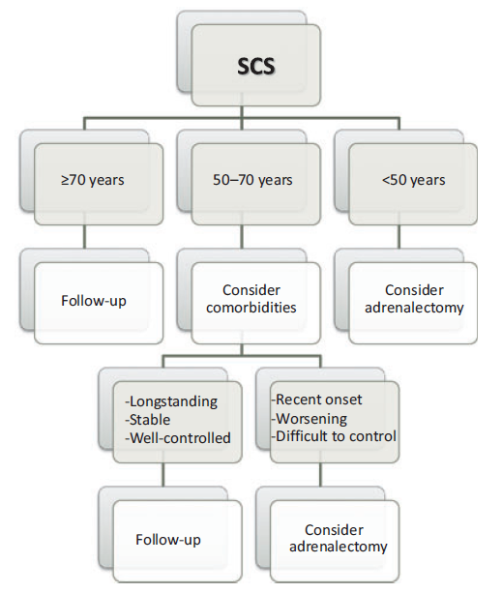
SUMMARY AND RECOMMENDATIONS

Slide 45
Our Case Recomendation :
Laparoscopic Right adrenalectomy

Slide 46
Thanks For Your Patience

