Slide 1
Standards of Medical Care
in Diabetes - 2018
Majid Valizadeh, M.D
Endocrinologist.
Associate prof. Research institute for endocrine sciences.
Shahid Beheshti University of Medical Sciences.
Tehran -97.09.22

Slide 2
Agenda
Introduction
Pre-diabetes
Case presentation
Treatment goals.
Comprehensive medical care.
Guidelines: ADA 2018 , AACE 2016.
Different anti-diabetic drugs (Advantages-Disadvantages)
Drug selection (First- Second and Third choices)
Conclusion.

Slide 3
Introduction
Diabetes is one of the largest global health emergencies of the 21st century.
Each year more and more people live with this condition, which can result in life-changing complications. In addition to the 415 million adults who are estimated to currently have diabetes, there are 318 million adults with impaired glucose tolerance, which puts them at high risk of developing the disease in the future.

Slide 4
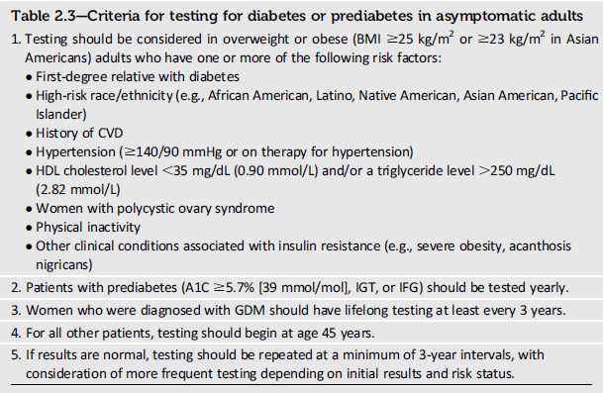
T2DM risk factors

Slide 5
Prediabetes
Those determined to be at high risk for type 2 diabetes, including people with:
  A1C 5.7–6.4% (39–47 mmol/mol),
  impaired glucose tolerance,
  impaired fasting glucose,
are ideal candidates for diabetes prevention efforts.

Slide 6
Diabetes Prevention Program
The two major goals of the DPP intensive, behavioral, lifestyle intervention were to achieve and maintain a minimum of 7% weight loss and 150min of physical activity per week similar in intensity to brisk walking.

Slide 7
Insulin resistance:
An underlying problem
Time
Insulin resistance
Insulin production
Glucose level
Non-
diabetes
Pre-
diabetes
Type 2
diabetes
Adapted from Opara & Levine, South Med J 90:1162-1168, 1997
Notes:
KEY MESSAGE: Insulin resistance precedes the elevation in plasma glucose levels.

Slide 8
Rising Prevalence of Diabetes Mellitus
Frequency of Diagnosed and Undiagnosed Diabetes and IGT by Age
Adapted from M Harris Diabetes Care 16:642-52, 1993
Notes:
1.5 Million Canadians Have Diabetes Mellitus
According to data from the Heart and Stroke Foundation of Canada, overall, 4% of Canadian men and 5% of women report having diabetes mellitus, that is 1.5 million Canadians.¹ They report an increasing prevalence of diabetes with age, ranging from 1-3% in the youngest (15-34 years) to 9-12% in the oldest (55-74 years) age groups.¹
The true prevalence may be double that of self-reported diabetes, based on this U.S. study by Harris, which showed that 50% of adults with diabetes have not been diagnosed.² The high incidence of impaired glucose tolerance (IGT) in the population is also a consideration. Although the data in this graph are from the U.S., the prevalence data for Canada are very similar.
Type 2 (noninsulin dependent) diabetes accounts for up to 95% of cases, while type 1 (insulin dependent) diabetes is much less frequent, affecting about 5-10% of the population with diabetes.^{2,3} By 1995, an estimated 110 million individuals worldwide had been diagnosed with diabetes, and the WHO projects this will double by the year 2010.³
References: 1. Heart and Stroke Foundation of Canada. Heart Disease and Stroke in Canada, Ottawa, Canada, 1997. 2. Harris MI. Undiagnosed NIDDM: Clinical and public health issues. Diabetes Care 1993;16:642-52. 3. Plosker GL, Faulds D. Troglitazone. Drugs 1999;57(3):410-32. 4. Turner NC, Clapham JC. Insulin resistance, impaired glucose tolerance and non-insulin-dependent diabetes, pathologic mechanisms and treatment: current status and therapeutic possibilities. Prog Drug Res 1998;51:33-94.

Slide 9
Life style intervention- Nutrition
Reducing caloric intake is of paramount importance for those at high risk for developing type 2 diabetes,
The quality of fats consumed in the diet is more important than the total quantity of dietary fat.
overall healthy low-calorie eating patterns should be encouraged

Slide 10
Life style intervention- Physical activity
150min/week of moderate-intensity physical activity, such as brisk walking.
In addition to aerobic activity, an exercise regimen designed to prevent diabetes may include resistance training
Breaking up prolonged sedentary time may also be encouraged, as it is associated with moderately lower postprandial glucose levels

Slide 11
Technology Assistance to Deliver
Lifestyle Interventions
electronic and mobile health-based modalities as effective vehicles for DPP-based interventions.
Recent studies support content delivery through virtual small groups , Internet-driven social networks , cell phones, and other mobile devices.
Mobile applications for weight loss and diabetes prevention have been validated for their ability to reduce A1C in the setting of prediabetes.

Slide 12
PHARMACOLOGIC INTERVENTIONS
Metformin therapy for prevention of T2DM should be considered in those with prediabetes, especially for those:
  with BMI$35 kg/m2,
  those aged < 60 years,
  and women with prior GDM.

Slide 13
Diabetes Mellitus (Type 2)

Slide 14
خانم 53 ساله با سابقه دیابت از 3 سال پیش برای پیگیری مراجعه کرده، ویزیت قبلی وی 4 ماه پیش بوده ولی بعلت مسایل مالی قادر به مراجعه در زمان تعیین شده (1 ماه قبل ) نبوده. درحال حاضر روزانه 2 گرم متفورمین ، 2.5 میلی گرم (نصف قرص) روزانه گلی بن کلامید و یک عدد اتورواستاتین 20 میلی گرم مصرف می کند. در معاینه BP: 130/80 - BMI: 30 Kg/m2 دارد و سایر معاینات طبیعی هستند.
FBS: 160 mg/dl BS: 210 mg/dl Hb A1c: 8% و LDL: 75 mg/dl دارد.
در مراجعه قبلی Hb A1c : 7.5 % داشته
توصیه شما برای بهبود کنترل گلایسمیک وی چیست؟

Slide 15
Relative Risk of Progression of Diabetic Complications
RELATIVE RISK
Mean A1C
        DCCT Research Group, N Engl J Med 1993, 329:977-986.

Slide 16
The goals of therapy
Eliminate symptoms related to hyperglycemia.
Reduce or eliminate the long-term microvascular and macrovascular complications.
Allow the patient to achieve as normal a lifestyle as possible.
The care of an individual with either type 1 or type 2 DM requires a multidisciplinary team:
Endocrinologist or diabetologist, a certified diabetes educator, a nutritionist, and a psychologist, neurologists, nephrologists, vascular surgeons, cardiologists, ophthalmologists, and podiatrists.
Diabetes Care Volume 40, Supplement 1, January 2017

Slide 17
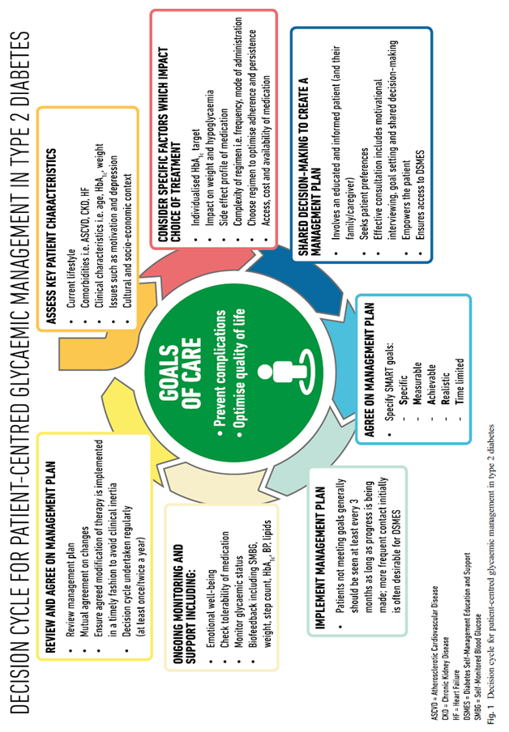

Slide 18
Primary Objectives of Effective Management
Diagnosis
lGæde P, Vedel P, Larsen N, Jensen GVH, Parving H-H, Pedersen O. Multifactorial intervention and cardiovascular disease in patients with type 2 diabetes. N Engl J Med. 2003;348:383-393.
A1C
%
9
8
7
Reduction
of both
micro- and macro-
vascular
event
rates
…by 75%!
SBP
mm Hg
145
130
LDL
mg/dL
140
100
45
50
55
60
65
70
75
80
85
90
Patient Age
Notes:
Key Points
The primary objectives of effective diabetes management are to reduce A1C to as near-normal levels (ie, 4%–6%) as is possible and safe, to lower systolic blood pressure to <130 mm Hg, and to decrease LDL cholesterol to <100 mg/dL
Achieving target levels of A1C, systolic blood pressure, and LDL cholesterol may reduce the risk of the micro- and macrovascular complications of diabetes by up to 75%
As illustrated in this slide, the objectives of effective diabetes management are to reduce A1C to as near-normal levels as is possible and safe (ie, 4%–6%), lower systolic blood pressure to <130 mm Hg, and to decrease LDL cholesterol to <100 mg/dL. Evidence suggests that achieving these target levels can reduce the risk of both microvascular and macrovascular complications of diabetes by >75%.¹
Most recently, the Steno-2 Study followed 160 patients with type 2 diabetes and microalbuminuria over 7.8 years to determine the effect of intensive treatment on long-term CV and microvascular outcomes. Researchers found that target-driven, intensive treatment consisting of stepwise diet, exercise, and pharmacotherapy for glycemia, microalbuminuria, lipids, and blood pressure resulted in a decreased risk of CV and microvascular events of about 50%. Control group members received conventional treatment in accordance with national guidelines. However, factors leading to diminished degrees of separation between the intensive treatment and control groups (eg, more than 50% of control group members were referred for specialist treatment during the course of the study) led the authors to estimate that the actual risk reduction associated with intensive versus conventional therapy may be even greater than that observed.²
References
American Diabetes Association. Clinical Practice Recommendations. Implications of the United Kingdom Prospective Diabetes Study. Diabetes Care. 2003;26(suppl 1):S28-S32.
Gæde P, Vedel P, Larsen N, Jensen GVH, Parving H-H, Pedersen O. Multifactorial intervention and cardiovascular disease in patients with type 2 diabetes. N Engl J Med. 2003;348:383-393.

Slide 19
Guidelines for Ongoing, Comprehensive Medical Care for
Patients with Diabetes
Optimal and individualized glycemic control.
SMBG (individualized frequency).
HbA1c testing (2–4 times/year).
Patient education in diabetes management (annual).
Medical nutrition therapy and education (annual).
Eye examination (annual or biannual).
Foot examination (1–2 times/year by physician; daily by patient).
Screening for diabetic nephropathy (annual).
Blood pressure measurement (quarterly).
Lipid profile and serum creatinine (estimate GFR) (annual).
Influenza/pneumococcal/hepatitis B immunizations.
Consider antiplatelet therapy.
Diabetes Care Volume 40, Supplement 1, January 2017

Slide 20
Treatment goals

Slide 21


Summary of glycemic recommendations for non-pregnant adults with diabetes.
*More or less stringent glycemic goals may be appropriate for individual patients. Goals should be individualized based on duration of diabetes, age/life expectancy, comorbid conditions, known CVD or advanced microvascular complications, hypoglycemia unawareness, and individual patient considerations.
Diabetes Care Volume 40, Supplement 1, January 2017

Slide 22
Current glycaemic targets
Current HbA_{1c} goals include:
  ADA, EASD: <7%
  AACE, JDS , IDF ≤6.5%
Current pre- and postprandial glucose goals include:
ADA
  Pre-meal: 80–130 mg/dL (5.0–7.2 mmol/L)
  Peak: <180 mg/dL (<10 mmol/L)
IDF
  Pre-meal: <110 mg/dL (<6.0 mmol/L)
  1–2-h peak: <160 mg/dL (<9.0 mmol/L)
AACE, American Association of Clinical. Endocrinologists; JDS, Japan Diabetes Society

Slide 23
A1C and Glycemic Targets
Numerous aspects must be considered when setting glycemic targets. The ADA proposes optimal targets, but each target must be individualized to the needs of each patient and his or her disease factors.
The Goal of Therapy is to achieve an HbA₁c level as close to normal as possible, without subjecting the patient to excessive risk of hypoglycaemia.

Slide 24
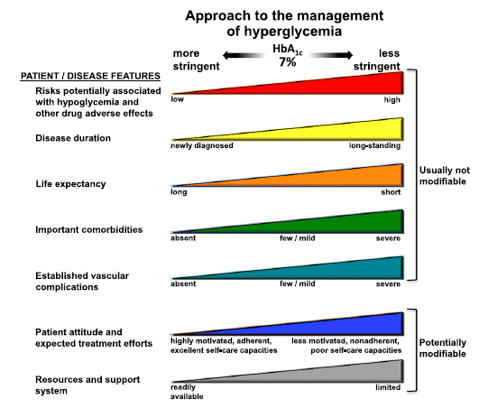
Approach to the management of hyperglycemia
Bio-
Patient-centred care
Psycho
-social
Diabetes Care Volume 40, Supplement 1, January 2017
Inzucchi et al. Diabetes Care 2012;35:1364–79

Slide 25
More Stringent HbA1c Targets <6.5%
Short disease duration.
Long life expectancy.
No significant CVD .
Type 2 diabetes treated with lifestyle or metformin only.
If this can be achieved without significant hypoglycemia or other adverse effects of treatment.
Diabetes Care Volume 40, Supplement 1, January 2017

Slide 26
Less Stringent HbA1c Targets < 8.0
History of severe hypoglycemia.
Limited life expectancy.
Advanced complications.
Extensive comorbid conditions.
In whom the target is difficult to attain despite intensive self-management education, repeated counseling, and effective doses of multiple glucose-lowering agents, including insulin.
Diabetes Care Volume 40, Supplement 1, January 2017

Slide 27
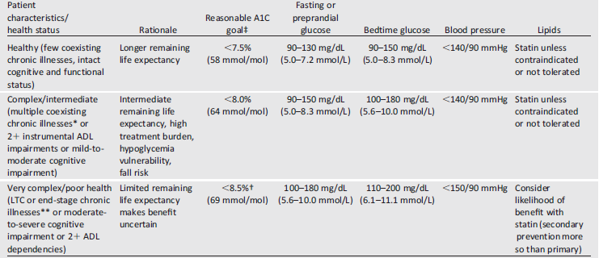
Treatment goals for glycemia, blood pressure, and dyslipidemia in older adults with diabetes.
About 26% of patients over the age of 65 years have diabetes
Diabetes Care Volume 40, Supplement 1, January 2017

Slide 28
Guidelines:
ADA 2018 , AACE 2016

Slide 29
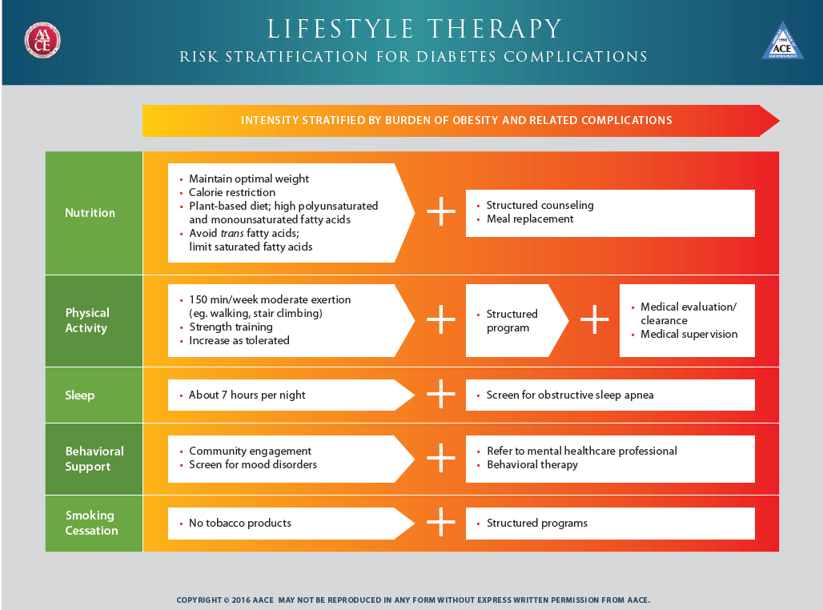
ENDOCRINE PRACTICE Vol 22 No. 1 January 2016

Slide 30
The choice of medication
Antihyperglycemic efficacy.
Mechanism of action.
Risk of inducing hypoglycemia.
Risk of weight gain.
Other adverse effects.
Tolerability.
Ease of use, likely adherence.
Cost.
Safety in heart, kidney, or liver disease.

Slide 31
Effectiveness
safety profiles
Side effects
Cost
Patient satisfaction
.extraglycemic effect.

Slide 32
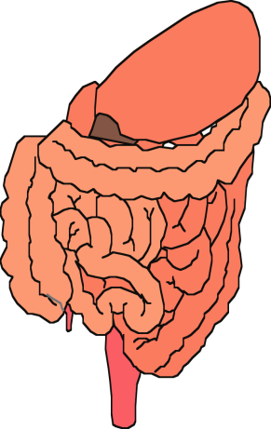
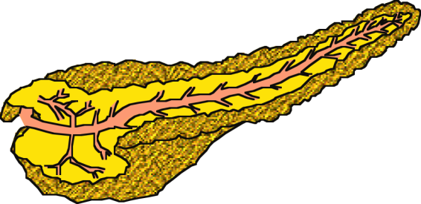


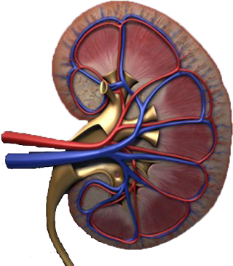
Multiple, Complex Pathophysiological Abnormalities in T2DM
GLP-1R
agonists
Insulin
pancreatic
insulin
secretion
incretin
effect
Glinides
S U s
DPP-4
inhibitors
Amylin
mimetics
pancreatic
glucagon
secretion
_
DA agonists
?
A G I s
gut
carbohydrate
delivery &
absorption
HYPERGLYCEMIA
Metformin
_
T Z D s
Bile acid
sequestrants
+
peripheral
glucose
uptake
hepatic
glucose
production
renal glucose excretion
Adapted from: Inzucchi SE, Sherwin RS in: Cecil Medicine 2011
Notes:
Anti-hyperglycemic drugs for patients with T2DM are targeted at one or more of the pathophysiological abnormalities of this disease. On this slide, the main sites of action of the currently available 12 individual drug classes is depicted. Combination glucose-lowering therapy has become a standard treatment strategy when patients do not adequately respond to a single agent (often metformin.)

Slide 33
Oral Class | Mechanism | Advantages | Disadvantages | Cost
Biguanides | Activates AMP-kinase (?other) ↓ Hepatic glucose production | Extensive experience No hypoglycemia Weight neutral ? ↓ CVD | Gastrointestinal Lactic acidosis (rare) B-12 deficiency Contraindications | Low
Sulfonylurea | Closes K_{ATP} channels ↑ Insulin secretion | Extensive experience ↓ Microvascular risk | Hypoglycemia ↑ Weight Low durability ? Blunts ischemic preconditioning | Low
Meglitinides | Closes K_{ATP} channels ↑ Insulin secretion | ↓ Postprandial glucose Dosing flexibility | Hypoglycemia ↑ Weight ? Blunts ischemic preconditioning Dosing frequency | Mod.
TZDs | PPAR-g activator ↑ Insulin sensitivity | No hypoglycemia Durability ↓ TGs (pio) ↑ HDL-C ? ↓ CVD events (pio) | ↑ Weight Edema/heart failure Bone fractures ↑ LDL-C (rosi) ? ↑ MI (rosi) | Low
Table 1. Properties of anti-hyperglycemic agents
Diabetes Care 2015;38:140-149;
Diabetologia 2015;58:429-442
Notes:
Here are some of the older oral drug classes used in T2DM. The table describes the mechanism of action of each class, its advantages, disadvantages and cost. Less commonly used classes are denoted in grey font.

Slide 34
Oral Class | Mechanism | Advantages | Disadvantages | Cost
a-Glucosidase inhibitors | Inhibits a-glucosidase Slows carbohydrate digestion / absorption | No hypoglycemia Nonsystemic ↓ Postprandial glucose ? ↓ CVD events | Gastrointestinal Dosing frequency Modest ↓ A1c | Mod.
DPP-4 inhibitors | Inhibits DPP-4 Increases incretin (GLP-1, GIP) levels | No hypoglycemia Well tolerated Weight neutral | Angioedema / urticaria ? Pancreatitis ? ↑ Heart failure | High
Bile acid sequestrants | Bind bile acids ? ↓ Hepatic glucose production | No hypoglycemia ↓ LDL-C | Gastrointestinal Modest ↓ A1c Dosing frequency | High
Dopamine-2 agonists | Activates DA receptor Alters hypothalamic control of metabolism ↑ insulin sensitivity | No hypoglyemia ? ↓ CVD events | Modest ↓ A1c Dizziness, fatigue Nausea Rhinitis | High
SGLT2 inhibitors | Inhibits SGLT2 in proximal nephron Increases glucosuria | ↓ Weight No hypoglycemia ↓ BP Effective at all stages | GU infections Polyuria Volume depletion ↑ LDL-C ↑Cr (transient) | High
Table 1. Properties of anti-hyperglycemic agents
Diabetes Care 2015;38:140-149
Diabetologia 2015;58:429-442
Notes:
Additional oral agent classes used in T2DM are included on this slide. The table describes the mechanism of action of each class, its advantages, disadvantages and cost. Less commonly used classes are denoted in grey font.

Slide 35
Injectable Class | Mechanism | Advantages | Disadvantages | Cost
Amylin mimetics | Activates amylin receptor ↓ glucagon ↓ gastric emptying ↑ satiety | ↓ Weight ↓ Postprandial glucose | Gastrointestinal Modest ↓ A1c Injectable Hypo if insulin dose not reduced Dosing frequency Training requirements | High
GLP-1 receptor agonists | Activates GLP-1 R ↑ Insulin, ↓ glucagon ↓ gastric emptying ↑ satiety | ↓ Weight No hypoglycemia ↓ Postprandial glucose ↓ Some CV risk factors | Gastrointestinal ? Pancreatitis ↑ Heart rate Medullary ca (rodents) Injectable Training requirements | High
Insulin | Activates insulin receptor Myriad | Universally effective Unlimited efficacy ↓ Microvascular risk | Hypoglycemia Weight gain ? Mitogenicity Injectable Patient reluctance Training requirements | Variable
Table 1. Properties of anti-hyperglycemic agents
Diabetes Care 2015;38:140-149;
Diabetologia 2015;58:429-442
Notes:
Here now are the injectable drugs used in T2DM. The table describes the mechanism of action of each class, its advantages, disadvantages and cost. Less commonly used classes are denoted in grey font.

Slide 36
Expected HbA_{1c} reduction according to intervention
Intervention | Expected ↓ in HbA_{1c} (%)
Lifestyle interventions | 1 | to | 2%
Metformin | 1 | to | 2%
Sulfonylureas | 1 | to | 2%
Insulin | 1.5 | to | 3.5%
Glinides | 1 | to | 1.5%¹
Thiazolidinediones | 0.5 | to | 1.4%
α-Glucosidase inhibitors | 0.5 | to | 0.8%
GLP-1 agonist | 0.5 | to | 1.0%
Pramlintide | 0.5 | to | 1.0%
DPP-IV inhibitors | 0.5 | to | 0.8%
Nathan DM, et al. Diabetes Care 2009;32:193-203.
Notes:
36

Slide 37
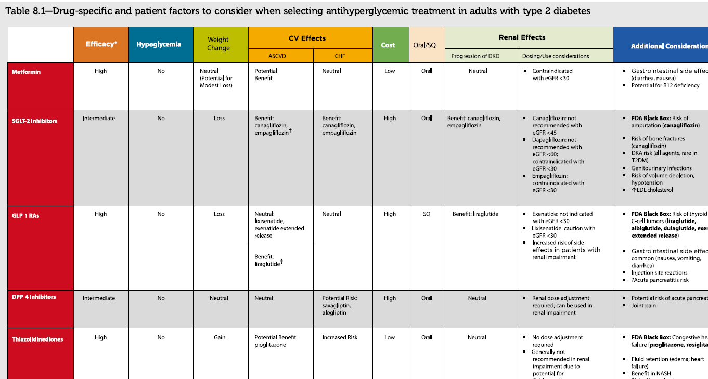

Slide 38
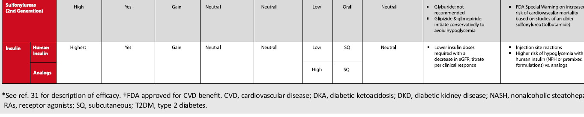
Figure 8.1 and Table 8.1 are meant to be used together to guide the choice of antihyperglycemic agents as part of patient– provider shared decision-making.

Slide 39
Diabetes Care Volume 40, Supplement 1, January 2017

Slide 40
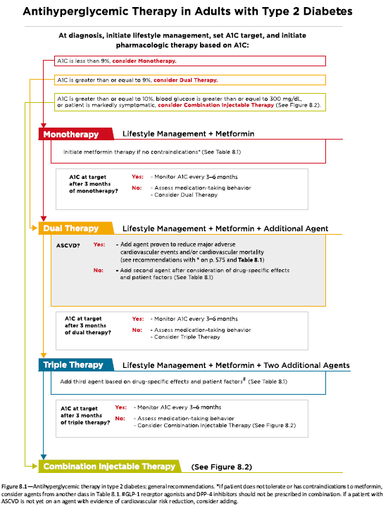
Section 8. Pharmacologic Approaches to Glycemic Treatment

Slide 41
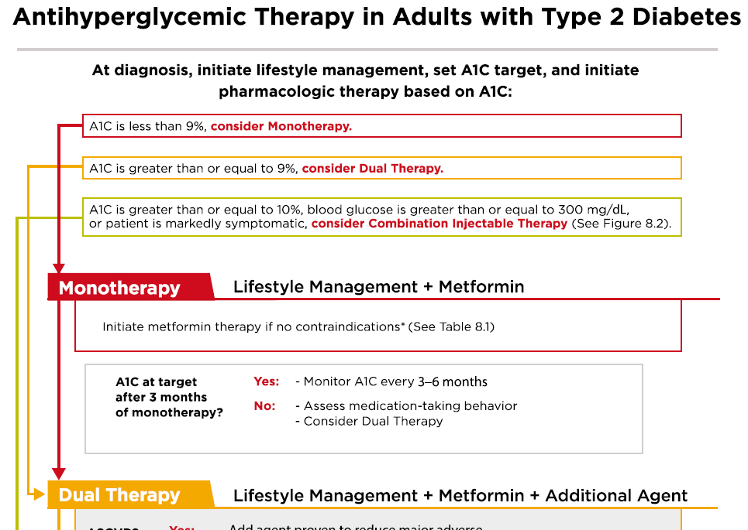

Slide 42
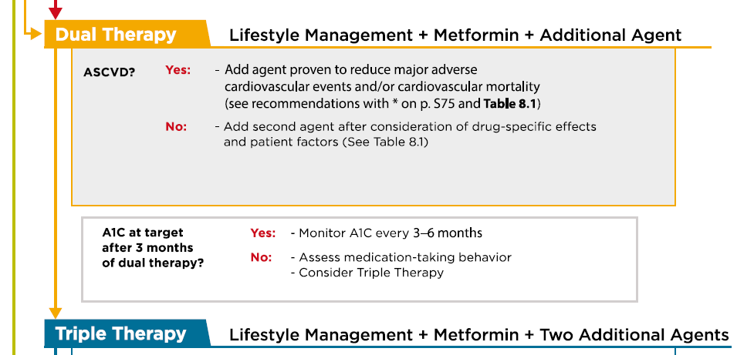

Slide 43
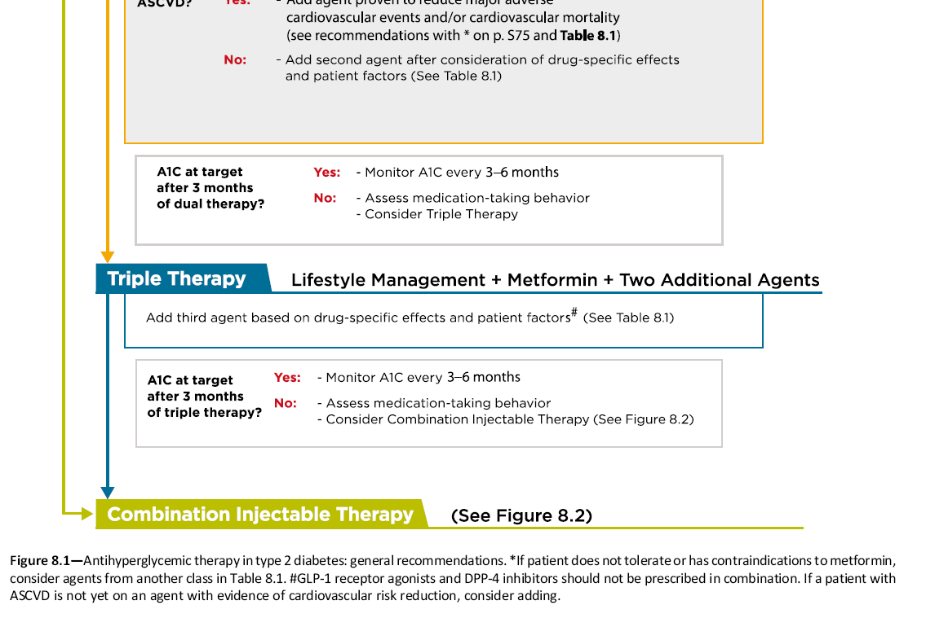

Slide 44
Metformin intolerance or
contraindication
HbA1c ≥9%
Uncontrolled hyperglycemia (catabolic features,
BG ≥300-350 mg/dl, HbA1c ≥10-12%)
Diabetes Care 2015;38:140-149; Diabetologia 2015;58:429-442
Notes:
Potential sequences of antihyperglycemic therapy for patients with type 2 diabetes are displayed, the usual transition being vertical, from top to bottom (although horizontal movement within therapy stages is also possible, depending on the circumstances). The figure denotes relative glucose lowering efficacy, risk of hypoglycemia, effect on body weight, other side effects and approximate relative cost for each drug class.
In most patients, begin with lifestyle changes; metformin monotherapy is added at, or soon after, diagnosis, unless there are contraindications.

Slide 46
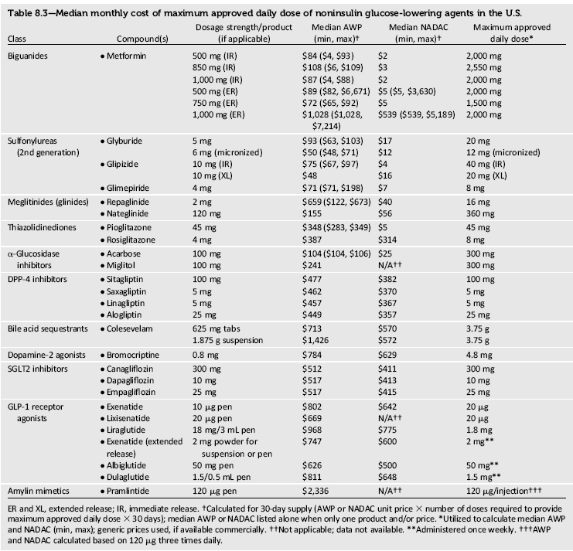

Slide 47
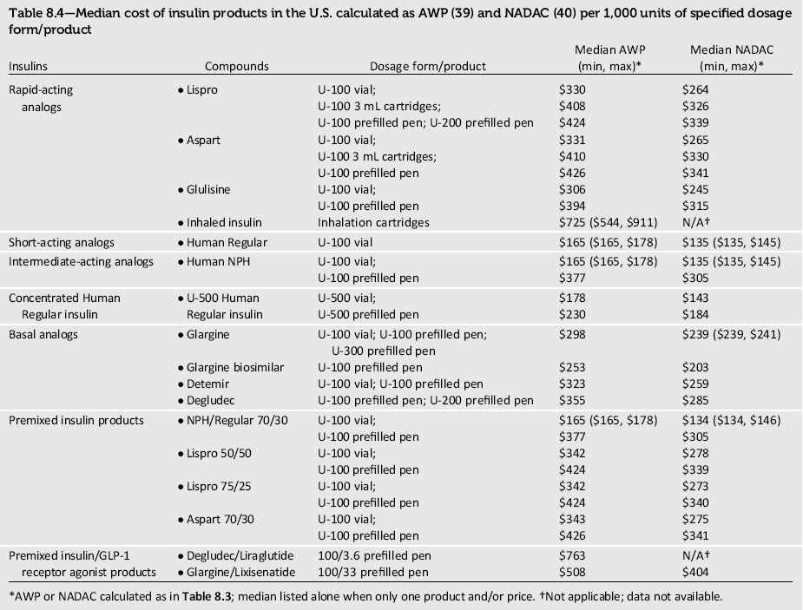

Slide 48
پوشش بیمه | قیمت (تومان) | تعداد | نام دارو
√ | 11000 (25150) | 100 | متفورمین
● | 24.000-30.000 | 100 | Gly-Once 500-750
√ | 5200 | 100 | گلی بن کلامید
√ | 13000 (19000) | 100 | گلی کلازید 80
● | 82.500 | 30 | Empagliflozin 10
√ | 8500-14.400-20.000 | 100 | ریپگلیناید (05-1-2)
● | 35-42-50000 | 100 | گلوتازون (15-30-45)
● | 27.000-50.000 | 100 | آکاربوز (50-100)
● | 39.750-79500 | 30 | سیتاگلیپتین 50-100
√ | 18.840 | 1 ویال | NPH
√ | 18.840 | 1 ویال | Regular
● | 20000 | 100 عدد | سرنگ

Slide 49
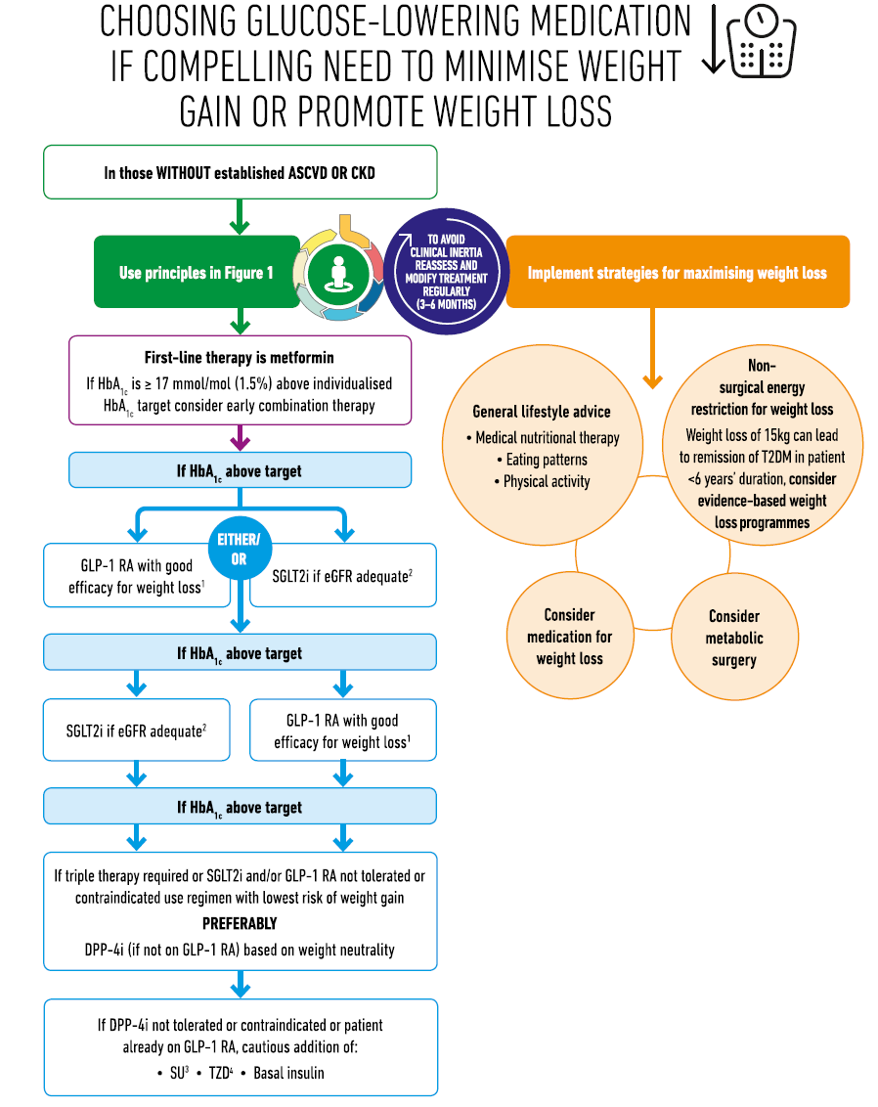

Slide 50
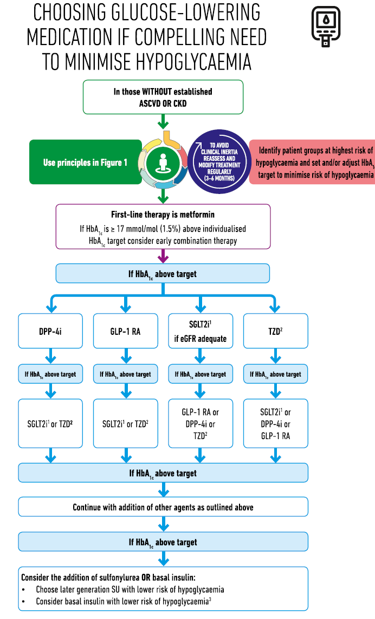

Slide 51
Take home massage:
Treat the patient /Not his (her) sugar
Reduce the CV risk, Not only the HbA1c
Patient center diabetes management
  assessment of efficacy, hypoglycemia risk, impact on weight, side effects, costs, and patient preferences

Slide 52

Thanks for your attention

Slide 53
....................................................................
پاسخ:
ارزیابی وضعیت Life style، Compliance دارویی و درصورت نیاز بیشتر کردن مقدار گلی بن کلامید
........................................................................................................................................

Slide 58
Achievement of goals in U.S.
33–49% of patients still do not meet targets for glycemic, blood pressure, or cholesterol control, and only 14% meet targets for all three measures and nonsmoking status.
Ali MK et al N Engl J Med 2013 Apr 25;368(17):1613-24

Slide 59
COMPREHENSIVE DIABETES CARE
Optimal diabetes therapy involves more than plasma glucose management and medications.
Although glycemic control is central to optimal diabetes therapy, comprehensive diabetes care of both type 1 and type 2 DM should also detect and manage DM-specific complications and modify risk factors for DM-associated diseases.
Diabetes Care Volume 40, Supplement 1, January 2017

Slide 60

Blood-pressure control
Most patients with diabetes and hypertension should be treated to a systolic blood pressure goal of ,140 mmHg and a diastolic blood pressure goal of ,90 mmHg. (A)
Lower systolic and diastolic blood pressure targets, such as ,130/80 mmHg, may be appropriate for individuals at high risk of cardiovascular disease if they can be achieved without undue treatment burden. (B)
Lifestyle Management : For patients with systolic blood pressure 120 mmHg or diastolic blood pressure 80 mmHg, lifestyle intervention consists of weight loss if overweight or obese; a Dietary Approaches to Stop Hypertension (DASH)-style dietary pattern including reduced sodium and increased potassium intake; increased fruit and vegetable consumption; moderation of alcohol intake ; and increased physical activity. (B )
Diabetes Care Volume 40, Supplement 1, January 2017

Slide 61
Diabetes Care Volume 40, September 2017

Slide 62
Management of dyslipidaemia
  Lifestyle interventions
  Lipid-lowering agents (principally statins) recommended for CV risk reduction in T2DM patients with >40 years.
Diabetes Care Volume 40, Supplement 1, January 2017

Slide 63
Platelet inhibition
Dual antiplatelet therapy is reasonable for up to a year after an acute coronary syndrome.
Consider aspirin therapy (75–162 mg/day) for primary prevention in those with type 1 or type 2 diabetes at increased CV risk.
Use aspirin therapy (75–162 mg/day) for secondary prevention in those with diabetes with a history CVD. For patients with CVD and documented aspirin allergy, use clopidogrel (75 mg/day).
ADA 2017
Diabetes Care Volume 40, Supplement 1, January 2017

Slide 64
Summary
Diabetes is a complex, chronic illness requiring continuous medical care with multifactorial risk-reduction strategies beyond glycemic control.
Treatment decisions should be timely, rely on evidence-based guidelines, and be made collaboratively with patients based on individual preferences, prognoses, and comorbidities.

