Slide 1
Role of Calcium and Vitamin D in Management of Osteoporosis
Hengameh Abdi, MD
Endocrine Research Center
Research Institute for Endocrine Sciences
Shahid Beheshti University of Medical Sciences
2014 December 11

Slide 2
Agenda
Dietary reference intakes for calcium and vitamin D
Calcium intake in Iran
Calcium and bone loss/fracture prevention
Vitamin D and bone loss/fracture prevention
Vitamin D and fall
Health risks of calcium/vitamin D supplementation
- Cardiovascular events
- Nephrolithiasis

Slide 3
Recommended dietary intake of elemental calcium and vitamin D (mg/IU/day) for healthy persons
Sex and Age | Recommended Dietary Allowance | Upper Intake Level
Female
19-50 yr | 1000/600 | 2500/4000
>50-70 yr | 1200/600 | 2000/4000
>70 yr | 1200/800 | 2000/4000
Male
19-50 yr | 1000/600 | 2500/4000
>50-70 yr | 1000/600 | 2000/4000
>70 yr | 1200/800 | 2000/4000
Institute of Medicine. Dietary reference intakes for calcium and vitamin D. Washington, DC: National Academies Press, 2011.

Slide 4
Daily calcium intake in TLGS [mg/day, mean (SD)]
TLGS Phase/Sex | Male | Female
1 (1377-80) | 627 (232) | 640 (213)
2 (1380-84) | 674 (255) | 707 (264)
3 (1384-87) | 891 (317) | 932 (322)
4 (1387-90) | 870 (287) | 926 (295)
Unpublished data
TLGS: Tehran Lipid and Glucose Study

Slide 5
Lancet 2007; 370: 657–66

Slide 6
Design: Meta-analysis of 29 RCTs (1966-2007, 12 countries)
Participants: Adults >= 50 yr
Treatment dose thresholds: Ca 1200 mg,VD 800 IU
Main outcomes:
Fractures of all types
Percentage change of BMD from baseline

Slide 7
Results
63,897 individuals (92% Women)
Age: 67.8 yr (SD 9.7)
Median baseline risk for fracture:16% (10–22)
13 trials: Ca-VD, 16 trials: Ca-only
Trials’ duration: average of 3.5 yr

Slide 8
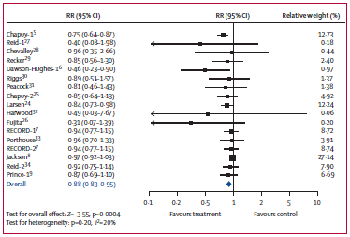
Effect of Ca and Ca-VD on fracture risk

Slide 9
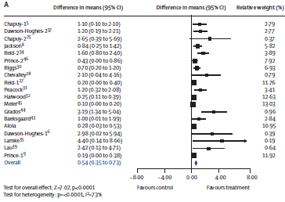
Effect of Ca and Ca-VD on hip BMD
Reduced rate of bone loss of 0·54% (0·35–0·73; p<0·0001)

Slide 10
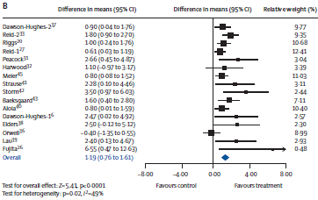
Effect of Ca and Ca-VD on vertebral BMD
Reduced rate of bone loss of 1.19% (0·76–1.61; p<0·0001)

Slide 11
Subgroup analysis for fracture:
Significantly greater risk reduction:
Institutionalized setting
Low dietary calcium intake (<700 mg/d)
Higher calcium dose (≥1200 mg)
Higher vitamin D dose (≥800 IU)
Lesser BMD reduction
Older age (>70 yr)
Higher compliance rate
Lower body weight
Higher baseline risk

Slide 12
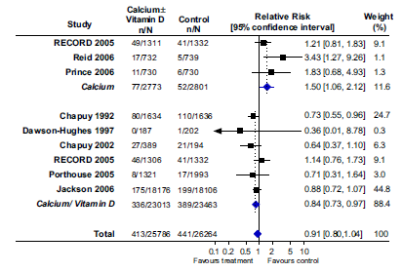
Effect of Ca or Ca-VD on hip fracture risk reduction
Reid IR. Osteoporos Int (2008); 19:1119–1123.

Slide 13
Lancet 2014; 383: 146-55

Slide 14
Design: Meta-analysis of 23 RCTs (Inception-2012, 10 countries)
Participants: Adults >20 yr (w/o other metabolic bone dis.)
Intervention: Vitamin D2 or D3
Primary endpoint:
Percentage change of BMD from baseline
1-5 sites (lumbar spine, femoral neck, total hip, trochanter, total body, or forearm)

Slide 15
Results
4082 individuals (92% Women)
Average age: 59 yr
Trials’ duration: mean of 23.5 months
Mean baseline serum 25(OH)D was less than 50 nmol/L in 8 studies (n=1791).
In 10 studies (n=2294), individuals were given vitamin D doses less than 800 IU per day.
The unweighted mean serum 25(OH)D across all studies increased from 53 nmol/L to 92 nmol/L with treatment.

Slide 16
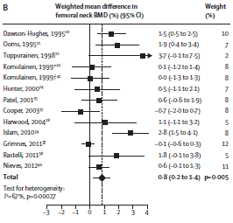
Effect of Vitamin D on femoral neck BMD
No effect at any other site

Slide 17
Subgroup analysis for effects on BMD:
Greater benefits:
Only with lower vitamin D dose (<800 IU/d) in the lumbar spine
No effects from age, serum 25(OH)D level, study duration or supplemental calcium

Slide 18
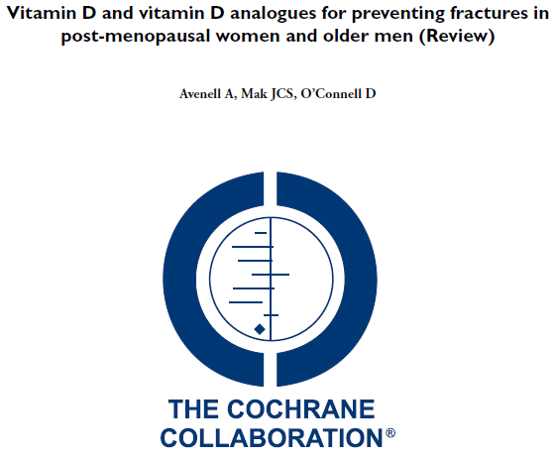
The Cochrane Library. 2014, Issue 4

Slide 19
Design: Review of 53 randomized or quasi-randomized trials
Participants: Post-menopausal women or older men (mean or median population age over 65 years), or both
Intervention: Vitamin D, Calcitriol, Alfacalcidol either alone or with calcium
Primary outcome:
Hip fracture
Secondary outcomes:
Any non-vertebral fracture, Vertebral fracture, Any new fracture, Adverse effects

Slide 20
Results
Vitamin D alone with placebo or no treatment
No statistically significant effect on:
hip fracture (11 trials, 27,693 participants, RR 1.12, 95% CI 0.98 to 1.29)
non-vertebral fractures
vertebral fractures or deformities
For any new fracture: no statistically significant reduction (15 trials, 28,271 participants, RR 1.03, 95% CI 0.96 to 1.11).
Vitamin D plus calcium versus calcium alone
Vitamin D plus calcium was no more effective than calcium alone.

Slide 21
Vitamin D versus calcium
No evidence of a statistically significant difference between vitamin D alone and calcium in the prevention of hip fracture, non-vertebral fractures or any fracture.
Vitamin D alone was less effective than calcium for the prevention of vertebral fracture or deformity (3 trials, 2976 participants, RR 2.21, 95% CI 1.08 to 4.53).

Slide 22
Vitamin D plus calcium versus placebo or no treatment
High quality evidence: reduction in hip fracture risk (RR 0.84 (0.74-0.96); I²=0%). In low-risk populations (residents in the community): 1 fewer hip fracture per 1000 older adults per year (95% CI 0 to 2). In high risk populations (residents in institutions): 9 fewer hip fractures per 1000 older adults per year (95% CI 2 to 14).
High quality evidence: reduction in incidence of new non-vertebral fractures (RR 0.86 (0.78-0.96) ).
Moderate quality evidence of an absence of a statistically significant preventive effect on clinical vertebral fractures.
High quality evidence: reduction in the risk of any type of fracture (RR 0.95 (0.90 to 0.99).

Slide 23
J Clin Endocrinol Metab 2011; 96: 2997–3006

Slide 24
26 RCTs of moderate quality
45,782 participants:
Mean age of 76 yr, 78% Female, very high baseline risk of falling (median, 50% [15-69%])
Duration of VD administration:
Median, 12 m (3-62 m)

Slide 25
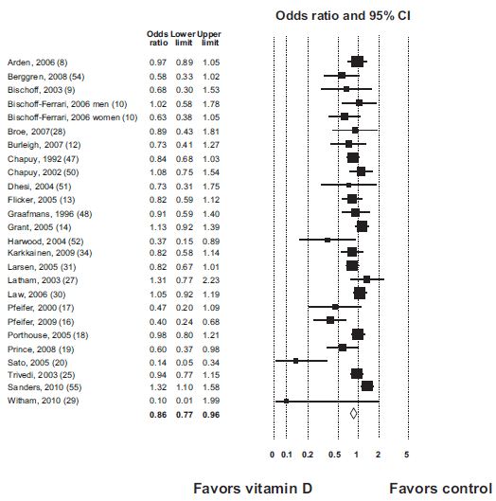
Random effects meta-analysis of OR of patients suffering at least one fall (I²=66%; P value for test of heterogeneity 0.01)

Slide 26
Subgroup analysis:
Population’s dwelling
Administration route
Vitamin D deficiency status (more reduction in falls in deficient patients.)
Documented increase in serum 25(OH) D level
Vitamin D2 vs. D3
Adherence Vitamin D dose
Calcium coadministration status (the reduction in the risk of fall was greater when calcium was administered to both study arms.)
Study quality

Slide 27
Health Risks

Slide 28
BMJ 2011;342:d2040

Slide 29
WHI CaD Study:
Design: Randomized, placebo controlled trial
Participants: 36,282 community dwelling postmenopausal women
Intervention: Ca-VD (1g/400 IU)
Duration: Average of 7 yr
Primary endpoint:
Hip fracture
Secondary endpoints:
Total fracture
Colorectal cancer

Slide 30
Effect of allocation to calcium and vitamin D supplement on cardiovascular events among participants in the WHI CaD Study
In the 16,718 women (46%) who were not taking personal calcium supplements at randomization, HR for cardiovascular events with Ca-VD:
Clinical MI: 1.22 (1.00-1.50), P=0.05
Clinical MI or stroke: 1.16 (1.00-1.35), P=0.05
Clinical MI or revascularization: 1.16 (1.01-1.34), P=0.04
In the women taking personal calcium supplements:
cardiovascular risk did not alter with allocation to Ca-VD

Slide 31
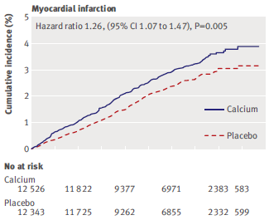
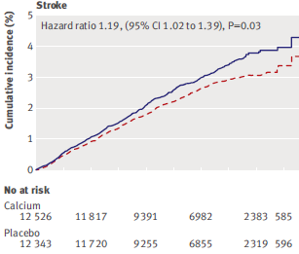
Meta-analysis Effect of calcium supplements with or without vitamin D on cardiovascular events: based on patient-level data (5 trials of Ca supplements and WHI CaD Study participants not taking personal Ca)

Slide 32
Meta-analysis Effect of calcium supplements with or without vitamin D on cardiovascular events: trial-level data
28,072 participants in eight trials of calcium supplements plus data for the WHI CaD Study participants not taking personal calcium supplements at baseline:
RR for MI: 1.24 (1.07-1.45), P=0.004
RR for stroke: 1.15 (1.00-1.32), P=0.06
RR for the composite of MI or stroke:
1.15 (1.03-1.27). P=0.009

Slide 33
Comparisons of the benefits of calcium on fracture prevention with the risk of cardiovascular events:
The risk to benefit profile is unfavourable.
Treating 1000 patients with calcium or calcium and vitamin D for five years would cause an additional six myocardial infarctions or strokes and prevent only three fractures!
(NNH=178, NNT=302)

Slide 34
Calcium and Nephrolithiasis

Slide 35
Calcium supplementation and kidney stone risk in osteoporosis: a systematic literature review
8 RCTs and 2 cohort studies of moderate quality with >8.000 patients, mostly women with a mean age of 50-70 years.
Daily calcium doses varied from 120 mg up to 1.500 mg, and treatment duration from 3 days to 3 years.
No cases of nephrolithiasis were found in more than a half of the included studies.
In total: 3 cases of kidney stone, 2 urinary tract calcifications, 16 cases of nephrolithiasis or urolithiasis.
In WHI-CaD Study (2011): HR: 1.17 (95% CI 1.02, 1.34)
Candelas G., et al. Clin Exp Rheumatol. 2012;30(6):954-61.

Slide 36
Vitamin D supplementation for prevention of mortality in adults
Vitamin D3 combined with calcium increased the risk of nephrolithiasis:
42,876 participants; 4 trials; I²=0%
RR 1.17 (95% CI 1.02 to 1.34); P = 0.02
Bjelakovic G, et al. Cochrane Database Syst Rev. 2014 Jan

Slide 37
Take home messages
Beneficial effects of calcium and vitamin D on bone health.
Supplementation with calcium and vitamin D or with calcium alone has a modest overall effect on the risk of fracture.
The evidence suggesting adverse cardiovascular effects of calcium supplementation is inconsistent.
A reasonable approach is to preferentially encourage dietary calcium intake and discourage the routine use of calcium supplements.

Slide 38
Thanks for your patience!

