Slide 1
In the name of GOD
1
1

Slide 2
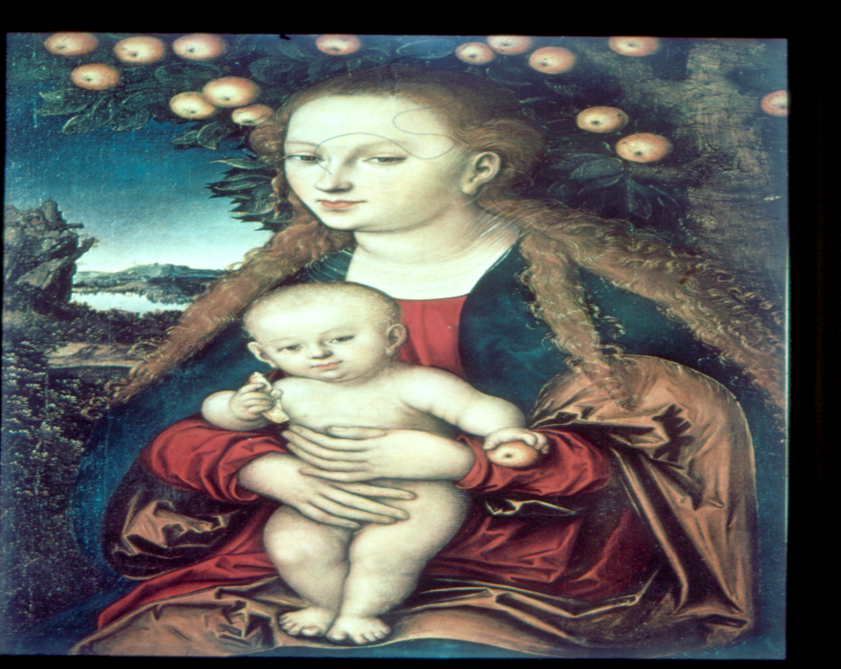
Approach to the woman with positive anti TPO antibody
F.Sarvghadi M.D
Endocrinologist.
Associate prof. Research institute for endocrine sciences. Shahid Beheshti University of Medical Sciences.
Tehran 94.11.08

Slide 3
Agenda
Introduction.
Hypotheses may underlie the association of thyroid. autoimmunity with pregnancy complications.
Thyroid autoimmunity and pregnancy outcomes.
Thyroid autoimmunity and postpartum phase.
Therapeutic interventions.
Conclusion.

Slide 4
Introduction
Pregnancy has a profound impact on the thyroid gland and thyroid function.
In essence, pregnancy is a stress test for the thyroid, resulting in hypothyroidism in women with limited thyroidal reserve or iodine deficiency, and postpartum thyroiditis in women with underlying Hashimoto’s disease who were euthyroid prior to conception.
Ten percent to 20% of all pregnant women in the first trimester of pregnancy are thyroid peroxidase (TPO) or thyroglobulin (Tg) antibody positive and euthyroid.
Stagnaro-Green, S. et al Journal of the American Medical Association, , 1990 vol. 264, 11, 1422–1425,

Slide 5
TPOAb constitutes a risk factor for:
Hypothyroidism.
Miscarriage.
Premature delivery .
Perinatal death .
Postpartum dysfunction.
Subfertility.
Low motor and intellectual development (IQ) in the offspring.
Negro et al. J Clin Endocrinol Metab, July 2006, 91(7):2587–2591
Mannisto T, et al J Clin Endocrinol Metab 2009 Mar;94(3):772-9.
Li Y, et al 2010 Clin Endocrinol (Oxf) 72:825–829.

Slide 6
Hypotheses may underlie the association of thyroid autoimmunity with pregnancy complications:
Thyroid autoantibodies may be considered as a marker of generalized autoimmune dysfunction in the body.
TPOAb + euthyroid women before pregnancy are more prone to develop subclinical or overt hypothyroidism during pregnancy due to hormonal imbalance in particular in the first trimester.
Thyroid autoimmunity is considered as one of the risk factors of infertility.
In TAI positive women antithyroid antibodies were found in the ovarian follicular fluid, providing antibody mediated cytotoxicity in the growing ovarian follicle and damage to the maturing oocyte.
Despite these possible mechanisms, the exact linkage between thyroid autoimmunity and pregnancy outcomes, especially in euthyroid women, has not been well described.
Negro et al. J Clin Endocrinol Metab, July 2006, 91(7):2587–2591
MEDENICA S , et al European Review for Medical and Pharmacological Sciences 2015; 19: 977-987

Slide 7
In euthyroid women who are TAb+ prior to conception, what is the risk of hypothyroidism once they become pregnant?
Prospective study on 87 thyroid autoantibody positive (TAb‏) euthyroid women evaluated before and during early pregnancy:
Twenty percent of women in the study developed a TSH level of > 4 mIU/L during gestation despite normal TSH and no requirement for LT4 prenatally.
Glinoer D, et al J Clin Endocrinol Metab 1994 79:197–204.

Slide 8
TSH values during gestation
In TAb‏ +Euthyroid women, TSH levels increased progressively as gestation progressed, from a mean of 1.7 mIU/L (12th week ) to 3.5 mIU/L (term), with 19% of women having a supranormal
TSH value at delivery.
In summary : patients who are Tab +‏ have an increased propensity for hypothyroidism to occur later in gestation.
Negro et al. J Clin Endocrinol Metab, July 2006, 91(7):2587–2591

Slide 9
ATA RECOMMENDATION:
How should TAb+ euthyroid women be monitored and treated during pregnancy?
Euthyroid women (not receiving LT4) who are TAb‏ + require monitoring for hypothyroidism during pregnancy. Serum TSH should be evaluated every 4 weeks during the first half of pregnancy and at least once between 26 and 32 weeks gestation. Level B-USPSTF.
women with elevated anti-TPO antibodies are at increased risk for progression of hypothyroidism, if identified such women should be screened for serum TSH abnormalities before pregnancy, as well as during the first and second trimesters of pregnancy. Recommendation. level: C - USPSTF (2+ ---).
De Groot et al , J Clin Endocrinol Metab, August 2012, 97(8):2543–2565
STAGNARO-GREEN ET AL.THYROID Volume 21, Number 10, 2011

Slide 10
Pregnancy outcomes
Numbers in parentheses represent percentage.
Negro et al. J Clin Endocrinol Metab, July 2006, 91(7):2587–2591

Slide 11
A meta-analysis of 10 longitudinal studies
It does not prove causality
Prummel MF et al European Journal of Endocrinology (2004) 150 751–755

Slide 12
Objective: We sought to determine whether these women suffer from a higher rate of obstetrical complications and whether levothyroxine (LT4) treatment exerts beneficial effects.
Patients: A total of 984 pregnant women were studied from November 2002 to October 2004; 11.7% were thyroid peroxidase antibody positive (TPOAb).
Negro et al. J Clin Endocrinol Metab, July 2006, 91(7):2587–2591

Slide 13
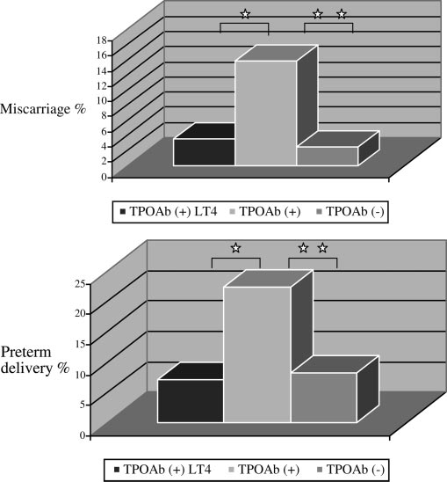
Percentage of miscarriages (top) and premature deliveries (bottom) in group A ( +TPOAb treated with LT4), group B (+TPOAb), and group C (-TPOAb).
* P 0.05
* * P 0.01.
Negro et al. J Clin Endocrinol Metab, July 2006, 91(7):2587–2591

Slide 14
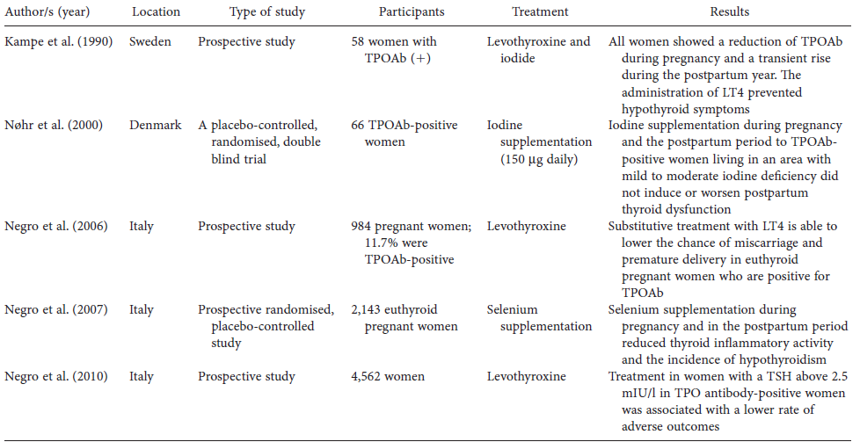
Therapeutic interventions:
Considered interventions are levothyroxine treatment, iodine supplementation and selenium supplementation.
These treatments must be evaluated by several well designed randomised clinical trials.
Nazarpour S et al Journal of Obstetrics and Gynaecology DOI:10.3109/01443615.2014.968110

Slide 15
Should euthyroid women who are known to be positive for anti-thyroid antibodies either before or during pregnancy be treated with LT4 in order to decrease the chance of sporadic or recurrent miscarriage?
ATA RECOMMENDATION:
There is insufficient evidence to recommend for or against LT4 therapy in TAb‏ + euthyroid women during pregnancy. Level I-USPSTF
STAGNARO-GREEN ET AL.THYROID Volume 21, Number 10, 2011

Slide 16
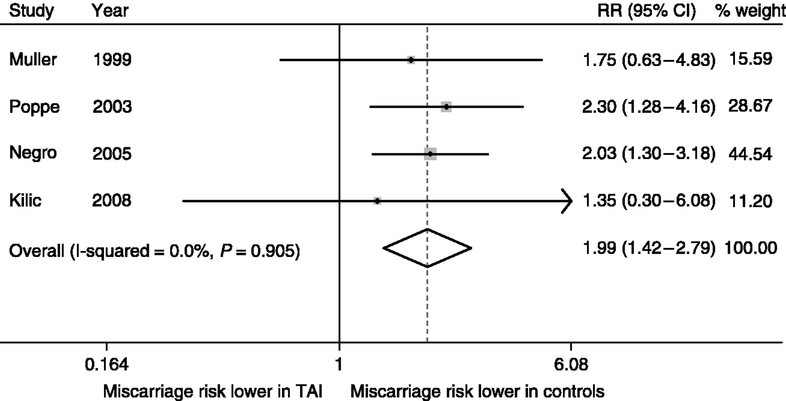
Risk of spontaneous miscarriage in euthyroid women with thyroid autoimmunity undergoing IVF: a meta-analysis
Subfertile euthyroid woman with TAI is at a twofold higher risk of miscarriage in an IVF pregnancy compared with a counterpart without TAI
Konstantinos A Toulis et al. Eur J Endocrinol 2010;162:643-652
Notes:
Miscarriage risk in euthyroid women with TAI undergoing IVF.

Slide 17
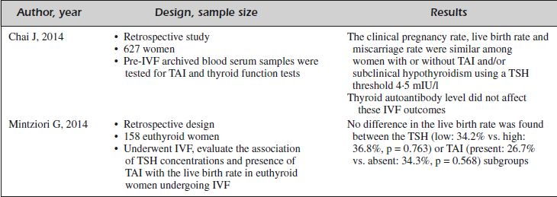
The clinical pregnancy rate, live birth rate and miscarriage rate among women undergoing IVF with or without TAI
MEDENICA S , et al European Review for Medical and Pharmacological Sciences 2015; 19: 977-987

Slide 18
Objective : to investigate if (LT4) exerts any effect on pregnancy and/or delivery rates in TPOAb positive women undergoing assisted reproductive technologies.
A total of 72 (15%) out of the 484 euthyroid women selected were TPOAb (+). These 72 patients were randomly divided into two groups: group A (n = 36) underwent LT4 treatment, group B (n = 36) placebo. Group C consisted of 412 women (85%) who were TPOAb negative.
Results : No differences in pregnancy rate were observed between the three groups
Roberto Negro et al Human Reproduction 2005 Vol.20, No.6 pp. 1529–1533

Slide 19
Should women with recurrent abortion be screened for thyroid antibodies before or during pregnancy with the goal of treating TAb+ euthyroid women with LT4 or intravenous immunoglobulin therapy (IVIG) to decrease the rate of recurrent spontaneous abortion?
ATA RECOMMENDATION:
There is insufficient evidence to recommend for or against screening for anti-thyroid antibodies, or treating in the first trimester of pregnancy with LT4 or IVIG, in euthyroid women with sporadic or recurrent abortion or in women undergoing in vitro fertilization (IVF). Level I-USPSTF
STAGNARO-GREEN ET AL.THYROID Volume 21, Number 10, 2011

Slide 20
ATA RECOMMENDATION:
There is insufficient evidence to recommend for or against screening for anti-thyroid antibodies in the first trimester of pregnancy, or treating TAb‏+ euthyroid women with LT4,to prevent preterm delivery. Level I-USPSTF
There is insufficient evidence to recommend for or against LT4 therapy in euthyroid TAb‏+ women undergoing assisted reproduction technologies. Level I-USPSTF
STAGNARO-GREEN ET AL.THYROID Volume 21, Number 10, 2011

Slide 21
Thyroid autoimmunity and postpartum phase
PPT will develop in 33%–50% of women who present with anti-thyroid antibodies in the first trimester, conferring a relative risk of PPT of between 10 and 59 compared with women who are negative for anti-thyroid antibodies.
Women known to be TPO-Ab+ should have TSH measured at 6–12 wk gestation and at 6 months postpartum, or as clinically indicated.
Level: A (1 +++- )
Smallridge RC Clin Appl Immunol Rev 2000 ,1:89–103.
De Groot et al , J Clin Endocrinol Metab, August 2012, 97(8):2543–2565

Slide 22
Does treatment of TAb+ euthyroid women with LT4 or iodine during pregnancy prevent PPT?
Two prospective randomized placebo-controlled controlled trials have evaluated the efficacy of iodine or LT4 treatment during pregnancy to prevent the development of PPT in TAb‏ women. Neither intervention decreased the prevalence of PPT.
ATA RECOMMENDATION:
Treatment of Tab + ‏euthyroid pregnant woman with either LT4 or iodine to prevent PPT is ineffective and is not recommended. Level D-USPSTF
STAGNARO-GREEN ET AL.THYROID Volume 21, Number 10, 2011

Slide 23
Some studies have found, in nonpregnant women, that selenium is capable of diminishing the TPOAb titers.
Objective: We examined whether Se supplementation, during and
after pregnancy, influences the thyroidal autoimmune pattern and
function.
Design: This was a prospective, randomized, placebo-controlled study.
Patients: A total of 2143 euthyroid pregnant women participated in
the study; 7.9% were TPOAb(+).
Negro et al J Clin Endocrinol Metab, April 2007, 92(4):1263–1268

Slide 24
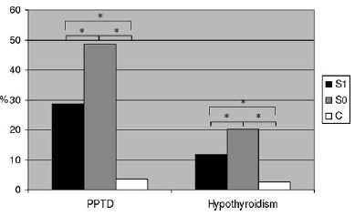
* P<0.01.
* P<0.01.
Trends in TPOAb titers in TPOAb(+) women who received Se (group S1) or placebo (group S0).
Percentage of patients who had PPTD (left) and hypothyroidism
(right) develop in TPOAb(+)women who received Se (group S1)
or placebo (group S0), and in TPOAb(-) women (group C).
Results: PPTD and permanent hypothyroidism were significantly lower in group S1 compared with S0 (28.6 vs. 48.6%, P<0.01; and 11.7 vs. 20.3%, P < 0.01).
Negro et al J Clin Endocrinol Metab, April 2007, 92(4):1263–1268

Slide 25
Does treatment of TAb+ euthyroid women with selenium during pregnancy prevent PPT?
ATA RECOMMENDATION:
A single RCT has demonstrated a reduction in postpartum thyroiditis from selenium therapy. No subsequent trials have confirmed or refuted these findings. At present, selenium supplementation is not recommended for TPOAb‏ + women during pregnancy. Level C-USPSTF
STAGNARO-GREEN ET AL.THYROID Volume 21, Number 10, 2011

Slide 26
ATA RECOMMENDATION:
There is insufficient evidence to recommend for or against screening all women for anti-thyroid antibodies in the first trimester of pregnancy. Level I-USPSTF
STAGNARO-GREEN ET AL.THYROID Volume 21, Number 10, 2011

Slide 27
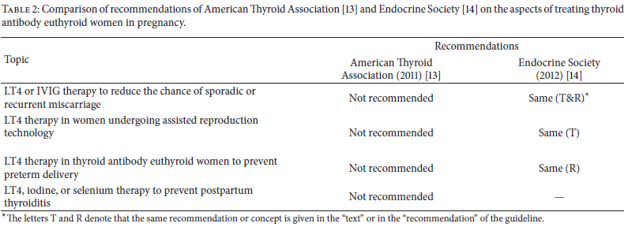
Mehran L et al Journal of Thyroid Research http://dx.doi.org/10.1155/2013/542692

Slide 28
Conclusions
The current available data regarding associations between thyroid autoantibodies and spontaneous or recurrent pregnancy loss and preterm delivery is convincing.
However, the reduction of these complications by treatment with LT4 supplementation is less robust.
The evidence is not conclusive enough to recommend screening for thyroid autoantibodies or for the treatment of euthyroid women who are positive for thyroid autoantibodies during pregnancy.
Further randomized trials are needed.

Slide 29
Two large randomized controlled trials are currently underway:
A Randomised Controlled Trial of the Efficacy and Mechanism of Levothyroxine Treatment on Pregnancy and Neonatal Outcomes in Women with Thyroid Antibodies. (TABLET: Thyroid AntiBodies and LEvoThyroxin study)
T4 life trial (http://www.trialregister.nl/trialreg/admin/rctview.asp?TC=3364).

Slide 30
Thank you

