Slide 1
Barriers to Insulin Therapy
Alireza Amirbaigloo, MD

Slide 2
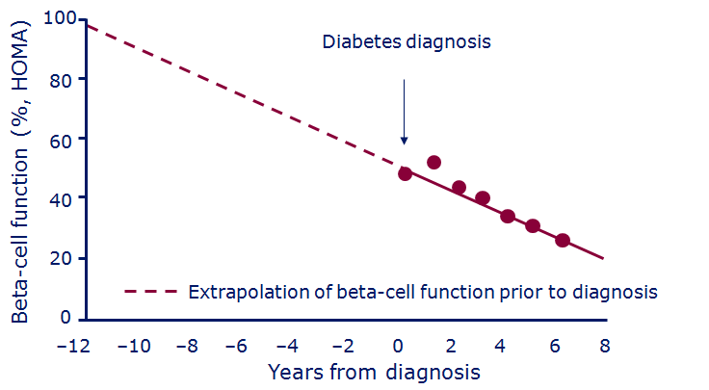
Beta-cell function progressively declines
HOMA, homeostasis model assessment
Lebovitz. Diabetes Reviews 1999;7:139–53 (data are from the UKPDS population: UKPDS 16.
Diabetes 1995;44:1249–58)
Notes:
Beta cell function progressively declines
UKPDS shows that at the time of diagnosis β-cell function is already markedly compromised by up to 50%, with β-cell function continuing to deteriorate in the years following diagnosis. Furthermore, extrapolation of these data tells us that β-cell function in UKPDS patients may have been suboptimal for 10 years prior to diagnosis.
Reference
UKPDS population: UKPDS 16. Diabetes 1995;44:1249–58

Slide 3
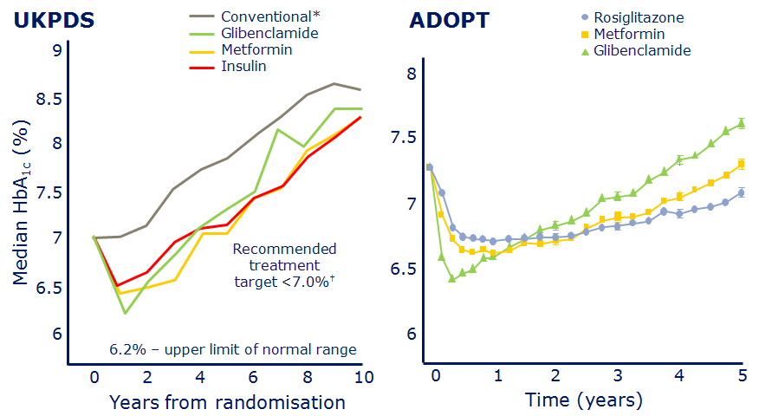
Over time, glycaemic control deteriorates
*Diet initially then sulphonylureas, insulin and/or metformin if FPG>15 mmol/L †ADA clinical practice recommendations. UKPDS 34, n=1704
UKPDS 34. Lancet 1998:352:854–65; Kahn et al. (ADOPT). N Engl J Med 2006;355:2427–43
Notes:
Over time, glycaemic control deteriorates
UKPDS clearly showed the need for new diabetes treatments
In UKPDS, the yearly median HbA_{1c} in patients receiving conventional treatment increased steadily throughout the trial. In contrast, median HbA_{1c} fell during the first year in patients receiving intensive treatment (Glibenclamide, metformin or insulin) but gradually increased subsequently and only remained within the recommended treatment target for the first 3–6 years of treatment (depending on assigned treatment). During the remaining years of follow-up, median HbA_{1c} continued to rise steadily above treatment targets. This failure of existing treatments, even when used intensively in highly motivated patients highlights the need for new treatments in the management of type 2 diabetes.
UKPDS recruited 5102 patients with newly diagnosed type 2 diabetes; 4209 were randomised. The patients were treated for a median of 4.0 years.
Conventional therapy aimed to maintain fasting plasma glucose (FPG) at < 15 mmol/l (270 mg/dl) using diet alone initially. However, sulphonylureas, insulin or metformin could be added if target FPG was not met.
References
UKPDS 34. Lancet 1998;352:854–865
UKPDS 33. Lancet 1998;352:837–853
ADOPT
The more recent ADOPT study supports this. In the ADOPT study, rosiglitazone, metformin, and glibenclamide were evaluated as initial treatment for recently diagnosed type 2 diabetes in a double-blind, randomized, controlled clinical trial involving 4360 patients. The study showed that HbA1c increases with time, irrespective of OAD choice.
Kahn et al. (ADOPT). N Engl J Med 2006;355(23):2427–43

Slide 4
Need for treatment intensification
Over 50% of T2D patients require insulin after 6 years
Bergenstal 2001; Wright 2002
Notes:
4

Slide 5
Baseline characteristics by pre-study therapy: Iran
 | Total | No therapy | OGLD alone | Insulin± OGLD
N | 919 | 36 | 566 | 317
% of total | - | 3.9 | 61.6 | 34.5
Gender M/F (%) | 37.6/62.4 | 55.6/44.4 | 37.3/62.7 | 36.3/63.7
Age (years) | 56.6 (12.0) | 51.7 (16.5) | 57.3 (11.0) | 55.9 (13.0)
Weight (kg) | 73.0 (13.3) | 71.5 (12.9) | 71.9 (12.1) | 75.1 (15.1)
BMI (kg/m²) | 27.7 (4.4) | 25.7 (3.7) | 27.5 (4.2) | 28.2 (4.8)
Diabetes duration (yrs) | 11.3 (7.5) | 7.6 (9.0) | 10.9 (7.1) | 12.4 (7.8)
HbA_{1c} (%) | 9.4 (1.7) | 9.7 2.1) | 9.6 (1.8) | 8.9 (1.6)
All data are mean (SD)
Notes:
5
5
5

Slide 6
Baseline characteristics by pre-study therapy: global
 | Total | No therapy | OGLD alone | Insulin± OGLD
N | 66726 | 6010 | 38862 | 21854
Percent of total | - | 9 | 58 | 33
Sex M/F (%) | 55.6/44.4 | 60.9/39.1 | 56.8/43.2 | 51.9/48.1
Age (years) | 54.0 (12.0) | 51.8 (14.4) | 53.5 (11.1) | 55.6 (12.5)
Weight (kg) | 72.9 (15.0) | 67.3 (12.7) | 72.4 (14.6) | 75.3 (15.9)
BMI (kg/m²) | 27.1 ( 5.0) | 25.2 ( 4.2) | 26.9 ( 4.7) | 27.9 ( 5.5)
Diabetes duration (yr) | 8.0 ( 6.2) | 2.6 ( 4.9) | 7.2 ( 5.2) | 10.8 ( 6.8)
HbA_{1c} (%) | 9.5 ( 1.8) | 10.2 ( 2.3) | 9.5 ( 1.7) | 9.4 ( 1.8)
Home et al. Diabetes Res Clin Pract. 2011;94:352–63
Notes:
6
6
6

Slide 7
The Burden of Type 2 Diabetes Treatment Failure
Clinical Inertia: “Failure to advance therapy when required”
10
9.6%
8.9%
Combination
oral agents
Mean HbA_{1c} at Last Visit* (%)
8.6%
9
SU or
metformin
Diet and
Exercise
8
ADA Goal
7
2.5 Years
2.9 Years
2.8 Years
8.2 Years
Initiation
of
insulin therapy
Years Elapsed Since Initial Diagnosis
Brown JB et al., Diabetes Care. 2004;27:1535-1540
Notes:
Brown et al estimated glycemic burden that accumulates from treatment failure in a prospective, population-based study in patients with type 2 diabetes completing courses of treatment with nondrug therapy diet and exercise, sulfonyluria monotherapy, metformin monotherapy, and combination oral antihyperglycemic therapy.
The average patient accumulated nearly 5 A1C years of excess glycemic burden >8.0% from diagnosis until starting insulin and about 10 A1C years of burden <7.0%.
These data support the concept that glucose-lowering treatments in type 2 diabetes should be changed much sooner or that treatments less likely to fail should be used. An action point at 7.0% or lower is more likely to prevent additional deterioration than the traditional action point of 8.0%.

Slide 8
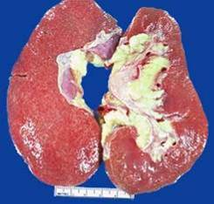
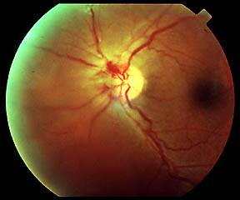
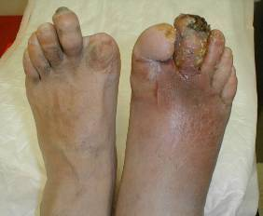
Poor glycaemic control leads to long-term complications…
Diabetic nephropathy
Atherosclerosis
Diabetic foot
Proliferative
diabetic retinopathy

Slide 9
Baseline characteristics by pre-study therapy: Iran
 | Total | No therapy | OGLD alone | Insulin± OGLD
N | 919 | 36 | 566 | 317
% of total | - | 3.9 | 61.6 | 34.5
Gender M/F (%) | 37.6/62.4 | 55.6/44.4 | 37.3/62.7 | 36.3/63.7
Age (years) | 56.6 (12.0) | 51.7 (16.5) | 57.3 (11.0) | 55.9 (13.0)
Weight (kg) | 73.0 (13.3) | 71.5 (12.9) | 71.9 (12.1) | 75.1 (15.1)
BMI (kg/m²) | 27.7 (4.4) | 25.7 (3.7) | 27.5 (4.2) | 28.2 (4.8)
Diabetes duration (yrs) | 11.3 (7.5) | 7.6 (9.0) | 10.9 (7.1) | 12.4 (7.8)
HbA_{1c} (%) | 9.4 (1.7) | 9.7 2.1) | 9.6 (1.8) | 8.9 (1.6)
All data are mean (SD)
Notes:
9
9
9

Slide 10
Baseline characteristics by pre-study therapy: global
 | Total | No therapy | OGLD alone | Insulin± OGLD
N | 66726 | 6010 | 38862 | 21854
Percent of total | - | 9 | 58 | 33
Sex M/F (%) | 55.6/44.4 | 60.9/39.1 | 56.8/43.2 | 51.9/48.1
Age (years) | 54.0 (12.0) | 51.8 (14.4) | 53.5 (11.1) | 55.6 (12.5)
Weight (kg) | 72.9 (15.0) | 67.3 (12.7) | 72.4 (14.6) | 75.3 (15.9)
BMI (kg/m²) | 27.1 ( 5.0) | 25.2 ( 4.2) | 26.9 ( 4.7) | 27.9 ( 5.5)
Diabetes duration (yr) | 8.0 ( 6.2) | 2.6 ( 4.9) | 7.2 ( 5.2) | 10.8 ( 6.8)
HbA_{1c} (%) | 9.5 ( 1.8) | 10.2 ( 2.3) | 9.5 ( 1.7) | 9.4 ( 1.8)
Home et al. Diabetes Res Clin Pract. 2011;94:352–63
Notes:
10
10
10

Slide 11
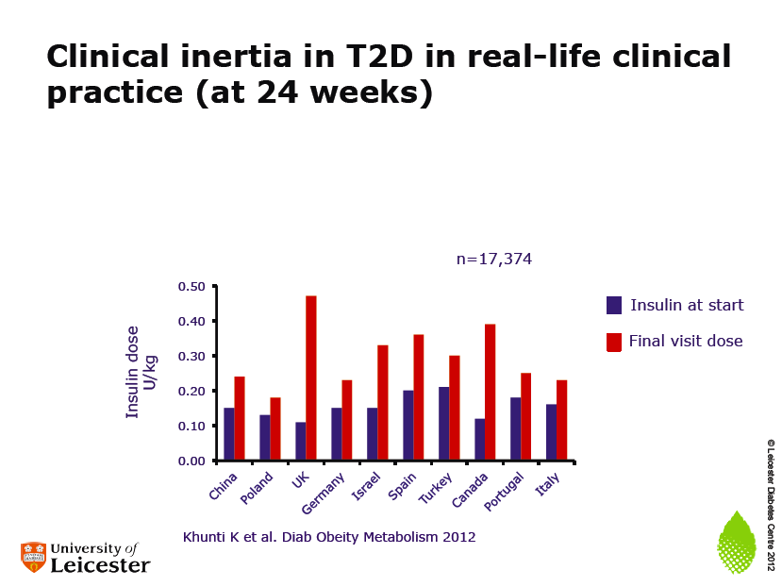

Slide 12
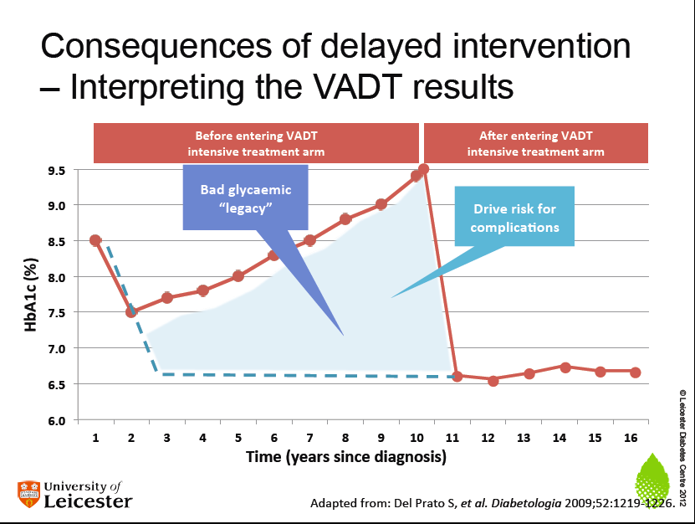

Slide 13
Improving control reduces risks of long-term complications
Every 1% drop in HbA_{1c} can reduce long-term diabetes complications
43%
37%
19%
16%
14%
12%
Stroke
MI
Heart failure
Cataract extraction
Microvascular disease
Lower extremity amputation or fatal peripheral vascular disease
UKPDS: Stratton et al. BMJ 2000;32:405–12
Notes:
NEXT SLIDE: Conclusions.

Slide 14
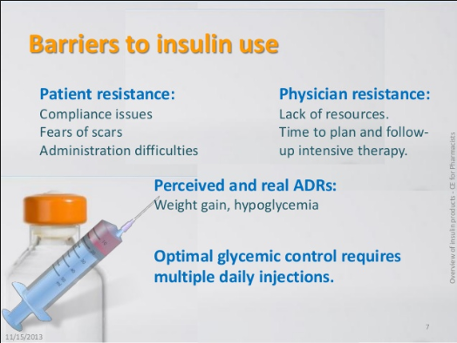

Slide 15

WHAT!?
Did you say
INSULIN?!

Slide 16
Psychological Insulin Resistance (PIR)
perceived loss of control over one’s life
poor self-efficacy
personal failure
Perceived disease severity
Injection related anxiety
perceived lack of positive gain
not-so-subtle messages received from providers
clinicians’ negative feelings and the extra time
CLINICAL DIABETES • Volume 22, Number 3, 2004

Slide 17
perceived loss of control over one’s life
61.4% of patients agreed that, “Once I start insulin, I can never stop”
50.6% believed that insulin therapy would restrict their lives “too hard to travel, or eat out”
CLINICAL DIABETES • Volume 22, Number 3, 2004

Slide 18
poor self-efficacy
40–50% of patients do not feel confident that they could handle the demands of insulin therapy, such as determining the proper timing and dosages
“too complicated and overwhelming”
CLINICAL DIABETES • Volume 22, Number 3, 2004

Slide 19
personal failure
insulin is viewed as a well-deserved punishment for one’s own negligence in some other area of diabetes self-care
“I haven’t done a good enough job taking care of my diabetes”
CLINICAL DIABETES • Volume 22, Number 3, 2004

Slide 20
Perceived disease severity
Concerned that insulin therapy may cause further health problems
Sometimes partially correct (e.g., a slightly increased hypoglycemia risk), while in other cases (e.g., “Insulin will cause me to go blind.”), they may be quite wrong
sizeable ethnic split
CLINICAL DIABETES • Volume 22, Number 3, 2004

Slide 21
Injection related anxiety
50% of patients report being fearful of injections
True injection phobia is rare
When patients report that they “could never take the needle,” this may often represent a broader reluctance to consider insulin therapy
CLINICAL DIABETES • Volume 22, Number 3, 2004

Slide 22
perceived lack of positive gain
Less than 10% believed that insulin might help them achieve good glycemic control, improve their energy level, or improve their health
patients’ personal experiences : “My mother had diabetes, and it was no big deal to her for over 20 years. She rarely saw a doctor and never paid much attention to it, and it never really bothered her. But then her doctor finally convinced her to start insulin and—bam! Over the next year, she started having serious problems with her eyes, and then there were terrible pains in her legs. In fact, she eventually lost most of her left leg. No way!”
CLINICAL DIABETES • Volume 22, Number 3, 2004

Slide 23
subtle and not-so-subtle messages received from providers
perhaps the major one
it is common for insulin-naive patients to be threatened with insulin
if you don’t work harder to manage diabetes, then there will be no choice but to start insulin
CLINICAL DIABETES • Volume 22, Number 3, 2004

Slide 24
clinicians’ negative feelings and the extra time
Potentially unpleasant confrontations with patients who do not want to take insulin
Potential for severe hypoglycemia, excessive weight gain, or other adverse effects
extra time needed to start and manage insulin therapy
“Why don’t you take a few more months and try to get more serious about exercise and weight loss. Maybe you can get those numbers down by the time we meet again.”
CLINICAL DIABETES • Volume 22, Number 3, 2004

Slide 25
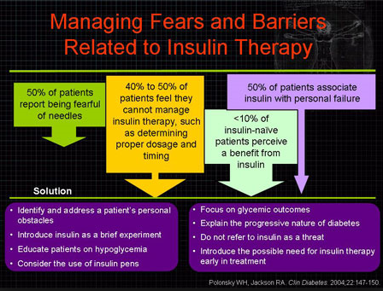

Slide 26
Possible Intervention Strategies
Identify the patient’s personal obstacles
Restore the patient’s sense of personal control
Enhance self-efficacy as quickly as possible
Consider insulin pens
Frame the insulin message properly
Discuss the real risks of hypoglycemia
Tackle injection phobias
Pass along the good news
CLINICAL DIABETES • Volume 22, Number 3, 2004

Slide 27
Identify the patient’s personal obstacles
“Injections aren’t so bad”
“Taking insulin doesn’t mean your diabetes is getting worse”
“You’re going to have so much more energy”
Unlikely to be beneficial
“Could you tell some of the reasons why you feel so strongly about not taking insulin?”
CLINICAL DIABETES • Volume 22, Number 3, 2004

Slide 28
Restore the patient’s sense of personal control
“I’d like you to try insulin for just a month. At the end of the month, if you don’t think it has been worthwhile, or if it still seems as awful as you’re imagining it might be, I promise to help you stop.”
CLINICAL DIABETES • Volume 22, Number 3, 2004

Slide 29
Enhance self-efficacy as quickly as possible
the process of insulin use should be demonstrated for patients while they are in the clinician’s office
they should be encouraged to practice before returning home
hands-on discovery
CLINICAL DIABETES • Volume 22, Number 3, 2004

Slide 30
The number of recommended behavioral changes should be minimized, at least at first
No frequent self-monitoring of blood glucose
a single shot of insulin
Quick dose adjustments to ensure that patients will quickly see improvements in their glucose
CLINICAL DIABETES • Volume 22, Number 3, 2004

Slide 31
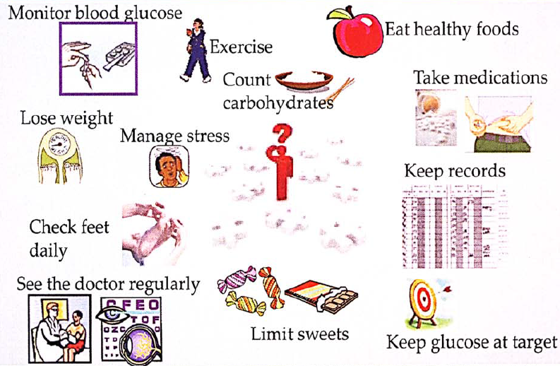

Slide 32
Consider insulin pens
only anecdotal evidence to support this observation but many providers have commented that PIR in their practices has dramatically lessened
a single shot of insulin
CLINICAL DIABETES • Volume 22, Number 3, 2004

Slide 33
Frame the insulin message properly
stay focused on glycemic outcomes, sharing SMBG & A1C results
When targets are not met by oral agents and lifestyle changes, insulin becomes a natural choice
It should be stressed to patients that they have not “failed” with their diabetes
CLINICAL DIABETES • Volume 22, Number 3, 2004

Slide 34
Discuss the real risks of hypoglycemia
In the UKPDS the annual incidence of severe hypoglycemia in insulin-treated patients was < 3.0%
more frequent SMBG and a careful review of results
further diabetes education
CLINICAL DIABETES • Volume 22, Number 3, 2004

Slide 35
Tackle injection phobias
where patients are truly too fearful of needles
cognitive behavioral therapy
Systematic desensitization
CLINICAL DIABETES • Volume 22, Number 3, 2004

Slide 36
Pass along the good news
Once patients’ personal obstacles have been addressed,
it may be worthwhile to review the positive benefits associated with insulin
improvements in their mood, sleep, and energy level and investment in the protection of their long-term health
CLINICAL DIABETES • Volume 22, Number 3, 2004

Slide 37
Intentional Insulin Injection Omission
Intentional insulin omission was reported by more than half of respondents
regular omission was reported by 20%
DIABETES CARE, VOLUME 33, NUMBER 2, FEBRUARY 2010

Slide 38
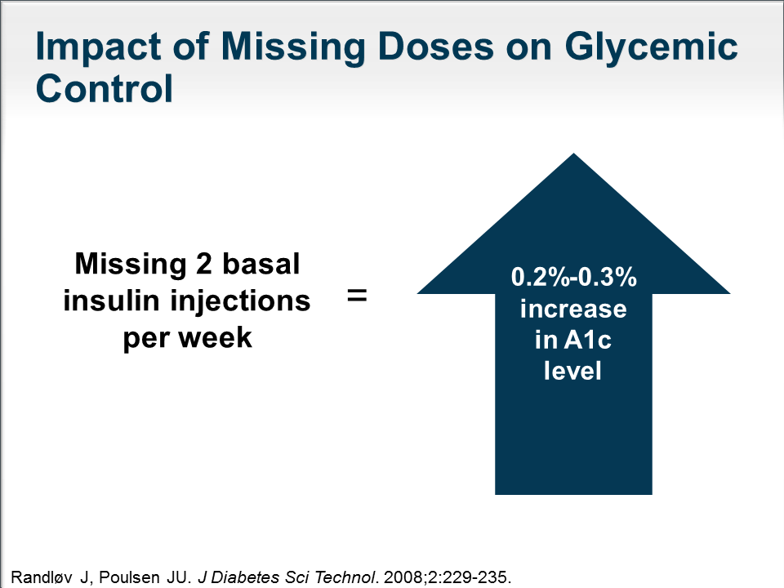

Slide 39
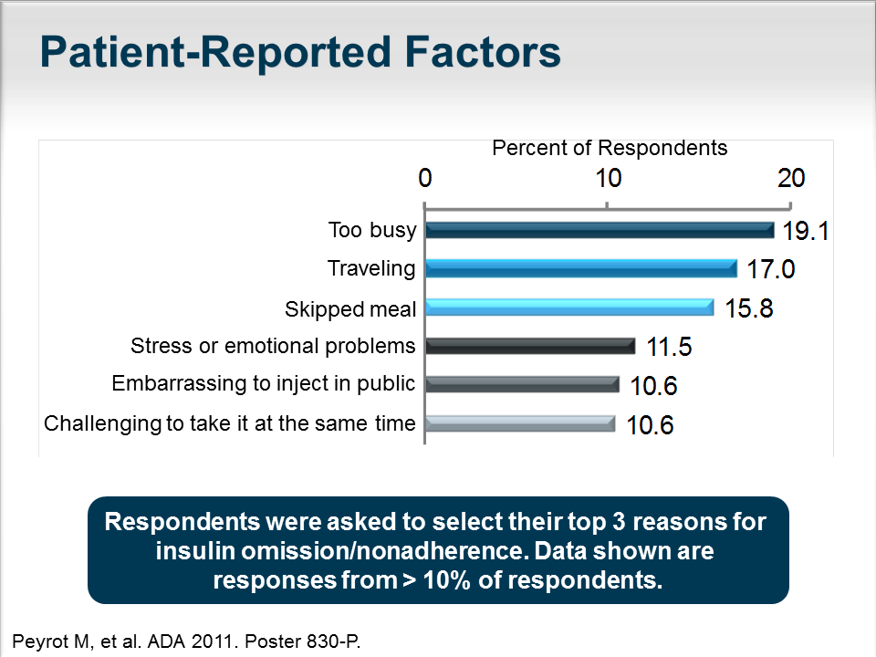

Slide 40
Intentional Insulin Injection Omission
younger age
lower income
higher education
type 2 diabetes
not following a healthy diet
taking more daily injections
interference of injections with daily activities
injection pain and embarrassment
DIABETES CARE, VOLUME 33, NUMBER 2, FEBRUARY 2010

Slide 41
weight gain as a consequence of insulin treatment
Insulin commonly leads to an increase in weight
Adherence to insulin may be compromised to avoid weight gain
30% of women admitted to underdosing insulin to manipulate their weight¹
1. Bryden et al. Diabetes Care 1999;22:1956–60
Notes:
Speaker notes:
Obesity and diabetes are intertwined conditions
Increased body weight is a risk factor for and can exacerbate diabetes
Therefore, weight loss is a foundation stone of diabetes prevention and management
However, weight loss is difficult for many patients to achieve and maintain
This is not helped by the fact that several diabetes therapies, including most insulins, are associated with weight gain
Thus a vicious cycle, as seen in the graphic to the right, is perpetuated
Clearly, an insulin that is weight neutral is a valuable clinical asset
Abbreviations:
CVD=cardiovascular disease
References:
Rojas et al. Nutrition and Diabetes 2011;1:e10
Purnell et al. JAMA 1998;280:140–146
Bryden et al. Diabetes Care 1999;22:1956–1960

Slide 42
Traditionally, insulin is used only when OADs fail to control glucose
Lifestyle changes
E.g. diet and exercise
Adequate in only ~15% of people
Oral antidiabetic agents
E.g. metformin, sulphonylurea
(or glitazone)
Poor glycaemic control
Oral combination therapy
E.g. metformin plus sulphonylurea, metformin plus glitazone
Poor glycaemic control
INSULIN
With/without oral agent*
*Glitazones are contraindicated in combination with insulin
Bergenstal RM et al. In: Degroot et al. (eds) Endocrinology 2001: pp. 821–35
Notes:
It is common for many type 2 diabetes patients to progress from treatment with non-pharmacological measures (diet and exercise alone) to gradually more intensive treatment. For example, when a patient is initially diagnosed with type 2 diabetes, they are usually overweight or obese and so weight loss can help with glucose control. The patient is given advice on how to change their diet and how to introduce more exercise into their lifestyle. However, diet and exercise alone are sufficient to achieve adequate glucose control in only approximately 15% of people (UKPDS Group, 1990). If glycaemic control is not achieved with diet and exercise alone, first-line treatment is usually oral blood glucose lowering agents, such as metformin, sulphonylureas or glitazones (pioglitazone and rosiglitazone). Metformin facilitates glucose uptake and may also decrease appetite and therefore helps with weight loss. Sulphonylureas stimulate insulin secretion and glitazones enhance insulin sensitivity. Once monotherapy with oral agents fails, oral combination therapy is typically the next step (e.g. metformin plus sulphonylurea, or metformin plus glitazone). However, most patients ultimately require insulin, either with or without an oral agent (glitazones are contraindicated in combination with insulin).
References
Bergenstal RM, Kendall DM, Franz MJ, Rubenstein AH. Management of type 2 diabetes: a systematic approach to meeting the standards of care. II: Oral agents, insulin, and management of complications. In: Degroot LJ, Jameson J (eds). Endocrinology. Philadelphia: WB Saunders Co, 2001:821–35
UKPDS Group. UK Prospective Diabetes Study 7. Response of fasting plasma glucose to diet therapy in newly presenting type II diabetic patients. Metabolism 1990;39:905–12

Slide 43
Traditional approach to stepwise management of type 2 diabetes
Intensify insulin
Start insulin
Combination
oral agents
Add a GLP-1R agonist
(or DPP-4 inhibitor)
Diabetes disease progression
Start an oral agent
Diet/exercise
GLP-1R, Glucagon-like peptide 1 receptor; DPP-4, dipeptidyl peptidase-4

Slide 44
ADA/EASD Position Statement 2012
Initial drug
monotherapy
Metformin
If needed to reach individualised HbA_{1c} target after ~3 months, proceed to two-drug combination
(order not meant to denote any specific preference)
Two-drug
combinations
Metformin +
Metformin +
Metformin +
Metformin +
Metformin +
SU
TZD
DPP-4
inhibitor
GLP-1
receptor
agonist
Insulin
(usually
basal)
If needed to reach individualised HbA_{1c} target after ~3 months, proceed to three-drug combination
(order not meant to denote any specific preference)
Three-drug
combinations
Metformin+
Metformin+
Metformin+
Metformin+
Metformin+
SU
+
OR
OR
OR
TZD
+
OR
OR
OR
DPP-4 i
+
OR
OR
GLP-1 RA
+
OR
OR
Insulin
+
OR
OR
TZD
SU
SU
SU
TZD
DPP-4 i
DPP-4 i
TZD
TZD
DPP-4 i
GLP-1 RA
GLP-1 RA
Insulin
Insulin
GLP-1 RA
More complex insulin strategies
Insulin
Insulin
If combination therapy that includes basal insulin has failed to achieve HbA_{1c} target after 3–6 months,
proceed to a more complex insulin strategy, usually in combination with one or two non-insulin agents
Insulin (multiple daily doses)
ADA/EASD Position Statement. Diabetologia Online; 24 February 2012

Slide 45
Insulin or a third oral agent
What is the best therapeutic choice for a patient who fails to obtain adequate glycemic control with the combination of a sulfonylurea and metformin to treat hyperglycemia?

Slide 46
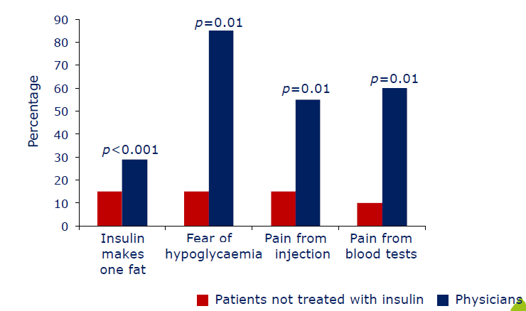
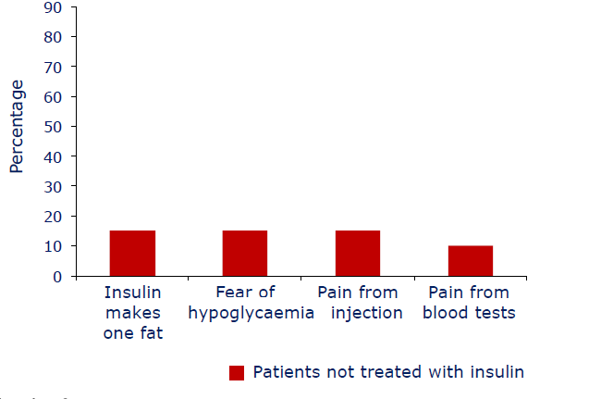
Barriers to insulin initiation
Nakar et al. J Diabetes Complications 2007;21:220–6

Slide 47
Resistance to Insulin Among Providers
Delay of oral hypoglycemic medication was the strongest correlate of insulin therapy delay
Physicians with higher insulin delay reported significantly higher levels of patient adherence to recommendations for medication
Patients who reported high belief in insulin efficacy also reported significantly poorer relationships with their providers
DIABETES CARE, VOLUME 28, NUMBER 11, NOVEMBER 2005

Slide 48
UKPDS – Legacy Effect of Earlier Glucose Control
After median 8.5 years post-trial follow-up
Aggregate Endpoint |  | 1997 | 2007
Any diabetes related endpoint | RRR: | 12% | 9%
 | P: | 0.029 | 0.040
Microvascular disease | RRR: | 25% | 24%
 | P: | 0.0099 | 0.001
Myocardial infarction | RRR: | 16% | 15%
 | P: | 0.052 | 0.014
All-cause mortality | RRR: | 6% | 13%
 | P: | 0.44 | 0.007
RRR = Relative Risk Reduction, P = Log Rank
Holman et al NEJM 2008;359:1565-76
Notes:
48

Slide 49

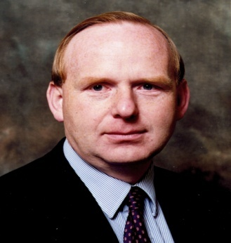
UKPDS 1977 – 2008
Global conclusions
UKPDS
“ Our results show a sustained
legacy effect of an intensive
glucose control strategy”
Prof Rury Holman
How well you are treated now ,
and how well you were treated in the past , determines the long-term health outcomes
as far as glycaemic control is concerned”
“
UKPDS 80 N Engl J Med 2008; 359:1577-89
EASD 2008 UKPDS Press Release

Slide 50
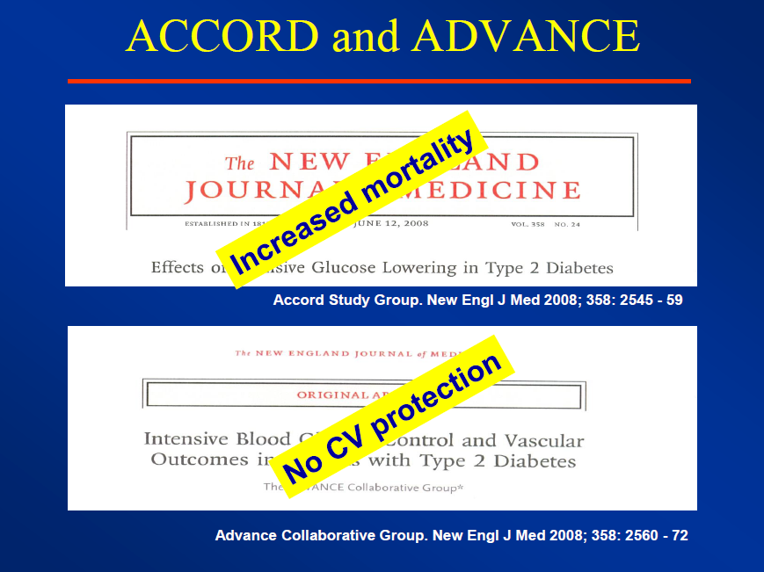

Slide 51
UKPDS ( Early intervention) versus ADVANCE , ACCORD and RECORD
100
RECORD | Diagnosis (+) 7years
ADVANCE | Diagnosis (+) 8years
ACCORD | Diagnosis (+) 10 years
80
60
Beta cell function (%)
10-12 Year
Probationary Period
40
20
Clinical
Diagnosis
UKPDS
NO CV
BENEFITS
0
–12
–10 –8 –6 –4 –2 0 2 4 6
Years from diagnosis of diabetes
Adapted from UKPDS 16. Diabetes 1995; 44: 1249-58

Slide 52

LESSONS FROM LANDMARK TRIALS UKPDS, ACCORD and ADVANCE
These studies show that if measures
to control glycaemia are applied too late ,
“you can’t stop the moving train”
Prof Rury Holman
Oxford , UK
Measures to control glycaemia are not like
interventions to control blood pressure or abnormal
lipid profiles in patients with established
cardiovascular disease – “you can’t play catch up
with glucose control”
Treat glucose from day 1
and treat it intensively to reach treatment goals

Slide 53


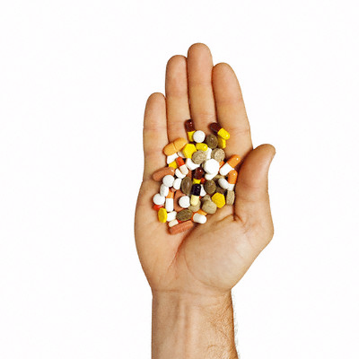

Slide 54
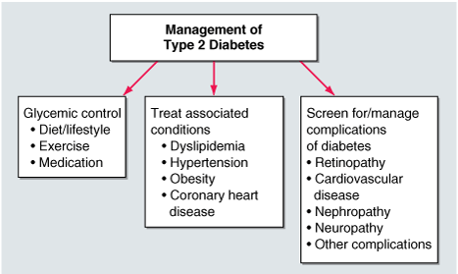

Slide 55


