Slide 1
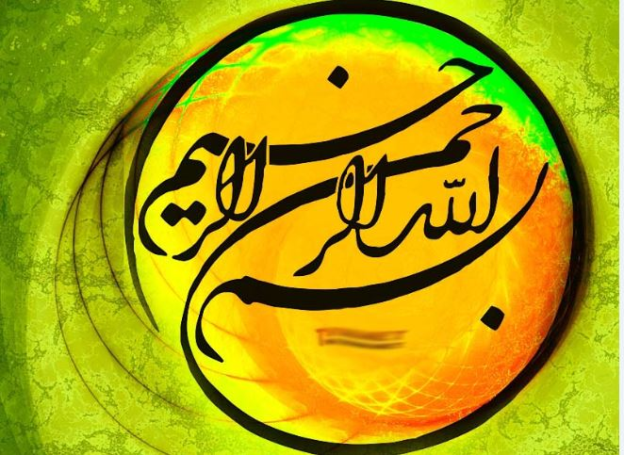

Slide 2
Endocrine grand rounds
Notes:
Indocrain grand rounds

Slide 3
CC : Fatigue and generalized body pain
PI :Patient is a 19 years old lady who is single and student of material engineering.
The patient has started with symptoms of a feeling of fatigue and pain in the body without any history of the other disease, except dysmenorrhoea since two years ago.
Notes:
The

Slide 4
PI…
The body pain was vague and permanent and did not relate to the time or place and the particular condition. At the same time, it felt tired.
She Has had anorexia, and during last year she had weight loss (about 5 kg/past 1 year).
There was no Fx and no Renal stones had ever been developed.
History of constipation or diarrhea has not been repeated. Epigastric pain or Gi upset are not mentioned .

Slide 5
PI
No HTN. No Arrhythmia .
No polyuria and polydipsia .
After Referring to internist at 1395, she was undergoing multiple lab tests and investigations that detect high and abnormal Ca and high-frequency repeated tests, but none of the trials were higher than 11/3

Slide 6
P.M.Hx:
(-)Hx of jaw tumor or any other mass.
(-)Hx HTN
Hyperthyroidism or hypothyroidism are not mentioned.
(-)Hx of renal stone .
(-)Hx of any Fx.
(+)Hx of dysmenorrhoea.

Slide 7
Personal And Habits Hx:
No smoker
No addicted or Durg abused.

Slide 8
Medication Hx:
Vit D 50000 per month since 2 years ago.
Powder Myoinositol 2000mg + Folic acid 200mcgr one sochet Daily.
Tab Belara: chlormadinone CMA 1tab daily

Slide 9
Family Hx:
Her mother and father alive .
(+) Hx of PUD in her mother.
(+) Hx of major Depression in her father’s.
(+) Hx of Hypothyroidism in her father
Her brother is alive and healthy.
There are no Hx of hypercalcemia ,Fx. or renal stone in her family.

Slide 10
General appearance and PH/E :
The patient is a young woman who is tall and sober, appears reliable reliable and informative and answers to the questions are good and cooperative.
wt:62 Kg
Ht :176 cm
BMI:21 Kg/m2
VS : Bp:110/80 mmHg PR:74/min RR:14/min T:36.8

Slide 11
PE
Pupils are mid size and reactive to light
Sclera is not icteric
Conjunctiva is Not pale
Face skin is acnetic
No mas detected in her jaw
No thyromegaly or nodule or lAp
Chest auscultation is clear
Heart sounds are NL S1S2 ,no additional sound or murmur
Abdomen is soft with no organomegaly
Ext s have no deformity with mp 5/5 in lower and upper and there is No edema

Slide 12
تاریخ | آزمایشگاه | Ca(mg/dl) | P (mg/dl) | PTH (pg/ml) | Vit D(ng/ml) | ALP(u/l) | LDH (u/l)
95/5/1 | پارس | 10.8 | 2.8 | --------- | 16.1
95/5/8 | پارس | 10.8 | 3.1 | 58.1 | -''-------- |  | 151
95/5/22 | پارس | 10.8 | 3 | 50.8 | 14.2
95/8/13 | ارغوان | 10.5 | 3.3 | 40.9 | 53.5
95/8/13تکرار | ارغوان | 10.47 | ---------- | 40.9 | 47.7
95/9/18 | مرکزی پاتوبیولوژی | 10.7 | 3.3 | 47.68 | 24.7 | 63
96/4/20 | مرکزی | 10.4 | 3.2 | -------'' | 33.9 | 55
97/2/16 | مرکزی | 10.8 | 3.4 | 37.2 | ------- | 50
97/3/21 | مرکزی | 10.3 | 3.3 | 40.89 | 32.51
97/3/22 | مرکزی | 10.6 | 3.3 | 37.38 | --------
97/8/3 | مرکزی | 11.3 | 3.2 | 35.3 | 50.7
97/8/10 | مرکزی | 11 | -------- | 55.6 | ----------

Slide 14
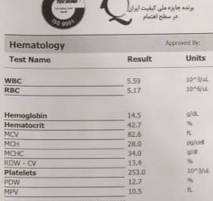
ESR:9mm. TSH:1/16ulu/ml. Urea:25mg/dl. Cr: ./64mg/d
Alb:4/1gr/dl Mg:1/8 mg/dl

Slide 15
 | آزمایشگاه | تاریخ | Ca | P | PTH | VitD | ALP
پدر | مرکزی پاتوبیولوژی | 95/9/18 | 9/8 | 3/6 | ___ | 10/7 | 59
مادر | مرکزی پاتوبیولوژی | 95/9/18 | 9/4 | 3/7 | ____ | 29 | 52

Slide 16
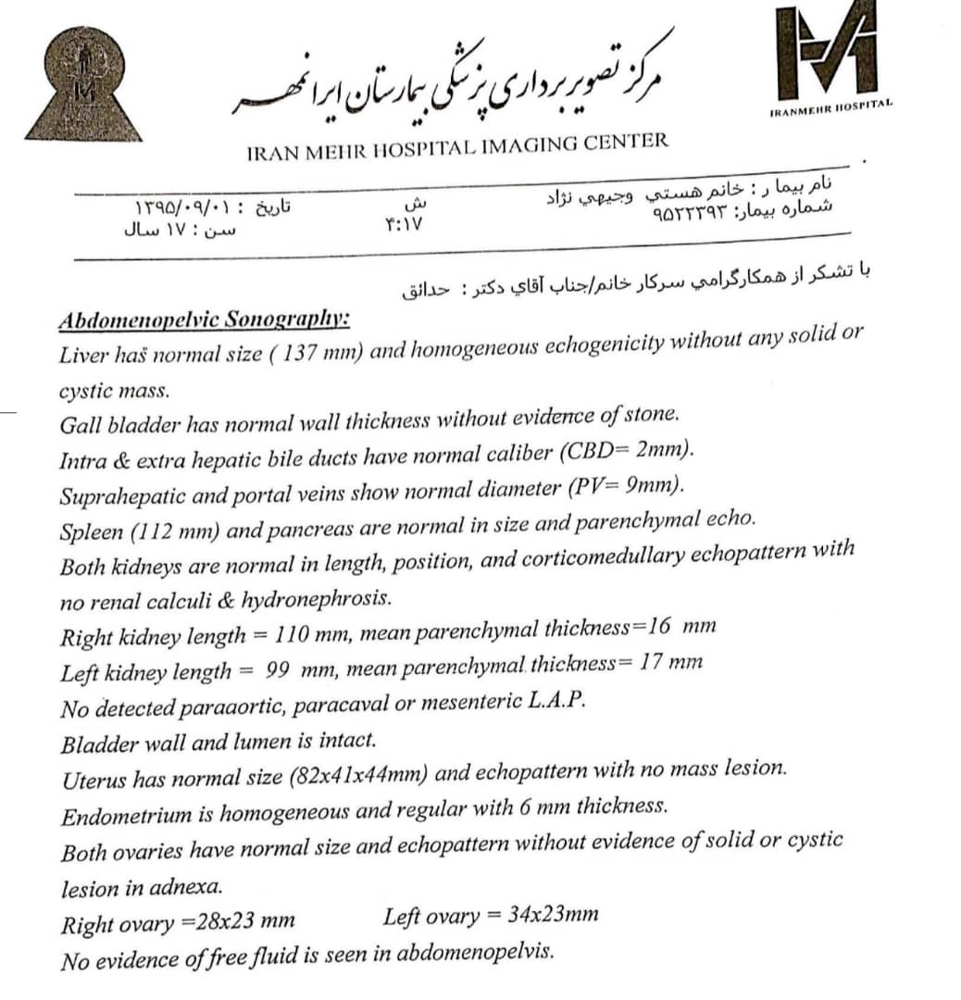

Slide 17
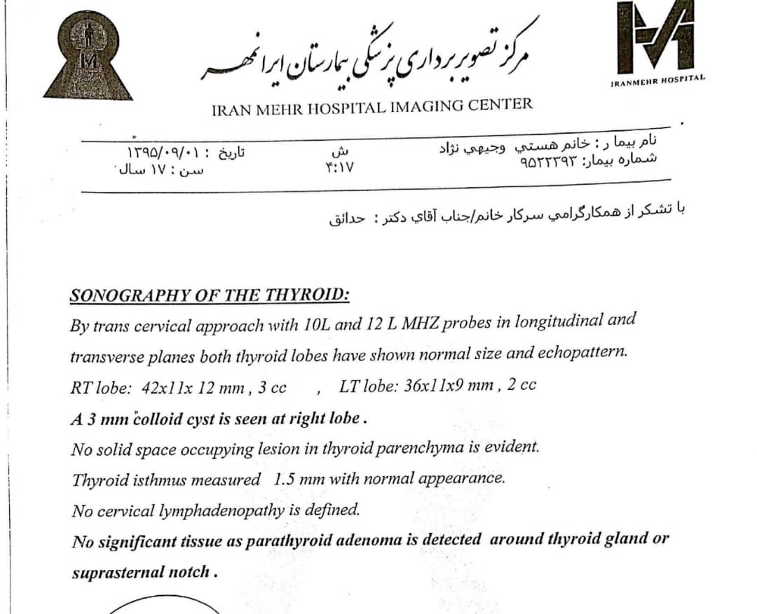

Slide 18
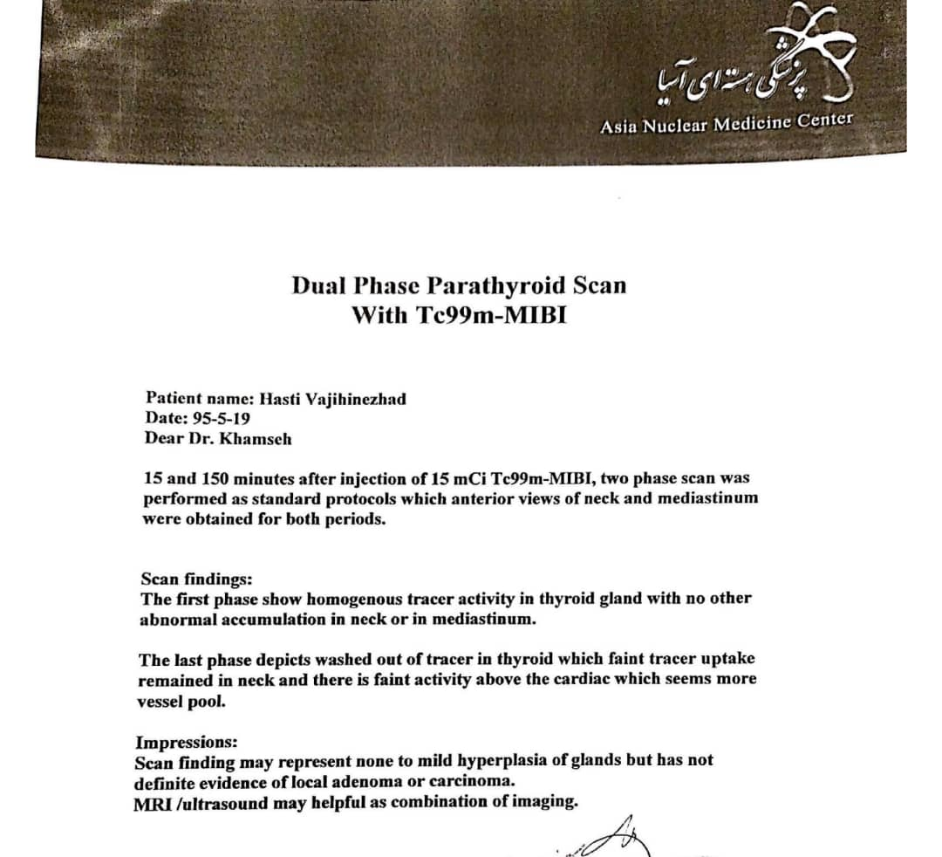

Slide 19
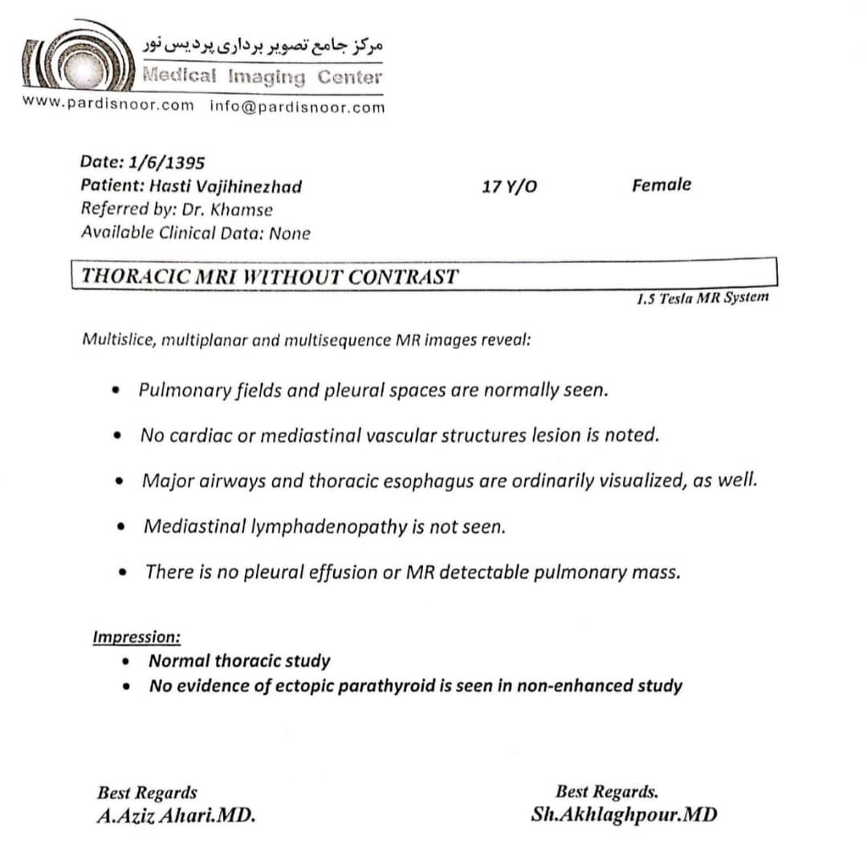

Slide 20
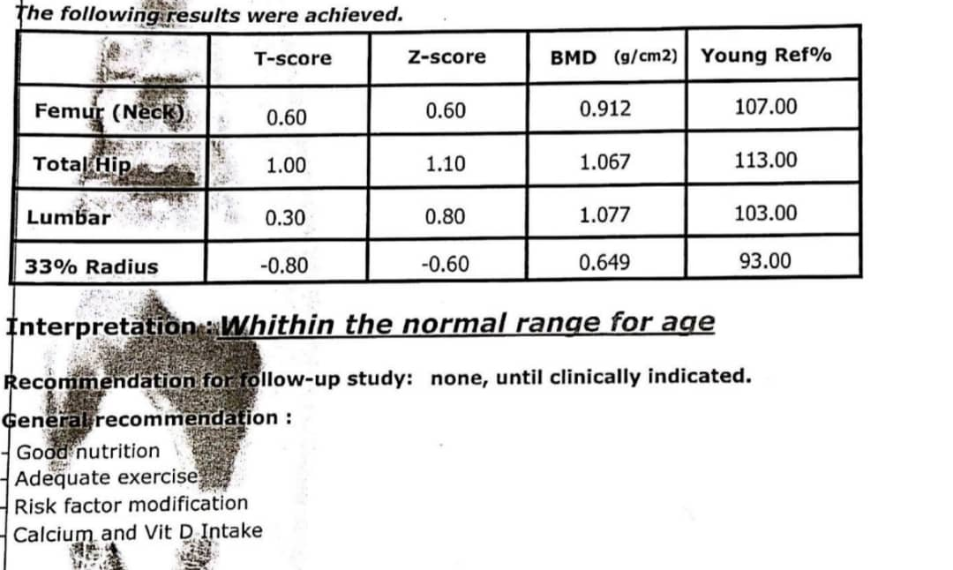
Bone densitometry
1395/9/29

Slide 21
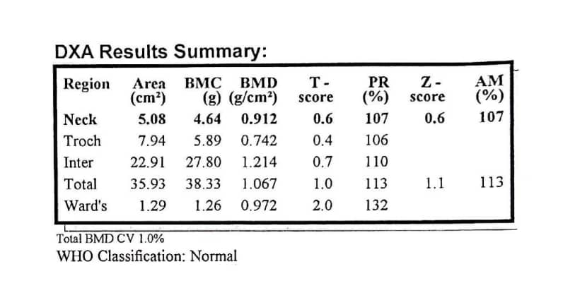
Bone densitometry 18 December 2016

Slide 22
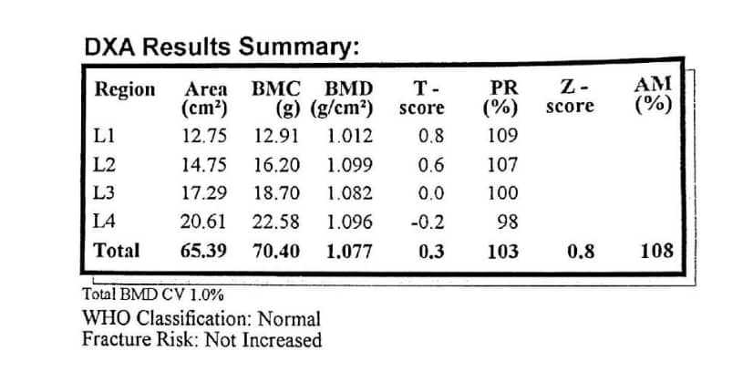
Bone densitometry. 18. December. 2016

Slide 23
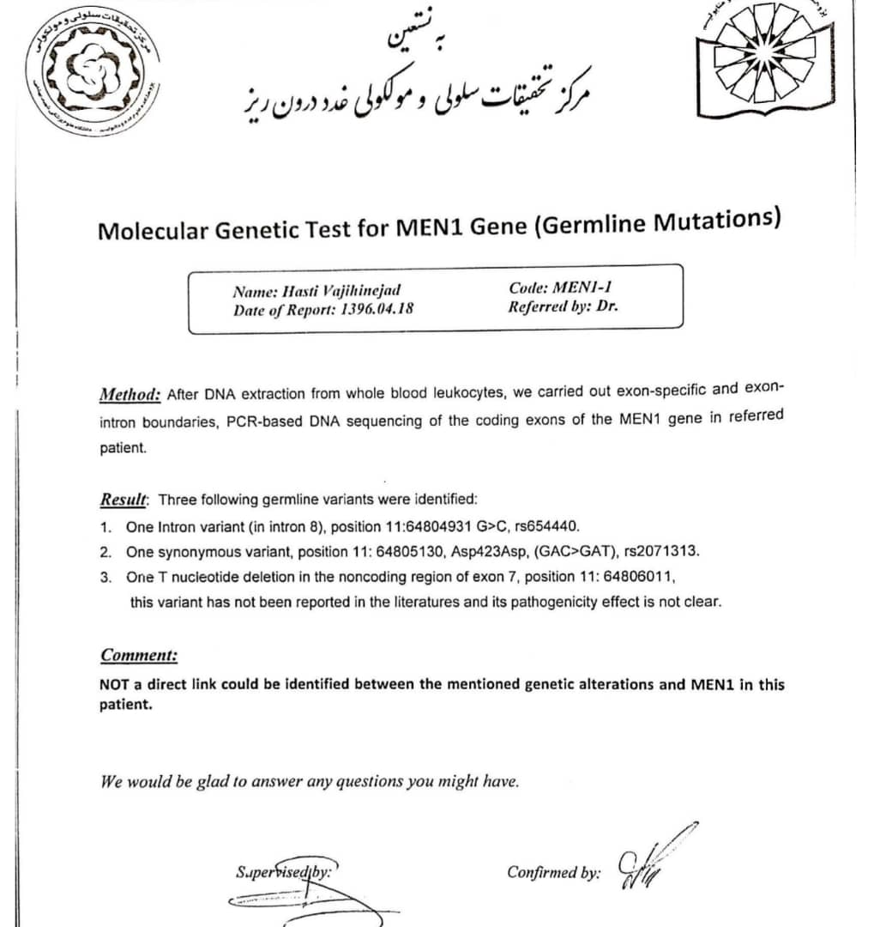

Slide 24
