Slide 1
Renoprotection with new antidiabetic drugs
Amouzegar MD
Endocrine Research Center
Research Institute for Endocrine Sciences
22.09.97
Tehran

Slide 2
Objectives:
Definition of renal outcomes
Mechanism of action
Clinical trials with renal outcomes as a primary outcomes
Clinical trials with renal outcomes as secondary outcomes
Ongoing trials
Conclusions

Slide 3
Definition of renal endpoints
The definition of renal endpoints is heterogeneous a wide range of variable outcomes are used.
ADVANCE,LEADER, EMPA-REG OUTCOME kidney study used composite renal endpoints:
New onset of macroalbuminuria (UACR >300 mg/g)
Doubling of serum Cr with an eGFR ≤ 45 ml/min per 1.73 m2
Initiation of RRT or death from renal cause

Slide 4
Cond’t
In Empa –REG trial, prespecified renal outcomes included:
Incident or worsening nephropathy (progression to macroalbuminuria, doubling of the serum cr level, initiation of renal-replacement therapy, or death from renal disease) and incident albuminuria.

Slide 5
Cont’d
Renal endpoints were performed as prespecified secondary outcomes in the cardiovascular safety trials.
Some ongoing studies have renal outcomes as primary outcomes.

Slide 6
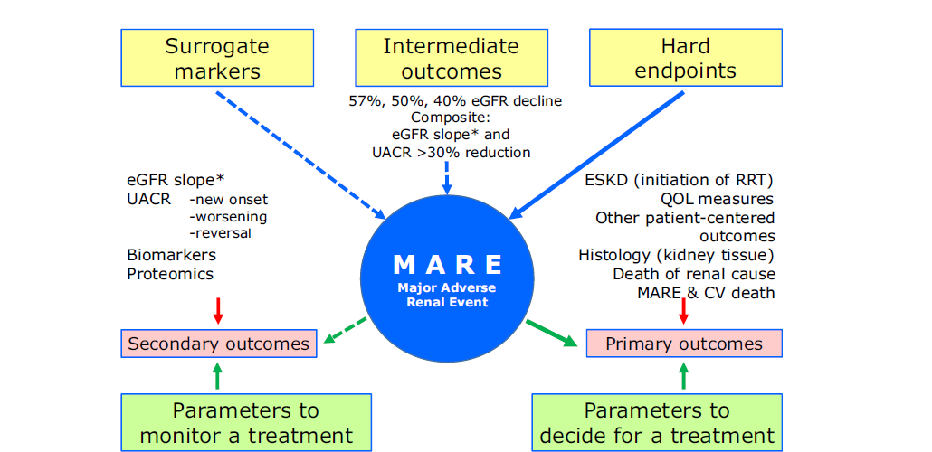
Renal outcome measures in drug studies of diabetic (chronic) kidney disease
Kidney International Reports (2018) 3, 1030–1038

Slide 7
New antidiabetic drugs
Completed and ongoing
Renal outcomes Trials
DPP4 inhibitors
SGLT2 inhibitors
GLP1 receptor agonists

Slide 8
SGLT2 Inhibitors

Slide 9
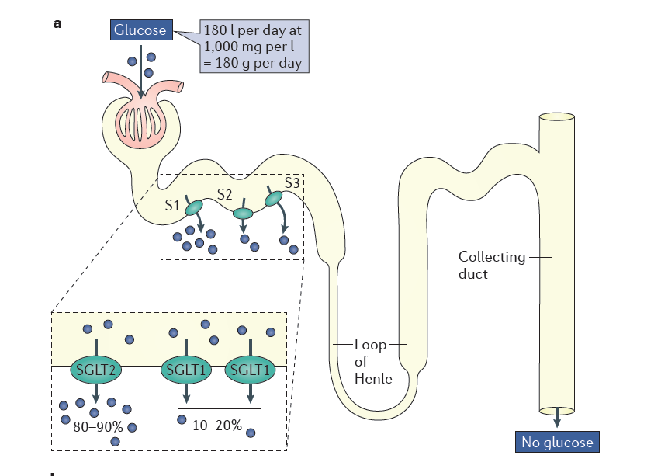
Endocrine Rev. 32, 515–531 (2011); permission conveyed through Copyright Clearance Center, Inc.

Slide 10
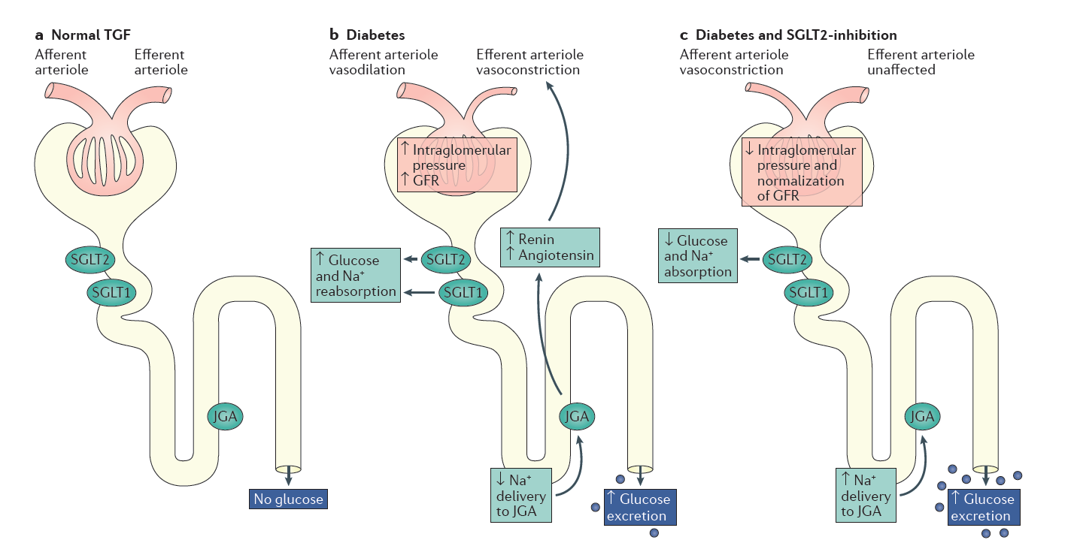
Endocrine Rev. 32, 515–531 (2011); permission conveyed through Copyright Clearance Center, Inc.

Slide 11
Mechanism of action of SGLT2is
Decrease intraglomerular pressure
Decrease arterial stiffness
Decrease vascular resistance
Lower rate of hyperglycemia
Decreased body weight
Decrease in SBP and DBP

Slide 12
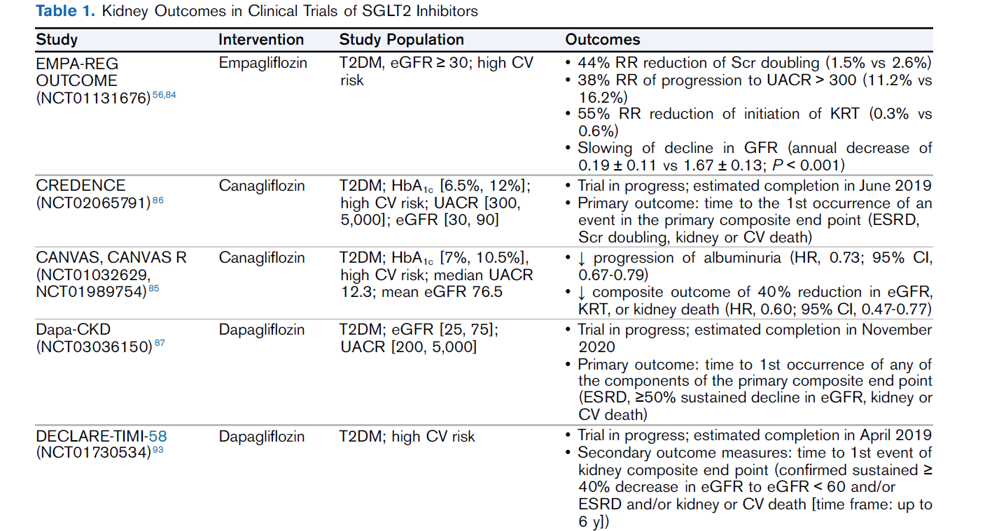
CANVAS R:The primary end point was
Development of microalbuminuria or macroalbuminuria in participants with baseline normoalbuminuria
Development of macroalbuminuria in participants with baseline microalbuminuria, accompanied by an increase in the urinary Alb /Cr ratio of ≥30% from baseline

Slide 13
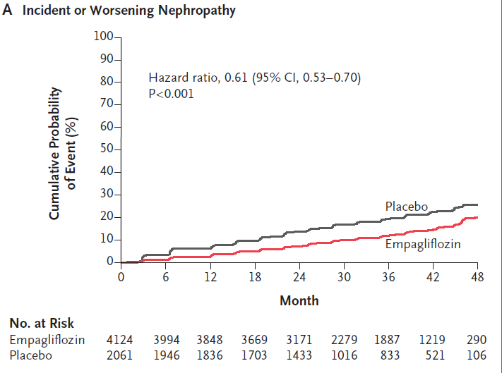
Renal outcome of nephropathy of Empagliflozin
N Engl J Med. 2016 Jul 28;375(4):323-34

Slide 14
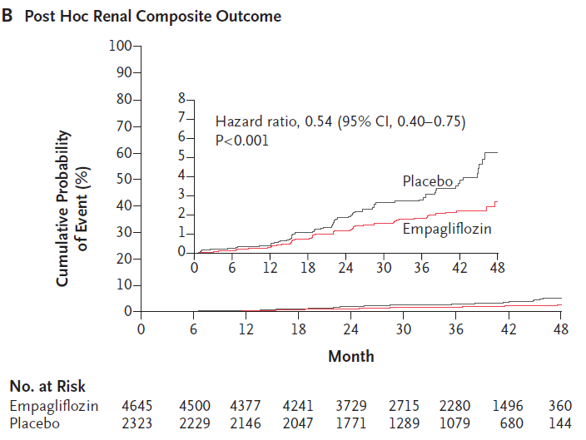
Cond’t
Subgroup of pts with prevalent kidney dis
eGFR ≤ 59 ml/min/1.73 m2
N Engl J Med. 2016 Jul 28;375(4):323-34

Slide 15
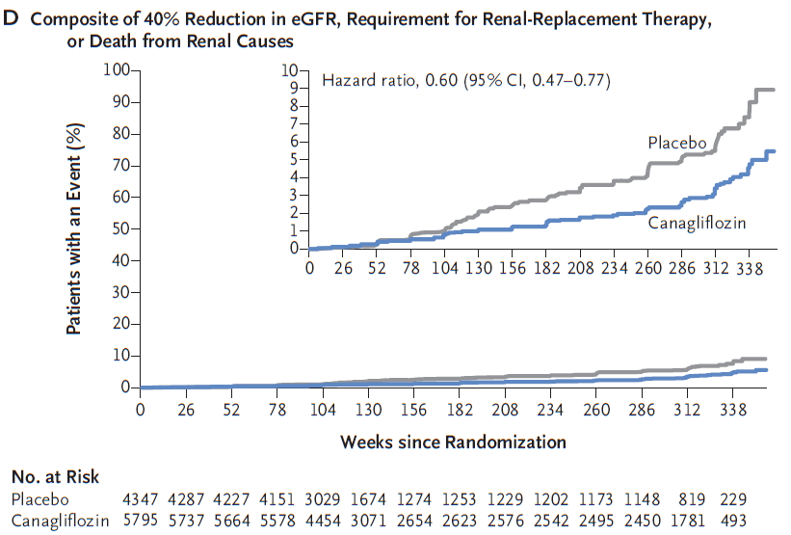
CANVAS Trial
N Engl J Med. 2017 Aug 17;377(7):644-657

Slide 16
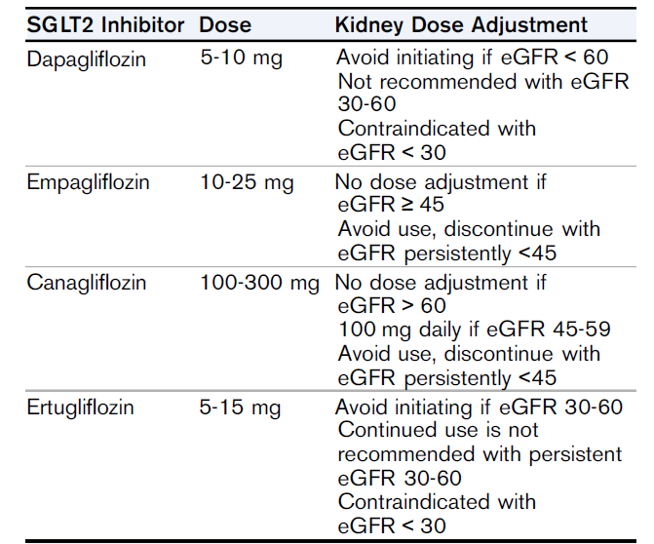
Kidney Function Dose Adjustments for Approved SGLT2 Inhibitors

Slide 17
DPP4 Inhibitors

Slide 18
Renal outcomes of DPP4 i
Glucose control
Upregulation of GLP-1and GLP-1 receptors
Inhibition of renal DPP-4 activity
Attenuation of inflammatory some activation
Reduction of oxidative stress; mitochondrial dysfunction and apoptosis
Suppression of connective-tissue growth factor
limitation of TGF-b-related fibrosis and NF-kB p65-mediated macrophage infiltration
Reduction of renal tubulointerstitial fibronectin
Upregulation of advanced glycation end-products
Regulation of proliferation of preglomerular vascular smooth muscle and mesangial cells
Attenuation of rises in blood pressure

Slide 19
Renal outcomes reported with DPP-4is in patients with T2DM and high cardiovascular risk
Doubling of serum cr | New-onset persistent macroAlb | Change in UACR | Change in eGFR vs. placebo | Baseline mean eGFR | F/U | Vs Comprator | Studies
NA | NA (micro: 7.8% vs. 7.9%) | -0.18 (-0.35 to -0.02 P=0.031 | -1.34 ( 1.76 - 0.91) P < 0.0001 | 79.4 | 3 | Sitagliptin 100mg once daily vs. placebo | TECOSE
1.1(0.89-1.36),NS | 2.2% vs2.8% | -34.3 | NA | 72.5 | 2.1 | Saxagliptin vs. Placebo | SAVOR-TIMI
NA | NA | NA | NA | 71.1 | 1.5 | Alogliptin vs. placebo | EXAMINE
Diabetes Metab. 2018 Oct 25 pii: S1262-3636(18)30197-6

Slide 20
Cond’t
Death from any cause | Composite renal outcome | Progression to ESRD requiring RRT | Studies
1.01-(0.9-1.14) P=0.88 | NA | 1.4% vs 1.5% | TECOSE
1.05(0.74-1.50) P=0.79 | 1.8(0.88-1.32) p=0.4 | 0.7% vs 0.9% NS | SAVOR-TIMI
0.88(0.71-1.09) P=0.23 | NA | 0.9% vs 0.8% | EXAMINE
Diabetes Metab. 2018 Oct 25 pii: S1262-3636(18)30197-6

Slide 21
CARMELINA will evaluate CV and renal safety of linagliptin in patients with T2D at high CV and renal risk
Inclusion criteria
T2D with HbA1c ≥ 6.5% and ≤ 10.0%
Stable background anti-diabetes medication, excluding GLP1, DPP4 inhibitors, SGLT2 inhibitors
High risk of CV, defined by:
1) albuminuria (micro or macro) and previous macrovascular disease
and/or
2) impaired renal function with predefined UACR
MAIN OUTCOMES AND MEASURES
Primary outcome was time to first occurrence of the composite of CV death, nonfatal MI , or nonfatal stroke.
Secondary outcome was time to first occurrence of adjudicated death due to renal failure, ESRD, or sustained 40% or higher decrease in eGFR from baseline.

Slide 22
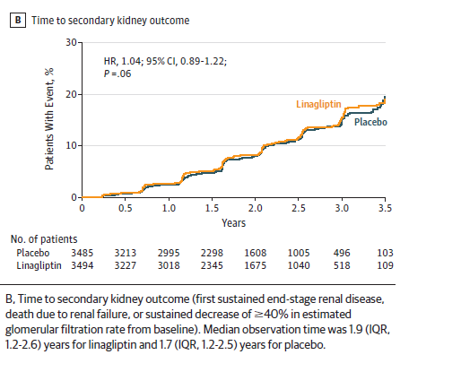
The CARMELINA Randomized Clinical Trial
The risk of the secondary kidney composite outcome was not significantly different between the groups randomized
to linagliptin and placebo
-Secondary outcome was time to first occurrence of adjudicated death due to renal failure, ESRD, or sustained 40% or higher decrease in eGFR from baseline.
-Drug was associated with a sig reduction in albuminuria.
The
JAMA. 2018 Nov 9. doi: 10.1001/jama.2018.18269. [Epub ahead of print]

Slide 23
What are the currently available DPP-4 Inhibitors on the market?
Alogliptin | Linagliptin | Vildagliptin | Saxagliptin | Sitagliptin
25 mg qd | 5 mg qd | 50 mg bid | 5 mg qd | 100 mg qd | Dosage
21 hours | >120 hours | 3 hours | 2 hours | 12 hours | Approximate half-life
Renal clearance (63%) | Entero-hepatic Eliminated unchanged in feces via biliary excretion (85%) | Hepatic metabolism to active metabolite Renal :half excretion (12%-29% unchanged parent and 21%-52% as metabolite) | Hepatic metabolism to active metabolite (half:Renal excretion (12%-29% unchanged parent and 21%-52% as metabolite) | Renal clearance (75%) | Elimination
Neutral | Neutral | Neutral | Neutral | Neutral | Effect on weight
Low | Low | Low | Low | Low | Adverse events

Slide 24
GLP1 Agonists

Slide 25
Renal effects of GLP1R agonists
Improvement of glucose control.
Lowering of BP and weight.
Direct effects on the kidney, including the intrarenal RAAS, ischaemia/ hypoxia, apoptosis and neural signaling, oxidative stress, collagen accumulation.
Induce natriuresis.
Reduce inflammation, macrophage infiltration.

Slide 26
Renal outcomes reported for GLP1RA and high CV risk
studies | GLP-1RA dose vs. comparator | Active vs. placebo (n) | Median follow-up (years) | Baseline mean eGFR | Baseline UACR | Change in UACR
LEADER [92.93] | Liragutide 1.8 mg once daily vs. placebo | 4668 vs.4672 | 3.84 | 80.4 | Micro:26.3% Macro: 10.5% | -17% (-12-21), p<0.001
SUSTAIN-6 [94] | Semaglutide 0.5 Or 1.0 mg Once daily vs. placebo | 1648 vs. 1649 | 2 | NA | NA | NA
EXSCEL [95] | Exenatide ER 2 mg once Weekly vs. placebo | 7356 vs. 7396 | 3.2 | 76.6 | NA | NA

Slide 27
Cond’t
studies | New-onset persistent macroALb | Doubling of serum Cr | Progression to ESRD requiring RRT | Composite renal outcome | Death from any cause
LEADER [92.93] | 0.74 (0.60-0.91), P<0.004 | 0.89(0.67-1.19), p=0.43 | 0.87(0.61-1.24), P=0.44 | o.78(0.67-0.92), P=0.003 | 0.85 (0.74-0.97), P=0.02
SUSTAIN-6 [94] | 0.54 (0.37-0.77), P=0.001 | 1.28(0.64-2.58), p=0.48 | 0.91(0.40-2.07), P=0.83 | 0.64(0.46-0.88), P=0.005 | 1.05 (0.74-1.50), P=0.79
EXSCEL [95] | 2.2% VS. 2.8% | NA | 0.7% vs. 0.9% | NA | 0.86 (0.77-0.98), P not tested

Slide 28
Outcomes
Renal outcome was observed in fewer participants in the GLP1RA – trials than in the placebo group.
This result was driven primarily by the new onset of persistent macroalbuminuria, whereas no significant differences were observed for persistent doubling of serum cr, ESRD and death due to renal disease.

Slide 29
Renal excretion
Exenatide and lixisenatide are eliminated by renal excretion and should not be used in patients with eGFR<30 mL/min.
Liraglutide, albiglutide, dulaglutide, and semaglutide are not renally excreted but should be used with caution in patients with renal impairment.

Slide 30
Conclusion
Improving glucose control remains essential to either prevent or slow the progression of DKD.
The renal-protective potential of DPP-4is remained largely unproven.
GLP-1RAs and SGLT2is have proven their ability to reduce composite renal outcomes including albuminuria, eGFR decline, doubling of Cr and progression to ESRD or kidney-related death, mainly driven by the reduction of new-onset macroalbuminuria.
Only SGLT2is have proved capable of reducing hard clinical endpoints, such as doubling of cr and progression to ESRD.

Slide 31
با تشکر

