Slide 1
Treatment of Symptoms of the Menopause

Slide 2
AGENDA
Intruduction
WHI:
During the study
13 years post study
Risks in early post menopause
JCEM Practice Guideline

Slide 3
Menopausal Hormone Therapy: Current Considerations. Cynthia A. Stuenkel, Endocrinol Metab Clin N Am 44 (2015) 565–585

Slide 4
The Women’s Health Initiative Hormone Therapy Trials: Update
and Overview of Health Outcomes During the Intervention and
Post-Stopping Phases
JAMA. 2013 October 2; 310(13): 1353–1368,doi:10.1001/jama.
2013.278040.

Slide 5
INTRODUCTION:
At least 40 percent of postmenopausal women in the United States were using HT shortly before the publication of the initial WHI findings.
Study Design:
27,347 postmenopausal women ages 50 to 79 were recruited from 1993 to 1998 at 40 U.S. clinical centers; 16,608 women with a uterus were randomized to daily oral CEE (0.625 mg) plus MPA (2.5 mg) (Prempro) or placebo and 10,739 women with hysterectomy were randomized to daily oral CEE (0.625 mg) alone (Premarin) or placebo.

Slide 6
Intervention in the CEE+MPA trial ended on July 7, 2002 (after a median of 5.6 years) because of increased breast cancer risk and an unfavorable risk-benefit ratio with CEE+MPA.
Intervention in the CEE trial ended on February 29, 2004 (after a median of 7.2 years) because of increased stroke incidence not offset by lower CHD risk in the hormone group.
Post-intervention follow-up through September 30, 2010 is based on 81.1% of surviving participants.
The cumulative results reported here include a median post-intervention follow-up of 8.2 years and median cumulative follow-up of 13.2 years for the CEE+MPA trial, and a median post-intervention follow-up of 6.6 years and median cumulative follow-up of 13.0 years for the CEE-alone trial.

Slide 7
Primary Endpoints in the Two Trials: Intervention and Post-Intervention Results
Coronary heart disease
Breast cancer

Slide 8
Coronary heart disease (CHD)
defined as: nonfatal (MI) or coronary death.
Intervention phase:
CEE+MPA :HR of 1.18 (95% CI, 0.95–1.45)
The HR at year one was 1.80 (1.08–2.99
(p for trend by time = 0.03).
CEE :HR of 0.94 (95% CI, 0.78–1.14
(p for trend by time = 0.21).

Slide 9
Post-intervention: both trials were neutral.
cumulative 13-year follow-up:
CEE+MPA :1.09 (0.96–1.24)
CEE : 0.94 (0.82–1.09)
Stratified analyses (by age and time since menopause):
(p for trend =0.08)

Slide 10
Breast cancer
Intervention phase:
Results for breast cancer differed between the two trials.
HR for CEE+MPA was 1.24 (1.01–1.53)
(p for time trend = 0.005), with cancers diagnosed at more advanced stages.
HR for CEE was 0.79 (0.61–1.02) and HRs did not differ by time since randomization
Post-intervention and cumulative follow-up:
CEE +MPA: (HR :1.28 [1.11–1.48])
CEE: (HR=0.79 [0.65–0.97])
Stratified analyses:
No appreciable differences by age or time since menopause emerged

Slide 11
Other Endpoints in the Global Index: Intervention and Post-Intervention Results

Slide 12
Stroke
Intervention phase:
Stroke risk was increased by 37% with CEE+MPA and by 35% with CEE, reflecting increased ischemic, but not hemorrhagic, stroke risk.
Post-intervention and cumulative follow-up:
Post-intervention results were neutral in both trials Cumulatively, the HRs for stroke were 15–16% higher in the hormone therapy groups in both trials
Stratified analyses:
No appreciable differences were seen in either trial.

Slide 13
Pulmonary embolism
Intervention phase:
While a statistically significant doubling of pulmonary embolism (PE) risk was seen with CEE+MPA the 35% higher PE risk with CEE was not statistically significant.
Post-intervention and cumulative follow-up:
Post-stopping :neutral in both trials.
Cumulatively, the HRs were 1.26 (1.00–1.59) for CEE+MPA and 1.15 (0.87–1.51) for CEE
Stratified analyses:
No appreciable differences by age or time since menopause were seen in either trial.

Slide 14
Colorectal cancer
Intervention phase:
For CEE+MPA, the HR was 0.62 (0.43–0.89), but the cancers were diagnosed at a more advanced stage.
CEE : (HR =1.15 [0.81–1.64])
Post-intervention and cumulative follow-up:
HRs were neutral in both trials.
Stratified analyses:
CEE: more adverse in older women (p for trend = 0.02)
no age differences : CEE+MPA

Slide 15
Endometrial cancer
Intervention phase:
CEE+MPA : HR of 0.83 (0.49–1.40)
Post-intervention and cumulative follow-up:
post intervention: (HR=0.58 [0.40–0.86])
cumulative follow up: (HR=0.67 [0.49–0.91]).
Hip fracture
Intervention phase:
CEE+MPA and CEE, : statistically significant 33% reductions in hip fracture.
Post-intervention and cumulative follow-up:
Post-intervention, the risk reductions were attenuated in both trials but a significant fracture benefit persisted at 13 years for CEE+MPA (HR=0.81 [0.68–0.97]).

Slide 16
All-cause mortality
Intervention phase:
Neither CEE+MPA nor CEE affected all-cause mortality.
Post-intervention and cumulative follow-up:
neutral
Stratified analyses:
In both trials: more favorable in younger women were during the intervention phase
HRs : 0.67 (0.43–1.04) and 0.70 (0.46–1.09) among women ages 50–59 in the CEE+MPA and CEE trials, respectively,
HRs ranged from 1.01 to 1.21 among women ages 60–79.

Slide 17
Global index
Intervention phase:
Overall, the health risks of CEE+MPA significantly outweighed the benefits.
For the global index HR was elevated at 1.12 (1.02–1.24).
for every 10,000 women taking CEE+MPA per year, there were 6 more coronary events, 9 more strokes, 9 more pulmonary emboli, 9 more breast cancers, 6 fewer colorectal cancers, 1 fewer endometrial cancers, 6 fewer hip fractures, and 1 fewer death, yielding a net effect of 20 additional adverse events per 10,000 person-years (pys).
HR for the global index for CEE was 1.03, with a net of 4 adverse events.
Post-intervention and cumulative follow-up:
As most risks became attenuated after stopping, the global index was neutral for both trials post-intervention and cumulatively.

Slide 18
Secondary Endpoints in the Two Trials
Myocardial Infarction
CABG/PCI
deep vein thrombosis
total cardiovascular events
cardiovascular death
Cancer risk
Clinical vertebral and total fractures
Dementia
treated diabetes
gallbladder disease
Self-reported urinary incontinence (at least once/week)
VMS

Slide 19
Women aged 70–79 with moderate-to-severe vasomotor symptoms at baseline
CEE+MPA :HR for CHD of 5.79 (1.29–25.97)
CEE : HR for CHD of 4.34 (1.43–13.14)

Slide 20
Key message
CEE+MPA
intervention phase:
hazard ratio (HR) for CHD was 1.18 (95% confidence interval [CI] 0.95–1.45) and overall risks outweighed benefits, with increases in invasive breast cancer, stroke, pulmonary embolism, and the global index. Other risks included increased dementia (in women >65 years), gallbladder disease, and urinary incontinence
benefits included: decreased hip fractures, diabetes, and vasomotor symptoms.
Postintervention:
most risks and benefits dissipated, although some elevation in breast cancer risk persisted (cumulative hazard ratio [HR] =1.28; 95% confidence interval, 1.11–1.48).

Slide 21
Cont..
CEE alone
During intervention for, risks and benefits were more balanced, with a HR for CHD of 0.94 (0.78–1.14), increased stroke and venous thrombosis, decreased hip fractures and diabetes, and over cumulative follow-up, decreased breast cancer (HR=0.79 [0.65–0.97]).
Neither regimen affected all-cause mortality.
With CEE, younger women (50–59 years) had more favorable results for all-cause mortality, myocardial infarction, and the global index (nominal P values for trend by age <0.05), but not for stroke and venous thrombosis.
Absolute risks of adverse events (measured by the global index) per 10,000 women per year on CEE+MPA ranged from 12 excess cases for age 50–59 to 38 for age 70–79 and, for CEE, from 19 fewer cases for age 50–59 to 51 excess cases for age 70–79. Results for quality of life outcomes in both trials were mixed.

Slide 22
Menopausal Hormone Therapy: Current Considerations. Cynthia A. Stuenkel, Endocrinol Metab Clin N Am 44 (2015) 565–585

Slide 23
Treatment of Symptoms of the Menopause: An Endocrine Society Clinical Practice Guideline
Cynthia A. Stuenkel, Susan R. Davis, Anne Gompel, Mary Ann Lumsden,M. Hassan Murad, JoAnn V. Pinkerton, and Richard J. Santen
J Clin Endocrinol. August 28, 2015. (doi: 10.1210/jc.2015-2236)

Slide 24
1.0 Diagnosis and symptoms of menopause
1.1 We suggest diagnosing menopause based on the clinical criteria of the menstrual cycle. (2 ++○○)
1.2 If establishing a diagnosis of menopause is necessary in women having undergone a hysterectomy without bilateral oophorectomy or presenting with a menstrual history that is inadequate to ascertain menopausal status, we suggest making a diagnosis based on the presence of (VMS) and laboratory testing :FSH and serum estradiol. (2 ++○○)

Slide 25
Definitions of Spectrum of Menopause
Menopause
cessation of menses for 12 mo in a previously cycling woman
Spontaneous menopause
Cessation of menses at an average age of 51 y in the absence of surgery or medication.
Menopausal transition (or perimenopause)
An interval preceding the menopause characterized by variations in menstrual cycle length and bleeding pattern, mood shifts, vasomotor, and vaginal symptoms and with rising FSH levels and falling anti-Mullerian hormone and inhibin B levels, which starts during the late reproductive stage and progresses during the menopause transition.
Climacteric
The phase in the aging of women marking the transition from the reproductive phase to the nonreproductive state.

Slide 26
Climacteric syndrome
When the climacteric is associated with symptomatology.
Menopause after hysterectomy without oophorectomy
Spontaneous cessation of ovarian function without the clinical signal of cessation of menses (elevated FSH levels and estradiol concentrations <20 (pg/mL on several occasions.
Induced menopause
Cessation of ovarian function induced by chemotherapy, radiotherapy(ovarian function may resume after 12 months of amenorrhea) or bilateral oophorectomy.
Early menopause
Cessation of ovarian function occurring between ages 40 and 45 in the absence of other etiologies for secondary amenorrhea (pregnancy, hyperprolactinemia, and thyroid disorders).
POI
Loss of ovarian function before the age of 40 y with waxing and waning course and potential resumption of menses, conception, and pregnancy.(persistent FSH elevation)

Slide 27
VMS, hot flashes, and night sweats, are the hallmarks of menopause
Other climacteric symptoms include:
→ sleep disturbance
→ Arthralgia
→ vaginal dryness
→ dyspareunia
less clear symptoms :
-anxiety
-irritability
-Depression
-Palpitations
-skin dryness
-loss of Libido
-fatigue
Start: years before the final menstrual period
Last: from a few years to more than 13 years

Slide 28
Vasomotor symptoms
Hot flashes
approximately 75% of postmenopausal women
the sudden sensation of heat centered on the upper chest and face.
moderate or severe: rapidly becomes generalized, lasts from 2 to 4 minutes, and can be associated with profuse perspiration, palpitations, or anxiety.
Triggers include: spicy food or alcohol.

Slide 29
At night, vasomotor instability manifests as hot flashes or night sweats
New-onset VMS in older (age, ≥ 65 y) postmenopausal women may be associated with increased risk of major CHD and all-cause mortality
In polysomnography studies, nocturnal hot flashes are more common during the first 4 hours of sleep, whereas subsequent rapid eye movement sleep suppresses hot flashes, arousals, and awakenings.

Slide 30
“genitourinary syndrome of menopause” (GSM) combines the conditions of VVA and urinary tract dysfunction (dysuria, urinary frequency, and recurrent urinary tract infections)
VVA most often presents in the late postmenopausal stage, when VMS may have abated.

Slide 31
2.0 Health considerations for all menopausal women
2.1 When women present during the menopausal transition, we suggest using this opportunity to address bone health, smoking cessation, alcohol use, cardiovascular risk assessment and management, and cancer screening and prevention. (Ungraded best practice statement)

Slide 32
3.0 Hormone therapy for menopausal symptom relief

Slide 33
3.1 Estrogen and progestogen therapy
3.1a For menopausal women <60 years of age or<10 years past menopause with bothersome VMS (± additional climacteric symptoms) who do not have contraindications or excess cardiovascular or breast cancer risks and are willing to take menopausal hormone therapy (MHT), we suggest initiating estrogen therapy (ET) for those without a uterus and estrogen plus progestogen therapy (EPT) for those with a uterus. (2 ++○○)

Slide 34
Specific Cautions to Use of Systemic MHT or SERMs for Treatment of Menopausal Symptoms
In general, ET should not be used in women with any of the following conditions:
→ Undiagnosed abnormal genital bleeding
→ Known, suspected, or history of cancer of the breast
→ Known or suspected estrogen-dependent neoplasia including endometrial cancer
→ Active DVT, pulmonary embolism, or history of these conditions
→ Active arterial thromboembolic disease (for example, stroke, MI) or a history of these conditions
→ Known anaphylactic reaction or angioedema in response to any ingredient in the medication
→ Known liver impairment or disease
→ Known protein C, protein S, or antithrombin deficiency, or other known thrombophilic disorders(Specific to CEE ± combination with BZA)
→ Known or suspected pregnancy

Slide 35
Caution:
Gallbladder disease (oral ET)
Hypertriglyceridemia (400 mg/d) (oral ET)
Diabetes
Hypoparathyroidism (risk of hypocalcemia)
Benign meningioma
Intermediate or high risk of breast cancer
High risk of heart disease
Migraine with aura (oral ET)
Other conditions: Estrogen therapy may cause an exacerbation of asthma, diabetes mellitus, epilepsy, migraine, porphyria, systemic lupus erythematosus, and hepatic hemangiomas

Slide 37
effects of CEE alone or combined with MPA in women ages 50–59 years during intervention phase of WHI.
WHI studies were not powered for age-related subset analyses, and none of the data presented in the figure are statistically significant
a, HR, 0.60 (0.35–1.04)
b, HR, 1.34 (0.82–2.19)
c, HR, 0.82 (0.50 –1.34)
d, HR, 1.21 (0.81–1.80)
e, HR, 0.99 (0.53–1.85)
f, HR, 1.51(0.81–2.82)
g, HR, 1.53 (0.63–3.75)
h, HR, 2.05 (0.89–4.71)
i, HR, 1.66 (0.76 –3.67)
j, HR,3.01 (1.36–6.66)
k, HR, 0.71 (0.30 –1.67)
l, HR, 0.79 (0.29 –2.18)
m, HR, 1.00 (ns-ns)
n, HR,1.12 (0.45–2.75)
o, HR, 0.62 (0.30 –1.29)
p, HR, 0.90 (0.72–1.11)
q, HR, 0.82 (0.68 –1.00)
r, HR, 5.01 (0.59–42.9)
s, HR, 0.17 (0.02–1.45)
t, HR, 0.70 (0.46 –1.09)
u, HR, 0.67 (0.43–1.04);
v, HR, 0.83 (0.67–1.04)
w, HR, 0.85 (0.66 –1.09)

Slide 38
Benefits of MHT
Vasomotor symptoms: reduces hot flash frequency by approximately 75% and severity by 87%, compared with 50% with placebo
Genitourinary syndrome of menopause
Sleep disruption
Anxiety and depressive symptoms
Arthralgia

Slide 39
Potential preventive benefits of menopausal hormone therapy
U.S. Preventive Services Task Force and many expert groups recommend against MHT for primary or secondary disease prevention, whereas other experts disagree
Bone loss and fracture
Type 2 diabetes
Colorectal cancer (combined CEE and MPA)
Endometrial cancer(combined CEE and MPA)

Slide 40
Risks of MHT
Endometrial cancer
Breast cancer
Lung cancer
Ovarian cancer
Coronary heart disease
Stroke
Venous thromboembolic events
Gallbladder disease
Incontinence

Slide 41
Individual baseline risk assessment and therapeutic decisions
no clinical trial evidence is available to support the practice of incorporating risk assessment instruments for quantifying cardiovascular (CHD, stroke, and VTE) and breast cancer risks among women considering MHT.
Nevertheless, we feel that risk assessment instruments are useful to facilitate decision-making regarding MHT.

Slide 42
Cardiovascular risk
For women age <60 or <10 years past menopause onset considering MHT for menopausal symptom relief, we suggest evaluating the baseline risk of cardiovascular disease (CVD) and taking this risk into consideration when advising for or against MHT and when selecting type, dose, and route of administration. (2 ++○○)
For women at high risk of CVD, we suggest initiating nonhormonal therapies to alleviate bothersome VMS (with or without climacteric symptoms) over MHT. (2 ++○○)

Slide 43
High risk includes:
known MI
cerebrovascular disease
peripheral arterial disease
abdominal aortic aneurysm
diabetes mellitus
chronic kidney disease
10-year CVD risk > 10%

Slide 44
For women with moderate risk of CVD, we suggest transdermal estradiol as first-line treatment, alone for women without a uterus or combined with micronized progesterone (or another progestogen that does not adversely modify metabolic parameters) for women with a uterus, because these preparations have less untoward effect on blood pressure, triglycerides, and carbohydrate metabolism. (2 ++○○)

Slide 46
Metabolic syndrome.
(MetS) higher risk of cardiovascular events and breast and colon cancers.
In a nested case-control study in the WHI:
with MetS at baseline :twice as likely to have CHD
without MetS : no increase in CHD risk on MHT.
Transdermal estradiol with micronized progesterone might have less deleterious metabolic effects.
no RCTs that have evaluated the safety of these preparations in women with MetS.

Slide 47
Venous thromboembolic events
3.1e For women at increased risk of venous thromboembolism (VTE) who request MHT, we recommend a nonoral route of ET at the lowest effective dose, if not contraindicated (1 ++○○); for women with a uterus, we recommend a progestogen (for example, progesterone and dydrogestone) that is neutral on coagulation parameters.
(1 +++○)

Slide 48
Obesity, age, and thrombophilia are associated with increased risk of VTE.
An approximately 2-fold increased risk of VTE (both DVT and PE) with oral MHT is similar among women at low, intermediate, or high risk.
A prior history of VTE confers the highest risk.
known inherited coagulation defect, such as Factor V Leiden, oral ET or EPT should be avoided (high risk of VTE recurrence).
A history of VTE due to pregnancy, oral contraceptives, unknown etiology, or blood clotting disorders poses a contraindication to any ET
VTE due to past immobility, surgery, or bone fracture would be a contraindication to oral but not necessarily transdermal MHT.

Slide 49
Breast cancer
3.1f For women considering MHT for menopausal symptom relief, we suggest evaluating the baseline risk of breast cancer and taking this risk into consideration when advising for or against MHT and when selecting type, dose, and route of administration. (2 ++○○)
3.1g For women at high or intermediate risk of breast cancer considering MHT for menopausal symptom relief, we suggest nonhormonal therapies over MHT to alleviate bothersome VMS. (2 ++○○)

Slide 50
There are no established clear criteria for recommending (or avoiding)MHT based on a woman’s risk of breast cancer.
not to recommend MHT for women whose risk meets the criteria for breast cancer prevention with SERMs or aromatase inhibitors.

Slide 52
Tailoring MHT
3.1h We suggest a shared decision-making approach to decide about the choice of formulation, starting dose, the route of administration of MHT, and how to tailor MHT to each woman’s individual situation, risks, and treatment goals. (Ungraded best practice statement)
Starting dosages are generally lower than those in the WHI
use the lowest effective dose
not measure estradiol levels
surgical menopause / POI

Slide 53
Systemic estrogen therapies
Doses Oral estrogen tablets
Micronized E2 0.5, 1.0, 2.0 mg/d
Estradiol valerate 1.5 mg/d
CEE 0.3, 0.45, 0.625 mg/d
Transdermal estrogens
Estradiol patch 0.025 to 0.1 mg once or twice weekly (Corresponds to 0.5 to 2.0 mg estradiol tablets)
( 0.014 mg/wk (Preserved bone in women 60 y old
Estradiol percutaneous gel 0.25–1.5 mg qd (Corresponds to 0.5 to 2.0 mg estradiol tablets Can be transferred to persons and pets by skin contact)
Estradiol transdermal spray 1.5 mg qd (Estradiol via spray)
Vaginal ring
Estradiol acetate 0.05–0.10 mg/d (Systemic levels of estradiol provide relief of VMS;90-d duration/ring)

Slide 54
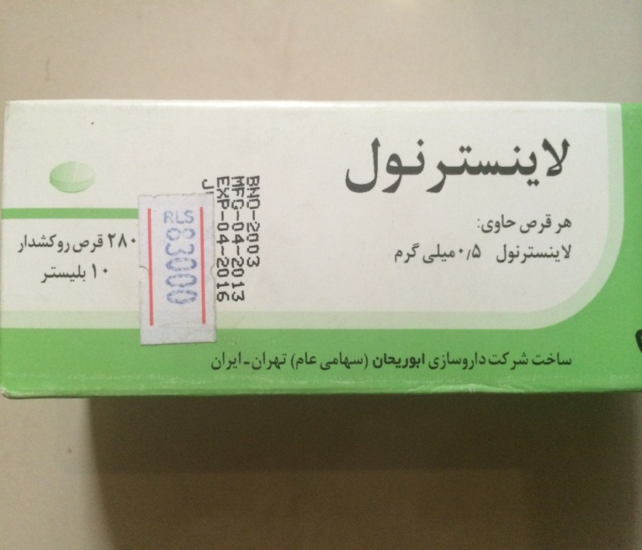

Slide 55
Progestogen therapies
Doses Oral progestin tablets
Medroxyprogesterone acetate 2.5, 5, 10 mg/d Utilized in WHI
Norethindrone 0.35 mg/d
Neta 5.0 mg/d
Megestrol acetate 20, 40 mg/d
Dydrogesterone 10 mg/d
Chlormadinone acetate 5, 10 mg/d
Medrogestone 5 mg/d
Nomegestrol acetate 3.75, 5 mg/d
Promegestone 0.125, 0.25, 0.5 mg/d
Oral progesterone capsule
Micronized progesterone 100, 200 mg/d In (peanut oil; avoid peanut allergy. May cause drowsiness should be taken at bedtime)
Intrauterine system progestinc
(LNorg 20 micg released/d(IUD for 5-y use
( 6 micg/d(IUD for 3-y use
Vaginal gel progesteronec 4%, 8%(45- or 90-mg applicator)

Slide 56
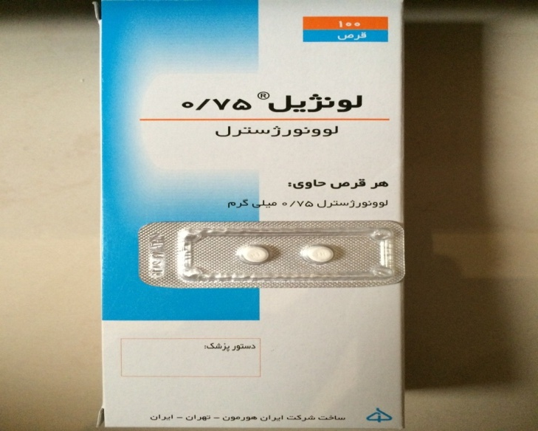
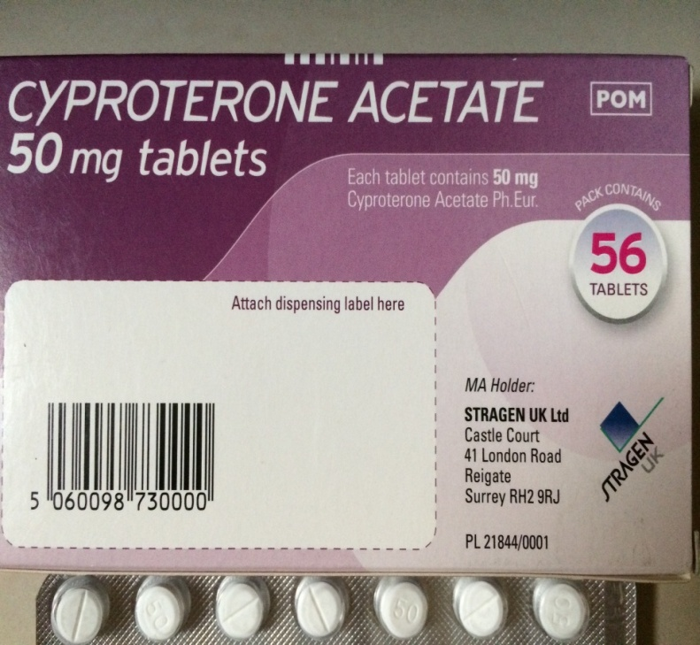
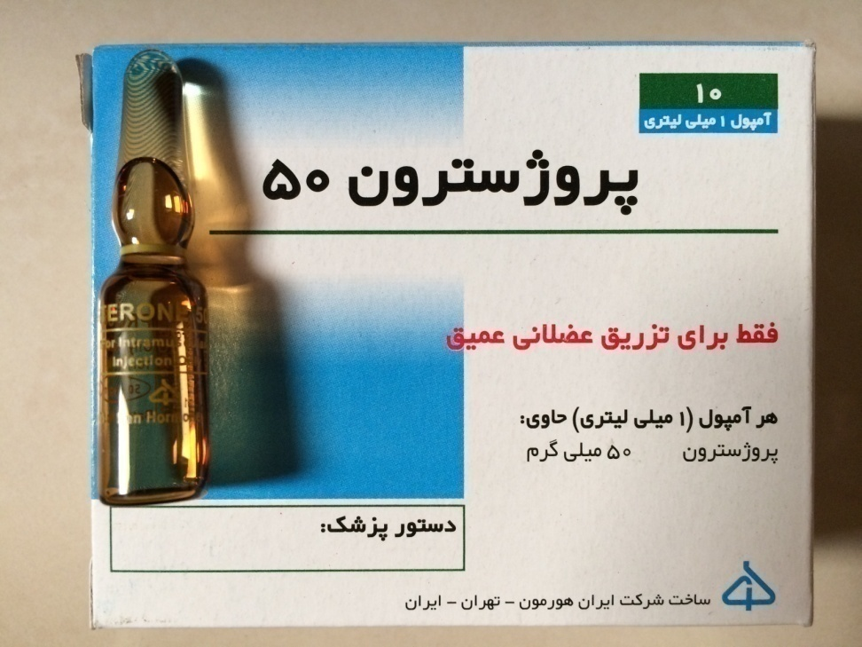

Slide 57
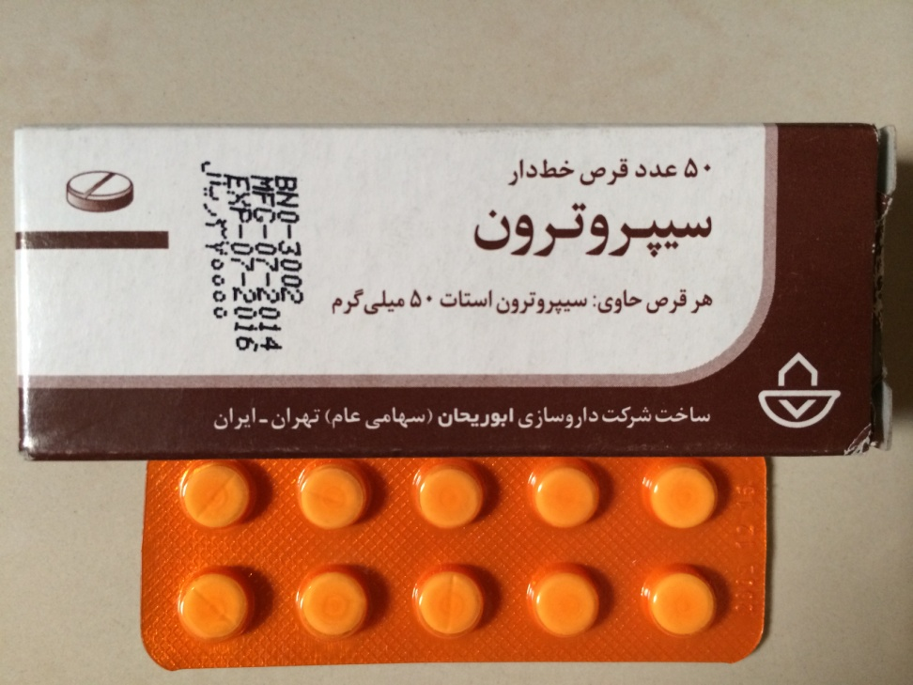
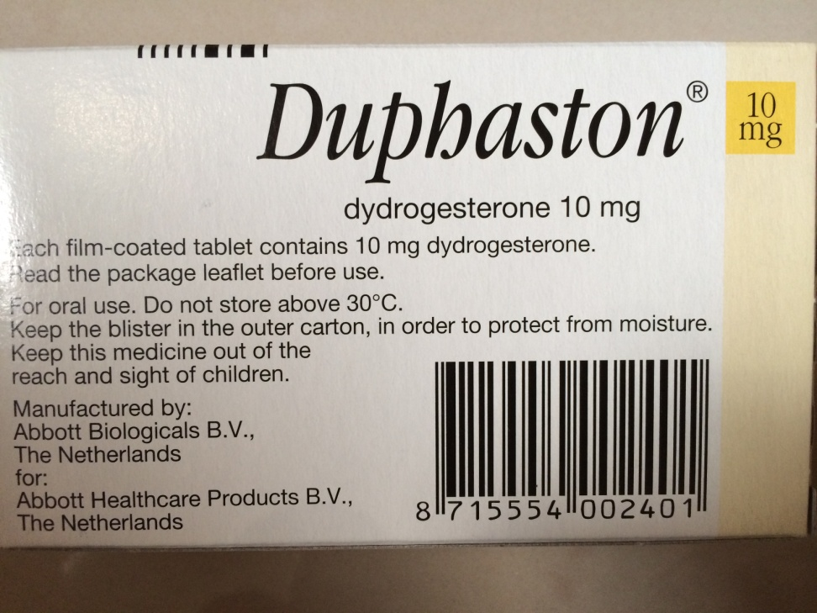

Slide 58
Combination hormone therapies
Oral Doses
CEE + MPA 0.3–0.625 mg/1.5–5 mg/d (Cyclic or continuous)
E2 + Neta 0.5–1 mg/0.1–0.5 mg/d (Continuous)
E2 + drospirenone 0.5–1 mg/0.25–1 mg/d (Continuous)
E2 + norgestimate 1 mg, 1/0.09 mg/d (Cycle 3 d E alone, 3 d E +progesterone)
E2 + dydrogesteroneb 1–2 mg/5–10 mg/d (Cyclic and continuous)
E2 + cyproterone acetateb 2 mg/1 mg/d (Continuous)
E2 + MPAb 1–2 mg/2–10 mg/d (Continuous)
CEE + BZAd 0.45 mg/20 mg/d (Continuous)
Transdermal
E2 + Neta 50 micg/0.14–0.25 mg/patch (Twice weekly)
E2 + LNorg 45 micg/0.015 mg/patch (Once weekly)

Slide 59
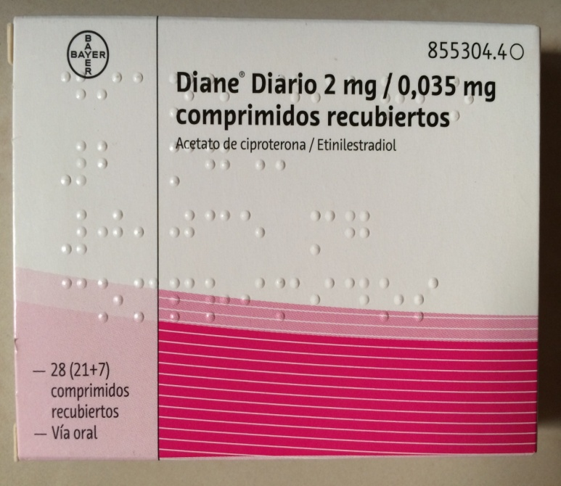
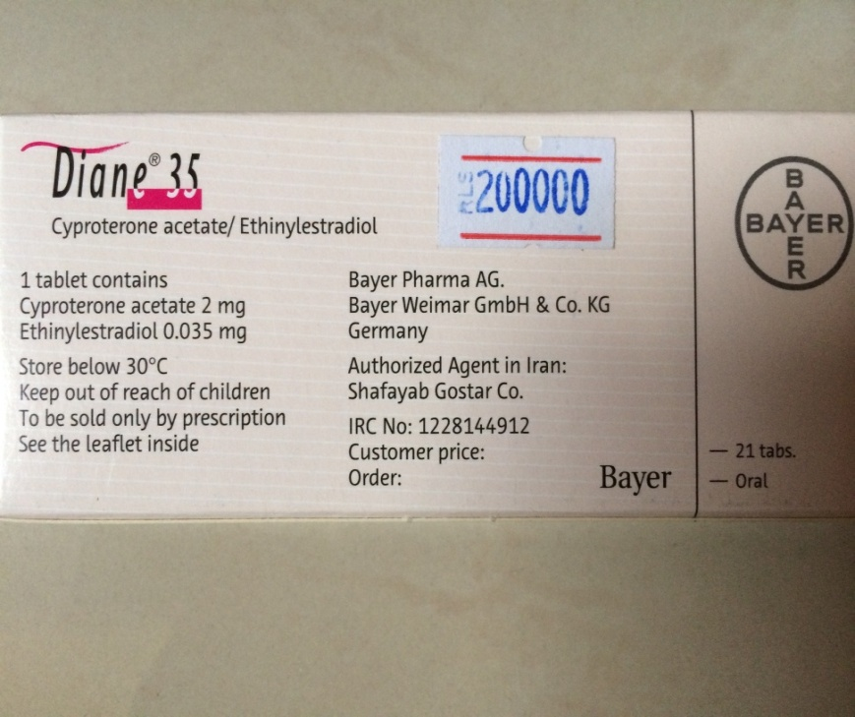
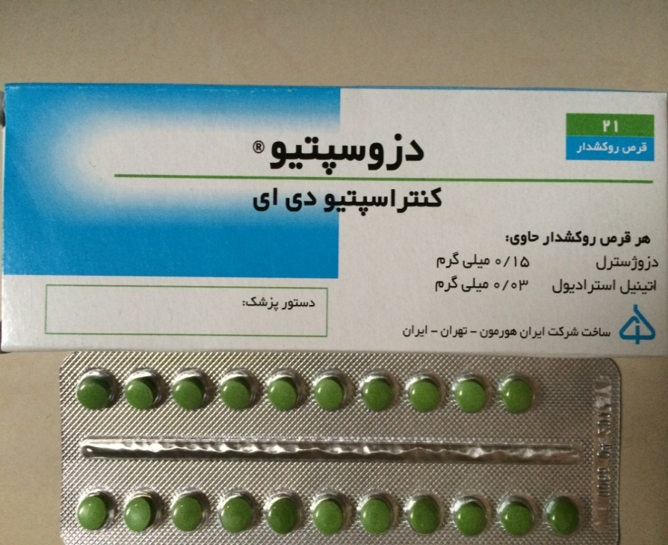
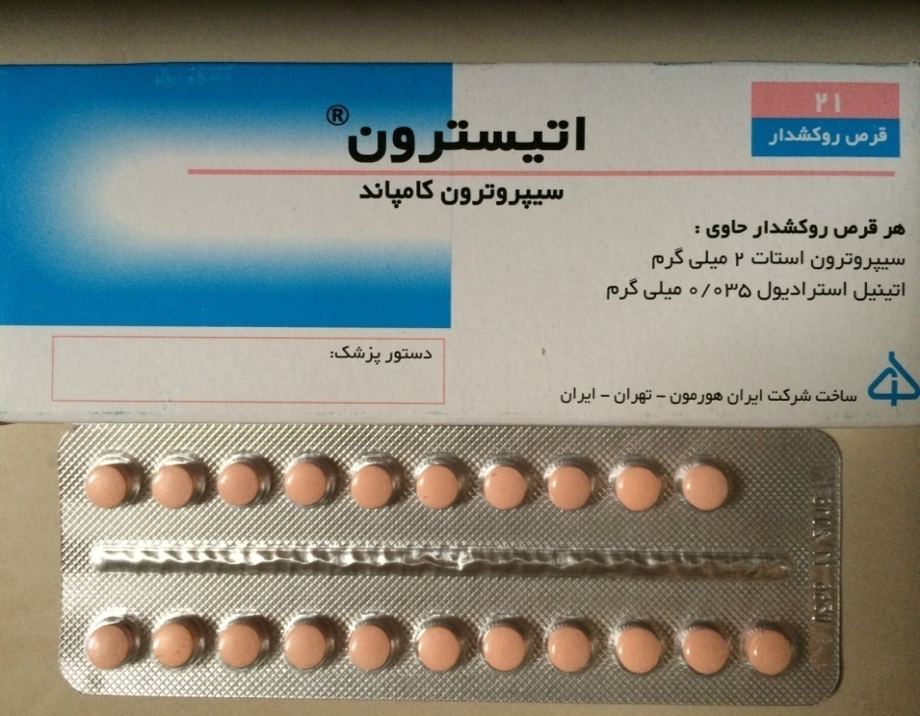

Slide 60
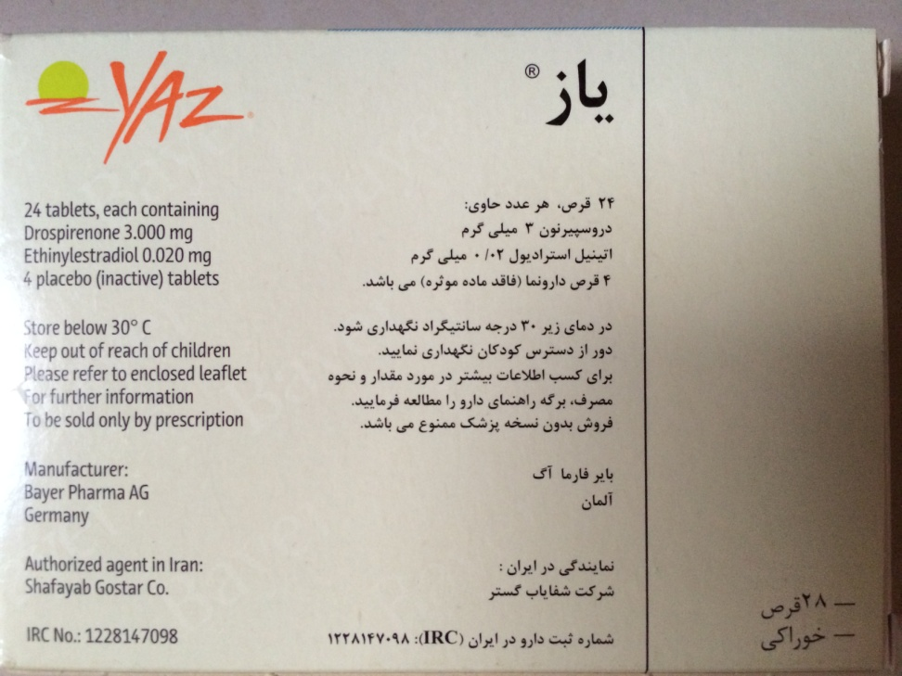
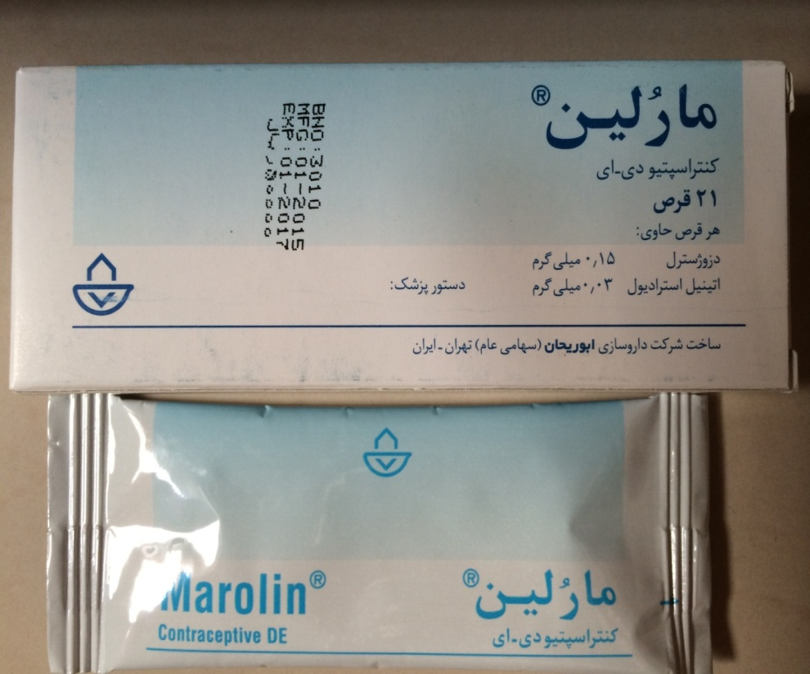
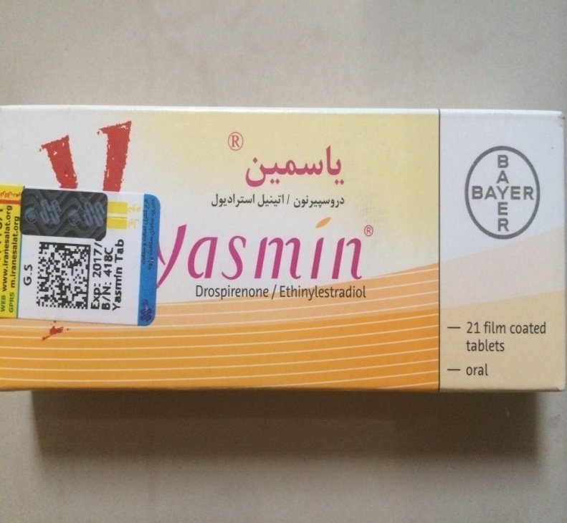
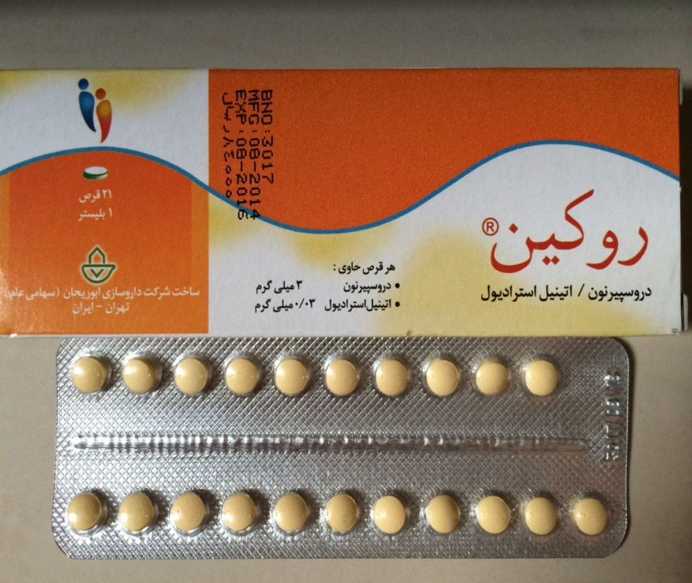

Slide 61
Cutaneous and transdermal estradiol
percutaneous gels, sprays, emulsions, or transdermal patches
have a similar efficacy as oral ET in reducing climacteric symptoms.
The primary advantage of transdermal ET is to alleviate the firstpass hepatic metabolic effect of oral estrogens resulting in a procoagulant effect and increases in SHBG, thyroid-binding globulin, cortisol-binding globulin, triglycerides, and markers of inflammation such as C-reactive protein.
Transdermal therapies, at low doses, are preferable for women with a VTE risk
may also be preferable in patients with hypertension, hypertriglyceridemia, obesity, MetS, diabetes, or a history of gallbladder disease.
no existing head-to-head RCTs with clinical outcomes that compare transdermal with oral therapies.

Slide 62
Progestogen administration
1- The combined sequential regimen includes estrogen for 20 to 25 days and a progestogen for 12 to 15 days each month.
preferred for recently menopausal woman who are prone to breakthrough bleeding during the first year or two of therapy.
2- The combined continuous regimen utilizes both an estrogen and prodoigestogen daily on a continuous basis.

Slide 63
Progestogen alone
those who do not tolerate ET, progestogens can relieve VMS.
oral synthetic progestogens and micronized progesterone were effective.
Clinical outcome trials are lacking in women with breast cancer

Slide 64
Custom-compounded hormones
3.1i We recommend using MHT preparations approved by the US Food and Drug Administration (FDA) and comparable regulating bodies outside the United States and recommend against the use of custom-compounded hormones. (Ungraded best practice statement)

Slide 65
3.2 Conjugated equine estrogens with bazedoxifene
3.2 For symptomatic postmenopausal women with a uterus and without contraindications, we suggest the combination of conjugated equine estrogens (CEE)/bazedoxifene (BZA) (where available) as an option for relief of VMS and prevention of bone loss. (2+++○)

Slide 66
3.3 Tibolone
3.3a For women with bothersome VMS and climacteric symptoms and without contraindications, we suggest tibolone (in countries where available) as an alternative to MHT. (2 ++○○)
3.3b We recommend against adding tibolone to other forms of MHT. (1 ++○○)
3.3c We recommend against using tibolone in women with a history of breast cancer. (1 ++○○)

Slide 67
3.4 Clinical management of patients taking hormone therapies

Slide 68
Monitoring during therapy
3.4a For women with persistent unscheduled bleeding while taking MHT, we recommend evaluation to rule out pelvic pathology, most importantly, endometrial hyperplasia and cancer. (1 +++○)
3.4b We recommend informing women about the possible increased risk of breast cancer during and after discontinuing EPT and emphasizing the importance of adhering to age-appropriate breast cancer screening. (1 +++○)

Slide 69
Technical remarks
Regular clinical follow-up, initially, within 1 to 3 months after starting MHT, and then every 6 to 12 months, depending upon the individual (and health care system):
monitoring efficacy and side effects (abdominal/pelvic pain, mastalgia, metrorrhagia, weight gain, mood changes, blood pressure)
if necessary, making treatment adjustments

Slide 70
Clinical Caveats During Treatment With MHT
1- Persistent, intolerable VMS(Hot flashes that persist after treatment
2-Bleeding: approach depends on time since menopause, MHT regimen, duration of therapy, duration and character of
bleeding (adjustment
-Switch mode of administration or adjust dose of estrogen and/or progestogen.
-another etiology of flashes
-Ensure absorption
-Sequential regimen may be more appropriate for recently menopausal (2 y),
-Persistent irregular bleeding (6 mo) should be evaluated for endometrial pathology; if obese, diabetic, or having family history for endometrial cancer, evaluate sooner.
-Atrophic endometrium in women more remote from menopause may respond to increased estrogen dose if otherwise appropriate.

Slide 71
3-Breast tenderness
4-Baseline TG level 200 mg/dL
5-Hypothyroid on thyroid replacement
-Usually responds to a reduction in estrogen dose or change in progestogen preparation.
-CEE/BZA may improve symptoms.
-Changing to tibolone may be helpful in women who develop mastalgia on conventional MHT
Review family history and seek contributing factors.
-Transdermal ET is preferred.
-If oral estrogen is selected, monitor serum TG levels 2 wk after starting therapy
Monitor TSH 6 to 12 wk after starting oral MHT; T4 dose may need to be increased

Slide 72
3.4c We suggest that the decision to continue MHT be
revisited at least annually, targeting the shortest total duration of MHT consistent with the treatment goals and evolving risk assessment of the individual woman. (Ungraded best practice statement)
3.4d For young women with primary ovarian insufficiency (POI), premature or early menopause, without contraindications, we suggest taking MHT until the time of anticipated natural menopause, when the advisability of continuing MHT can be reassessed. (2 ++○○)

Slide 73
Stopping considerations
3.4e For women preparing to discontinue MHT, we suggest a shared decision-making approach to elicit individual preference about adopting a gradual taper vs abrupt discontinuation. (2 ++○○)

Slide 74
A number of studies have compared methods (ie, taper protocols vs abrupt cessation) have detected no differences.
Menopausal symptoms and joint pain can recur when MHT is discontinued.
Depending on the severity of the symptoms, women may elect to restart MHT, perhaps at a lower dose, or seek relief with nonhormonal therapies.
Accelerated bone loss was reported after the discontinuation of MHT, whereas in contrast, bone density is stable for some years after discontinuing bisphosphonate therapy.

Slide 75
4.0 Nonhormonal therapies for VMS
4.0 For postmenopausal women with mild or less bothersome hot flashes, we suggest a series of steps that do not involve medication, such as
→turning down the thermostat
→ dressing in layers
→ avoiding alcohol and spicy foods
→ reducing obesity and stress. (2 ++○○)

Slide 76
4.1 Nonhormonal prescription therapies for VMS
4.1a For women seeking pharmacological management for moderate to severe VMS for whom MHT is contraindicated, or who choose not to take MHT, we recommend
→ selective serotonin reuptake inhibitors
(SSRIs)/serotonin norepinephrine reuptake inhibitors (SNRIs)
→ gabapentin
→ pregabalin (if there are no contraindications).
(1 +++○)

Slide 77
placebo effect: averages 30%(range, 4–57%) and in women with high anxiety and stress scores.
Clinical trials of paroxetine, venlafaxine, desvenlafaxine, citalopram, and escitalopram demonstrate statistically significant efficacy with a reduction of frequency of hot flashes ranging from 25 to 69%.
sertraline and fluoxetine are associated with non-statistically significant trends toward the reduction of hot flashes and inconsistent results.

Slide 78
SSRIs and SNRIs exert mild-to-moderate effects to reduce hot flashes in women with a history of breast cancer.
Caution is advised in the use of paroxetine in patients taking tamoxifen because paroxetine markedly interferes with the metabolism of tamoxifen to its metabolite, Endoxifen.

Slide 79
Gabapentin
moderate efficacy in relieving hot flashes.
women whose hot flashes occur primarily at night respond well to a single bedtime dose.
Individual dose requirements vary widely(range from 300 to 1200 mg)
Pregabalin
pregabalin (75–150 mg twice daily) decreased mean hot flash scores by 65 and 71%, compared with 50% by placebo

Slide 80
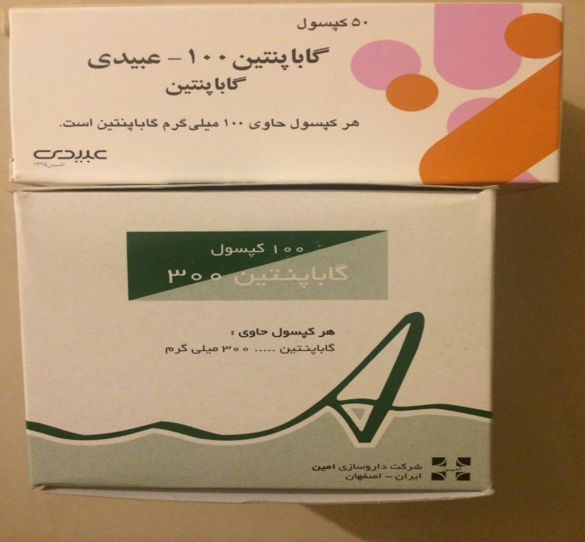
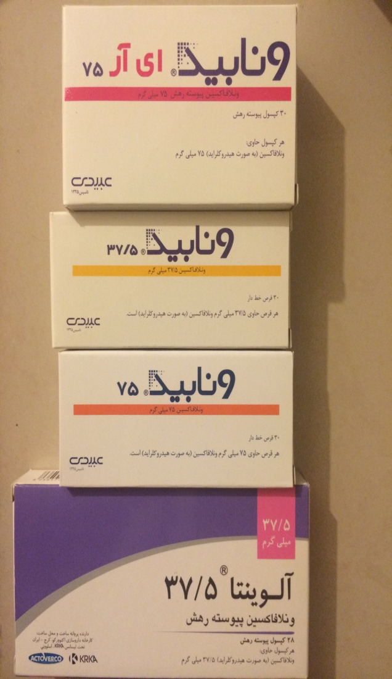
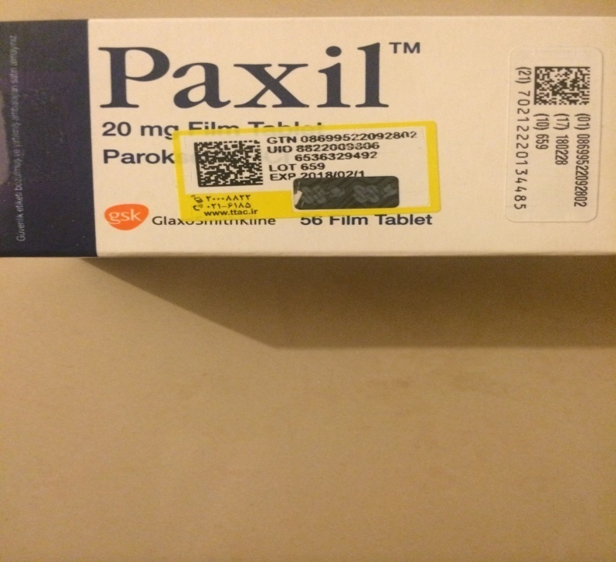
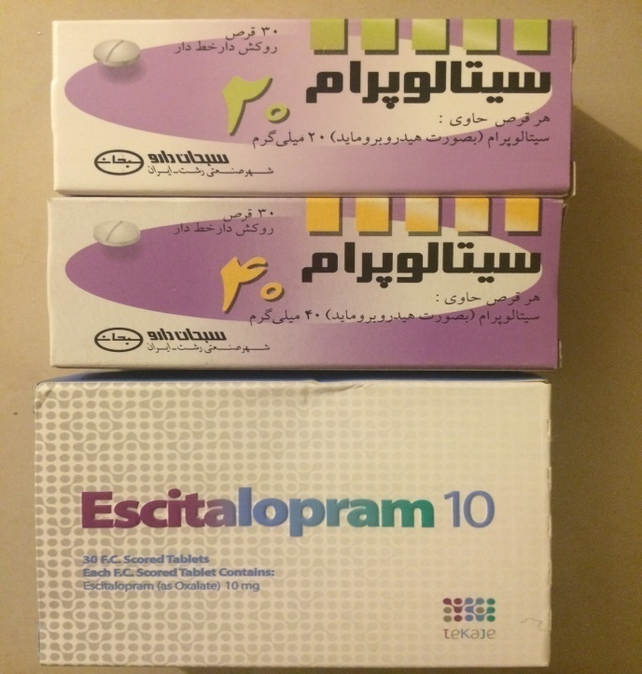

Slide 81
Relative efficacy of nonhormonal prescription therapies vs estrogens
A limited number of head-to-head RCTs have compared varying estrogen doses, preparations, and routes of administration with nonhormonal agents.
None of the RCTs established statistically significant superiority of one treatment regimen over another.
limited evidence: standard-dose MHT is more effective than nonhormonal agents.

Slide 82
4.1b For those women seeking relief of moderate to severe VMS who are not responding to or tolerating the nonhormonal prescription therapies, SSRIs/SNRIs or gabapentin or pregabalin, we suggest a trial of clonidine (if there are no contraindications). (2 ++○○)

Slide 83
4.2 Over-the-counter and alternative nonhormonal therapies for VMS
4.2 For women seeking relief of VMS with over-the counter (OTC) or complementary medicine therapies, we suggest counseling regarding the lack of consistent evidence for benefit for botanicals, black cohosh, omega-3-fatty acids, red clover, vitamin E, and mind/ body alternatives including anxiety control, acupuncture, paced breathing, and hypnosis. (2 ++○○)

Slide 84
The MSFLASH trial showed that omega-3 fatty acids do not improve VMS.
In a randomized trial of 187 symptomatic menopausal women, clinical hypnosis was associated with a 74.2% reduction in hot flashes compared with a 17.1% reduction in women randomized to structured attention control (P .001).
The phytoestrogens are nonsteroidal compounds that have both estrogenic and anti-estrogenic properties.
Caution is advised because some of these agents, when consumed as supplements, can exert estrogenic effects, a concern in breast cancer survivors
although dietary soy appears to have no adverse effects on breast cancer prognosis.

Slide 86
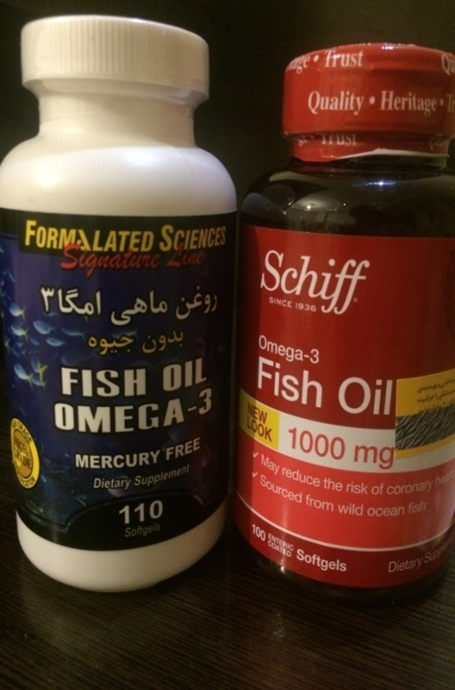
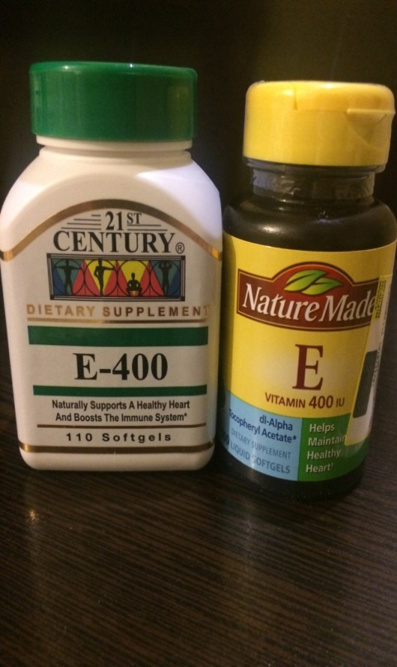
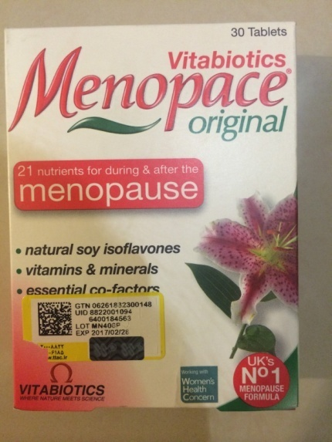
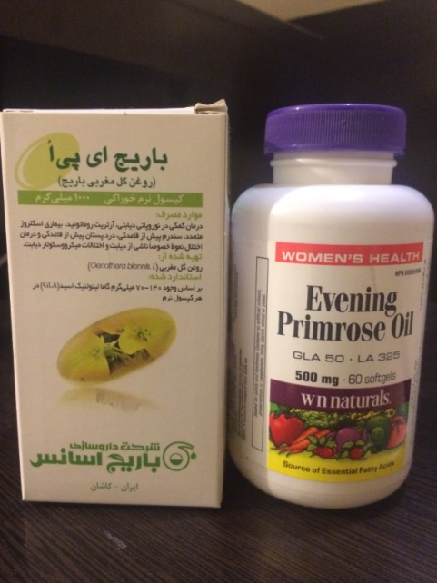
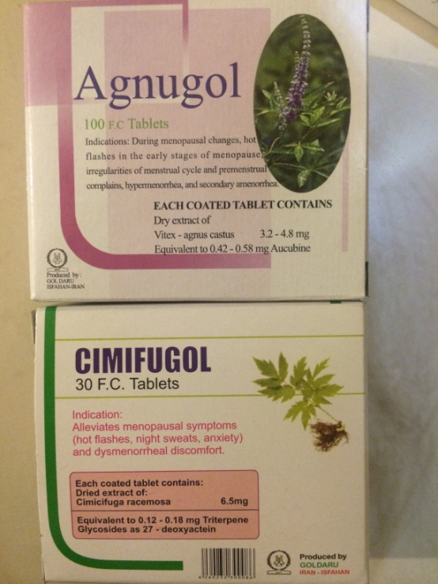
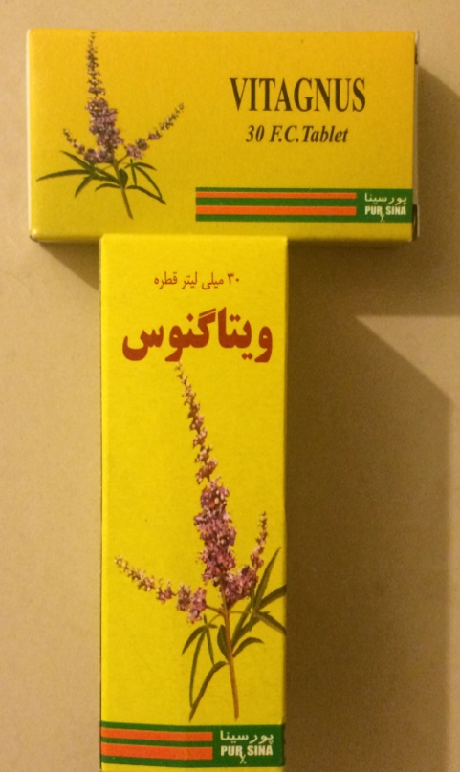
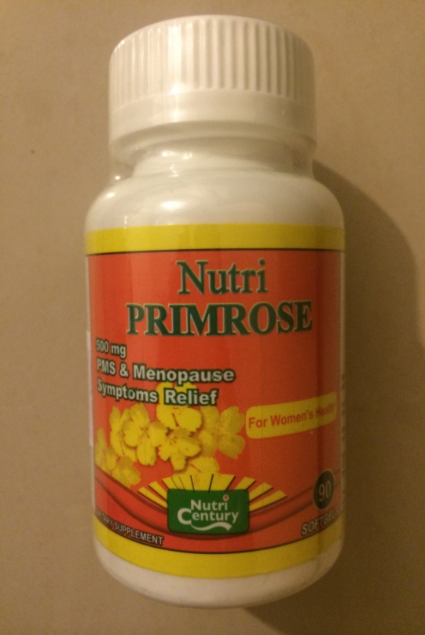

Slide 87
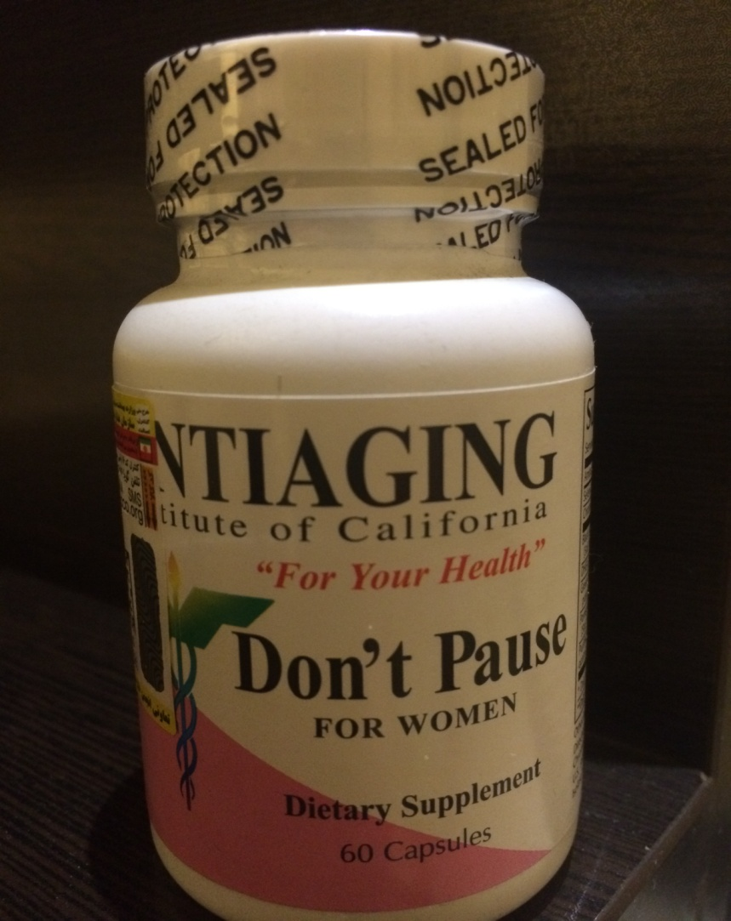
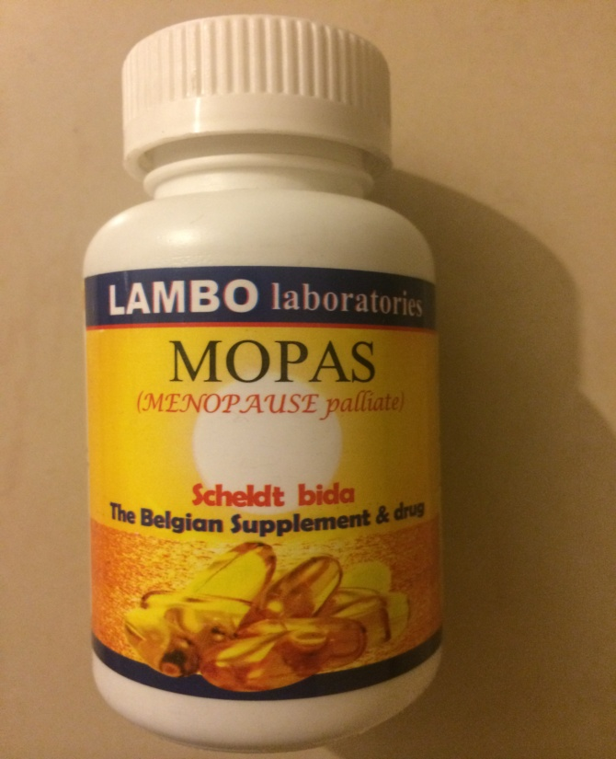
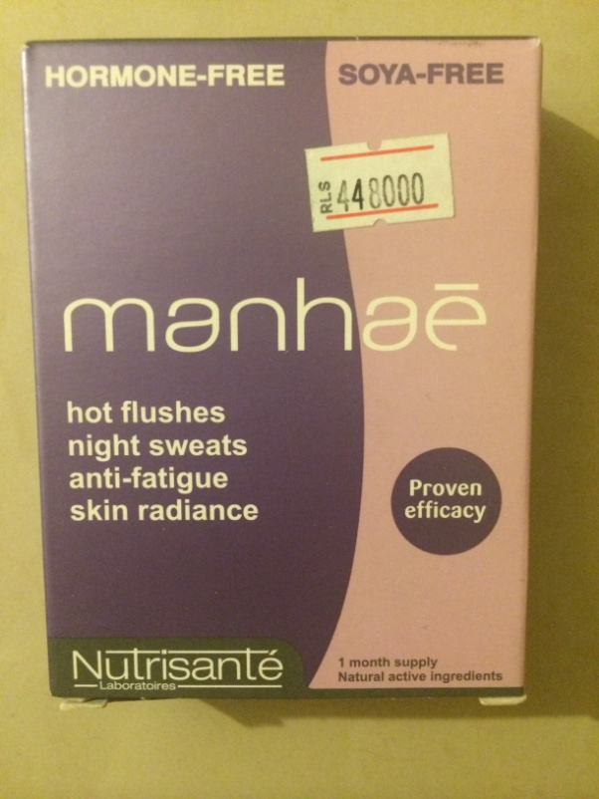

Slide 88
Treatment of genitourinary syndrome of menopause
5.1 Vaginal moisturizers and lubricants
5.1a For postmenopausal women with symptoms of vulvovaginal atrophy (VVA), we suggest a trial of vaginal moisturizers to be used at least twice weekly. (2 ++○○)
5.1b For women who do not produce sufficient vaginal secretions for comfortable sexual activity, we suggest vaginal lubricants. (2++○○)

Slide 89
Vaginal estrogen therapies
5.2a For women without a history of hormone- (estrogen) dependent cancers who are seeking relief from symptoms of genitourinary syndrome of menopause (GSM) (including VVA) that persist despite using vaginal lubricants and moisturizers, we recommend low-dose vaginal ET. (1 +++○)

Slide 90
As a guiding principle, we recommend using the lowest effective dose.
RCTs of low-dose vaginal estrogen products report rapid improvement of vaginal symptoms (vagina dryness or dyspareunia) and urinary symptoms (dysuria and urge incontinence) within 2 to 3 weeks.
Objective improvements continue at 12 weeks and are maintained to 1 year.
Limited evidence suggests that vaginal ET may prevent recurrent urinary tract infections and overactive bladder.
No clear proof exists that vaginal ET prevents or improves pelvic prolapse but it may be advantageous preoperatively .

Slide 93
Side effects:
vulvovaginal candidiasis
with higher dosing and systemic absorption, vaginal bleeding and breast Pain
Increased CVD or VTE risk has not been reported (actual neutral effect due
to the absence of a first-pass hepatic effect by vaginal estrogens, or that studies of women at high CVD or VTE risk are lacking)

Slide 94
Practice statement
5.2b In women with a history of breast or endometrial cancer, who present with symptomatic GSM (including VVA), that does not respond to nonhormonal therapies, we suggest a shared decision-making approach that includes the treating oncologist to discuss using low-dose vaginal ET. (Ungraded best practice statement)
5.2c For women taking raloxifene, without a history of hormone- (estrogen) dependent cancers, who develop symptoms of GSM (including VVA) that do not respond to nonhormonal therapies, we suggest adding low-dose vaginal ET. (2 ++○○)

Slide 95
5.2d For women using low-dose vaginal ET, we suggest against adding a progestogen (ie, no need for adding progestogen to prevent endometrial hyperplasia). (2+○○○)
5.2e For women using vaginal ET who report postmenopausal bleeding or spotting, we recommend prompt evaluation for endometrial pathology. (1++○○)

Slide 96
Ospemifene
5.3a For treatment of moderate to severe dyspareunia associated with vaginal atrophy in postmenopausal women without contraindications, we suggest a trial of ospemifene. (2 +++○)
5.3b For women with a history of breast cancer presenting with dyspareunia, we recommend against ospemifene. (1 +○○○)

Slide 97
Thanks
For
Your
Attention

