Slide 1
به نام يگانه پروردگار

Slide 2
Statistical Modeling Just Simply to Understand !
Davood Khalili, MD, MPH, PhD
Department of Biostatistics & Epidemiology
Research Institute for Endocrine Sciences
Shahid Beheshti University of Medical Sciences

Slide 3
In a food poisoning how can we determine whether an excess risk is associated with each of the food items?
One approach is to calculate the ratio of the attack rate in those who ate each food to the attack rate in those who did not eat the food.(column C)
- An alternate approach for identifying any excess risk in exposed individuals is to subtract the risk in those who did not eat the food from the risk in those who did eat the food. (column D)
Food | Ate (% sick) a | Did not ate (% sick) b | a/b c | A-b d
Egg salad | 83 | 30 | 2.77 | 53
Macaroni | 76 | 67 | 1.13 | 9
Cheese | 71 | 69 | 1.03 | 2
Tuna salad | 78 | 50 | 1.56 | 28
Ice cream | 78 | 64 | 1.21 | 14
Other | 72 | 50 | 1.44 | 22

Slide 4
It is a simple approach for a distinct disease (e.g. an infectious disease) which has a single cause.
How about multifactorial diseases like NCDs?

Slide 5
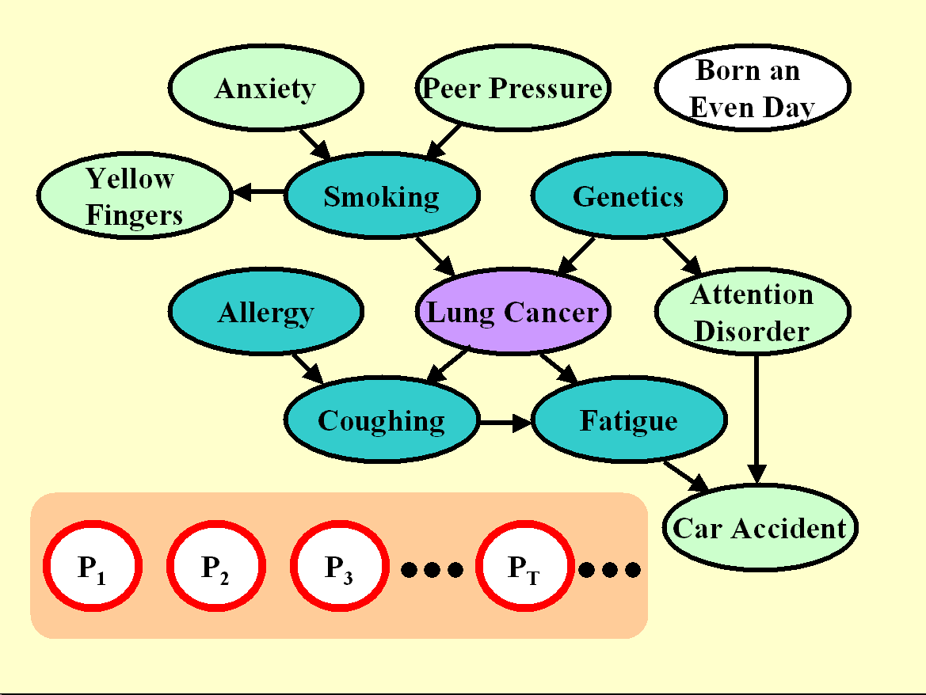

Slide 6
A regression model, put simply, is:
Y = β0 + β1 X1 + β2 X2 + β3 X3 + …. + βn Xn
X is a risk factor / predictor
β1-n emphasizes on the importance of the risk factor.
β0 shows the baseline

Slide 7
Extensions to simple regression models
f(Y) = β0 + β1 X1 + β2 X2 + β3 X3 + …. + βn Xn
f(Y) = β0 + β1 f(X1) + β2 X2 + β3 X3 + …. + βn Xn
Y = β0 + β1 X1 + β2 X2 + β3 X3 + γ1 X1 X2 + …. + βn Xn
2
Y = β0 + β1 X1 + β2 X2 + β3 X3 + γ1 X1 + …. + βn Xn
. . .

Slide 8
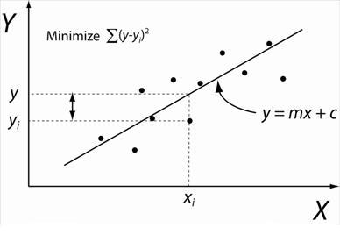
A simple linear regression

Slide 9
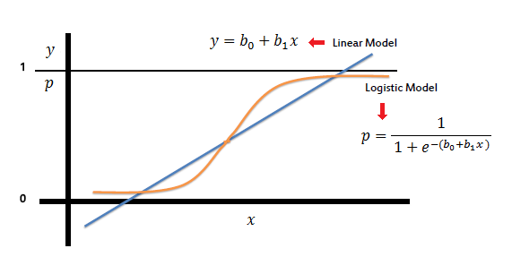
A Logistic regression

Slide 10
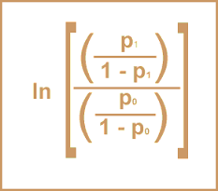
Ln (OR) = β

Slide 11
Challenges in regression models
Model assumptions
Fitness of the model(s)
Which variables/covariates should be included.
How many covariates could be included.
Which variables/covariates should be adjusted.
Overfitting / Optimization
. . .

Slide 12
از توجه شما سپاسگزارم

