Slide 1
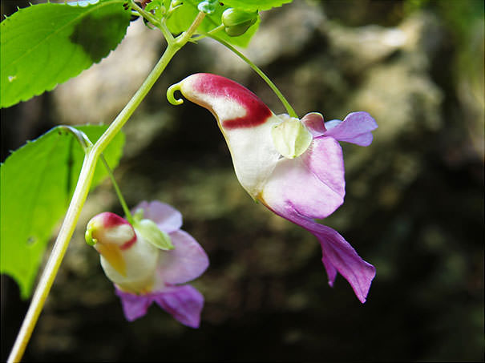
بنام خدا

Slide 2
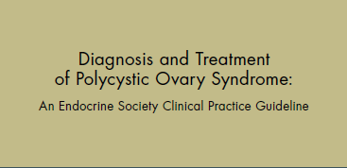

gtttttttttttttttttttttttttttttttttttttttttttttttttttttt
A.Beik Yazdi ,MD
Research Institute for Endocrine Sciences
Shahid Beheshti university of medical sciences
June, 2014, Tehran

Slide 3
agenda
Abstract
Method of Development of Evidence-Based Clinical Practice Guidelines
Summary of Recommendations
Diagnosis of PCOS
Associated Morbidity and Evaluation
Treatment

Slide 4
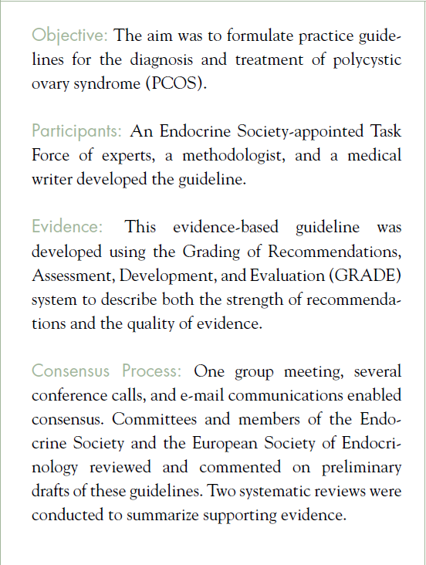
Abstract

Slide 5
Method of Development of Evidence-Based Clinical Practice Guidelines
In terms of the strength of the recommendation:
Strong recommendations use the phrase “we recommend” and the number 1
Weak recommendations use the phrase “we suggest” and the number 2.
Cross-filled circles indicate the quality of the evidence,such that denotes
Very low quality evidence; ,
Low quality; ,
Moderate quality;
High quality

Slide 6
Summary of Recommendations

Slide 7
1.0. Diagnosis of PCOS
Diagnosis in adults
1.1. We suggest that the diagnosis of PCOS be made if two of the three following criteria are met:
androgen excess, ovulatory dysfunction, or polycystic ovaries , whereas disorders that mimic the clinical features of PCOS are excluded.
These include, in all women: thyroid disease, hyper prolactinemia, and nonclassic CAH (by serum 17-OHP).
In select women with amenorrhea and more severe phenotypes, we suggest more extensive evaluation excluding other causes

Slide 8
Diagnosis in adolescents
1.2. We suggest that the diagnosis of PCOS in an adolescent girl be made based on the presence of clinical and/or biochemical evidence of hyper androgenism (after exclusion of other pathologies) in the presence of persistent oligomenorrhea.
Anovulatory symptoms and PCO morphology are not sufficient to make a diagnosis in adolescents, as they may be evident in normal stages in reproductive maturation

Slide 9
Diagnosis in peri menopause and menopause
1.3. Although there are currently no diagnostic criteria for PCOS in peri menopausal and menopausal women, we suggest that a presumptive diagnosis of PCOS can be based upon a well-documented long term history of oligomenorrhea and hyper androgenism during the reproductive years.
The presence of PCO morphology on ultrasound would provide additional supportive evidence, although this is less likely in a menopausal woman

Slide 10
2.0.Associated morbidity and evaluation
Cutaneous manifestations
2.1.We recommend that a physical examination should document cutaneous manifestations of PCOS: terminal hair growth, acne, alopecia, acanthosis nigricans, and skin tags
Infertility:
2.2.Women with PCOS are at increased risk of anovulation and infertility; in the absence of anovulation, the risk of infertility is uncertain.
We recommend screening ovulatory status using menstrual history in all women with PCOS seeking fertility. Some women with PCOS and a eumenorrheic menstrual history may still experience anovulation and a midluteal serum progesterone may be helpful as an additional screening test
2.3.We recommend excluding other causes of infertility,beyond anovulation, in couples where a woman has PCOS

Slide 11
Pregnancy complications:
2.4.Because women with PCOS are at increased risk of pregnancy complications (GDM,preterm delivery, and pre-eclampsia) exacerbated by obesity, we recommend preconceptual assessment of BMI, blood pressure, and oral glucose tolerance
Fetal origins:
2.5.The evidence for intrauterine effects on development of PCOS is inconclusive. We suggest no specific interventions for prevention of PCOS in offspring of women with PCOS

Slide 12
Endometrial cancer:
2.6.Women with PCOS share many of the risk factors associated with the development of endometrial cancer including obesity, hyperinsulinism, diabetes, and AUB.
However, we suggest against routine ultrasound screening for endometrial thickness in women with PCOS

Slide 13
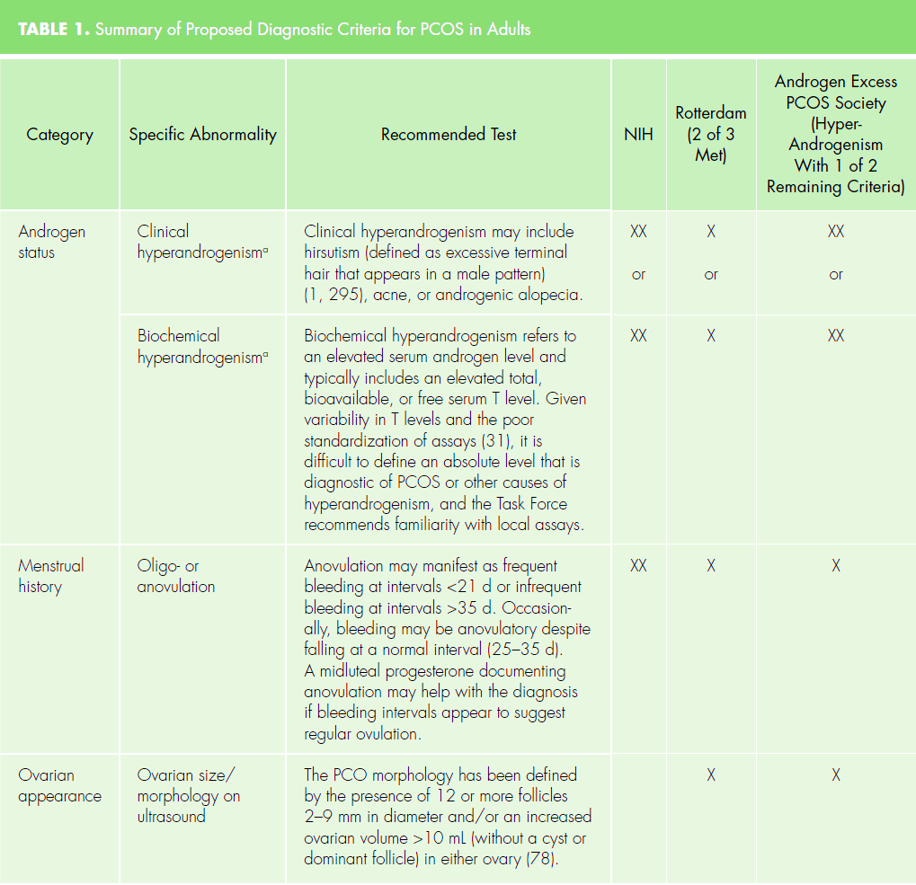

Slide 14
Obesity
2.7.Increased adiposity, particularly abdominal, is associated with hyper androgenemia and increased metabolic risk , Therefore, we recommend screening adolescents and women with PCOS for increased adiposity, by BMI calculation and measurement of waist circumference.
Depression
2.8. We suggest screening women and adolescents with PCOS for depression and anxiety by history and, if identified, providing appropriate referral and/or treatment

Slide 15
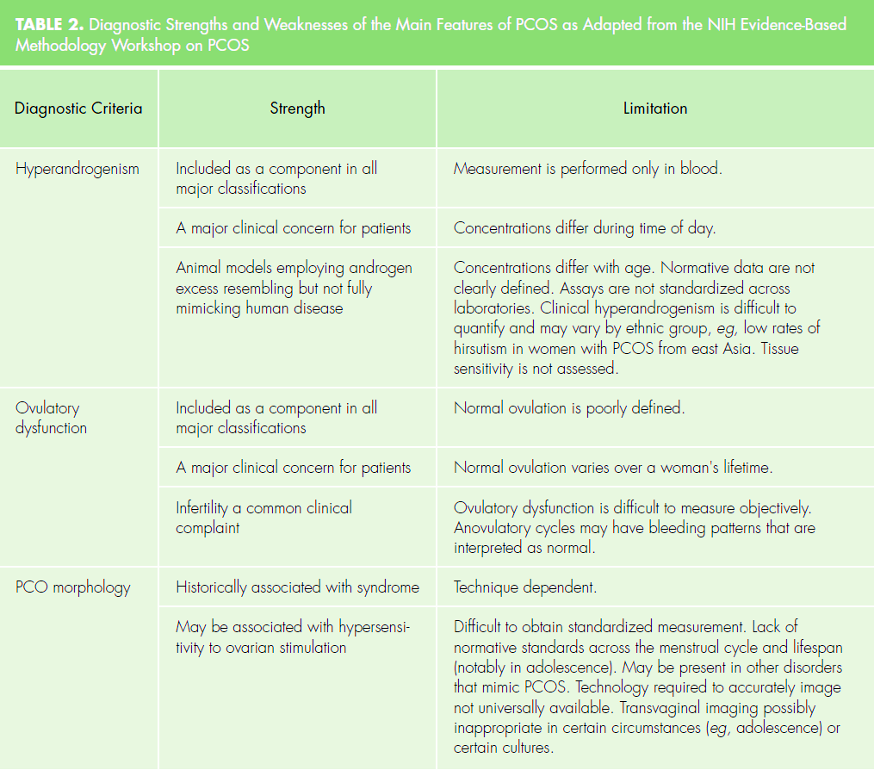

Slide 16
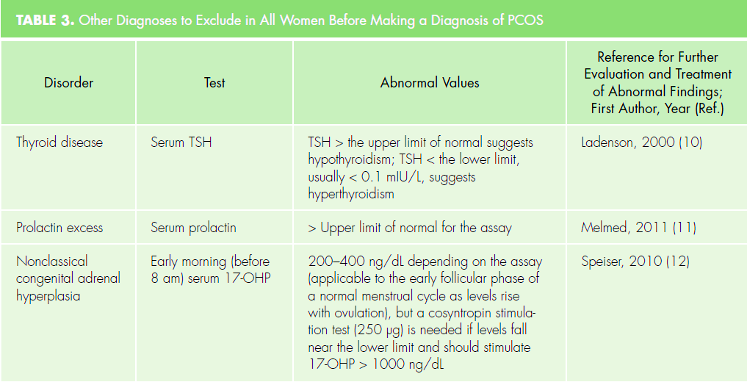

Slide 17
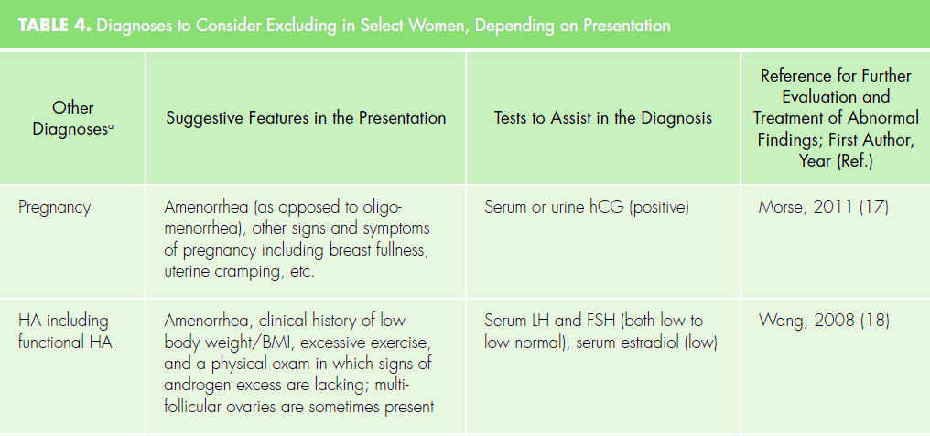

Slide 18
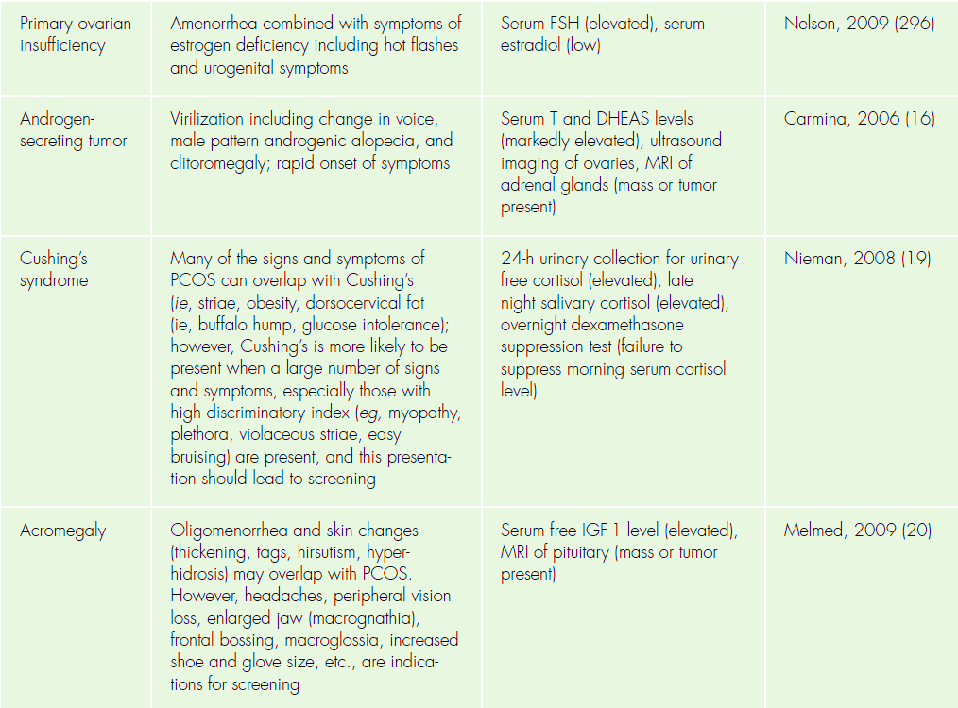
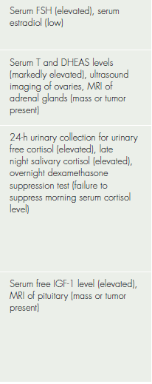

Slide 19
Sleep-disordered breathing/obstructive sleep apnea
2.9. We suggest screening overweight/obese adolescents and women with PCOS for symptoms suggestive of OSA and, when identified, obtaining a definitive diagnosis using polysomnography.
If OSA is diagnosed, patients should be referred for institution of appropriate treatment
Nonalcoholic fatty liver disease (NAFLD) and nonalcoholic steatohepatitis (NASH)
2.10. We suggest awareness of the possibility of NAFLD and NASH but recommend against routine screening

Slide 20
Type 2 diabetes mellitus
We recommend the use of an OGTT (consisting of a fasting and 2-hour glucose level using a 75-g oral glucose load) to screen for impaired glucose tolerance (IGT) and T2DM in adolescents and adult women with PCOS because they are at high risk for such abnormalities .
HgbA1c test may be considered if a patient is unable or unwilling to complete an OGTT
Rescreening is suggested every 3–5 years, or more frequently if clinical factors such as central adiposity, substantial weight gain, and/or symptoms of diabetes develop

Slide 21
Cardiovascular risk
We recommend that adolescents and women with PCOS be screened for the following cardiovascular disease risk factors :
Family history of early cardiovascular disease,
Cigarette smoking,
IGT/T2DM,
hypertension,
Dyslipidemia,
OSA, and
Obesity (especially increased abdominal adiposity)

Slide 22
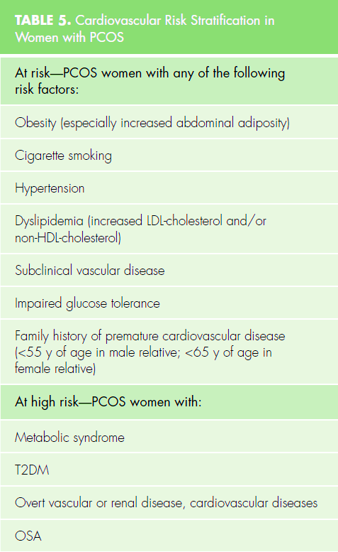

Slide 23
3.0 Treatment
Hormonal contraceptives (HCs): indications and screening
3.1. We recommend HCs (ie, oral contraceptives, patch, or vaginal ring) as first-line management for the menstrual abnormalities and hirsutism/acne of PCOS, which treat these two problems concurrently
3.2. We recommend screening for contraindications to HC use via established criteria .
For women with PCOS, we do not suggest one HC formulation over another

Slide 24
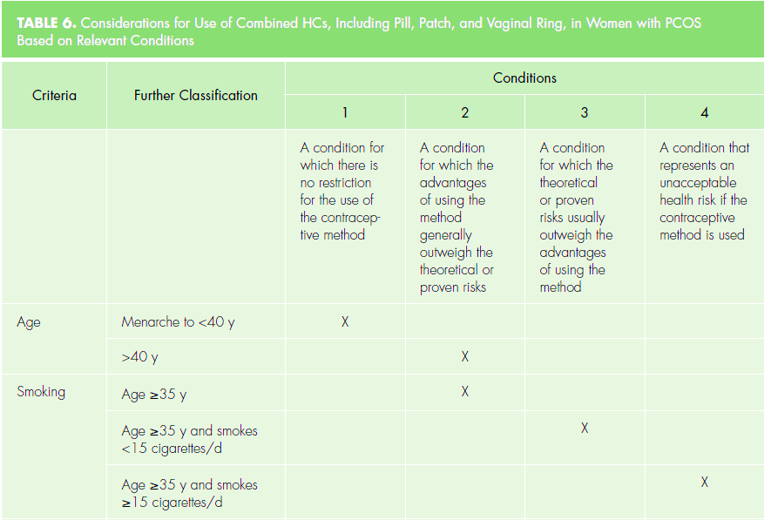

Slide 25
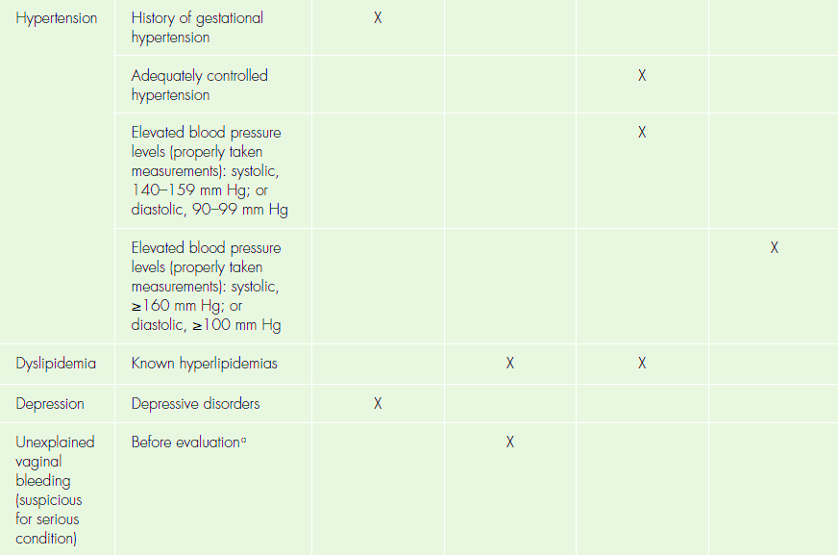

Slide 26
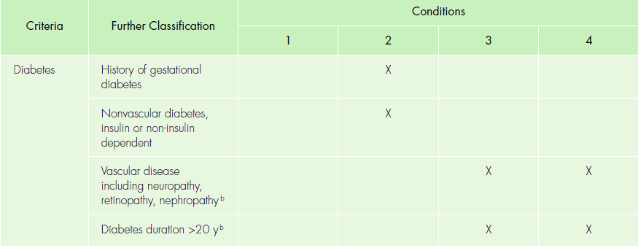

Slide 27
Role of exercise in lifestyle therapy
3.3. We suggest the use of exercise therapy in the management of overweight and obesity in PCOS .
Although there are no large randomized trials of exercise in PCOS, exercise therapy, alone or in combination with dietary intervention, improves weight loss and reduces cardiovascular risk factors and diabetes risk in the general population.

Slide 28
Role of weight loss in lifestyle therapy
3.4. We suggest that weight loss strategies begin with calorie-restricted diets (with no evidence that one type of diet is superior) for adolescents and women with PCOS who are overweight or obese .
Weight loss is likely beneficial for both reproductive and metabolic dysfunction in this setting. Weight loss is likely insufficient as a treatment for PCOS in normal-weight women

Slide 29
Use of metformin
3.5. We suggest against the use of metformin as a first-line treatment of cutaneous manifestations, for prevention of pregnancy complications, or for the treatment of obesity
3.6. We recommend metformin in women with PCOS who have T2DM or IGT who fail lifestyle modification .
For women with PCOS with menstrual irregularity who cannot take or do not tolerate HCs, we suggest metformin as second-line therapy

Slide 30
Treatment of infertility
3.7. We recommend clomiphene citrate (or comparable estrogen modulators such as letrozole) as the first-line treatment of anovulatory infertility in women with PCOS
3.8. We suggest the use of metformin as an adjuvant therapy for infertility to prevent ovarian hyperstimulation syndrome in women with PCOS undergoing IVF
Use of other drugs
3.9. We recommend against the use of insulin sensitizers, such as inositols (due to lack of benefit) or thiazolidinediones (given safety concerns), for the treatment of PCOS

Slide 31
Treatment of adolescents
3.11. We suggest HCs as the first-line treatment in adolescents with suspected PCOS (if the therapeutic goal is to treat acne, hirsutism, or anovulatory symptoms, or to prevent pregnancy)
We suggest that lifestyle therapy (calorie-restricted diet and exercise) with the objective of weight loss should also be first-line treatment in the presence of overweight/obesity
We suggest metformin as a possible treatment if the goal is to treat IGT/metabolic syndrome . The optimal duration of HC or metformin use has not yet been determined.
3.12. For premenarchal girls with clinical and biochemical evidence of hyper androgenism in the presence of advanced pubertal development (ie, ≥ Tanner stage IV breast development), we suggest starting HCs

Slide 32
1.0. Diagnosis of PCOS
1.1. Evidence
The features leading to the diagnosis are documented.
Recommend using of the Rotterdam criteria to document PCO morphology in the absence of age-based criteria.
All women should be screened with a TSH, prolactin, and 17-OHP level . Non classic CAH should be excluded because it can be found in 1.5–6.8% of androgen excess .
In women with amenorrhea, virilization, or physical findings such as proximal muscle weakness (Cushing’s syndrome) or frontal bossing (acromegaly), other diagnoses should be considered and excluded

Slide 33
1.1. Values and preferences
In the absence of evidence-based diagnostic criteria, relied on the recommendations of the NIH Panel
Specific phenotypic features may result in different risk and comorbidity profiles.
The diagnosis of PCOS is problematic in peri menarchal or peri menopausal because amenorrhea and oligomenorrhea are natural stages in reproductive maturation and senescence, as are changes in circulating androgens and ovarian morphology.
Because there is evidence of a genetic component to PCOS and familial clustering of reproductive and metabolic abnormalities in male and female relatives, a careful family history should be taken, and further screening of first-degree relatives is a consideration.

Slide 34
Diagnosis in adolescents
All PCOS diagnostic criteria were derived for adults , not adolescents.
Oligomenorrhea is common after menarche during normal puberty
Anovulatory cycles comprise 85% of menstrual cycles in the first year after menarche, 59% in the third year, and 25% by the sixth year.
Anovulatory cycles are associated with higher serum androgen and LH levels . Approximately two-thirds of adolescents with PCOS will have menstrual symptoms, with the spectrum from primary amenorrhea to frequent dysfunctional bleeding .
Appropriate to evaluate persistent oligomenorrhea or amenorrhea as an early clinical sign of PCOS, especially when it persists 2 years beyond menarche

Slide 35
Acne is common although transitory during adolescence ; thus, it should not be used in isolation to define hyperandrogenism in adolescents.
Hirsutism may develop slowly and thus be less severe in adolescents than in adults due to the shorter exposure to hyperandrogenism .
Hirsutism was a major symptom in about 60% of adolescents in one study and may be suggestive of PCOS in adolescents . The Ferriman-Gallwey hirsutism score was standardized only in adult Caucasians and may have a lower cut-point in adolescents .
Androgenic alopecia has not been studied in adolescents and should be viewed cautiously in diagnosing PCOS

Slide 36
There is a lack of well-defined cutoff points for androgen levels during normal pubertal maturation , as well as the lack of T assay standardization .
Hyper androgenemia appears to be exacerbated by obesity because a significant proportion of obese girls have elevated androgen levels across puberty compared with normal-weight girls.
Hyper androgenemia during puberty may be associated with infertility in later life , and adult cutoffs should be used until appropriate pubertal levels are defined.
The Rotterdam ultrasound PCO criteria were not validated for adolescents.
Recommending a transvaginal ovarian ultrasound in this group raises practical and ethical concerns. Transabdominal ultrasound, already limited in evaluating the ovaries, is rendered even less technically adequate with obesity, common in adolescent PCOS .

Slide 37
In addition, multi follicular ovaries are a feature of normal puberty that subsides with onset of regular menstrual cycling and may be difficult to distinguish from PCO morphology .
It is possible that elevated anti-Mullerian hormone levels may serve as a noninvasive screening or diagnostic test for PCO in this population, although there are no well-defined cutoffs
In summary, the diagnosis of PCOS in adolescents should be based on a complete picture that includes clinical signs and symptoms of androgen excess, increased androgen levels, and exclusion of other causes of hyperandrogenemia in the setting of oligomenorrhea

Slide 38
1.2. Values and preferences
In making this recommendation, the committee acknowledges that the diagnosis of PCOS in adolescents is less straightforward than in adults.
A high index of awareness is needed to initiate a thorough medical and laboratory evaluation of adolescent girls with signs and symptoms of PCOS, including a family history of PCOS.
Until higher quality evidence becomes available, this recommendation places a higher value in making an early diagnosis of PCOS in adolescents for timely initiation of therapy, which outweighs harms and burdens of misdiagnosis.

Slide 39
Diagnosis in perimenopause and menopause
1.3. Evidence
Ovarian size, follicle count, and AMH levels decrease with normal aging in women with and without PCOS .
The decline in ovarian volume and follicle count may be less in women with PCOS than in normal women .
Similarly, androgen levels decline with age in women with and without PCOS (serum T declines ~50% between the ages of 20 and 40 y), with reports of improved menstrual frequency in PCOS , although there is little evidence to support a decline in serum T associated with the menopause transition per se

Slide 40
The diagnosis of PCOS in postmenopausal women is more problematic than in adolescents.
No age-related T cutoffs for the diagnosis.
T assays used to diagnose hyper androgenemia in women are imprecise , even for assays utilizing tandem mass spectrometry technology .
Supporting studies have shown that PCOS phenotype may persist with age .
Very high T levels and/or virilization may suggest an androgen-producing tumor in postmenopausal women

Slide 41
1.3. Values and preferences
We recognize that the diagnosis of PCOS in postmenopausal women is problematic but feel that it is unlikely that a woman can develop PCOS in the peri menopause or menopause if she has not had symptoms earlier.
We recognize that there are few prospective studies to document the natural history of ovarian function with age in women with PCOS.

Slide 42
2.0. Associated morbidity and evaluation
Cutaneous manifestations
2.1. Evidence
The history of skin problems should assess the age at onset, the rate of progression, previous long-term treatments (including anabolic agents),any change with treatment or with fluctuations in body weight, and the nature of the skin complaint relative to those of other family members.
In rare instances, male pattern balding, increased muscle mass, deepening of the voice, or clitoromegaly may occur, suggesting virilizing androgen levels and a possible underlying ovarian or adrenal neoplasm or severe insulin-resistant states .
In obese, acanthosis nigricans is often present, as are skin tags

Slide 43
Hirsutism
The prevalence of hirsutism in the general population ranges from 5–15%, with relevant differences according to ethnicity and geographic location .
Overall, hirsutism is present in approximately 65–75% of patients with PCOS (although lower in Asian populations) .
PCOS represents the major cause of hirsutism, but the presence of hirsutism does not fully predict ovulatory dysfunction.
Hirsutism may predict the metabolic sequelae of PCOS or failure to conceive with infertility treatment and often tends to be more severe in abdominally obese patients .

Slide 44
2.1. Values and preferences
Evaluating hirsutism, acne, and alopecia in women with PCOS depends on careful grading, but is subjective
Alopecia and acne may be related to hyper androgenism and are distressing; therefore, our preference is to document and consider consultation with a dermatologist and to determine whether they are related to other etiologies in the case of alopecia or in the case of acne if unresponsive to HCs.
More research is needed to quantify the relationship between cutaneous signs of hyper androgenism and cardiovascular disease

Slide 45
Infertility
2.2–2.3. Evidence
Among a large series of women with PCOS, close to 50% reported primary infertility, and 25% reported secondary infertility .
Population-based studies of infertility have suggested that anovulatory infertility is common, accounting for 25–40%
PCOS is estimated to be the most common cause of ovulatory dysfunction, accounting for 70–90% of ovulatory disorders . Prolonged periods of anovulation are likely associated with increased infertility .
Lifetime fecundity in Swedish women with PCOS was similar to controls and almost three-fourths of women with PCOS conceived spontaneously

Slide 46
Although the primary mechanism of infertility is presumed to be oligo- or anovulation, there are other potential factors including diminished oocyte competence and endometrial changes discouraging implantation .
Other factors associated with PCOS, such as obesity, have also been associated with subfertility and delayed conception .
Male factor infertility or tubal occlusion must also be considered

Slide 47
Pregnancy complications
2.2–2.3. Values and preferences
In making this recommendation, we emphasize the overall increased infertility burden among women with PCOS and ovulatory dysfunction, although there are spontaneous conceptions, which may increase with improved menstrual frequency and aging.
The natural history of fertility in women with PCOS and the influence of milder phenotypes lacking ovulatory dysfunction are not well understood or Pregnancy complication.

Slide 48
2.4. Evidence
Confounders for adverse pregnancy outcomes include: iatrogenic multiple pregnancy due to ovulation induction, higher complications in pregnancies resulting from infertility treatment per se, and higher rates of obesity in women with PCOS.
Some studies have suggested increased early pregnancy loss in women with PCOS .
A meta-analysis of studies comparing IVF outcomes in women with and without PCOS demonstrated no significant difference in miscarriage rates between the two groups (OR, 1.0; 95% CI, 0.5–1.8)
A study of 99 women with PCOS and 737 controls noted a higher rate of GDM, but it was largely explained by a higher prevalence of obesity in the PCO group

Slide 49
In contrast, a meta-analysis in which confounding factors such as BMI were taken into account demonstrated that PCOS was independently associated with an increased risk for GDM and HTN . This meta-analysis demonstrated a small but significant association between premature singleton births (<37 wk g) and PCO
Most studies reporting an association between hypertension or pre-eclampsia and pregnancy in PCOS are small and poorly controlled and show mixed results
In one of the largest studies, PCOS (n = 99) was not a significant predictor of pre-eclampsia compared with control pregnancies (n = 737), when controlled for nulliparity (more common in PCOS) .

Slide 50
2.4. Values and preferences
In making this recommendation, we believe that a priority should be placed on reducing the overall increased morbidity from pregnancy complications such as GDM, pre-eclampsia, and preterm delivery in women with PCOS.
Whether these increased risks are due to PCOS itself or the features associated with PCOS such as IR or obesity requires further study.

Slide 51
Fetal origins
2.5. Evidence
Nonhuman models suggest that androgen exposure in utero may program the fetus to express features characteristic of PCOS in adult life .
Human data are limited, but there is evidence of fetal programming by androgens in girls with CAH or with a mother with a virilizing tumor .
Androgen levels may be increased in pregnant women with PCO
The relationship between T levels during pregnancy in women with PCOS to outcomes remains to be determined using accurate assay methodology.

Slide 52
IUGR has been associated with increased rates of CHD, HTN, and T2DM, providing evidence for fetal programming of adult diseases
There are limited data to suggest that IUGR may be associated with subsequent development of PCOS in some populations .
In addition, a subset of girls born small for gestational age are at risk for developing premature adrenarche, IR, or PCOS
Available data support the concept that rapid postnatal weight gain and subsequent adiposity can exacerbate metabolic abnormalities and PCOS symptoms

Slide 53
Endometrial cancer
2.6. Evidence
In a long-term follow-up of women with PCOS in the UK, morbidity data over 31 years were available on 319 compared with 1,060 control women. Women with PCOS did not have a higher all-cause mortality but did show a 3.5 increased relative risk of development of endometrial cancer .
A more recent meta-analysis assessing the association between PCOS and endometrial cancer suggested that women with PCOS had an increased risk of developing endometrial cancer (RR = 2.7; 95% CI, 1.0–7.29), confirmed by a subsequent systematic review with a 3-fold increased risk

Slide 54
Young women with endometrial cancer are more likely to be nulliparous and infertile, have higher rates of hirsutism, and have a slightly higher chance for oligomenorrhea .
There currently are no data supporting routine endometrial biopsy of asymptomatic women or ultrasound screening of endometrium .
US screening in women without abnormal bleeding shows poor diagnostic accuracy for diagnosing intrauterine pathology .
The American Cancer Society recommends against routine cancer screening for endometrial cancer in women at average or increased risk (with the exception of Lynch syndrome), but women should be counseled to report unexpected bleeding and spotting

Slide 55
2.6. Values and preferences
In making this recommendation for increased awareness of endometrial cancer risk in women with PCOS, particularly those with AUB, prolonged amenorrhea, diabetes, and/or obesity, we believe that a priority should be placed on the consequences of development of endometrial cancer, and this priority offsets the limited data available for independent association with PCOS.

Slide 56
Obesity
2.7. Evidence
Prevalence of obesity in PCOS
Studies in different countries with significantly different background rates of obesity (30–70%) have yielded similar rates for the prevalence of PCOS .
Whether the incidence of PCOS may parallel the growing epidemic of obesity is unknown, although a modest but non significant trend in the prevalence of PCOS with increasing BMI has been reported .
Obesity may also cluster in PCOS families , and referral bias to specialty clinics may also elevate the association of PCOS with obesity .

Slide 57
Impact of obesity on the phenotype of PCOS:
Obesity in general and abdominal obesity in particular cause relative hyper androgenemia, characterized by reduced levels of SHBG and increased bioavailable androgens delivered to target tissues .
Abdominal obesity is also associated with an increased T production rate and a non-SHBG-bound androgen production rate of dehydro epiandrosterone and androstenedione .
Estrogen levels, particularly estrone, may also be higher in PCOS .
Menstrual disorders are frequent when the onset of excess weight occurs during puberty rather than during infancy .

Slide 58
2.7. Values and preferences
In making this recommendation, the committee believes that excess weight and obesity may have an important impact on the early development of PCOS and on the clinical presentation .
Obesity may change in degree and possibly in distribution from adolescence to postmenopausal age, and these changes should be monitored

Slide 59
Depression
2.8. Evidence
Small observational community- and patient-based case control studies consistently demonstrate an increased prevalence of depression in women with PCOS.
In studies with direct psychiatric interviews, there was a higher lifetime incidence of a major depression episode and recurrent depression (OR, 3.8; 95% CI, 1.5–8.7; P = .001) and a history of suicide attempts that was seven times higher in PCOS cases vs. controls .
In a longitudinal study the incidence of depression was 19% in 1–2 years of follow-up The increased prevalence of depression and depressive symptoms in women with PCOS appears to be independent of obesity, androgen levels, hirsutism, acne, and infertility .
Studies demonstrate higher rates of anxiety and panic disorders in women with PCOS and eating disorders

Slide 60
Sleep-disordered breathing/OSA
Women with PCOS develop OSA at rates that equal or exceed those in men.
The high prevalence of OSA is thought to be a function of hyper androgenism as well as obesity, these factors alone do not fully account for the finding.
Even after controlling for BMI, women with PCOS were 30 times more likely to have sleep-disordered breathing and nine times more likely than controls to have daytime sleepiness
It also appeared that women with PCOS taking ocp were less likely to have sleep-disordered breathing , consistent with the lower likelihood of sleep-disordered breathing in : postmenopausal women treated with HRT

Slide 61
2.9. Values and preferences
Polysomnography, when performed, should occur in a certified sleep laboratory with proper accreditation. The interpretation and recommendation(s) for treatment of sleep-disordered breathing/OSA should be made by a board-certified expert in sleep medicine.
In young obese women with PCOS, successful treatment of OSA improves insulin sensitivity, decreases sympathetic output, and reduces D BP
The magnitude of these beneficial effects is modulated by the hours of CPAP use and the degree of obesity.

Slide 62
NAFLD and NASH
2.10. Evidence
NAFLD is characterized by excessive fat accumulation in the liver (steatosis), whereas NASH defines a subgroup of NAFLD in which steatosis coexists with liver cell injury and inflammation (after exclusion of other causes of liver disease.
Primary NAFLD/NASH is most commonly associated with IR and its phenotypic manifestations.
The prevalence of ultrasound-documented NAFLD in the general population is 15–30% .
Risk factors pertinent to PCOS include increasing age, ethnicity, and metabolic dysfunction (obesity, hypertension, dyslipidemia, diabetes).

Slide 63
Clinical studies report a 15–60% prevalence of NAFLD in the population, depending on the index used to define liver damage, the presence of obesity, and ethnicity .
Whether androgen excess may be involved in the pathophysiology of NAFLD in women with PCOS is still unclear . Thus, women with PCOS and metabolic risk factors and/or IR may be screened using serum markers of liver dysfunction.
ultrasound and liver biopsy may be considered

Slide 64
2.10. Values and preferences
In making this recommendation we believe that a priority should be placed on identifying this potentially major complication in women with PCOS with IR and/or metabolic syndrome.
There is currently no simple and reliable screening test for NAFLD because elevated serum transaminases have low sensitivity and specificity
There is no approved drug to treat NAFLD, lifestyle therapy, insulin sensitizers, and antioxidants are thought to be beneficial

Slide 65
Type 2 diabetes mellitus
2.11. Evidence
A diagnosis of PCOS confers a 5- to 10-fold increased risk of developing T2DM .
The overall prevalence of glucose intolerance among U.S. women and adolescents with PCOS was 30–35%, and 3–10% had T2DM.
Non obese women with PCOS had a 10–15% prevalence of IGT and a 1–2% prevalence of T2DM .
So periodic screening of patients to detect early abnormalities in glucose tolerance is recommended by several scientific organizations, although an interval for screening has not been specified

Slide 66
2.11. Values and preferences
In making this recommendation, the committee believes in the strength of the evidence for a tight link between PCOS and diabetes and believes
We have recommended an OGTT over an HgbA1c because of the potential increased association between IGT and CVD in women and the potential to identify women at risk for gestational DM before pregnancy.
Women with PCOS and IGT early in pregnancy are at greater risk for developing GDM , but there are currently insufficient data to recommend earlier screening for GDM in women with PCOS.
Given the lack of evidence of the ideal period for rescreening, we have arbitrarily recommended a period of 3–5 years

Slide 67
Cardiovascular risk
2.12. Evidence
Members of the Androgen Excess and PCO Syndrome Society conducted a systematic analysis and published a consensus statement regarding assessment of CV risk and prevention of CVD in women with PCOS.
In addition to elevations in triglycerides and decreases in HDL, women with PCOS have higher LDL and non- HDL-cholesterol, regardless of BMI .
Women with PCOS should have BMI and BP measured at each clinic visit (and consider waist circumference if non obese; ≥36 inches is abnormal), and upon diagnosis of PCOS, additional testing should include a complete fasting lipid profile

Slide 68
PCOS appear to be at risk of HTN, at least later in life
In many studies both systolic and diastolic blood pressures are normal , in others MAP and ambulatory systolic pressures are elevated in women with PCOS compared with controls.
In addition, the nocturnal drop in MAP is lower, a finding that has also been demonstrated in obese adolescents with PCOS Anatomic evidence of early coronary and other vascular disease in PCOS has been documented using varied techniques.
Increased carotid artery intima media thickness, an independent predictor of stroke and MI, has been noted in PCOS compared with age-matched control women .
Coronary artery calcification, is more common in women with PCOS even after adjusting for the effects of age and BMI

Slide 69
Echocardiography revealed both anatomic and functional differences between women with PCOS and controls including an increased LA size, increased LV mass index, lower left ventricular ejection fraction , and diastolic dysfunction .
The LV mass index was linearly related to the degree of IR .
Some studies demonstrate impaired endothelial function in women with PCOS, and reduced vascular compliance, independent of obesity, IR, total T, or total cholesterol .
Improved endothelial function has been documented when IR is attenuated with insulin lowering medication or through weight loss

Slide 70
Epidemiological data consistently point to increased cardiovascular risk in women with stigmata of PCOS.
The Nurses’ Health Study noted an adjusted RR of 1.53 (95% CI, 1.24–1.90) for CHD in women with a history of irregular menstrual cycles .
In addition, a case-control study based on data in the Women’s Health Study database found that women who developed CV events had lower SHBG and higher calculated free androgen index
Among postmenopausal women evaluated for suspected ischemia, clinical features of PCOS were associated with more angiographic CAD and worsening CV event free survival

Slide 71
2.12. Values and preferences
We acknowledge that there is a paucity of studies identifying the rates of cardiovascular events and age of onset in women with PCOS; therefore, we have focused on cardiovascular disease risk factors.
However, these may not necessarily equate with events or mortality

Slide 72
3.0. Treatment
HCs: indications and screening
3.1–3.2. Evidence
In women with PCOS, the progestin in HCs suppresses LH levels and thus ovarian androgen production, and the estrogen increases SHBG, thus reducing bioavailable androgen.
Some progestins have anti androgenic properties, due to their antagonizing effects on the androgen receptor and/or to the inhibition of 5α-reductase activity
The choice of oral vs. parenteral HC (ie, patch or vaginal ring) is uncertain, although risk-benefit ratios may vary among preparations and with different progestins in oral contraception.
There is some evidence that extended-cycle HCs (vs. cyclic therapy) offer greater hormonal suppression and prevent rebound ovarian function during the pill-free interval

Slide 73
HCs, insulin sensitivity, and glucose tolerance
The impact of HCs on carbohydrate metabolism in PCOS women is still in doubt because available studies are small and short-term, and they utilize varying methodologies assessing endpoints.
Studies, mostly cross-sectional in healthy women, found decreased insulin sensitivity and increased glucose response to a glucose load during HC use, although these results varied according to the estrogen dose and the type of progestin used .
The residual androgenic activity of the progestin contained in the HC formulation may influence glucose metabolism more than the dose of ethinyl estradiol .
Some of these studies found that HCs had deleterious effects on glucose tolerance in obese, but not in lean, women with PCOS , but our systematic review did not confirm this.

Slide 74
No data are available assessing the long-term effect of HCs on glucose tolerance in non diabetic and diabetic women with PCOS.
On the other hand, long-term studies performed in healthy women are promising because HC use did not result in an increased incidence of T2DM either in the general population or in women with a history of GDM and was not associated with an increased risk of complications in women with type 1 diabetes .
Therefore, the ADA along with the Centers for Disease Control and Prevention (CDC) concluded that HCs are not contraindicated in women with diabetes without vascular complications

Slide 75
HCs and lipids
As with glucose metabolism, the effect of HCs on lipid balance appears to be related to the formulation used.
When estrogenic activity prevails, there is an increase in HDL-cholesterol and a decrease in LDL cholesterol levels,
Whereas the opposite occurs when androgenic activity is higher
However, lipids seem to be less sensitive to the residual androgenic properties of the progestins
Increase HDL cholesterol levels is the most favorable and promising metabolic effect in PCOS and may overcome the negative impact on triglycerides and LDL-cholesterol because low HDL-cholesterol may be the critical link between PCOS and the metabolic syndrome

Slide 76
HCs and body weight
The impact of HCs on body weight and fat distribution is similar between healthy women and women with PCOS.
In particular, BMI and the waist-to-hip ratio were unchanged or occasionally improved, independent of coexiste
3.1–3.2. Values and preferencesnt obesity
In evaluating the benefits and risks of HC treatment in women with PCOS, we believed concerns related to untreated menstrual dysfunction and quality of life related to anovulatory bleeding and hirsutism to be the primary considerations.
Screening recommendations follow the current WHO and CDC medical eligibility guidelines .

Slide 77
There are insufficient data about whether women with PCOS face increased risk of thromboembolism on particular HC preparations, although preparations may vary with respect to thromboembolic risk in the general population.
There are insufficient data to define the optimal duration of treatment with HCs.
Women with severe hirsutism or contraindications to HC may require other therapies such as antiandrogens (spironolactone, flutamide,finasteride, etc.) or mechanical hair removal

Slide 78
Role of exercise in lifestyle therapy
3.3. Evidence
Thirty minutes per day of moderate to vigorous physical activity is effective in reducing the development of metabolic syndrome and diabetes .
There are few trials of exercise therapy targeting women with PCOS, and no large randomized trials are available , but there is a suggestion of weight loss, improved ovulation, and decreased IR
3.3. Values and preferences
Despite the limited evidence in PCOS, we suggest that the benefits of exercise in improving metabolic disease are strong enough to favor its recommendation, despite a paucity of controlled trials available for review

Slide 79
Role of weight loss in lifestyle therapy
3.4. Evidence
Weight loss in PCOS has been accomplished via lifestyle modification, use of medications designed for weight loss, and bariatric surgery.
Studies performed after sustained weight loss (up to 61% of initial weight) by bariatric surgery or long-term dietary intervention demonstrate that normalization of hyper androgenemia can be achieved in obese women with PCOS.
Few data document subsequent improvements in hirsutism .
Menstrual function is improved in some women with as little as 5–10% reduction in body weight ; however, there are no long-term data available to assess the sustainability of menstrual cycling and few data on pregnancy outcomes after weight reduction.

Slide 80
In the short term, there is some evidence for improved pregnancy rates and a decreased requirement for use of ovulation induction or other fertility treatments in small uncontrolled trials of weight reduction , although there are no RCT supporting weight loss in the improvement of pregnancy rates.
The response to weight loss is variable; not all individuals have restoration of ovulation or menses despite similar weight reduction .
Improvements in reproductive and metabolic status in PCOS have been described with all weight loss methods
Our own meta-analysis showed that weight loss had minimal effects on hirsutism and fertility, although there were significant improvements in some metabolic parameters (mainly glycemic effects related to improvements in fasting blood glucose and insulin

Slide 81
3.4. Values and preferences
The data in general populations and in our meta-analysis in women with PCOS support the role of lifestyle change for prevention and treatment of metabolic dysfunction.
We found little evidence to support lifestyle change as an infertility treatment , although other reports and national guidelines have found a benefit.
Despite the relative lack of evidence, we recommend lifestyle change in overweight and obese women with PCOS.

Slide 82
Use of metformin in adults
3.5–3.6. Evidence
Metformin use has been suggested for a number of comorbidities in women with PCOS. We agree with the suggestion that metformin should not be used for hirsutism. Metformin studies have not been sufficiently powered to study acne
We agree with the recommendation that lifestyle management be considered first-line therapy for women with PCOS at increased metabolic risk .

Slide 83
A systematic review and meta-analysis demonstrated that there was significant weight loss in trials using metformin compared with placebo in women with PCOS but not in our meta-analysis.
The absolute weight lost was estimated to be 2.7 kg, equaling a 2.9% decrease in body weight, comparable to what occurs with orlistat treatment.
When weight loss and lifestyle modifications are used to treat obesity, there is no benefit to adding metformin.
Diet and exercise, not metformin, should be the first line of therapy in obese women with PCOS.
Metformin may remain a treatment consideration if the patient fails with diet and exercise.

Slide 84
Metformin could be used to regulate menses .
A systematic review and meta-analysis demonstrated an improvement in ovulation rate in women taking metformin
It is unknown whether ovulation occurs at a rate that is adequate to protect against endometrial carcinoma.
Trials directly comparing metformin with oral contraceptives demonstrate that metformin is not as effective as HC for menstrual cycle regulation .

Slide 85
In patients with IGT, lifestyle modification with exercise and diet can decrease the progression to T2DM by 58% vs. a 31% decrease with metformin
Intensive lifestyle modification, not metformin, was the only therapy that restored normal glucose tolerance in subjects with IGT .
Metformin is recommended for prevention of diabetes in women with PCOS and IGT when lifestyle modification is not successful.

Slide 86
3.5–3.6. Values and preferences
The committee believes that a priority should be placed on effective treatment.
Although the preferred treatment for prevention of T2DM is diet and lifestyle modification, there are a significant number of women who will fail this option.
Although metformin treatment incurs expense and has the potential for side effects, the committee feels that metformin may provide an option for treatment of IGT in those women who fail lifestyle management.

Slide 87
Treatment of infertility
3.7–3.8. Evidence
Clomiphene and metformin have been studied extensively for infertility in PCOS with multiple large multicenter trials.
In almost all of these, clomiphene has had improved pregnancy rates vs. metformin, as well as providing comparable rates to injectable gonadotropins .
A recent meta analysis of insulin sensitizers for the treatment of infertility in PCOS concluded that “the use of metformin for improving reproductive outcomes in women with PCOS appears to be limited” .

Slide 88
Metformin has been recommended for use in infertility treatment partly because it is thought to be associated with monofollicular ovulation and lower multiple pregnancy rates.
None of the trials have been adequately powered to detect differences in multiple pregnancy rates, although multiple pregnancies with metformin have been rare in these trials (≤5%) and more common (around 5%) with clomiphene.
The benefit of multiple pregnancy reduction must be balanced against the substantially lower pregnancy rates and lower fecundity per ovulation with metformin alone

Slide 89
Aromatase inhibitors have been proposed as oral agents, and although current cumulative evidence suggests an uncertain risk/benefit ratio to treat infertility,
A recent large NIH-sponsored, multicenter, double-blind, randomized, clinical trial(n = 750 subjects) has been completed with a marked superiority in live birth rate of letrozole over clomiphene for the treatment of anovulatory infertility in women with PCOS
Although concerns about the relative teratogenicity of letrozole compared to clomiphene remain, this trial and other publications are reassuring .

Slide 90
Metformin may have some use as an adjuvant agent for infertility in select women with PCOS, although it is likely to be more effective in obese women than non obese women .
A systematic review of metformin noted that in clomiphene-resistant women, metformin plus clomiphene led to higher live birth rates than clomiphene alone (RR, 6.4; 95% CI, 1.2–35);
metformin also led to higher live birth rates than laparoscopic ovarian drilling (RR, 1.6; 95% CI, 1.1–2.5)

Slide 91
The routine use of metformin during pregnancy in women with PCOS is unwarranted, although it may be useful to treat GDM .
A meta analysis of RCT demonstrated no effect of metformin on abortion rate(OR, 0.89; P = .9).
A large, RCT demonstrated no difference in the prevalence of pre-eclampsia, preterm delivery, or GDM in women with PCOS treated with metformin during pregnancy .
Metformin was associated with a significantly higher incidence of GI disturbance, but no serious maternal or fetal adverse effects

Slide 92
3.7–3.8. Values and preferences:
The committee recognizes that the use of letrozole for the treatment of infertility in PCOS is promising. However, we believe, as with all recent discoveries
The committee also acknowledges that metformin may have some benefit as an adjuvant agent in the treatment of infertility in obese women, despite conflicting systematic reviews on the topic.
Other national guidelines have favored metformin more than in the current guidelines .
We recommend discontinuing metformin (when used to treat PCOS as opposed to T2DM) with a positive pregnancy test, given the lack of benefit associated with its routine use during pregnancy.
In the face of resistance (anovulation) or failure (no conception despite ovulation)with front-line oral agents, referral to a subspecialist in infertility for further care is recommended

Slide 93
Use of other drugs
3.9–3.10. Evidence
Although a large phase II study sponsored by a pharmaceutical company provided evidence of a dose response improvement in reproductive and metabolic abnormalities in PCOS with troglitazone , there have been no subsequent large randomized trials of thiazolidinediones in PCOS.
The U.S. FDA has removed troglitazone from the market due to hepatic toxiticity and restricted the use of rosiglitazone due to excess CV events.
A recent FDA advisory linked pioglitazone to bladder cancer. The risk-benefit ratio may also be less favorable for infertility because animal studies suggest that thiazolidinediones may be associated with fetal loss (C).
Although there are no known serious adverse events related to D-chiro-inositol therapy, there are concerns about the formulation of the drug and limited evidence of its efficacy

Slide 94
There is some evidence that ovarian T production may be reduced by administration of statins .
This effect may be due to inhibition of theca cell growth and by decreasing the concentration of precursor for production of androstenedione .
Statins appear to have antioxidant properties. Clinical trials of statins alone or in combination with other medications among women with PCOS are limited in number, and conclusive evidence that statins ameliorate PCOS symptoms is lacking, although improvements in hyper androgenemia have been noted.
Recent data show that statin use may increase the risk for developing T2DM

Slide 95
3.9–3.10. Values and preferences
There are few data to support the use of newer diabetes drugs that improve insulin action, such as the GLP-1 analogs or the DPP-4 inhibitors in women with PCOS.
There are potential serious side effects to statins (myopathy and renal impairment), which may be more common in women then men, and these drugs are theoretically teratogenic (Pregnancy Category X), which merits caution in their use. Until additional studies demonstrate a clear risk-benefit ratio favoring statin therapy for other aspects of PCOS, statins should only be used in women with PCOS who meet current indications for statin treatment

Slide 96
Treatment of adolescents
3.11–3.12. Evidence
The treatment of PCOS in adolescents is controversial.
Many support the symptom-driven approach, whereas others support an approach targeting the underlying reproductive/hormonal and metabolic abnormalities associated with PCOS .
There are no adequately powered, randomized, double-blind, placebo-controlled trials in adolescents with PCOS.
The dual goal of treating hyper androgenism and providing contraception prompts the use of HCs as the mainstay of therapy for adolescents with PCOS . Additionally, benefits such as normal menses and decreased acne and hirsutism are typically of the greatest importance to an adolescent .

Slide 97
Some of these can also be improved by lifestyle therapy and weight loss
Nonetheless, the initiation of HCs in early adolescence is controversial, and few data exist to guide recommendations.
After excluding other causes of primary amenorrhea, HCs could be considered in a patient with proven hyper androgenism if the patient has achieved a sexual maturity of Tanner stage 4–5 when menarche should have occurred .
A longer duration of treatment with a combined HC may lead to a lower chance of developing signs of hyper androgenism as an adult .
Some authors suggest continuing with HC until the patient is gynecologically mature (defined by these authors as 5 years post menarcheal) or has lost a substantial amount of weight.

Slide 98
Metformin may be more beneficial for adolescents with PCOS than it is for adults with this condition
In one study, the beneficial effects of metformin on menstrual cycles persisted for 6 months after discontinuation of metformin , but in another study the effects were lost 3 months after discontinuing the medication .
lifestyle therapy should be recommended in overweight/obese adolescents.
Metformin may also be considered for treatment of PCOS
Because lifestyle change and/or metformin may increase ovulatory frequency and because cutaneous manifestations are common, appropriate contraception must be recommended to a sexually active teenager

Slide 99
3.11–3.12. Values and preferences
In recommending metformin in adolescents with PCOS, the committee believes that:
1) early treatment with metformin and/or lifestyle changes may yield promising and preventative results
2) priority should be placed on treating PCOS not only as a hormonal/ reproductive disorder, but also as a dysmetabolic syndrome characterized by IR
3) the safety of metformin and its reported outcomes outweigh the limited data.
Because adolescents have higher user failure rates for hormonal contraception and because of the known teratogenicity of antiandrogens during pregnancy, we have avoided any specific recommendation of antiandrogens in this population; however, these agents may be beneficial in selected individuals.
We note that our treatment recommendations in adolescents do not extend to girls with precocious pubarche, given the uncertain risk-benefit ratio in this age group

Slide 100


Slide 101
Conclusions:
We suggest using the Rotterdam criteria for diagnosing PCOS (presence of two of the following criteria: androgen excess, ovulatory dysfunction, or polycystic ovaries).
Establishing a diagnosis of PCOS is problematic in adolescents and menopausal women.
Hyperandrogenism is central to the presentation in adolescents, whereas there is no consistent phenotype in postmenopausal women.
Evaluation of women with PCOS should exclude alternate androgen-excess disorders and risk factors for endometrial cancer, mood disorders, obstructive sleep apnea, diabetes, and cardiovascular disease.
Hormonal contraceptives are the first-line management for menstrual abnormalities and hirsutism/acne in PCOS.
Clomiphene is currently the first-line therapy for infertility;

Slide 102
metformin is beneficial for metabolic/glycemic abnormalities and for improving menstrual irregularities, but it has limited or no benefit in treating hirsutism, acne, or infertility
Hormonal contraceptives and metformin are the treatment options in adolescents with PCOS.
The role of weight loss in improving PCOS status per se is uncertain, but lifestyle intervention is beneficial in overweight/obese patients for other health benefits.
Thiazolidinediones have an unfavorable risk-benefit ratio overall, and statins require further study

