Slide 1
Glucagon-Like Peptide-1 Agonists in Diabetes
Hengameh Abdi
Endocrine Research Center
Research Institute for Endocrine sciences
Shahid Beheshti University of Medical Sciences
12 January 2016

Slide 2
Outlines
Biology of GLP-1
GLP-1 agonist formulations
Comparison with other glucose-lowering drugs
Focus on Liraglutide
Efficacy
Cardiovascular safety (LEADER trial)
Safety of GLP-1 agonists
Position of GLP-1 agonists in ADA standards of medical care in diabetes
Conclusions

Slide 3
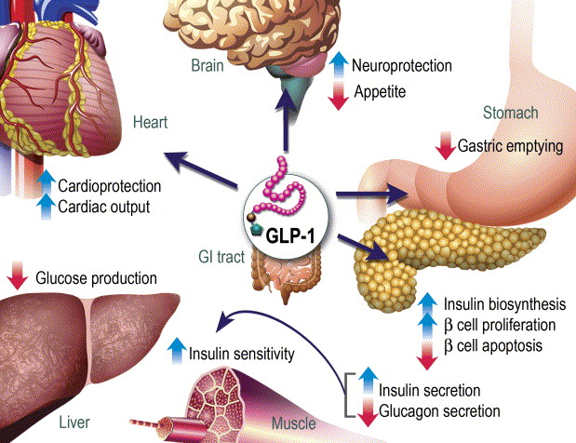
GLP-1 Actions on Different Target Tissues
Drucker DJ. Cell Metab 2006;3(3):153-65.

Slide 4
Various GLP-1 Agonists
Short-acting:
Exenatide (53% homology with human GLP)
Twice-daily injection
Lixisenatide (50% homology with human GLP)
Once-daily injection
Long-acting:
Liraglutide (97% homology with human GLP)
Once-daily injection
Exenatide (sustained-release)
Once-weekly injection
Albiglutide, Dulaglutide, Semaglutide
Once-weekly injection

Slide 5
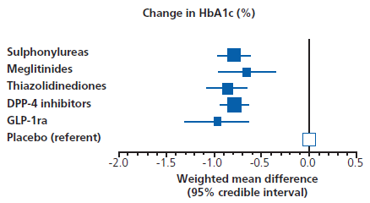
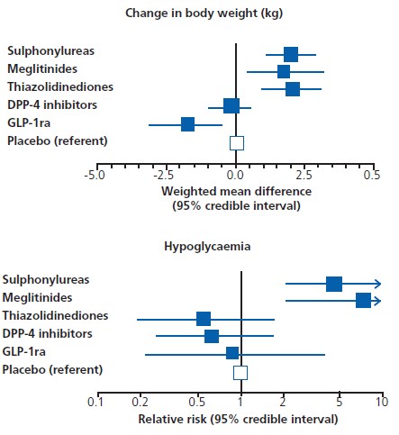
Comparison of Noninsulin Antidiabetic Drugs added to Metformin-Position of GLP-1 Agonists
−1.76 (−2.90 to −0.62)
−0.99 (−1.19 to −0.78)
Phung OJ, et al. JAMA 2010;303(14):1410-18.

Slide 6
Liraglutide

Slide 7
Liraglutide Effect and Action in Diabetes (LEAD) Studies
A series of 6 randomized controlled studies (duration of 26 wk except LEAD-3 which was 52 wk) involving more than 4400 patients with type 2 diabetes who were unable to maintain glycemic control with diet and exercise alone or with oral treatment, ∼2700 of whom received liraglutide.
The studies demonstrated the efficacy and safety of liraglutide both as monotherapy and as combination therapy with 1 or 2 oral agents.
Liraglutide reduced weight in most patients, improved β-cell function, lowered blood pressure and triglycerides, and was well tolerated with minimal risk of hypoglycemia.
McGill JB. Postgrad Med 2009;121(3):16-25.

Slide 8
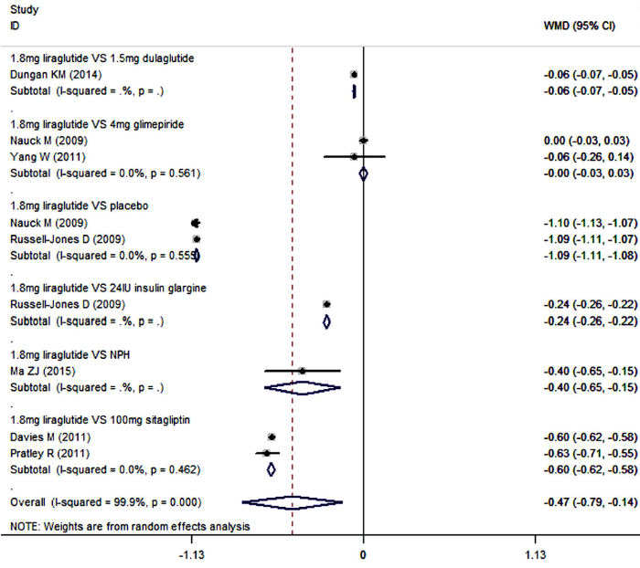
Compared with control (placebo, sitagliptin, glimepiride, dulaglutide, insulin glargine, and NPH), liraglutide in combination with metformin resulted in significant reductions in HbA1c-Meta-analysis of RCTs
Gu J, et al. Scientific Reports 2016 Sep 7;6:32714

Slide 9
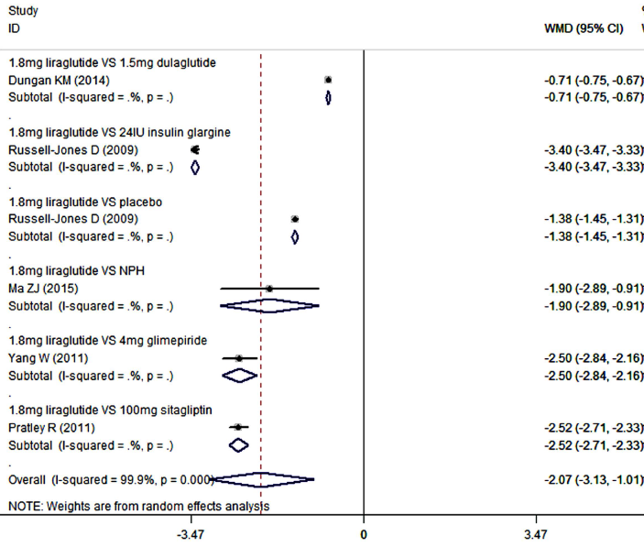
Compared with control (placebo, sitagliptin, glimepiride, dulaglutide, insulin glargine, and NPH), liraglutide in combination with metformin resulted in significant reductions in body weight
Gu J, et al. Scientific Reports 2016 Sep 7;6:32714

Slide 10
Treatment-related adverse events
Compared with control (placebo, sitagliptin, glimepiride, dulaglutide, insulin glargine, and NPH), liraglutide added to metformin,
Did not increase the risk of hypoglycemia.
(RR = 0.33, 95% CI: 0.08, 1.44; P = 0.14)
Increased the risk of gastrointestinal disorders.
(RR = 1.59, 95% CI: 1.15, 2.19; P = 0.005)
No cases of pancreatitis were reported in these included studies.
Gu J, et al. Scientific Reports 2016 Sep 7;6:32714

Slide 11
Cardiovascular Effects of GLP-1 Agonists
FDA issued an updated guidance for industry in 2008 requiring that preapproval and postapproval studies for all new antidiabetic drugs rule out excess cardiovascular risk.
FDA/CDER Dec 2008.

Slide 12
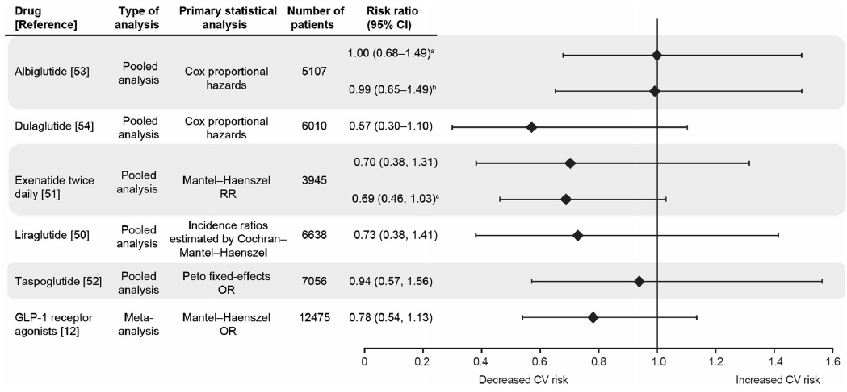
There is no increased risk of MACE (Major Adverse Cardiac Event) with GLP-1 agonists relative to controls in the short term.
a Primary endpoint: MACE composite endpoint or hospital admission for unstable angina.
b Secondary endpoint: MACE composite endpoint only.
c Secondary MACE composite endpoint, which included all relevant CV AEs [i.e., all terms of the primary MACE endpoint plus terms for arrhythmia, heart failure (with or without hospitalization), and mechanical-related events].
Mannucci E, Monami M. Adv Ther 2017.34:1-40

Slide 13
Liraglutide Effect and Action in Diabetes:
Evaluation of Cardiovascular Outcome Results
(LEADER)
Marso SP, et al. N Engl J Med 2016;375(4):311-22.

Slide 14
The LEADER trial was designed to investigate the cardiovascular profile of liraglutide versus placebo in addition to standard care.

Slide 15
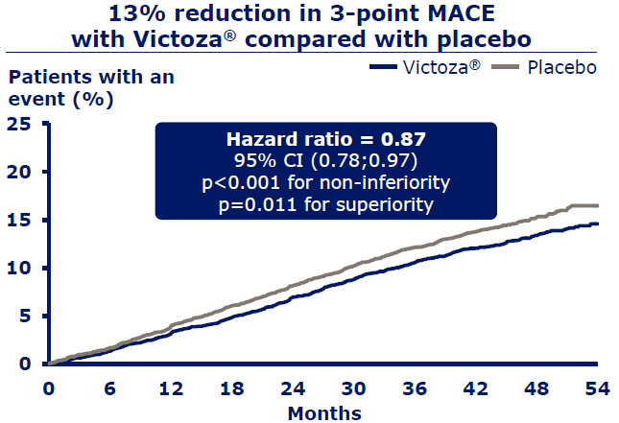
MACE: major adverse cardiovascular events
3-point MACE: cardiovascular death, non-fatal myocardial infarction and non-fatal stroke

Slide 16
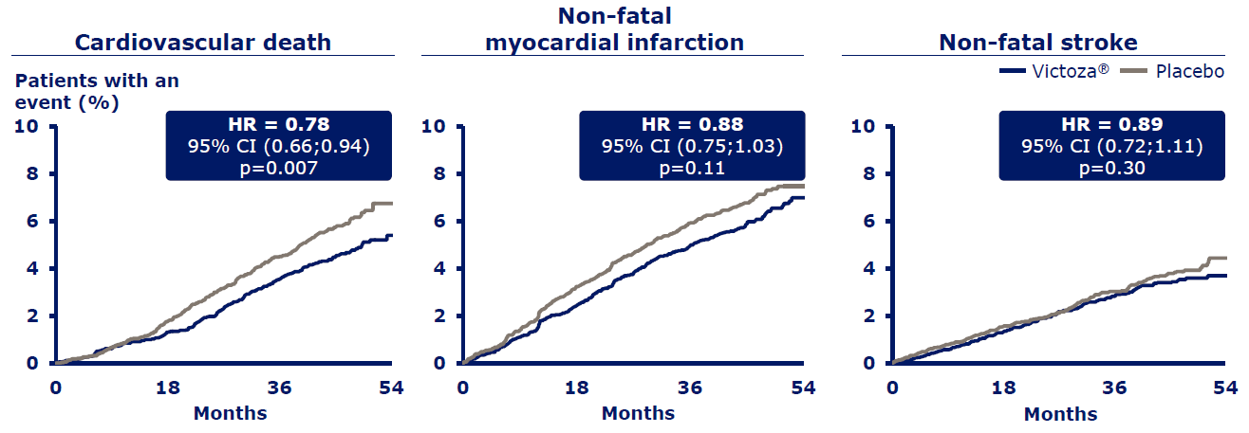
In the liraglutide group, cardiovascular death decreased significantly (22%); The frequencies of nonfatal myocardial infarction and nonfatal stroke were also lower, although the differences were not significant.

Slide 17
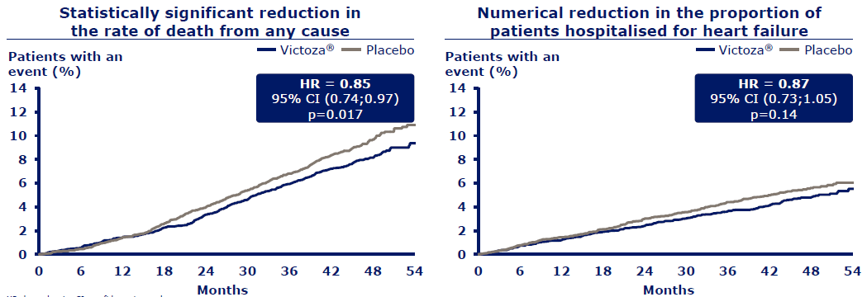
LEADER trial exploratory outcomes

Slide 18
LEADER Summary
Liraglutide significantly reduced the risk of the primary composite cardiovascular (CV) outcome by 13% vs placebo.
Compared with placebo, liraglutide also significantly reduced the risk of CV and all-cause death (22% and 15% reduction, respectively).
Liraglutide resulted in greater reductions in HbA_{1c} [-0.40% (95% CI, -0.45 to -0.34)], body weight [-2.3 kg (95% CI, -2.5 to -2.0)] and systolic blood pressure [-1.2 mmHg (95% CI, -1.9 to -0.5)] vs placebo.
Liraglutide was associated with a higher frequency of adverse events leading to permanent treatment discontinuation.

Slide 19
Safety and Tolerability of
GLP-1 Agonists

Slide 20
Gastrointestinal Adverse Events
The most common side effect of GLP-1 agonists.
Tend to occur early in treatment and subside over time.
Nausea, vomiting, diarrhea.
Nausea: 8-40% more than placebo or active comparator.
Diarrhea: 3-118% more than placebo or active comparator.
Nausea can be reduced with dose titration.
Nausea occurs less frequently with exenatide once weekly than exenatide twice daily or liraglutide.
Shyangdan DS, et al. Cochrane Database Syst Rev 2011.
Madsbad S. Diabetes Obes Metab 2016;18:317–332.

Slide 21
Pancreatitis
A meta-analysis including 41 RCTs (8353 patient x years total exposure for GLP agonists):
The overall risk of pancreatitis was not different between GLP-1 agonists and comparators (OR: 1.01 [0.37; 2.76]; p = 0.99).
A meta-analysis considering pancreatitis risk of incretin-based treatments:
29 RCTs (14,562 patients) compared GLP-1 agonists vs control:
16 pancreatitis events (0.11%); (OR 1.05 [0.37-2.94])
Monami M, et al. Diabetes Res Clin Pract 2014;103:269-275.
Li L, et al. BMJ 2014;348:1-19

Slide 22
Pancreatitis
The available evidence suggests that the incidence of pancreatitis among patients using incretins is low and that the drugs do not increase the risk of pancreatitis.
Current evidence, however, is not definitive, and more carefully designed and conducted observational studies are warranted to definitively establish the extent, if any, of increased risk.
Monami M, et al. Diabetes Res Clin Pract 2014;103:269-275.
Li L, et al. BMJ 2014;348:1-19.

Slide 23
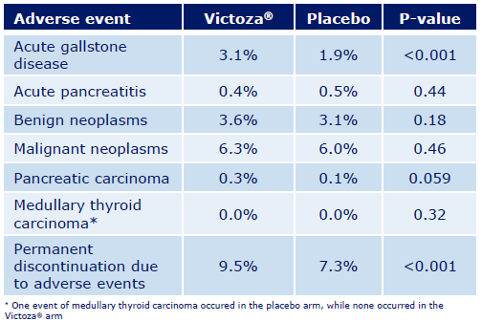
Liraglutide appeared to have a safe and well- tolerated profile in the LEADER trial.
18/4668 vs
23/4672
Marso SP, et al. N Engl J Med 2016 375(4):311-22.

Slide 24
Precautions when prescribing Victoza (liraglutide)
Victoza is contraindicated in patients with a personal or family history of medullary thyroid carcinoma or Multiple Endocrine Neoplasia syndrome type 2 (MEN 2).
Victoza should be used with caution in patients with a history of pancreatitis.
No dose adjustment of Victoza is recommended for patients with renal impairment.
FDA Victoza prescribing information Updated 2012.

Slide 25
GLP-1 Agonists in
Recent American Diabetes Association Standards of Medical Care in Diabetes

Slide 26
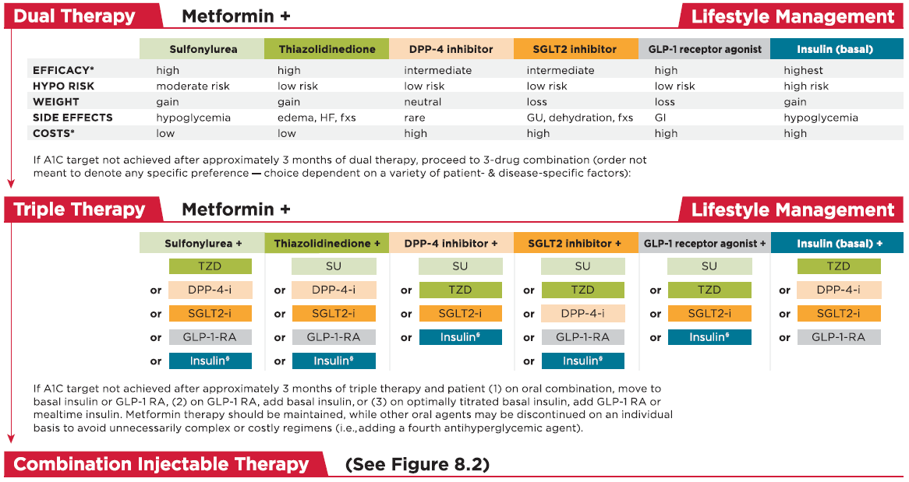
ADA. Diabetes Care 2017;40(Suppl 1)

Slide 27
In patients with long-standing suboptimally controlled type 2 diabetes and established atherosclerotic cardiovascular disease, empagliflozin or liraglutide should be considered as they have been shown to reduce cardiovascular and all-cause mortality when added to standard care. (Level of evidence B)
ADA. Diabetes Care 2017;40(Suppl 1)

Slide 28
Concluding Remarks
GLP-1 agonists affect glucose control through several mechanisms:
Enhancement of glucose-dependent insulin secretion
Slowed gastric emptying
Regulation of postprandial glucagon
Reduction of food intake
They do not usually cause hypoglycemia in the absence of therapies that otherwise cause hypoglycemia.

Slide 29
Concluding Remarks
GLP-1 agonists can be prescribed in combination with metformin (and/or another oral agent) also basal insulin for patients who fail initial therapy, particularly when weight loss or avoidance of hypoglycemia is a primary consideration, the HbA1c is close to target (within 1 to 1.5 percentage points), and cost is not a major barrier.
A prior history of atherosclerotic cardiovascular disease might favor choosing liraglutide as the second drug to be added to metformin.

Slide 30
Concluding Remarks
The side effects of GLP-1 agonists are predominantly gastrointestinal, particularly nausea and diarrhea.
There are few long-term studies of GLP-1 agonists to assess clinically important health outcomes (cardiovascular events, mortality), durability of glucose control or weight loss, or safety.
Many questions remain unanswered regarding clinical use in type 2 diabetes, including long-term benefits and risks and their role in combination with other diabetes medications.

Slide 31
با توجه به بهبود هوشياري بيمار توصيه شما براي ادامه درمان وي چيست؟
Thanks for your patience!
Admission for at least 72 hours
Serum : DW5% 100 cc / h
saline for hydration

