Slide 1
به نام ايزد يكتا
دكتر داود خليلي (MD, MPH, PhD)
مرکز تحقیقات پیشگیری از بیماریهای متابولیک،
پژوهشکده علوم غدد درون ریز و متابولیسم دانشگاه علوم پزشکی شهید بهشتی

Slide 2
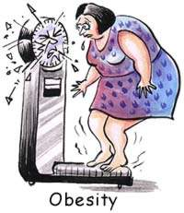
Cut-off points for OBESITY
Dr. Khalili
MD, MPH, PhD in epidemiology,
Research institute for Endocrine Sciences,
Shahid Bheshti University of Medical Sciences

Slide 3
Some Points About Dichotomizing continuous predictors
Trade off
Simplicity & Practicality
Measurement error & low Power
Avoid of assumptions
Calculate better effect measurements
We loss some information
Throwing about 1/3 of data away

Slide 4
Some Points About Dichotomizing continuous predictors
Dichotomizing: to create two relatively homogenous group
According to variable distribution
Dichotomizing
95% or …of percentile
Using a gold standard (usually another variable or event)

Slide 5
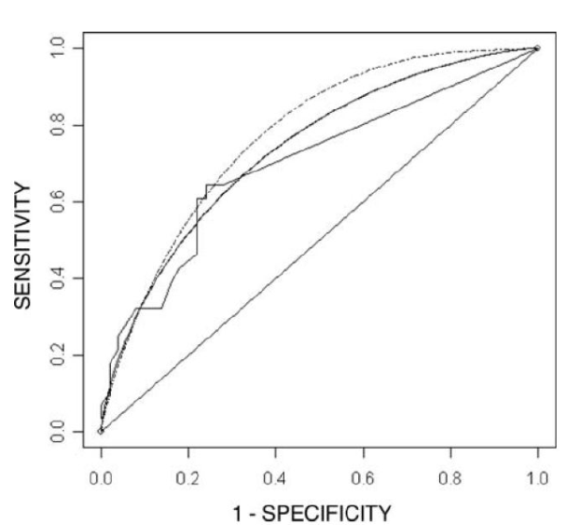
Cut points based on a Gold Standard
Receiver Operating Characteristic (ROC) Curve
AUC (area Under the Curve)

Slide 6
Cut points based on a Gold Standard
(ROC)
Sensitivity 1
1 - specificity
Min
Sensitivity + Specificity -1
Max

Slide 7
Cut points based on a Gold Standard (other methods)
Calculating an effect measure (OR, RR, HR, …)
To compare with a reference
Calculating Net Benefit considering different weights for False positive and False Negative
Using Data Mining methods

Slide 9
NIH consensus conference (1985):
According to NHANES II and 85th percentile values (men and women ages 20-29 y)
BMI of 27.8 for men
BMI of 27.3 for women

Slide 10
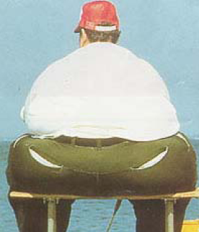
Probloms of this statistical approach:
Distribution Changes
Theoretical Curves
Need of more information on BMI complication
Low sensitivity because of underestimation of Obesity
Age-adjusted trends in obesity (BMI >=30): United States

Slide 11
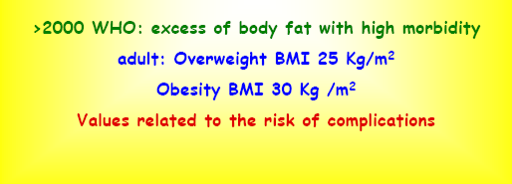

Slide 12
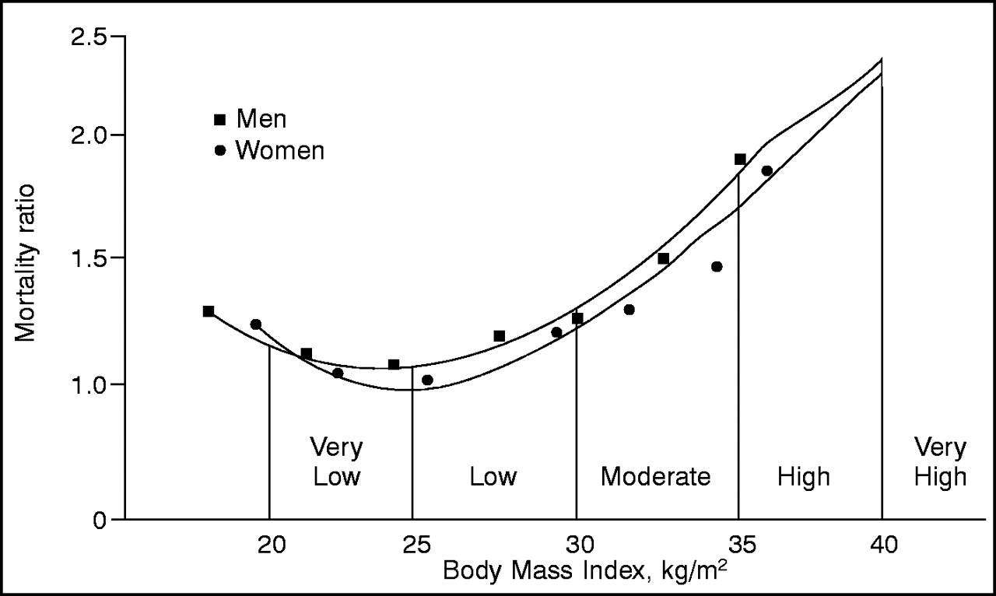
Relation between mortality and BMI
Data from Lew EA: Mortality and weight: insured lives and the American Cancer Society studies. Ann Intern Med 103:1024-1029, 1985.

Slide 13
The method used to establish BMI cut-off is:
largely arbitrary
&
visual inspection

Slide 14
Recent study in western Europe and North America
“Body-mass index and cause-specific mortality in 900 000 adults:
collaborative analyses of 57 prospective studies”
At 30–35 kg/m2, median survival is reduced by 2–4 years;
at 40–45 kg/m2, it is reduced by 8–10 years (which is comparable with the effects of smoking).
The definite excess mortality below22· 5 kg/m2 is due mainly to smoking-related diseases, and is not fully explained.
Lancet. 2009 March 28; 373(9669): 1083–1096.

Slide 15
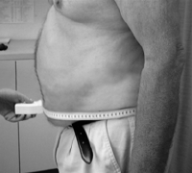
Because of some Reasons: WC instead of BMI

Slide 16
WC cut points
According to:
- Lean MEJ, Han TS, Morrison CE. Waist circumference as a measure for indicating need for weight management. BMJ 1995;311:158–61.
Randomly recruited 904 men and 1014 women,
aged 25 to 74 years, from the general population of
north Glasgow between January and August 1992

Slide 17
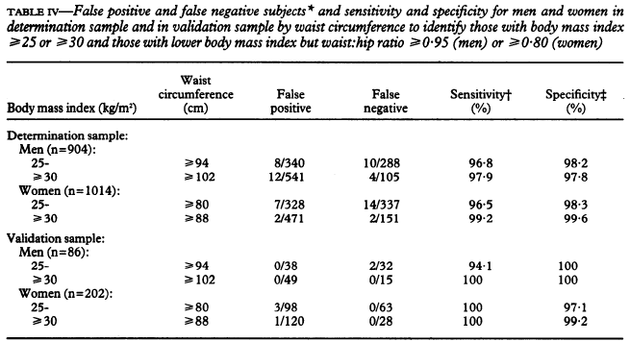
BMI as
Gold Standard
Using in ATPIII

Slide 18
ShanKuan Zhu,
Am J Clin Nutr 2002;76:743–9.
If WC has an independent or a stronger association with risk factors
than BMI has, then it is inappropriate to base WC thresholds
on their association with BMI thresholds. Rather, thresholds for
each should be based on their relation to risk factors.

Slide 19
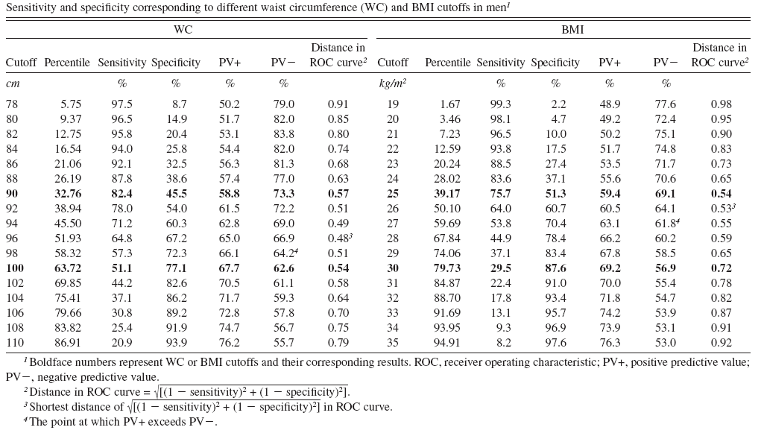

Slide 20
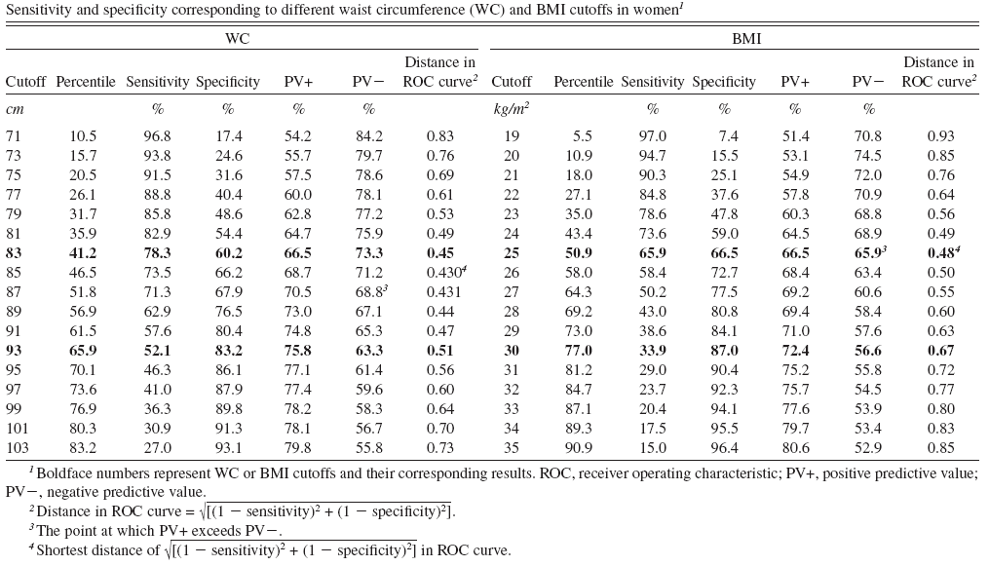

Slide 21
Different Gold Standard
Different Cut points
The more Hard Outcome with lower prevalence
One prevalent CVD rick factor
Two prevalent CVD rick factor
Three prevalent CVD rick factor
Incident CVD
CVD mortality
The higher Cut point

Slide 22
Based on: Circulation. 2009; 120: 1640 – 1645.
A joint interim statement of
the International Diabetes Federation Task Force on Epidemiology and Prevention
National Heart, Lung, and Blood Institute
American Heart Association
World Heart Federation
International Atherosclerosis Society
International Association for the Study of Obesity. Circulation. 2009
Appropriate Waist Circumference Cut-off Points among Iranian Adults: The First Report of the Iranian National Committee of Obesity

Slide 23
Mirmiran P, Esmaillzadeh A, Azizi F. Detection of cardiovascular risk factors by anthropometric measures in Tehranian adults: receiver operating characteristic (ROC) curve analysis. Eur J Clin Nutr. 2004; 58: 1110 – 1118.
Delavari A, Forouzanfar MH, Alikhani S, Sharian A, Kelishadi R. First nationwide study of the prevalence of the metabolic syndrome and optimal cutoff points of waist circumference in the Middle East: the national survey of risk factors for noncommunicable diseases of Iran. Diabetes Care. 2009; 32: 1092 – 1097.
Esteghamati A, Abbasi M, Rashidi A, Meysamie A, Khalilzadeh O, Haghazali M, et al. Optimal waist circumference cut-offs for the diagnosis of metabolic syndrome in Iranian adults: results of the third national survey of risk factors of non-communicable diseases (SuRFNCD-2007). Diabet Med. 2009; 26: 745 – 746.
Hadaegh F, Zabetian A, Sarbakhsh P, Khalili D, James WP, Azizi F. Appropriate cutoff values of anthropometric variables to predict cardiovascular outcomes: 7.6 years follow-up in an Iranian population. Int J Obes (Lond). 2009; 33: 1437 – 1445.

Slide 24
The ministerial committee, therefore, proposed WC cut-offs for the Iranian adult population as follows:
WC of >= 90 cm in both genders: at risk for CVD risk factors requiring life style change.
WC of >= 95 cm in both genders: high risk for CVD events requiring immediate preventive interventions.

Slide 25
It is concluded that:
Anthropometric cut-offs, based on European populations are not appropriate for Iranians and that WC cut-off points, based on both cross-sectional and longitudinal outcome based studies, are equal in both genders in Iran.

Slide 26
هر پايان، شروع ديگری است پس بازهم
به نام ايزدمان

