Slide 1
اصول کیفی در پیشگیری و مراقبت دیابت
MD, PhD دکتر سارا کاظم پور اردبیلی
دکترای تخصصی غدد و متابولیسم با گرایش دیابت از ایمپریال کالج لندن

Slide 2
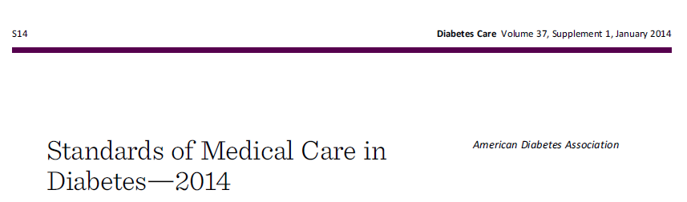


Slide 3

I. Classification and Diagnosis
A. Classification
  Type 1 diabetes
  Type 2 diabetes
  Other specific types of diabetes, e.g., genetic defects, cystic fibrosis, and drug- or chemical-induced (such as in the treatment of HIV/ AIDS or after organ transplantation)
  Gestational diabetes mellitus (GDM)

Slide 4


Slide 5
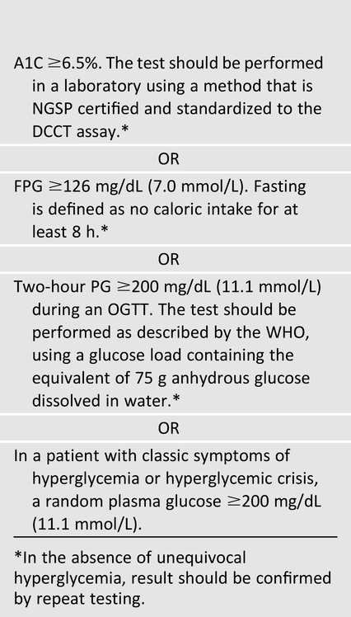
I. Classification and Diagnosis
B. Diagnosis of Diabetes
  FPG
  OGTT
  Random BS
  HbA1c

Slide 6


Slide 7
I. Classification and Diagnosis
The A1C test should be performed using a method that is certified by the National Glycohemoglobin Standardization Program (NGSP) and standardized or traceable to the Diabetes Control and Complications Trial (DCCT) reference assay.
The A1C has several advantages to the FPG and OGTT, including greater convenience (fasting not required), possibly greater pre-analytical stability, and less day-to-day perturbations during stress and illness.

Slide 8
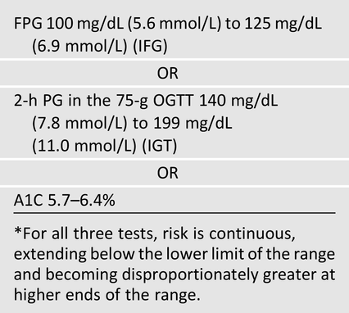
I. Classification and Diagnosis
C. Categories of Increased Risk for Diabetes (Pre-diabetes)

Slide 9

100

Slide 10
پیشگیری

Slide 11
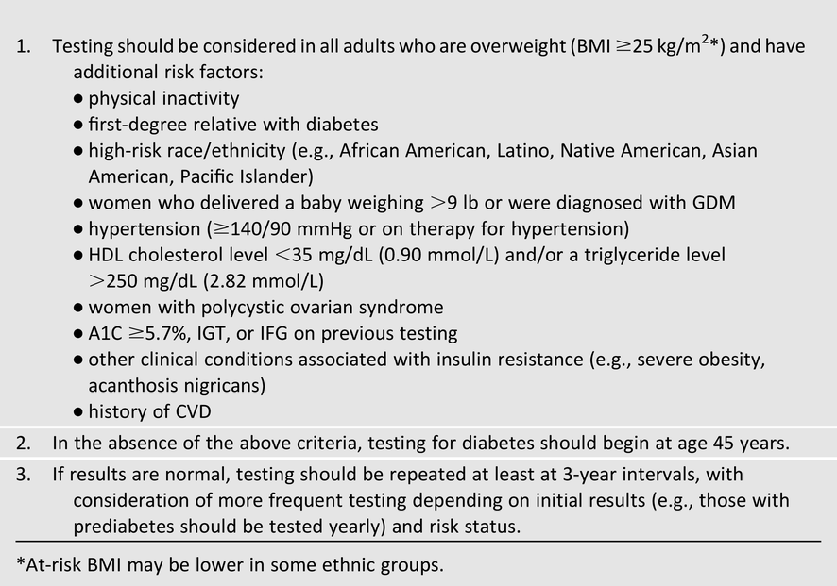
II. Testing for Diabetes in Asymptomatic Patients
A. Testing for Type 2 Diabetes and Risk of Future Diabetes in Adults

Slide 12
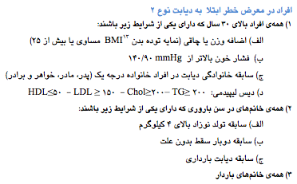

Slide 13
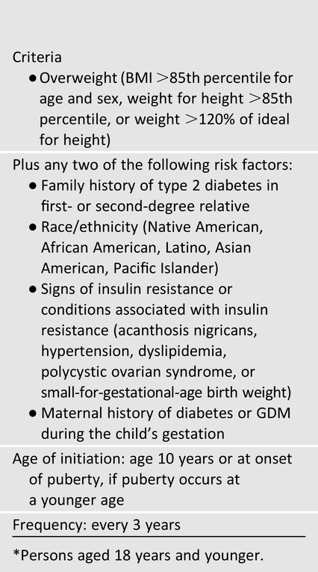
II. Testing for Diabetes in Asymptomatic Patients
B. Screening for Type 2 Diabetes in Children

Slide 15
II. Testing for Diabetes in Asymptomatic Patients
C. Screening for Type 1 Diabetes
  While there is currently a lack of accepted screening programs, one should consider referring relatives of those with type 1 diabetes for antibody testing for risk assessment in the setting of a clinical research study

Slide 17
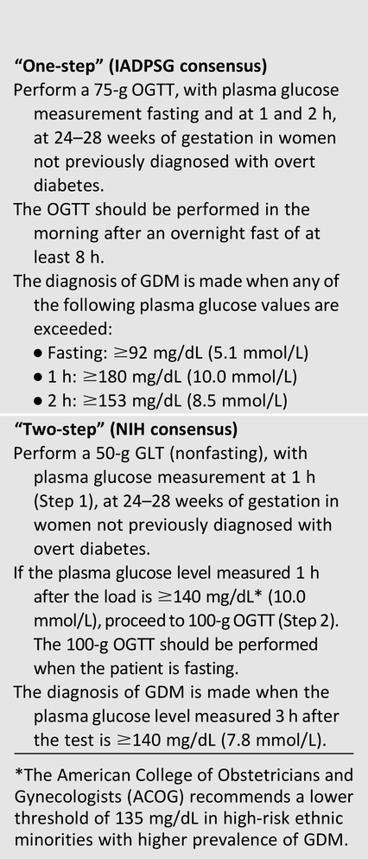
III. Detection and Diagnosis of Gestational Diabetes Mellitus
International Association of Diabetes and Pregnancy Study Groups
National Institutes of Health

Slide 18
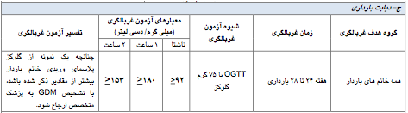

Slide 19
III. Detection and Diagnosis of Gestational Diabetes Mellitus
Recommendations
Screen for undiagnosed type 2 diabetes at the first prenatal visit in those with risk factors, using standard diagnostic criteria.
Screen for GDM at 24–28 weeks of gestation in pregnant women not previously known to have diabetes.
Screen women with GDM for persistent diabetes at 6–12 weeks postpartum, using the OGTT and non-pregnancy diagnostic criteria.
Women with a history of GDM should have lifelong screening for the development of diabetes or pre-diabetes at least every 3 years.
Women with a history of GDM found to have pre-diabetes should receive lifestyle interventions or metformin to prevent diabetes.

Slide 20
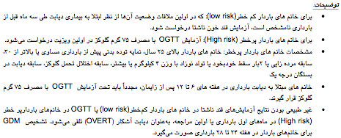

Slide 21
IV. Prevention/Delay of Type 2 Diabetes
Patients with IGT , IFG , or an A1C 5.7–6.4% should be referred to an effective ongoing support program targeting weight loss of 7% of body weight and increasing physical activity to at least 150 min/week of moderate activity such as walking.
Metformin therapy for prevention of type 2 diabetes may be considered in those with IGT , IFG , or an A1C 5.7–6.4% , especially for those with BMI >35 kg/m², aged <60 years, and women with prior GDM.
At least annual monitoring for the development of diabetes in those with pre-diabetes is suggested.
Screening for and treatment of modifiable risk factors for CVD is suggested.

Slide 22
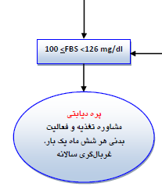

Slide 23
مراقبت از بیمار دیابتی

Slide 24
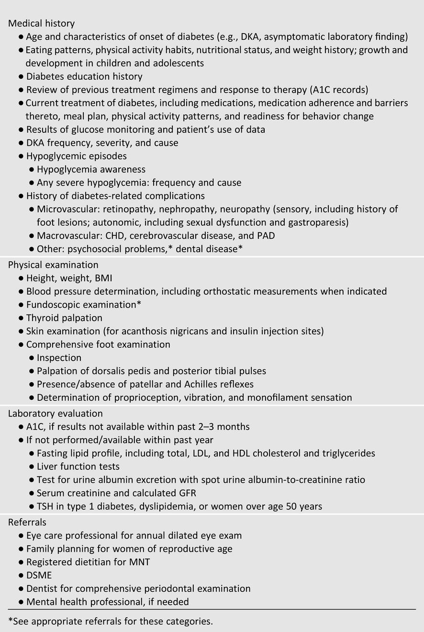
V. Diabetes Care
A. Initial Evaluation

Slide 25
V. Diabetes Care

Slide 26
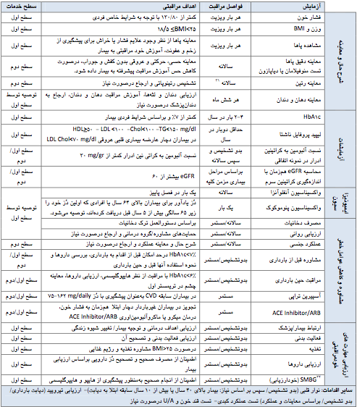

Slide 27
V. Diabetes Care
B. Management
  The management plan should be formulated as a collaborative therapeutic alliance among the patient and family, the physician, and other members of the health care team
  health care team may include physicians, nurse practitioners, physician’s assistants, nurses, dietitians, pharmacists, and mental health professionals with expertise in diabetes

Slide 29
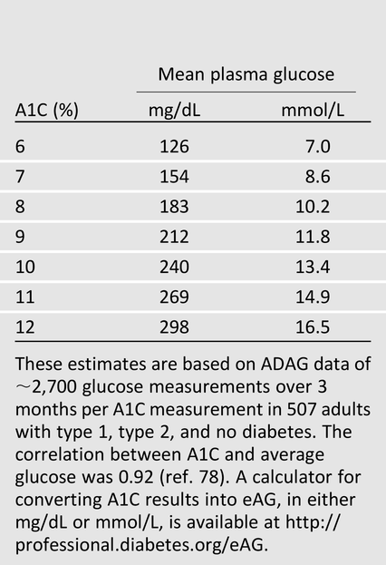
V. Diabetes Care
C. Glycemic Control
  1. Assessment of Glycemic Control
    a. Glucose Monitoring (SMBG, CGMS)
    b. A1C

Slide 31
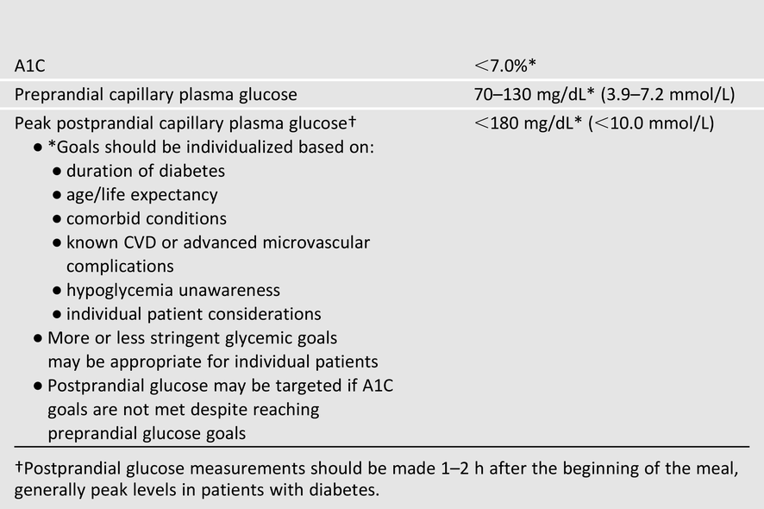
V. Diabetes Care
  - 2. Glycemic Goals in Adults

Slide 32
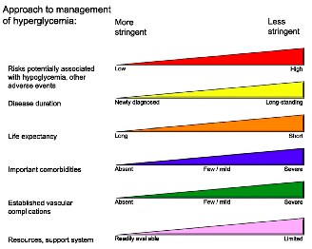
V. Diabetes Care
Ismail-Beigi F, Moghissi E, Tiktin M, Hirsch IB, Inzucchi SE, Genuth S. Individualizing glycemic targets in type 2 diabetes mellitus: implications of recent clinical trials. Ann Intern Med 2011;154: 554–559

Slide 34
V. Diabetes Care
-2. Glycemic Goals in Pregnant Women
  Pre-prandial: ≤95 mg/dL (5.3 mmol/L), and either:
  1-h post-meal: ≤140 mg/dL (7.8 mmol/L) or
  2-h post-meal: ≤120 mg/dL (6.7 mmol/L)

Slide 36
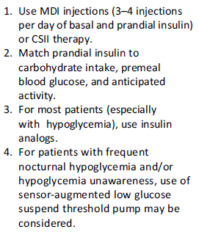
V. Diabetes Care
D. Pharmacological and Overall Approaches to Treatment
  1. Insulin Therapy for Type 1 Diabetes
    Screening: Consider screening those with type 1 diabetes for other autoimmune diseases (thyroid, vitamin B₁₂ deficiency, celiac) as appropriate.
  2. Pharmacological Therapy for Hyperglycemia in Type 2 Diabetes

Slide 37
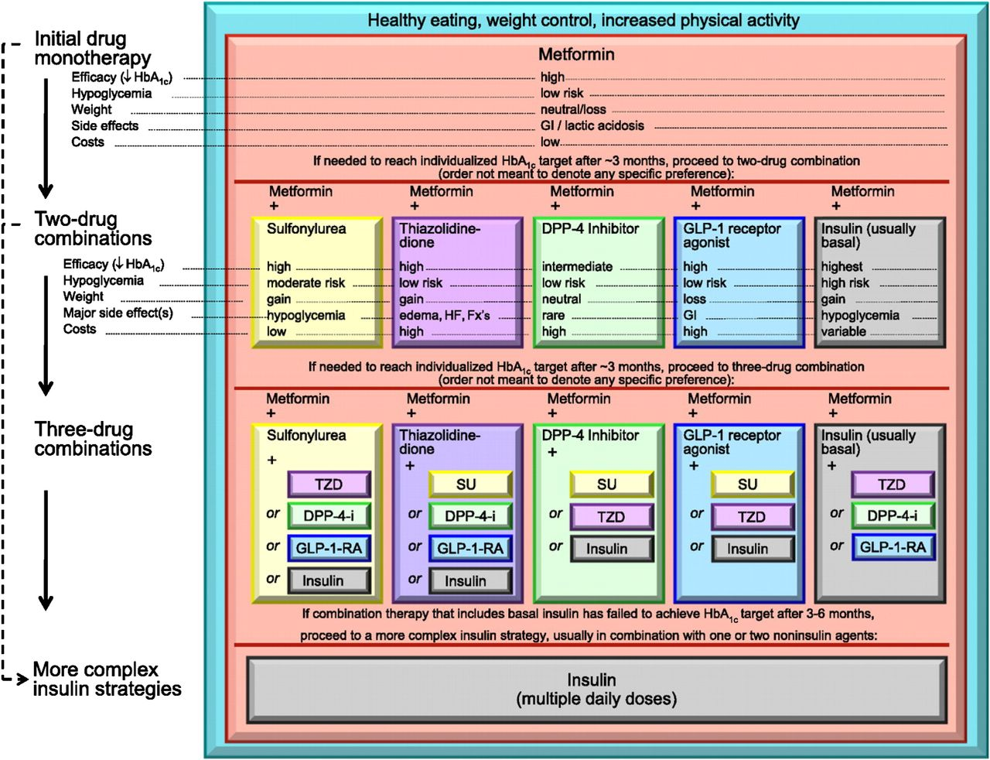

Antihyperglycemic therapy in type 2 diabetes: general recommendations.
American Diabetes Association Dia Care 2014;37:S14-S80
Copyright © 2011 American Diabetes Association, Inc.
Notes:
Antihyperglycemic therapy in type 2 diabetes: general recommendations. DPP-4-i, DPP-4 inhibitor; Fx's, bone fractures; GI, gastrointestinal; GLP-1-RA, GLP-1 receptor agonist; HF, heart failure; SU, sulfonylurea; TZD, thiazolidinedione. For further details, see ref. 113. Adapted with permission.

Slide 38
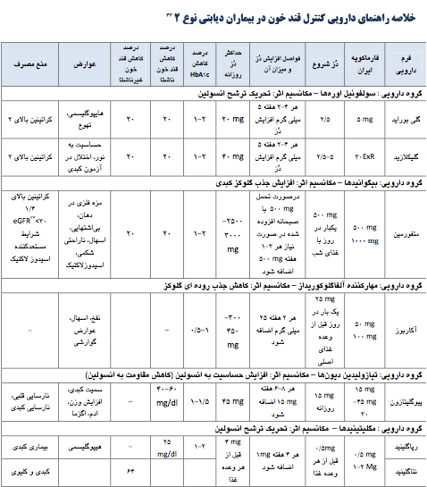

Slide 39
Insulin Recommendations???

Slide 40
V. Diabetes Care
E. Medical Nutrition Therapy
  Energy Balance, Overweight, and Obesity
  Eating Patterns and Macronutrient Distribution
  Carbohydrate Amount and Quality
  Dietary Fat Quantity and Quality
  Supplements for Diabetes Management
  Alcohol
  Sodium
  Primary Prevention of Type 2 Diabetes

Slide 41
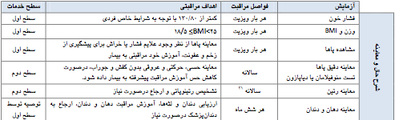


Slide 42
V. Diabetes Care
F. Diabetes Self-Management Education and Support
G. Physical Activity
  Frequency and Type of Exercise
  Pre-exercise Evaluation of the Diabetic Patient
  Exercise in the Presence of Specific Long-Term Complications of Diabetes
H. Psychosocial Assessment and Care
I. When Treatment Goals Are Not Met
  Rethinking the treatment regimen may require assessment of barriers including income, health literacy, diabetes-related distress, depression, and competing demands, including those related to family responsibilities and dynamics.
J. Inter-current Illness
  Inpatient care for subjects with diabetes

Slide 43


Slide 44
V. Diabetes Care
K. Hypoglycemia
  Glucose (15–20 g) is the preferred treatment for the conscious individual with hypoglycemia. After 15 min of treatment, if SMBG shows continued hypoglycemia, the treatment should be repeated. Once SMBG returns to normal, the individual should consume a meal or snack to prevent recurrence of hypoglycemia.
  Glucagon should be prescribed for all individuals at significant risk of severe hypoglycemia. Glucagon administration is not limited to health care professionals
L. Bariatric Surgery
  Bariatric surgery may be considered for adults with BMI >35 kg/m²and type 2 diabetes, especially if diabetes or associated co-morbidities are difficult to control with lifestyle and pharmacological therapy.
M. Immunization
  Annually provide an influenza vaccine to all diabetic patients ≥6 months of age.
  Administer pneumococcal polysaccharide vaccine to all diabetic patients ≥2 years of age
  Administer hepatitis B vaccination to unvaccinated adults with diabetes

Slide 46
پیشگیری و مراقبت از عوارض دیابت

Slide 47
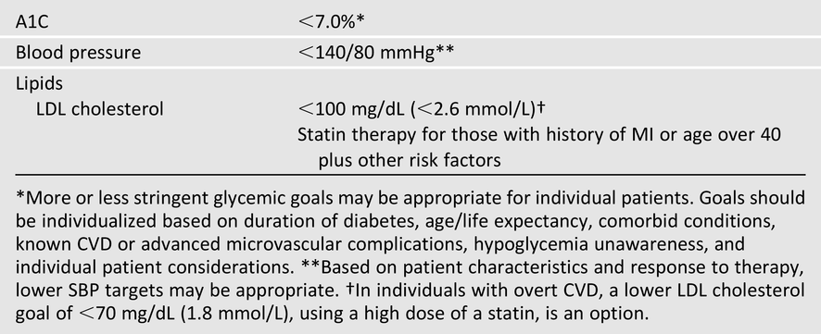
VI. Prevention and Management of Diabetes Complications
A. Cardiovascular Disease
  1. Hypertension/Blood Pressure Control
  2. Dyslipidemia/Lipid Management

Slide 48
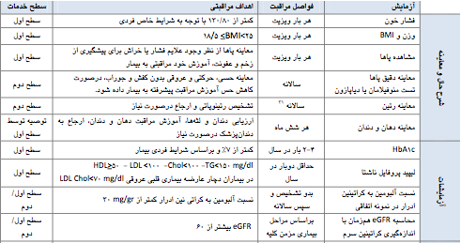

Slide 49
VI. Prevention and Management of Diabetes Complications
  3. Anti-platelet Agents
  4. Smoking Cessation
  5. Cardiovascular Disease Screening

Slide 50
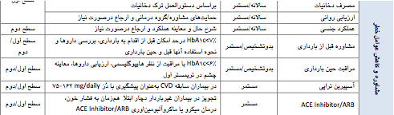

Slide 51
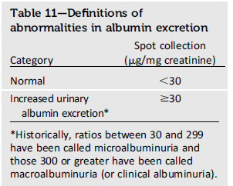
VI. Prevention and Management of Diabetes Complications
B. Nephropathy
  Optimize glucose control to reduce the risk or slow the progression of nephropathy.
  Optimize blood pressure control to reduce the risk or slow the progression of nephropathy.

Slide 53
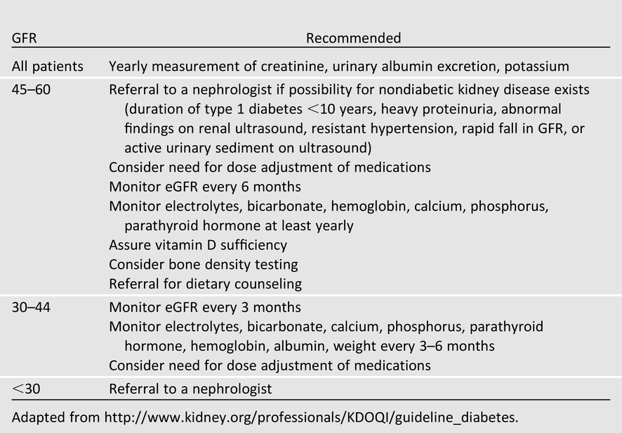
VI. Prevention and Management of Diabetes Complications

Slide 54
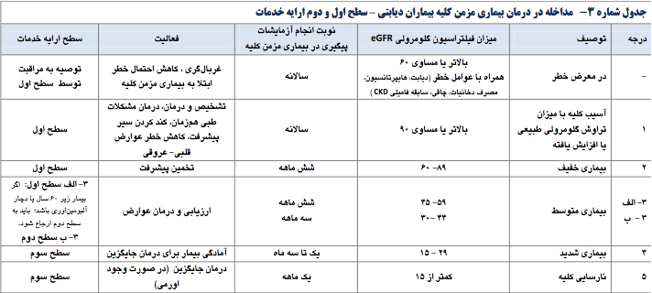

Slide 55
VI. Prevention and Management of Diabetes Complications
C. Retinopathy
  Optimize glycemic control & blood pressure control
  type 1 diabetes: within 5 yrs of diagnosis
  Type 2 diabetes: at diagnosis
  If no evidence of problems: repeat every two years
D. Neuropathy
  Distal Symmetric Poly-neuropathy
  Diabetic Autonomic Neuropathy
  Cardiovascular Autonomic Neuropathy
  Gastrointestinal Neuropathies
  Genitourinary Tract Disturbance

Slide 56

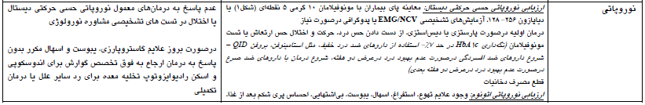
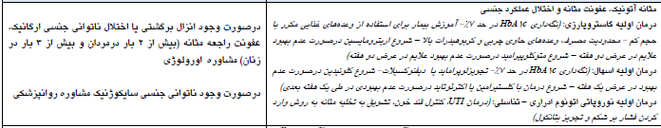

Slide 57
VI. Prevention and Management of Diabetes Complications
E. Foot Care
  For all patients with diabetes, perform an annual comprehensive foot examination to identify risk factors predictive of ulcers and amputations.
  A multidisciplinary approach is recommended for individuals with foot ulcers and high-risk feet, especially those with a history of prior ulcer or amputation.
  Refer patients who smoke, have LOPS and structural abnormalities, or have history of prior lower-extremity complications to foot care specialists for ongoing preventive care and lifelong surveillance.
  Initial screening for peripheral arterial disease (PAD) should include a history for claudication and an assessment of the pedal pulses.

Slide 59
VII. Assessment of Common Comorbid Conditions
Depression
Obstructive Sleep Apnea
Fatty Liver Disease
Cancer
Fractures
Cognitive Impairment
Low Testosterone in Men
Periodontal Disease
Hearing Impairment

Slide 61
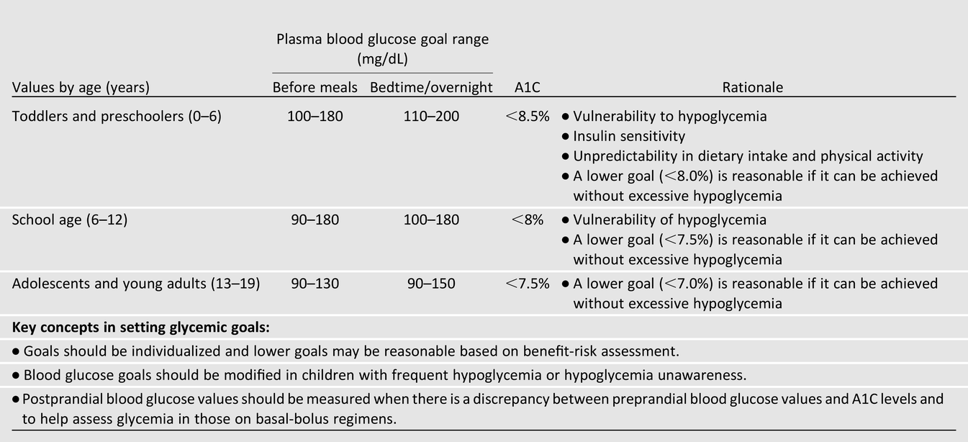
VIII. Diabetes Care in Specific Populations
A. Children and Adolescents
  1. Type 1 Diabetes
    a. Glycemic Control

Slide 62
VIII. Diabetes Care in Specific Populations
    b. Screening and Management of Complications
      i. Nephropathy: Annual screening for albumin levels, should be considered for the child at the start of puberty or at age ≥10 years, whichever is earlier, once the youth has had diabetes for 5 years.
      ii. Hypertension: Blood pressure should be measured at each routine visit. Children found to have high-normal blood pressure or hypertension should have blood pressure confirmed on a separate day.
      iii. Dyslipidemia: Consider the first lipid screening at puberty (≥10 years). For children diagnosed with diabetes at or after puberty, consider obtaining a fasting lipid profile soon after the diagnosis (after glucose control has been established).
        if lipids are abnormal, annual monitoring is reasonable. If LDL cholesterol values are within the accepted risk levels (<100 mg/dL [2.6 mmol/L]), a lipid profile repeated every 5 years is reasonable.

Slide 63
VIII. Diabetes Care in Specific Populations
      iv. Retinopathy: An initial dilated and comprehensive eye examination should be considered for the child at the start of puberty or at age ≥10 years, whichever is earlier, once the youth has had diabetes for 3–5 years.
        annual routine follow-up is generally recommended.
      v. Celiac Disease: Testing should be considered in children with a positive family history of celiac disease, growth failure, failure to gain weight, weight loss, diarrhea, flatulence, abdominal pain, or signs of malabsorption or in children with frequent unexplained hypoglycemia or deterioration in glycemic control.
      vi. Hypothyroidism: Consider screening children with type 1 diabetes for Anti-TPO and Anti-TG

Slide 64
VIII. Diabetes Care in Specific Populations
    c. Self-Management
    d. School and Day Care
    e. Transition From Pediatric to Adult Care
  2. Type 2 Diabetes
  3. Monogenic Diabetes Syndromes

Slide 65
VIII. Diabetes Care in Specific Populations
B. Preconception Care
  The goals of preconception care are to
    1) involve and empower the patient on diabetes management,
    2) achieve the lowest A1C test results possible without excessive hypoglycemia,
    3) assure effective contraception until stable and acceptable glycemia is achieved, and
    4) identify, evaluate, and treat long-term diabetes complications such as retinopathy, nephropathy, neuropathy, hypertension, and CHD
  Statins, ACE inhibitors, ARBs and should generally be discontinued before pregnancy.
  Potential risks and benefits of oral anti-diabetic agents in the preconception period must be carefully weighed, recognizing that data are insufficient to establish the safety of these agents in pregnancy.

Slide 66
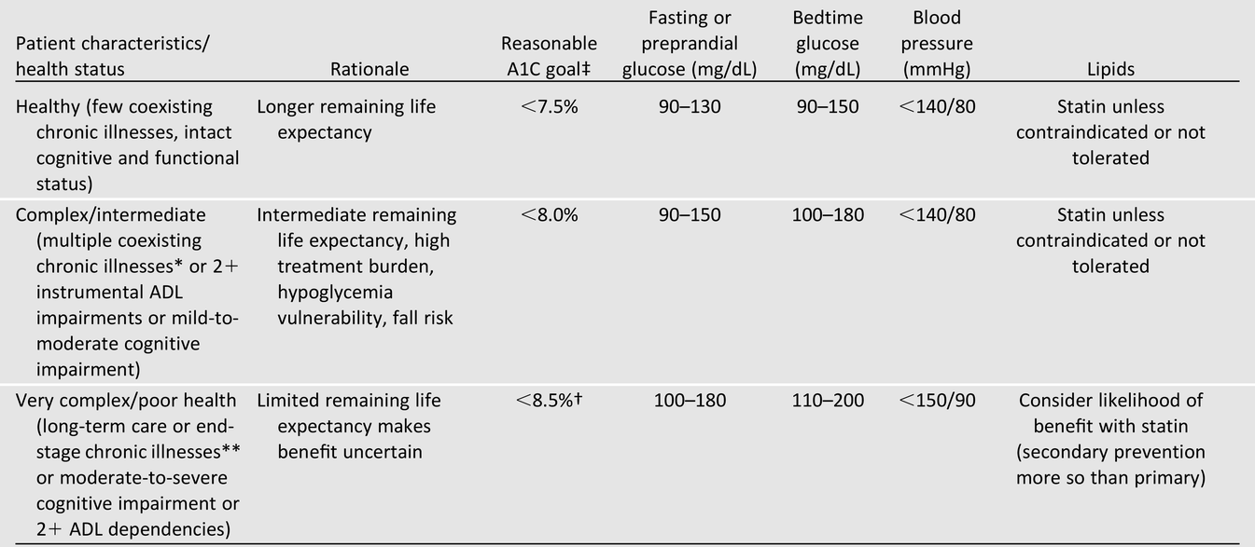
VIII. Diabetes Care in Specific Populations
C. Older Adults
D. Cystic Fibrosis–Related Diabetes
  Screen from 10yrs
  HbA1c not to be used for screening

Slide 67
IX. Diabetes Care in Specific Settings
A. Diabetes Care in the Hospital
  1. Glycemic Targets in Hospitalized Patients
  2. Anti-hyperglycemic Agents in Hospitalized Patients
  3. Preventing Hypoglycemia
  4. Diabetes Care Providers in the Hospital
  5. Self-Management in the Hospital
  6. MNT in the Hospital
  7. Bedside Blood Glucose Monitoring
  8. Discharge Planning and DSME

Slide 68
IX. Diabetes Care in Specific Settings
B. Diabetes and Employment
C. Diabetes and Driving
D. Diabetes Management in Correctional Institutions

Slide 69
X. Strategies for Improving Diabetes Care
Objective 1: Optimize Provider and Team Behavior
Objective 2: Support Patient Behavior Change
Objective 3: Change the System of Care

Slide 70


خسته نباشید!

