Slide 1
A 41 year old man with FSGS,DM,bilateral adrenal mass.

Slide 2
We here in present the case of 41-year-old man with bilateral adrenal mass.he had history of MNG,20 years ago; managed with subtotal thyroidectomy due to large goiter size.the patient has been taking levothyroxine100 mcg daily. Ever since he –also-a history of focal segmental glomerulosclerosis (FSGS) since 17years ago that has been being treated with prednisolone and sandimmune(just fore few month long ago).he is currently taking prednisolone 30mg and losartan25mg twice daily.

Slide 5
He has history of DM and taking Insulin Lantus 20unit BID and Insulin Novorapid 8,12,12 units before breakfast, lunch and dinner respectively. He had history of mild to moderate headaches and N/V 1/5 years ago with Dx migraine taking valperoat sodium 200 daily.

Slide 7
He had polyuria, polydipsia and costipation for long time.one year ago he had an episode of hypertension crisis (SBP 220mmhg) with paroxysmal attack’s of palpitation , dizziness ,blurring vision and headaches. The attacks have become more morefrequent in-the past few month.he had never been diagnosed with hypertension till one year ago.due to hypertension crisis urinary catecholamines were measured which were quite high in two separate measurements; metanephrine>2000mcg/24hrs(nl up to350)

Slide 8
Patient was given prazosin 5 mg TDS and Inderal 10mg TDS.the details of his laboratory and images and diagnostic work up are as follow:

Slide 9
A CT of abdomen/pelvis revealed a round,heterogenous solid, 5/6cm mass in right adrenal and 3/8cm mass in left adrenal.

Slide 18
Lab data30/11/96: urine metanephrine 24hrs>2000micg/d (Elisa) Urine VMA(24hrs)(chemical):9 micg/24h (Adult: up to 13/6) Urine volume 24hrs: 7500ml

Slide 20
Lab data 21/12/96: - cortisol 8am:10mcg/dl (NL:6-20) - Urine normetanephrine:925 (NL˂600micg/day) -Urine volume 24hrs:10200ml

Slide 21
TSH :2/2 T4:6 T3:0/9 Hb A1C:8/6 Cr:1 Ca:8/3 Alb:3/2

Slide 22
Lab data 19/1/97: WBC:12/4 Hb:14/6 Plt:337000 MCV:90 PMN:86% CRP:5 BUN:26 Cr:1/3 k:4/5 Na:134 Ca:9/4 Alb:3/7 LFT:NL P:2/8 Mg:2/2

Slide 23
Past medical history hypothyroidism/FSGS/DM cholecystectomy 16years ago/migraine/ total thyroidectomy

Slide 24
Drug history: Ins. Lantus , novorapid Tab metformin 1gr BD Tab losartan 25 BD Tab prazosin 5mg Tds Tab levothyroxine daily Tab prednisolone 30mg daily Tab ASA80 daily Tab Na Valproat200 daily Tab atorvastatin80 mg daily

Slide 25
Social history: married,2 kids job:taxi driver

Slide 26
Familial history two times surgery of thyroid in his mother total thyroidectomy in his sister (pathology?? No malignancy) Habit history :negative

Slide 27
Physical examination The patient is characterized as being conscious,non ill,non toxic with BMI:21 Vital signs Rt BP:120/80 Lt BP:115/80 PR:84 T:36/8 Tilt:Neg. RR:13 Head & neck:NL fondoscopy did not show signs of chronic HTN Chest:clear lung and normal s1 s2 heart sounds.

Slide 28
Abdomen:mid line scar of cholecystectomy ,thick steria soft,without organomegaly and nagative shifting dullness Ext:normal & symetric puls, no edema. middle of the back there is hypo pigment areas(vitiligo)

Slide 29
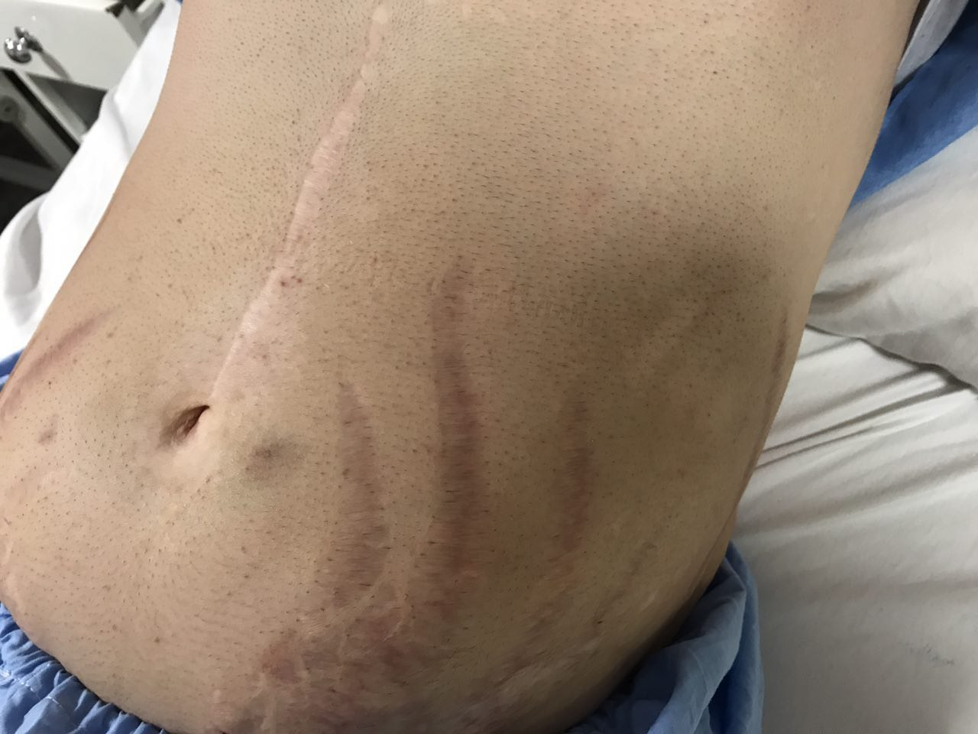

Slide 32
problem list: hypothyroidism FSGS DM HTNcrisis,Palpitation,dizziness, Headaches steria in abdomen,vitiligo ,bilateral adrenal mass high urine metanephrine

