Slide 1
IN THE NAME OF GOD
The management of type 1 diabetes in adults
A consensus report
By the American Diabetes Association (ADA) and
the European Association for the Study of Diabetes (EASD)
Presentation By Dr. Ali Golshaian
17th ABAN 1400

Slide 2
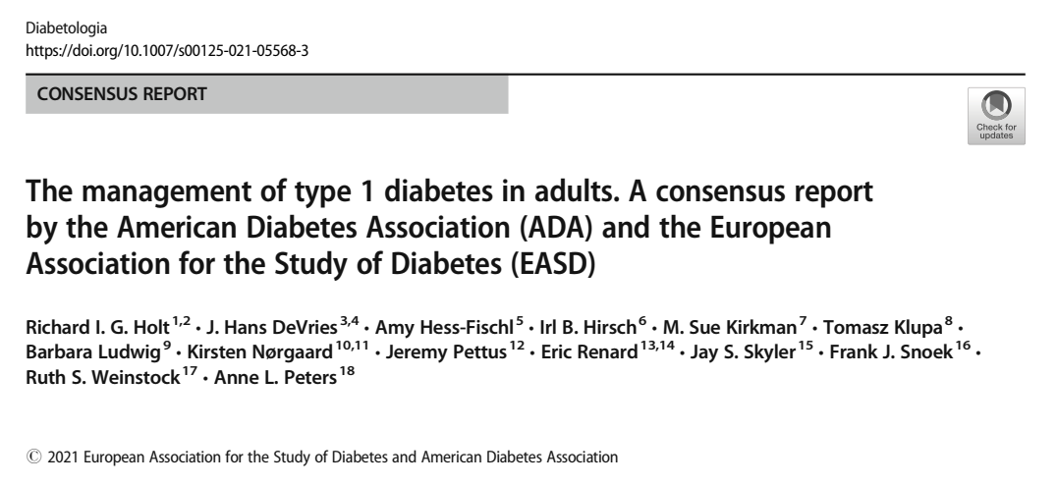
Published: 30 September 2021

Slide 3
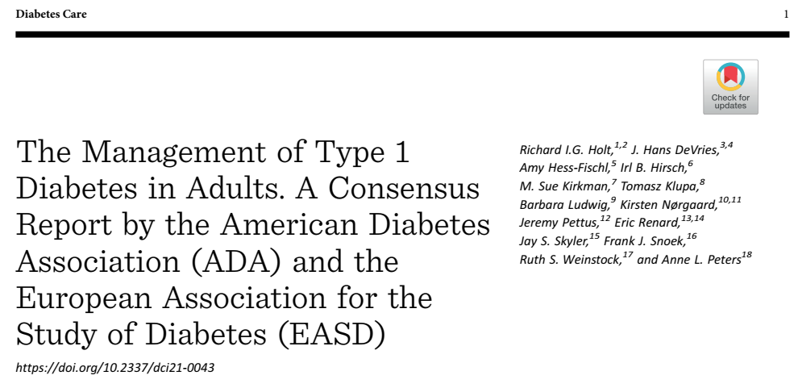

Slide 4
Agenda
Introduction and rationale for the consensus report
Diagnosis of type 1 diabetes
Aims and goals of management of type 1 diabetes
Schedule of care
Diabetes self-management education and support
Monitoring of glucose levels
Insulin therapy
Hypoglycaemia
Additional behavioural considerations
Psychosocial care

Slide 5
Agenda
Diabetic ketoacidosis
Pancreas and islet transplantation
Adjunctive therapies
Special populations
Inpatient management of type 1 diabetes
Emergent and future perspectives
Conclusion

Slide 6
Section 1: Introduction and rationale for the consensus report
Type 1 diabetes is a condition caused by autoimmune damage of the insulin-producing beta cells of the pancreatic islets
Type 1 diabetes accounts for approximately 5–10% of all cases of diabetes
The global prevalence of type 1 diabetes is 5.9 per 10,000 people, while the incidence has risen rapidly over the last 50 years and is currently estimated to be 15 per 100,000 people per year.
(2020) Prevalence and incidence of type 1 diabetes in the world: a systematic review and meta-analysis Health Promot Perspect 10(2):98–115

Slide 7
Prior to the discovery of insulin a century ago, type 1 diabetes was associated with a life expectancy as short as a few months.
In 1922, relatively crude extracts of exogenous insulin, derived from animal pancreases.
In the 1980s, semi-synthetic and recombinant human insulins were developed and in the mid 1990s, insulin analogues became available.
(2020) The evolution of insulin and how it informs therapy and treatment choices. Endocr Rev 41(5):733–755

Slide 8
The discovery of insulin transformed the lives of many people, but still type 1 diabetes is associated with the development of long-term complications and shortened life expectancy.
Recognising the ongoing challenge of type 1 diabetes and the rapid development of new treatments and technologies, the European Association for the Study of Diabetes (EASD) and the American Diabetes Association (ADA) convened a writing group to develop a consensus report on the management of type1diabetes in adults.
Aimed to highlight the major areas of care that healthcare professionals should consider

Slide 9
The importance of diabetes self-management education and support (DSMES) and psychosocial care are rightly documented in the report.
Large areas of clinical practice in type 1 diabetes are based on expert opinion and cohort studies rather than RCTs and so the writing group considered both observational and clinical trial findings, rather than relying solely on unbiased RCTs and meta-analyses.
The report represents the consensus opinion of the authors, given that the available evidence is incomplete.

Slide 10
Section 2: Diagnosis of type 1 diabetes
Adults with new-onset type 1 diabetes can present more slowly evolving process, can be mistaken for type 2 diabetes.
Several other types of diabetes, for example monogenic diabetes, can be misdiagnosed as type 1 diabetes.
In older adults, pancreatic cancer may present with
diabetes and weight loss.
A new and emerging issue is the development of profound insulin deficiency associated with the use of immune check-point inhibitors, which may present with hyperglycaemia and diabetic ketoacidosis (DKA). ¹
1= (2018) Collateral damage: insulin-dependent diabetes induced with checkpoint inhibitors. Diabetes. 67(8):1471–1480

Slide 11
Accurate classification of the type of diabetes has implications beyond the use of insulin treatment; education, insulin regimen, use of adjuvant therapies, access to newer technologies, need for psychosocial support.
Furthermore, accurate diagnosis allows an assessment of the risk of diabetes in first-degree relatives and appropriate counseling.

Slide 12
Differentiating type 1 diabetes from type 2 diabetes
Misclassification of type 1 diabetes in adults is common and over 40% of those developing type 1 diabetes after age 30 years are initially treated as type 2 diabetes. ¹
The most discriminative feature is
younger age at diagnosis (<35 years),
lower BMI (<25 kg/m),
unintentional weight loss,
Ketoacidosis
glucose (>360 mg/dl) at presentation. ²
1= (2019) Type 1 diabetes defined by severe insulin deficiency occurs after 30 years of age and is commonly treated as type 2 diabetes. Diabetologia. 62(7): 1167–1172
2= (2015) Can clinical features be used to differentiate type 1 from type 2 diabetes? A systematic review of the literature. BMJ Open 5(11):e009088

Slide 13
There is the very strong relationship between type 2 diabetes incidence and age. ¹
Rapid progression to insulin treatment (<3 years) is strongly suggestive of type 1 diabetes at any age. ²
1= (2018) Frequency and phenotype of type 1 diabetes in the first six decades of life: a cross-sectional, genetically stratified survival analysis from UK Biobank. Lancet Diabetes Endocrinol 6(2):122–129
2= (2016) Practical classification guidelines for diabetes in patients treated with insulin: a cross-sectional study of the accuracy of diabetes diagnosis. Br J Gen Pract 66(646):e315–e322

Slide 14
Differentiating type 1 diabetes from monogenic diabetes
Monogenic diabetes is found in approximately 4% of those diagnosed with diabetes before the age of 30 years.
The likelihood of monogenic diabetes rises to 20% where islet antibodies are negative and C-peptide secretion is maintained.
A diagnosis of monogenic diabetes allows specific treatment with discontinuation of insulin in many cases and has implications for screening family members.
1= (2017) Populationbased assessment of a biomarker-based screening pathway to aid diagnosis of monogenic diabetes in young-onset patients. Diabetes Care 40(8):1017–1025
2= (2018) ISPAD clinical practice consensus guidelines 2018: the diagnosis and management of monogenic diabetes in children and adolescents. Pediatr Diabetes 19(S27):47–63

Slide 15
Investigation of an adult with suspected type 1 diabetes
GAD should be the primary antibody measured and, if negative, should be followed by islet tyrosine phosphatase 2 (IA2) and/or zinc transporter 8 (ZNT8) where these tests are available.
Islet cell antibody (ICA) measurement is no longer recommended.
In people with clinical features suggesting type 1 diabetes, the presence of one or more positive islet autoantibodies is highly predictive of rapid progression and severe insulin deficiency.

Slide 16
C-peptide measurement Beyond 3 years after diagnosis where there is uncertainty about diabetes type, (with concurrent glucose) within 5 h of eating is recommended.
Persistent C-peptide >600 pmol/l (non-fasting) is strongly suggestive of type 2 diabetes and people with C-peptide in this range are often able to replace insulin with other agents.
Routine C-peptide testing in those with clinically diagnosed type 1 DM of at least 3 years duration has led to reclassification in 11% of those with adult-onset DM. ¹
(2015) The effect of early, comprehensive genomic testing on clinical care in neonatal diabetes: an international cohort study. Lancet. 386(9997):957–963

Slide 17
Monogenic diabetes should be considered in those with one or more of the following features:
Age at diagnosis of less than 35 years
HbA1c < 7.5% at diagnosis
One parent with diabetes
Features of specific monogenic cause (e.g. renal cysts, partial lipodystrophy, maternally inherited deafness, severe insulin resistance in the absence of obesity)
Molecular genetic testing should only be considered if the antibodies are negative and non-fasting C-peptide is >200 pmol/l .
(2020) Absence of islet autoantibodies and modestly raised glucose values at diabetes
diagnosis should lead to testing for MODY: lessons from a 5- year pediatric Swedish National Cohort Study. Diabetes Care 43(1):82–89

Slide 18
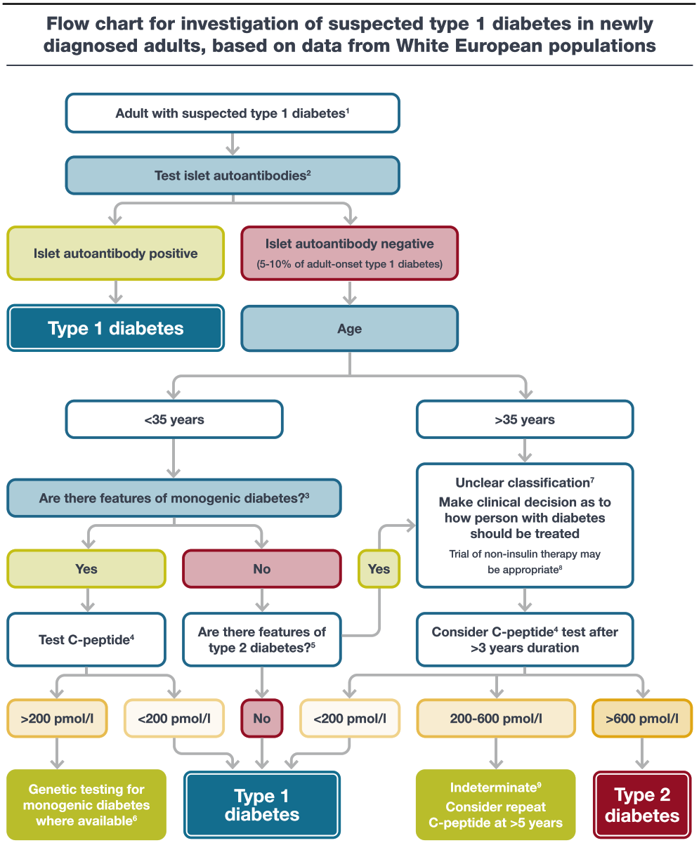

Slide 19
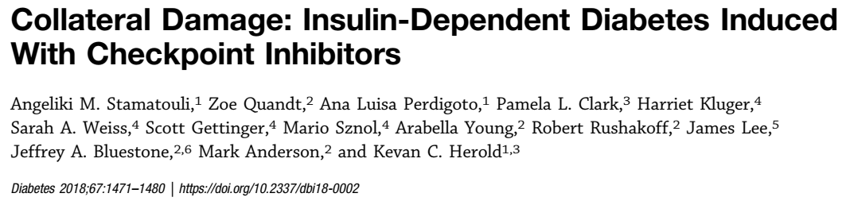
Insulin deficiency associated with the use of immune check-point inhibitors:
Insulin-dependent diabetes may occur in patients with cancers who are treated with checkpoint inhibitors (CPIs). Authors reviewed cases occurring over a 6-year period at two academic institutions and identified 27 patients in whom this developed, or an incidence of 0.9%.
(2018) Collateral damage: insulin-dependent diabetes induced with checkpoint inhibitors. Diabetes. 67(8):1471–1480

Slide 20
Monoclonal antibodies (mAbs) that block immune inhibitory ligands CTLA-4 and PD-1, known as immune checkpoint inhibitors (CPIs), have revolutionized the treatment of cancers that are resistant to conventional cancer therapies.
As a result, life expectancy of patients with malignancies such as melanoma, lung cancer, renal cell carcinoma, and several other cancers has significantly improved.
(2018) Collateral damage: insulin-dependent diabetes induced with checkpoint inhibitors. Diabetes. 67(8):1471–1480

Slide 21
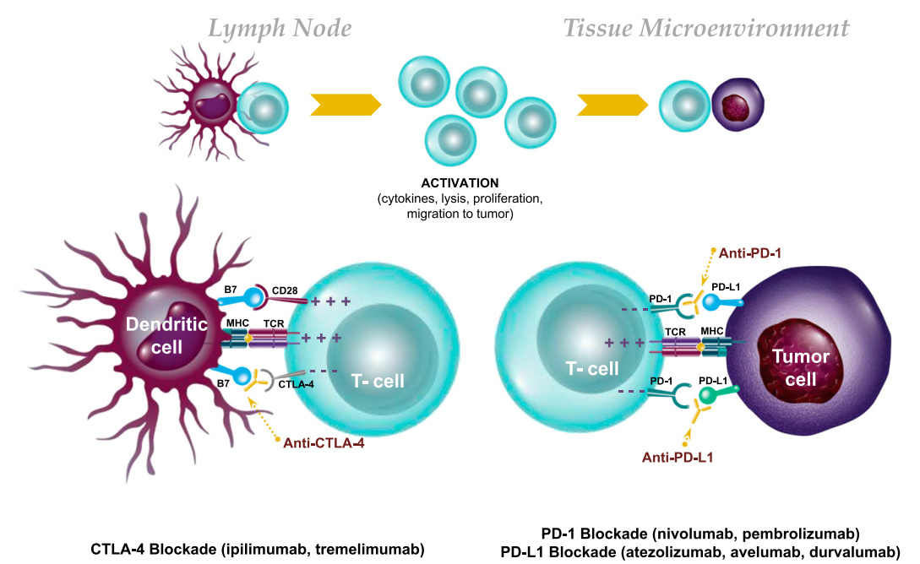
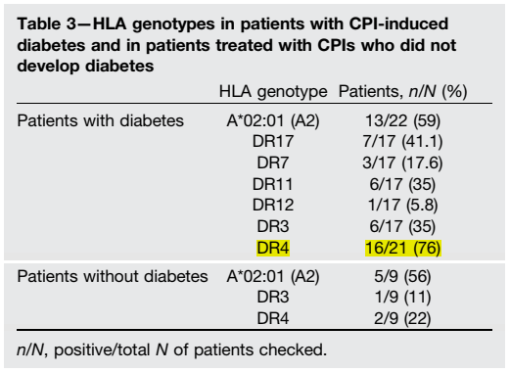
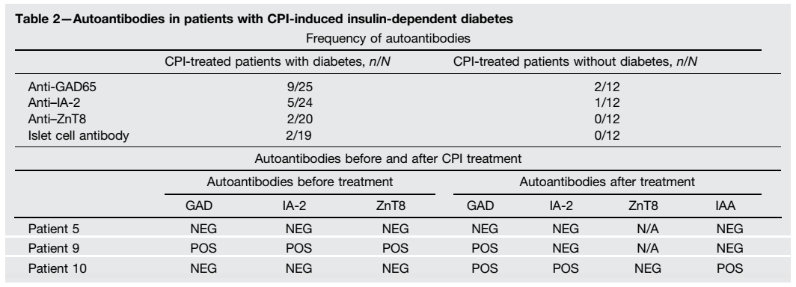
(2018) Collateral damage: insulin-dependent diabetes induced with checkpoint inhibitors. Diabetes. 67(8):1471–1480

Slide 22
Section 3: Aims and goals of management of type 1 diabetes
The aim of diabetes care and management is to support people with type 1 diabetes to live a long and healthy life.
With the use of intensive insulin therapy aimed to achieve blood glucose levels close to the non-DM range:
HbA1c ~7.0%
↓ 2% vs. standard care (HbA1c ~9.0%):
The risk of primary development of retinopathy ↓75%
Progression of retinopathy ↓ 54%
The development of microalbuminuria ↓ 39%
Clinical neuropathy by 60% ↓
The Diabetes Control and Complications Trial (DCCT)/ Epidemiology of Diabetes Interventions and Complications (EDIC) Study Research Group (2016) Intensive diabetes treatment and cardiovascular outcomes in type 1 diabetes: the DCCT/EDIC study 30-year follow-up. Diabetes Care 39(5): 686–693

Slide 23
Reductions in incident cardiovascular disease and mortality in the intensively-treated group emerged with time.
Achievement of lower HbA1c levels than the goal of (7%) may be acceptable, and even beneficial,
Less-stringent HbA1c goals (<8.0%) may be appropriate for individuals with limited life expectancy or where the harms of treatment are greater.
The Diabetes Control and Complications Trial (DCCT)/ Epidemiology of Diabetes Interventions and Complications (EDIC) Study Research Group (2016) Intensive diabetes treatment and cardiovascular outcomes in type 1 diabetes: the DCCT/EDIC study 30-year follow-up. Diabetes Care 39(5): 686–693

Slide 24
With newer glucose monitoring technologies, although the evidence of HbA1c reduction remains the most robust measure
More recent studies have begun to examine the relationship between time that glucose is within the target range and long-term complications and have provided the basis for glycaemic targets.
TIR is associated with microvascular complications.
(2019) Validation of time in range as an outcome measure for diabetes clinical trials. Diabetes Care 42(3):400–405

Slide 25
Further measurements that complement HbA1c and BGM are assessments of the glucose management indicator (GMI) and time in range (TIR) from continuous glucose monitoring (CGM) data.
GMI is calculated based on the average sensor glucose over the last 14 days, ~ HbA1C.
GMI and TIR may be more useful than HbA1c:
Reflecting more recent blood glucose levels
Providing more detailed clinical information.

Slide 26
A typical GMI goal = <7.0%
TIR : 70–180 mg/dl
Time below range (TBR) : <70 mg/dl (risk alert level)
<54 mg/dl (clinically significant)
Target TIR should be above 70%, with TBR less than 4% and less than 1% for clinically significant hypoglycaemia. (The primary target for older people with a long duration of diabetes should be TBR less than 1%).
(2019) Clinical targets for continuous glucose monitoring data interpretation: recommendations from the international consensus on time in range.
Diabetes Care 42(8):1593–1603.

Slide 27
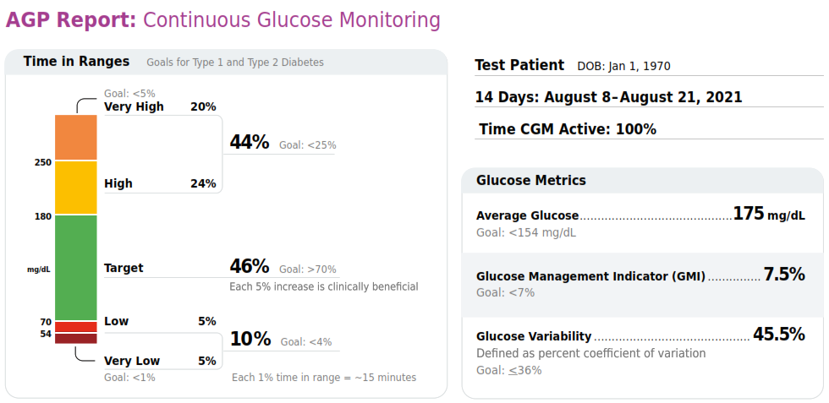
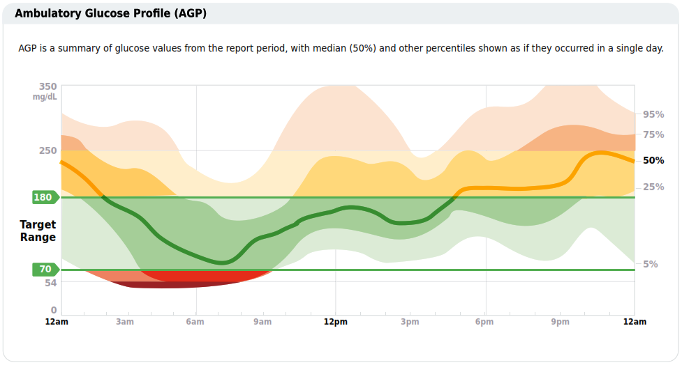

Slide 28
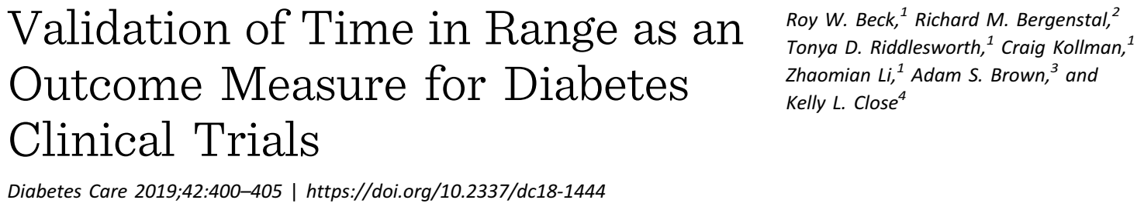
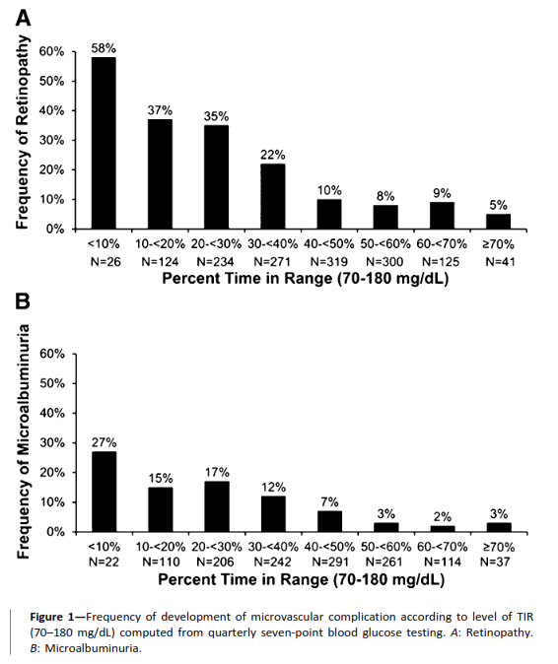
Mean TIR of seven-point proﬁles for the 1,440 participants was 41±16%. The hazard rate of development of retinopathy progression was increased by 64% (95% CI 51–78), and development of the microalbuminuria outcome was increased by 40% (95% CI 25–56), for each 10 percentage points lower TIR (P < 0.001 for each).
(2019) Validation of time in range as an outcome measure for diabetes clinical trials. Diabetes Care 42(3):400–405

Slide 29
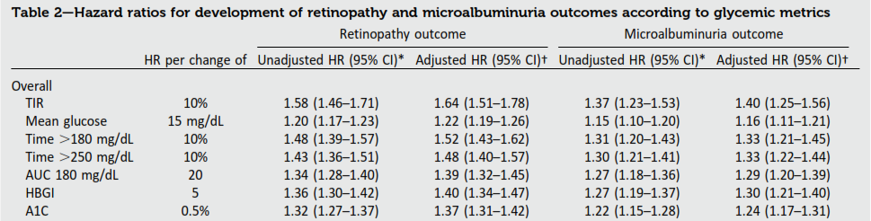
Using the DCCT data set, study has demonstrated that TIR of 70–180 mg/dL, has a strong association with the risk of development or progression of retinopathy and development of microalbuminuria.
The ﬁndings, which parallel the DCCT A1C results.
An increase in TIR of 10% (2.4 h /day) corresponded to a decrease in A1C of approximately 0.5% (5.0 mmol/mol).
(2019) Validation of time in range as an outcome measure for diabetes clinical trials. Diabetes Care 42(3):400–405

Slide 30
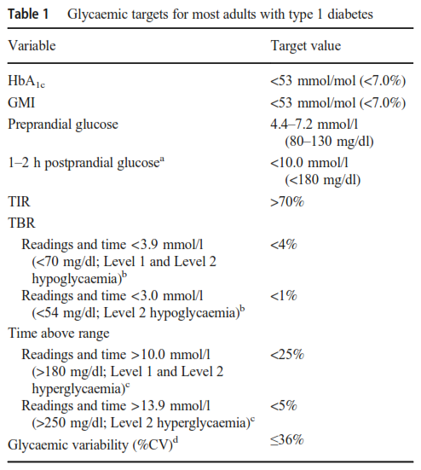

Slide 31
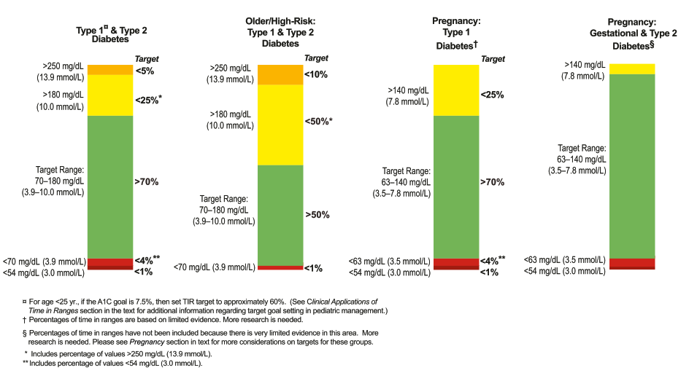
Goal Setting: Numerous studies have demonstrated the clinical beneﬁts of early achievement of near-normal glycemic control in individuals with type 1 diabetes and type 2 diabetes.
(2019) Clinical targets for continuous glucose monitoring data interpretation: recommendations from the international consensus on time in range. Diabetes Care 42(8):1593–1603

Slide 32
HbA1c:
Reflects blood glucose concentrations over 3–4 months
Conditions that affect red blood cell life span
Hypoglycaemia, glycemic variability, Daily pattern of BG
It is the only metric of glycemic control that has been strongly associated with chronic diabetic vascular complications
Well known, Available
GMI (%) = 3.31 + 0.02392 × mean glucose in mg/dL
(2018) Glucose Management Indicator (GMI): A New Term for Estimating A1C From Continuous Glucose Monitoring Diabetes Care:41:2275–2280
(2019) The Relationships Between Time in Range, Hyperglycemia Metrics, and HbA1c. Journal of Diabetes Science and Technology, Vol. 13(4) 614–626
(2017) The Fallacy of Average: How Using HbA1c Alone to Assess Glycemic Control Can Be Misleading Diabetes Care:40:994–999

Slide 33
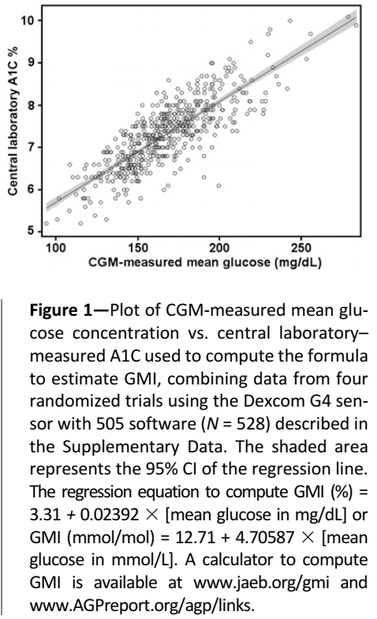
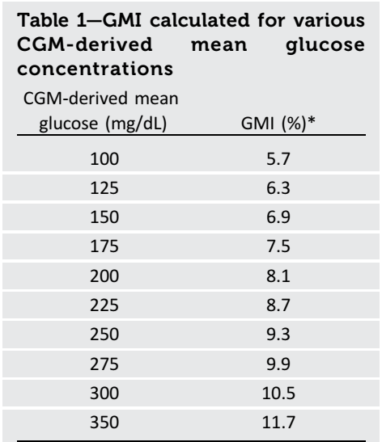
“Estimated” or “A1C”
“Index”
“Glucose control indicator” or
“Glucose management indicator”
(2018) Glucose Management Indicator (GMI): A New Term for Estimating A1C From Continuous Glucose Monitoring Diabetes Care:41:2275–2280

Slide 34
An increase in TIR70-180 or a decrease in T>180 of 10% (corresponding to 2.4 hours per day) is associated with a reduction in A1C of about 0.6%
With baseline A1C ≥8.0%, for example, a 10%
increase in TIR was associated on average with a change in
A1C of approximately -1% whereas for subjects with a
baseline A1C of 7.0-7.9%, a 10% increase in TIR was associated on average with a change in A1C of only -0.4%
Without diabetes: TIR70-180 was 99% (IQR 97% to 99%), median TIR70-140 was 95% (IQR 92% to 97%) and median mean glucose concentration was 99 mg/dL (IQR 95 to 105)
(2019) The Relationships Between Time in Range, Hyperglycemia Metrics, and HbA1c. Journal of Diabetes Science and Technology, Vol. 13(4) 614–626

Slide 35
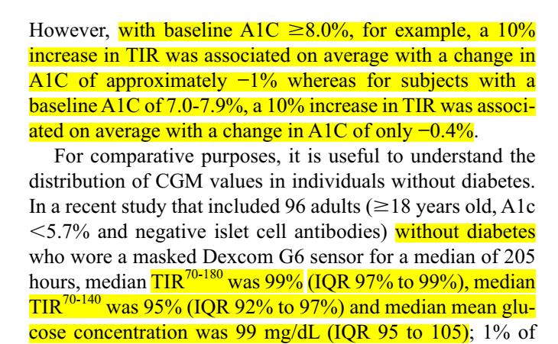
An increase in TIR70-180 or a decrease in T>180 of 10% (corresponding to 2.4 hours per day) is associated with a reduction in A1C of about 0.6%
With baseline A1C ≥8.0%, for example, a 10%
increase in TIR was associated on average with a change in
A1C of approximately -1% whereas for subjects with a
baseline A1C of 7.0-7.9%, a 10% increase in TIR was associated on average with a change in A1C of only -0.4%
Without diabetes: TIR70-180 was 99% (IQR 97% to 99%), median TIR70-140 was 95% (IQR 92% to 97%) and median mean glucose concentration was 99 mg/dL (IQR 95 to 105)
(2019) The Relationships Between Time in Range, Hyperglycemia Metrics, and HbA1c. Journal of Diabetes Science and Technology, Vol. 13(4) 614–626

Slide 36
To more clearly demonstrate the relationship between Time-in Range and HbA1c
Selected paired HbA1c and %TIR data from 18 articles were evaluated by linear regression analysis and Pearson’s correlation coefficient
Diabetes Technol Ther 2019;21:81–85

Slide 38
For every absolute 10% change in %TIR, there was a 0.8% change in HbA1c

Slide 39
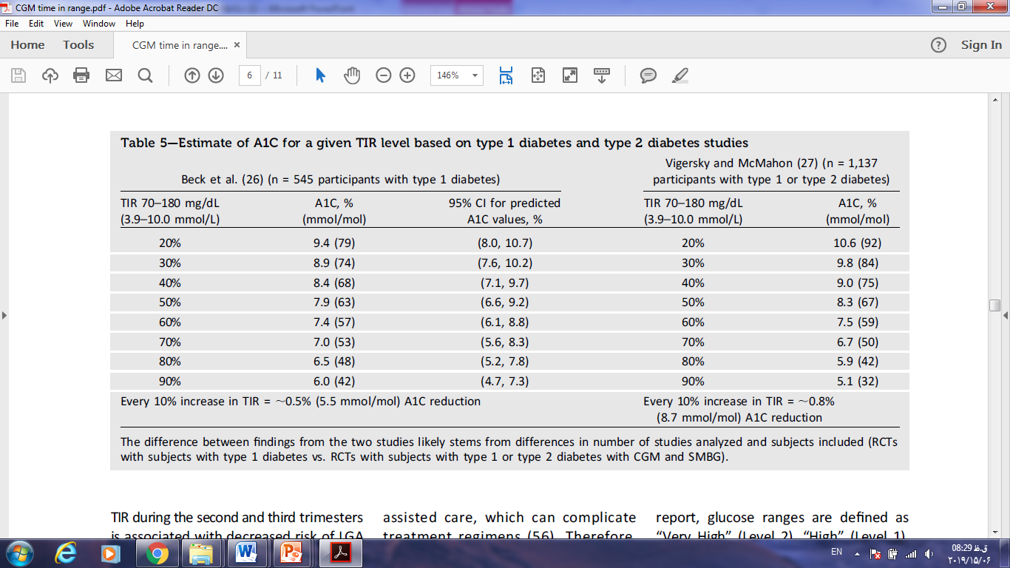
Estimate of HbA1C for a given TIR level based on type 1 diabetes and type 2 diabetes studies
Diabetes Care 2019 Aug; 42(8): 1593-1603

Slide 40
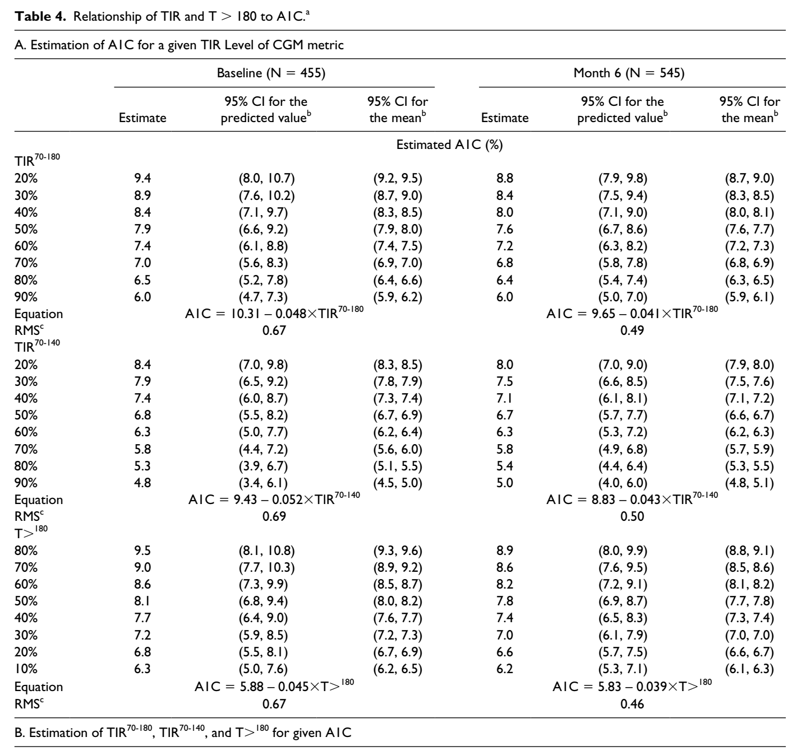
(2019) The Relationships Between Time in Range, Hyperglycemia Metrics, and HbA1c. Journal of Diabetes Science and Technology, Vol. 13(4) 614–626

Slide 41
A rationale that has been championed for why A1C should remain the gold standard for assessing glycemic control is that A1C is the only metric that has been associated with chronic diabetic complications.
Nevertheless, A1C remains a valuable metric for assessing glycemic control. It can be measured easily with precision and does not require the wearing of a device
As use of CGM becomes more widespread, and as progressively more data become available confirming that TIR correlates with long-term diabetes complications, we expect that we may reach a point in the future where A1C adds little to the wealth of information available from CGM to make diabetes management decisions.

Slide 42
The prevention of long-term complications of diabetes, particularly cardiovascular disease, extends beyond glycaemic management.
Blood pressure targets should be <140/90 mmHg is appropriate for those with a lower risk for cardiovascular disease (10 year risk of <15%).
A lower target of <130/80 mmHg is recommended for those at higher cardiovascular disease risk or with evidence of microvascular complications, particularly renal disease.
ACE inhibitors or angiotensin receptor blockers are recommended first-line therapies.

Slide 43
There is a paucity of trials of lipid-lowering therapy in people with type 1 diabetes
An observational study reported that lipid-lowering therapy is associated with a 22–44% reduction in the risk of cardiovascular disease and death among individuals with type1 diabetes without a prior history of cardiovascular disease.
Hero C, Rawshani A, Svensson A-M et al (2016) Association between use of lipid-lowering therapy and cardiovascular diseasesand death in individuals with type 1 diabetes. Diabetes Care 39(6): 996–1003

Slide 44
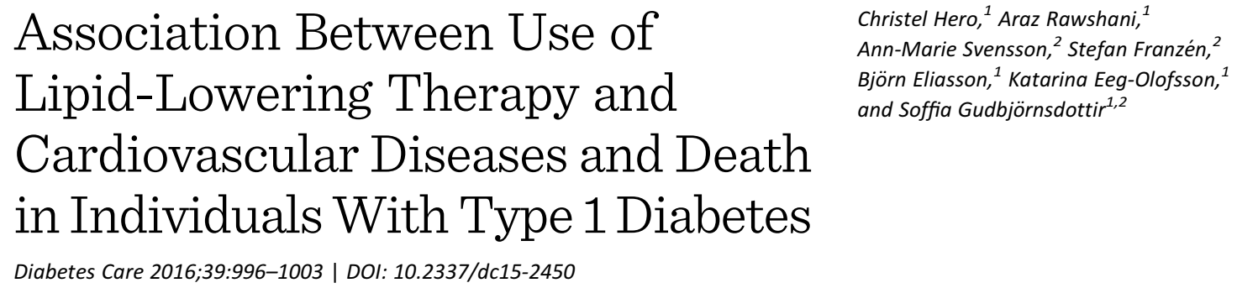
Propensity scores for treatment with LLT were calculated from 32 baseline clinical and socioeconomic variables.
A total of 24,230 individuals included, with type 1 diabetes, without a history of CVD were followed. The mean follow-up was 6.0 years
Hazard ratios (HRs) for treated versus untreated were as follows:
Cardiovascular death 0.60 (95% CI 0.50–0.72),
All-cause death 0.56 (0.48–0.64),
Fatal/nonfatal stroke 0.56 (0.46–0.70),
Fatal/nonfatal acute myocardial infarction 0.78 (0.66–0.92),
Fatal/nonfatal coronary heart disease 0.85 (0.74–0.97),
Fatal/nonfatal CVD 0.77 (0.69–0.87).
(2016) Association between use of lipid-lowering therapy and cardiovascular diseasesand death in individuals with type 1 diabetes. Diabetes Care 39(6): 996–1003

Slide 45
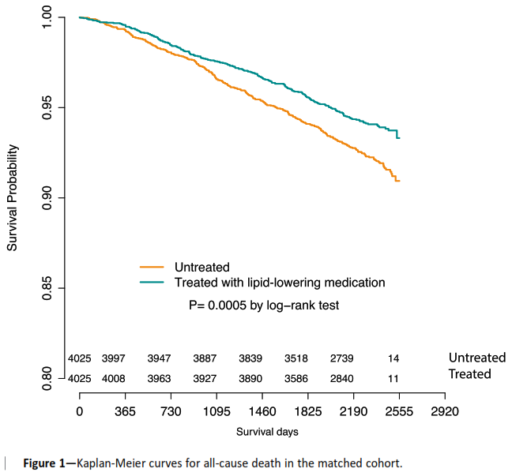
(2016) Association between use of lipid-lowering therapy and cardiovascular diseasesand death in individuals with type 1 diabetes. Diabetes Care 39(6): 996–1003

Slide 46
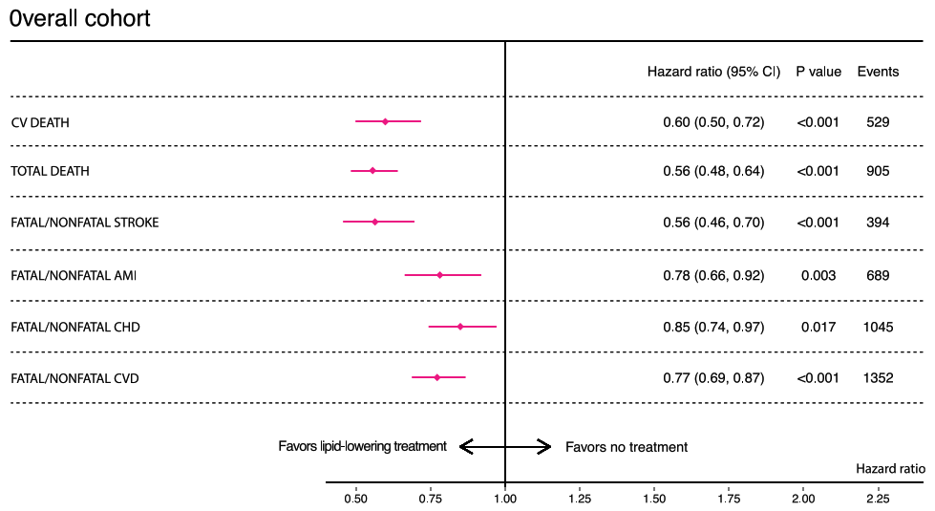
(2016) Association between use of lipid-lowering therapy and cardiovascular diseasesand death in individuals with type 1 diabetes. Diabetes Care 39(6): 996–1003

Slide 47
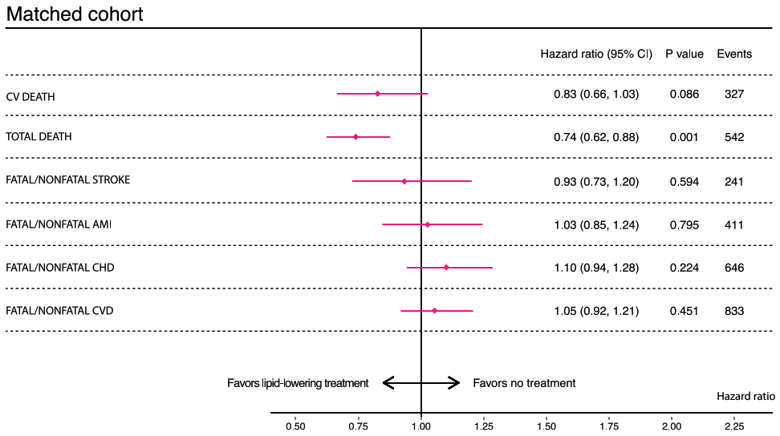
(2016) Association between use of lipid-lowering therapy and cardiovascular diseasesand death in individuals with type 1 diabetes. Diabetes Care 39(6): 996–1003

Slide 48
We believe this is due to exclusion of treated patients who were at the highest risk of events and would thus have had greatest beneﬁt from treatment.
Current guidelines for LLT in type 1 diabetes are based on randomized controlled trials in individuals with type 2 diabetes. Studies examining beneﬁt of statins in younger patients with type 1 diabetes are lacking.
The mean age of the individuals with treatment in the overall and the matched cohort was 50 and 48 years and diabetes duration 34 and 32 years, respectively, and perhaps we need to start to take preventive measures earlier to be able to prevent cardiovascular morbidity.
(2016) Association between use of lipid-lowering therapy and cardiovascular diseasesand death in individuals with type 1 diabetes. Diabetes Care 39(6): 996–1003

Slide 49
Antiplatelet agents, such as aspirin, should be considered for all people with type 1 diabetes and existing cardiovascular disease.
Antiplatelet agents may be indicated for primary prevention but the benefit should be balanced with the increased risk of gastrointestinal bleeding.
In asymptomatic people with type 1 diabetes, routine screening for coronary artery disease is not recommended.
Investigations for coronary artery disease should be considered if the person has any of the following: atypical cardiac symptoms, signs or symptoms of associated vascular disease or electrocardiogram abnormalities.

Slide 50
Section 4: Schedule of care
With the onset of the coronavirus disease-2019 (COVID19) pandemic, the use of telemedicine became a necessity and there was an abrupt widespread adoption of remote visits (videoconference/telephone call) to deliver diabetes care.
Pre COVID-19, results from a limited number of studies using telemedicine suggested that remote monitoring, education and provider visits have the potential to: improve outcomes, quality of life and self-management; increase access to care and reduce costs; and are well-accepted with improved treatment satisfaction.
(2020) Mapping the evidence on the effectiveness of telemedicine interventions in diabetes, dyslipidemia, and hypertension: an umbrella review of systematic reviews and meta-analyses. J Med Internet Res 22(3): e16791

Slide 51
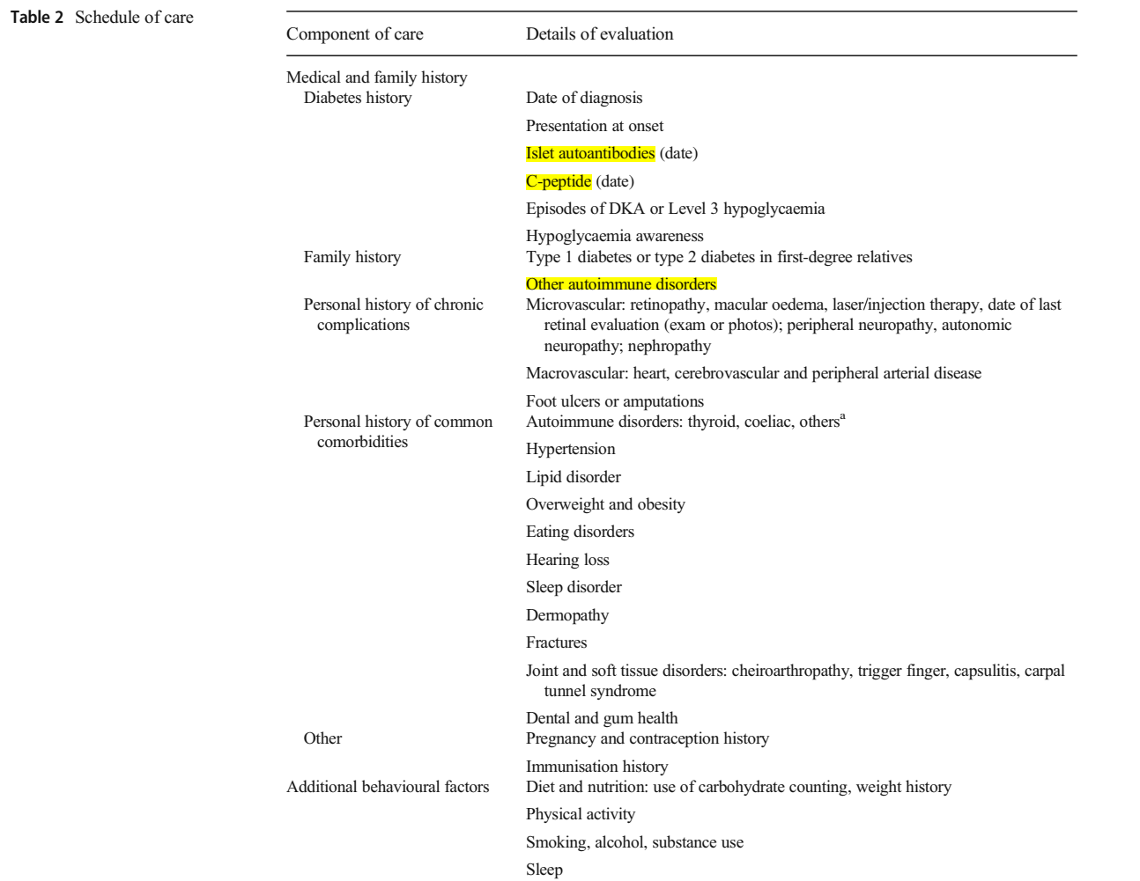

Slide 52
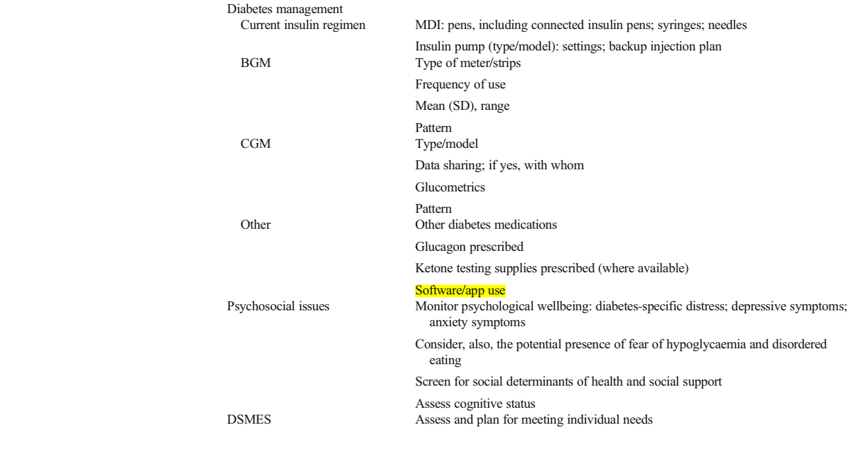

Slide 53
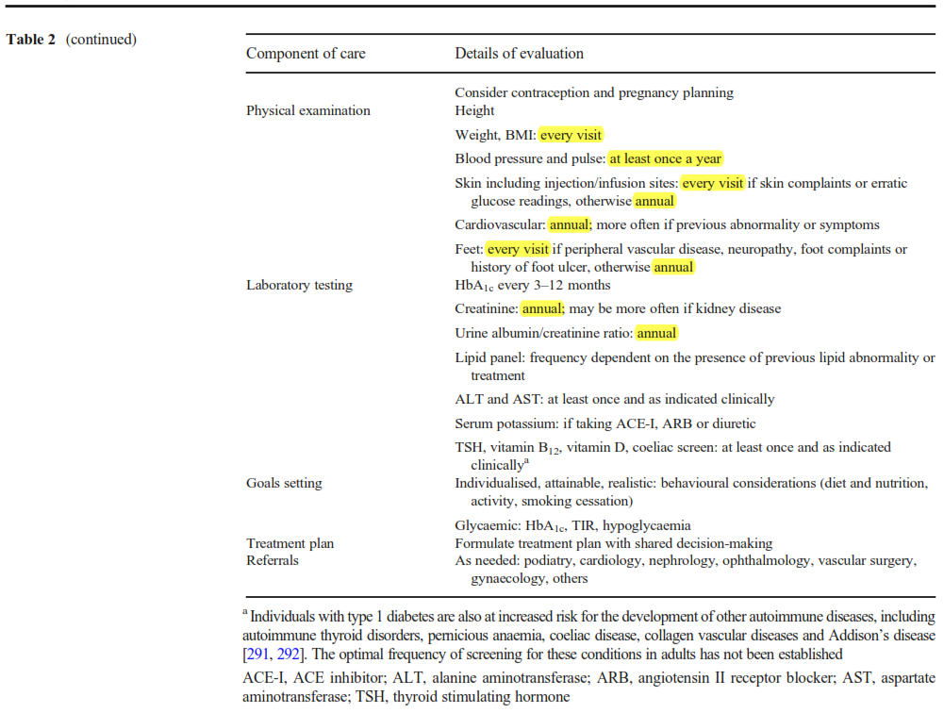

Slide 54
Section 5: Diabetes self-management education and support
DSMES is an essential component of type 1 diabetes, reduces the risks of acute and long-term complications while maintaining quality of life.
Three levels of DSMES can be distinguished:
Comprises provision of diabetes information and one-to-one advice.
Refers to ongoing learning that may be informal, perhaps through a peer group.
Refers to structured education that meets nationally agreed criteria, including an evidence-based curriculum, quality assurance of teaching standards and regular audit.
(2017) 2017 national standards for diabetes self-management education and support. Diabetes Care 40(10):1409–1419

Slide 55
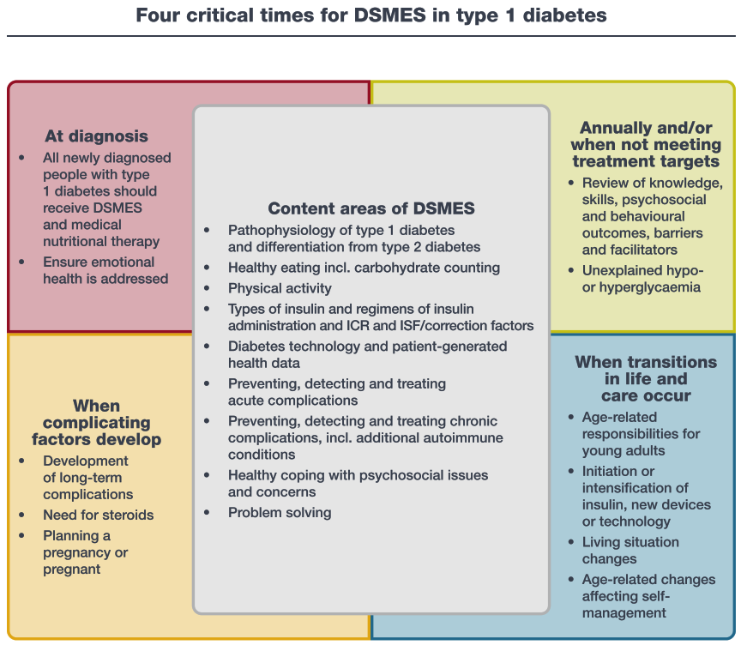
(2020) Diabetes selfmanagement education and support in adults with type 2 diabetes: a consensus report of the American Diabetes Association, the Association of Diabetes Care & Education Specialists, the Academy of Nutrition and Dietetics, the American Academy of Family Physicians, the American Academy of PAs, the American Association of Nurse Practitioners, and the American Pharmacists Association. Diabetes Care 43(7):1636–1649

Slide 56
Section 6: Monitoring of glucose levels
People with type 1 diabetes should have an assessment of their glucose levels with their healthcare professional as often as is clinically indicated, but at least annually.
Glycaemic status should be assessed at least every 3 months in those whose therapy has changed or who are not meeting glycaemic goals.

Slide 57
HbA1c
There is a strong correlation (r =>0.9) between HbA1c and mean blood glucose levels during the preceding 3 months. ¹
In several conditions, however, HbA1c does not reflect mean glucose. these are mainly situations where erythrocyte turnover is altered or in the presence of haemoglobinopathies. ²
1= (2008) Translating the A1C assay into estimated average glucose values. Diabetes Care 31(8): 1473–1478
2= (2014) Pitfalls in hemoglobin A1c measurement: when results may be misleading. J Gen Intern Med 29(2):388–394.

Slide 58
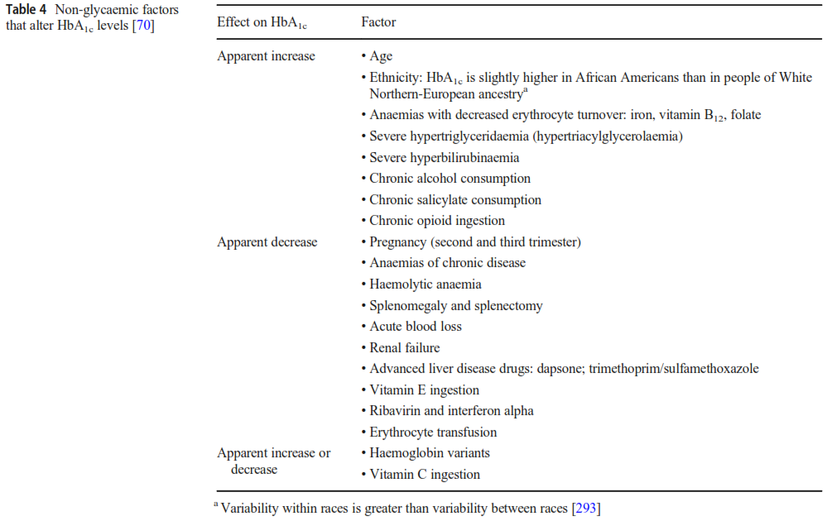
(2019) Update on biomarkers of glycemic control. World J Diabetes 10(1):1–15.

Slide 59
Although HbA1c is an indicator of mean glucose, it does not inform glycaemic variability and hypoglycaemia. ¹
Other biomarkers, fructosamine, 1,5-anhydroglucitol and glycated albumin, provide measures of mean glucose, with shorter durations than HbA1c. None of these are as well associated with diabetes complications as HbA1c. ²
1= (2019) The relationships between time in range, hyperglycemia metrics, and HbA1c. J Diabetes Sci Technol 13(4):614–626
2= (2019) Update on biomarkers of glycemic control. World J Diabetes 10(1):1–15.

Slide 60
Capillary blood glucose monitoring
Increased testing frequency is associated with lower HbA1c. ¹
Not feasible and can be distressing.
1= (2013) Evidence of a strong association between frequency of self-monitoring of blood glucose and hemoglobin A1c levels in T1D exchange clinic registry participants. Diabetes Care 36(7):2009–2014

Slide 61
Continuous glucose monitoring
CGM is the standard for glucose monitoring for most adults with type 1 diabetes:
real-time CGM (rt-CGM)
intermittently scanned CGM (is-CGM)
Switching from is-CGM without alarms to rt-CGM improved TIR and HbA1c and reduced Level 3 hypoglycaemia.
(2021) Comparing realtime and intermittently scanned continuous glucose monitoring in
adults with type 1 diabetes (ALERTT1): a 6-month, prospective, multicentre, randomised controlled trial. Lancet. 397(10291):2275–2283

Slide 62
In the near future, these sensors will increasingly connect to other devices, including connected insulin pens. All currently available devices can be uploaded to an internet cloud.
Disadvantages:
‘Attached to a device’
Alarm fatigue.
Cost
Contact dermatitis (both irritant and allergic)

Slide 63
Ketone measurement
Modern technology allows the rapid and accurate measurement of ketones from a finger prick blood sample using a strip and meter.
Measurement of blood ketones (β-hydroxybutyrate) provides a more accurate assessment of adequate treatment.

Slide 64
Section 7: Insulin therapy
The ideal regimen of insulin replacement maintains blood glucose in the normal physiological range.
MDI of subcutaneous basal insulin analogues and mealtime rapid-acting or ultra-rapid-acting insulin analogues
Continuous subcutaneous insulin infusion of a rapid-acting insulin analogue via a pump, delivered as continuous basal insulin combined with manual mealtime boluses.

Slide 65
Ultra-rapid analogues reduce postprandial hyperglycaemia but have not been shown to reduce HbA1c or hypoglycaemia to a greater extent than rapid-acting analogues. ¹
HbA1c, TIR, and TBR are improved further when physiological MDI or pump regimens are augmented with CGM Usage,
With the greatest benefits seen with algorithm driven automated basal (and in some systems correction) insulin delivery, which is commonly called hybrid closed-loop therapy. ²
Disadvantages:
The costs of insulin analogues and CGM or pump therapy.
1= (2020) The evolution of insulin and how it informs therapy and treatment choices. Endocr Rev 41(5):733–755
2= (2019) Six-month randomized, multicenter trial of closed-loop control in type 1 diabetes. N Engl J Med 381(18):1707–1717

Slide 66
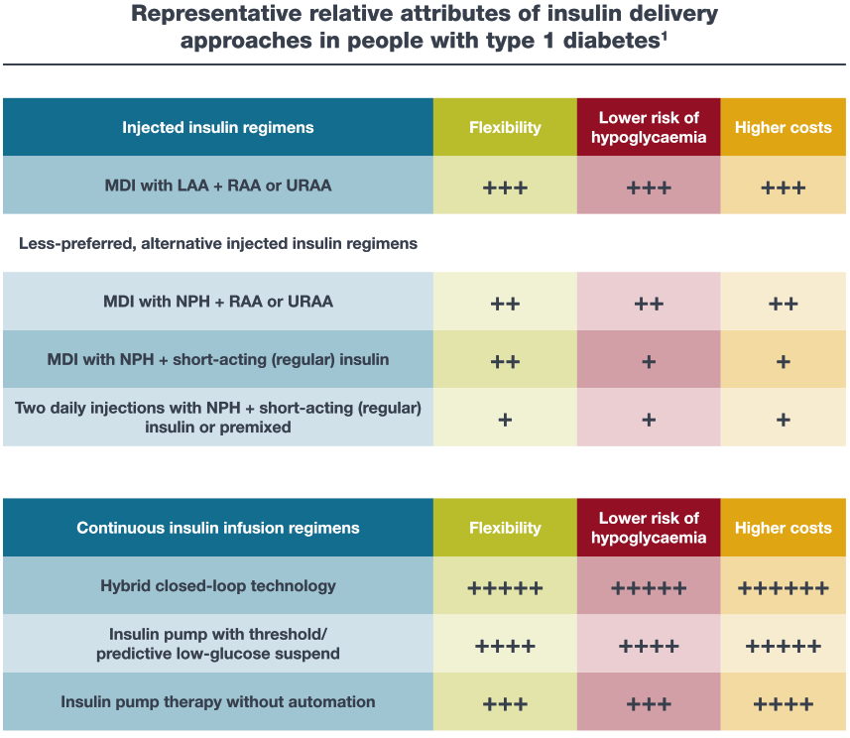

Slide 67
Mode of delivery
Hybrid closed loop systems are the most effective means.¹
Smaller gauge and shorter needles provide almost painless injections.
Needles as short as 4 mm, injected at a 90° angle, enter the subcutaneous space with minimal risk of intramuscular injection in most adults. ²
1= (2019) Six-month randomized, multicenter trial of closed-loop control in type 1 diabetes. N Engl J Med 381(18):1707–1717
2= (2010) Skin and subcutaneous adipose layer thickness in adults with diabetes at sites used for insulin injections: implications for needle length recommendations. Curr Med Res Opin 26(6):1519–1530

Slide 68
Fully closed-loop automated insulin delivery systems are currently being evaluated in clinical trials being conducted by several collaborative groups in both North America and Europe.
Bi-hormonal (insulin and glucagon) automated insulin delivery systems are under investigation and could also contribute to the optimisation of glucose management.

Slide 69
Adverse effects
Hypoglycaemia
Body weight gain
Lipoatrophy (has become rare)
Lipohypertrophy is common and typically occurs when the same sites are repeatedly used, leads to glycaemic variability, leading to both hyper- and hypoglycaemia. ¹
1= (2016) Insulin injection into lipohypertrophic tissue: blunted and more variable insulin absorption and action and impaired postprandial glucose control. Diabetes Care 39(9):1486–1492

Slide 70
Alternative routes of administration
Inhaled human insulin
Very rapid onset of action and short duration
Less control of later postprandial hyperglycaemia
Must be monitored with periodic spirometry ¹
Peritoneal delivery with implantable insulin pumps
Reduces HbA1c, glycaemic variability and hypoglycaemia
Insulin aggregation, local infections and catheter occlusions
Increased production of anti-insulin antibodies ²
1= (2020) Comprehensive pulmonary safety review of inhaled Technosphere® insulin in patients with diabetes mellitus. Clin Drug Investig 40(10):973–983
2= (2014) Systematic review: continuous intraperitoneal insulin infusion with implantable insulin pumps for diabetes mellitus. Acta Diabetol 51(3):339–351

Slide 71
In long-term CIPII treated patients with high anti-insulin antibody level, this emphasizes the need for a less immunogenic insulin preparation. ¹
Even if CSII and CPII might promote the development of circulating IAs, this increase did not lead to immunological insulin resistance, compared to that previously described with animal non-purified insulin preparations and seemed to have only marginal influence on blood glucose control or complications in most diabetic patients ²
1= (1996) Insulin Kinetics in Type I Diabetic Patients Treated by Continuous Intraperitoneal Insulin Infusion: Influence of Anti-insulin Antibodies. Diabet. Med., 13:1051-1055.
2= (2018) Exogenous insulin antibody syndrome (EIAS): a clinical syndrome associated with insulin antibodies induced by exogenous insulin in diabetic patients. Endocr Connect. 2018;7(1):R47-R55

Slide 72
The main advantage of this route (intraperitoneal) is that it restores the physiological insulin gradient between the portal vein and the peripheral circulation.
An average two- to three-fold increase of circulating IAs detected by a radioimmuno-electrophoretic method has been reported after 6 to 84 months.
It appeared that only IP delivery was associated with an increase of IAs, suggesting that the route or the delivery mode rather than the insulin was immunogenic.
(2009) Circulating insulin antibodies: influence of continuous subcutaneous or intraperitoneal insulin infusion, and impact on glucose control. Diabetes Metab Res Rev. Sep;25(6):491-501

Slide 73
HOE 21 PH insulin formulation itself (although its SC infusion does not increase IA levels, as already mentioned)
Peritoneal route since the peritoneum is a macrophage-rich area, which may promote lymphocyte activation and antibody production.
Insulin aggregates formed in the pumping mechanism, which have been shown as strongly immunogenic.
HOE 21 PPR | Insuman Infusat | regular, for use in insulin infusion system, 100 % dissolved insulin | 100 IU/ml, vials 100 IU/ml, cartridges
(2009) Circulating insulin antibodies: influence of continuous subcutaneous or intraperitoneal insulin infusion, and impact on glucose control. Diabetes Metab Res Rev. Sep;25(6):491-501

Slide 74
Section 8: Hypoglycaemia
The main limiting factor in the glycaemic management
Level 1: 70 mg/dl > glucose value > 54 mg/dl: Alert value (most people with type 1 diabetes experiencing several episodes per week)
Level 2: 54 mg/dl > glucose value: Clinically important hypoglycaemia
Level 3 designates any hypoglycaemia characterised by altered mental state and/or physical status needing the intervention of a third party for recovery (12% of adults with type 1 diabetes over a 6 month)

Slide 75
Several studies have shown that rates of hypoglycaemia have not declined, even with more widespread use of insulin analogues and CGM, while other studies have shown benefit ¹ (2013)
Usage of rtCGM reduced the number of hypoglycaemic events in individuals with type 1 diabetes treated by MDI ² (2018)
Risks for hypoglycaemia, particularly Level 3: Longer duration of diabetes, older age, history of recent level 3 hypoglycaemia, alcohol ingestion, exercise, lower education levels, lower household incomes, chronic kidney disease and IAH
1= (2013) Severe hypoglycemia and diabetic ketoacidosis in adults with type 1 diabetes: results from the T1D Exchange clinic registry. J Clin Endocrinol Metab 98(8):3411–3419
2= (2018) Real-time continuous glucose monitoring in adults with type 1 diabetes and impaired hypoglycaemia awareness or severe hypoglycaemia treated with multiple daily insulin injections (HypoDE): a multicentre, randomised controlled trial. Lancet. 391(10128): 1367–1377

Slide 76
In the Type 1 Diabetes, the risk of Level 3
hypoglycaemia was increased not only in those whose HbA1c was below 7.0%, but also in people with an HbA1c above 7.5% ¹
The use of insulin analogue regimens are associated with less hypoglycaemia, while hybrid closed-loop systems result in both improvement in TIR and reduction in TBR ²
1= (2013) Severe hypoglycemia and diabetic ketoacidosis in adults with type 1 diabetes: results from the T1D Exchange clinic registry. J Clin Endocrinol Metab 98(8):3411–3419
2= (2019) Six-month randomized, multicenter trial of closed-loop control in type 1 diabetes. N Engl J Med 381(18):1707–1717

Slide 77
Mortality from hypoglycaemia in type 1 diabetes is not trivial; One recent trial noted more than 8% of deaths for those younger than 56 y were from hypoglycaemia ¹
What may not be as well recognised is that Level 3 hypoglycaemia is also associated with:
Major microvascular events
Non-cardiovascular disease
Death from any cause,
Much of this evidence is obtained from people with type 2 DM
1= (2017) Causes of death in childhood-onset type 1 diabetes: long-term follow-up. Diabet Med 34(1):56–63
2= (2019) Hypoglycaemia, cardiovascular disease, and mortality in diabetes: epidemiology, pathogenesis, and management. Lancet Diabetes Endocrinol 7(5):385–396

Slide 78
Cardiac arrhythmias have been reported to be induced by hypoglycaemia.
Emerging evidence suggests that the association between hypoglycaemia and cardiovascular events and mortality is likely to be multifactorial.
Hypoglycaemia is occurring more frequently in people with comorbidities who are also more likely to die than those without.
Independent of other risk factors and comorbidities, more episodes of severe hypoglycaemia were associated with greater decrements in psychomotor and mental efficiency that were most notable after 32 years of follow-up ¹
1= (2019) Hypoglycaemia, cardiovascular disease, and mortality in diabetes: epidemiology, pathogenesis, and management. Lancet Diabetes Endocrinol 7(5):385–396
2= (2021) Cognitive performance declines in older adults with type 1 diabetes: results from 32 years of follow-up in the DCCT and EDIC study. Lancet Diabetes Endocrinol 9(7):436–445

Slide 79
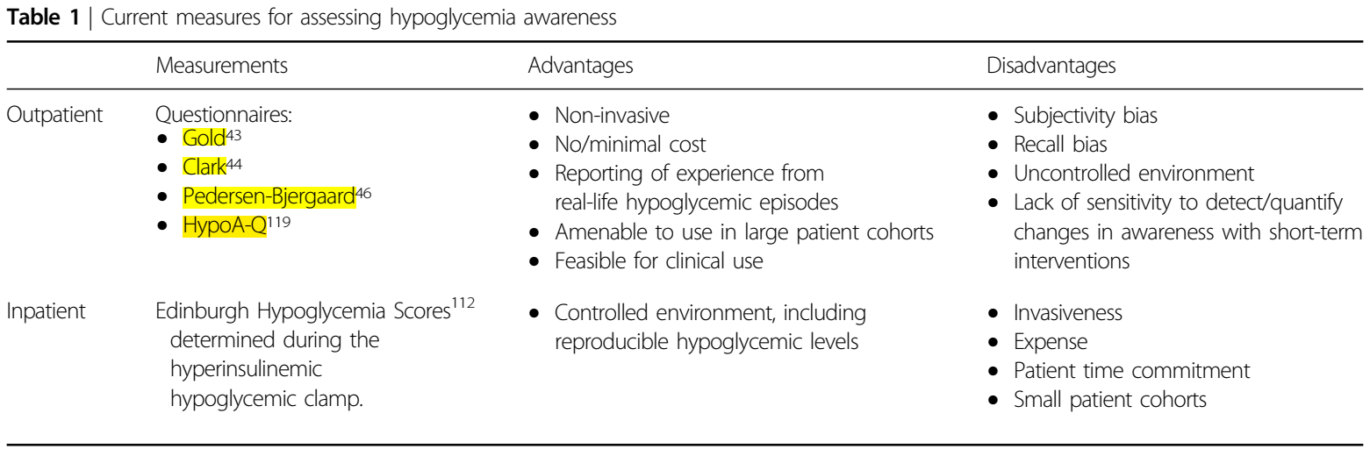
Impaired awareness of hypoglycemia (IAH)
IAH is a reduction in the ability to recognize low blood glucose levels
Identified in approximately 25% of patients with type 1 diabetes
IAH has complex pathophysiology, and might lead to serious and potentially lethal consequences in patients with diabetes, particularly in those with more advanced disease and comorbidities
CGM is an effective tool to help reduce hypoglycemia and IAH in type 1 DM
(2020) Hypoglycemia unawareness and autonomic dysfunction in diabetes: lessons learned and roles of diabetes technologies. J Diabetes Investig 11(6):1388–1402.

Slide 80
Another good test for hypoglycaemia awareness is to ask:
Do your symptoms of hypoglycaemia usually occur at a blood glucose level of ≥54 mg/dl or <54 mg/dl or do you not feel symptoms?’ Those responding, ‘less than 54 mg/dl’ or not experiencing symptoms have a >4-fold increased risk of Level 3 hypoglycaemia.
A structured education program delivered in routine clinical practice not only improves HbA1c while reducing severe hypoglycemia rate and restoring hypoglycemia awareness but also reduces psychological distress and improves perceived well-being.
(2012) Improved biomedical and psychological outcomes 1 year after structured education in flexible insulin therapy for people with type 1 diabetes: the U.K. DAFNE experience. Diabetes Care 35(8):1638–1642.

Slide 81
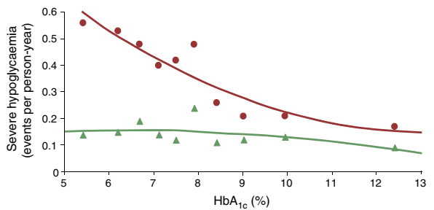
Prevention of hypoglycaemia
Structured education programmes, such as Dose Adjustment For Normal Eating (DAFNE) and blood glucose awareness training (BGAT), are the key to the prevention of hypoglycaemia and lead to sustained falls in Level 3 hypoglycaemia rates in those at high risk
Evaluation of the efficacy of teaching flexible, in 9583 individuals. Participants underwent 20 h of training as inpatients and were advised to measure blood glucose before main meals and at bedtime. Insulin was adjusted to actual blood glucose level and intended carbohydrate intake. Red circles, 1 year prior to intervention; Green triangles, 1 year after intervention
(2018) The role of structured education in the management of hypoglycaemia. Diabetologia. 61(4):751–760

Slide 82
Treatment of hypoglycaemia
Oral intake of approximately 15 g of glucose or equivalent simple carbohydrate when a capillary blood glucose level is <70 mg/dl (repeated every 15 min)
A larger amount of glucose may be needed if glucose levels are below 54 mg/dl
Reduced level of consciousness: Glucagon, Intravenous glucose
After the acute symptoms have resolved, a further 20 g of long-acting carbohydrate
The use of capillary glucose measurement is recommended to prevent over-treatment of the hypoglycaemia.

Slide 83
Section 9: Additional behavioural considerations
Nutrition therapy
Reduction in HbA1c of 1.0–1.9% ¹
The average BMI of individuals with type 1 DM is rising at a faster rate than the general population, partly as a result of insulin intensification and societal factors that also affect the others.
New interactive technologies using mobile phones to provide information, insulin bolus calculations based on insulin: carbohydrate ratios and telemedicine communications with care providers may be used to aid in reducing both weight gain and the time required for education. ²
1= (2019) 5. Lifestyle management: standards of medical care in diabetes—2019. Diabetes Care 42(Suppl 1):S46–S60
2= (2020) Diabetes digital app technology: benefits, challenges, and recommendations. A consensus report by the European Association for the Study of Diabetes (EASD) and the American Diabetes Association (ADA) Diabetes Technology Working Group. Diabetologia. 63(2):229–241

Slide 84
Section 9: Additional behavioural considerations
Goal of Nutrition Therapy for Type 1 Diabetes
Promote healthy eating patterns, emphasizing a variety of nutrient dense foods in appropriate sizes to improve overall health and to: Improve HbA1c, blood pressure, and cholesterol and aid in maintaining weight
Individualize nutrition needs based on personal and cultural preferences, health literacy, and access to healthy food choices
Provide practical tools for day to-day meal planning
Focus on matching insulin doses with meal composition through advanced carbohydrate counting
(2019) Nutrition therapy for adults with diabetes or prediabetes: a consensus report. Diabetes Care 42(5):731–754

Slide 85
Alcohol and recreational drug use
Increased alcohol consumption is associated with a higher risk of DKA and Level 3 hypoglycaemia
Other risk-taking behaviour
Impairs cognitive function leading to a diminished ability to self-manage
Alcohol promotes ketosis ¹
Alcohol intake increased risk for delayed hypoglycemia
Inhibition of gluconeogenesis
Reduced hypoglycemia awareness due to the cerebral effects of alcohol
Impaired counterregulatory responses to hypoglycemia ²
1= (2009) The influence of liberal alcohol consumption on glucose metabolism in patients with type 1 diabetes: a pilot study. QJM 102(3):169–174
2= (2019) Nutrition therapy for adults with diabetes or prediabetes: a consensus report. Diabetes Care 42(5):731–754

Slide 86
Alcohol and recreational drug use
Use of cannabis and other synthetic cannabinoids, cocaine and other stimulant-like drugs, such as amfetamine, methamfetamine and ecstasy (MDMA), increase glucose production and inhibit glucose clearance, which increases the risk of DKA.
Increased all-cause mortality ~ cocaine, opioids and cannabis ¹
Healthcare professionals have a responsibility to inform people with type 1 diabetes about the effects of drugs ²
1= (2020) Alcohol and illicit drug use in people with diabetes. Lancet Diabetes Endocrinol 8(3):239–248
2= (2014) Alcohol health literacy in young adults with type 1 diabetes and its impact on diabetes management. Diabet Med 31(12):1625–1630

Slide 87
Smoking
Increases the risk of macrovascular and microvascular complications in people with diabetes, smoking cessation should be promoted.
The direct effect of smoking on blood glucose levels in people with diabetes needs more research to assess the impact.
(2015) Relation of smoking with total mortality and cardiovascular events among patients with diabetes mellitus: a meta-analysis and systematic review. Circulation. 132(19):1795–1804

Slide 88
Physical activity
Exercise is associated with improved fitness, increased insulin sensitivity, leading to reduced insulin requirement, improved cardiovascular health with better lipid profile and endothelial function, and decreased mortality ¹
Reduces risk of microvascular complications, osteoporosis and cancer
Also helps maintain a healthy BMI and promotes sleep quality and mental wellbeing ²
1= (2019) Cardiovascular health benefits of exercise training in persons living with type 1 diabetes: a systematic review and meta-analysis. J Clin Med 8(2):253
2= (2008) Physical activity and diabetes complications in patients with type 1 diabetes: the Finnish Diabetic Nephropathy (FinnDiane) Study. Diabetes Care 31(2): 230–232

Slide 89
People with type 1 diabetes should be taught about the effects of exercise on glucose levels and how to balance exogenous insulin delivery and carbohydrate intake.
Glycaemic management during exercise should be made safer with CGM system. ¹
Advice should be given about appropriate footwear and foot inspection for those with peripheral neuropathy
Walking does not increase the risk of ulceration in people with peripheral neuropathy
Weight-bearing exercise should be avoided in active foot disease
In proliferative diabetic retinopathy or severe non-proliferative diabetic retinopathy, vigorous activity requiring straining may be contraindicated. ²
1= (2020) Glucose management for exercise using continuous glucose monitoring (CGM) and intermittently scanned CGM (isCGM) systems in type 1 diabetes: position statement of the European Association for the Study of Diabetes (EASD) and of the International Society for Pediatric and Adolescent Diabetes (ISPAD) endorsed by JDRF and supported by the American Diabetes Association (ADA). Diabetologia. 63(12):2501–2520
2= (2017) Exercise management in type 1 diabetes: a consensus statement. Lancet Diabetes Endocrinol 5(5):377–390

Slide 90
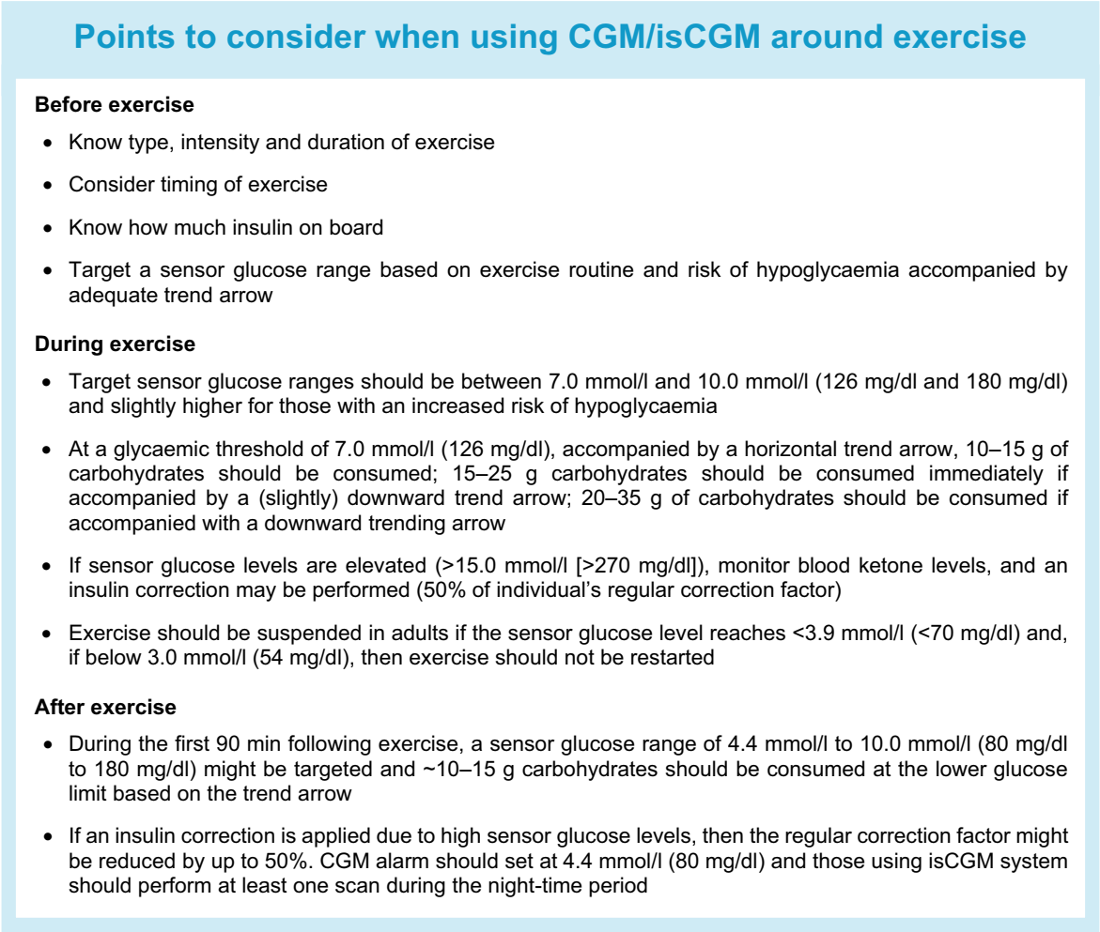
(2020) Glucose management for exercise using continuous glucose monitoring (CGM) and intermittently scanned CGM (isCGM) systems in type 1 diabetes: position statement of the European Association for the Study of Diabetes (EASD) and of the International Society for Pediatric and Adolescent Diabetes (ISPAD) endorsed by JDRF and supported by the American Diabetes Association (ADA)

Slide 91
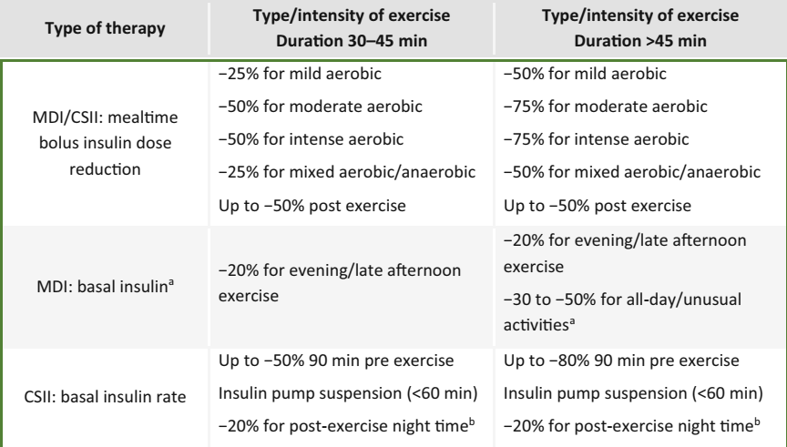
(2020) Glucose management for exercise using continuous glucose monitoring (CGM) and intermittently scanned CGM (isCGM) systems in type 1 diabetes: position statement of the European Association for the Study of Diabetes (EASD) and of the International Society for Pediatric and Adolescent Diabetes (ISPAD) endorsed by JDRF and supported by the American Diabetes Association (ADA)

Slide 92
Sleep
Sleep may be disrupted in people with type 1 diabetes as a result of behavioural and physiological aspects of diabetes.
Sleep disturbances including poor sleep quality and shorter sleep duration are associated with worsening glycaemic levels in type 1 diabetes
(2016) Subjective sleep disturbances and glycemic control in adults with long-standing type 1 diabetes: the Pittsburgh’s Epidemiology of Diabetes Complications study. Diabetes Res Clin Pract 119:1–12

Slide 93
Sick day/illness management
Stressful events, including illness, may affect glucose levels and increase risk of DKA.
Ingestion of adequate amounts of fluids and carbohydrates,
Monitoring of glucose and ketone levels
Giving insulin
Knowing under what circumstances should seek urgent medical care
Driving
Use of CGM or BGM prior to driving and at 2 hourly intervals
Hypoglycemia is a common side-effect of insulin, impairing many cognitive domains necessary for safe driving performance
1 = (2020) 6. Glycemic targets: standards of medical care in diabetes-2020. Diabetes Care 43(Suppl 1):S66–S76
2 = (2015) Driving and diabetes: problems, licensing restrictions and recommendations for safe driving. Clin Diabetes Endocrinol 1:8

Slide 94
Employment
The main concerns are associated with the risks of acute hypoglycaemia
Certain situations in which continued supply of effective insulin is not possible
Employment circumstances should allow the safe use and storage of insulin and unrestrained access to glucose monitoring and self-treatment of hyper- or hypoglycaemia
(2014) Diabetes and employment.Diabetes Care 37(Suppl 1):S112–S117

Slide 95
Travel
Travelling across time zones
The impact of change in usual schedule, hot weather, reduced stress and relaxation, and changes in exercise patterns, the carbohydrate content of local foods
Frequent glucose measurement with CGM or BGM is advisable for any travel.
(2019) World travel with type 1 diabetes using continuous subcutaneous insulin infusion. Br J Diabetes 19(2):141–146

Slide 96
Additional religious and cultural considerations
Fasting
A pre-Ramadan clinical evaluation and a full review of an individual’s glucose profile should be completed. If poor glycaemic control is found (HbA1c >9% or 75 mmol/mol and or wide glucose fluctuation), the insulin treatment regimen should be adjusted as necessary and re-evaluated once again before the start of fasting.
Individuals with T1DM, regardless of their age, and their carers or guardians should be taught about the potential adverse effects of fasting, including hypoglycaemia, hyperglycaemia and dehydration, and appropriate preventative measures to minimise the risks of these occurring. Additionally, the rationale for the revised insulin regimen should be explained and emphasised.
(2021) Diabetes and Ramadan: Practical Guidelines January 2021
Publisher: International Diabetes Federation and the DAR International Alliance Editor: Mohamed Hassanein ISBN: 978-2-930229-99-7
Project: Health and Metabolic Aspects of Ramadan Diurnal Intermittent Fasting

Slide 97
Fasting
There should be a nutritional assessment reviewing carbohydrate (CHO) intake and recommendations about the proper food options for the two main meals of the day. Carbohydrate counting techniques should also be discussed. An emphasis needs to be placed on the importance of a scheduled time for meals rather than following a looser erratic and frequent eating pattern. Also, an adequate intake of sugar-free beverages, especially with the pre-dawn meal, should be stressed.
While there is still a debate about the best insulin regimen for during fasting, a basal insulin dose reduction by 10-30% has been recommended by the majority of experts and medical societies. More importantly, an individualised regimen should be considered and based on a review of the individual’s glucose profile within the first few days of fasting.
(2021) Diabetes and Ramadan: Practical Guidelines January 2021
Publisher: International Diabetes Federation and the DAR International Alliance Editor: Mohamed Hassanein ISBN: 978-2-930229-99-7
Project: Health and Metabolic Aspects of Ramadan Diurnal Intermittent Fasting

Slide 98
Fasting
Frequent glucose testing is fundamental to ensure early recognition of abnormal glucose readings and that the proper measures in controlling them are taken. The use of CGM or FGM is superior to the traditional BG monitoring and should be the method of choice if available.
Fasting should be broken immediately with hypoglycaemia (< 70mg/dL) in individuals using MDI, both symptomatic or asymptomatic. Those using CSII may try suspending the pump if glucose drops below 90mg/dL but should also break the fast if glucose is < 70 mg/dL.
(2021) Diabetes and Ramadan: Practical Guidelines January 2021
Publisher: International Diabetes Federation and the DAR International Alliance Editor: Mohamed Hassanein ISBN: 978-2-930229-99-7
Project: Health and Metabolic Aspects of Ramadan Diurnal Intermittent Fasting

Slide 99
Section 10: Psychosocial care
Psychological distress, including mild to major depression, is a risk factor for poor self-care, hyperglycaemia, complications and excess mortality
Feeling powerless by the daily self-care demands
Fear of hypoglycaemia
Worries about complications
Prolonged significant diabetes distress elevated HbA1c levels
Longitudinally, elevated baseline distress was related to increased missed insulin boluses, and decreases in distress were associated with decreases in HbA1c >> suggesting a potential intervention target
No parallel associations were found for major depressive disorder or depression symptoms
(2017) Diabetes distress is linked with worsening diabetes management over time in adults with type 1 diabetes. Diabet Med 34(9):1228–1234

Slide 100
Section 10: Psychosocial care
Systematic reviews have shown that depression occurs more frequently in people with type 1 or type 2 diabetes compared with people without diabetes.
Depression in diabetes is associated with less optimal self-care behaviours, suboptimal glycaemic control, impaired quality of life, incident micro- and macrovascular diseases, and elevated mortality rates.
Scientific evidence about depression in diabetes remains incomplete ¹
It was found that there is a negative correlation between participants’ HbA1c levels and quality of life, and a positive correlation between HbA1c levels and depression. (R² = 0.72, P < 0.01) ²
The analysis of 37 selected articles with a total sample size of 7849 indicated that the overall prevalence of depression in Iranian patients with diabetes was 54% (95% CI: 47.32-60.70)
1= (2020) How 25 years of psychosocial research has contributed to a better understanding of the links between depression and diabetes. Diabet Med 37(3):383–392
2= (2019) The relationship between the quality of life and depression levels of young people with type I diabetes. Perspectives in Psychiatric Care. 2019; 55: 291– 299
3= (2019) The prevalence of comorbid depression in patients with diabetes: A meta-analysis of observational studies. Diabetes Metab Syndr. Nov-Dec;13(6):3113-3119

Slide 101
Practical and validated psychosocial measures, including:
WHO-5 Wellbeing Index (WHO-5)
Problem Areas in Diabetes (PAID) scale
Patient Health Questionnaire (PHQ-9)
For generalised anxiety, the Generalized Anxiety Disorder 7-item (GAD-7)
Brief screeners for depression (two items), depression and anxiety (four items) and diabetes distress (five or two items)
Completion of these questionnaires takes approximately 7 min and can be scheduled prior to the visit, either online or in the waiting room.
Assessment and periodic monitoring of emotional health, at least on an annual basis, is recommended to promote case finding, emotional wellbeing and patient satisfaction with care
(2012) Monitoring of Individual Needs in Diabetes (MIND)-2: follow-up data from the cross-national Diabetes Attitudes, Wishes, and Needs (DAWN) MIND study. Diabetes Care 35(11):2128–2132

Slide 102
Fear of hypoglycaemia affects up to 10% of adults with type 1 diabetes, resulting in persistent hyperglycaemia. Administering the Hypoglycemia Fear Survey (HFS) can help ¹
Eating disorders, including anorexia nervosa, bulimia nervosa and binge eating, are over-represented in type 1 diabetes populations, particularly in young women. ²
Insulin omission as a weight-loss strategy (‘diabulimia’) often starting in teenage years warrants special attention. ³
Diabulimia is an eating disorder in which people with type 1 diabetes deliberately give themselves less insulin than they need or stop taking it altogether for the purpose of weight loss.
1= (2011) Psychometric properties of the hypoglycemia fear survey-ii for adults with type 1 diabetes. Diabetes Care 34(4):801–806
2= (2015) Eating disorders in girls and women with type 1 diabetes: a longitudinal study of prevalence, onset, remission, and recurrence. Diabetes Care 38(7): 1212–1217
3= (2017) Eating patterns in adolescents with type 1 diabetes: associations with metabolic control, insulin omission, and eating disorder pathology. Appetite. 114:226–231

Slide 103
Social determinants of health
Social and financial hardships can negatively impact an individual’s mental health, motivation, and capacity to engage in self-management practices, increasing the risk for elevated HbA1c and complications
Neighbourhood and physical environment (e.g. housing stability)
Built environment (e.g. walkability, access to green spaces)
Environmental exposures (e.g. pollution)
Food access, availability and affordability
Healthcare access, affordability and quality
-) How hard is it for you to pay for the very basics like food, housing, medical care, and heating?
-) At any time since the last interview or in the last 2 years have you ended up taking less insulin than was prescribed for you because of cost?
(2020) Social determinants of health and diabetes: a scientific review. Diabetes Care

Slide 104
Psychosocial interventions
First level: people with type 1 DM don’t require professional mental health care
Second level: approximately one-quarter, some degree of professional psychosocial support is warranted; Support for social needs, Psychological therapies,…
Third level: Approximately 5%, are in need of psychiatric treatment, that can have an impact on glycaemic management.
Psychiatric comorbidities, such as anorexia nervosa and schizophrenia, require close collaboration between the mental health specialist and DM care team. ¹
The effects of psychotherapy on glycaemic levels are generally small but tend to increase when diabetes self-management education is incorporated in the treatment. ²
1= (2020) “Mental health professionals have never mentioned my diabetes, they don’t get into that”: a qualitative study of support needs in adults with type 1 and type 2 diabetes and severe mental illness. Can J Diabetes 44(6):494–500
2= (2010) Effect of interventions for major depressive disorder and significant depressive symptoms in patients with diabetes mellitus: a systematic review and meta-analysis. Gen Hosp Psychiatry 32(4):380–395

Slide 105
Section 11: Diabetic ketoacidosis
DKA is a life-threatening but preventable acute complication of type 1 diabetes.
As DKA occurs repeatedly, risk factors should be identified:
Non-modifiable: low socioeconomic status, younger age, female sex and ethnicity
Modifiable: previous episode of DKA, high HbA1c, low self-management skills (including omission of insulin therapy), psychiatric disorders, infections, somatic comorbidity, alcohol and drug abuse and less interaction with the healthcare team
(2019) Event rates and risk factors for the development of diabetic ketoacidosis in adult patients with type 1 diabetes: analysis from the DPV registry based on 46,966 patients. Diabetes Care 42(3):e34–e36
(2020) Risk factors and prevention strategies for diabetic ketoacidosis in people with established type 1 diabetes. Lancet Diabetes Endocrinol 8(5):436–446

Slide 106
Adjunctive use of sodium–glucose cotransporter (SGLT) inhibitors in adults with type 1 diabetes increases the risk of DKA by an absolute rate of about 4% per year
Some cases presented with near-normal blood glucose levels or mild hyperglycemia, complicating the recognition/diagnosis of DKA and potentially delaying treatment
The reduction of total daily insulin doses and particularly basal insulin may cause failure to suppress lipolysis and ketogenesis even if blood glucose levels do not rise
SGLT inhibitors are associated with an increase in glucagon, perhaps as a result of urinary glucose loss or through direct action upon pancreatic α-cells, which increases lipolysis and ketogenesis
It has also been proposed that SGLT inhibitors decrease renal clearance of ketone bodies
Volume depletion
(2019) International consensus on risk management of diabetic ketoacidosis in patients with type 1 diabetes treated with sodium-glucose cotransporter (SGLT) inhibitors. Diabetes Care 42(6):1147–1154

Slide 107
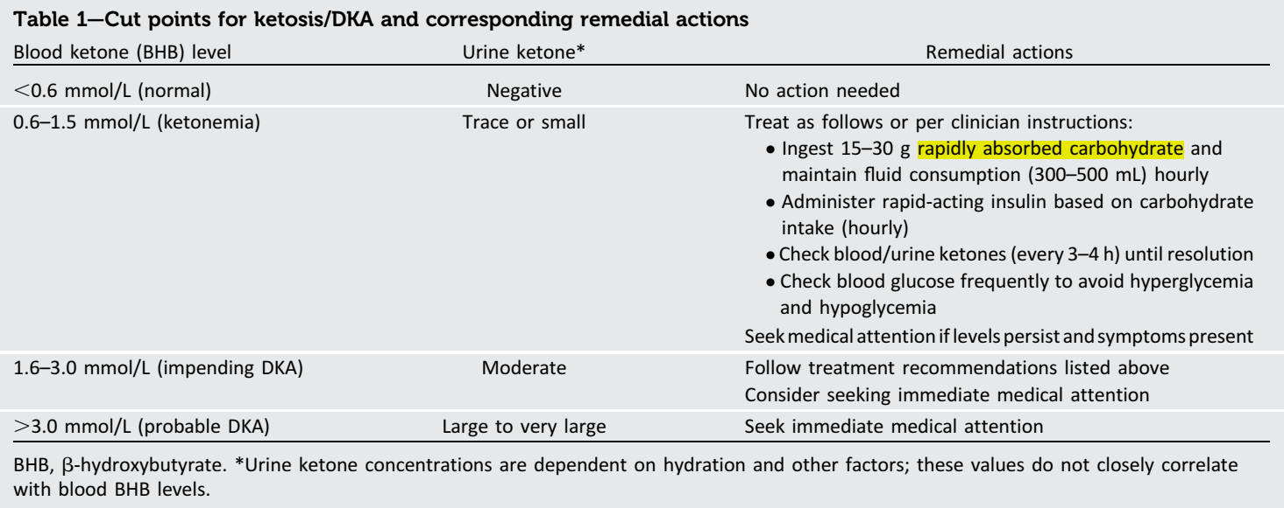
(2019) International consensus on risk management of diabetic ketoacidosis in patients with type 1 diabetes treated with sodium-glucose cotransporter (SGLT) inhibitors. Diabetes Care 42(6):1147–1154

Slide 108
Section 12: Pancreas and islet transplantation
Whole organ pancreas and pancreatic islet transplantation are currently the only means of clinical beta cell replacement.
Chronic systemic immunosuppression is needed in both forms, Therefore, the indication must thoroughly balance risk and benefit. ¹
In the USA, islet transplantation is not yet approved for clinical use.
Most whole-pancreas transplants are performed simultaneously with a kidney transplant (simultaneous pancreas and kidney [SPK] transplant). This is the ‘gold-standard’ therapy for people with type 1 diabetes and pre-final or end-stage renal disease if no contraindications. ²
1= (2016) Well, I wouldn’t be any worse off, would I, than I am now? A qualitative study of decision-making, hopes, and realities of adults with type 1 diabetes undergoing islet cell transplantation. Transplant Direct 2(5):e72
2= (2012) Long term outcome after pancreas transplantation. Curr Opin Organ Transplant 17(1):100–105

Slide 109
Main indications
A history of frequent, acute and severe metabolic complications (hypoglycaemia, hyperglycaemia, ketoacidosis)
Clinical and emotional problems with exogenous insulin therapy that are incapacitating
Consistent failure of insulin-based management, including technological aids
PTA are usually performed in people who are relatively young (<50 years) and do not have obesity (<30 kg/m2) or coronary artery disease.
Islet transplantation, a less invasive procedure, and allows for inclusion of older people and those with coronary artery disease who would not be eligible for a whole-pancreas transplant.
(2015) Evidence informed clinical practice recommendations for treatment of type 1 diabetes complicated by problematic hypoglycemia. Diabetes Care 38(6):1016–1029

Slide 110
Islet and pancreas transplants are the only approaches to date that confer both sustained recovery from IAH and Level 3 hypoglycaemia, via restoration of glucose counter-regulation. ¹
However, these approaches have not been compared with the newer systems of hybrid closed-loop technology, which might render immunosuppression requiring therapies less necessary, in large long-term studies. ²
1= (2015) Evidence informed clinical practice recommendations for treatment of type 1 diabetes complicated by problematic hypoglycemia. Diabetes Care 38(6):1016–1029
2= (2018) Islet transplantation versus insulin therapy in patients with type 1 diabetes with severe hypoglycaemia or poorly controlled glycaemia after kidney transplantation (TRIMECO): a multicentre, randomized controlled trial. Lancet Diabetes Endocrinol 6(7):527–537

Slide 111
Section 13: Adjunctive therapies
Metformin
The largest study to date assessed the use of metformin 1 g, twice daily, in 428 people who were treated for 3 years, with a primary endpoint of changes in mean carotid intima–media thickness.
The study ultimately found no difference in the primary endpoint, minimal and non-sustained effects on HbA1c, minimal effects on weight (~1 kg reduction) and no change in total daily insulin dose. ¹
Pramlintide
Clinical trials have shown a reduction in HbA1c (0.3–0.4% ) and modest (~1 kg) weight loss. ²
As a result of its adverse effects and need for additional injections, clinical uptake has been limited.
1= ( (2017) Cardiovascular and metabolic effects of metformin in patients with type 1 diabetes (REMOVAL): a double-blind, randomised, placebo-controlled trial. Lancet Diabetes Endocrinol 5(8):597–609
2= (2004) ) Amylin replacement with pramlintide as an adjunct to insulin therapy improves long-term glycaemic and weight control in type 1 diabetes mellitus: a 1-year, randomized controlled trial. Diabet Med 21(11):1204–1212

Slide 112
Glucagon like peptide-1 receptor agonists
Have been explored in people with type 1 diabetes for two indications:
To ameliorate beta cell decline, when used in combination with anti-IL-21 ¹
An adjunctive therapy by blunting glucagon secretion, decreasing gastric emptying, and promoting satiety and weight loss. ²
The largest clinical trials in people with type 1 diabetes were conducted with liraglutide and showed decreases in HbA1c at daily doses of 1.8 mg (0.2–0.4), decreases in weight (~5 kg) and reductions in insulin doses. However, increased rates of hypoglycaemia and ketosis were shown. ³
Trials in people with type 2 diabetes have shown convincing reductions in cardiovascular events with some GLP-1 RA. ⁴
1= (2021) Anti-interleukin-21 antibody and liraglutide for the preservation of β-cell function in adults with recent-onset type 1 diabetes: a randomised, doubleblind, placebo-controlled, phase 2 trial. Lancet Diabetes Endocrinol 9(4):212–224
2= (2020) GLP-1 receptor agonists in type 1 diabetes: a MAG1C bullet? Lancet Diabetes Endocrinol 8(4):262– 264
3= (2016) Efficacy and safety of liraglutide added to capped insulin treatment in subjects with type 1 diabetes: the ADJUNCT TWO randomized trial. Diabetes Care 39(10):1693–1701
4= (2020) An overview of GLP-1 agonists and recent cardiovascular outcomes trials. Postgrad Med J 96(1133):156–161

Slide 113
SGLT inhibitors
The use of SGLT-1 or SGLT-1/2 inhibitors reduced HbA1c, improved TIR, reduced body weight and improved blood pressure. ¹
However, an increased rate of DKA led to rejection of market authorization for type 1 diabetes by the FDA, whereas the European Medicines Agency has approved low-dose dapagliflozin (5 mg) and sotagliflozin(200 mg) for those with a BMI ≥27 kg/m². ²
A consensus statement on SGLT2 inhibitors and DKA suggested:
Careful patient selection
Appropriate insulin dose adjustment to avoid insulinopaenia
Starting with a low dose of SGLT2 inhibitors
Regular ketone measurements ³
1= (2020) Reducing type 1 diabetes mortality: role for adjunctive therapies? Trends Endocrinol Metab 31(2):150–164
2= (2019) SGLT2 inhibitors as adjunctive therapy for type 1 diabetes: balancing benefits and risks. Lancet Diabetes Endocrinol 7(12):949–958
3= (2019) International consensus on risk management of diabetic ketoacidosis in patients with type 1 diabetes treated with sodium-glucose cotransporter (SGLT) inhibitors. Diabetes Care 42(6):1147–1154.

Slide 114
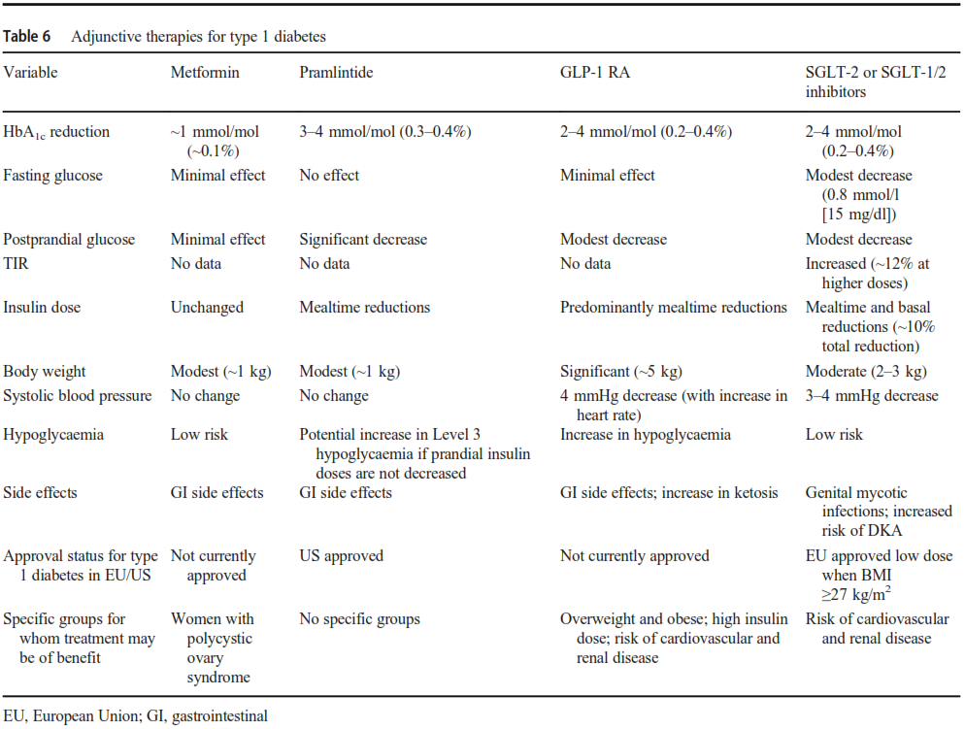

Slide 115
Section 14: Special populations
Pregnancy including preconception and postnatal care
HbA1c ≤6.5%
Pre-meal glucose concentrations below 95 mg/dl
Postprandial values of below 140 mg/dl 1 h after a meal and below 120 mg/dl 2 h after a meal.
Women with type 1 diabetes, even when managed in a specialist setting, still experience adverse obstetric and neonatal outcomes.
Poor glycaemic control is not wholly responsible for adverse outcomes, reinforcing the importance of other risk factors, such as obesity and weight gain
(2016) Contemporary type 1 diabetes pregnancy outcomes: impact of obesity and glycaemic control. Med J Aust 205(4):162–167

Slide 116
The major limiting step to achieving normoglycaemia is hypoglycaemia, which occurs more frequently in the first half of pregnancy, in part because of diminished awareness of hypoglycaemia and pregnancy-associated nausea and vomiting. ¹
A declining insulin requirement in the late first trimester of pregnancy with type 1 diabetes was reported, and overinsulinization has been suggested as a contributing reason for severe hypoglycemia in early pregnancy. The insulin requirement decreased from week 8 to week 14 and increased from week 14 onwards. ²
1= (2008) Hypoglycemia in pregnant women with type 1 diabetes: predictors and role of metabolic control. Diabetes Care 31(1):9–14
2= (2001) Declining insulin requirement in the late first trimester of diabetic pregnancy. Diabetes Care 24:1130–1136

Slide 117
Pregnant women with type 1 diabetes are at risk of DKA at lower blood glucose levels than in the nonpregnant state and should receive education on DKA prevention and detection. ¹
Postpartum breastfeeding, erratic sleep and eating schedules may increase the risk of hypoglycaemia and insulin dosing adjustment. ²
All women of childbearing age with type 1 diabetes should be informed about the importance of seeking professional help prior to trying to conceive; this provides:
An opportunity to improve glycaemic management
To offer folic acid to prevent neural tube defects, screen for diabetes-related complications and stop potentially teratogenic medications.
1= (2014) Diabetic ketoacidosis in pregnancy. Obstet Gynecol 123(1):167–178
2= (2016) Changes in postpartum insulin requirements for patients with well-controlled type 1 diabetes. Am J Perinatol 33(7):683–687
3= (2021) 14. Management of diabetes in pregnancy: standards of medical care in diabetes—2021. Diabetes Care 44(Suppl 1):S200–S210

Slide 118
Older people with type 1 diabetes
Glycaemic targets should be based on functional status and life expectancy, rather than chronological age.
Target glucose values should be adjusted to minimise the occurrence of hypoglycaemic events.
Simplification of insulin management may be justified in cases of individuals with complications or functional or cognitive impairment.
(2018) Diabetes management in the elderly. Diabetes Spectrum 31(3):245–253

Slide 119
People with late complications of type 1 diabetes
Optimising blood glucose levels in this group should also be individualised as rapid improvement may be associated with transient early worsening of retinopathy or the development of acute painful neuropathy.
In people with cardiovascular complications, hypoglycaemia avoidance should be one of the management priorities.
(2014) Type 1 diabetes mellitus and cardiovascular disease: a scientific statement from the American Heart Association and American Diabetes Association. Diabetes Care 37(10):2843–2863

Slide 120
Section 15: Inpatient management of type 1 diabetes
People with type 1 diabetes are at high risk of
developing ketosis if insulin is withheld.
Therefore, inpatients with type 1 diabetes should be clearly identified to avoid common errors, such as omission of mealtime insulin or withholding of basal insulin for procedures or surgery.
Patients using diabetes devices should be allowed to use them in an inpatient setting or during outpatient procedures when proper supervision is available and the patient/caregiver is capable of managing the device(s).
(2020) Continuous glucose monitors and automated insulin dosing systems in the hospital consensus guideline. J Diabetes Sci Technol 14(6): 1035–1064

Slide 121
Section 16: Emergent and future perspectives
Both xenotransplantation with porcine islets and human stem cells are under investigation to solve the problem of limited availability of donors for pancreas or islet transplantation.
Stem cell strategies have used either patient-specific stem cells or universal allogeneic cells:
The patient’s own stem cells are reprogrammed or transdifferentiated to become beta cells.
Generic allogeneic cells may be used for patients and centrally produced from a bank of human embryonic stem cells (hESCs) or of induced pluripotent stem cells (iPSCs).
(2020) Emerging routes to the generation of functional β-cells for diabetes mellitus cell therapy. Nat Rev Endocrinol 16(9):506–518

Slide 122
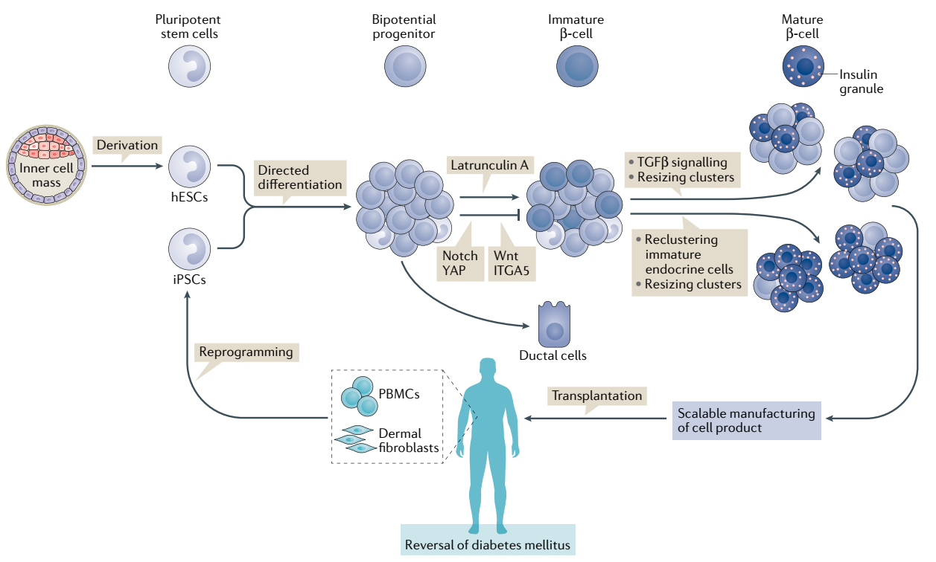
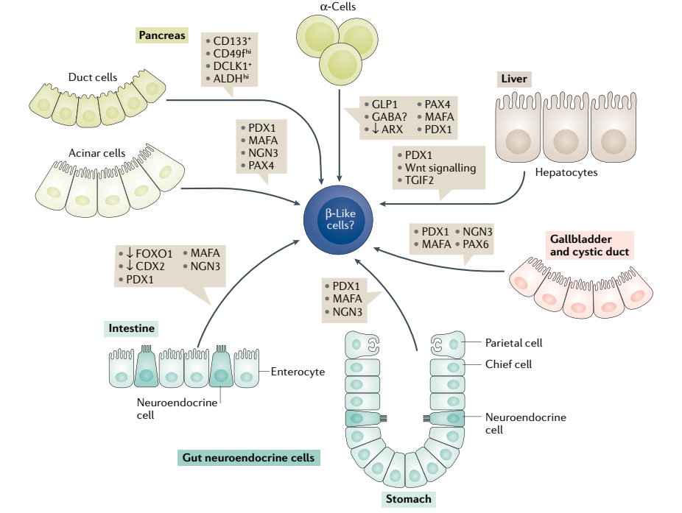
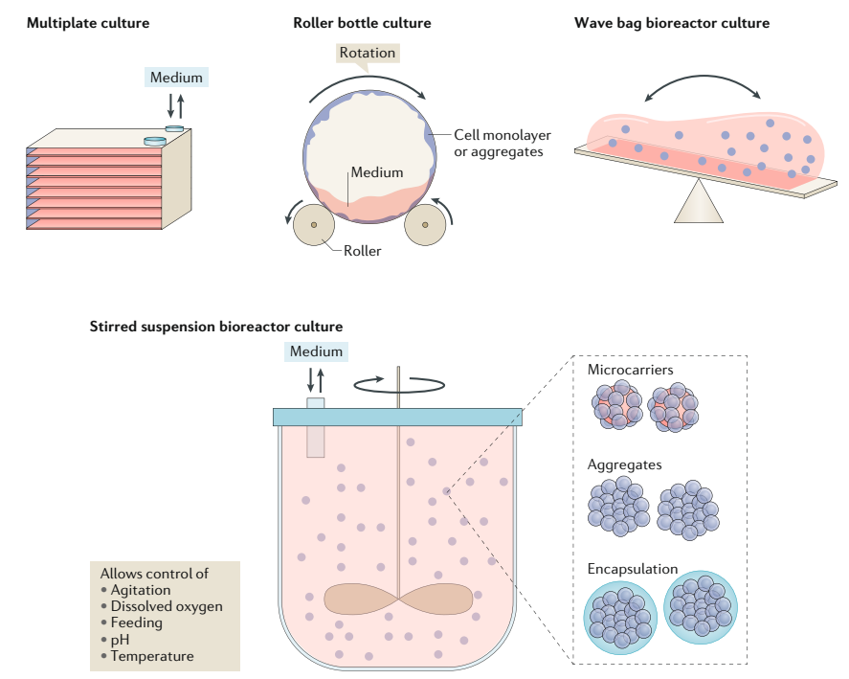
(2020) Emerging routes to the generation of functional β-cells for diabetes mellitus cell therapy. Nat Rev Endocrinol 16(9):506–518

Slide 123
One of the key issues is protecting the cells from immune attack, both rejection and recurrent autoimmunity.
Use of immunosuppressive or immunomodulatory drugs;
Use of a physical barrier (e.g. encapsulation);
Gene editing for immune evasion and/or immune protection.
Many interventions have been tested in clinical trials but, to date, the most promising results have been from:
The anti-CD3 monoclonal antibody (teplizumab)
Low-dose anti-thymocyte globulin (ATG)
The anti-TNF drug, golimumab
These have been shown to preserve beta cell function in recent-onset type 1 diabetes, and teplizumab also has delayed the clinical onset of type 1 diabetes.
1= (2017) Advances in islet encapsulation technologies. Nat Rev Drug Discov 16(5):338–350
2= (2016) Genome editing in human pluripotent stem cells: approaches, pitfalls, and solutions. Cell Stem Cell 18(1):53–65
3= (2019) Changing the landscape for type 1 diabetes: the first step to prevention. Lancet. 394(10205):1286–1296

Slide 124
Section 17: Conclusion
This report has covered many areas of the management of type 1 diabetes, however, the writing group recognises that huge gaps exist in our knowledge in the prevention, diagnosis and treatment of the disease.

Slide 125

Thanks for your attention

