Slide 1
A 59 y/o man with bilateral adrenal mass Problem list:
Abdominal pain
Flank pain
LBP
Weight loss
Headache
Ataxia
N/V
Bilateral adrenal mass
Adrenal insufficiency
Cerebellar mass
Old MI
HF
Anorexia
weakness

Slide 2
diagnostic approach
Clinical assessment: the initial clinical evaluation is focused on assessing the clinical signs and symptoms of hormone overproduction syndromes
Laboratory evaluation: Screening for phaeochromocytoma ,Cushing's syndrome, hyperaldosteronism, Blood levels of androgens or oestrogens
Imaging: abdominal CT, MRI, PET or US

Slide 3
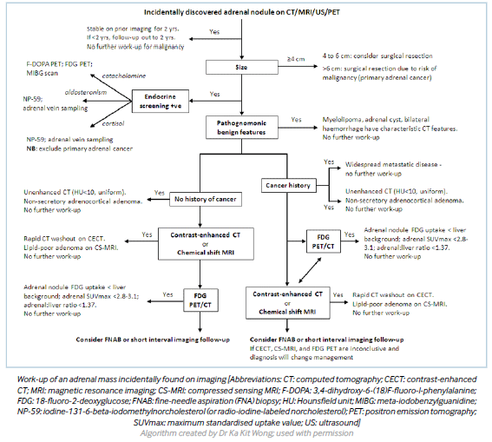

Slide 4
CT-guided biopsy
biopsy is performed for diagnostic evaluation of adrenal masses in patients with a history of cancer (particularly lung, breast, and kidney) and no other metastases, in order to differentiate between adrenal tissue and non-adrenal tissues (e.g., metastases or infection)
It should not be routinely done, due to the risk of procedure-related complications (2.8%; including abdominal pain, adrenal haematoma, haematuria, pancreatitis, pneumothorax, formation of an adrenal abscess), small risk of needle tract metastasis (0.3% of subjects with long-term follow-up), and high rate of false-negative results
FNA biopsy may be required for diagnosis of adrenal nodules/masses still indeterminate for malignancy after imaging evaluation

Slide 5
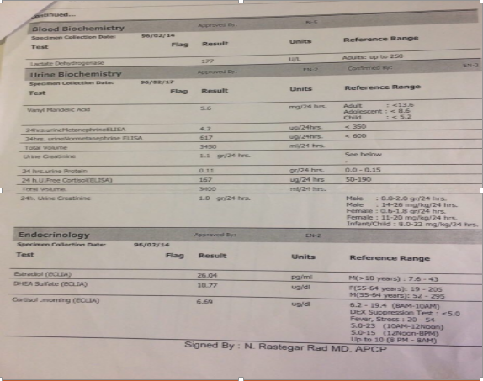
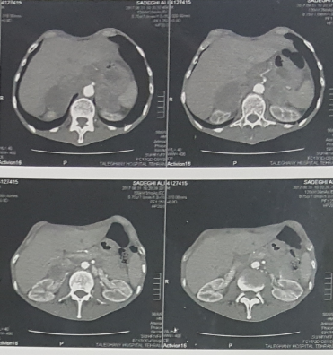
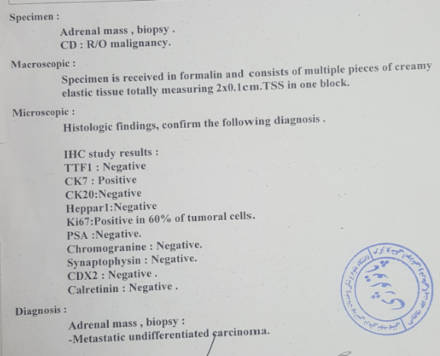

Slide 6
F/U treatment and
Chemotherapy: folfox+taxoter
Prednisolon+fludrocortisone
Recheck of IHC on biopsy block

Slide 7
Bilateral adrenal masses: a single-centre experience Nilesh Lomte, Tushar Bandgar, Shruti Khare, Swati Jadhav, Anurag Lila, Manjunath Goroshi, Rajeev Kasaliwal, Kranti Khadilkar and Nalini S Shah Department of Endocrinology, Seth G S Medical College, KEM Hospital, Mumbai, Maharashtra, India
From 2002 to 2015, 560 patients with adrenal masses presented to a tertiary care endocrine centre in western India and 70 of them had bilateral masses (12.5%)
Retrospective analysis of 70 patients with bilateral adrenal masses presenting to a single tertiary care endocrine centre from western India (2002–2015).
The most common aetiology was pheochromocytoma (40%), followed by tuberculosis (27.1%), primary adrenal lymphoma (PAL) (10%), metastases (5.7%), non-functioning adenomas (4.3%), primary bilateral macronodular adrenal hyperplasia (4.3%), and others (8.6%)

Slide 8
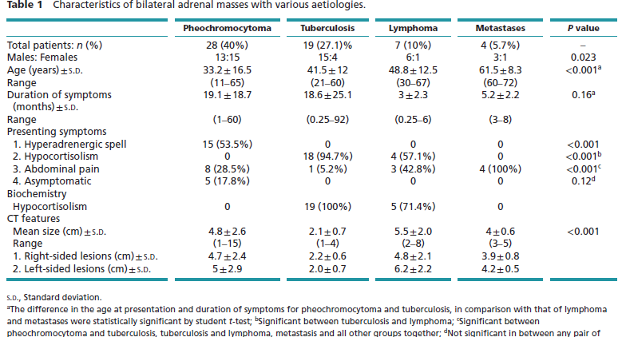

Slide 9
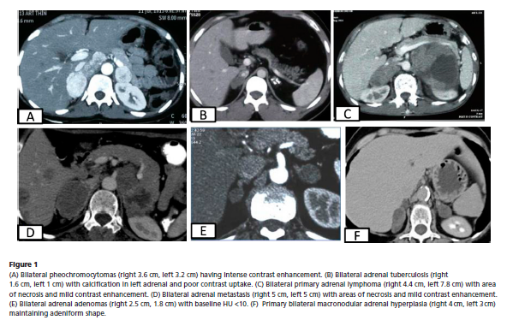

Slide 11
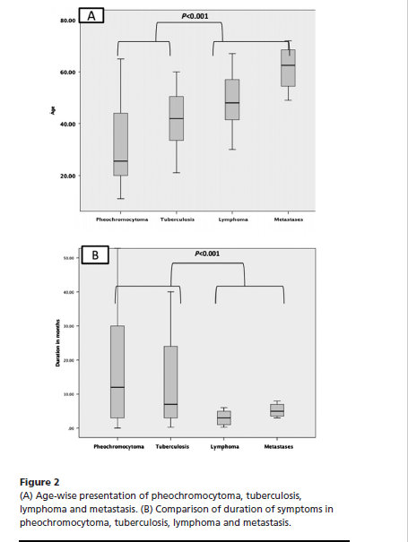

Slide 12
Other masses
Histoplasmosis (n = 2; 1 male, 1 female)
Myelolipoma (n = 2; both males)
Cysts (n = 1)
Leiomyoma (n = 1)

Slide 13
Histopathological diagnosis (n = 40)
As per our methodology, diagnosis of patients with secretory masses could be made on the basis of secretory profile (e.g. pheochromocytoma and PBMAH) and were not subjected to biopsy
For non-secretory masses, histopathological confirmation of diagnosis was sought only in patients with equivocal radiological findings and no additional clinical and radiological clues (extra-adrenal tuberculosis and evidence of primary malignancy)
On following this protocol, biopsy was required for 18 patients (7 patients with lymphoma, 7 with tuberculosis, 2 with histoplasmosis, and one each with metastasis and cyst)

Slide 14
Metastatic tumours of the adrenal glands: a 30-year experience in a teaching hospital K.-Y. Lam* and C.-Y. Lo† *School of Medicine, James Cook University, Townsville, Australia & †Department of Surgery, University of Hong Kong, Hong Kong, Clinical Pathology Building, Hong Konghospital
The records of the Queen Mary Hospital (a teaching hospital serving a population of over a million in Hong Kong) from 1971 through 2000 were reviewed for the presence of metastatic tumours involving the adrenal glands
Over the 30-year study period, 464 patients (288 men and 176 women) of median age 62 years (range 5 months to 94 years) were confirmed to have metastatic tumours upon histological examination of the adrenal glands
These included 435 patients identified at postmortem examination, 21 at adrenalectomy and eight at fineneedle aspiration biopsy

Slide 15
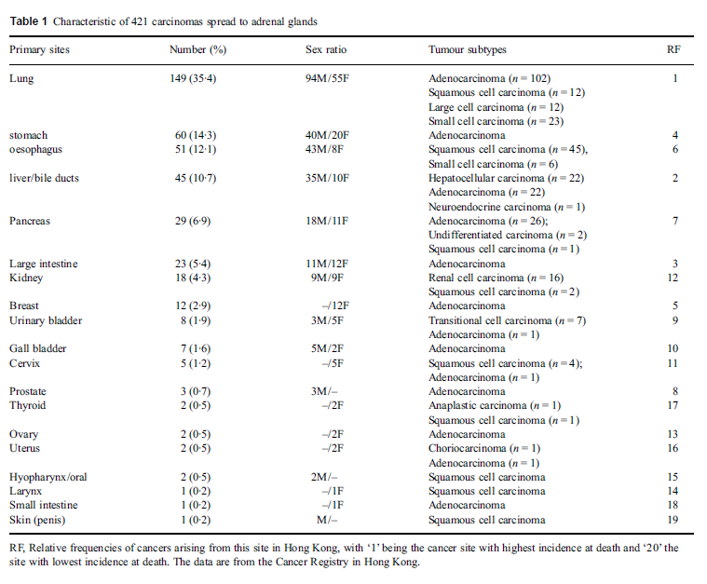

Slide 16
Pathological features
Ninety per cent (421 cases) of the metastatic lesions in the adrenal glands were carcinomas
The other cases comprised 33 hematopoetic neoplasms, seven sarcomas and three melanomas
The 33 hematopoetic neoplasms comprised two leukemias and 31 lymphomas, including three Hodgkins and 28 non-Hodgkins lymphomas

Slide 17
Discussion
Despite the high incidence of adrenal metastases in autopsy studies, Addison,s disease is infrequently reported in patients with adrenal metastases
Fewer than 100 cases have been reported in the literature
Kong & Jeffcoate (1994) in the UK noted that 2% of 86 patients with Addison,s disease were due to adrenal metastases
Soule (1999) in South Africa reported a 6% prevalence of adrenal metastases in 50 patients with Addison,s disease

Slide 18
The low incidence of Addison,s disease in adrenal metastases may be attributed to the fact that over 90% of the adrenal glands must be destroyed before there is functional adrenal cortical loss
Also, the signs and symptoms of Addison,s disease may be masked or overlooked in patients with advanced malignancies
In the study period, Addison,s disease was noted in five patients with adrenal metastases and seven with adrenal tuberculosis
The discovery of an adrenal metastasis in patients with primary tumours automatically transfers them to an advanced stage
On the other hand, many patients have been demonstrated to benefit from surgical resection of adrenal metastasis and long-term survival can be achieved

Slide 19
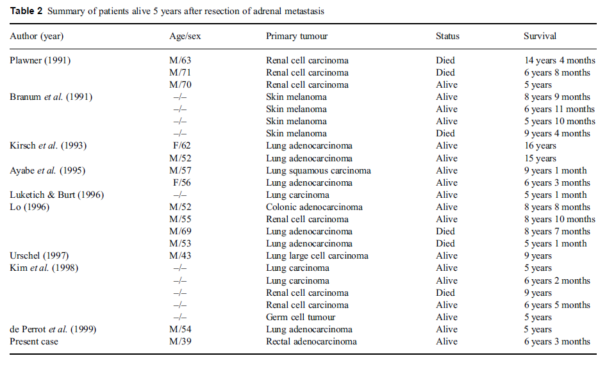

Slide 20
Thank you for attention Rahim zahedi MD

