Slide 1

Management of Loco-regional Metastasis in DTC
H.kadkhodazadeh
Endocrinology Fellowship
Research Institute for Endocrine sciences
Shahid Beheshti University of Medical Sciences
february 2nd, 2015, Tehran

Slide 2
Agenda:
Definition loco-regional metastasis in DTC
Introduction
Risk factors for recurrence
Imaging modality
Treatment strategies : surgery/RAI/Ethanol injection/radiotherapy
Recent studies

Slide 3
SEER staging system: “local” denotes disease
confined to the thyroid and “regional” tumor extension
into adjacent organs, regional lymph nodes, or both.

Slide 4
Recurrent
recurrent: biochemical or structural identification of disease in a patient previously thought to have no evidence of disease (undetectable stimulated or highly sensitive Tg and negative cross-sectional imaging)
Ralph P. Tufano et al, Management of Recurrent/Persistent Nodal Disease in Patients with Differentiated Thyroid Cancer: A Critical Review of the Risks and Benefits of Surgical Intervention Versus Active Surveillance. 2015.

Slide 5
R0: No residual tumor
R1: Microscopic residual tumor
Recurrent Thyroid cancer should be divided to :
local recurrence: thyroid bed or residual thyroid tissue
regional recurrence: central / lateral
distant recurrence
Ralph P. Tufano et al, Management of Recurrent/Persistent Nodal Disease in Patients with Differentiated Thyroid Cancer: A Critical Review of the Risks and Benefits of Surgical Intervention Versus Active Surveillance. 2015.

Slide 6
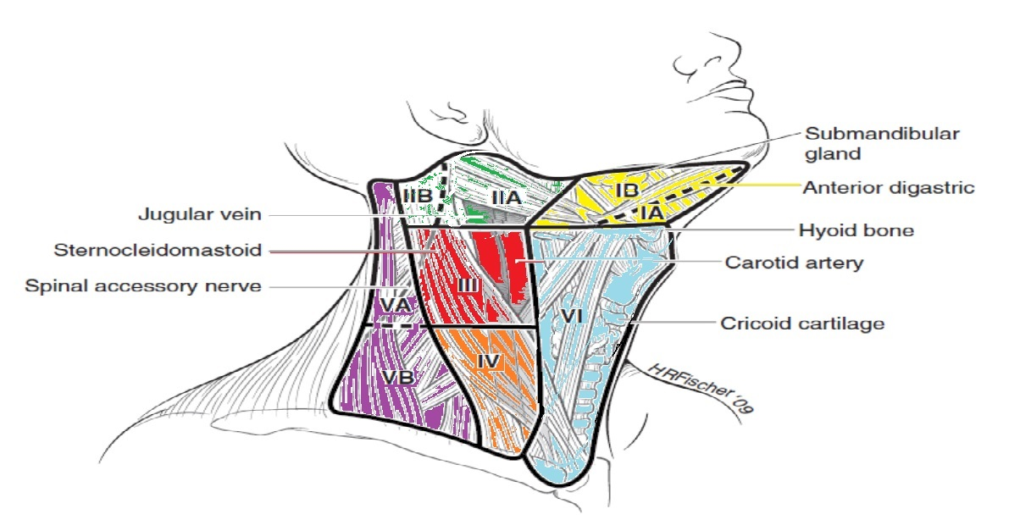
Notes:
Level 1 : submental- submandibular
Level 2,3,4,: upper middle and lower jugular
Level 5: posterior
Level6: Anterior

Slide 7
Notes:
Study Design: Retrospective chart review.
Materials and Methods: Between October 2001
and December 2006, a total of 27 consecutive patients (12
males, 15 females) with clinical evidence of cervical metastasis
of well-differentiated thyroid carcinoma (WDTC)
underwent 28 neck dissections (ND) with a mean
follow-up 33.7 months. Papillary carcinoma was found in
24 patients and follicular carcinoma in 3.
All neck dissection specimens were separated during
surgery into levels, and analysis was done with respect to
the levels of the neck.
Clinical and demographic parameters were correlated
to the pathologic parameters, including number of
pathologic nodes, size of tumor, and the patient’s age,
with univariate and multivariate analysis.
Results: The mean number of pathologic nodes in
NDspecimen was 6.7. The predominant site of metastasis
was level VI (95%), followed by level III (68%), level IV
(57%), and level II (54%). Metastases above the XI nerve
were found in 7% of the patients. Level V showed 20% of
nodal metastasis. A correlation was found between size of
primary

Slide 8
Head and neck cancers tend to metastasize to specific neck lymph node clusters.
lymph nodes in the :
lower third :67%
middle third : 20%
superior third :13%
in contrast to benign lymph nodes, which are more commonly seen the superior and middle thirds of the neck.

Slide 9
central compartment dissection (CLND) :
removal of lymph nodes and soft tissues in level VI with preservation of the recurrent laryngeal nerves and at least the superior parathyroid glands.
lateral compartment dissection (LLND) :
to removal of all soft tissue and lymph nodes inlevels IIA ,III ,IV and V. usually with preservation of the internal jugular vein,carotid artery,vagus nerve, phrenic nerve,SCM muscle,and spinal accessory nerve .

Slide 10
burry picking
used mainly in the 60s and 70s only suspicious and/or enlarged lymph nodes are removed &Cannot achieve complete
removal of metastatic.
Nowadays, selective neck dissection(a compartment-oriented procedure)is the preferred type of surgery,which avoids the increased morbidity of the more extensive dissections, while at the same time minimizes localrecurrence rate.

Slide 11
Agenda:
Definition loco-regional metastasis in DTC
Introduction
Risk factors for recurrence
Imaging modality
Treatment strategies : surgery/RAI/Ethanol injection/radiotherapy
Recent studies

Slide 12
Regional lymph node metastases are present at the time of diagnosis in 20–90% of patients with PTC and lesser patients with other histotypes.
Mazzaferri and Jhiang: tumor recurrence rates were 30% during postoperative surveillance and that approximately 66% of these recurrences were detected within 10 years of the initial therapy

Slide 13
PTC lymph node metastases are reported by some to have no clinically important effect on outcome in low risk patients.
SEER database: among 9904 patients with PTC, lymph node metastases, age>45 years, distant metastasis, and large tumor size significantly predicted poor outcome on multivariate analysis.

Slide 14
Another recent SEER registry study:
Cervical lymph node metastases conferred an independent risk of decreased survival, but only in patients with FTC and patients with PTC over age 45 years.

Slide 15
Agenda:
Definition loco-regional metastasis in DTC
Introduction
Risk factors for recurrence
Imaging modality
Treatment strategies : surgery/RAI/Ethanol injection/radiotherapy
Recent studies

Slide 16
Significant Prognostic Lymph Node Metastasis:
larger than 3 cm
extranodal extension
metastasis present in more than five nodes
Ralph P. Tufano et al, Management of Recurrent/Persistent Nodal Disease in Patients with Differentiated Thyroid Cancer: A Critical Review of the Risks and Benefits of Surgical Intervention Versus Active Surveillance. 2015.

Slide 17
Prognostic & recurrence factors :
age less than 15 years or greater than or equal to 45 years
male gender
tumor size greater than 4 cm
Follicular histology or tall and columnar cell variants
multifocality
initial local tumor invasion
regional lymph node metastasis
genotype –BRAF-positive tumors

Slide 18
Biologic factors impacting virulence and likelihood for progression of metastatic nodes
Primary tumor factors
(b) Lymph node factors
(c) Patient factors
Ralph P. Tufano et al, Management of Recurrent/Persistent Nodal Disease in Patients with Differentiated Thyroid Cancer: A Critical Review of the Risks and Benefits of Surgical Intervention Versus Active Surveillance. 2015.

Slide 19
Primary tumor factors
Adverse histology of the primary tumor (tall cell variant, insular, poorly differentiated) is associated with aggressiveness
The change in Tg levels in the blood, namely a rapid Tg level doubling time (< 1 year and possibly < 3 years) represents a dynamic measure of a tumor’s virulence and rate of growth in the absence of other disease.
The inability of the tumor to concentrate RIA or produce tg
The presence of markedly FDG –PET -avid disease.
Ralph P. Tufano et al, Management of Recurrent/Persistent Nodal Disease in Patients with Differentiated Thyroid Cancer: A Critical Review of the Risks and Benefits of Surgical Intervention Versus Active Surveillance. 2015.

Slide 20
Molecular markers for aggressive behavior: BRAF; RAS
Presence of lymphocytic infiltration associated with decreased aggressiveness, such as small tumor size and low stage. DTC in the presence of chronic lymphocytic infiltration in the thyroid control, lesser rates of recurrence, and greater overall and disease-free survival
Ralph P. Tufano et al, Management of Recurrent/Persistent Nodal Disease in Patients with Differentiated Thyroid Cancer: A Critical Review of the Risks and Benefits of Surgical Intervention Versus Active Surveillance. 2015.

Slide 21
Lymph node factors
Documented stability or change in the size of lymph node(s) on serial imaging studies.
Presence of direct extranodal extension to the trachea, esophagus, or carotid artery with loss of tissue planes between structures in a previously dissected lymph node compartment on imaging.
Ralph P. Tufano et al, Management of Recurrent/Persistent Nodal Disease in Patients with Differentiated Thyroid Cancer: A Critical Review of the Risks and Benefits of Surgical Intervention Versus Active Surveillance. 2015.

Slide 22
Patient factors
Significant comorbidities that are likely to affect quality of life and life expectancy of the patient independent of the recurrent/persistent DTC at the time of the work-up for recurrent/persistent disease.
Vocal fold paralysis contralateral to the side of central nodal recurrence (location of node near the only working RLN).
High-risk surgical comorbidities such as history of extensive neck surgery or external radiation therapy of the neck.
Ralph P. Tufano et al, Management of Recurrent/Persistent Nodal Disease in Patients with Differentiated Thyroid Cancer: A Critical Review of the Risks and Benefits of Surgical Intervention Versus Active Surveillance. 2015.

Slide 23
Agenda:
Definition loco-regional metastasis in DTC
Introduction
Risk factors for recurrence
Imaging modality
Treatment strategies : surgery/RAI/Ethanol injection/radiotherapy
Recent studies

Slide 24
ULTRA SONOGERAPHY

Slide 25
Imaging Modality
US is the imaging modality of choice of thyroid cancer.
assess the primary tumor
to identify abnormal lymph nodes in the central and lateral neck that should
be targeted for compartment-oriented surgical removal.
all patients with FNA proven DTC should be staged preoperatively and undergo a neck US with node mapping evaluating the contralateral lobe and lymph nodes for the presence of disease

Slide 26
Suspicious lesions in the thyroid bed (mainly local recurrence)
1. Ovoid shape in the longitudinal plane but taller than wide in the transverse plane
2. Hypoechogenicity
3. Microcalcifications
4. Irregular borders
5. Increased vascularization
B. Suspicious lesions in the lateral neck compartment (mainly lymph node metastases)
1. Round shape
2. Loss of hilum
3. Microcalcifications
4. Hypoechogenicity or cystic features or even hyperechoic tissue looking like thyroid tissue

Slide 27
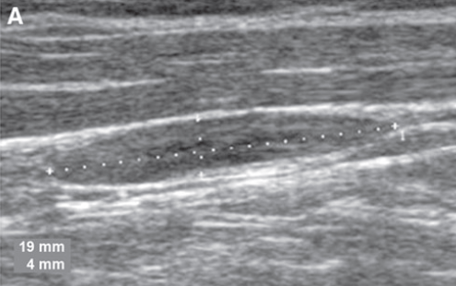
Benign fusiform lymph node

Slide 28
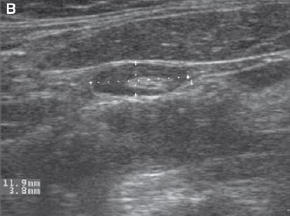
Benign lymph node with hyperechoic central fatty hilum

Slide 29
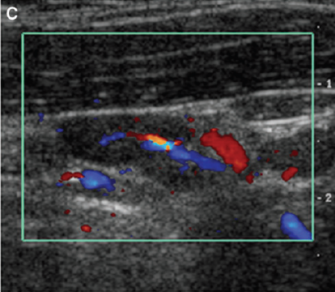
Hilar blood ﬂow pattern in a normal lymph node

Slide 30
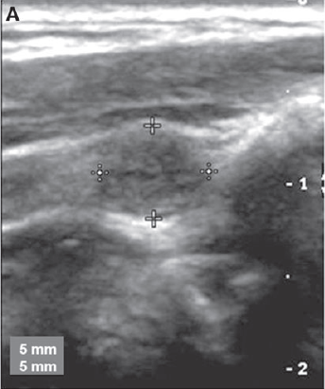
Solid, rounded lymph node with metastatic papillary thyroid carcinoma (PTC)

Slide 31
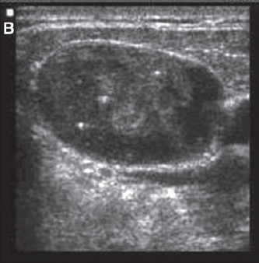
Punctate internal calciﬁcations in a lymph node with metastatic PTC

Slide 32
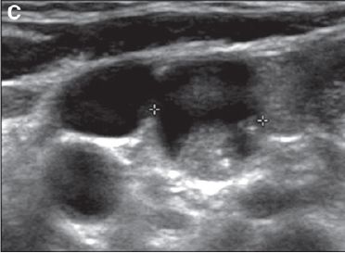
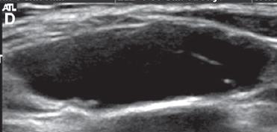
Complex solid/cystic lymph node with metastatic PTC
Completely cystic lymph node with metastatic PTC

Slide 33
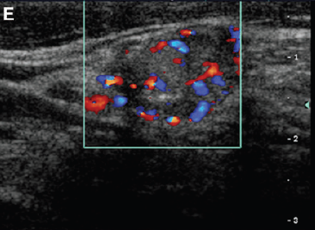
Peripheral hypervascular pattern in a lymph node with metastatic PTC

Slide 34
CT, MRI, or PET can be useful in monitoring patients with thyroid cancer and for preoperative planning. may be useful in the assessment of large, rapidly growing, retrosternal, or invasive tumors to characterize the involvement of extrathyroidal.

Slide 35
FDG_ PET

Slide 36

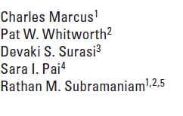
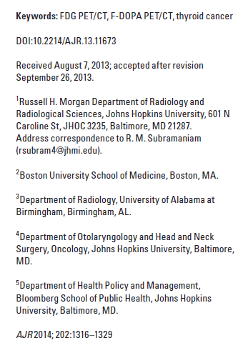

Slide 37
FDG_ PET has been known to show metastases in131I scan-negative thyroid cancer with a high accuracy, related to increased glucose metabolism in poorly differentiated carcinoma
The preoperative use of PET remains controversial and has not been thoroughly evaluated .It can be useful in patients with a high tumor stage and less nodal disease than expected or in those with indeterminate nodes on CT or MRI.

Slide 38
The combination of 131IWBS and thyroglobulin measurement is a reliable indicator of the presence of metastases in 82.6% of patients with DTC after surgery.
However, FDG PET/CT plays a valuable role in the post thyroidectomy workup of patients with DTC who have elevated thyroglobulin levels and a negative 131I-WBS

Slide 39
Reviewed a total of 25 studies comprising of 789 patients and concluded that FDG PET/CT has a high pooled sensitivity of 93.5% for detecting DTC recurrence and metastasis in the absence of radioiodine uptake.
In a similar meta-analysis of 12 studies and literature review, Miller et al. found that PET/CT had a sensitivity of 94.0% for detecting recurrence of PTC.

Slide 40
Weber et al. found that ultrasound provided localization of recurrent or metastatic thyroid disease in only eight of the 14 patients (57%)
Seo et al. reported that 21.1% of lymph-node and soft tissue lesions missed on neck US were identified with PET/CT studies
PET/CT has also shown a clear advantage compared with PET in revealing small metastatic lesions.

Slide 41
In addition to its proven role in the localization of disease in Tg-positive, RAI scan–negative patients, 18FDG-PET scanning may be employed
1) as part of initial staging in poorly differentiated thyroid cancers and invasive Hurthle cell carcinomas, especially those with other evidence of disease on imaging or because of elevated serum Tg levels,
2) as a prognostic tool in patients with metastatic disease to identify those patients at highest risk for rapid disease progression and disease-specific mortality
3) as an evaluation of posttreatment response following systemic or local therapy of metastatic or locally invasive disease. Recommendation
rating: C

Slide 44
Agenda:
Definition loco-regional metastasis in DTC
Introduction
Risk factors for recurrence
Imaging modality
Treatment strategies: surgery/RAI/Ethanol injection/radiotherapy
Recent studies

Slide 45
Therapeutic central-compartment (level VI) neck dissection for patients with clinically involved central or lateral neck lymph nodes should accompany total thyroidectomy to provide clearance of disease from the central neck. Recommendation rating: B
Performing prophylactic centeral lymph node dissection at the time of thyroidectomy is controversial, and surgical expertise is warranted. However, it allows pathologic identification of metastases and leads to up-staging in patients over the age of 45. This can help guide further treatment options, including utility and dose of RIA.
David S. Cooper, et al. Revised American Thyroid Association Management Guidelines for Patients with Thyroid Nodules and Differentiated Thyroid Cancer. 2009.

Slide 46
Prophylactic central-compartment neck dissection (ipsilateral or bilateral): in patients with PTC with clinically uninvolved central neck lymph nodes, especially for advanced primary tumors (T3 or T4). Recommendation rating: C
Near-total or total thyroidectomy without prophylactic central neck dissection may be appropriate for small (T1 or T2), noninvasive, clinically node-negative PTCs and most FTC. with intraoperative inspection of the central compartment & dissection only in the presence of involved lymph nodes. Recommendation rating: C
David S. Cooper, et al. Revised American Thyroid Association Management Guidelines for Patients with Thyroid Nodules and Differentiated Thyroid Cancer. 2009.

Slide 47
Prophylactic:
May be performed for advanced primary tumor (>4 cm/or with extra thyroidal invasion but was not necessary for small. Not invasive PTC and most FTC.
Risk than benefit microscopic lymph node metastasis dissection but in experienced hands done with minimal additional risk.
Thyroid cancers harboring the BRAF mutation more clinically aggressive & less responsive to RAI some authors prophylactic central neck dissection but not advocating prophylactic neck dissection on the basis of the molecular profile at the current time.

Slide 48
If Lymph nodes in the lateral neck (compartments II–V), level VII (anterior mediastinum), and rarely in Level I is evident clinically, on preoperative US and nodal FNA or Tg measurement, or at the time of surgery, surgical resection of lateral neck compartmental lymph node dissection should be performed for patients with biopsyproven metastatic lateral cervical lymphadenopathy. Recommendation rating: B
David S. Cooper, et al. Revised American Thyroid Association Management Guidelines for Patients with Thyroid Nodules and Differentiated Thyroid Cancer. 2009.

Slide 49
Therapeutic comprehensive compartmental lateral and/or central neck dissection, sparing uninvolved vital structures, should be performed for patients with persistent or recurrent disease confined to the neck. Recommendation rating: B
(b) Limited compartmental lateral and/or central compartmental neck dissection may be a reasonable alternative to more extensive comprehensive dissection for patients with recurrent disease within compartments having undergone prior comprehensive dissection and/or external beam radiotherapy. Recommendation rating: C
David S. Cooper, et al. Revised American Thyroid Association Management Guidelines for Patients with Thyroid Nodules and Differentiated Thyroid Cancer. 2009.

Slide 50
(a) Following surgery, cervical US to evaluate the thyroid bed and central and lateral cervical nodal compartments should be performed at 6–12 months and then periodically, depending on the patient’s risk for recurrent disease and Tg status. Recommendation rating: B
(b) If a positive result would change management, ultrasonographically suspicious lymph nodes greater than 5–8mm in the smallest diameter should be biopsied for cytology with Tg measurement in the needle washout fluid.
Recommendation rating: A
(c) Suspicious lymph nodes less than 5–8mm in largest diameter may be followed without biopsy with consideration for intervention if there is growth or if the node threatens vital structures. Recommendation rating:
David S. Cooper, et al. Revised American Thyroid Association Management Guidelines for Patients with Thyroid Nodules and Differentiated Thyroid Cancer. 2009.

Slide 51
Surgery for Invasive Disease
The primary tumor or loco-regional metastases may invade the strap muscles (sternohyoid, sternothyroid, thyrohyoid and omohyoid muscles), trachea, recurrent laryngeal nerve, larynx, esophagus, thoracic duct or carotid sheet. Careful preoperative & intraoperative evaluation, including laryngoscopy & symptom guided imaging is essential.
Conservative procedures such as vertical hemilaryngectomy for unilateral laryngeal invasion or circumferential tracheal resection for subglottic invasion.
While attempting to preserve normal organ function gross resection of all visible tumor should be the goal of surgical intervention.
R Michael Tuttle, et al. Overview of papillary thyroid cancer. Uptodate, 2014.

Slide 52
Reopration

Slide 53
more than one-third of reoperations for persistent or recurrent disease are related to insufficient initial thyroid surgery.
If a recurrence is easily palpable or visualized on radiography, excision should be strongly considered, because even small lymph node metastases are commonly more extensive than would appear clinically or on imaging.
In a study done by Travagli and colleagues in France, 54 patients with persistent or recurrent disease in the neck after surgery for thyroid cancer were enrolled to undergo a combination protocol of radioiodine and probe-guided surgery. Interestingly, in 14 patients, lymph node metastases were not initially visualized by the surgical probe or postoperative 131I whole-body scan, but were found upon histologic dissection.
Rachna M. Goyal, et al. Management of Recurrent Cervical Papillary Thyroid Cancer.

Slide 54
Al-Saif and colleagues retrospectively analyzed 95 patients with a neck dissection for recurrent or persistent PTC in the cervical lymph nodes. patients underwent lymphadenectomies, and complete biochemical remission was initially achieved in only17% an undetectable serum tg after 1 cervical neck dissection.
After 2 or 3 reoperations, 27% achieved biochemical remission. In those patients who did not reach biochemical remission, there was a significant reduction in serum tg after both the first and second reoperation, and none of the patients developed detectable distant metastases or died from PTC during a 60-month average follow-up.
Rachna M. Goyal, et al. Management of Recurrent Cervical Papillary Thyroid Cancer.

Slide 55
The efficacy of first reoperation was subsequently observed by Yim and colleagues:
51% of patients biochemical remission with a stimulated tg < 1 ng/mL. & stimulated tg>5 ng/mL after the first reoperation had a higher chance of clinical recurrence (the estimated 5-year clinical recurrence-free survival rate was 94 vs 74).
Additionally, Clayman and colleagues:
71% of patients had an undetectable unstimulated tg (<3 ng/mL) after reoperation.
Rachna M. Goyal, et al. Management of Recurrent Cervical Papillary Thyroid Cancer.

Slide 56
optimal goal appears to be negative thyroid ultrasounds and undetectable thyroglobulin levels.
There is clearly a range of patients that achieve this goal, anywhere from 17% to 71%.
The potential complications of a reoperation must also be weighed and discussed with the patient.
For small metastases, a reasonable approach is radioiodine, but their persistence after 2 or 3 treatments should usually lead to surgery.
Rachna M. Goyal, et al. Management of Recurrent Cervical Papillary Thyroid Cancer.

Slide 57
Agenda:
Definition loco-regional metastasis in DTC
Introduction
Risk factors for recurrence
Imaging modality
Treatment strategies: surgery/RAI/Ethanol injection/radiotherapy
Recent studies

Slide 58
Patients with residual postoperative disease in the thyroid bed or in local regional lymph node are usually treated with higher I131.
Efficacy has been reported with 150 mCi as an average activity either as a result of empiric therapy or as determined by dosimetry.
In patients with renal failure or on hemodialysis, there are 2 approaches: Lower dose followed by the usual dialysis schedule or standard dose followed by more frequent dialysis.

Slide 59
We currently recommended postoperative RIA for
Known distant metastasis
Gross extrathyroidal extension regardless of tumor size
Primary tumor > 4 cm even in the absence of high risk features.
We also suggest RIA for select patients with tumor size 1-4 cm who have
Documented lymph node metastasis
Other high risk features (eg. vascular invasion more aggressive histologic subtypes such as tall cell, columnar cell, insular or poorly differentiated)
Combination of age, tumor size, lymph node status and histology predicts an intermediate to high risk of recurrence or death.

Slide 60
For low-risk patients (unifocal or multifocal tumor burden <1 cm without high-risk features), the use of remnant ablation is usually not necessary.
Its utility is more controversial for those patients with intermediate-risk disease.

Slide 61
Agenda:
Definition loco-regional metastasis in DTC
Introduction
Risk factors for recurrence
Imaging modality
Treatment strategies: surgery/RAI/Ethanol injection/radiotherapy
Recent studies

Slide 62
Radiotherapy
in patients over age 45 with grossly visible extrathyroidal extension at the time of surgery and a high likelihood of microscopic residual disease.
patients with gross residual tumor in whom further surgery or RAI would likely be ineffective.
The sequence of external beam irradiation and RAI therapy depends on the volume of gross residual disease and the likelihood of the tumor being RAI responsive. Recommendation rating: B

Slide 63
Agenda:
Definition loco-regional metastasis in DTC
Introduction
Risk factors for recurrence
Imaging modality
Treatment strategies: surgery/RAI/Ethanol injection/radiotherapy
Recent studies

Slide 64
ETHANOL INJECTION
Another feasible alternative treatment to surgery, RAI ablation, and observation is percutaneous use of ethanol injections into lymph nodes .
In 2011, Heilo and colleagues29 published a retrospective study assessing the efficacy of ultrasound-guided PEI :
63 patients
total 109 lymph nodes
38.4-month follow-up, 93% of the ethanol-injected lymph nodes decreased in size, with 84% showing a complete resolution.
Of the 38 patients with elevated serum tg levels before treatment, 30 patients had undetectable serum tg levels after injection.

Slide 65
In another study:
29 metastatic lymph nodes in 14 patients.
average follow-up was 18 months
and all the treated lymph nodes decreased in volume, from a mean of 492 mm3 before percutaneous injection to 76 mm3 at 1 year and 20 mm3 at 2 years.30 Percutaneous ethanol injection may be useful for patients with a limited number of metastatic lymph nodes who are not amenable to surgery or RAI ablation.
The procedure carries low risk and far less invasive than neck re-exploration; additionally, it can be repeated without technical difficulty, has less of a health care burden given its cheaper cost, and has a short recovery time.

Slide 66
Conversely, if the ethanol leaks out of the desired cervical lymph node site, it can lead to neck pain and infrequently hoarseness, hypoparathyroidism, and tissue fibrosis.
Thus, percutaneous ethanol ablation should be limited to tertiary care centers with experience.

Slide 67
Agenda:
Definition loco-regional metastasis in DTC
Introduction
Risk factors for recurrence
Imaging modality
Treatment strategies: surgery/RAI/Ethanol injection/radiotherapy/observation
Recent studies

Slide 68
OBSERVATION
Monitoring patients with low-risk disease but recurrent or persistent cervical thyroid cancer in the lateral lymph nodes is generally a reasonable approach.
retrospective cohort study analyzing 166 patients with PTC (patients with aggressive histology or clinical features were excluded) and at least 1 abnormal lateral neck lymph node on ultrasound noted during a 3.5-year follow-up
period. Only 20% of the patients had lymph nodes that grew at least 3 mm; 9% grew at least 5 mm, and 14% actually resolved. There were no local complications related to the abnormal lymph nodes and no disease-related mortality.
The authors concluded that lateral neck lymph nodes could be closely monitored through serum thyroglobulin levels along with clinical and radiologic parameters.

Slide 69
Agenda:
Definition loco-regional metastasis in DTC
Introduction
Risk factors for recurrence
Imaging modality
Treatment strategies: surgery/RAI/Ethanol injection/radiotherapy
Recent studies

Slide 70
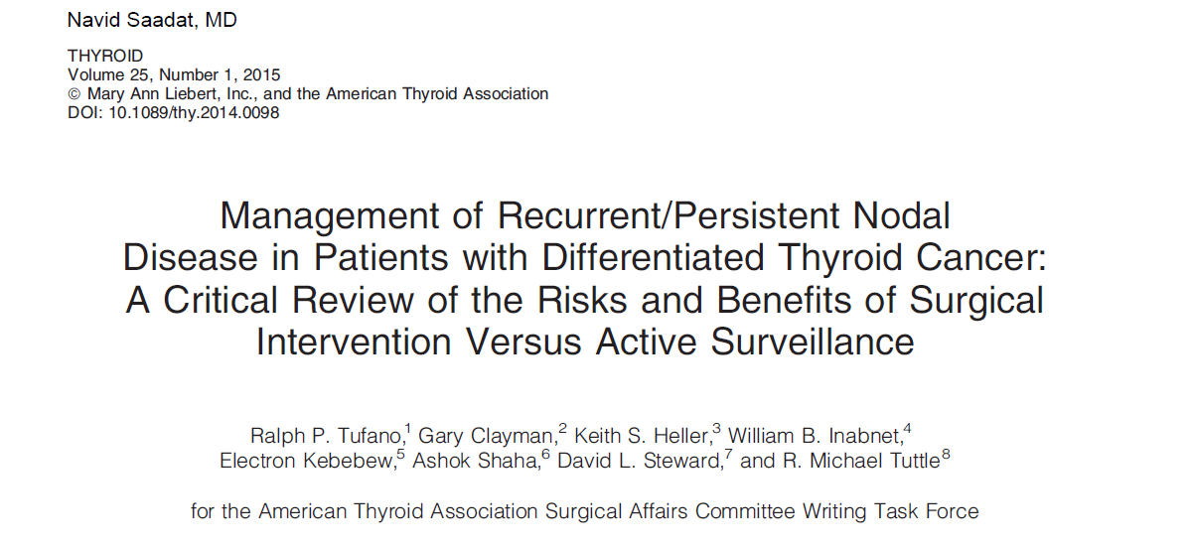

Slide 71
The general consensus is that secondary nodal surgery, if per-formed, should be reserved for therapeutic resection of clinically evident nodal disease.
Secondary nodal surgery in a previously undissected lateral neck should include levels II–V to maximize nodal yield and possibly reduce re-currence while limiting morbidity to the regional nerve structures. In reoperative settings, it is recommended that the surgeon dissect only the compartments with clinically identiﬁable disease, and adjacent previously un-dissected compartments. However, some authors favor a more extensive approach to include the compartments im-mediately adjacent to the clinically identiﬁable disease on oncological grounds, even if previously dissected

Slide 72
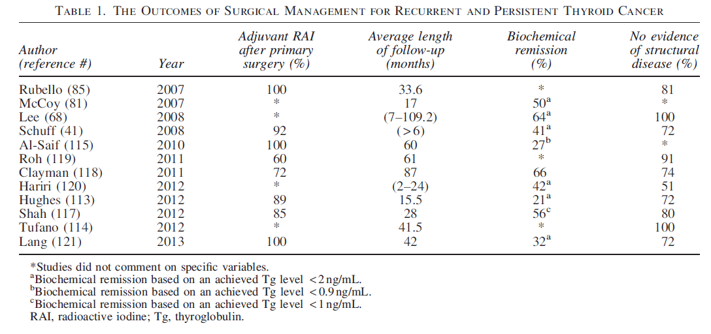

Slide 73
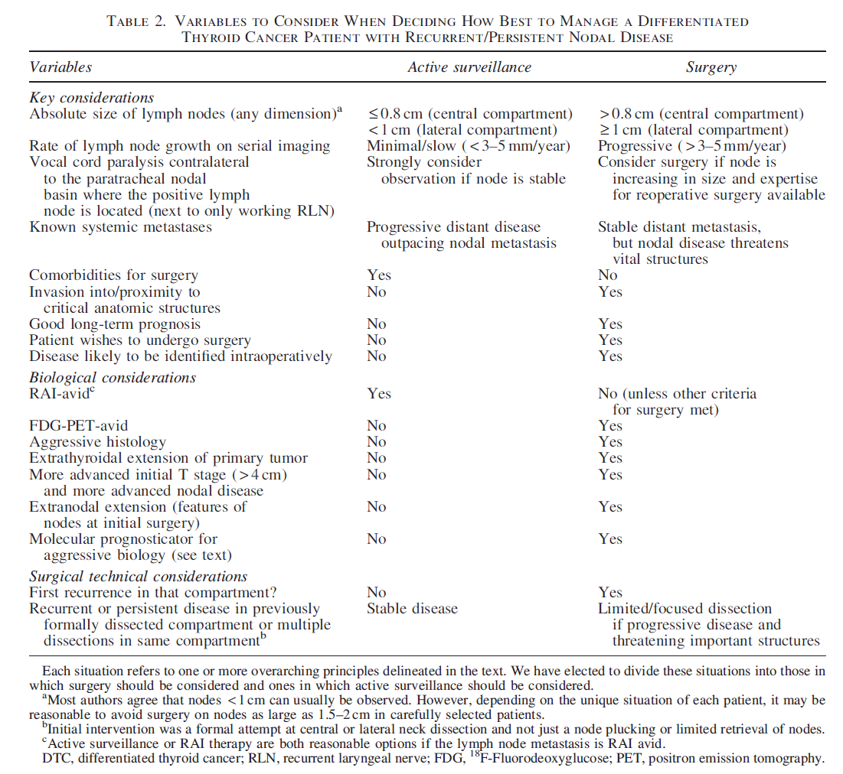

Slide 82
this prospecive RCT study:
5-year follow-up of cN0 PTC patients treated either with TTx or TTx pCCND similar outcome in the two Groups.
To obtain the same outcome, a greater number of patients treated with TTx needed a higher number of 131-I courses, but those treated with TTxpCCND had a higher number of permanent hypoPTH that severely affect the quality of life (QOL).
Key massage of the study: there are no clinical advantages in performing pCCND in PTC patients with cN0 at neck ultrasound

Slide 83
Take Home please
Preoperative assessment of nodal status with US & regional neck dissection only if there is clinical involvement in the central or lateral neck compartments.
During the operation the lymph node should be inspected & any suspected should be biopsied.
Monitoring patients with low-risk disease but recurrent or persistent cervical thyroid cancer in the lateral lymph nodes is generally a reasonable approach.

Slide 84
For small metastases, a reasonable approach is radioiodine, but their persistence after 2 or 3 treatments should usually lead to surgery.
The general consensus is that secondary nodal surgery, if per-formed, should be reserved for therapeutic resection of clinically evident nodal disease.

Slide 85

Thank you for your attention

