Slide 1
Exercise therapy in NAFLD
Mohammad Hassabi (MD)
Assistant Professor of Sports and Exercise Med. Dept.
Shahid Beheshti University of Medical Sciences
Taleghani Medical Center

Slide 2
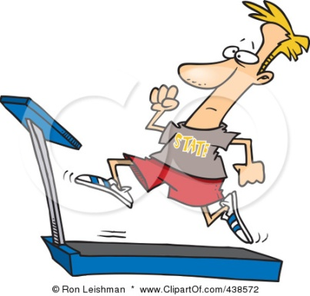
Physical activity
Exercise
Sports

Slide 3
Physical fitness is considered a measure of the body’s ability to function efficiently and effectively in work and leisure
Components of physical fitness
Physiological | Health related | Skill related
Metabolic Morphological Bone integrity Other | Cardiovascular fitness Flexibility Muscular endurance Muscle strength Body composition | Agility Balance Coordination Power Speed Reaction time Other

Slide 4
Types of exercise

Slide 5
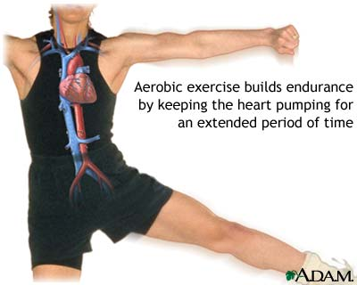
Aerobic exercise
Incorporate Rhythmic use of large groups of muscle
Performed at moderate levels of intensity
Extended periods of time
Aimed to improve cardio-respiratory fitness
And increasing energy expenditure
Walking, jogging, swimming or bicycling are some examples of aerobic activities

Slide 6
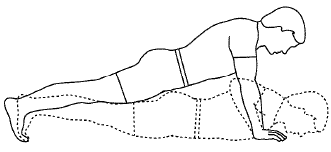
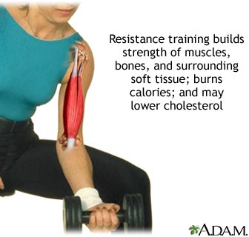
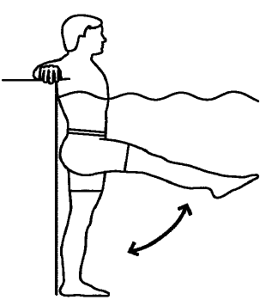
Resistance training
Resistance training is a form of muscular fitness training in which each effort is performed against a specific opposing force

Slide 7
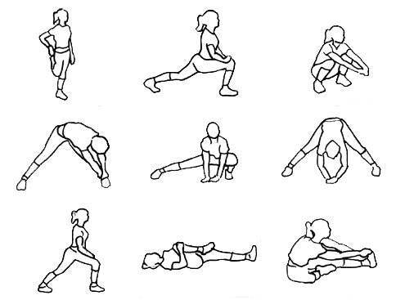
Flexibility Training
Flexibility training can be included as part of the warm-up or cool-down, or undertaken at a separate time.

Slide 8
Lifestyle Modification
To date there is no effective drug treatment for nonalcoholic fatty liver disease (NAFLD). A combination of dietary modifications and increased physical activity remains the mainstay of NAFLD therapy
Exercise is now an established therapy for the management of NAFLD
Based on the 2012 published practice guidelines, lifestyle intervention has shown to improve hepatic aminotransferases along with steatosis

Slide 9
In overweight or obese NAFLD patients, weight reduction mediated by dietary and exercise therapies decreases liver fat content
7–10% reduction in body weight can lead to significant reduction in hepatic steatosis, improved NAFLD activity score and the reversal of NASH
Human data clearly demonstrate that regular exercise itself reduces liver fat and can do so in the absence of clinically significant weight loss

Slide 10
the possible mechanisms related to beneficial effects of aerobic exercise

Slide 11
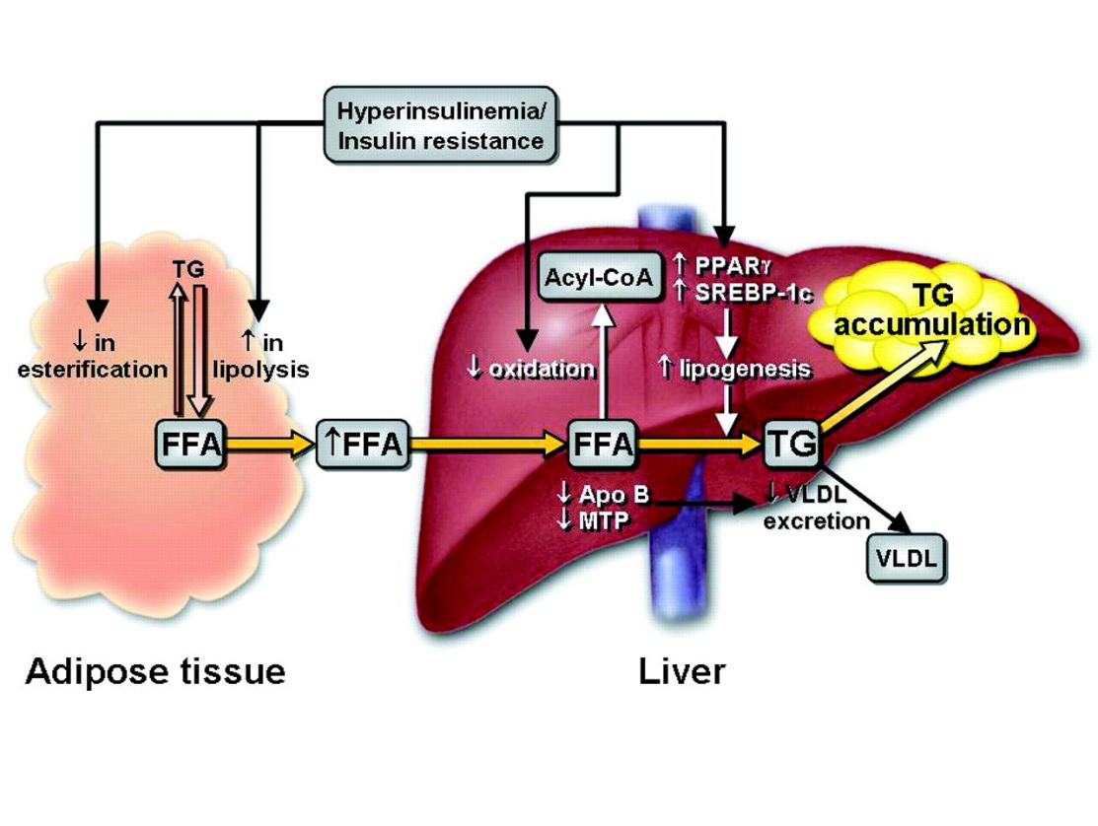
Modulating intrahepatic fat content
exercise could regulate hepatic lipid metabolism by modulating hepatic β-oxidation and reducing hepatic lipogenesis
exercise can ameliorate NAFLD by regulating SREBP-1c and PPARγ expression and activities
- hepatic steatosis is highly associated with the dysregulation of sterol regulatory element-binding protein-1c (SREBP-1c), a transcription factor that regulates genes which enhance triglyceride synthesis, with associated reductions in hepatic capacity for fatty acid oxidation
- PPARγ, a nuclear receptor protein transcription factor regulating lipid metabolism
Leon A. Adams et al. CMAJ 2005;172:899-905

Slide 12
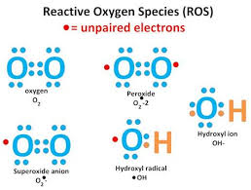
Decreasing NAFLD-induced oxidative stress
There is a close relationship between oxidative stress and the severity of NASH
When oxidative stress occurs in NAFLD, two general products are often excessively generated: reactive oxygen species (ROS) and reactive nitrogen species (RNS)
exercise attenuates the oxidative damage triggered by NAFLD partly through enhancing the antioxidant enzyme level (such as catalase (CAT), GPx and SOD-1) and regulating ROS level

Slide 13
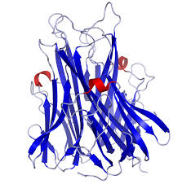
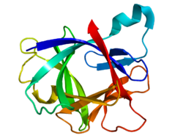
Reducing hepatic inflammation
Hepatic inflammation, another major event in NAFLD, is also a key transitional event that progresses from a simple steatosis to NASH
Aerobic exercise decreases the expression of pro-inflammatory mediators TNF-α and IL-1β

Slide 14
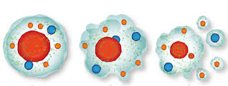
Ameliorating NAFLD-induced hepatocyte apoptosis
The occurrence of apoptosis in hepatocytes is often seen in NAFLD patients and experimental animal models
Luo et al, demonstrated that chronic resistance exercise reduces the level of cytochrome C released from the mitochondria to the cytosol as well as the expression level of cleaved caspase-3 in aged rats, suggesting that exercise inhibits mitochondria-dependent apoptosis.
treadmill exercise reduces diabetes-triggered apoptosis by enhancing the p-AKT expression level in diabetic rats
Additionally, it has been shown that hepatocyte apoptotic markers are diminished
aerobic excercise reduces hepatocyte apoptosis through enhancing the p-AKT level and down-regulating the apoptotic markers such as caspase-3

Slide 15
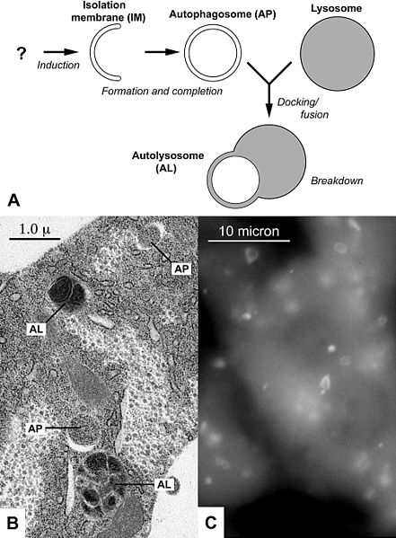
Triggering Hepato-protective autophagy
Autophagy is a cellular process of degradation of intracellular components to recycle cellular waste and maintains energy balance under starvation
Even though the mechanism has not been shown, a reasonable speculation could be deduced that exercise is considered as a newly defined stimulus that triggers autophagy, leading to the attenuation of NAFLD pathology ultimately

Slide 17
The optimal ‘dose’ of exercise for patients with NAFLD

Slide 18
Aerobic exercise training
There is no specific exercise guideline for NAFLD
most studies have conformed to doses recommended by the ACSM for in apparently healthy adults:
moderate-intensity for ≥30 min at least 5 d/w,
or vigorous cardiorespiratory exercise training for ≥20 min 3 d/w
Exercise interventions meeting these guidelines consistently demonstrate reduction in liver fat of 10–43% in patients with NAFLD

Slide 19
Keating et al, recently observed in previously inactive obese adults significant reduction in intrahepatic lipid (IHL) with exercise training doses which emphasized:
volume over intensity (45–60 min of aerobic exercise at 50% VO2peak on 4 days per week, mean relative IHL reduction of 28%) or
intensity over volume (30–45 min of aerobic exercise at 70% VO2peak on 3 days per week, mean relative IHL reduction of 29%)
Interestingly, a mean 18% relative reduction in IHL was also observed with prescription of low-to-moderate intensity and low-volume aerobic exercise (30 min at 70% VO2peak on 3 days per week), demonstrating that significant reductions can occur below the doses advocated in the current guidelines.

Slide 20
Progressive resistance training
General exercise guidelines : 2–3 non-consecutive sessions/w
Of the 9 studies employing PRT in isolation:
- 5 observed a significant reduction in liver fat, three of which conformed with the abovementioned guidelines,
- while 4 showed no benefit

Slide 21
Slentz CA, et al. Effects of aerobic vs resistance training
The largest study to date which has directly compared aerobic exercise with PRT observed significant reduction in liver fat score (assessed via attenuation of computed tomography) with 8 months of aerobic exercise training but not with PRT in overweight adults
144 subjects 18–70 yr old, overweight, sedentary,

Slide 22
Exercise for patients with NASH

Slide 23
There is no evidence to suggest that exercise has an effect on NASH
Cross-sectional data suggest that vigorous exercise intensity per se is required for histological improvement in the liver
Recent research from obese rodent models also suggests a superior benefit of high-intensity training compared with moderate-intensity continuous exercise on liver fat and markers of liver injury typically associated with NASH

Slide 24
Kistler KD, et al. Physical activity recommendations, exercise intensity, and histological severity of nonalcoholic fatty liver disease. Am J Gastroenterol 2011
a retrospective analysis of adults (N=813) with biopsy-proven NAFLD
Their findigs support an association of vigorous but not moderate or total exercise with the severity of NAFLD

Slide 25
Cho J, et al. Effect of training intensity on nonalcoholic fatty liver disease
Animal study
The intensity-dependent benefit of exercise training against hepatic steatosis was associated with greater activation of VIT on hepatic AMP-mediated protein kinase in conjunction with greater suppressive effect of VIT on hypoadiponectinemia, downregulation of the Adiponectin receptor 2 signaling pathway, and upregulation of the NF-κB signaling pathway in the liver.
The current findings suggest that VIT is an alternative way of exercise training to combat hepatic steatosis associated with an obese and impaired glucose tolerance phenotype.

Slide 26
However, until further evidence is available from human clinical trials, exercise for patients with NASH should be prescribed at similar exercise levels, cognizant of co-morbidities and in conjunction with lifestyle changes and pharmacotherapy

Slide 27
Safety of vigorous exercise in clinical populations

Slide 28
Vigorous physical activity may be contraindicated in patients with, or at risk of, cardiovascular disease, which includes those with NAFLD.
Vigorous exercise should only be initiated after appropriate pre-screening.
Available evidence suggests that vigorous exercise is safe in patients with coronary artery disease but pre-medical evaluation should include 12-lead electrocardiography (stress testing) and appropriate specialist review if indicated.

Slide 29
Exercise Recommendations

Slide 30
Based on current evidence
150–300 min per week of moderate- to vigorous-intensity (50–70% VO2peak) aerobic exercise, performed on a minimum of 3 d/w for hepatic benefits in patients with NAFLD
While evidence supports the prescription of aerobic exercise in the first instance, performing PRT for 2–3 days per week (3 sets of 8–12 Reps at an intensity of 70– 85% 1RM) may provide additional benefit for optimizing insulin sensitivity and improving muscle strength and function

Slide 31
Ultimately, exercise prescription should be individualized to promote adoption and long term adherence to the exercise regimen, which may be facilitated by behavioral and cognitive strategies

Slide 32
References
Guo, R., et al. (2015). "Beneficial mechanisms of aerobic exercise on hepatic lipid metabolism in non-alcoholic fatty liver disease." Hepatobiliary Pancreat Dis Int 14(2): 139-144.
Keating, S. E., et al. (2015). "The benefits of exercise for patients with non-alcoholic fatty liver disease." Expert Rev Gastroenterol Hepatol 9(10): 1247-1250.
KASL clinical practice guidelines: Management of nonalcoholic fatty liver disease, Clinical and Molecular Hepatology, 2013;19:325-348

