Slide 1
Insulin Injection: Guidelines and Practical Aspects
Sara Sedaghat, MD
Gabric Diabetes Education Association
August 2019

Slide 2
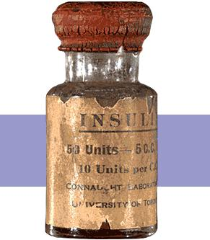
Banting-1922

Slide 4
Case
52 year old Female
T2DM for 12 years
Injecting insulin for the past 7 years.
On MDI:
Basal: Lantus 10 p.m.
Prandial: Apidra
(http://www.fit4diabetes.com/ 2016)

Slide 5
Current Challenges
HbA1c has been drifting up over the last 18 months from 7.8% to her most recent value of 8.4%
Unexplained glycaemic variability
Occasional episodes of unexplained hypoglycaemia.
How would you help her?

Slide 6
Injection Technique Review
Uses her abdomen and occasionally will use thighs but finds injections there “burn”
Using an 8mm pen needle
Rotates by moving from left to right on her abdomen, similar location either side, examination indicates evidence of lipohypertrophy
Injects at a 90° angle, no lifted skin fold
Now how would you help her?

Slide 7
The Neglected Area of Concern
Incorrect Insulin Administration:
Behavior that affect glycaemia
Frid, A. H., L. J. Hirsch, A. R. Menchior, D. R. Morel and K. W. Strauss (2016). Worldwide Injection Technique Questionnaire study: injecting complications and the role of the professional. Mayo Clinic Proceedings, Elsevier.
Notes:
It is increasingly apparent that proper injection
technique is essential to good diabetes management.
It may be as important as the choice
and dose of insulin because the insulin will not
work effectively unless injected properly

Slide 8
Current State of Insulin Injection
Injection Technique Questionnaire (ITQ) Survey Worldwide Results:
From February 1, 2014, through June 30, 2015
13,289 insulin-injecting patients
423 centers in 42 countries
https://public.tableau.com/profile/adam.yeung#!/vizhome/ITQsurveydataMayo/START
Frid, Hirsch et al(2016). Worldwide Injection Technique Questionnaire study: injecting complications and the role of the professional. Mayo Clinic Proceedings, Elsevier.
Frid, Hirsch et al (2016). Worldwide injection technique questionnaire study: population parameters and injection practices. Mayo Clinic proceedings, Elsevier.

Slide 9
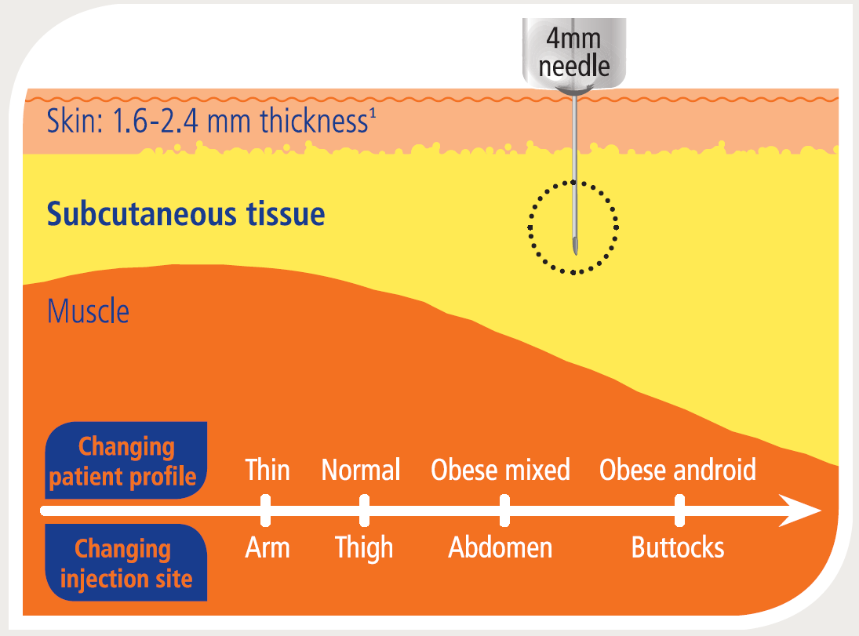
SC Insulin Injection
www.fit4diabetes.com
FIT Technique Plus Needle Length Education

Slide 10
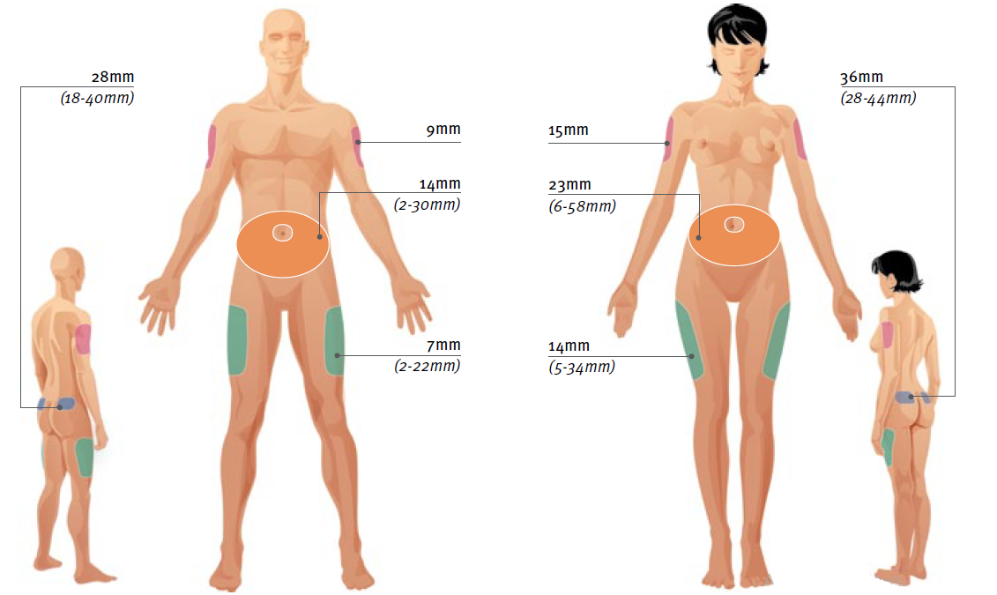
Injection Sites
1
1
4
2
3
FIT Forum for Injection Technique Canada Recommendations for Best Practice in Injection Technique (2nd Edition)
Notes:
FIT Forum for Injection Technique Canada Recommendations for Best Practice in Injection Technique (2nd Edition)

Slide 11
Injection Sites
47%: One site
26%: Two sites
13%: Three sites
8%: all four sites
Frid, Hirsch et al (2016). Worldwide injection technique questionnaire study: population parameters and injection practices. Mayo Clinic proceedings, Elsevier.

Slide 12
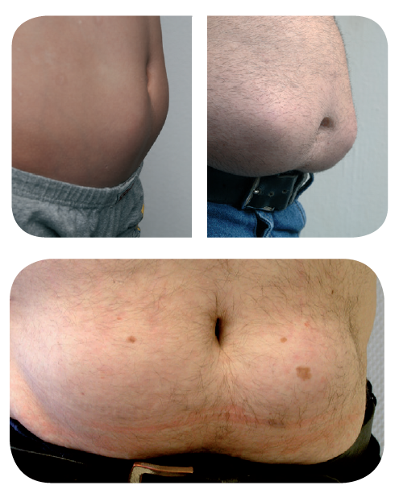
Lipohypertrophy (LH)
The most common cutaneous complication of insulin therapy
Change in the SC tissue
A raised or mound-like, convex pattern with no change in skin color or hair distribution
A harder, and more rubbery or less bouncy tissue.
Richardson, T., & Kerr, D. (2003). Skin-related complications of insulin therapy. American journal of clinical dermatology, 4(10), 661-667.

Slide 13
Lipohypertrophy
Unclear etiology:
Insulin molecule itself or by excipients added to the insulin formulations
LH was associated with:
Incorrect rotation of injection sites
Use of smaller injecting zones
Longer duration of insulin use
Reuse of pen needles
Blanco, M., et al (2013). Prevalence and risk factors of lipohypertrophy in insulin-injecting patients with diabetes. Diabetes & metabolism, 39(5), 445-453.
Frid, A. H., et al. (2016). New Insulin Delivery Recommendations. Mayo Clin Proc
Chandran, A.,et al(2015). Economic and patient burden of Lipohypertrophy in Chinese patients with Diabetes. Health Economics, 1(2), 3.
Notes:
Lipohypertrophy was associated with incorrect rotation of injection sites, use of smaller injecting zones, longer duration of insulin use, and reuse of pen needles (all significant at P<.05). The higher the number of times the pen needle was reused, the more frequently LH was reported (Table 6). The size of the LH was also related to the number of times the needle was used (Supplemental Table 2, available online at http://www.mayoclinicproceedings. org).2 Using logistic regression analysis, incorrect rotation and years taking insulin were shown to be the most important factors associated with LH (P<.001), and pen needle reuse
Frid, A. H., L. J. Hirsch, A. R. Menchior, D. R. Morel and K. W. Strauss (2016). Worldwide Injection Technique Questionnaire study: injecting complications and the role of the professional. Mayo Clinic Proceedings, Elsevier.

Slide 14
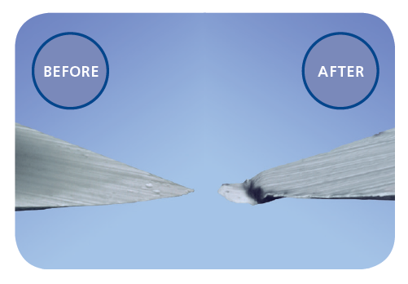
Most important factors associated with LH:
Pen needle reuse
Incorrect rotation
Blanco, M., et al(2013). Prevalence and risk factors of lipohypertrophy in insulin-injecting patients with diabetes. Diabetes & metabolism, 39(5), 445-453.
Frid, A. H., et al. (2016). New Insulin Delivery Recommendations. Mayo Clin Proc, 91(9), 1231-1255.
Chandran, A, et al. (2015). Economic and patient burden of Lipohypertrophy in Chinese patients with Diabetes. Health Economics, 1(2), 3.
Notes:
Lipohypertrophy was associated with incorrect rotation of injection sites, use of smaller injecting zones, longer duration of insulin use, and reuse of pen needles (all significant at P<.05). The higher the number of times the pen needle was reused, the more frequently LH was reported (Table 6). The size of the LH was also related to the number of times the needle was used (Supplemental Table 2, available online at http://www.mayoclinicproceedings. org).2 Using logistic regression analysis, incorrect rotation and years taking insulin were shown to be the most important factors associated with LH (P<.001), and pen needle reuse
Frid, A. H., L. J. Hirsch, A. R. Menchior, D. R. Morel and K. W. Strauss (2016). Worldwide Injection Technique Questionnaire study: injecting complications and the role of the professional. Mayo Clinic Proceedings, Elsevier.

Slide 15
Prevalence:
1-2 of every 3 people with diabetes on insulin therapy have some degree of LH
ITQ survey: 30%
Spanish study: 64.4%
Italian study: 48.7%
Chinese study: 53.1%.
Blanco, M., et al (2013). Diabetes & metabolism, 39(5), 445-453.
Grassi, et al (2014). Journal of Clinical & Translational Endocrinology
Sun, Z., et al (2015). Diabetologia.
Frid, A. H., et al. (2016). Mayo Clin Proc, 91(9), 1231-1255.
Saltiel-Berzin, R., et al. (2012). Diabetes Educ, 38(5), 635-643.

Slide 16
Lipohypertrophy: the Silent Enemy in Diabetes
Higher HbA1C values
Unexpected hypoglycemia
Glycemic variability
Frequent DKA
Increased total daily dose of insulin
Increased cost due to Excessive insulin and Hospitalization
Blanco, M., et al. (2013). Prevalence and risk factors of lipohypertrophy in insulin-injecting patients with diabetes. Diabetes & metabolism, 39(5), 445-453.
Frid, A. H., et al. (2016). New Insulin Delivery Recommendations. Mayo Clin Proc, 91(9), 1231-1255. doi:10.1016/j.mayocp.2016.06.010
Chandran, A., et al(2015). Economic and patient burden of Lipohypertrophy in Chinese patients with Diabetes. Health Economics, 1(2), 3.
Notes:
The presence of LH was associated with higher glycated hemoglobin (HbA1c) values, with a mean HbA1c level 0.55% higher in patients with LH than in those without LH
These differences were almost the same for patients with T1DM as for those with T2DM. Lipohypertrophy was associated with higher rates of unexpected hypoglycemia and glycemic variability as well as more frequent diabetic ketoacidosis. (Data not shown but all differences were significant at P<.05.)
There was a strong association between the
presence of LH and the total daily dose (TDD) of insulin (Table 4). A mean of 10.1 IU more insulin was consumed in the population with LH compared with those without LH. In patients with T2DM, this average TDD difference rose to 13.5 IU, whereas in patients with T1DM, the average TDD difference was 5.4 IU. These differences were similar in patients with LH who continued to inject into LH vs those who did not (Table 4).
Frid, A. H., L. J. Hirsch, A. R. Menchior, D. R. Morel and K. W. Strauss (2016). Worldwide Injection Technique Questionnaire study: injecting complications and the role of the professional. Mayo Clinic Proceedings, Elsevier.

Slide 17
Lipohypertrophy
Frid, A. H., et al(2016). Worldwide Injection Technique Questionnaire study: injecting complications and the role of the professional. Mayo Clinic Proceedings, Elsevier.
Notes:
Frid, A. H., L. J. Hirsch, A. R. Menchior, D. R. Morel and K. W. Strauss (2016). Worldwide Injection Technique Questionnaire study: injecting complications and the role of the professional. Mayo Clinic Proceedings, Elsevier.

Slide 18
Correct Site Rotation
Rotation within the site, rather than jumping from one side to another
Systematic rotation: easy-to-follow rotation scheme
Dividing sites into quadrants/halves when using the thighs or buttocks
One quadrant per week
Rotating quadrant to quadrant in a consistent direction (eg,clockwise)
Frid, A. H., et al (2016). Worldwide Injection Technique Questionnaire study: injecting complications and the role of the professional. Mayo Clinic Proceedings, Elsevier.
Spollett, G., et al (2016). Improvement of Insulin Injection Technique: Examination of Current Issues and Recommendations. Diabetes Educ, 42(4), 379-394.
Notes:
Injections should be systematically rotated to avoid LH. A2
This means injecting at least 1 cm (or approximately the width of an adult finger) from previous injections, a vital procedure that requires careful planning and attention. A2
The HCP should review the site rotation scheme with the patient at least once a year. A2
Frid, A., L. Hirsch, R. Gaspar, D. Hicks, G. Kreugel, J. Liersch, C. Letondeur, J. P. Sauvanet, N. Tubiana-Rufi, K. Strauss and W. Scientific Advisory Board for the Third Injection Technique (2010). "New injection recommendations for patients with diabetes." Diabetes Metab 36 Suppl 2: S3-18.
One evidence-based scheme:
dividing sites into quadrants/halves when using the thighs or buttocks
One quadrant per week
Rotating quadrant to quadrant in a consistent direction (eg,clockwise)
scheme courtesy of Lourdes Saez-de Ibarra and Ruth Gaspar, diabetes nurses and specialist educators at La Paz Hospital, Madrid, Spain(A3)
Frid, A. H., G. Kreugel, G. Grassi, S. Halimi, D. Hicks, L. J. Hirsch, M. J. Smith, R. Wellhoener, B. W. Bode, I. B. Hirsch, S. Kalra, L. Ji and K. W. Strauss (2016). "New Insulin Delivery Recommendations." Mayo Clin Proc 91(9): 1231-1255.

Slide 19
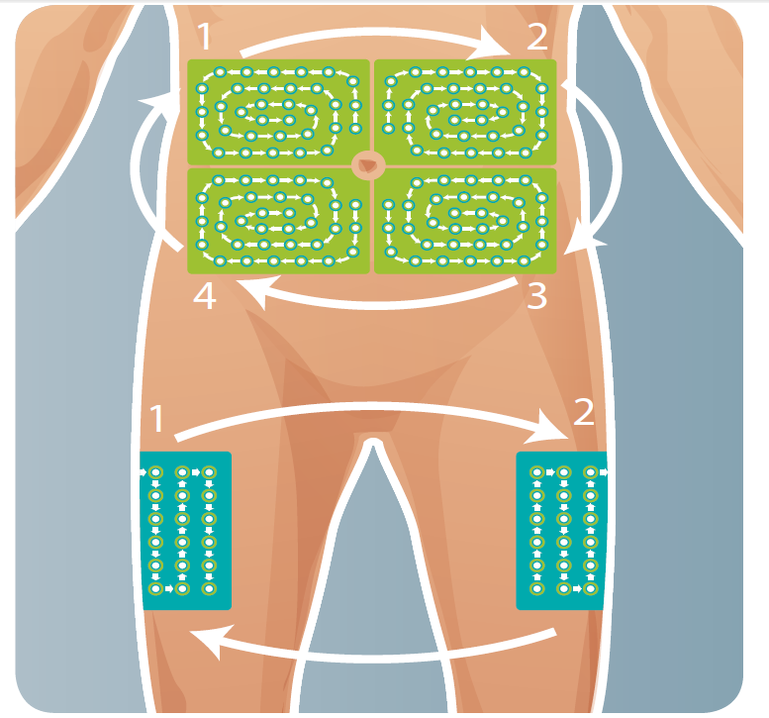
Structured Rotation Plan
Rotate the site you use
Rotate within the zone you use
Injections within any quadrant should be spaced at least 1-2cm from each other
Use 1 zone per week and move clockwise
Scheme courtesy of lourdes saez-de ibarra and ruth gaspar

Slide 20
HCP Role
Review the site rotation scheme with the patient at least once a year
Frid, A. H., et al (2016). Worldwide Injection Technique Questionnaire study: injecting complications and the role of the professional. Mayo Clinic Proceedings, Elsevier.
Spollett, G., et al (2016). Improvement of Insulin Injection Technique: Examination of Current Issues and Recommendations. Diabetes Educ, 42(4), 379-394.
Notes:
Injections should be systematically rotated to avoid LH. A2
This means injecting at least 1 cm (or approximately the width of an adult finger) from previous injections, a vital procedure that requires careful planning and attention. A2
The HCP should review the site rotation scheme with the patient at least once a year. A2
Frid, A., L. Hirsch, R. Gaspar, D. Hicks, G. Kreugel, J. Liersch, C. Letondeur, J. P. Sauvanet, N. Tubiana-Rufi, K. Strauss and W. Scientific Advisory Board for the Third Injection Technique (2010). "New injection recommendations for patients with diabetes." Diabetes Metab 36 Suppl 2: S3-18.
One evidence-based scheme:
dividing sites into quadrants/halves when using the thighs or buttocks
One quadrant per week
Rotating quadrant to quadrant in a consistent direction (eg,clockwise)
scheme courtesy of Lourdes Saez-de Ibarra and Ruth Gaspar, diabetes nurses and specialist educators at La Paz Hospital, Madrid, Spain(A3)
Frid, A. H., G. Kreugel, G. Grassi, S. Halimi, D. Hicks, L. J. Hirsch, M. J. Smith, R. Wellhoener, B. W. Bode, I. B. Hirsch, S. Kalra, L. Ji and K. W. Strauss (2016). "New Insulin Delivery Recommendations." Mayo Clin Proc 91(9): 1231-1255.

Slide 21
LH Management
LH are favorite spots!!
Switching injections from lipohypertrophic to normal tissue:
A decrease in the dose of insulin
The amount of change varies from one individual to another
Guided by frequent blood glucose measurements
The UK injection and infusion technique recommendations-4th Edition

Slide 22
LH Examination
Frequency:
At least once a year on all persons injecting insulin.
Patients with LH lesions:
More frequently
Educate patient for monthly self-examination and to report any change to the HCP.
Technique:
Visual Inspection
Palpation
Documentation and monitoring

Slide 23
Correct Examination Setting
Patient should be asked about abnormalities at injection sites (what, where and how long); this should guide examinations but not limit it to one area.
Patient must then disrobe to only underclothes.
Room must be warm
Light should be oblique to the skin
The UK injection and infusion technique recommendations-4th Edition
Notes:
Patient should be asked about abnormalities at injection sites (what, where and how long); this should guide examinations but not limit it to one area.
2 Patient must then disrobe to only underclothes. A chaperone may be needed in some cultures.
3 Room must be warm to prevent patient chilling (this ensures patient comfort but also prevents shivering and muscle tension which can interfere with the examinations).
4 Light should be oblique to the skin (not overhead); the use of an examining light with an adjustable neck is ideal; light should be shined onto skin surfaces at an angle of 30-45 degrees.

Slide 24
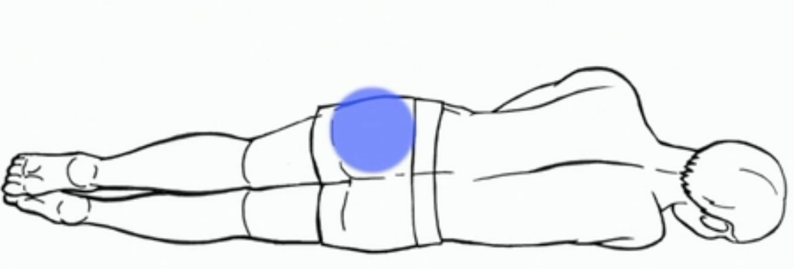
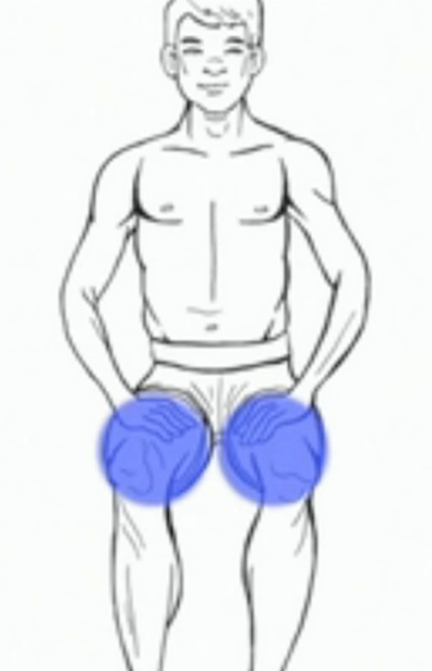
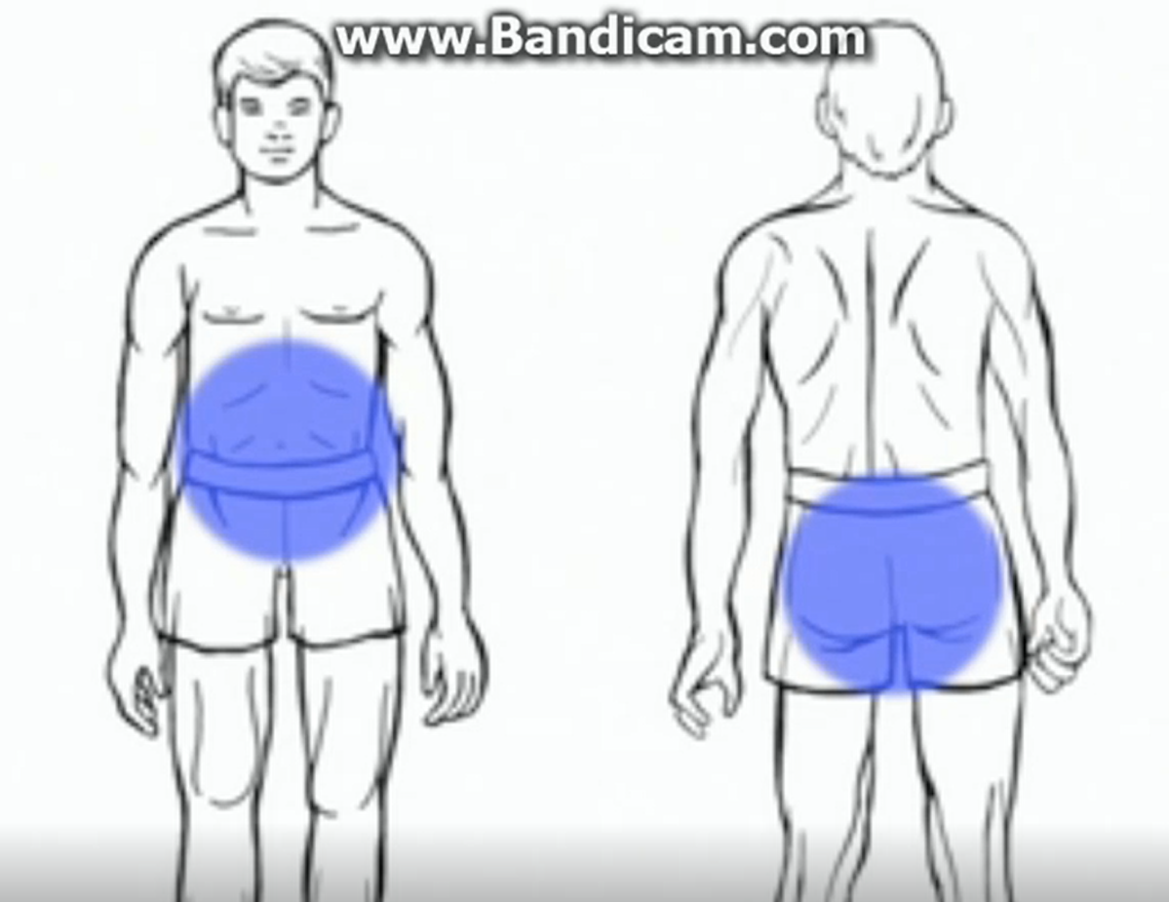
Patient Positioning
Notes:
Patient should be lying down on back (to relax abdominal muscles) with knees bent (to relax thigh [quadriceps] muscles) and arms folded over chest (to relax arm muscles).
If there is no table, an alternative is for the patient to be sitting, with knees bent and arms relaxed in lap

Slide 25
Technique for Visual Examination
Inspect site with lamp first
Manifestations:
Raised or mound-like
Convex pattern with no change in skin colour or hair distribution
Occasionally: only a shiny or hyper-pigmented (e area and/or an area of hair loss.
The UK injection and infusion technique recommendations-4th Edition
Notes:
1 Inspect site with lamp first, adjusting its angle to be able to detect any subtle risings or depressions across the surface of the skin.
2 Lipohypertrophy (LH) is usually manifested as a raised or mound-like, convex pattern with no change in skin colour or hair distribution; occasionally it can be manifested as only a shiny or hyper-pigmented (especially in dark-skinned persons) area and/or an area of hair loss.
3 If detected, gain consent and mark centre point with pen so that area can be palpated later

Slide 26
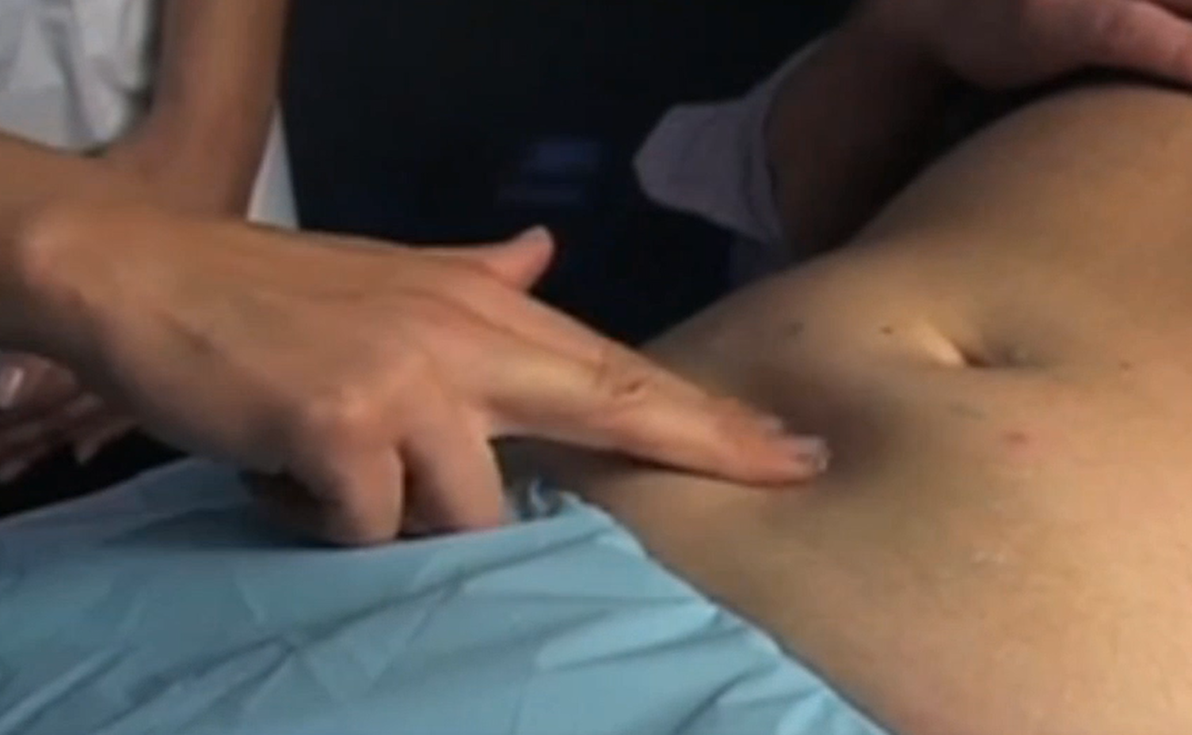
Technique of Palpation
Warm hands
Apply gel to the injecting area
Palpate with the tips of the fingers
Massage-like motions (forward thrusts or circular sweeps).
The transitional zone:
A ‘step-up’ from the surrounding soft tissue
The UK injection and infusion technique recommendations-4th Edition
Notes:
After hands are warmed by rubbing them together or washing in warm water, apply gel (ultrasound gel or another water-soluble lubricant for clinical use) to the injecting area and palpate with the tips of the fingers, working in towards the injecting area with light massage-like motions (forward thrusts or circular sweeps).
2 Lipohypertrophy is manifest by a change in the subcutaneous (SC) tissue, which is replaced by a harder, and more rubbery or less bouncy tissue.
3 Often the edges of this abnormal area are clearly demarcated and it is easy to feel the transitional zone, which appears as a ‘step-up’ from the surrounding soft tissue

Slide 27
Measuring and Documenting the LH
Mark the extent of lesion
Measure the distance along its largest dimension in mm and record in patient’s chart.
Photograph the lesion from a distance of 1 meter without flash
Use the measurements and photograph to follow progression of the lesion long-term.
Notes:
With the patient’s consent and using skin safe marker pen, mark the exact position of the lesion on the patient’s skin so that the patient can clearly see the extent of the lesion and avoid injecting into it.
Measure the distance along its largest dimension (usually the longest diameter) in mm and record in patient’s chart.
Photograph the lesion from a distance of 1 meter without flash, using the light from an oblique source so as to reveal surface contours once consent has been given. 4 Use the measurements and photograph to follow progression of the lesion long-term.
Patient should be taught to do the visual and palpation examination monthly (using soap or hand lotion as a lubricant) and to report any change to the HCP.

Slide 28
IM injection
Patients may be unaware that they are injecting IM
Clues to IM injection
Bleeding, bruising
Stinging pain/ worsened if the muscle contracts
Upright position after syringe release
Unexplained glycemic variability and episodes of hypoglycemia
Frid, A. H., et al. (2016). New Insulin Delivery Recommendations. Mayo Clin Proc, 91(9), 1231-1255. doi:10.1016/j.mayocp.2016.06.010
Notes:
Patients may be unaware that they are injecting IM. Several clinical pointers can give clues as to whether the injection is IM or SC. Intramuscular injections can lead to a greater risk of bleeding, bruising, and pain. The pain may be described as stinging, and it worsens if the relevant muscle is contracted with the needle in situ If a patient releases the syringe with the needle still under the skin, it may continue to stand upright if it is IM (whereas it topples over in SC injections).
Unexplained glycemic variability and episodes of hypoglycemia may suggest IM injection. At special risk are children, thin persons, and persons using longer needles or following improper technique.
REF:
Frid, A. H., G. Kreugel, G. Grassi, S. Halimi, D. Hicks, L. J. Hirsch, M. J. Smith, R. Wellhoener, B. W. Bode, I. B. Hirsch, S. Kalra, L. Ji and K. W. Strauss (2016). "New Insulin Delivery Recommendations." Mayo Clin Proc 91(9): 1231-1255.

Slide 29
IM Injection
Risk of IM injection:
IM injection leads to poor glycemic control
Excessive glycemic variability
Frequent and unexplained hypoglycemia
Vulnerable population:
Children
Thin persons
Using longer needles
Improper technique
Frid, A. H., et al. (2016). New Insulin Delivery Recommendations. Mayo Clin Proc, 91(9), 1231-1255. doi:10.1016/j.mayocp.2016.06.010
Notes:
Patients may be unaware that they are injecting IM. Several clinical pointers can give clues as to whether the injection is IM or SC. Intramuscular injections can lead to a greater risk of bleeding, bruising, and pain. The pain may be described as stinging, and it worsens if the relevant muscle is contracted with the needle in situ If a patient releases the syringe with the needle still under the skin, it may continue to stand upright if it is IM (whereas it topples over in SC injections).
Unexplained glycemic variability and episodes of hypoglycemia may suggest IM injection. At special risk are children, thin persons, and persons using longer needles or following improper technique.
REF:
Frid, A. H., G. Kreugel, G. Grassi, S. Halimi, D. Hicks, L. J. Hirsch, M. J. Smith, R. Wellhoener, B. W. Bode, I. B. Hirsch, S. Kalra, L. Ji and K. W. Strauss (2016). "New Insulin Delivery Recommendations." Mayo Clin Proc 91(9): 1231-1255.

Slide 30
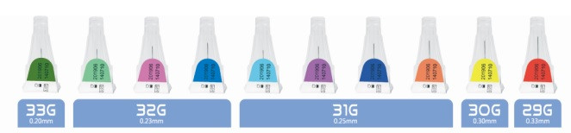
Pen Needles
4-mm: 30%
5-mm: 20%
6-mm: 20%
8-mm: 30%
Frid, A. H., et al (2016). Worldwide injection technique questionnaire study: population parameters and injection practices. Mayo Clinic Proceedings.

Slide 31
Syringe
The safest currently available syringe needle for all patients:
6 mm in length
Frid, A. H., et al. (2016). New Insulin Delivery Recommendations. Mayo Clin Proc, 91(9), 1231-1255. doi:10.1016/j.mayocp.2016.06.010
Notes:
The safest currently available syringe needle for all patients is 6 mm in length. However, when any syringe needle is used in children (≥6 years old), adolescents, or slim to normal weight adults (BMI of 19-25 [calculated as the weight in kilograms divided by the height in meters squared]), injections should always be given into a lifted skinfold. A1
Use of syringe needles in very young children (<6 years old) and extremely thin adults (BMI <19) is not recommended, even if they use a raised skinfold, because of the excessively high risk of IM injections.
REF:
Frid, A. H., G. Kreugel, G. Grassi, S. Halimi, D. Hicks, L. J. Hirsch, M. J. Smith, R. Wellhoener, B. W. Bode, I. B. Hirsch, S. Kalra, L. Ji and K. W. Strauss (2016). "New Insulin Delivery Recommendations." Mayo Clin Proc 91(9): 1231-1255.

Slide 32
Needle Length Recommendations
The 4-mm needle: long enough to traverse the skin Plus little risk of IM (or intradermal) injection.
Patients with tremors or other disorders that make them unable to hold a 4-mm pen needle in place may need longer needles.
Frid, A. H., et al. (2016). New Insulin Delivery Recommendations. Mayo Clin Proc, 91(9), 1231-1255. doi:10.1016/j.mayocp.2016.06.010
Notes:
The 4-mm needle is long enough to traverse the skin and enter the SC tissue, with little risk of IM (or intradermal) injection. Therefore, it is considered the safest pen needle for adults and children regardless of age, sex, ethnicity, or BMI.
Avoid pushing the needle hub in so deeply that it indents the skin because this increases the risk of IM injections. B3
Patients with tremors or other disorders that make them unable to hold a 4-mm pen needle in place may need longer needles. B3
High-flow needles (with extra-thin walls) have been shown to be appropriate for all injecting patients. Their obstruction, bending,and breakage rates are the same as for conventional- quality needles (extremely low) and offer flow and ease-of-use advantages.
REF:
Frid, A. H., G. Kreugel, G. Grassi, S. Halimi, D. Hicks, L. J. Hirsch, M. J. Smith, R. Wellhoener, B. W. Bode, I. B. Hirsch, S. Kalra, L. Ji and K. W. Strauss (2016). "New Insulin Delivery Recommendations." Mayo Clin Proc 91(9): 1231-1255.

Slide 33
Needle Length Recommendations
4 mm pen needle is considered the safest pen needle for adults and children regardless of age, sex, ethnicity, or BMI.
Frid, A. H., et al. (2016). New Insulin Delivery Recommendations. Mayo Clin Proc, 91(9), 1231-1255. doi:10.1016/j.mayocp.2016.06.010
Notes:
The 4-mm needle is long enough to traverse the skin and enter the SC tissue, with little risk of IM (or intradermal) injection. Therefore, it is considered the safest pen needle for adults and children regardless of age, sex, ethnicity, or BMI.
Avoid pushing the needle hub in so deeply that it indents the skin because this increases the risk of IM injections. B3
Patients with tremors or other disorders that make them unable to hold a 4-mm pen needle in place may need longer needles. B3
High-flow needles (with extra-thin walls) have been shown to be appropriate for all injecting patients. Their obstruction, bending,and breakage rates are the same as for conventional- quality needles (extremely low) and offer flow and ease-of-use advantages.
REF:
Frid, A. H., G. Kreugel, G. Grassi, S. Halimi, D. Hicks, L. J. Hirsch, M. J. Smith, R. Wellhoener, B. W. Bode, I. B. Hirsch, S. Kalra, L. Ji and K. W. Strauss (2016). "New Insulin Delivery Recommendations." Mayo Clin Proc 91(9): 1231-1255.

Slide 34
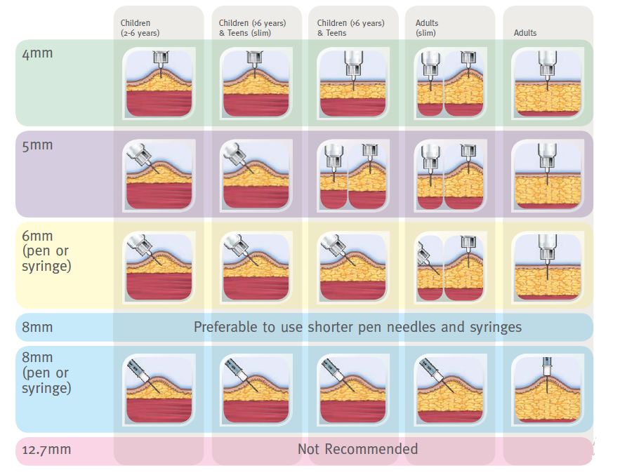

Slide 35
Lifting a Skinfold
Lifting a skinfold: to increase skin-to- muscle distance
Abdomen: nearly doubles the skin-to-muscle distance
Thigh: 20% increase in skin-to-muscle distance
Buttock: rarely needed
Arms: get help from others
Frid, A. H., et al. (2016). New Insulin Delivery Recommendations. Mayo Clin Proc, 91(9), 1231-1255. doi:10.1016/j.mayocp.2016.06.010
Notes:
Lifting a skinfold is required when the distance from the skin surface to the muscle is less than or equal to the needle length.
Lifting a skinfold in the abdomen nearly doubles the skin-tomuscle distance. In the thigh, it is sometimes difficult to lift a skinfold, and the mean increase in skin-to-muscle distance may be only 20%. In thin patients, thigh skinfolds may actually decrease the distance to muscle fasciadthe exact opposite of what is desired.
Lifting a skinfold is rarely needed in the buttocks because of the abundance of SC tissue there. When performed in the arm, skinfolds patient must be lifted by someone other than the patient.
Recommendations
A correct fold is made by lifting the skin with the thumb and index finger (possibly adding the middle finger). If the skin is lifted using the whole hand, muscle may be lifted as well as SC tissue, which can lead to IM injections 123 A3
Skinfolds should be lifted gently and not squeezed so tightly as to cause blanching or pain. A3
The optimal sequence when injecting into a skinfold is as follows: (1) gently lift a skinfold, (2) inject the insulin slowly at a 90 angle to the surface of the skinfold, (3) let the needle remain in the skin for a count of 10 after the plunger is depressed (when using the skin at the same angle it was inserted, (5) release the skinfold, and (6) dispose of the used needle safely. A3a pen), (4) withdraw the needle from

Slide 36
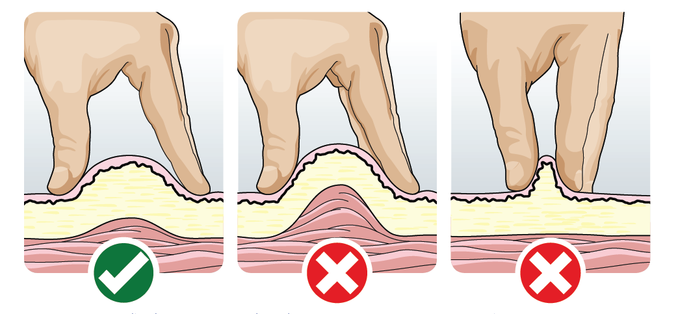
Lifting a Skinfold
Correct fold : lifting the skin with the thumb and index finger. Not the whole hand!
Do not squeeze so tightly as to cause blanching or pain
Frid, A. H., et al. (2016). New Insulin Delivery Recommendations. Mayo Clin Proc, 91(9), 1231-1255. doi:10.1016/j.mayocp.2016.06.010
Notes:
Lifting a skinfold is required when the distance from the skin surface to the muscle is less than or equal to the needle length.
Lifting a skinfold in the abdomen nearly doubles the skin-tomuscle distance. In the thigh, it is sometimes difficult to lift a skinfold, and the mean increase in skin-to-muscle distance may be only 20%. In thin patients, thigh skinfolds may actually decrease the distance to muscle fasciadthe exact opposite of what is desired.
Lifting a skinfold is rarely needed in the buttocks because of the abundance of SC tissue there. When performed in the arm, skinfolds patient must be lifted by someone other than the patient.
Recommendations
A correct fold is made by lifting the skin with the thumb and index finger (possibly adding the middle finger). If the skin is lifted using the whole hand, muscle may be lifted as well as SC tissue, which can lead to IM injections 123 A3
Skinfolds should be lifted gently and not squeezed so tightly as to cause blanching or pain. A3
The optimal sequence when injecting into a skinfold is as follows: (1) gently lift a skinfold, (2) inject the insulin slowly at a 90 angle to the surface of the skinfold, (3) let the needle remain in the skin for a count of 10 after the plunger is depressed (when using the pen) (4) withdraw the needle from at the same angle it was inserted, (5) release the skinfold, and (6) dispose of the used needle safely.

Slide 37
Lifting Skin Fold
The optimal sequence when injecting into a skinfold:
Gently lift a skinfold
Inject the insulin slowly
Let the needle remain in the skin for a count of 10
Withdraw the needle from at the same angle it was inserted
Release the skinfold
Dispose of the used needle safely
Frid, A. H., et al. (2016). New Insulin Delivery Recommendations. Mayo Clin Proc, 91(9), 1231-1255. doi:10.1016/j.mayocp.2016.06.010

Slide 38
Site care
Patients should inspect the site before injection.
Clean Sites, clean Hands
Disinfection: Not needed unless in institutional settings
If alcohol used, let it dry Completely
Patients should not inject through clothing
Frid, A. H., et al. (2016). New Insulin Delivery Recommendations. Mayo Clin Proc, 91(9), 1231-1255. doi:10.1016/j.mayocp.2016.06.010
Notes:
Patients should inspect the site before injection. Injections should be given into clean sites, only using clean hands.77-79 A2
If the site is found to be unclean it should be disinfected. Disinfection is also required in
institutional settings such as hospitals and nursing homes. If alcohol is used, it must be allowed to dry completely before the injection is given.80,81 A2
Disinfection is usually not required when such as homes, restaurants, and workplaces 82-86 A3
Patients should never inject into sites of lipohypertrophy (LH), inflammation, edema ulceration, or infection.84-92 A1
Patients should not inject through clothing because they cannot inspect the site beforehand or easily lift a skinfold.
REF:
Frid, A. H., G. Kreugel, G. Grassi, S. Halimi, D. Hicks, L. J. Hirsch, M. J. Smith, R. Wellhoener, B. W. Bode, I. B. Hirsch, S. Kalra, L. Ji and K. W. Strauss (2016). "New Insulin Delivery Recommendations." Mayo Clin Proc 91(9): 1231-1255.

Slide 39
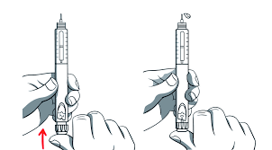
Proper Use of Pens
Priming before injection: free and unobstructed flow
Frid, A. H., et al. (2016). New Insulin Delivery Recommendations. Mayo Clin Proc, 91(9), 1231-1255. doi:10.1016/j.mayocp.2016.06.010
Notes:
Pens should be primed before injections to ensure free and unobstructed flow.
Needles should not be left attached to the pen .Otherwise, air or other contaminants can enter the cartridge or medication can leak out, both of which can distort dose accuracy
Pressure should be maintained on the thumb button until the needle is withdrawn from the skin to prevent aspiration of patient tissue into the cartridge. If the button is released while the needle is still in the skin, body fluid and cells may be aspirated into the cartridge and contaminate it.
Another important step is to always push the button vertically (along the axis of the pen). Some patients, especially the frail or elderly, are unable to completely inject their total dose because they are pushing the button obliquely, eg, by pushing on its edge, generating excessive resistance along its glide path
After the thumb button is completely pushed in, patients should count slowly to 10 and then withdraw the needle from the skin. This is necessary to prevent medication leakage and to get the full dose.
Some patients may need to count past 10, especially when giving higher doses. Counting only to 5 may be acceptable for lower doses. Patients may find the right time for themselves by trial and error, using leakage or dribbling of insulin as a guide.

Slide 40
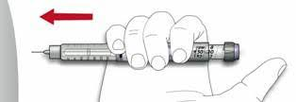
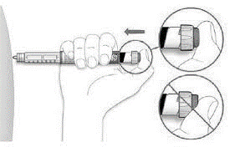
Proper Use of Pens
Always push the button vertically (along the axis of the pen)
Complete delivery of total dose
Frid, A. H., et al. (2016). New Insulin Delivery Recommendations. Mayo Clin Proc, 91(9), 1231-1255. doi:10.1016/j.mayocp.2016.06.010
Notes:
Pens should be primed before injections to ensure free and unobstructed flow.
Needles should not be left attached to the pen .Otherwise, air or other contaminants can enter the cartridge or medication can leak out, both of which can distort dose accuracy
Pressure should be maintained on the thumb button until the needle is withdrawn from the skin to prevent aspiration of patient tissue into the cartridge. If the button is released while the needle is still in the skin, body fluid and cells may be aspirated into the cartridge and contaminate it.
Another important step is to always push the button vertically (along the axis of the pen). Some patients, especially the frail or elderly, are unable to completely inject their total dose because they are pushing the button obliquely, eg, by pushing on its edge, generating excessive resistance along its glide path
After the thumb button is completely pushed in, patients should count slowly to 10 and then withdraw the needle from the skin. This is necessary to prevent medication leakage and to get the full dose.
Some patients may need to count past 10, especially when giving higher doses. Counting only to 5 may be acceptable for lower doses. Patients may find the right time for themselves by trial and error, using leakage or dribbling of insulin as a guide.

Slide 41
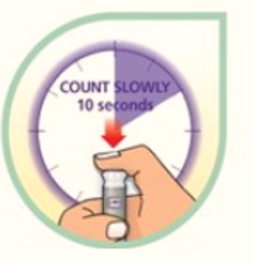
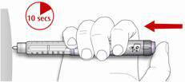
Proper Use of Pens
Pressure should be maintained on the thumb button until the needle is withdrawn from the skin
Prevent aspiration of patient tissue into the cartridge
More/ less seconds in higher/ lower dose
Leakage or dribbling of insulin as a guide
Frid, A. H., et al. (2016). New Insulin Delivery Recommendations. Mayo Clin Proc, 91(9), 1231-1255. doi:10.1016/j.mayocp.2016.06.010
Notes:
Pens should be primed before injections to ensure free and unobstructed flow.
Needles should not be left attached to the pen .Otherwise, air or other contaminants can enter the cartridge or medication can leak out, both of which can distort dose accuracy
Pressure should be maintained on the thumb button until the needle is withdrawn from the skin to prevent aspiration of patient tissue into the cartridge. If the button is released while the needle is still in the skin, body fluid and cells may be aspirated into the cartridge and contaminate it.
Another important step is to always push the button vertically (along the axis of the pen). Some patients, especially the frail or elderly, are unable to completely inject their total dose because they are pushing the button obliquely, eg, by pushing on its edge, generating excessive resistance along its glide path
After the thumb button is completely pushed in, patients should count slowly to 10 and then withdraw the needle from the skin. This is necessary to prevent medication leakage and to get the full dose.
Some patients may need to count past 10, especially when giving higher doses. Counting only to 5 may be acceptable for lower doses. Patients may find the right time for themselves by trial and error, using leakage or dribbling of insulin as a guide.

Slide 42
Only 31.9% of patients left it the recommended 10 seconds or longer.
Frid, A. H., Hirsch, L. J., Menchior, A. R., Morel, D. R., & Strauss, K. W. (2016). Worldwide injection technique questionnaire study: population parameters and injection practices. Paper presented at the Mayo Clinic Proceedings.

Slide 43
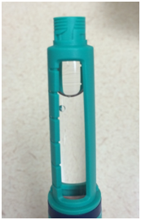
Proper Use of Pens
Needles should not be left attached to the pen.
Dose inaccuracy due to:
Air entrance
Medication leak out
Ginsberg, B. H. (2009). Factors Affecting Blood Glucose Monitoring: Sources of Errors in Measurement. J Diabetes Sci Technol, 3(4), 903-913.
Frid, A. H., et al. (2016). New Insulin Delivery Recommendations. Mayo Clin Proc, 91(9), 1231-1255. doi:10.1016/j.mayocp.2016.06.010
Notes:
Pens should be primed before injections to ensure free and unobstructed flow.
Needles should not be left attached to the pen .Otherwise, air or other contaminants can enter the cartridge or medication can leak out, both of which can distort dose accuracy
Pressure should be maintained on the thumb button until the needle is withdrawn from the skin to prevent aspiration of patient tissue into the cartridge. If the button is released while the needle is still in the skin, body fluid and cells may be aspirated into the cartridge and contaminate it.
Another important step is to always push the button vertically (along the axis of the pen). Some patients, especially the frail or elderly, are unable to completely inject their total dose because they are pushing the button obliquely, eg, by pushing on its edge, generating excessive resistance along its glide path
After the thumb button is completely pushed in, patients should count slowly to 10 and then withdraw the needle from the skin. This is necessary to prevent medication leakage and to get the full dose.
Some patients may need to count past 10, especially when giving higher doses. Counting only to 5 may be acceptable for lower doses. Patients may find the right time for themselves by trial and error, using leakage or dribbling of insulin as a guide.

Slide 44
Air Bubble Formation in Pen Cartridges
Greater than 50 μl of air is contained in the cartridges, the accuracy in clinical use might suffer considerably.
accumulate 200 μl of air in cartridge, the pen might deliver only 37 % of the dialed dose and a full 2/3 of the dose would be wasted.
Air buffers the flow rate of the insulin and slows it.
The greater amount of the air, the slower the flow rate.
Ginsberg, B. H. (2009). Factors Affecting Blood Glucose Monitoring: Sources of Errors in Measurement. J Diabetes Sci Technol, 3(4), 903-913.
Notes:
Greater than 50 ul of air is contained in the cartridges, the accuracy in clinical use might suffer considerably.
Indeed, were a patient to accumulate 200 ul of air in his/ her cartridge, the pen might deliver only 37 % of the dialed dose and a full 2/3 of the dose would be wasted(Ginsberg, Parkes et al. 1994)
Except air bubble formation, If needles are re-used, the presence of residual insulin within the needle can cause deposition of insulin within the needle and may lead to blockage, making it harder to press on the plunger or affect the dose of subsequent injections (Dolinar 2009, Spollett, Edelman et al. 2016)
There are at least two mechanisms by which the air gets into the insulin cartridge: The first is due to the method of insulin manufacture. Some cartridges are filled with cold insulin, which contains significant dissolved air. When the cartridges warm, the air comes out of solution and forms air bubbles in the cartridge. This may account for the average of 50 (ul of air found in the commercial cartridges. The second occurs when patients leave the pen needle on their pen between injections (Fig. 4). This creates an open path between the cartridge and the environment. When the pen is warmed, the insulin solution in the cartridge expands and fluid leaks out of the needle. When the pen is cooled, the insulin contracts and air is drawn into the cartridge.
The exact amount of air drawn in will depend on a number of factors, but the air drawn in will increase with:
- Greater temperature differences
- Larger cartridges (3 ml vs. 1.5 ml)
- More insulin remaining in the cartridge
For a full 1.5 ml cartridge, each change of temperature of 10 °C will lead to an accumulation of about 15 (ul of air. Thus, a patient during the summer, moving from an air conditioned 20 °C room to an outside temperature of 30 °C to 35 °C two or three times, might accumulate an additional 50 ul of air in his cartridge.
Air in an insulin cartridge reduces pen performance because it is a compressible element. In an insulin syringe the plunger physically moves the fluid out of the syringe, but in a pen, the plunger exerts a pressure on the fluid. Since liquids are virtually incompressible, this results in the movement of fluid out of the cartridge. When there is air in the cartridge, the plunger movement first compresses the air and the compressed air then moves the fluid out of the cartridge. This buffers the flow rate of the insulin and slows it. The greater the amount of the air, the slower the flow rate.
(Ginsberg, Parkes et al. 1994)

Slide 45
Air Bubble Formation in Pen Cartridges
Factors that increase the amount of air drawn in:
Greater temperature differences:
Every 10 °C: 15 μl of air
Larger cartridges (3 ml vs. 1.5 ml)
More insulin remaining in the cartridge
Ginsberg, B. H. (2009). Factors Affecting Blood Glucose Monitoring: Sources of Errors in Measurement. J Diabetes Sci Technol, 3(4), 903-913.
Notes:
Greater than 50 ul of air is contained in the cartridges, the accuracy in clinical use might suffer considerably.
Indeed, were a patient to accumulate 200 ul of air in his/ her cartridge, the pen might deliver only 37 % of the dialed dose and a full 2/3 of the dose would be wasted(Ginsberg, Parkes et al. 1994)
Except air bubble formation, If needles are re-used, the presence of residual insulin within the needle can cause deposition of insulin within the needle and may lead to blockage, making it harder to press on the plunger or affect the dose of subsequent injections (Dolinar 2009, Spollett, Edelman et al. 2016)
There are at least two mechanisms by which the air gets into the insulin cartridge: The first is due to the method of insulin manufacture. Some cartridges are filled with cold insulin, which contains significant dissolved air. When the cartridges warm, the air comes out of solution and forms air bubbles in the cartridge. This may account for the average of 50 (ul of air found in the commercial cartridges. The second occurs when patients leave the pen needle on their pen between injections (Fig. 4). This creates an open path between the cartridge and the environment. When the pen is warmed, the insulin solution in the cartridge expands and fluid leaks out of the needle. When the pen is cooled, the insulin contracts and air is drawn into the cartridge.
The exact amount of air drawn in will depend on a number of factors, but the air drawn in will increase with:
- Greater temperature differences
- Larger cartridges (3 ml vs. 1.5 ml)
- More insulin remaining in the cartridge
For a full 1.5 ml cartridge, each change of temperature of 10 °C will lead to an accumulation of about 15 (ul of air. Thus, a patient during the summer, moving from an air conditioned 20 °C room to an outside temperature of 30 °C to 35 °C two or three times, might accumulate an additional 50 ul of air in his cartridge.
Air in an insulin cartridge reduces pen performance because it is a compressible element. In an insulin syringe the plunger physically moves the fluid out of the syringe, but in a pen, the plunger exerts a pressure on the fluid. Since liquids are virtually incompressible, this results in the movement of fluid out of the cartridge. When there is air in the cartridge, the plunger movement first compresses the air and the compressed air then moves the fluid out of the cartridge. This buffers the flow rate of the insulin and slows it. The greater the amount of the air, the slower the flow rate.
(Ginsberg, Parkes et al. 1994)

Slide 46
Needle Reuse Risks:
Dose Inaccuracy:
air entrance/medication leak out/Needle blockage due to insulin deposition within needle
Development of LH:
association between needle reuse particularly reuse frequency with LH
Injection pain
Bleeding
Ginsberg, B. H. (2009). Factors Affecting Blood Glucose Monitoring: Sources of Errors in Measurement. J Diabetes Sci Technol, 3(4), 903-913.
Maljaars, C. (2002). Scherpe studie naalden voor eenmalig gebruik [Sharp study needles for single use]. Diabetes and Levery, 4, 36-37.
Dolinar, R. (2009). The importance of good insulin injection practices in diabetes management. US Endocrinol, 5(1), 49-52.
Frid, A. H., et al. (2016). New Insulin Delivery Recommendations. Mayo Clin Proc, 91(9), 1231-1255. doi:10.1016/j.mayocp.2016.06.010
Notes:
Needles should not be left attached to the pen. Dose inaccuracy due to air entrance/medication leak out
There is an association between needle reuse and LH, although a causal relationship has not been proved. There is also an association between reuse and injection pain or bleeding. Patients should be made aware of these associations.
It seems that needle reuse, particularly reuse frequency, is associated with the development of LH.
Local skin or SC tissue infections, injection pain, and unpleasantness have not been clearly associated with limited needle reuse (until needle blunting occurs). The lack of infectious complications may be attributed to the antimicrobial preservatives in insulin preparations.
REF:
Frid, A. H., G. Kreugel, G. Grassi, S. Halimi, D. Hicks, L. J. Hirsch, M. J. Smith, R. Wellhoener, B. W. Bode, I. B. Hirsch, S. Kalra, L. Ji and K. W. Strauss (2016). "New Insulin Delivery Recommendations." Mayo Clin Proc 91(9): 1231-1255.
If the needle is left on between injections, air can enter the reservoir of the insulin pen and affect the accuracy of the next dose. (Ginsberg, Parkes et al. 1994, Spollett, Edelman et al. 2016)
Greater than 50 ul of air is contained in the cartridges, the accuracy in clinical use might suffer considerably.
Indeed, were a patient to accumulate 200 ul of air in his/ her cartridge, the pen might deliver only 37 % of the dialed dose and a full 2/3 of the dose would be wasted(Ginsberg, Parkes et al. 1994)
Except air bubble formation, If needles are re-used, the presence of residual insulin within the needle can cause deposition of insulin within the needle and may lead to blockage, making it harder to press on the plunger or affect the dose of subsequent injections (Dolinar 2009, Spollett, Edelman et al. 2016)
Patient associated consequences of needle reuse:
Risk of contamination and infection:
Although sterility is guaranteed with the first use of the syringe and pen needles, Bacterial contamination increase in proportion to needle reuse .(Misnikova, Dreval et al. 2011)
One study showed biological material was trapped in the pen needles or cartridges of 62% of patients after injection.(Le Floch, Herbreteau et al. 1998)
Bacteriostatic agents are added to most insulins to stop bacterial growth; however, needle re-use can increase the risk of infection.(Dolinar 2009)
Injection pain:
There is also an association between reuse and injection pain and bleeding and seems to increase as a function of the number of times the needle is reused (Dolinar 2009, Frid, Hirsch et al. 2016, Frid, Kreugel et al. 2016)
Injection site irritation and damage:
Injection site irritation and damage such as local inflammatory changes and laceration increase in proportion to needle reuse (Misnikova, Dreval et al. 2011, Spollett, Edelman et al. 2016)
Risk of the needle breaking off and remaining in the tissue.(Sood, Miglani et al. 2001, Dolinar 2009, Spollett, Edelman et al. 2016)

Slide 47
Needle Reuse Risks:
Approximately 50% of the patients worldwide
use their needles more than once
Frid, A. H., Hirsch, L. J., Menchior, A. R., Morel, D. R., & Strauss, K. W. (2016). Worldwide injection technique questionnaire study: population parameters and injection practices. Paper presented at the Mayo Clinic Proceedings.
Notes:
Needles should not be left attached to the pen. Dose inaccuracy due to air entrance/medication leak out
There is an association between needle reuse and LH, although a causal relationship has not been proved. There is also an association between reuse and injection pain or bleeding. Patients should be made aware of these associations.
It seems that needle reuse, particularly reuse frequency, is associated with the development of LH.
Local skin or SC tissue infections, injection pain, and unpleasantness have not been clearly associated with limited needle reuse (until needle blunting occurs). The lack of infectious complications may be attributed to the antimicrobial preservatives in insulin preparations.
REF:
Frid, A. H., G. Kreugel, G. Grassi, S. Halimi, D. Hicks, L. J. Hirsch, M. J. Smith, R. Wellhoener, B. W. Bode, I. B. Hirsch, S. Kalra, L. Ji and K. W. Strauss (2016). "New Insulin Delivery Recommendations." Mayo Clin Proc 91(9): 1231-1255.
If the needle is left on between injections, air can enter the reservoir of the insulin pen and affect the accuracy of the next dose. (Ginsberg, Parkes et al. 1994, Spollett, Edelman et al. 2016)
Greater than 50 ul of air is contained in the cartridges, the accuracy in clinical use might suffer considerably.
Indeed, were a patient to accumulate 200 ul of air in his/ her cartridge, the pen might deliver only 37 % of the dialed dose and a full 2/3 of the dose would be wasted(Ginsberg, Parkes et al. 1994)
Except air bubble formation, If needles are re-used, the presence of residual insulin within the needle can cause deposition of insulin within the needle and may lead to blockage, making it harder to press on the plunger or affect the dose of subsequent injections (Dolinar 2009, Spollett, Edelman et al. 2016)
Patient associated consequences of needle reuse:
Risk of contamination and infection:
Although sterility is guaranteed with the first use of the syringe and pen needles, Bacterial contamination increase in proportion to needle reuse .(Misnikova, Dreval et al. 2011)
One study showed biological material was trapped in the pen needles or cartridges of 62% of patients after injection.(Le Floch, Herbreteau et al. 1998)
Bacteriostatic agents are added to most insulins to stop bacterial growth; however, needle re-use can increase the risk of infection.(Dolinar 2009)
Injection pain:
There is also an association between reuse and injection pain and bleeding and seems to increase as a function of the number of times the needle is reused (Dolinar 2009, Frid, Hirsch et al. 2016, Frid, Kreugel et al. 2016)
Injection site irritation and damage:
Injection site irritation and damage such as local inflammatory changes and laceration increase in proportion to needle reuse (Misnikova, Dreval et al. 2011, Spollett, Edelman et al. 2016)
Risk of the needle breaking off and remaining in the tissue.(Sood, Miglani et al. 2001, Dolinar 2009, Spollett, Edelman et al. 2016)

Slide 48
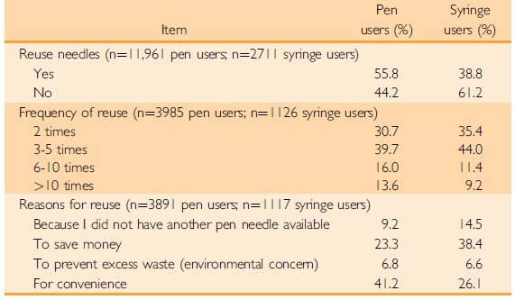
Needle Reuse:
Frid, A. H., Hirsch, L. J., Menchior, A. R., Morel, D. R., & Strauss, K. W. (2016). Worldwide injection technique questionnaire study: population parameters and injection practices. Paper presented at the Mayo Clinic Proceedings.
Notes:
Needles should not be left attached to the pen. Dose inaccuracy due to air entrance/medication leak out
There is an association between needle reuse and LH, although a causal relationship has not been proved. There is also an association between reuse and injection pain or bleeding. Patients should be made aware of these associations.
It seems that needle reuse, particularly reuse frequency, is associated with the development of LH.
Local skin or SC tissue infections, injection pain, and unpleasantness have not been clearly associated with limited needle reuse (until needle blunting occurs). The lack of infectious complications may be attributed to the antimicrobial preservatives in insulin preparations.
REF:
Frid, A. H., G. Kreugel, G. Grassi, S. Halimi, D. Hicks, L. J. Hirsch, M. J. Smith, R. Wellhoener, B. W. Bode, I. B. Hirsch, S. Kalra, L. Ji and K. W. Strauss (2016). "New Insulin Delivery Recommendations." Mayo Clin Proc 91(9): 1231-1255.
If the needle is left on between injections, air can enter the reservoir of the insulin pen and affect the accuracy of the next dose. (Ginsberg, Parkes et al. 1994, Spollett, Edelman et al. 2016)
Greater than 50 ul of air is contained in the cartridges, the accuracy in clinical use might suffer considerably.
Indeed, were a patient to accumulate 200 ul of air in his/ her cartridge, the pen might deliver only 37 % of the dialed dose and a full 2/3 of the dose would be wasted(Ginsberg, Parkes et al. 1994)
Except air bubble formation, If needles are re-used, the presence of residual insulin within the needle can cause deposition of insulin within the needle and may lead to blockage, making it harder to press on the plunger or affect the dose of subsequent injections (Dolinar 2009, Spollett, Edelman et al. 2016)
Patient associated consequences of needle reuse:
Risk of contamination and infection:
Although sterility is guaranteed with the first use of the syringe and pen needles, Bacterial contamination increase in proportion to needle reuse .(Misnikova, Dreval et al. 2011)
One study showed biological material was trapped in the pen needles or cartridges of 62% of patients after injection.(Le Floch, Herbreteau et al. 1998)
Bacteriostatic agents are added to most insulins to stop bacterial growth; however, needle re-use can increase the risk of infection.(Dolinar 2009)
Injection pain:
There is also an association between reuse and injection pain and bleeding and seems to increase as a function of the number of times the needle is reused (Dolinar 2009, Frid, Hirsch et al. 2016, Frid, Kreugel et al. 2016)
Injection site irritation and damage:
Injection site irritation and damage such as local inflammatory changes and laceration increase in proportion to needle reuse (Misnikova, Dreval et al. 2011, Spollett, Edelman et al. 2016)
Risk of the needle breaking off and remaining in the tissue.(Sood, Miglani et al. 2001, Dolinar 2009, Spollett, Edelman et al. 2016)

Slide 49
Frid, A. H., et al. (2016). New Insulin Delivery Recommendations. Mayo Clin Proc, 91(9), 1231-1255. doi:10.1016/j.mayocp.2016.06.010
Notes:
Needles should not be left attached to the pen. Dose inaccuracy due to air entrance/medication leak out
There is an association between needle reuse and LH, although a causal relationship has not been proved. There is also an association between reuse and injection pain or bleeding. Patients should be made aware of these associations.
It seems that needle reuse, particularly reuse frequency, is associated with the development of LH.
Local skin or SC tissue infections, injection pain, and unpleasantness have not been clearly associated with limited needle reuse (until needle blunting occurs). The lack of infectious complications may be attributed to the antimicrobial preservatives in insulin preparations.
REF:
Frid, A. H., G. Kreugel, G. Grassi, S. Halimi, D. Hicks, L. J. Hirsch, M. J. Smith, R. Wellhoener, B. W. Bode, I. B. Hirsch, S. Kalra, L. Ji and K. W. Strauss (2016). "New Insulin Delivery Recommendations." Mayo Clin Proc 91(9): 1231-1255.
If the needle is left on between injections, air can enter the reservoir of the insulin pen and affect the accuracy of the next dose. (Ginsberg, Parkes et al. 1994, Spollett, Edelman et al. 2016)
Greater than 50 ul of air is contained in the cartridges, the accuracy in clinical use might suffer considerably.
Indeed, were a patient to accumulate 200 ul of air in his/ her cartridge, the pen might deliver only 37 % of the dialed dose and a full 2/3 of the dose would be wasted(Ginsberg, Parkes et al. 1994)
Except air bubble formation, If needles are re-used, the presence of residual insulin within the needle can cause deposition of insulin within the needle and may lead to blockage, making it harder to press on the plunger or affect the dose of subsequent injections (Dolinar 2009, Spollett, Edelman et al. 2016)
Patient associated consequences of needle reuse:
Risk of contamination and infection:
Although sterility is guaranteed with the first use of the syringe and pen needles, Bacterial contamination increase in proportion to needle reuse .(Misnikova, Dreval et al. 2011)
One study showed biological material was trapped in the pen needles or cartridges of 62% of patients after injection.(Le Floch, Herbreteau et al. 1998)
Bacteriostatic agents are added to most insulins to stop bacterial growth; however, needle re-use can increase the risk of infection.(Dolinar 2009)
Injection pain:
There is also an association between reuse and injection pain and bleeding and seems to increase as a function of the number of times the needle is reused (Dolinar 2009, Frid, Hirsch et al. 2016, Frid, Kreugel et al. 2016)
Injection site irritation and damage:
Injection site irritation and damage such as local inflammatory changes and laceration increase in proportion to needle reuse (Misnikova, Dreval et al. 2011, Spollett, Edelman et al. 2016)
Risk of the needle breaking off and remaining in the tissue.(Sood, Miglani et al. 2001, Dolinar 2009, Spollett, Edelman et al. 2016)

Slide 50
Proper Use of Syringes
Patients should avoid using syringes with detachable needles.
Permanently attached needle syringes advantages:
far less dead space: Better dose accuracy
Ginsberg, B. H. (2009). Factors Affecting Blood Glucose Monitoring: Sources of Errors in Measurement. J Diabetes Sci Technol, 3(4), 903-913.
Notes:
Patients should avoid using syringes with detachable needles because permanently attached needle syringes deliver better dose accuracy, have far less dead space, and allow the mixing of insulins if needed.

Slide 51
Cloudy Insulin Resuspension
Inadequate resuspension
Various concentrations
Glycemic variability
Frid, A. H., et al. (2016). New Insulin Delivery Recommendations. Mayo Clin Proc, 91(9), 1231-1255. doi:10.1016/j.mayocp.2016.06.010
Notes:
Inadequate resuspension can lead to varying concentrations of insulin and unpredictable clinical responses.

Slide 52
Cloudy Insulin Resuspension
Avoid Vigorous shaking
Gently roll & tip:
Tipping: full up-down motion of the pen or vial
Rolling: full rotation cycle between the palms
Visual Confirmation
Frid, A. H., et al. (2016). New Insulin Delivery Recommendations. Mayo Clin Proc, 91(9), 1231-1255. doi:10.1016/j.mayocp.2016.06.010
Saltiel-Berzin, R., et al. (2012). Translating the research in insulin injection technique: implications for practice. Diabetes Educ, 38(5), 635-643. doi:10.1177/0145721712455107
Notes:
Tipping involves one full up-down motion of the pen or vial, and rolling is a full rotation cycle between the palms. One evidence-based method involves rolling the insulin cartridge horizontally between the palms 10 times for 5 seconds, then tipping 10 times for 10 seconds at room temperature.
Vigorous shaking should be avoided because this produces bubbles that will affect accurate dosing. Avoid exposing insulin to direct heat, light, or excessive agitation.
Visually confirm that the resuspended insulin is sufficiently mixed after each rolling and tipping, and repeat the procedure if crystal mass remains in the cartridge
REF:
Frid, A. H., G. Kreugel, G. Grassi, S. Halimi, D. Hicks, L. J. Hirsch, M. J. Smith, R. Wellhoener, B. W. Bode, I. B. Hirsch, S. Kalra, L. Ji and K. W. Strauss (2016). "New Insulin Delivery Recommendations." Mayo Clin Proc 91(9): 1231-1255.

Slide 53
Cloudy Insulin Resuspension
Rolling:
10 times
Tipping:
10 times
Visual Confirmation
Notes:
Tipping involves one full up-down motion of the pen or vial, and rolling is a full rotation cycle between the palms. One evidence-based method involves rolling the insulin cartridge horizontally between the palms 10 times for 5 seconds, then tipping 10 times for 10 seconds at room temperature.
Vigorous shaking should be avoided because this produces bubbles that will affect accurate dosing. Avoid exposing insulin to direct heat, light, or excessive agitation.
Visually confirm that the resuspended insulin is sufficiently mixed after each rolling and tipping, and repeat the procedure if crystal mass remains in the cartridge
REF:
Frid, A. H., G. Kreugel, G. Grassi, S. Halimi, D. Hicks, L. J. Hirsch, M. J. Smith, R. Wellhoener, B. W. Bode, I. B. Hirsch, S. Kalra, L. Ji and K. W. Strauss (2016). "New Insulin Delivery Recommendations." Mayo Clin Proc 91(9): 1231-1255.

Slide 54
Bleeding and Bruising
Reassurance
No significant clinical consequences
Excessive or frequent episodes:
Injection Technique review
Coagulopathy/ Drug History
The UK injection and infusion technique recommendations-4th Edition

Slide 55
Insulin Leakage
Leakage at cartridge pen and pen needle connection
ISO-Certified pen needle compatible with insulin pens
Position the PN along the axis of the pen before screwing or snapping it on
Pierce straight through the septum of the cartridge
The uk injection and infusion technique recommendations-4th Edition

Slide 56
Insulin Leakage
Skin Leakage
Use needles with thin-wall or extra thin-wall technology
Count to 10 after the plunger is fully depressed
A small amount of skin leakage (little pearl of liquid at injection site) can be ignored.
Frequent skin leakage: a direct observation to detect possible technique-related issues
The uk injection and infusion technique recommendations-4th Edition

Slide 57
Splitting Dose: Is it Necessary?
Human insulins: NPH, regular and mixed human insulins
The larger the dose, the more delayed the action
A longer, flatter action profile with doses >50 units
When injecting >50 units per dose, split the dose into 2 separate injections
Analogue insulins:
Does not appear to be affected by the volume of injection.
The decision to use 2 injection sites:
Function of the device (i.E. A maximum single dose of 80 units)
Discomfort with injection volume
Splitting insulin doses related to the volume of the injection should be individualized to each person after consideration of all factors.
Notes:
The larger the dose, the more delayed the action of NPH and short-acting (regular) human insulins. The clinical evidence regarding these human insulin formulations suggests a longer, flatter action profile with doses >50 units, which may compromise glycemic control. When injecting >50 units of short-acting (regular) or intermediate-acting (NPH) insulin per dose, it may be prudent to split the dose into 2 separate injections
The time-action profile of insulin analogues does not appear to be affected by the volume of injection. The decision to use 2 injection sites may be a function of the device (i.e. a maximum single dose of 80 units) or discomfort with injection volume, rather than a requirement to achieve a better pharmacokinetic profile.

Slide 58
Concentrated insulins: Practical Tips
Degludec U-200
Glargine U-300
Regular U-500

Slide 59
Concentrated insulins: Practical Tips
Delivers the same dose with less volume.
No calculation required when switching or starting these insulins: 1 unit on the pen = 1 unit of insulin.
Available in a pre-filled pen device specifically designed for this type of insulin.
There is no pen-to-syringe transfer, to avoid dosing errors.
It is also important that none of the concentrated insulins be removed from the prefilled pen device for use in a syringe, pump or other delivery device: potential overdose or hypoglycemia.

Slide 60
Factors that may affect insulin absorption
IM Injection
Exercise
Insulin dose volume
Site-related factors:
Massaging
Avoid damaged skin e.g. from surgical scars or lipohypertrophy
Injecting into an area that has an increased skin temperature
Insulin is absorbed most consistently from the abdominal area.

Slide 61
Factors that may affect insulin absorption
Site-related factors:
Massaging
Avoid damaged skin e.g. from surgical scars or lipohypertrophy
Injecting into an area that has an increased skin temperature

Slide 62
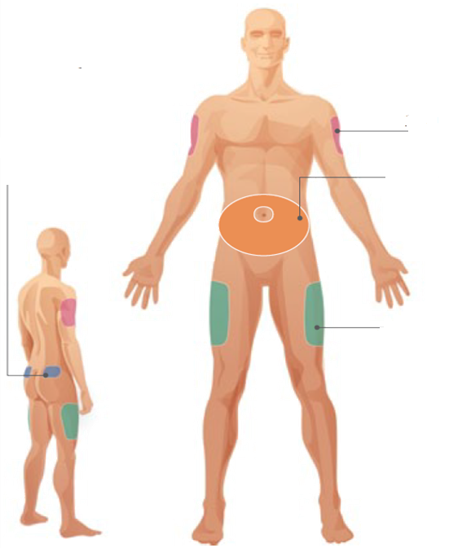
Injection Sites absorption rate
Insulin is absorbed most consistently from the abdominal area.
The abdomen: fastest insulin absorption rate
preferred site for regular isnulin /Premixed regular/NPH
The upper arm and the lateral side of the thigh: moderate insulin absorption rate
Buttock: The slowest absorption
Rapid- and long-acting insulin analogues may be administered at any injection site, as absorp-tion rates do not appear to be site-specific.
2
3
1
2
FIT Forum for Injection Technique Canada Recommendations for Best Practice in Injection Technique (2nd Edition)
Notes:
FIT Forum for Injection Technique Canada Recommendations for Best Practice in Injection Technique (2nd Edition)

Slide 63
HCP Roles
Examination by HCP at least once a year
Inspect and palpate. Use a lubricant gel to facilitate palpation
Insulin reduction when moving from a LH to a healthy tissue
Teach patients:
LH detection
Encouraged to avoid injecting into areas of LH
LH prevention strategies
Frid, A. H., L. J. Hirsch, A. R. Menchior, D. R. Morel and K. W. Strauss (2016). Worldwide Injection Technique Questionnaire study: injecting complications and the role of the professional. Mayo Clinic Proceedings, Elsevier.
Notes:
Sites should be examined by the HCP for LH at least once a year, or more frequently if LH is already present. It is often easier to palpate LH than to see it. Use of a lubricating gel facilitates palpation
Teach patients to inspect their own sites, and give training in site rotation, proper injection technique, and detection and prevention of LH.
Patients should be encouraged to avoid injecting into areas of LH until the next examination by an HCP. Use of larger injection
zones, correct injection site rotation, and non-reuse of needles should be recommended

Slide 64
Injection Technique Review
Uses her abdomen and occasionally will use thighs but finds injections there “burn”
Using an 8mm pen needle
Rotates by moving from left to right on her abdomen, similar location either side, examination indicates evidence of lipohypertrophy
Injects at a 90° angle, no lifted skin fold
Does not resuspend her insulin before each injection
Now How would you help her?

Slide 65
Recommendations
Resuspend cloudy insulin
Use a shorter pen needle to reduce pain and potential risk of IM injections
Inject at a 90° angle without a lifted skin fold
Use a structured rotation pattern including injections into abdomen and thighs
Avoid areas of lipohypertrophy
Consider reducing insulin dosage to prevent hypoglycaemia when using healthy injection sites.

Slide 66
Conclusion
Review patients injection techniques especially when patients are experiencing poor glycemic control
Education is a must for all including patients and HCPs.

Slide 67
Thanks for your attention
AUgust 2019

