Slide 1

In the name of God

Slide 2
Layegh p. assistant professor of endocrinology & metabolism
Mashhad University of Medical Sciences( MUMS)
Role of RET proto-oncogene in management of patients with MTC and their relatives

Slide 3
What is RET proto-oncogene?
The RET gene was first identified in 1985 by transfection of NIH/3T3 fibroblast cells with human lymphoma DNA. The transformed NIH/3T3 cells proved to harbor a fusion gene , which was absent in the original tumor.this fusion gene contained part of a gene that encoded a tyrosine kinase domain, and that gene from which the tyrosine kinase domain was part was thereafter called RET.
RET is localized on chromosome 10 and contains 21 exons.

Slide 4
REarranged during Transfection (RET) gene encodes a receptor tyrosin kinase that has an important role in many essential processes of cells.
Gain of function mutation in RET stimulates proliferation and blocks apoptosis.

Slide 5
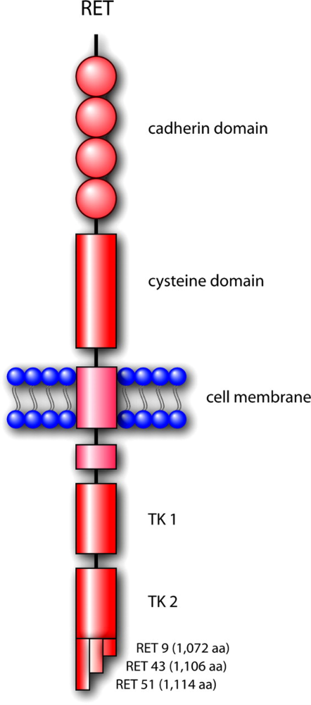
Schematic representation of the RET tyrosine kinase

Slide 6
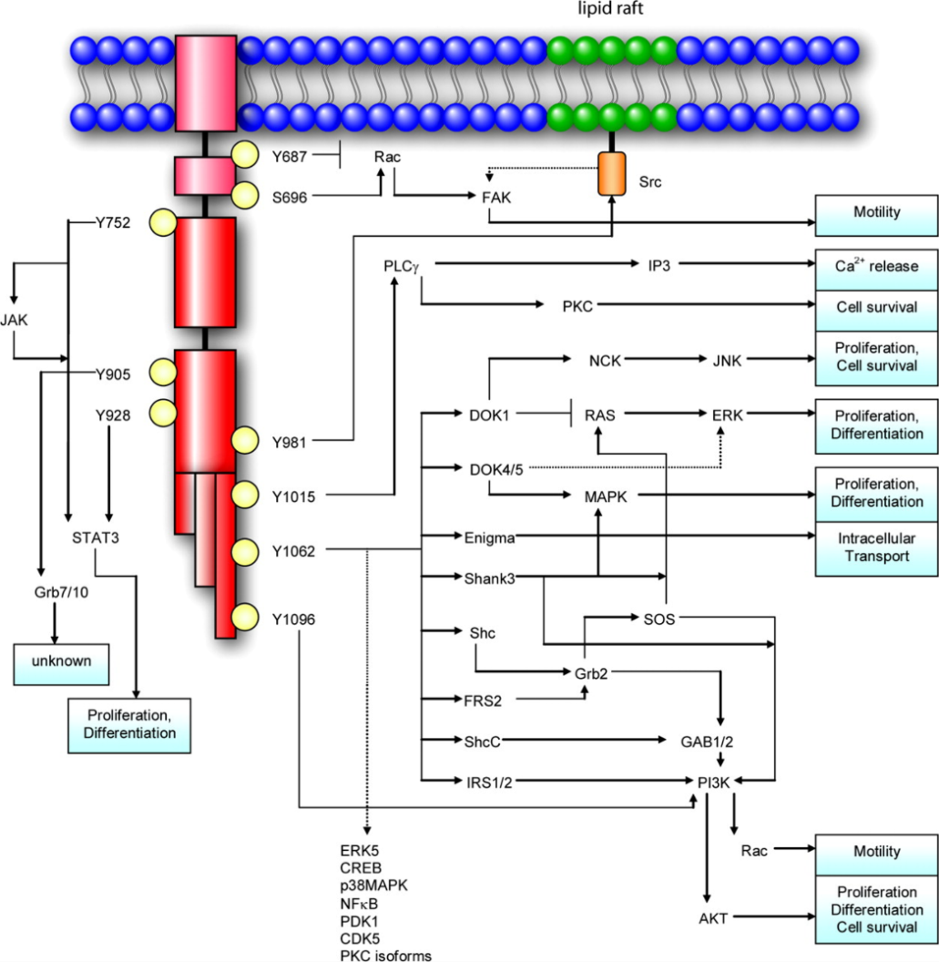
Synopsis of the signaling network mediated by RET

Slide 7
Case presentation
A 55 year-old woman presented with a neck mass from 2 years ago . There was a 45 mm hypoechoic nodule in R.thyroid lobe and also a 12 mm hypoechoic nodule in L.lobe.FNA was done and reported as follicular neoplasm(FN).

Slide 8
Case presentation (cont.)
Based on cytology and the size more than 4 cm, total thyroidectomy (TTX) was performed.Bilateral medullary thyroid carcinoma(MTC) was reported by pathologist.
Size of nodule in R.lobe was 4*3.2*1.3 and 0.3*1 cm in L.lobe.there was angiolymphatic and perineural invasion and extrathyroidal adipose tissue was involved.

Slide 9
Case presentation(cont.)
Metastasis to lymph nodes with extra nodal extension was also seen . (8 of 12 were involved)
IHC staining comfirmed diagnosis of MTC

Slide 10
All recommendations in management of this patient are based on ATA guidline 2015 untile mentioned otherwise

Slide 11
What should we do in follow up of this patient ?
Measurment of thyroid function tests ( normalization of TSH)
Measurement of calcitonin(Ctn) and carcinoembryonic antigen(CEA)
Neck ultrasound(US)
Genetic councelling and genetic testing for mutation in RET proto-oncogen

Slide 12
The results in our patient were as follows:
Ctn 191 pg/ml (↑)
CEA 6.1( ↑ )
Neck US : a 5 mm lymph node in submental area
Genetic testing : c.2370 (p.Leu790Phe) or (L790F)

Slide 13
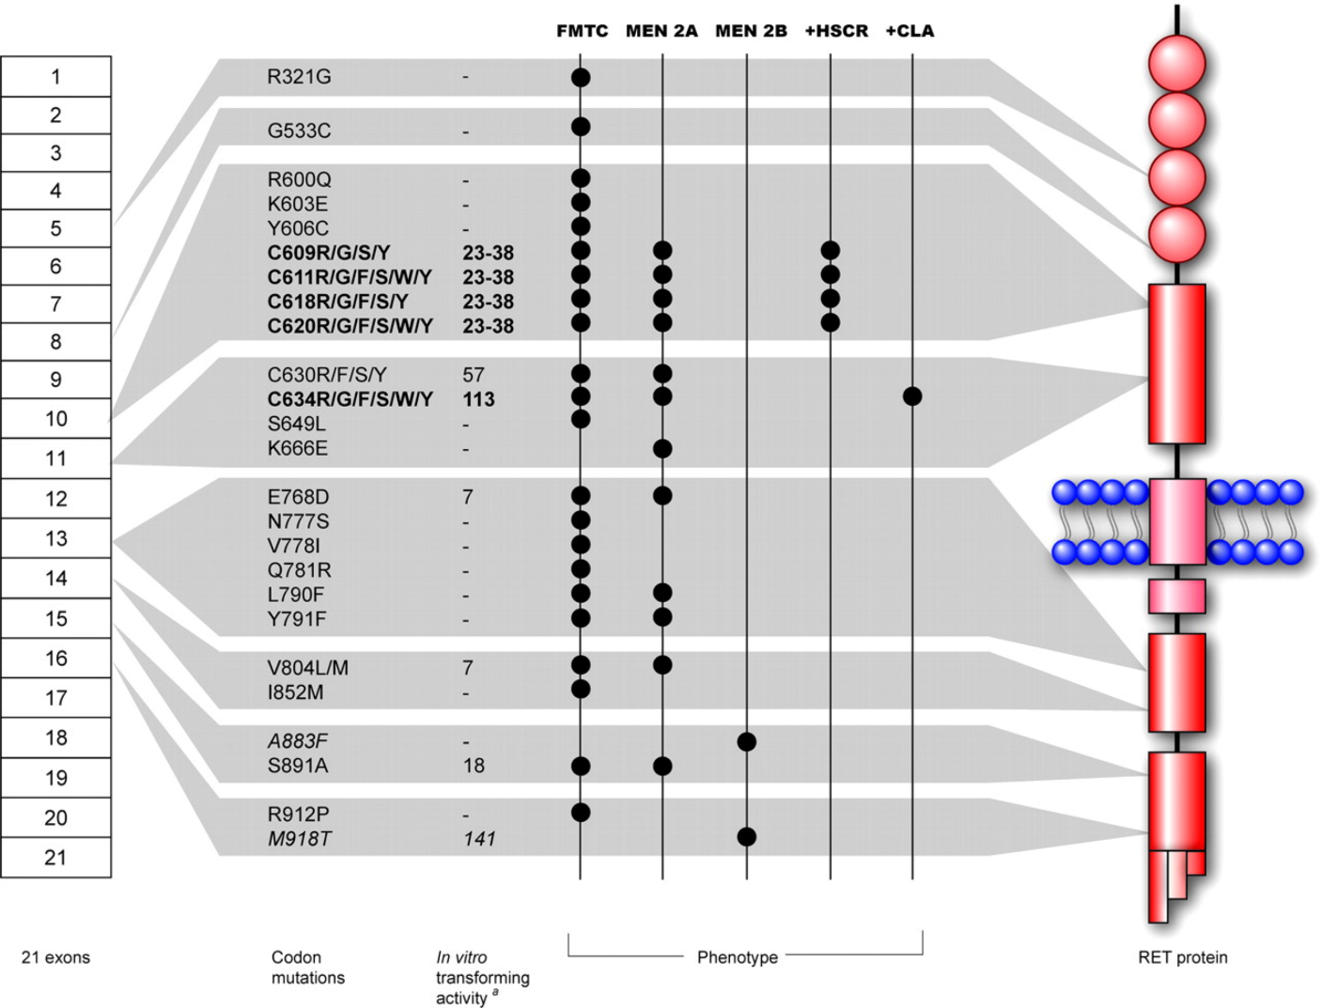
the known germline mutations in the RET gene and their associated human diseases

Slide 14
What are ATA risk categories based on aggressiveness of MTC and age of appearance of the tumor?
ATA-HST or highest risk ( M918T mutation)
ATA-H or high risk ( C634 , A883F)
ATA-MOD or moderate risk ( mutations other than 3 mutations that mentioned above)

Slide 15
What about the MTC risk category of our patient ?

Slide 16
She had RET mutation in L790F , so her ATA risk category is in ATA-MOD risk

Slide 17
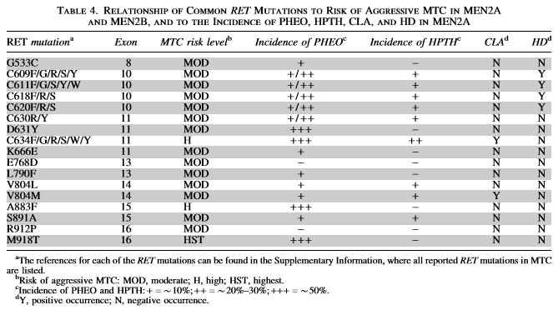

Slide 18
What is the next steps in management of this patient ?
Because of hereditary MTC in our patient(FMTC/MEN2A), evaluation for pheochromocytoma(PHEO) and hyperparathyroidism(HPTH) was performed. the results for both lab.tests were negative.

Slide 19
Based on Ctn level more than 150 pg/ml, the patient evaluated by neck and chest CT, three-phase contrast-enhanced CT of the liver and bone scintigraphy( because of complaining from scattered bone pains )
MRI of the pelvis and axial skeleton was not done( because bone complaints was not continued)
Fortunately, all of these evaluations were negative.

Slide 20
What is the future plan for this patient ?
Repeating ph.examination and imaging studies every 6-12 months
Measurement of Ctn and CEA every 3-6 months and calculation of doubeling times for decision-making

Slide 21
Because of hereditary MTC in our patient , genetic counseling and genetic testing recommend for her first-degree relatives.
In genetic testing of her children , one of her sons (25 year-old) and his 2 year-old dauther were positive for RET mutation of L790F.

Slide 22
What must we do for her son ?
Check Ctn and if it is normal repeat it annually
If Ctn is elevated ,first evaluate for PHEO and treat it if presents
If Ctn is elevated and evaluation for PHEO is negative , TTX±lymph node dissection must be done
Because of L790F mutation he had FMTC( a variant of MEN2A) or Classic MEN2A , so hyperparathyroidism also was checked

Slide 23
What about her grandchild?
In children with ATA-MOD risk category , begin ph.examination , neck US and measurement of Ctn around 5 years of age and repeat them every 6-12 months.
The timing of TTX should be based on the detection of an elevated Ctn.
Screening for PHEO and HPTH must be done at 16 years of age

Slide 24
If the parents do not wish to embark on lengthly period of evaluation ( years or even decades) , TTX may perform in childhood.

Slide 25
How to follow up children in ATA-HST and ATA-H categories?

Slide 26
Childern with ATA-HST category (codon M918T, MEN2B):
TTX must be done in the first year of life , perhaps even in the first months of life
Because Ctn level is extremely high in the first months of life , it has a limited value in determining the time of TTX in ATA-HST infants.
Screen for PHEO, should begin by age 11 years
this category of ATA has no risk for HPTH

Slide 27
In children with ATA-H category:
(codon 883 and 634)
Evaluation with ph.examination , neck US and Ctn level should begin by age 3 years and repeat annually if the results are negative
TTX must be performed in 5 years of age or earlier based on Ctn level.
Screen for PHEO and HPTH begins at 11 year of age

Slide 28
Recently , an update on MEN2 from Germany(2018) that focused on MTC, notes that the classification into one of the three RET mutation risk groups for predicting aggressiveness and prognosis has had limited impact and patients with RET mutation in different risk categories exhibit a broad spectrum of MTC aggressiveness during follow up , with no relevant difference in survival.

Slide 29
They conclude that the different risk-related RET mutations, after the initial onset of MTC, give rise to equally aggressive tumors
Once MTC developed ,the clinical course was statistically equivalent in terms of distant metastases and survival

Slide 30
Important clinical implication is : the follow- up for a patient with a moderate –risk mutation must be as intensive as the follow-up of an individual with a high-risk mutation.

Slide 31
Also, the authors that recently report a 3-year-old girl with bilateral MTC ( mutation in codon 634) have suggested to lowering the timing of initial screening for carriers of codon 634

Slide 32
How to follow up after TTX in this father and his dauther?
After TTX , check for Ctn:
If Ctn is more than 150 pg/ml : evaluate for metastases and treat based on involued site
If Ctn is less than 150 pg/ml : check for Ctn and CEA every 3-6 months and calculate doubling time for decision-making

Slide 33

Thank you for your attention

