Slide 1


Slide 2
ENDOCRINOLOGY GRAND ROUNDS
98.7.8
20 year old girl with abdominal pain and increased BP
Dr.Nosratzehi
Dr.Arefinia

Slide 3
ID
A 20 year old girl ,from Kermanshah , Sonqor ,single
Source of history is the patient herself and was reliable
Source of the history is the patient herself and was reliable

Slide 4
CC and PI
CC: Abdominal pain, nausea,vomitting from 2 m ago
History of HTN
History of blurred vision & headache
History of sweating & palpitation
History of weight loss(about 8kg in 6 m)
Irregular mensturation (amenorrhea from 6 m ago)

Slide 5
Past history
PMH : Abdominal PGL (3 y ago)
DH: neg
FH : neg
HH: neg

Slide 6
Review of system
■Constitutional symptoms: Lack of energy, unexplained weight gain or weight loss, loss of appetite, fever, night sweats, pain in jaws when eating, scalp tenderness, prior diagnosis of cancer, chronic fatigue
■ Skin: rash, sores, itching, dryness, change in hair or nail, dermatitis, facial plethora, thin and brittle skin, easy bruising, broad and purple stretch marks ,acne, hirsutism
■Eyes, Ears, nose, mouth, throat: Difficulty with hearing, sinus problems, runny nose, post-nasal drip, ringing in ears, mouth sores, loose teeth, ear pain, nosebleeds, sore throat, facial pain or numbness
■Cardiovascular: Irregular heartbeat, racing heart, chest pains, swelling of feet or legs, pain in legs with walking
■ Metabolism : Glucose intolerance/diabetes, dyslipidemia
■Respiratory: Shortness of breath, night sweats, prolonged cough, wheezing, sputum production, prior tuberculosis, pleurisy, oxygen at home, coughing up blood
■Gastrointestinal: Heartburn, constipation, intolerance to certain foods, diarrhea, abdominal pain, difficulty swallowing, nausea, vomiting, blood in stools, unexplained change in bowel habits, incontinence
■Genitourinary: Painful urination, frequent urination, urgency, bladder problems, impotence

Slide 7
■Musculoskeletal : Muscle or joint pain, stiffness, bone pain, gout , backache, any swelling, redness, pain, tenderness, stiffness, weakness, or limitation of motion or activity, history of trauma , history of fracture, Neck or low back pain
■Neurological: Frequent headaches, double vision, weakness, change in sensation, problems with walking or balance, dizziness, tremor, loss of consciousness, uncontrolled motions, episodes of visual loss
■Psychiatric: Insomnia, irritability, depression, anxiety, recurrent bad thoughts, mood swings, hallucinations, compulsions
■Endocrine: Intolerance to heat or cold, menstrual irregularities, frequent hunger/urination/thirst , hot flash
■Hematologic/Lymphatic: Easy bleeding, easy bruising, anemia, abnormal blood tests, leukemia, unexplained swollen areas
■Allergic/Immunologic: Seasonal allergies, hay fever symptoms, itching, frequent infections

Slide 8
General appearance
General appearance : A 20 y/o who is awake and alert and appears healthy
W : 45kg H :160 cm BMI : 17.5
Vital signs :
BP : 200/100 HR : 120 RR: 16
OT : 37 O2sat : 98%

Slide 9
Physical examination
Skin: NL
Head/ear/eye/nose/throat :NL
Neck: LAP(-)
Thorax & lungs: deformity(-), expansion : NL ,
auscultation : clear
Cardiovascular :NL
Abdomen: distension(-),midline scar due to previous laparotomy, guarding (-),tenderness(-),rebound T(-),organomegaly (-)
Extremities:NL
Nourologic:NL

Slide 10
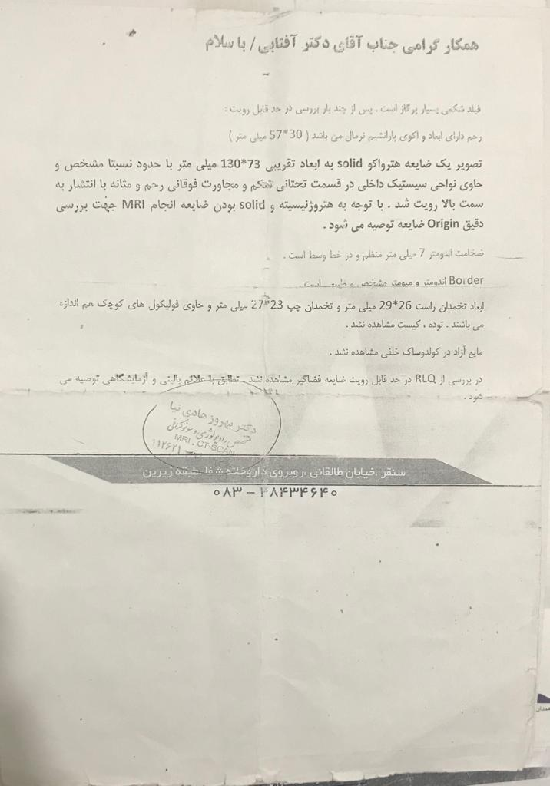

Slide 11
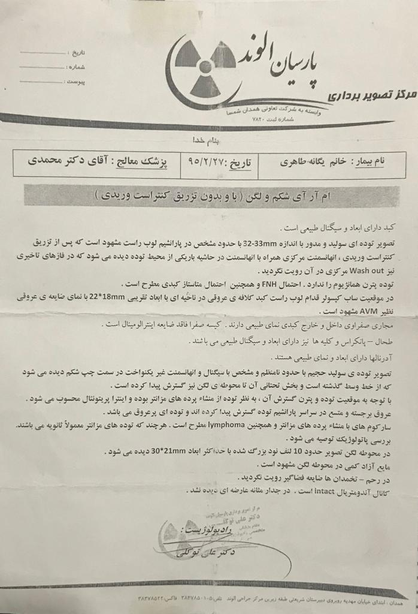

Slide 12
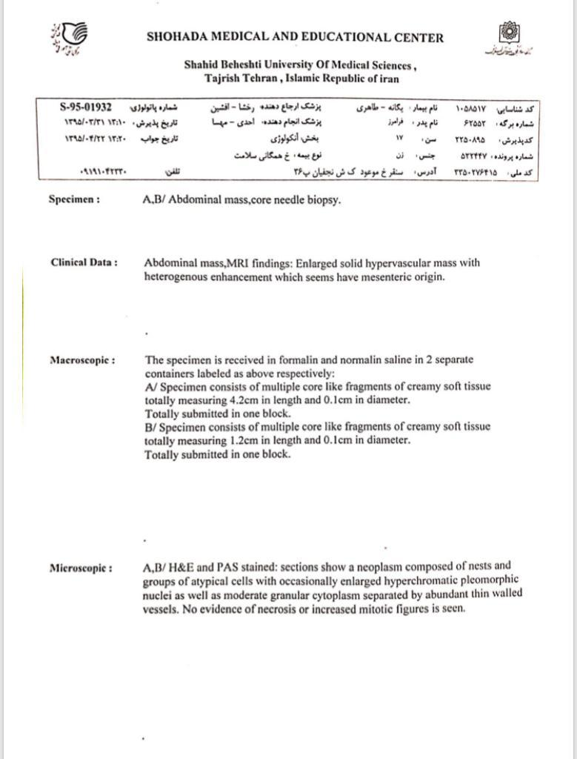

Slide 13
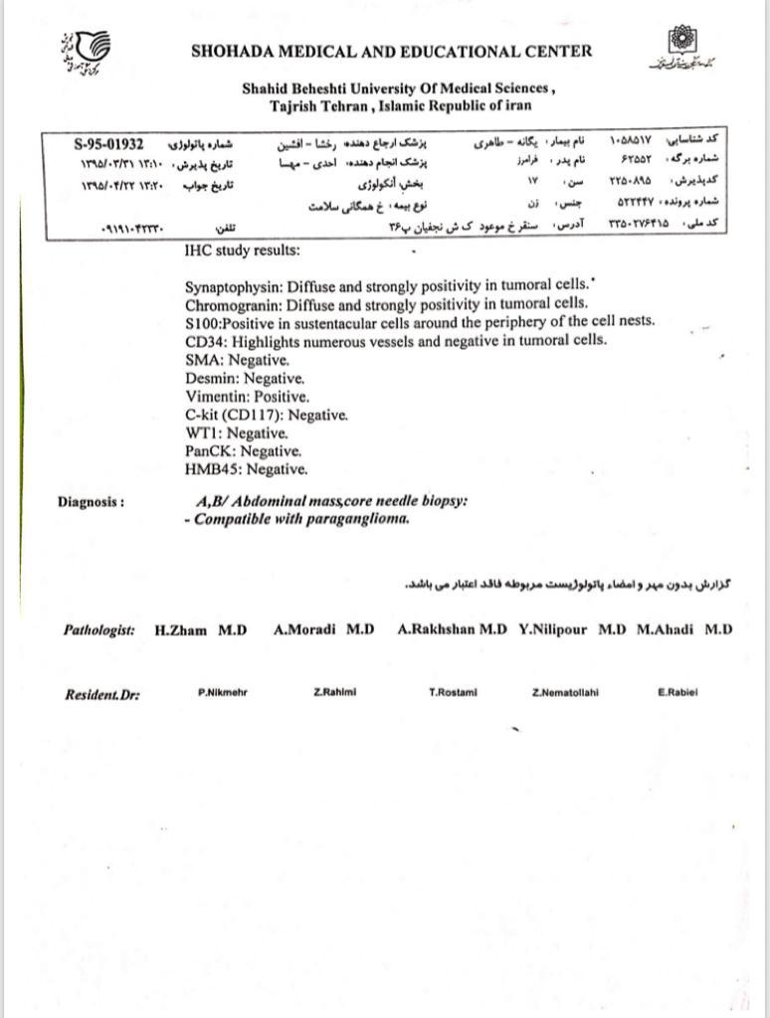

Slide 14
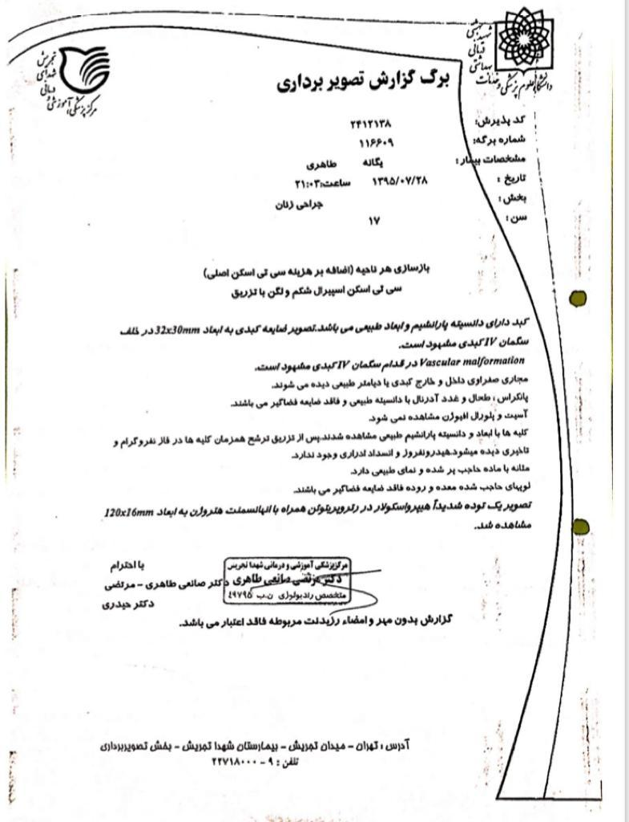

Slide 15
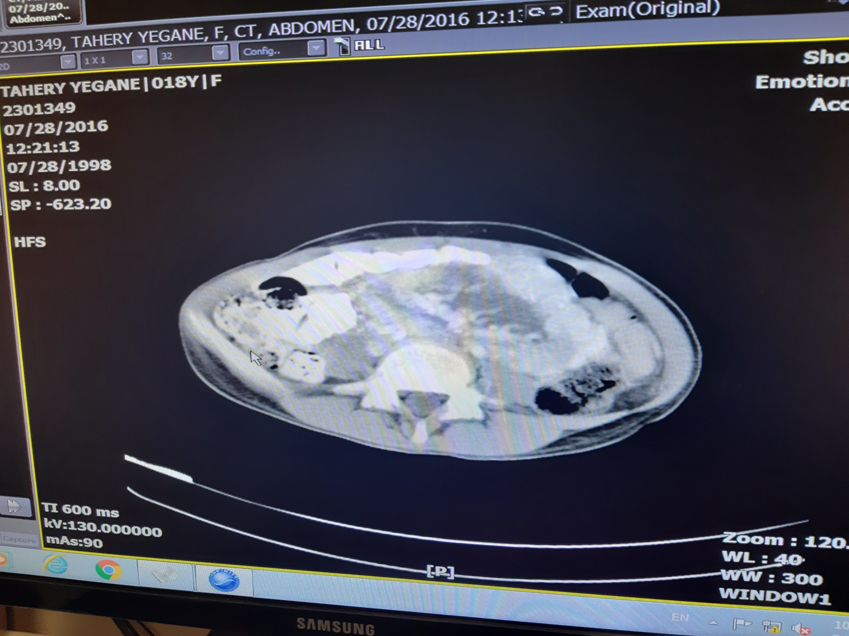

Slide 16
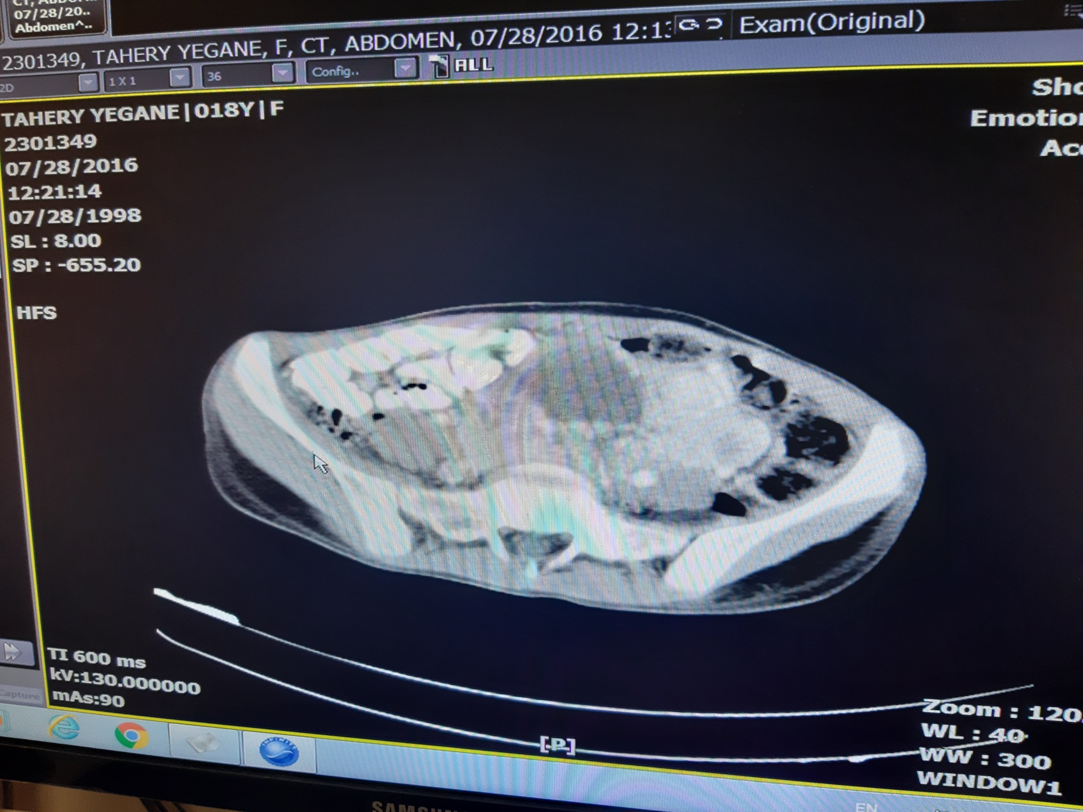

Slide 17
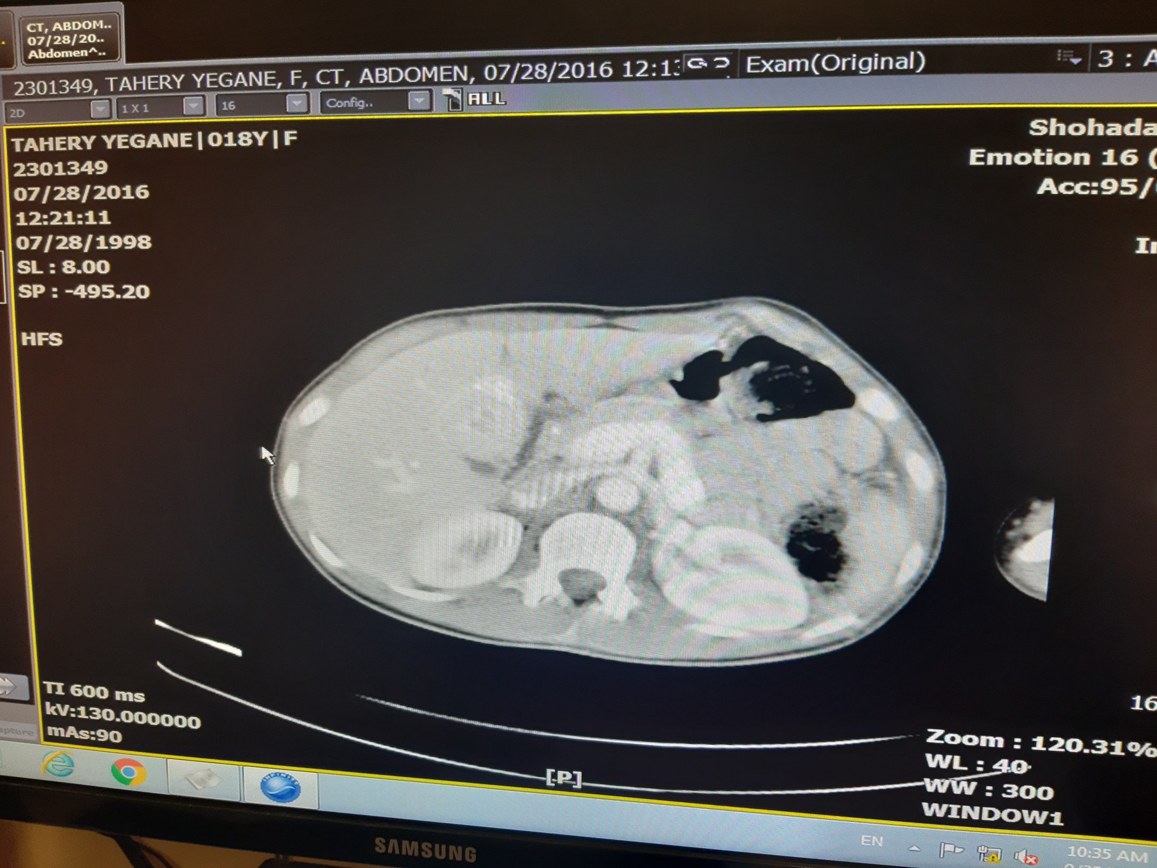

Slide 18
cardiology consult
Moderate LVH : chronic HTN

Slide 19
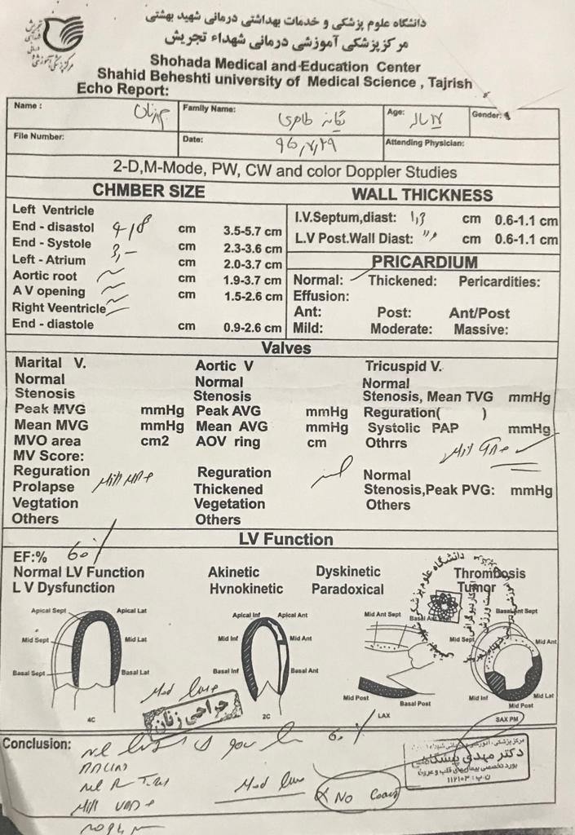

Slide 20
Endocrinology consult
Lab test
Control of BP with:
Tab Amlodipine 5 daily
Tab prazosin 5 daily
Ophthalmology consult request because of blurred vision
MIBG scan request

Slide 21
 | 95.7.28 | 95.8.1 | 95.8.5 | 95.8.9 | 95.8.15
BUN | 16 |  | 8 |  | 11
Cr | 1 |  | 0.82 |  | 0.93
WBC | 7.7 |  |  |  | 5.4
Hb | 11.3 |  |  |  | 10.6
RBC | 3.83 |  |  |  | 3.5
CA125 | 19.5
CA19-9 | 35
CEA | 1.2
Pr urine 24h |  | 500(20-150) |  |  | 100
Cr urine 24h |  | 410(600-1800) |  |  | 1530
Volume urine 24h |  | 1000 |  |  | 1700
VMA |  | 9.4 |  |  | 13.3
Urine metanephrine |  | 1.3 |  |  | 1.2(<350)
Urine normetanephrine |  | 82 |  |  | 256(<600)
Urine cortisol (µg) |  | 530(9.66-120.63) |  |  | 190

Slide 22
 | 95.7.28 | 95.8.1 | 95.8.5 | 95.8.9 | 95.8.15 | 98.4.29 | 98.5.7
Free metanephrin |  |  |  |  |  |  | 45(<65)
Free normetanephrin |  |  |  |  |  |  | 770.1(<196)
Epinephrine |  |  |  |  |  |  | 13.3(<100)
norepinephrine |  |  |  |  |  |  | 1730(<600)
T3 |  | 1.1
T4 |  | 5.3
TSH |  | 0.4
T3RU |  | 28.6
Ca |  |  | 9.9
P |  |  | 3.34
PTH |  |  | 32.7
25-vitamine D3 |  |  | 29.6
Beta-HCG |  |  |  |  |  | _
PRL |  | 6.6
Testosterone |  | 0.3(0.2-1)
Cortisol 8AM |  | 123.37
Renin |  |  |  | 3(4.4-46.1)
Aldosterone |  |  |  | 66.9(30-400)

Slide 23
 | 95.7.28 | 95.8.1 | 95.8.5 | 95.8.9 | 95.8.15 | 98.4.29 | 98.5.7
Anti EMA-IgG |  |  |  |  |  |  | _
Anti EMA-IgA |  |  |  |  |  |  | _
Anti Gliadin-IgG |  |  |  |  |  |  | 3.2(-)
Anti Gliadin-IgA |  |  |  |  |  |  | 2.9(-)
Anti TTG-IgA |  |  |  |  |  |  | 3.8(-)
Anti TTG-IgG |  |  |  |  |  |  | 0.4(-)

Slide 24
Ophthalmology consult
OS:10/10
OD : count finger 0.5m
Stage IV hypertensive retinopathy(retinal hemorrhage, hard exudate, cotton wool spot , ealsching spot , choroidal infarction , disk swelling ,blurred optic disk margin)in both eyes
Brain MRI request

Slide 25
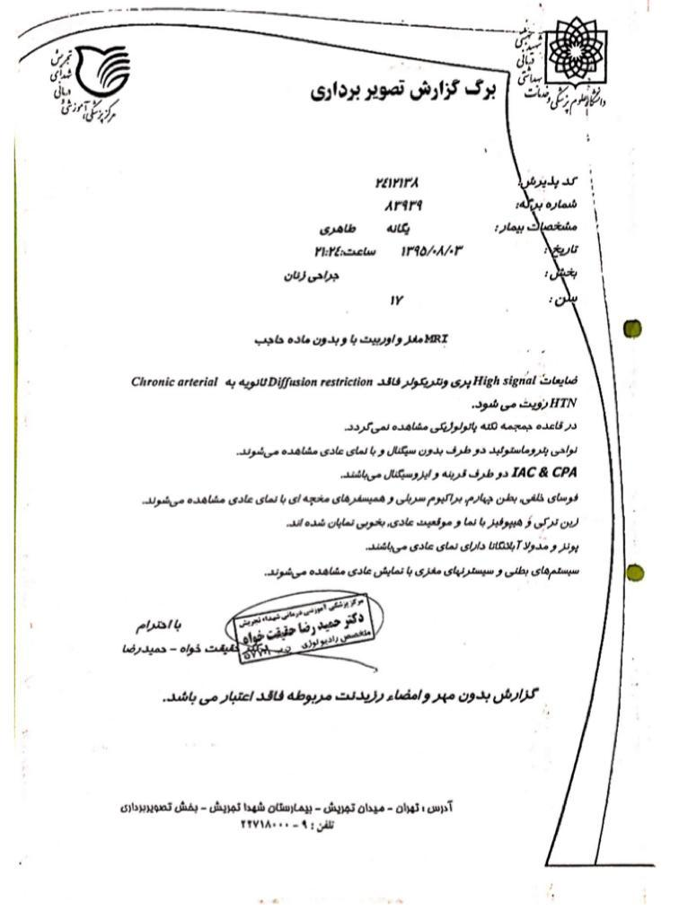

Slide 26
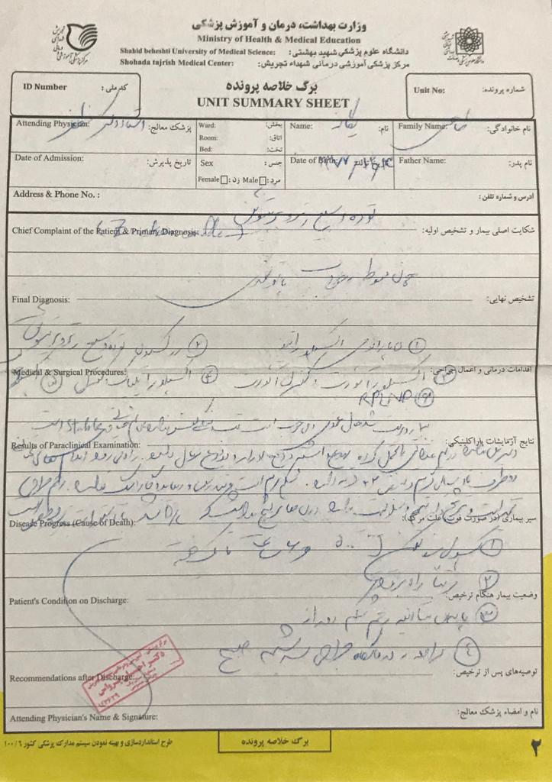

Slide 27
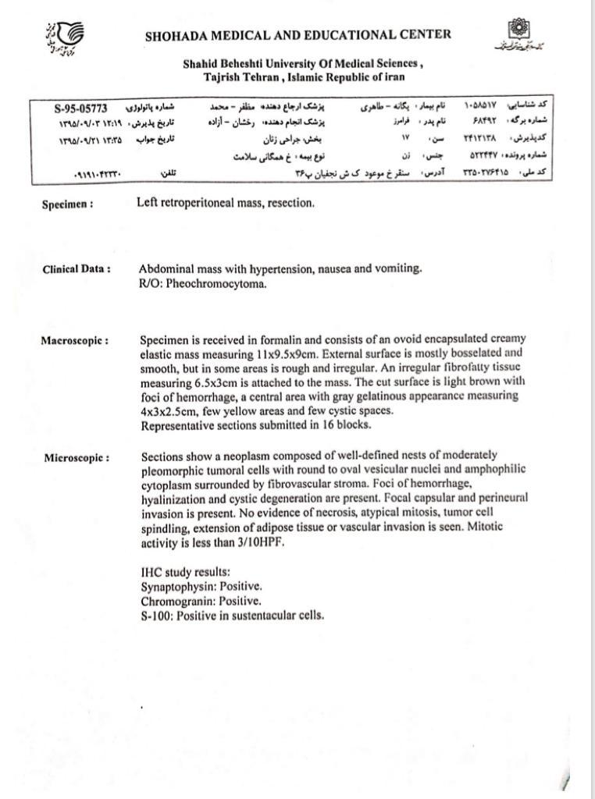

Slide 28
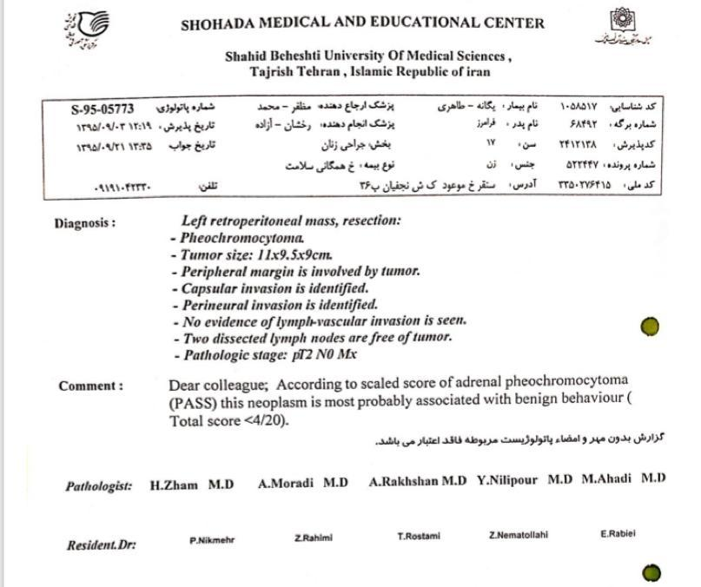

Slide 29
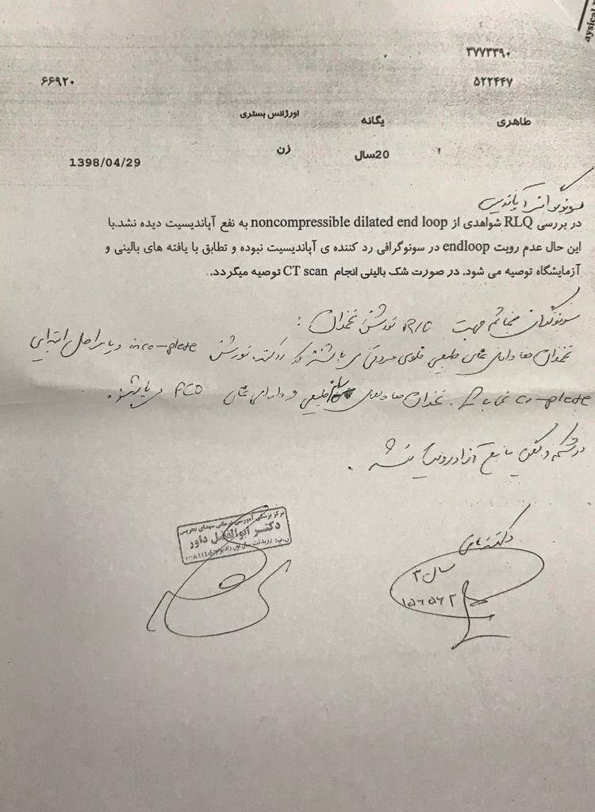

Slide 30
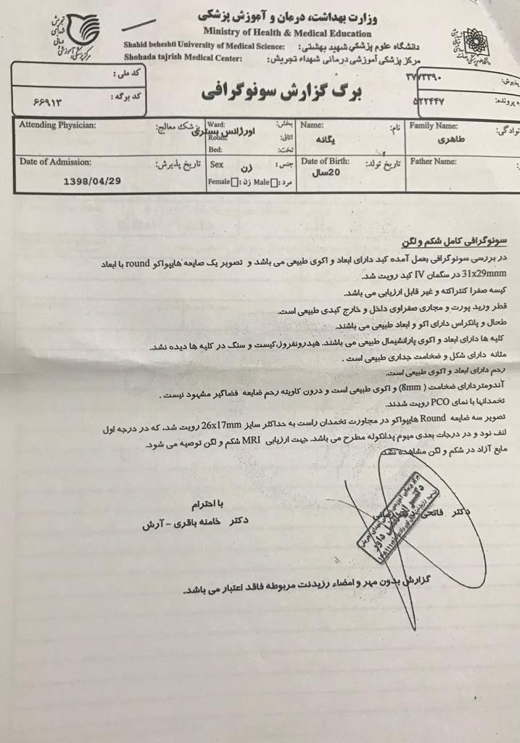

Slide 31
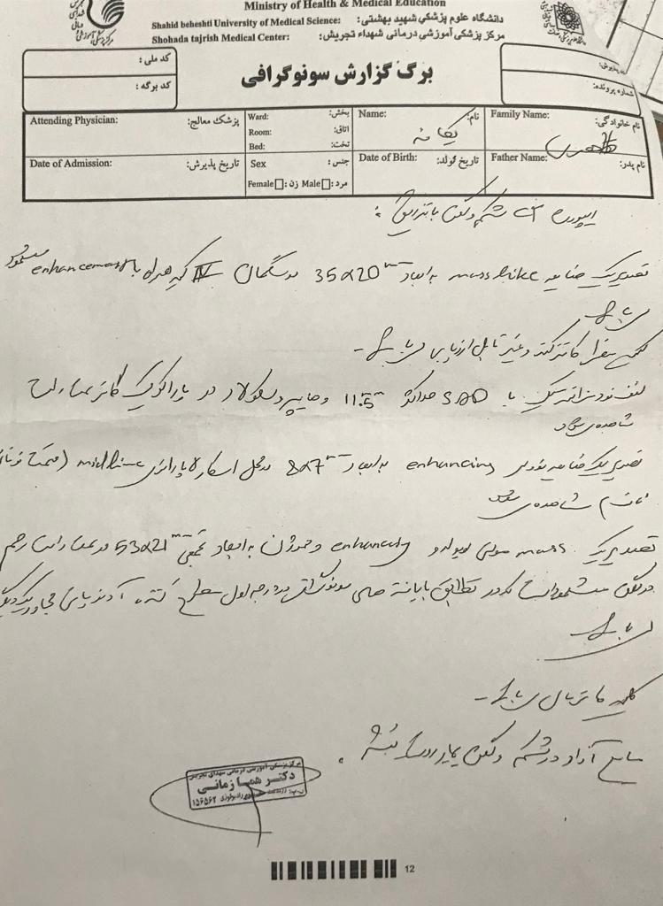

Slide 32
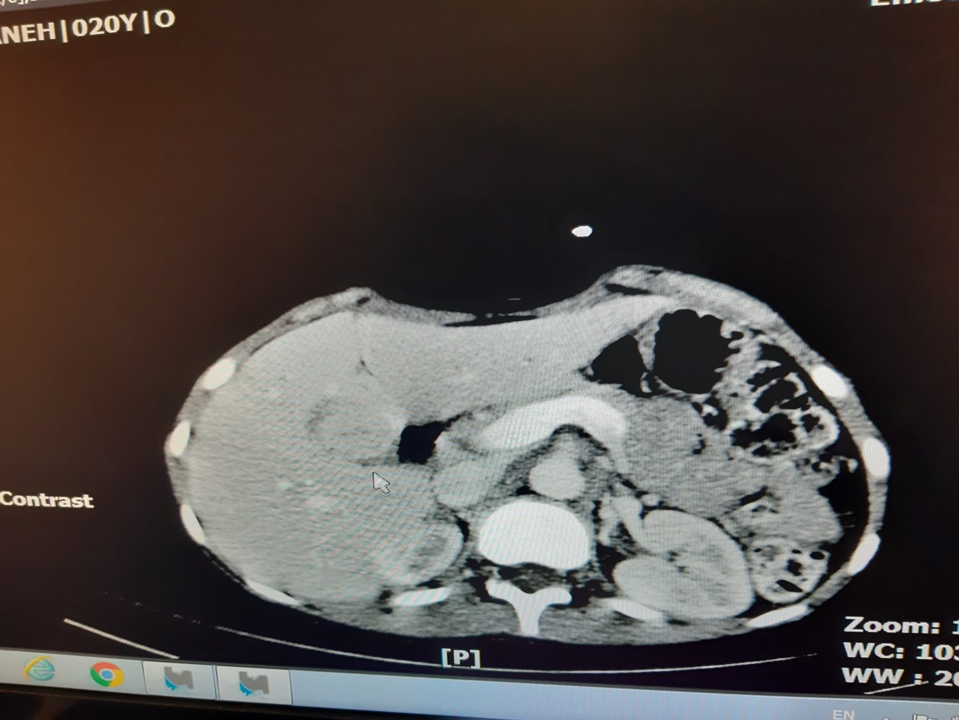

Slide 33
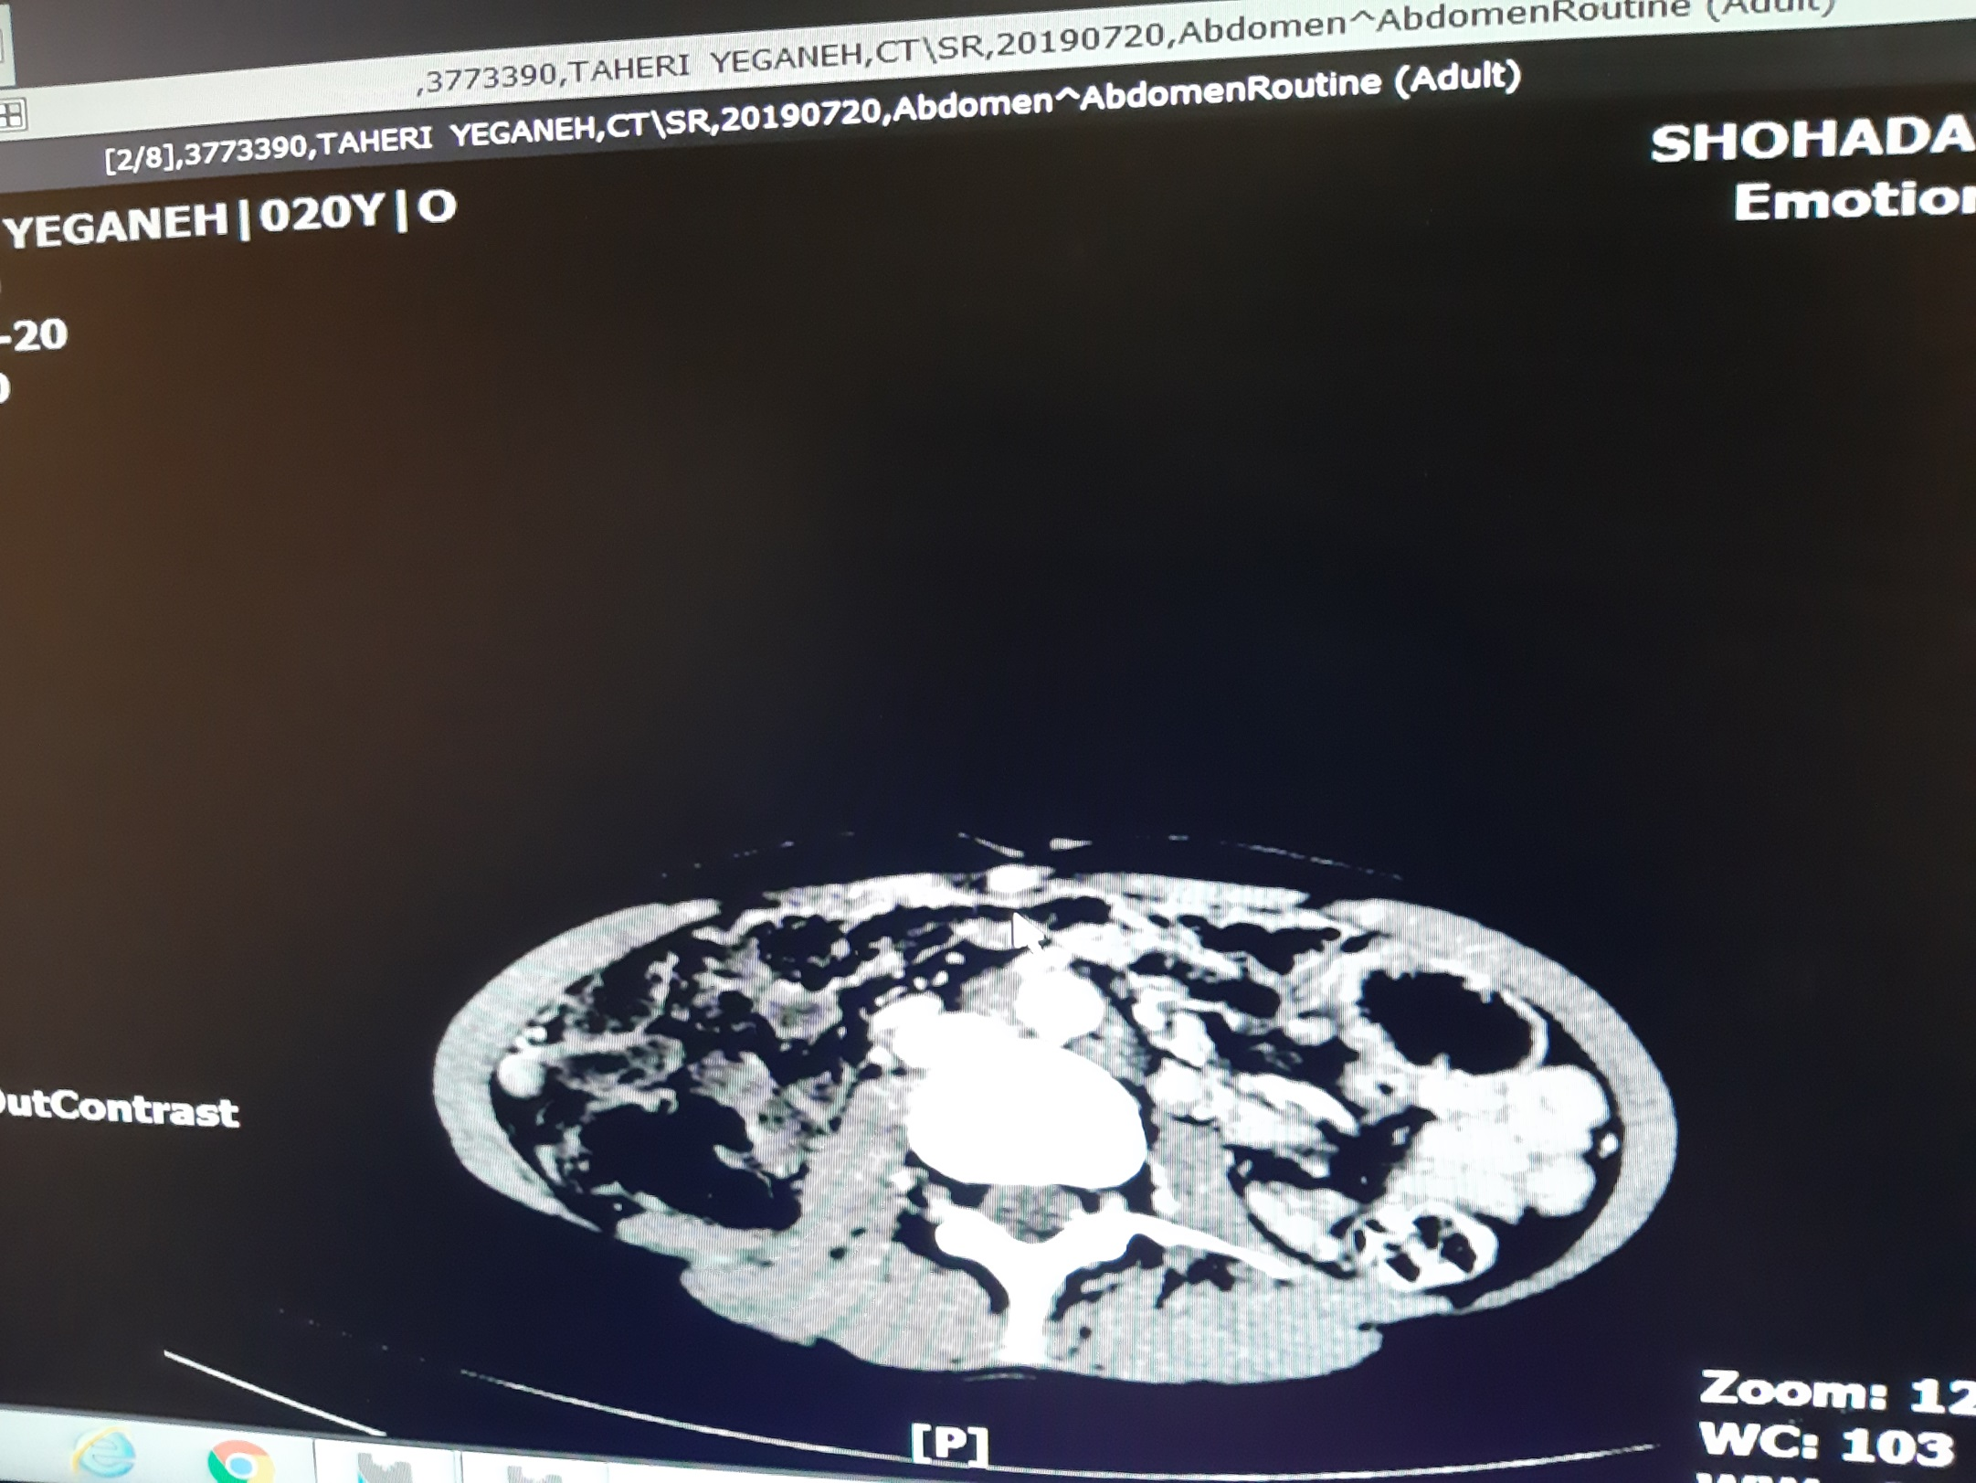

Slide 34
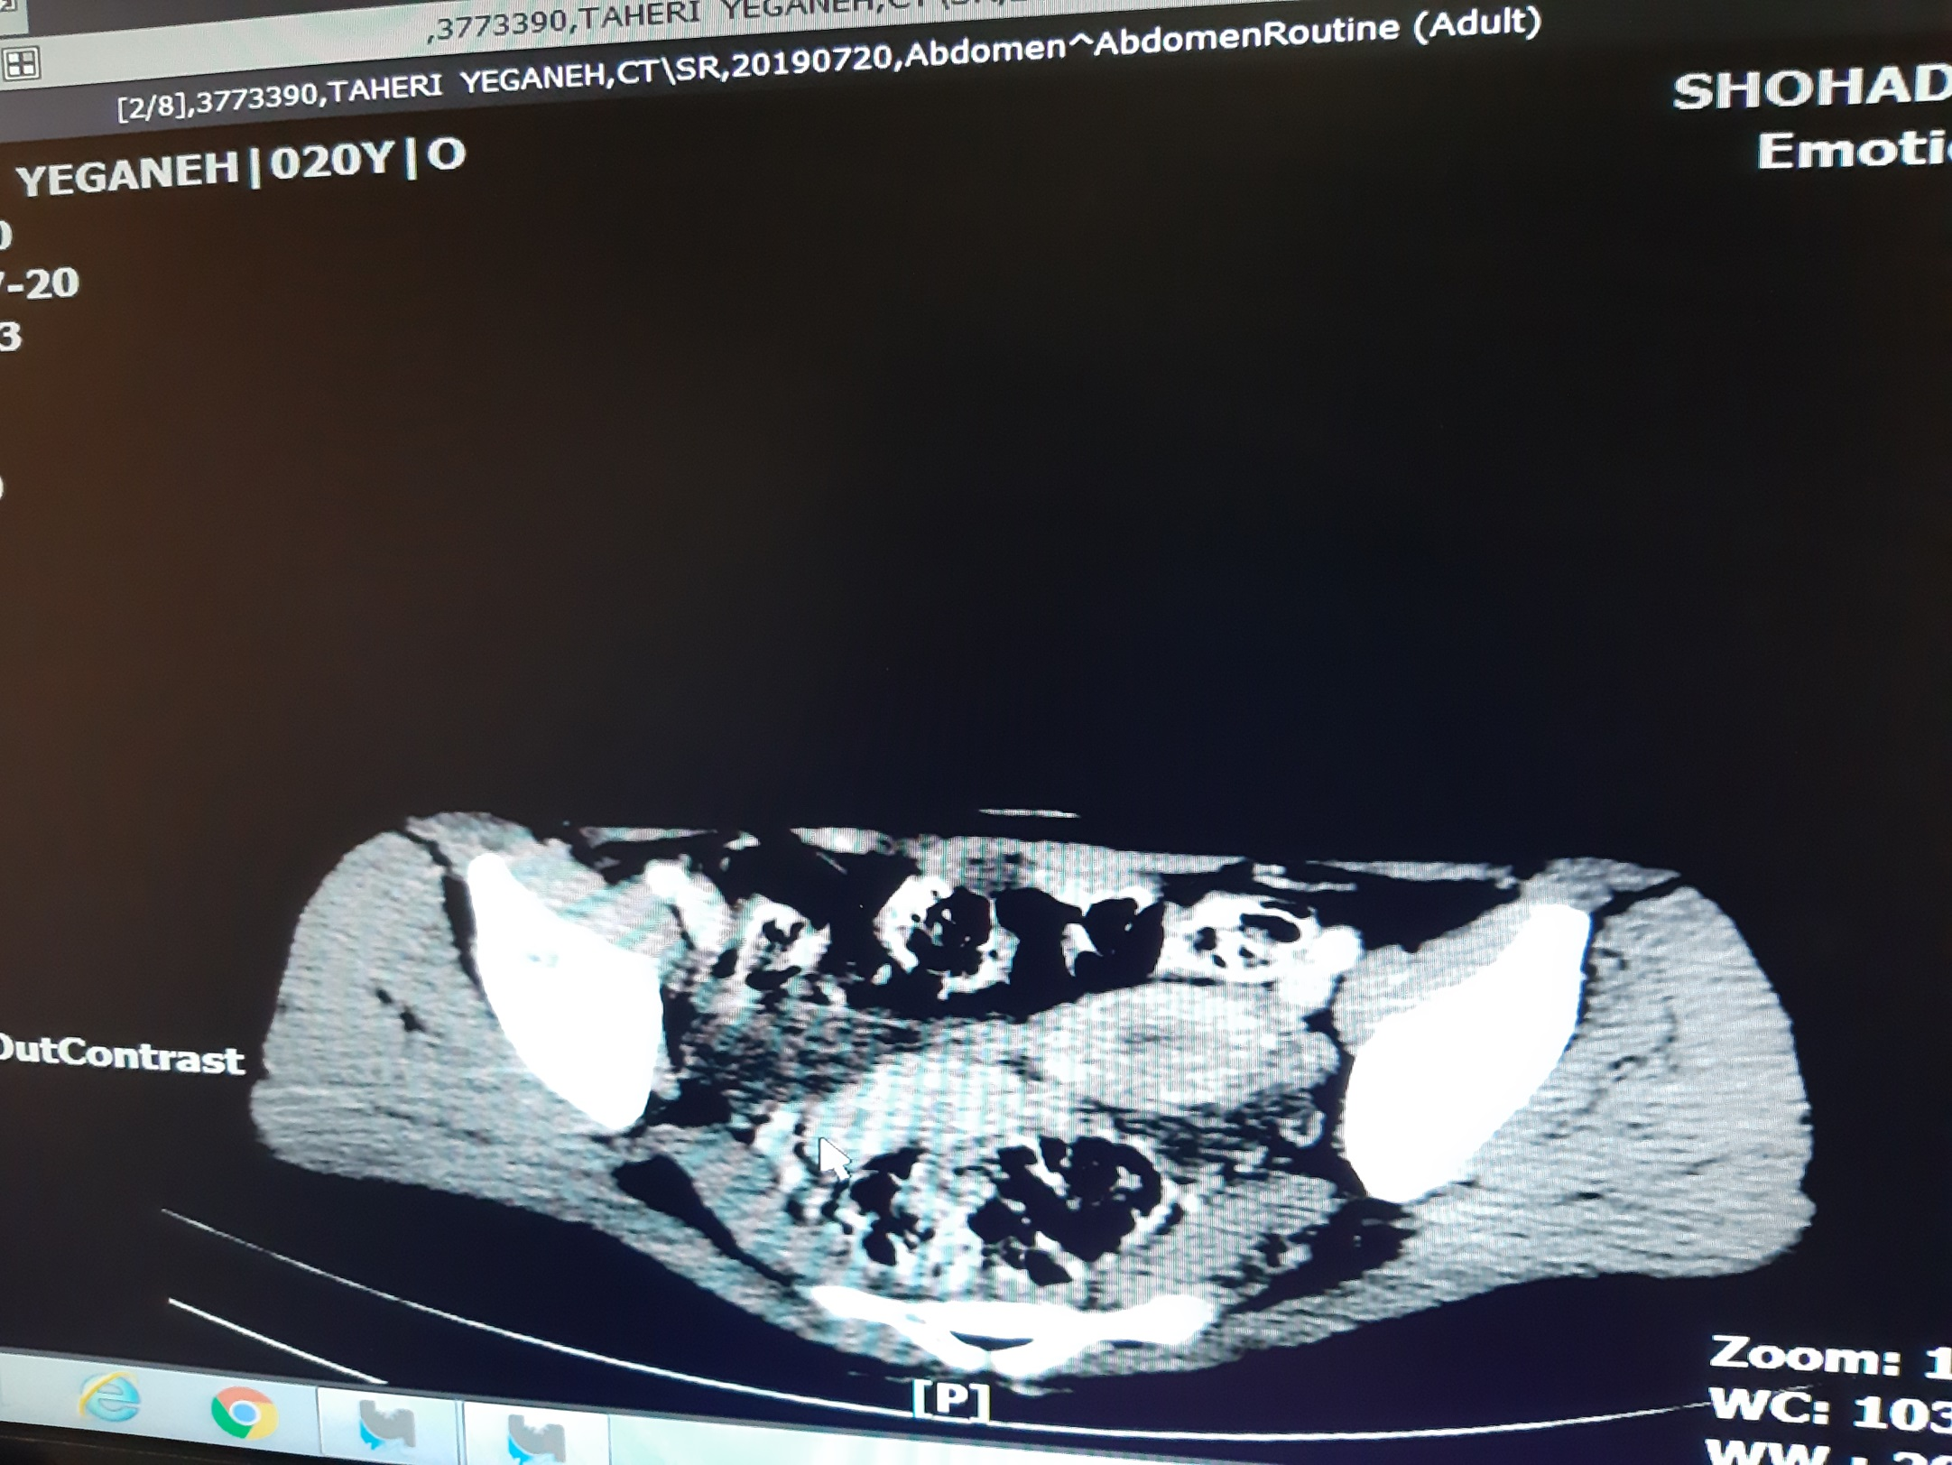

Slide 35
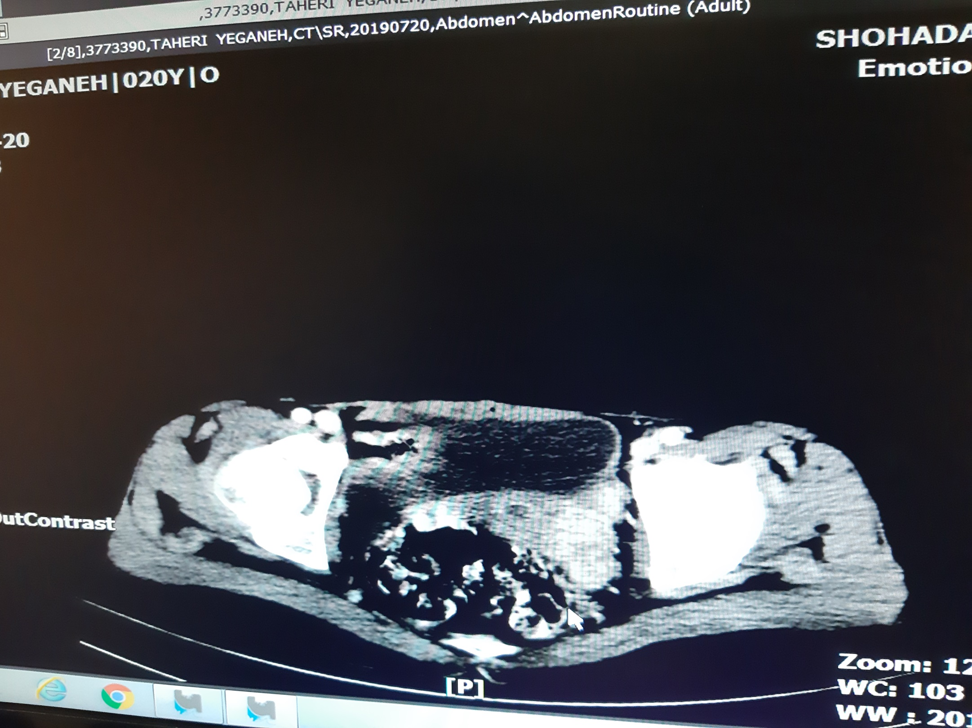

Slide 36
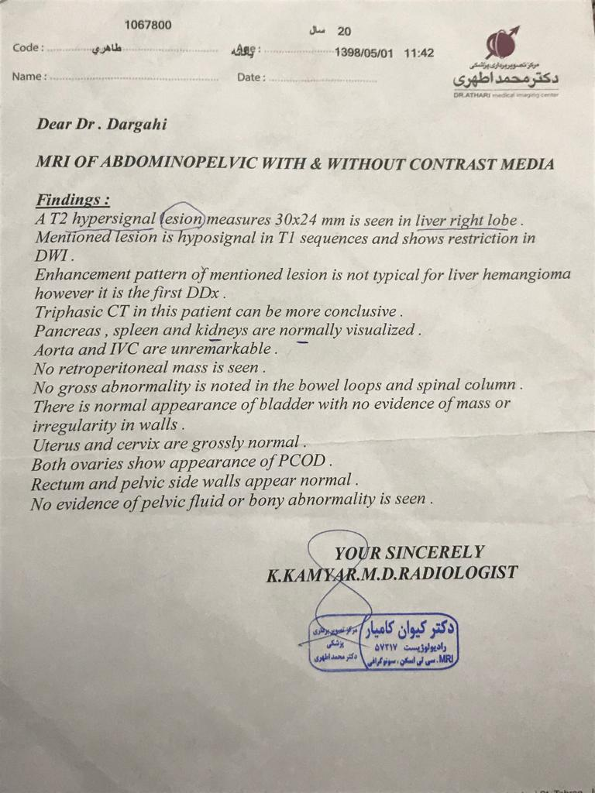

Slide 37
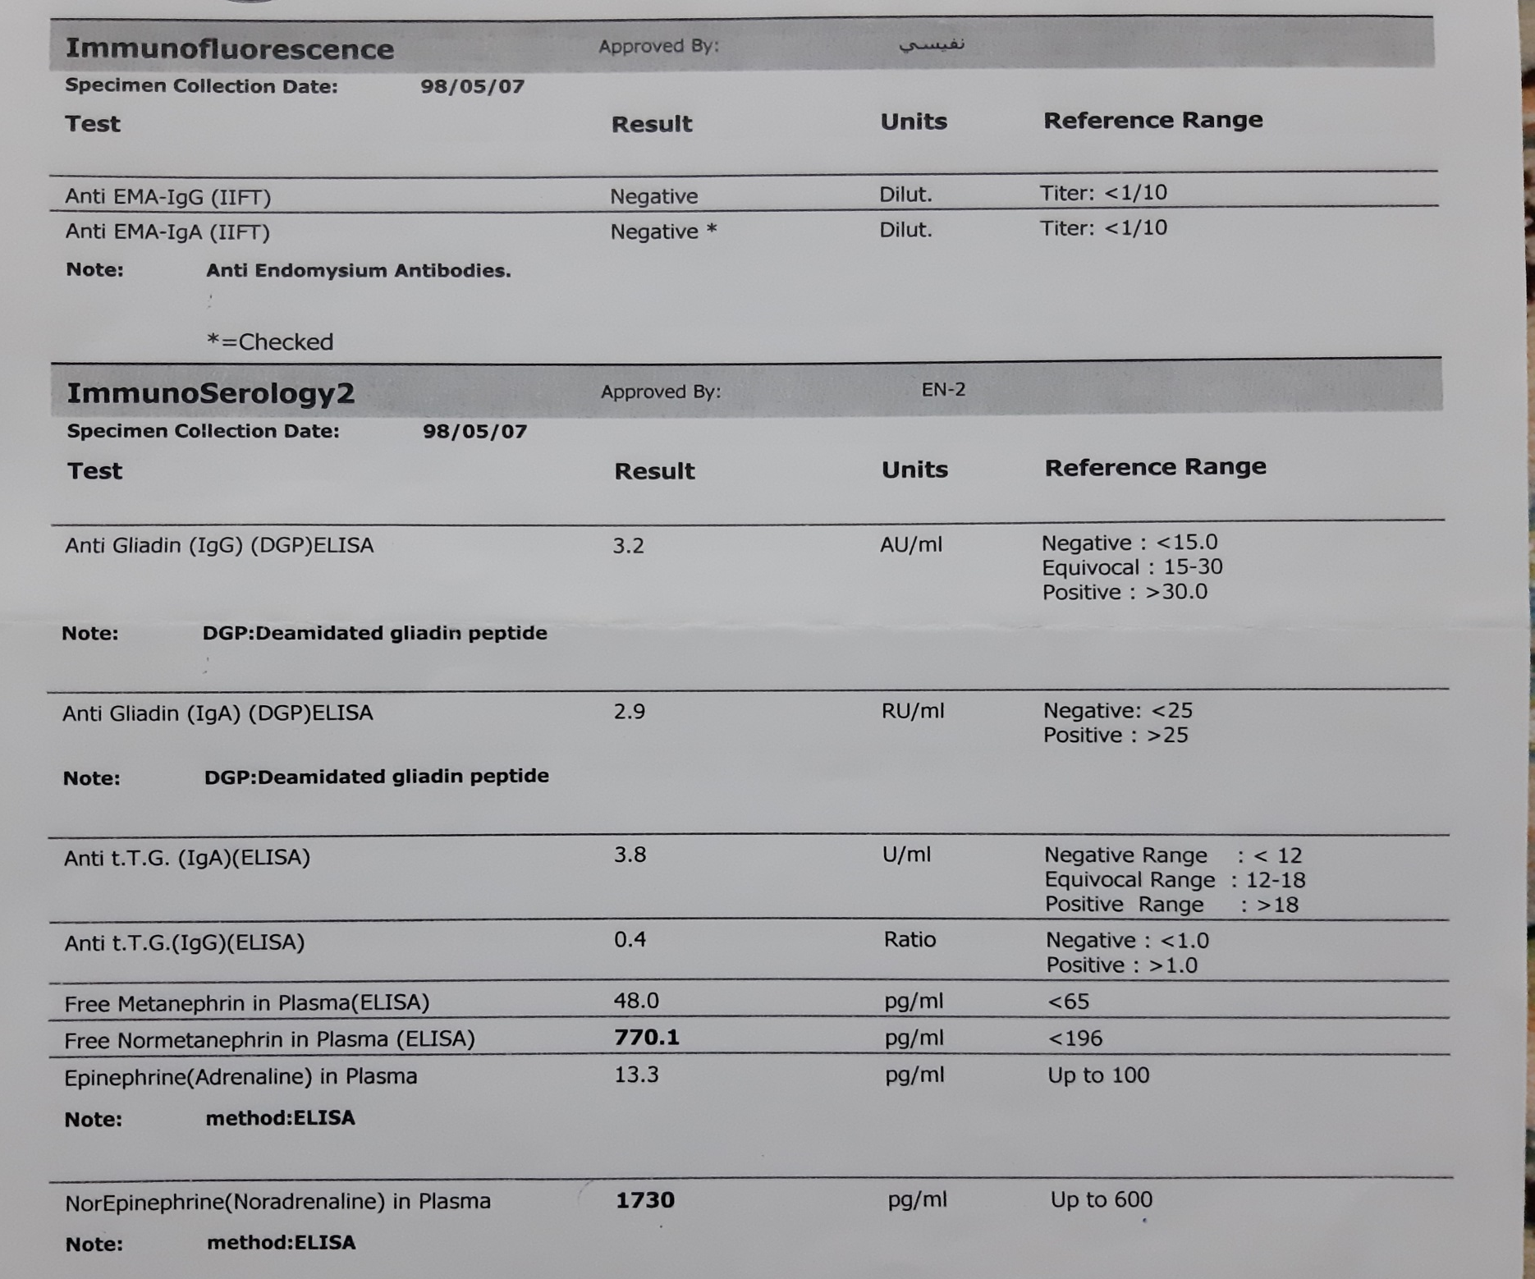

Slide 38
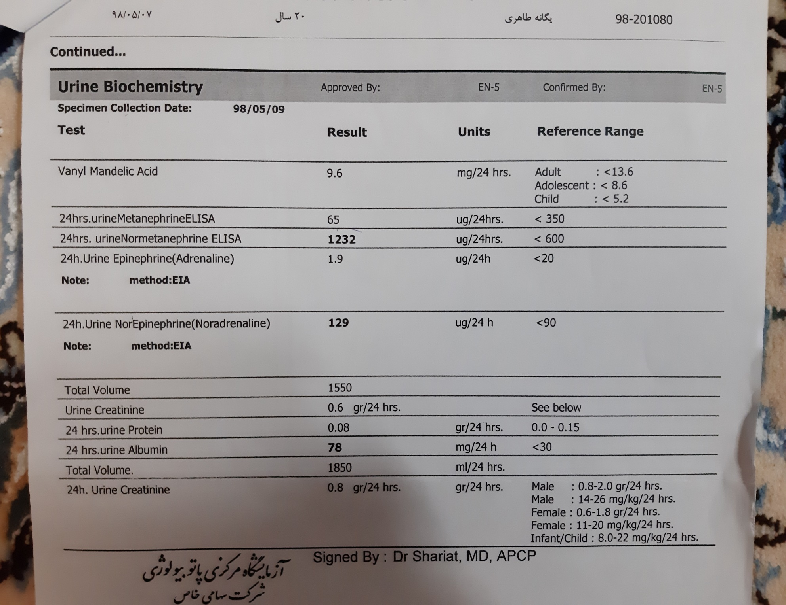

Slide 39
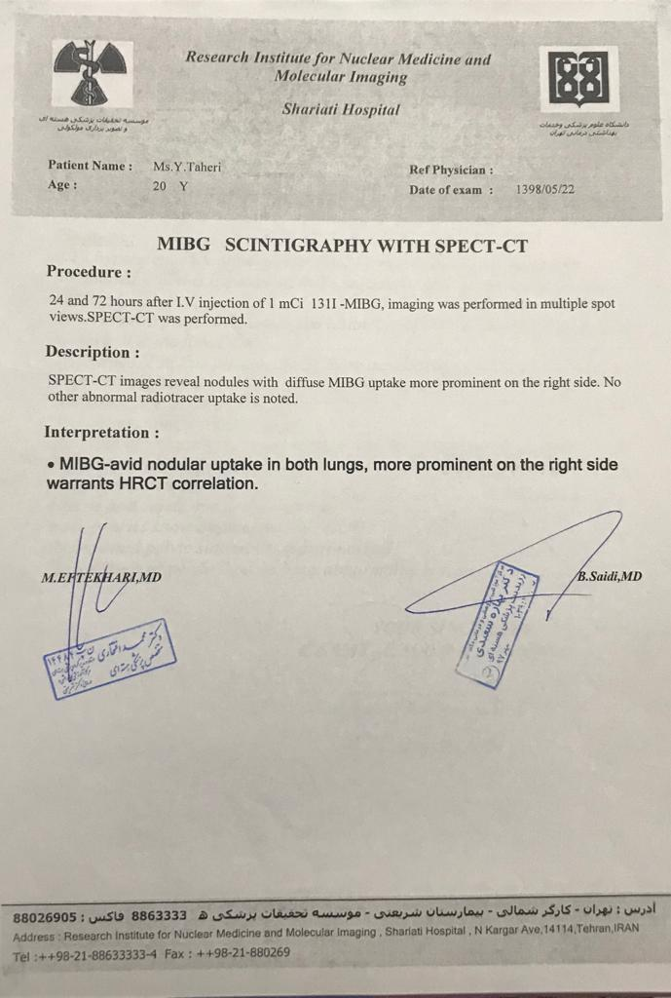

Slide 40
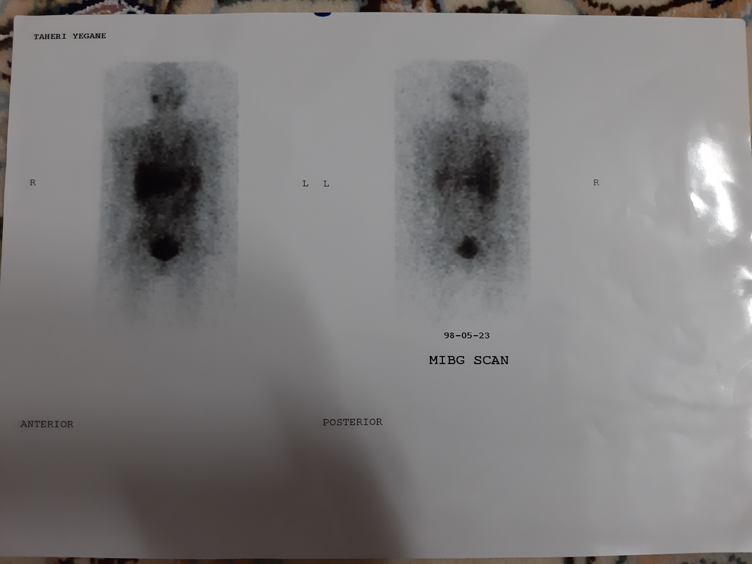

Slide 41
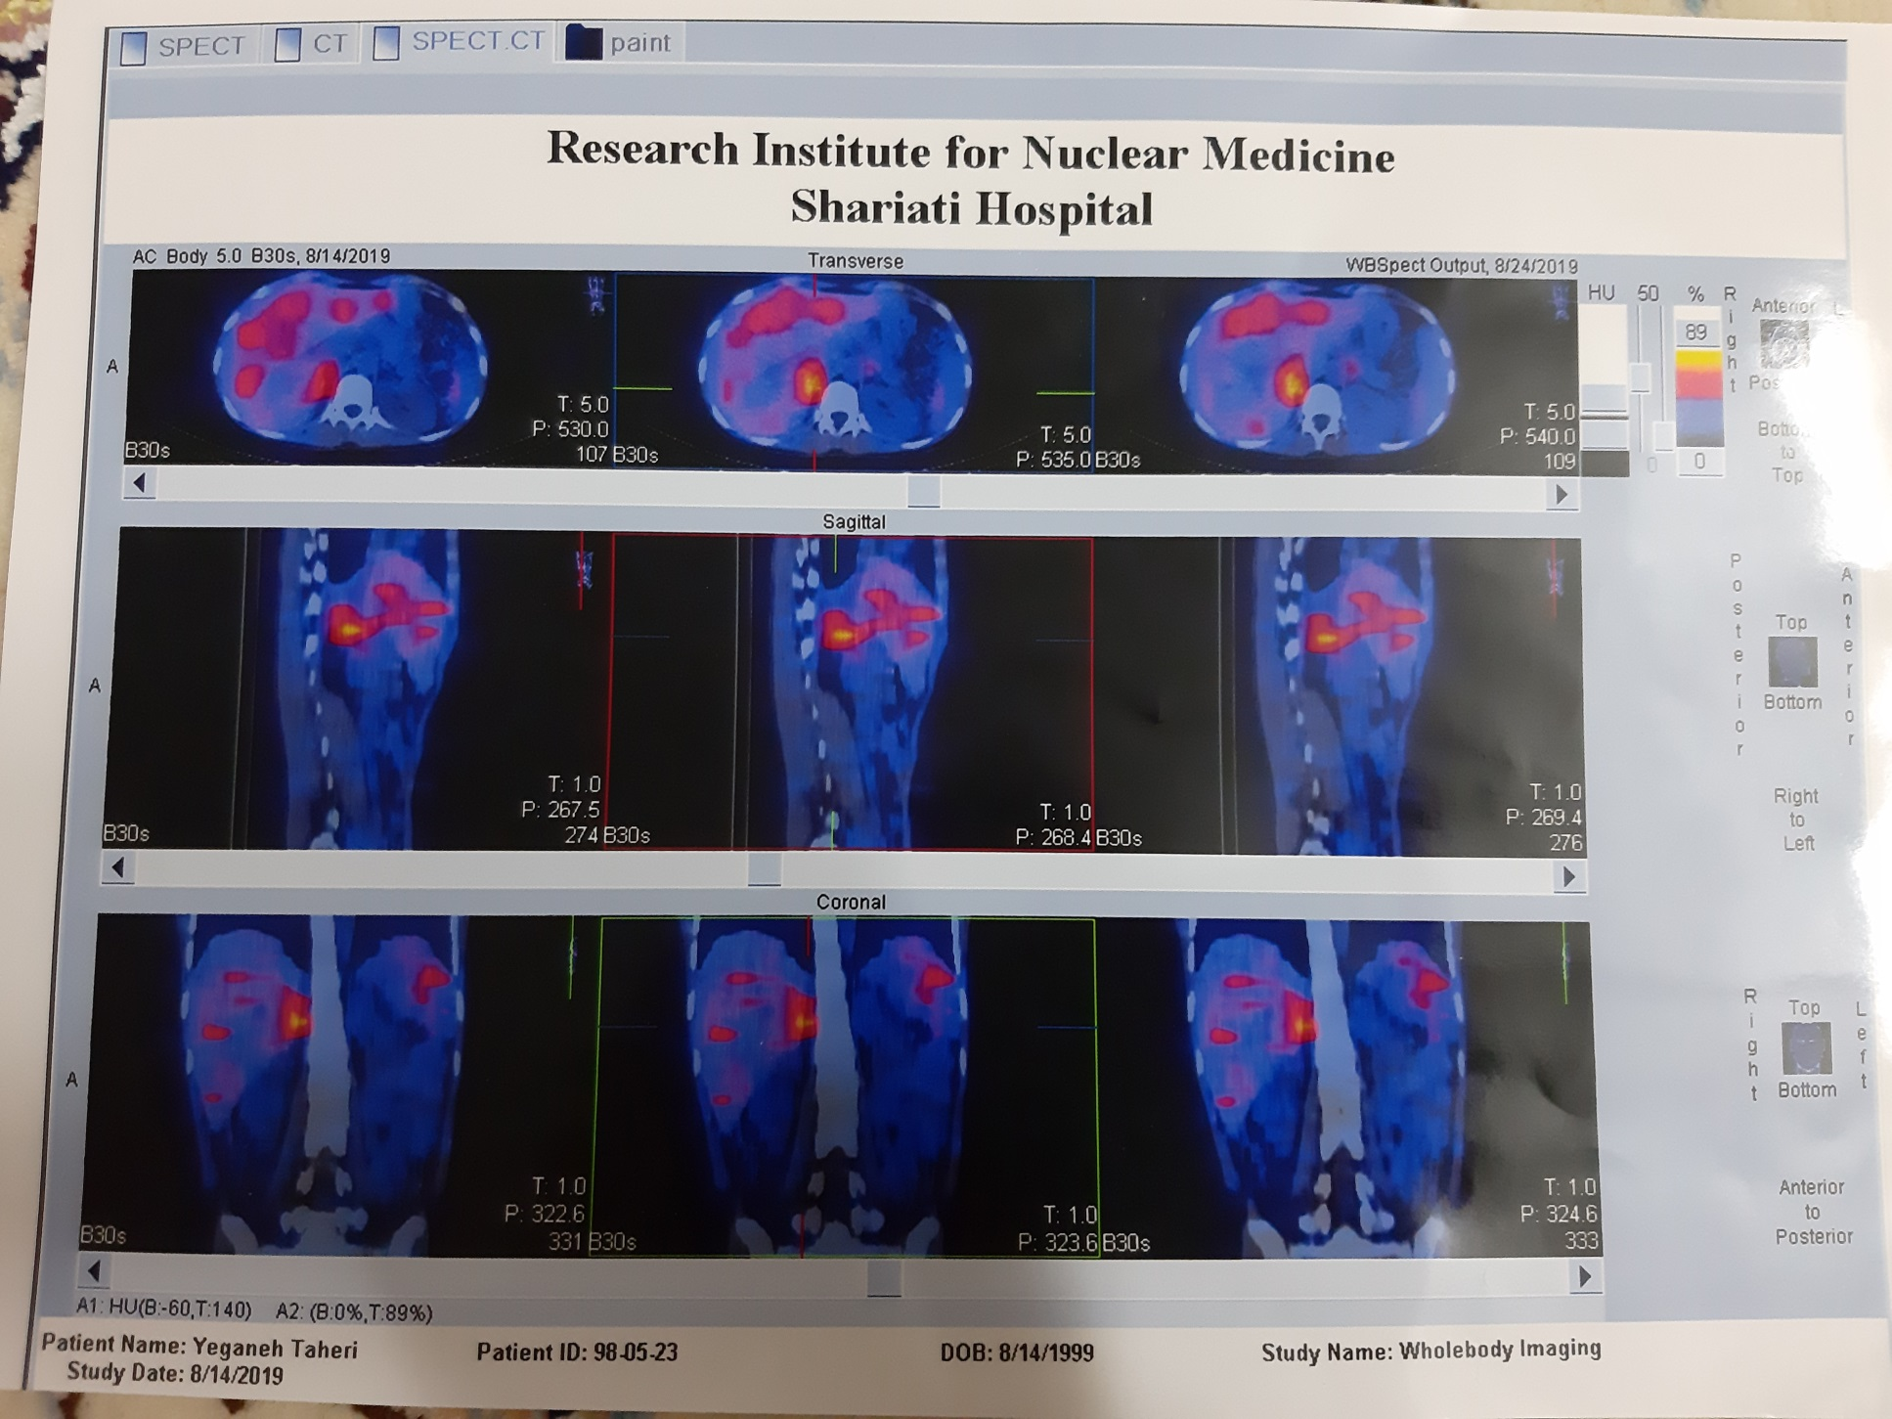

Slide 42
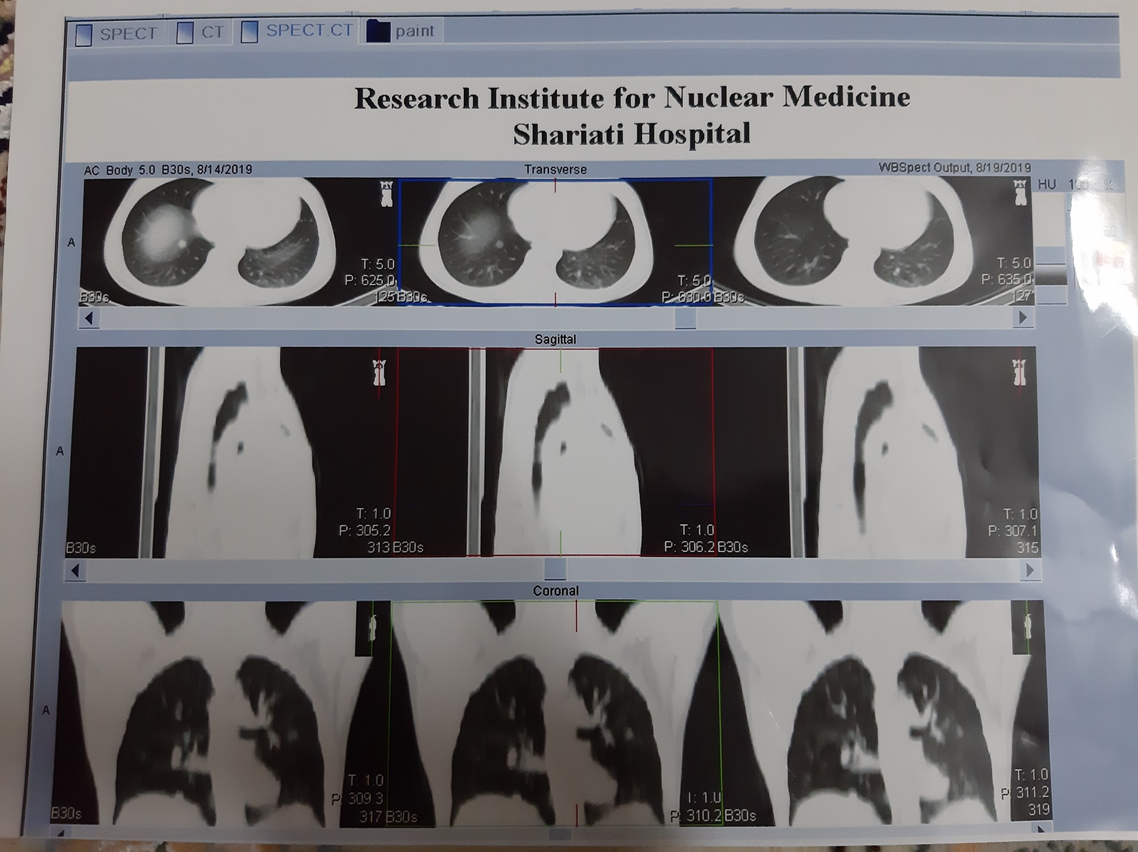

Slide 43
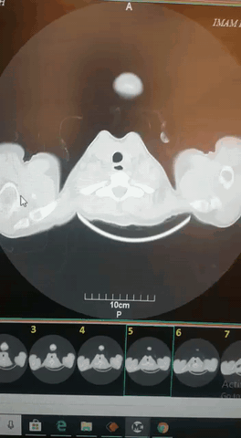

Slide 44
Problem list
History of abdominal PGL
History of surgery of abdominal mass
Abdominal pain
Increased BP
A mass like lesion with enhancement in liver, an enhancing & homogenous mass in pelvis in CT scan which is confirmed in MRI
Nodular uptake in both lungs in MIBG scan; one 1-cm nodule in Rt lung in CT.

Slide 45
Thank for your attention

