Slide 1
IN THE NAME OF GOD

Slide 2
cc
Tx of resistance thyrotoxicosis
ophtalmopathy

Slide 3
A 34 y/o married female(G2 P2 A0)
In the 3th months of pregnancy she was hospitalized in Ahwaz b/c of tremor + palpitation + diaphoresis + Rt middle of leg inflation & redness
Gynecologist began heparin for her(5000u BD/sc)
In the LAB tests they found hyperthyroidism
(TSH:0.005 T4:22.4 T3:7.04 TRAP 11:55)
They began Methimazole for her(10 mg in khordad & then added 5 mg every 3w up to 45 mg till now)
At the 34w of pregnancy b/c of diplopia & Lt eye ptosis & IUGR the pregnancy ended with C/S(96.7.12)

Slide 4
The eye problems(pain + diplopia +RT proptosis + LT ptosis began 3 months ago(96.7.10 /at 34w of pregnancy)
The baby TFT tests was NL
She doesn`t breast feed the baby

Slide 6
PMHX
Preeclampsia in 1th pregnancy------>c/s in 36w(year 89)
Lt breast lumpectomy (fibroadenoma)(year 93)
Hyperthyroidsim in 3th pregnancy ---→c/s in34 w(year 96)
Admission to ICU after 2th c/s

Slide 7
FHX
Brother : hyperthyroidism
Aunt : hyperthyroidism

Slide 8
MHX
Tab methimazole 45 mg daily
(96/3 began with 10mg every 3weeks added 5mg)
Tab prednisolone 50 mg daily(since 4months ago)
( 1m before c/s)
Tab inderal 20 mg TDS
AMP Heparin 5000u BD (3th months of pregnancy to the end of it)

Slide 9
ROS
Mood change + / palpitation+ / diaphoresis+
Throat pain+ / tremor+ / headache+ / shortness of breath+
Proptosis of Rt eye
ptosis of Lt eye & diplopia
Weakness+ /emotional lability+ /heat intolerance+
Anxiety + / increased perspiration+/ increased appetite+

Slide 10
Physical examination
BP:120/80 PR:102 OT:36.5 RR:14 BMI:37.6
Rapid speech & hyperactivity & tremor
Skin: warm & moist the hair thin & fine
Eye: lid lag +lid retraction +
redness of eye lids _ redness of conjunctive _
swelling of the eye lids _
inflammation of the caruncle or plica _
conjunctive edema _

Slide 11
Rt eye: proptosis & in the end of up gaze-→diplopia
Lt eye: ptosis & diplopia in all directions
spontaneous retrobulbar pain +
pain on attempted up or down gaze +
score of diplopia3(continuous)
NECK: Thyroid soft & enlarged( 45g ) with no nodules
thrill_ bruit+ no pain & no tenderness on thyroid
L.N was not enlarged JVP was NL

Slide 12
Heart :the pulse was regular S1 & S2 was NL
Chest :lung was clear
Abdomen: soft & fatty
EXT: force of upper & lower limbs was4/5
no peripheral edema
Cranial nerves: NL (eye movments /smile/close eyes tightly , open the jaw against resistance, hearing / tongue movments /head rot/shoulder elevation/symmetric pupils/

Slide 13
LAB
96.3 96.5 96.6 96.7 96.8 96.9 96.10
TSH <0.005 <0.OO5 0.01 0.007 0.14 0.OO5 0.01 uIU/l
T4 22.3 19.7 11.4 10.5 6.8 11.8 17.7 ug/dl
T3 7.04 l 7.4 4.01 2.6 2.3 3.4 5.7 nmol/l
FT4 2.6 2.12 ng/dl
FT3 8.19 7.03 pg/dl
TSH REC AB 14.14 IU/L
Methimazole 10 15 20 25 30 35 40 45 50mg

Slide 14
AchR_ab _ TG:131 (96.10.12)
Wbc:6.7 Chol:138
Hb:11.8 MCV(69) HDL:40
Plt:242 LDL:75
cr:0.9 ESR:13
AST:19
ALT:31
ALKP:173

Slide 15
Ophthalmologist consult: NL eye( graves dx)
Neurologist consult: NL (myasthenia gravis _)

Slide 16
THYROID SCAN:(96.10.3)
thyroid is enlarged with NL shape & outline the concentration of radionuclide in the both lobes are more than NL
interpertation: both lobes hyperactive thyroid gland with un even surface

Slide 17
ORBIT CT:(96.7.24) :NL
Brain MRI:(96.10.3):NL
ORBIT MRI:(96.10.3):NL
THYROID SONO : (96.10.13):enlarged & heterogen without nodule
Rt:39.20.21mm
LT: 15.23.40 mm

Slide 18
Problem list
Atypic graves dx
Orbitopathy
Resistance garves dx
Methimazol 45mg( TSH:0.01 T4:17.7 T3:5.7)

Slide 22
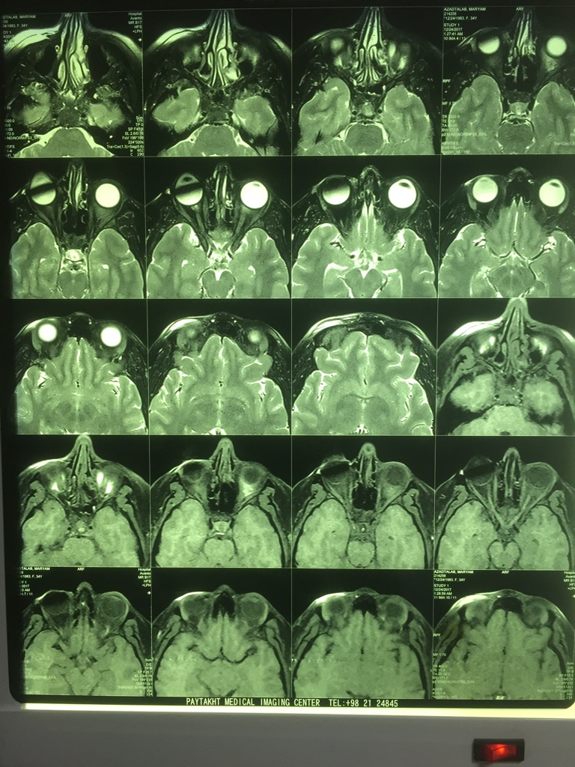

Slide 23
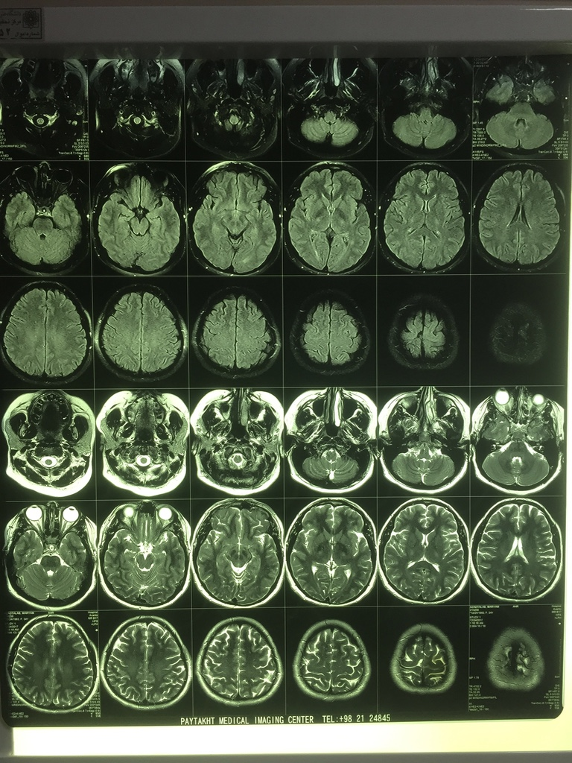

Slide 24
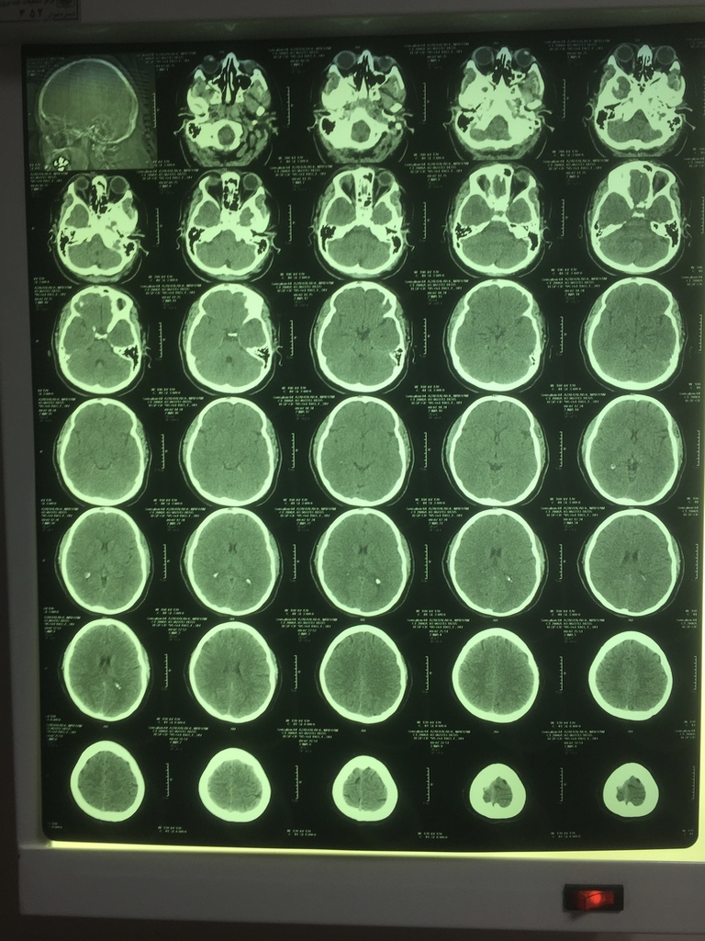

Slide 25
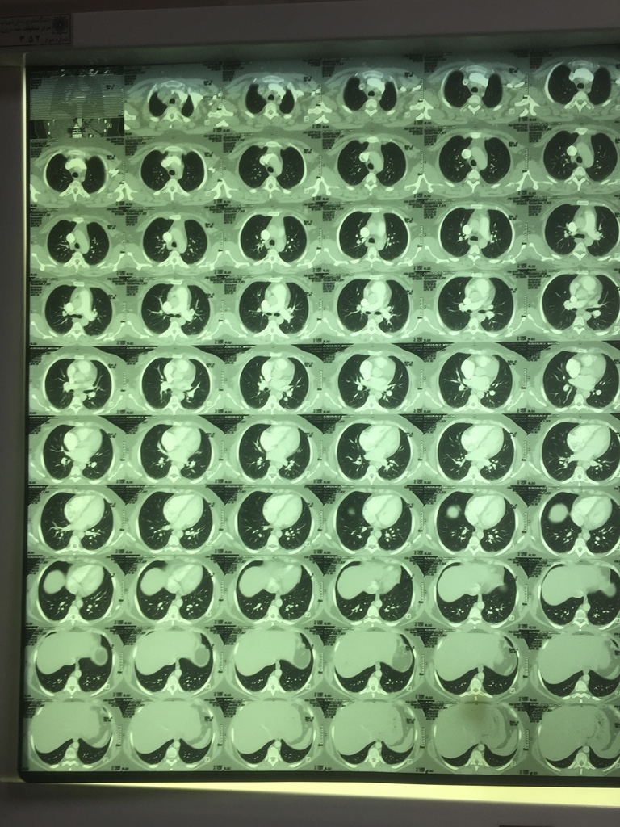

Slide 26
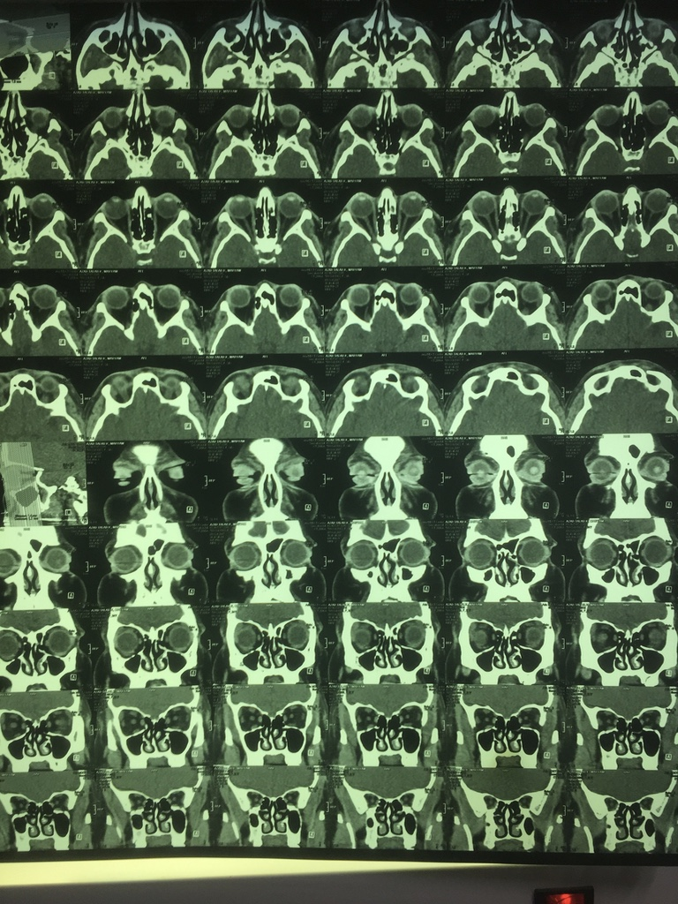

Slide 27
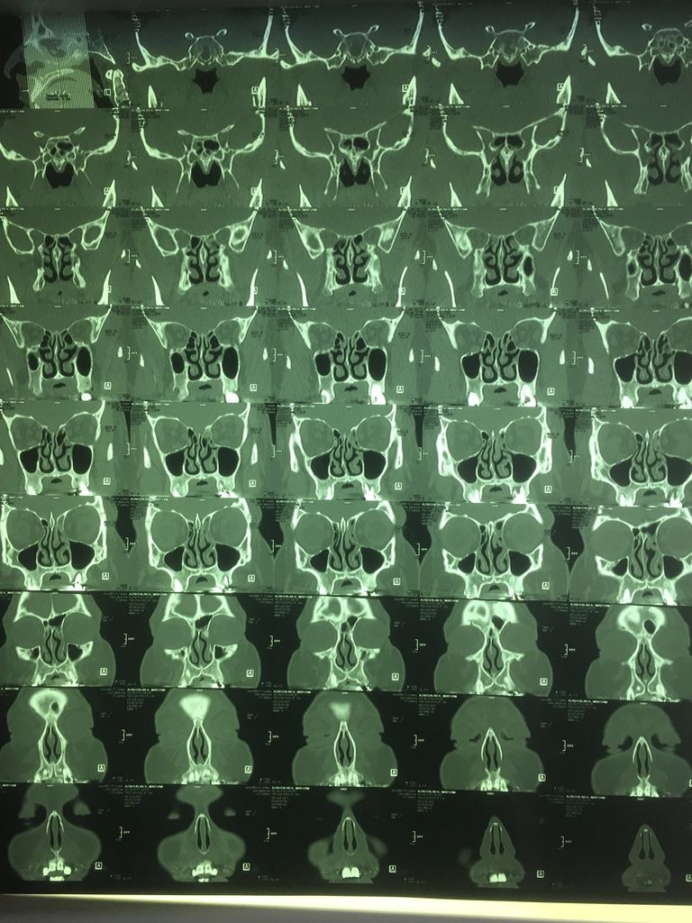

Slide 28
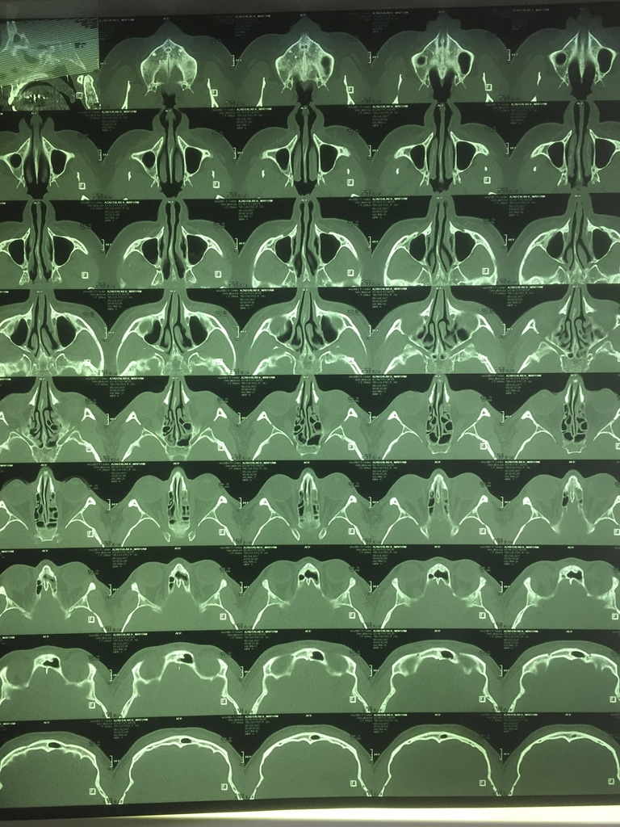

Slide 29
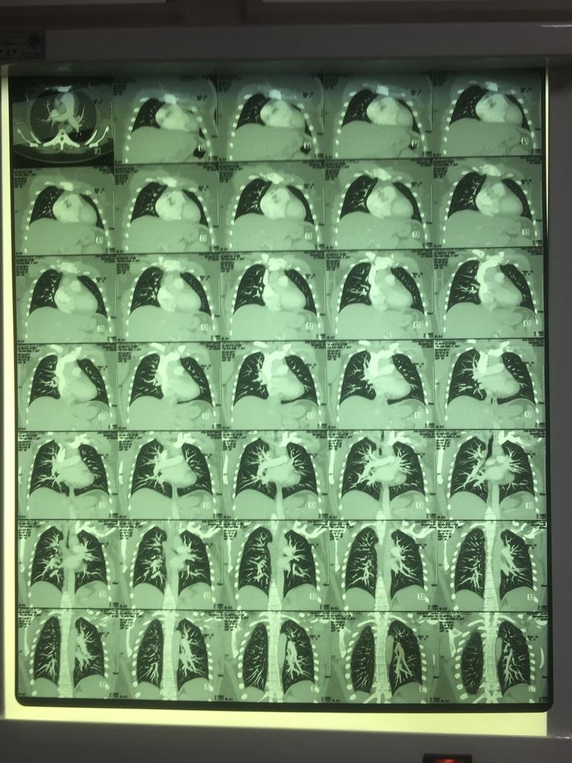

Slide 30
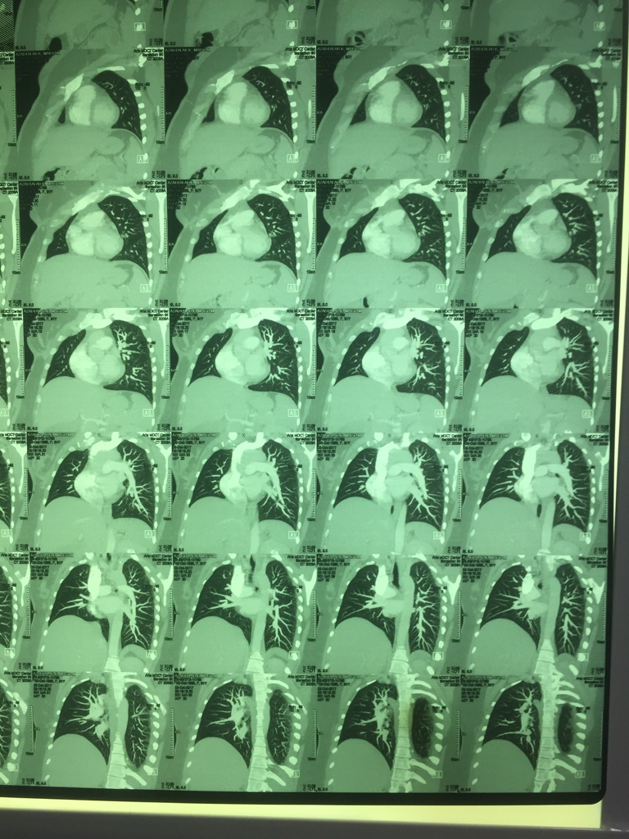

Slide 32
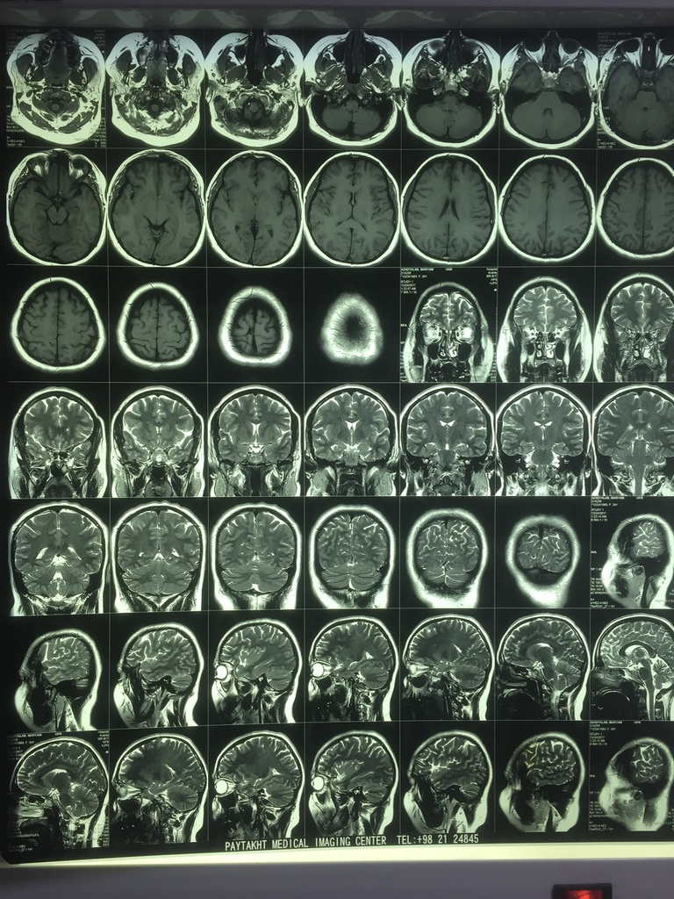

Slide 33
