Slide 1
Nonalcoholic Fatty Liver Disease in Endocrinology Clinical Settings
July 11,2022
Mahsa Abbaszadeh, MD
Research Institute for Endocrine Sciences, Shahid Beheshti University of Medical Sciences

Slide 2
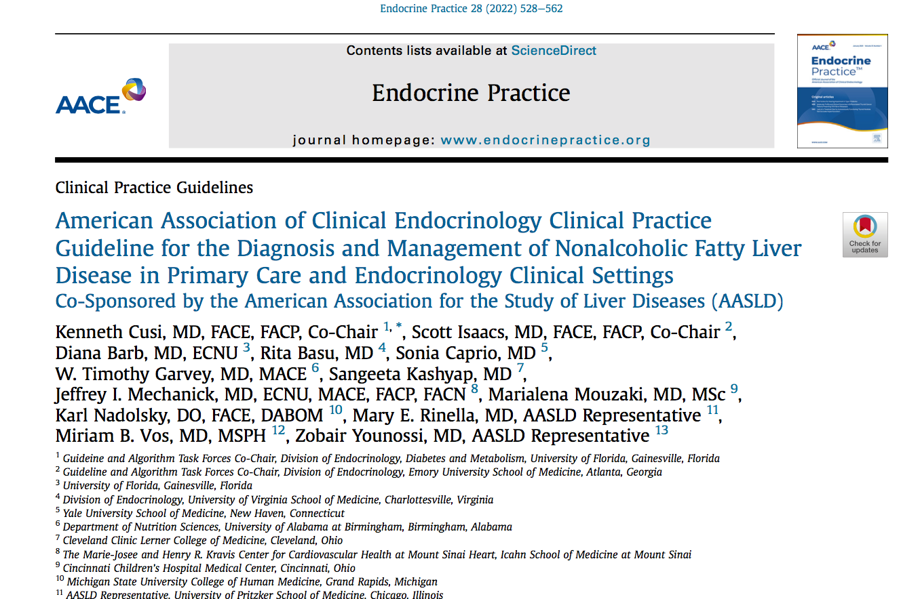

Slide 3
Outline:
  Introduction
  Natural history, Epidemiology and Complications of NAFLD
  MAFLD , A new definition
  Recommendations:
  Screening
  Risk stratification
  Diagnosis
  Management of NAFLD

Slide 4


Natural history of NAFLD
18%
Healthy
Steatosis
NASH (F1–2)
NASH (F3)
Cirrhosis (F4)
25-38%
37–44%
43%
38%
17%
1%
Normal progressors
Rapid progressors
CVD
Extra-hepatic cancers
End-stage liver disease
Armandi A and Bugianesi E. Liver Int. 2021;41(Suppl 1):78–82
J hepatology 2021, 75 (2); 284-291
Notes:
NAFLD is associated with insulin resistance, obesity and CV risk factors
Cirrhosis (fibrosis stage F4) is associated with increased risk of mortality.
CVD is the primary cause of death in people with NASH
People with pre-cirrhotic NASH have an increased risk of HCC

Slide 5
Nonalcoholic Fatty Liver Disease Activity Score

Slide 6
Fibrosis grade

Slide 7
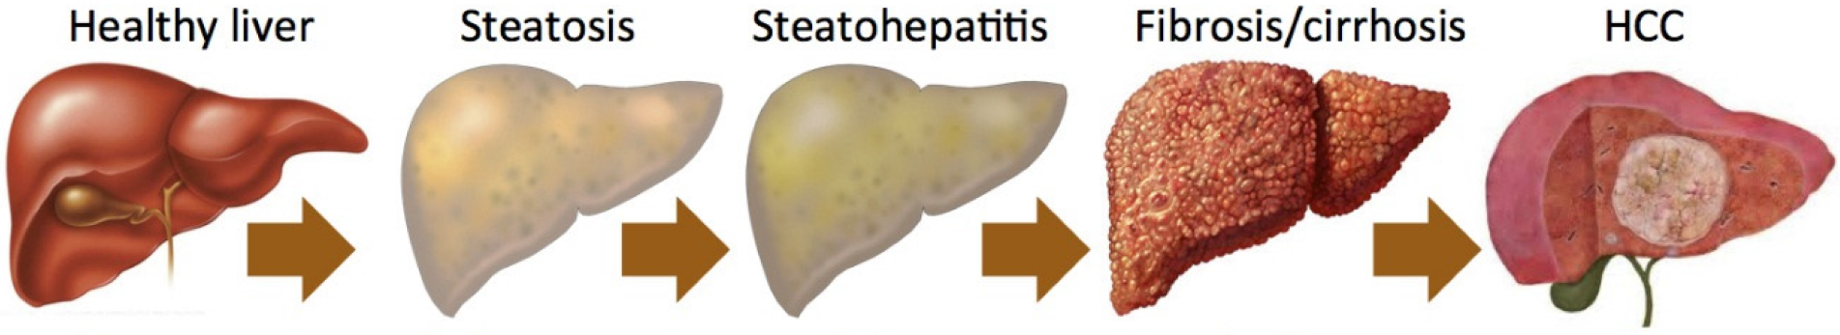
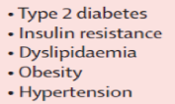
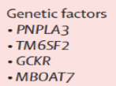

Risk factors
Age (>50 years)
Insulin Resistance
Features of metabolic syndrome (MetS)
Ethnicity: Hispanic population
Environmental factors
PCOS and hyperandrogenism (threefold higher prevalence)
All increase the probability of NASH with a more severe fibrosis stage and cirrhosis.
J Hepatol. 2021;75(2):284e291.

Slide 8
Epidemiology
  In a prospective large cohort of middle-aged Americans
  664 Participants
  Screening for NAFLD was performed using MRI-PDFF
  Definite diagnosis with liver biopsy
  The prevalence of NAFLD was estimated to be 38%
  NASH was diagnosed in 14% of the entire cohort
  Significant liver fibrosis in 6%
J hepatology 2021, 75 (2); 284-291

Slide 9
EPIDEMIOLOGY
38 % NAFLD (steatosis)
General population 14 % NASH
6% fibrosis (stages ≥ F2)
.
70% NAFLD (steatosis)
T2D 30-40% NASH (liver BX)
12-21% fibrosis (stages ≥ F2)
Among those with obesity 25-30% NASH
J Hepatol. 2021;75(2):284e291
Diabetes Care. 2021;44(2):399-406.

Slide 10
Prevalence of NAFLD in patients with type 2 diabetes mellitus is more than 2-fold higher than in the general population
Diabetes Care 2017;40:419–430

Slide 11
A total of 561 patients with T2DM (age: 60± 11 years; BMI: 33.4 ±6.2 kg/m2; and HbA1c: 7.5 ±1.8%) attending primary care or endocrinology outpatient clinics and unaware of having NAFLD.
At the visit, volunteers were invited to be screened by elastography for steatosis and fibrosis
A liver biopsy was performed were suggestive of fibrosis
Diabetes Care 2021 Feb; 44(2): 399-406.

Slide 12
With a lower cutoff of AST and ALT of≥30 units/L, it increased to 13% and 22%, 40% of patients with fibrosis had a plasma AST ≥26 units/L.
Diabetes Care 2021 Feb; 44(2): 399-406.

Slide 13
Fibrosis: 21%
moderate-to-advanced fibrosis (F2 or higher): 15%
(An established risk factor for cirrhosis and overall mortality)
Diabetes Care 2021 Feb; 44(2): 399-406.

Slide 14
Diabetes Care 2021 Feb; 44(2): 399-406.

Slide 15
Complications

Slide 16
Important Outcomes in Patients With NAFLD
CVD mortality
Progressive hepatic fibrosis, cirrhosis
Hepatocellular carcinoma

Slide 17
Other complications
Gallbladder disease,
Obstructive sleep apnea,
Colorectal neoplasm,
Other cancers
Endocrine Practice 28 (2022) 528e562

Slide 18
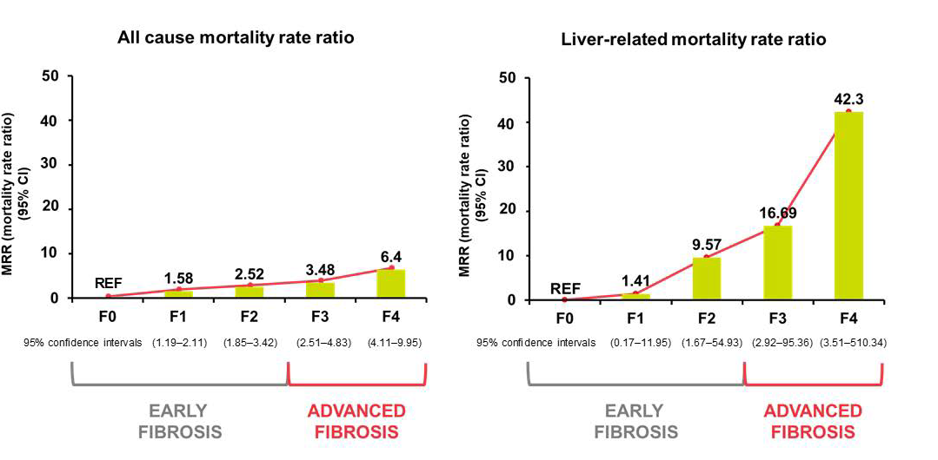
The risk of liver-related mortality increases exponentially with increasing fibrosis stage
Impact of fibrosis stage on liver-related mortality in a meta-analysis of five multinational cohorts (17,452 PYF)
Dulai PS, et al. Hepatology 2017

Slide 19
NAFLD and diabetic complications
NAFLD has been associated with microvascular diabetic complications, Especially chronic kidney disease (CKD)
Endocrine Practice 28 (2022) 528e562

Slide 20
NAFLD and diabetic complications
A meta-analysis including 20 cross-sectional studies
with approximately 28000 individuals
NAFLD was associated with a twofold increased prevalence of CKD (odds ratio [OR], 2.12; 95% CI, 1.69- 2.66).
PLoS Med. 2014;11(7):e1001680.

Slide 21
NAFLD and diabetic complications
In persons with diabetic retinopathy, the relationship remains controversial
with a recent meta-analysis of 9 studies
involving 7170 persons
unable to find an overall association between NAFLD and diabetic retinopathy
J Diabetes Investig. 2021;12(8):1471e1479.

Slide 22
Comorbid Conditions Associated With Nonalcoholic Steatohepatitis
JAMA. 2020;323(12):1175-1183

Slide 23
NAFLD and
CVD complications
In a recent cross-sectional study of asymptomatic individuals undergoing coronary CT angiography, NAFLD was consistently associated with high risk noncalcified atherogenic plaques, indicative of a greatly increased CV risk.
Persons with NAFLD have increased carotid intima-media thickness compared with those without NAFLD.
Liver Int. 2019;39(3):557e567. .

Slide 24
NAFLD and
CVD complications
In a longitudinal study of 603 individuals with biopsy-proven NAFLD
followed for a mean of 18.6 years
28% of persons with NAFLD versus 21% of controls experienced a CVD event (HR, 1.54; 95% CI, 1.30-1.83).
The increased risk of both fatal and nonfatal CV events has been correlated in some studies with the severity of hepatic steatosis, inflammation, or fibrosis.
Liver Int. 2019;39(1):197e204.

Slide 25
NAFLD and
CVD complications
A recent meta-analysis among 10 576 383 individuals
across 24 countries
in nonobese persons with NAFLD
aiming to remove obesity as a confounding factor
found that there was still a much higher incidence rate of new-onset CVD in individuals with NAFLD (18.7 per 1000 person- years; 95% CI, 9.2-31.2).
Lancet Gastroenterol Hepatol. 2020;5(8):739e752.

Slide 26
Other CV associations
atherosclerotic CVD
atrial fibrillation
ventricular arrhythmias
cardiomyopathy,
cardiac valvular calcification
heart failure with preserved ejection fraction

Slide 27
Aim of developing this guideline
  The growing prevalence of NAFLD
  In contrast to other highly prevalent noncommunicable chronic conditions NAFLD has received little attention from a public health perspective
  Disease awareness remains limited with <5% of persons with NAFLD being aware of their disease
  The aim:
  increase awareness about NAFLD and NASH
  provide easy-to-use and practical recommendations
Endocrine Practice 28 (2022) 528e562

Slide 28
MAFLD

Slide 29
Journal of Hepatology 2020 vol. 73 j 202–209

Slide 30
Journal of Hepatology 2020 vol. 73 j 202–209

Slide 31
Metabolic dysfunction-associated fatty liver disease
MAFLD
The former definition of nonalcoholic fatty liver disease (NAFLD) lacked a unified set of “positive” criteria accounting for the key metabolic features, leading to heterogeneous disease characterization and endpoint prognostication
MAFLD has its own inclusion criteria based on degree of metabolic abnormality and does not exclude other etiologies.

Slide 32
Metabolic Dysfunction-Associated Fatty Liver Disease and Incident Cardiovascular Disease Risk:
A Nationwide Cohort Study
From a nationwide health screening database, we included 9,584,399 participants aged 40-64 years between 2009 and 2010.
Participants were categorized by presence of NAFLD and MAFLD, separately, and by the combination of the 2 definitions—Neither-FLD, NAFLD-only, MAFLD-only, or Both-FLD.
The primary outcome was a composite CVD event, including myocardial infarction, ischemic stroke, heart failure, or CVD-related death
Clin Gastroenterol Hepatol 2021 Oct;19(10):2138-2147.e10.

Slide 33
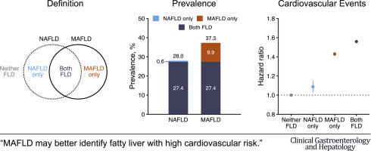

Slide 34
Change from NAFLD to MAFLD criteria may identify a greater number of individuals with metabolically complicated fatty liver and increased risk for CVD

Slide 35
Recommendations
Endocrine Practice 28 (2022) 528e562

Slide 36
Screening
Endocrine Practice 28 (2022) 528e562

Slide 37
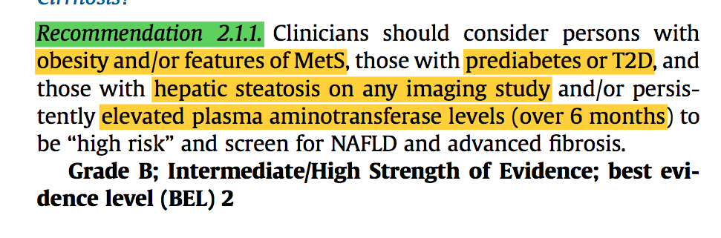
Who?
Endocrine Practice 28 (2022) 528e562

Slide 38
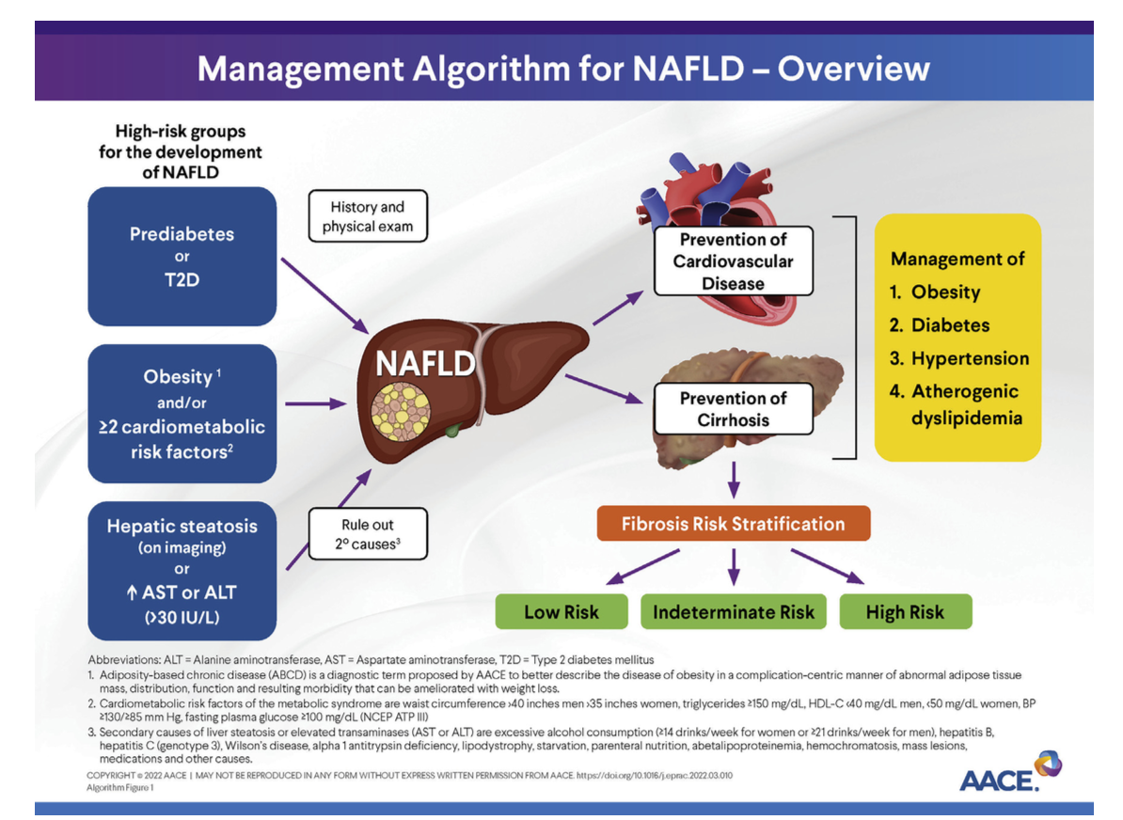
Endocrine Practice 28 (2022) 528e562

Slide 39
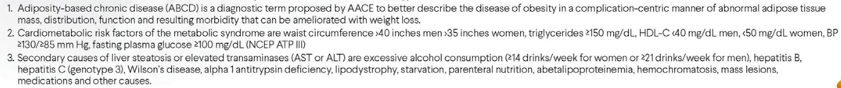
Definitions
Diabetes Care. 2020;43(2):283e289.

Slide 40
Adiposity-Based Chronic Disease (ABCD)
Adiposity-Based Chronic Disease (ABCD) is a new diagnostic term for obesity that explicitly identifies a chronic disease, alludes to a precise pathophysiologic basis, and avoids the stigmata and confusion related to the differential use and multiple meanings of the term obesity.
AACE and ACE have created a chronic care model, advanced diagnostic framework, clinical practice guidelines, and clinical practice algorithm for the comprehensive management of obesity.
This coordinated effort is not solely based on body mass index as in previous models
emphasizes a complications-centric approach that primarily determines therapeutic decisions and desired outcomes.
AACE/ACE POSITION STATEMENT| VOLUME 23, ISSUE 3, P372-378, MARCH 01, 2017

Slide 41
persistently abnormal aminotransferase levels
  ALT level, American College of Gastroenterology (2017):
  29 to 33 U/L for males
  19 to 25 U/L for females
Endocrine Practice 28 (2022) 528e562

Slide 42
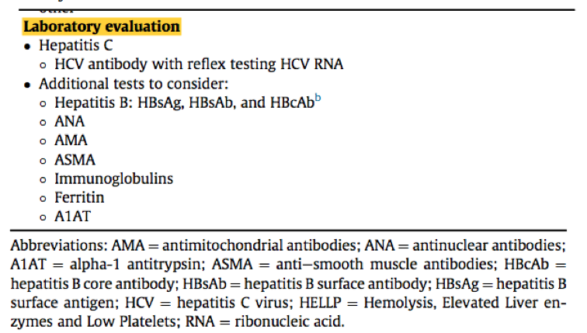
suspected or incidental finding of hepatic steatosis on imaging
Endocrine Practice 28 (2022) 528e562

Slide 43
DIGNOSTIC TEST
IN high risk of NAFLD
  In persons at high risk of NAFLD (eg, type 2 diabetes mellitus, obesity, and metabolic syndrome):
  abdominal ultrasound is not required to diagnose hepatic steatosis,
  it is reasonable to move directly to risk stratification after ruling out the secondary causes of liver disease.
Endocrine Practice 28 (2022) 528e562

Slide 44
World Health Organization Criterion for Screening
Is it a health problem?
Is there treatment?
Is it detectable pre-clinically?
Is there a suitable screening test?
Is the screening test acceptable to people?
Is the natural history of disease understood?
Are the costs acceptable?
Wilson JMG, Junger G. (1967) The principles and practice of screening for Disease
. Public Health Paper 34: Geneva, Switzerland: World Health Organization

Slide 45
Disease Burden
there were 18.2 million people in the United States living with T2D and NAFLD,
of whom 6.4 million had NASH.
Health care costs for persons with T2D and NASH were estimated to be $55.8 billion over the next 20 years,
transplants,
cardiovascular - related deaths,
liver-related deaths.
Diabetes Care. 2020;43(2):283e289.

Slide 46
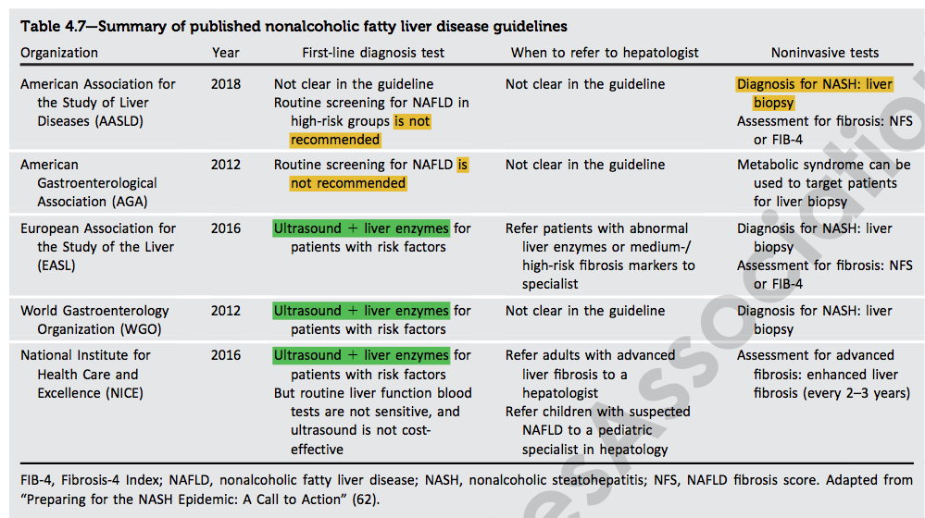
ADA 2022

Slide 47
BMJ 2021;372:m4747

Slide 48
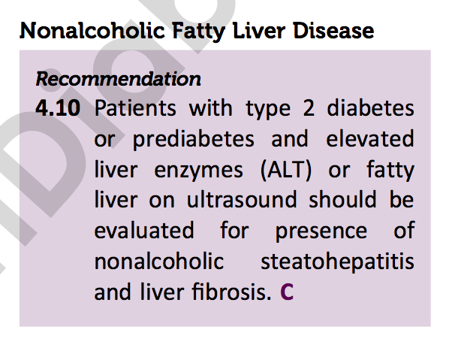

Slide 49
It is time to include NASH in the management plan of patients with T2D in the same way as today it includes diabetic retinopathy or nephropathy
All health care providers taking care of patients with diabetes need to be proactive in the diagnosis and monitoring of patients with this “new complication” of T2D

Slide 50
  Recent survey of 751 clinicians in the United States,
  primary care physicians, endocrinologists, and gastroenterologists or hepatologists,
  found that:
  they underestimated the prevalence of NAFLD in high-risk groups (eg, those with severe obesity or T2D)
  there was underutilization of medications with proven efficacy in NASH.
  Issued a call to action to create a unified, international response to NAFLD and NASH
Diabetes Care. 2021;44(9):2162e2172.

Slide 51
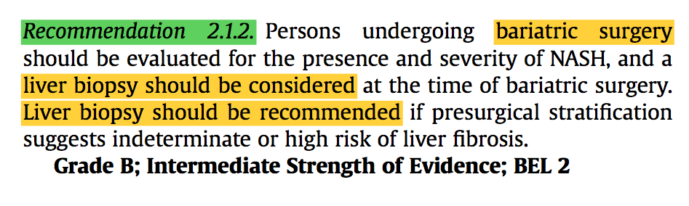
Bariatric surgery
Endocrine Practice 28 (2022) 528e562

Slide 52
The vast majority of persons undergoing bariatric surgery have NAFLD,
Approximately 8.5% have F3 and F4 (cirrhosis) at the time of intraoperative liver biopsy
2% to 4% have unexpected cirrhosis diagnosed at the time of surgery.
Obes Surg. 2016;26(1):177e181.

Slide 53
In a systematic review and meta-analysis
18 studies that reported outcomes of bariatric surgery in persons with cirrhosis:
the risks of :
postoperative complications: 22.14% (95% CI, 15.43%-29.55%),
liver-related complications: 4.62% (95% CI, 1.27%-9.30%),
liver failure-related mortality: 0.08% (95% CI, 0%-1.03%)
Surg Obes Relat Dis. 2021;17(3):525e537.

Slide 54
Risk stratification and
Diagnosis

Slide 55
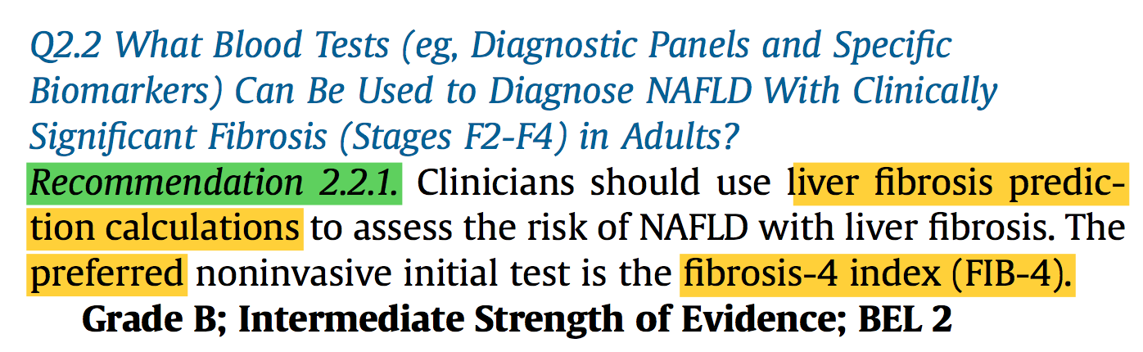
Endocrine Practice 28 (2022) 528e562

Slide 56
Fibrosis predictors
FIB-4 | Fibrosis-4 index: Low <1.3 Intermediate: 1.3- 2.67 High>2.67 | An index to estimate the risk of hepatic cirrhosis. This noninvasive estimate of liver scarring is used to assess the need for biopsy. FIB-4 score = (age * AST) /(PLT * ALT ^{1⁄2})
NFS | NAFLD fibrosis score Low <-1.455 Intermediate: -1.455 - 0.655 High> 0.655 | -1.675 + 0.037 * age (years) + 0.094 * BMI (kg/m2) + 1.13 * (impaired fasting glucose or DM) + 0.99 * (AST/ALT) - 0.013 * platelet ( 10⁹/L) = 0.66 * albumin (g/dL)
ELF | Enhanced liver fibrosis test Low <7.7 Intermediate: 7.7-9.8 High>9.8 | This blood test measures the levels of tissue inhibitor of metalloproteinases 1, amino-terminal propeptide of type III procollagen, and hyaluronic acid and is used to estimate the rate of liver extracellular matrix metabolism reflecting the severity of liver fibrosis.
APRI | AST-to-platelet ratio index | [AST level/AST (upper limit of normal AST range * 100] divided by platelet count (10⁹/L)
Endocrine Practice 28 (2022) 528e562

Slide 57
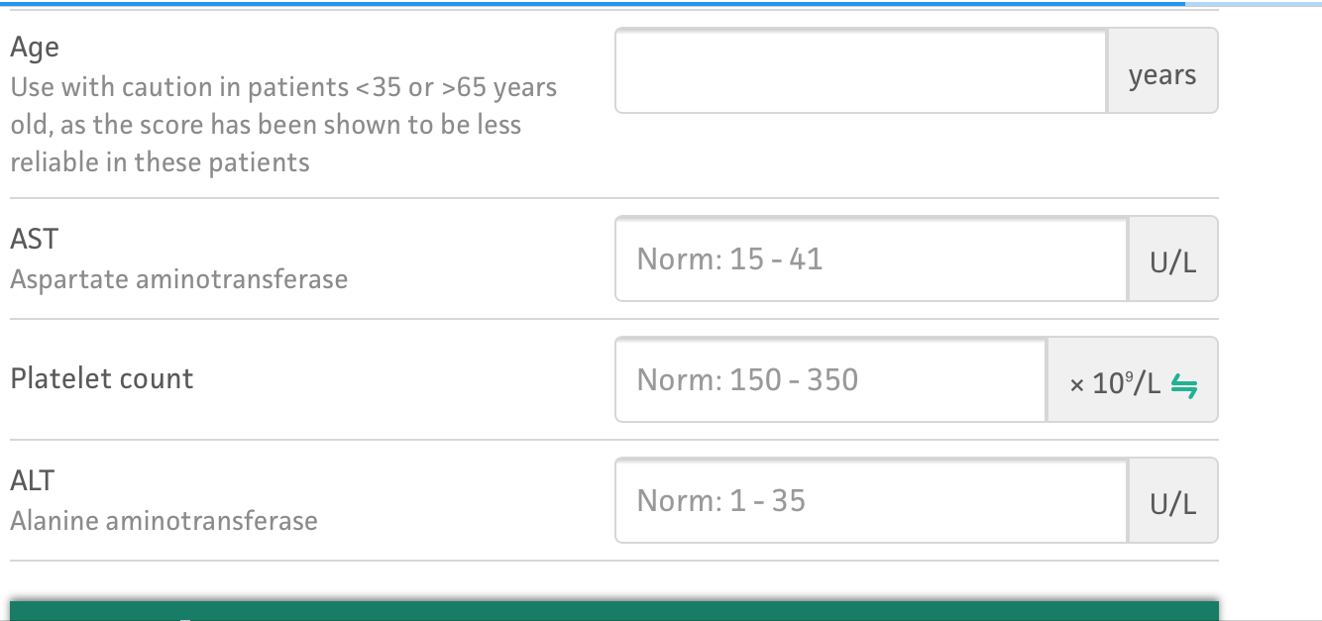
https://www.mdcalc.com/fibrosis-4-fib-4-index-liver-fibrosis

Slide 58
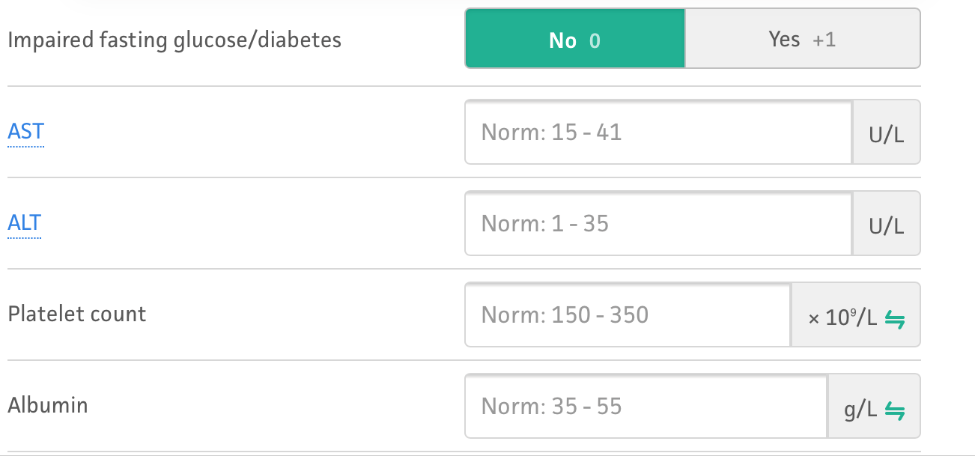
https://www.mdcalc.com/nafld-non-alcoholic-fatty-liver-disease-fibrosis-score

Slide 59
NAFLD fibrosis score (NFS)
  a liver score commonly used in hepatology clinics
  may overestimate in the primary care setting the prevalence of advanced liver fibrosis in persons with obesity, and in particular with T2D
  therefore, it should be avoided in this setting
J Clin Endocrinol Metab. 2021:dgab933.

Slide 60
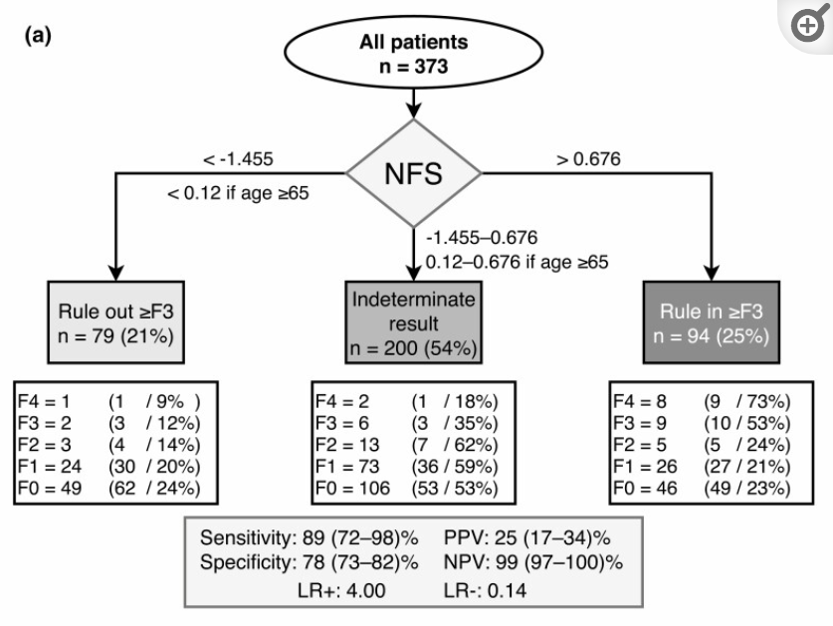
J Clin Endocrinol Metab. 2021:dgab933.

Slide 61
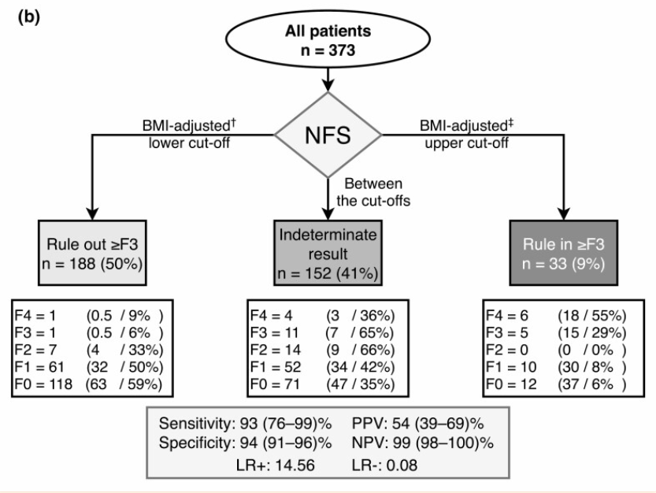
J Clin Endocrinol Metab. 2021:dgab933.

Slide 62
NAFLD fibrosis score (NFS)
  The widely used NFS loses specificity in obese individuals, which may be corrected with BMI-adjusted cutoffs.
J Clin Endocrinol Metab. 2021:dgab933.

Slide 63
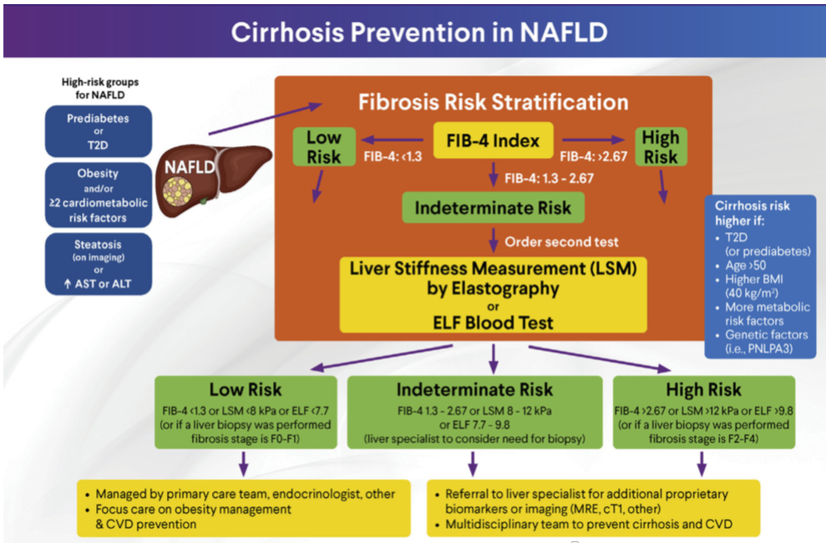
Endocrine Practice 28 (2022) 528e562

Slide 64
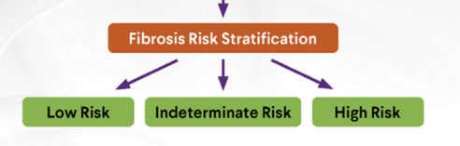
Limitations of blood panels
Have a good specificity and negative predictive value (NPV) that allow the clinician to rule out advanced fibrosis and use this as a rule-out test.
They lack adequate sensitivity and positive predictive value (PPV) to establish the presence of advanced fibrosis;
Several individuals fall in the “indeterminate-risk” group
Endocrine Practice 28 (2022) 528e562

Slide 65
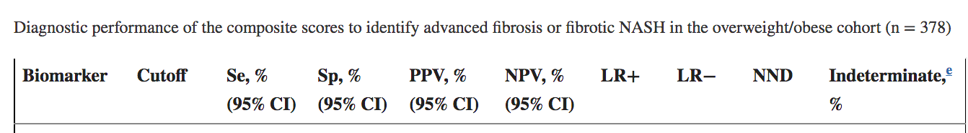
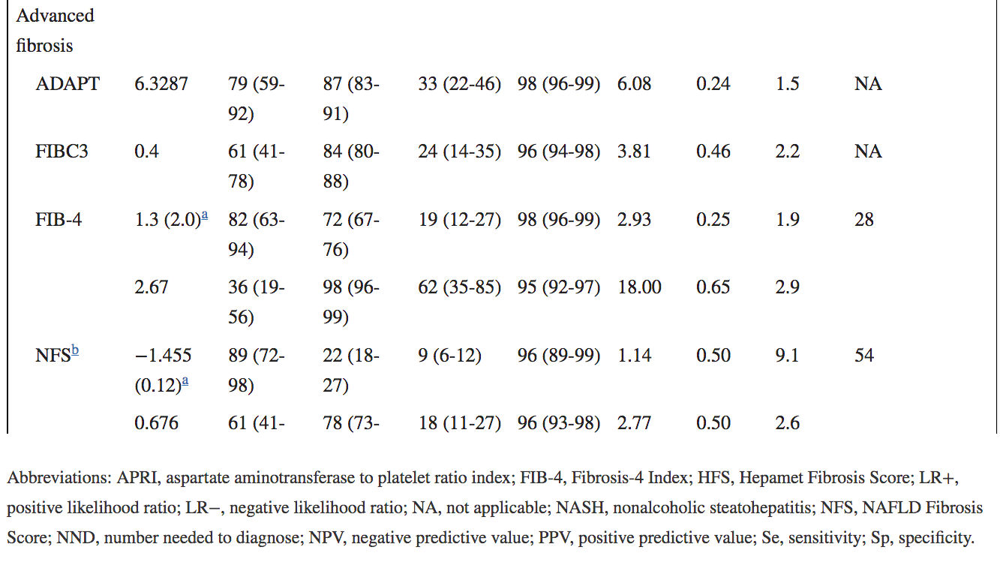
J Clin Endocrinol Metab. 2021:dgab933.

Slide 66
ADA 2022
Noninvasive tests, such as elastography or fibrosis biomarkers, may be used to assess risk of fibrosis,
referral to a liver specialist and liver biopsy may be required for definitive diagnosis

Slide 67
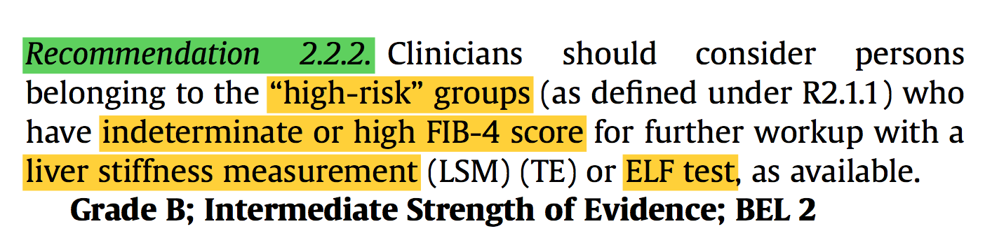
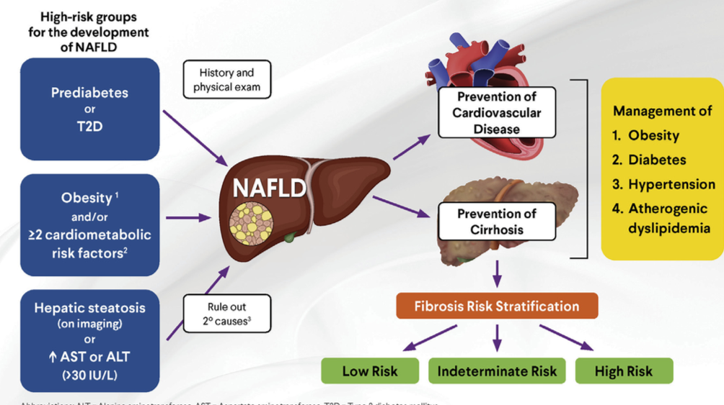
Endocrine Practice 28 (2022) 528e562

Slide 68
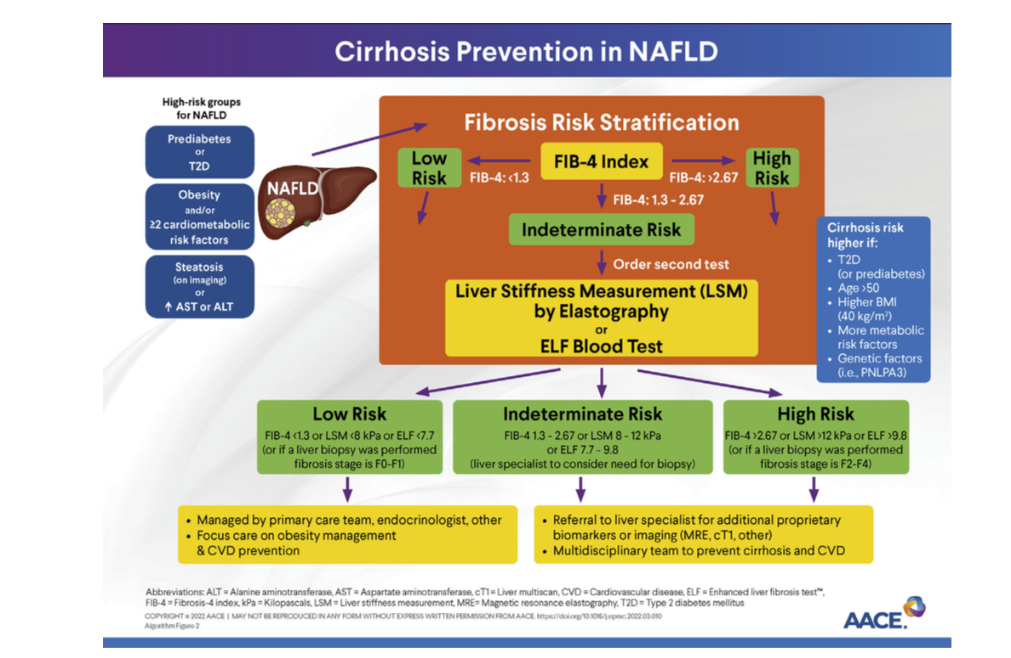
Endocrine Practice 28 (2022) 528e562

Slide 69
Vibration-controlled transient elastography (VCTE)
LSM (liver stiffness measurement):
a marker of hepatic fibrosis.
Measures the speed of a mechanically generated shear wave across the liver
CAP (controlled attenuation parameter):
a marker of hepatic steatosis
Measuring the attenuation of ultrasound signal through the liver

Slide 70
Fibrosis staging
 | mild fibrosis (F1) | moderate fibrosis (F2) | advanced fibrosis (F3) | cirrhosis (F4)
LSM (kPa) | 7.0–8.1 | 8.2–9.6 | 9.7–13.5 | ≥13.6
Gastroenterology 2019;156:1717–1730

Slide 71
  For practical purposes
  people with an LSM of <8.0 kPa determined using TE are considered low risk for clinically significant fibrosis (≥F2) and are best managed in the nonspecialty clinics with repeat surveillance testing in 2 to 3 years.
  If the LSM is >12.1 kPa based on VCTE, the risk of advanced fibrosis is high, with PPVs of 76% and 88% in persons seen in diabetes and hepatology clinics, respectively, but lower in primary care populations.
Endocrine Practice 28 (2022) 528e562

Slide 72
  values of <8.0 kPa for the low-risk group,
  8.0 to 12.0 for the indeterminate-risk group,
  and >12.0 kPa for the high- risk group for advanced liver fibrosis
  A referral to a hepatologist is given for all of those in the indeterminate- to high-risk groups.
Endocrine Practice 28 (2022) 528e562

Slide 73
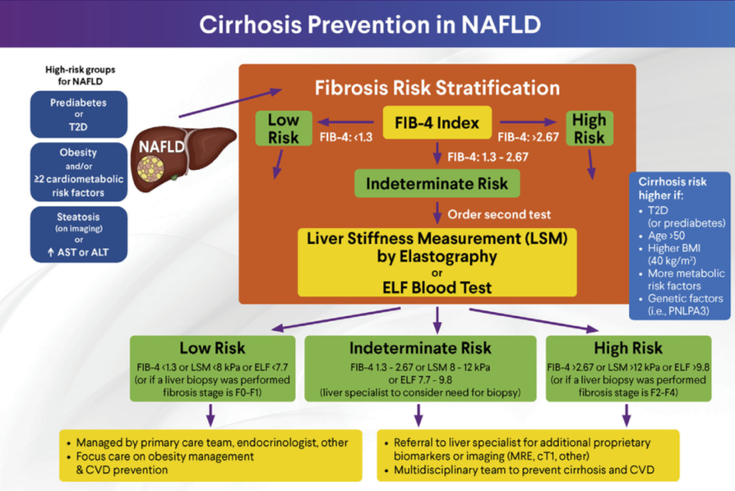

Slide 74
Steatosis staging
 | S1 = mild | S2=moderate | S3=severe
CAP(dB/m) | 274–289 | 290–301 | ≥ 302
Gastroenterology 2019;156:1717–1730

Slide 75
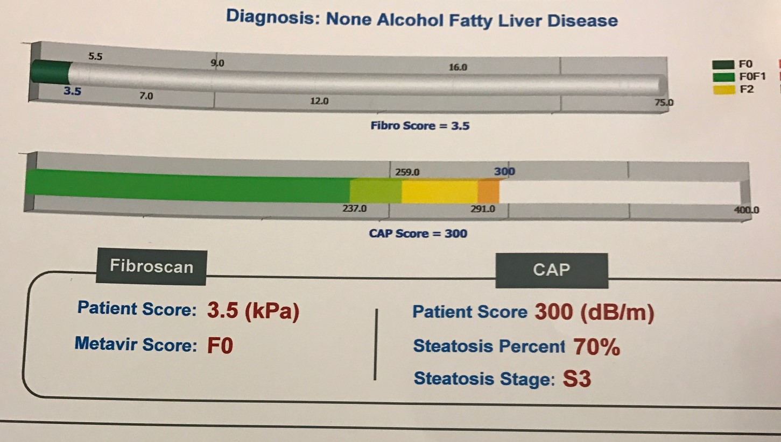

Slide 76
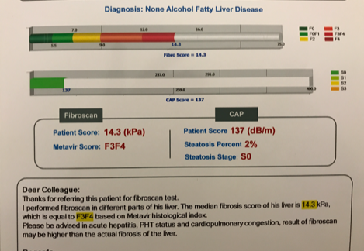

Slide 77
  Persons with high or intermediate fibrosis risk should be referred to hepatology for further evaluation and consideration of a liver biopsy.
  Liver biopsy remains the “gold standard” for the diagnosis of NASH.
Endocrine Practice 28 (2022) 528e562

Slide 78
2-step care pathway using the FIB-4 and ELF
A prospective longitudinal cohort study of 3012 adults
the results before and after the introduction of a 2-step care pathway were compared.
The implementation of this care pathway using the FIB-4 and ELF test resulted in:
An 88% reduction in unnecessary specialist referrals when the pathway was followed (OR, 0.12; 95% CI, 0.042-0.449; P < .0001)
A fourfold increase in the identification of individuals likely to have advanced fibrosis (OR, 4.32; 95% CI, 1.52- 12.25; P 1⁄4.006).
J Hepatol. 2019;71(2):371e378.

Slide 79
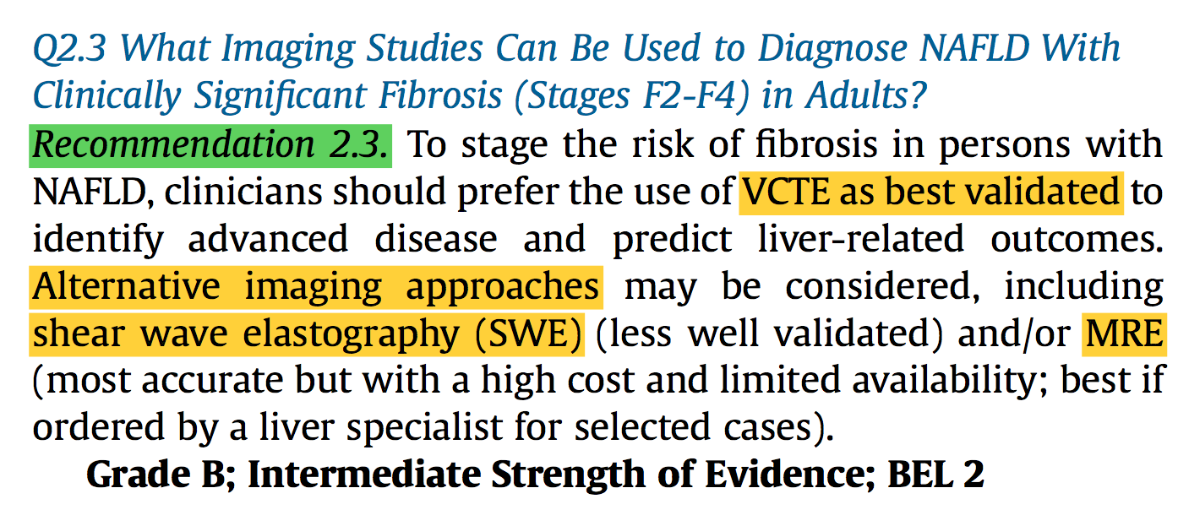
Imaging
Endocrine Practice 28 (2022) 528e562

Slide 80
Endocrine Practice 28 (2022) 528e562

Slide 81
Imaging
H-MRS | Proton magnetic resonance spectroscopy | A technique for quantifying hepatic steatosis
MRI-PDFF | Magnetic resonance imaging- proton density fat fraction | A technique for quantifying hepatic steatosis
VCTE | Vibration-controlled transient elastography | A technique for liver stiffness measurement that is correlated with the severity of liver fibrosis on histology.
MRE | Magnetic resonance elastography | Technology that combines MRI with low-frequency vibrations to assess liver stiffness.
Endocrine Practice 28 (2022) 528e562

Slide 82
MRE
  Has the best accuracy
  It is costly
  Has limited availability
  therefore, it is best ordered by the hepatologist when additional workup is needed in selected circumstances.
Endocrine Practice 28 (2022) 528e562

Slide 83
SWE
SWE: either 2-dimensional (2DSWE) or point (pSWE).
2DSWE and pSWE appear to have an accuracy similar to that of TE but less than that of MRE
the sensitivity, specificity, and area under the curve:
MRE > pSWE, VCTE > 2DSWE
Endocrine Practice 28 (2022) 528e562

Slide 84
US
The accuracy of liver US for the detection of moderate and severe steatosis was >80% in a meta-analysis when compared with liver histology.
In population with less severe disease observed in primary care or endocrinology clinics, liver US was shown to have suboptimal sensitivity for mild- to-moderate steatosis (below a liver fat content of 12.5%).
Liver US is also highly operator dependent
does not inform about the severity of liver fibrosis (unless cirrhosis is present).
Liver Int. 2015;35(9):2139e2146.

Slide 85
Noninvasive imaging assessment of NAFLD and advanced fibrosis
Clin Diabetes Endocrinol . 2020 Jun 5;6:9

Slide 86
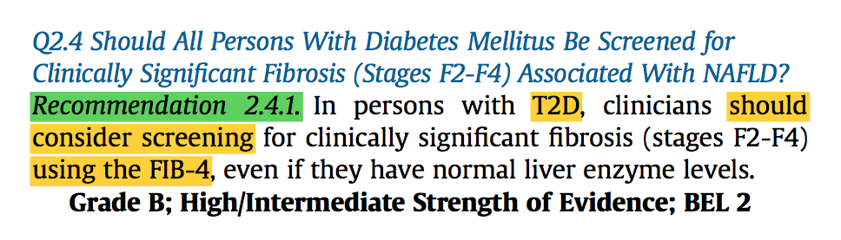
Screening in T2D
Endocrine Practice 28 (2022) 528e562

Slide 87
In a study in persons with T2D,
up to 50% had NAFLD despite the so-called “normal” ALT levels (defined as <40 U/L in this study).
J Clin Endocrinol Metab. 2015;100(6):2231e2238.

Slide 88
With a lower cutoff of AST and ALT of≥30 units/L, it increased to 13% and 22%, 40% of patients with fibrosis had a plasma AST ≥26 units/L.
Diabetes Care 2021 Feb; 44(2): 399-406.

Slide 89
Fibrosis: 21%
moderate-to-advanced fibrosis (F2 or higher): 15%
(An established risk factor for cirrhosis and overall mortality)
Diabetes Care 2021 Feb; 44(2): 399-406.

Slide 90
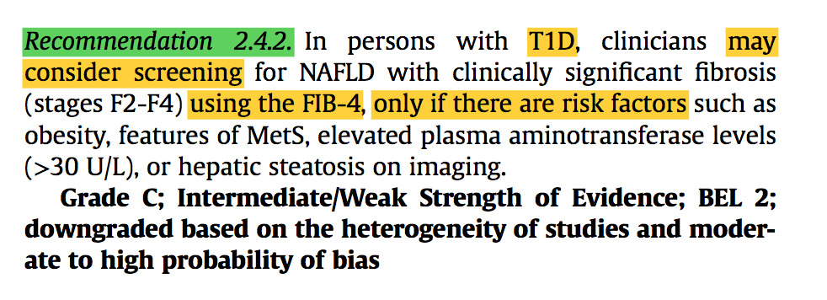
Endocrine Practice 28 (2022) 528e562

Slide 91
Because NAFLD affects mostly those with IR or obesity, it is not entirely surprising that depending on the population studied, some studies have not found persons with T1D to have a higher risk of NAFLD.
J Clin Endocrinol Metab. 2020;105(12): 3842e3853.

Slide 92
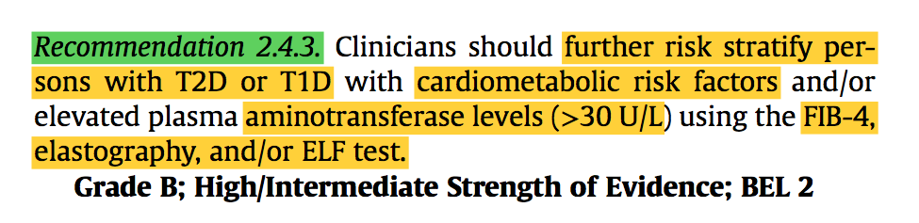
Endocrine Practice 28 (2022) 528e562

Slide 93
The presence of NAFLD is associated with the use of higher insulin doses for comparable glycemic control in both T1D and T2D populations
Diabetes Obes Metab. 2017;19(11):1630e1634.

Slide 94
Refer to Hepatologist
Endocrine Practice 28 (2022) 528e562

Slide 95
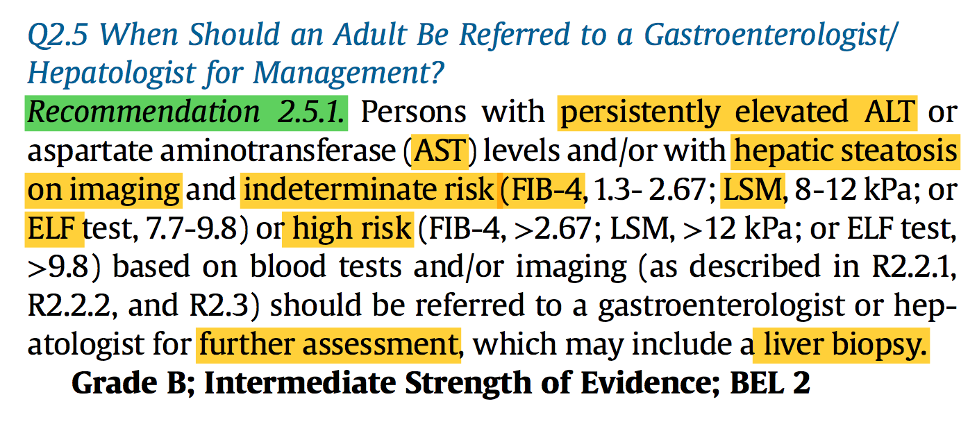
Endocrine Practice 28 (2022) 528e562

Slide 96
Endocrine Practice 28 (2022) 528e562

Slide 97
liver biopsy
  exclude other coexisting causes of liver disease (eg, autoimmune hepatitis and iron overload)
  firmly establish the stage of liver disease when blood tests and imaging provide conflicting results.
  is required for enrollment in most of the clinical trials for new pharmacologic treatment of NASH
Endocrine Practice 28 (2022) 528e562

Slide 98
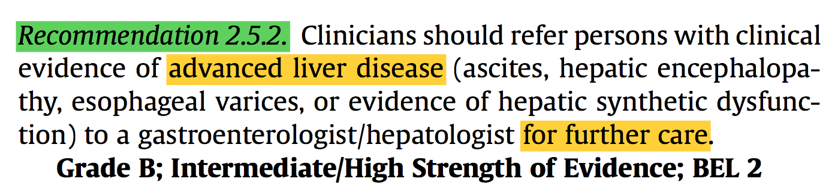
Endocrine Practice 28 (2022) 528e562

Slide 99
Rule out second causes
Prediabetes or T2D,
obesity or >= 2 cardiometabolic RF,
hepatic steatosis on imaging or AST or ALT>30
Low risk
Intermediate-high risk
(<1.30)
Fibrosis Risk Stratification
Calculate FIB-4 score
(Age, AST, ALT, platelet count)
(≥1.30)
Low risk
(<8 kPa)
Test liver stiffness by transient elastography*
No need for referral
Managed by primary care team or endocrinologist
Focus care on obesity and CVD prevention
Re-test in 2–3 years
Intermediate-high risk
(≥8 kPa)
Referral to liver specialist
EASL. J Hepatol. 2021;S0168–8278:00398–6.
Notes:
Non-invasive fibrosis tests should be used
to rule out rather than diagnose advanced fibrosis in low-prevalence populations
preferentially in patients at risk of advanced liver fibrosis* (not in unselected general populations)
ALT, AST and platelet count should be part of the routine investigations in primary care in patients with suspected liver disease
Calculation of simple non-invasive fibrosis tests such as FIB-4, in populations at risk of liver fibrosis* in primary care, is recommended

Slide 100
Management
Endocrine Practice 28 (2022) 528e562

Slide 101
Treatment
Life style change
≥ 5-10% weight loss
Mediterranean diet
Medications
At present, there are no FDA-approved drugs for the treatment of NASH.
Physical activity
NAFLD and T2D: Pioglitazone, GLp-1 Ras, SGLt2 inh
NAFLD and Obesity: Semaglutide, Liraglutide, Bariatric surgery
NASH: Pioglitazone, Vit E
Endocrine Practice 28 (2022) 528e562

Slide 102
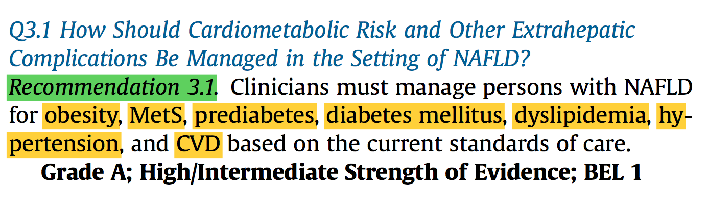
Cardiometabolic Risk and
Other Extrahepatic Complications
Endocrine Practice 28 (2022) 528e562

Slide 103
Pathophysiology
At the core of CMD is IR that encompasses abnormal glucose tolerance,
systemic inflammation,
oxidative stress,
mitochondrial dysfunction,
endothelial dysfunction,
dysfunctional adipose tissue.
Lancet Dia- betes Endocrinol. 2019;7(4):313e324.

Slide 104
CMD manifestations | NAFLD | NASH
obesity | 51% | 82%
T2D | 23% | 44%
hyperlipidemia | 69% | 83%
hypertension | 39% | 68%
MetS | 43% | 71%
  a systematic review
  analyzing 86 studies
  with a sample size of 8 515 431
  from 22 countries
  has documented high rates of CMD manifestations in persons with NAFLD and still higher rates in persons with NASH
  Thus, care of persons with NAFLD extends beyond the liver and must comprehensively consider the broader context of CMD.
JAm Coll Cardiol. 2020;75(5):525e538.

Slide 105
Comorbid Conditions Associated With Nonalcoholic Steatohepatitis
JAMA. 2020;323(12):1175-1183

Slide 106
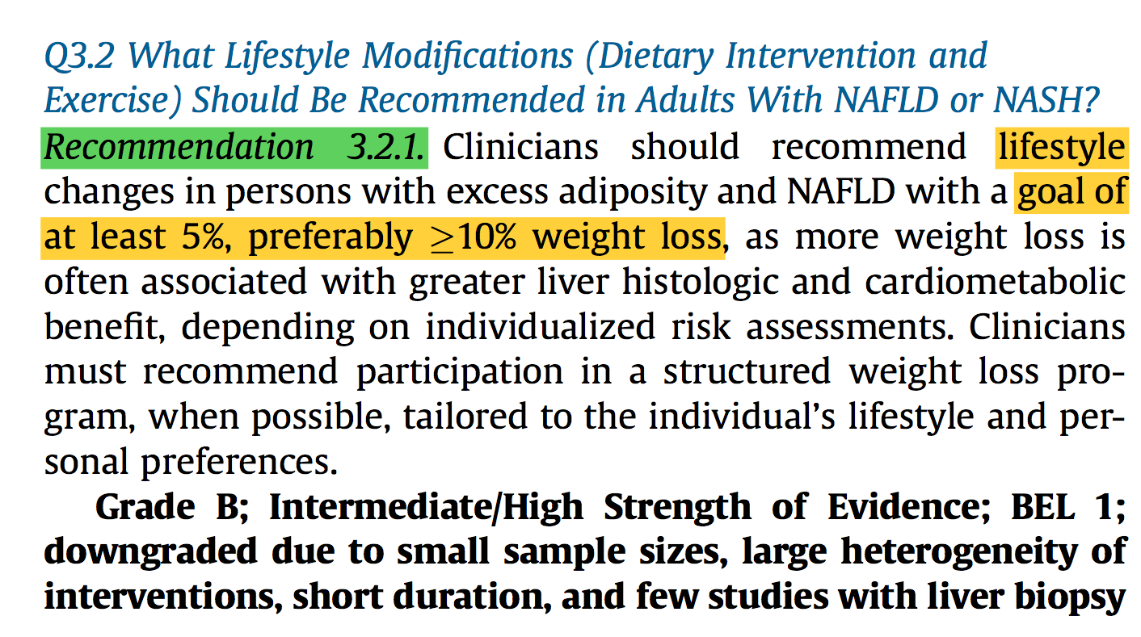
Goal of weight loss
Endocrine Practice 28 (2022) 528e562

Slide 107
Among persons with NASH,
weight loss of >5% TBW can reduce hepatic steatosis,
weight loss of >7% TBW can improve NASH,
and weight loss of >10% TBW can result in fibrosis regression/stability.238,239,241
Metabolism. 2021;115:154455.

Slide 108
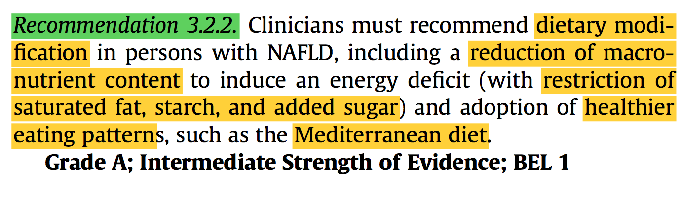
Dietary modification
Endocrine Practice 28 (2022) 528e562

Slide 109
Diet
  Energy deficit:
  DASH diet
  high protein/lower carbohydrate
  intermittent fasting
  time-restricted feeding.
  Caloric restriction within a Mediterranean diet appears to have the best evidence and likely the best chance of long-term adherence.
Endocrine Practice 28 (2022) 528e562

Slide 110
Curr Gastroenterol Rep 2021 Oct 15;23(12):21

Slide 111
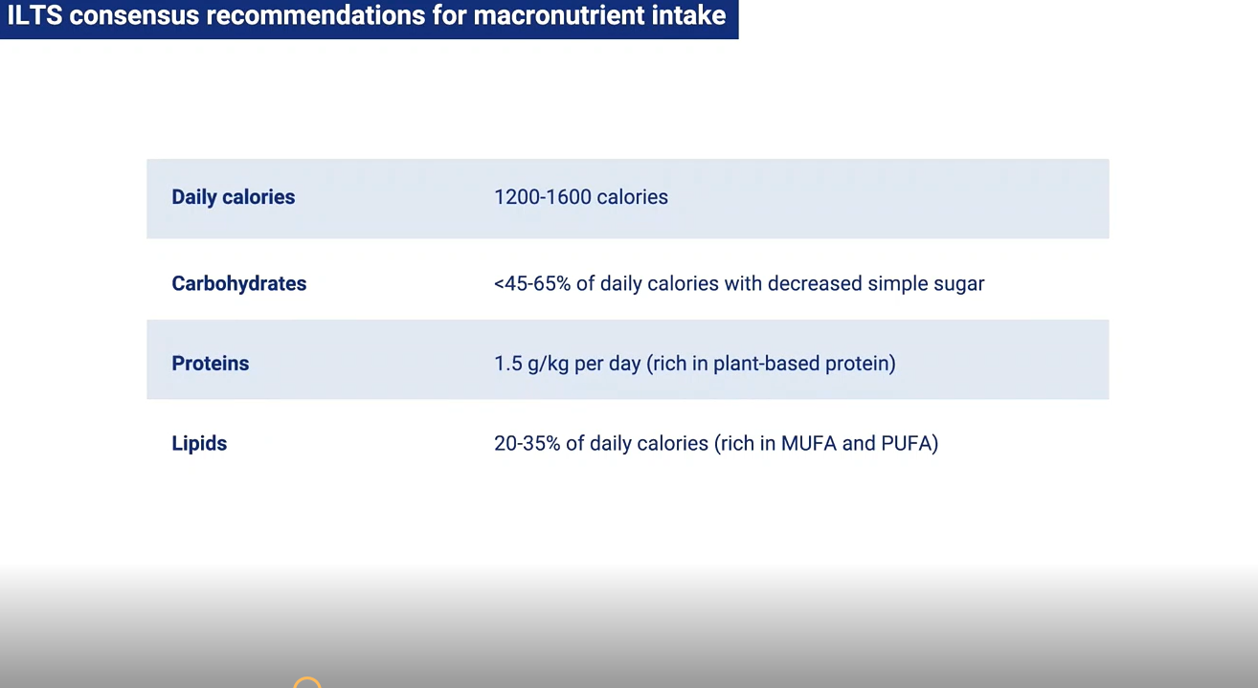

Slide 112
weight loss achieved through caloric deficit, irrespective of the specific dietary approach, is effective in reducing:
hepatic steatosis,
even necroinflammation,
although results are more variable for fibrosis.
Endocrine Practice 28 (2022) 528e562

Slide 113
In a prospective cohort study of individuals (N = 261)
undergoing a 52-week program of lifestyle intervention,
persons who lost ≧ 10% of their weight
All had NAS reductions,
90% had NASH resolution,
and 45% had fibrosis regression.
Gastroenterology. 2015;149(2):367e378.e5. quiz e14-e15.

Slide 114
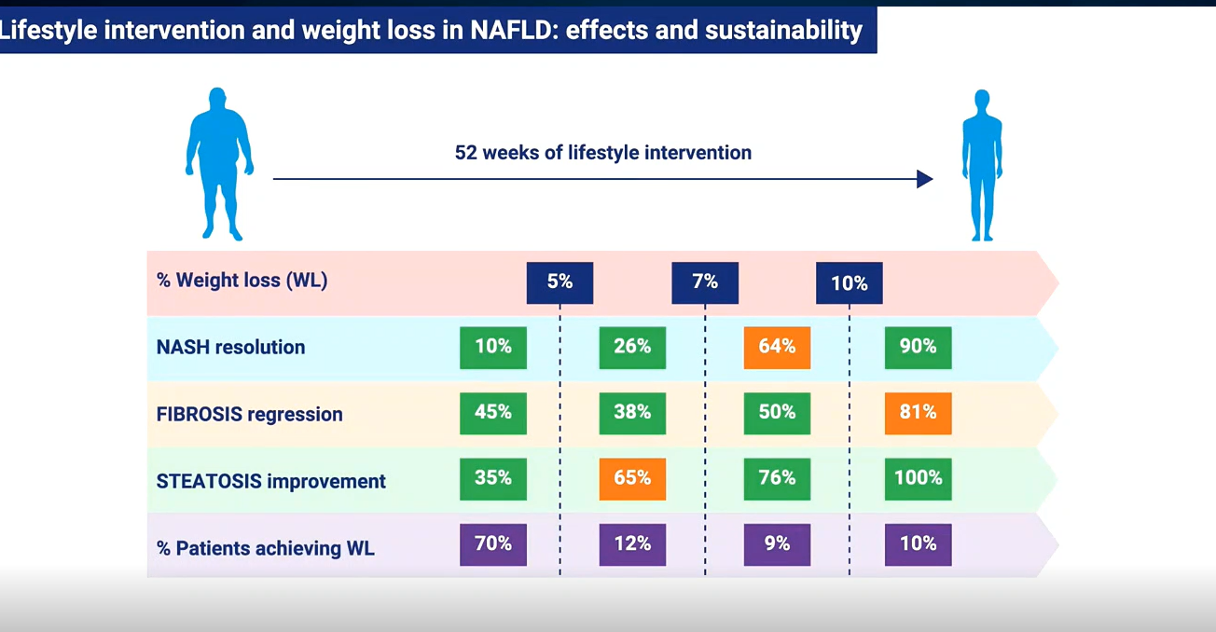
Gastroenterology. 2015;149(2):367e378.e5. quiz e14-e15.

Slide 115
  A 2021 meta-analysis
  of 43 studies involving 2809 participants
  26 behavioral weight-loss programs, 9 with pharmacotherapy, 8 with surgery
  A dose-response relationship between the magnitude of weight loss and the degree of liver improvement of steatosis and resolution of NASH but not for fibrosis.
Metabolism. 2021;115:154455.

Slide 116
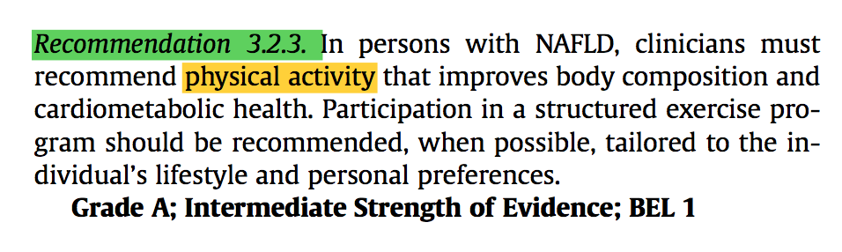
Physical activity
Endocrine Practice 28 (2022) 528e562

Slide 117
Types of exercise
Specific types of exercise exert different effects in persons with NAFLD.
There were no significant differences between aerobic and resistance trainings,
but there was more benefit with high-volume continuous training than with low-volume continuous training even with high intensity.
While there are more data on aerobic exercise, resistance training can improve NAFLD and may be more feasible for persons with poor cardiorespiratory fitness or an inability to participate in aerobic exercise.
190

Slide 118
The most common intervention frequency among studies was
3 times per week,
for 30 to 60 minutes each session
lasting 12 weeks.
However, greater intensity has not always translated into a more significant decrease in hepatic steatosis.
a systematic review and meta-analysis. Obes Rev. 2018;19(10):1446e1459.

Slide 119
An RCT (N=220) of 12-month duration
in people with biopsy-proven NAFLD
compared 3 interventions:
vigorous- moderate exercise (jogging 150 minutes per week for 6 months and brisk walking 150 minutes per week for another 6 months),
moderate exercise (brisk walking 150 minutes per week for 12 months),
no-exercise control group.
The investigators found that both exercise groups were equally effective in reducing the IHTG content measured by 1H-MRS and significantly reduced hepatic steatosis compared with those in the no-exercise controls.
JAMA Intern Med. 2016;176(8):1074e1082.

Slide 120
Exercise has shown to consistently benefit persons with NAFLD, the challenge being long-term adoption.
Benefit from increasing physical activity appears more linked to the intensity and adherence to the training program rather than the type of exercise.
Of note, a decrease in hepatic steatosis with exercise is observed even in the absence of major weight loss
Endocrine Practice 28 (2022) 528e562

Slide 121
Medications

Slide 122
New Drugs for the Treatment of NASH:
What Are the Endpoints for Approval?
Notes:
Non-invasive fibrosis tests should be used
to rule out rather than diagnose advanced fibrosis in low-prevalence populations
preferentially in patients at risk of advanced liver fibrosis* (not in unselected general populations)
ALT, AST and platelet count should be part of the routine investigations in primary care in patients with suspected liver disease
Calculation of simple non-invasive fibrosis tests such as FIB-4, in populations at risk of liver fibrosis* in primary care, is recommended

Slide 123
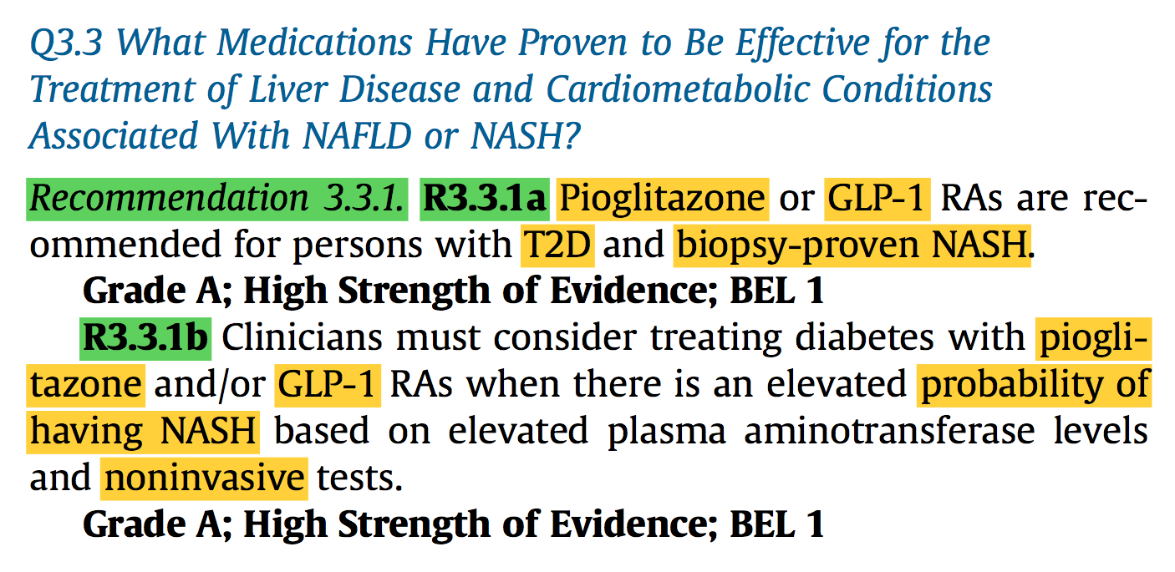
NASH and T2D
Endocrine Practice 28 (2022) 528e562

Slide 124
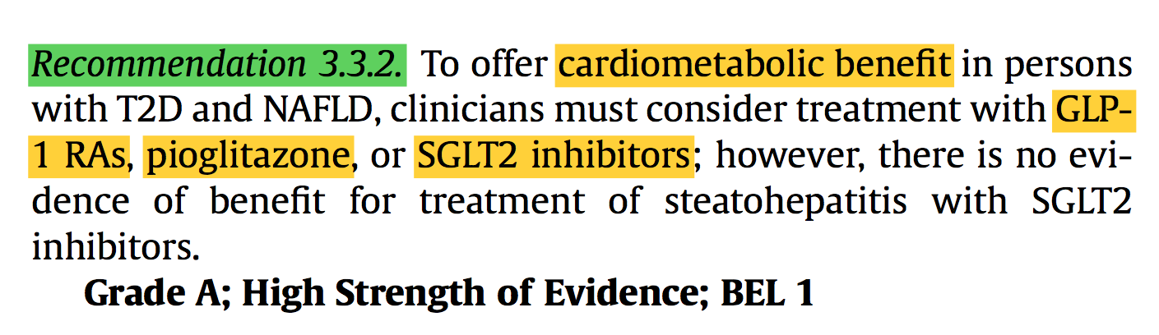
NASH and T2D
Endocrine Practice 28 (2022) 528e562

Slide 125
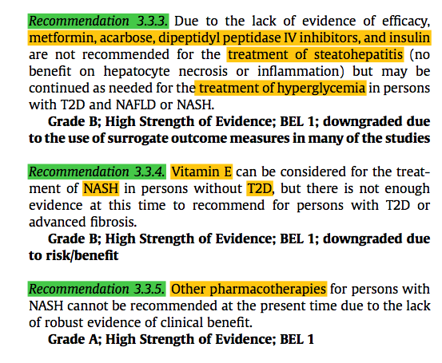
Endocrine Practice 28 (2022) 528e562

Slide 126
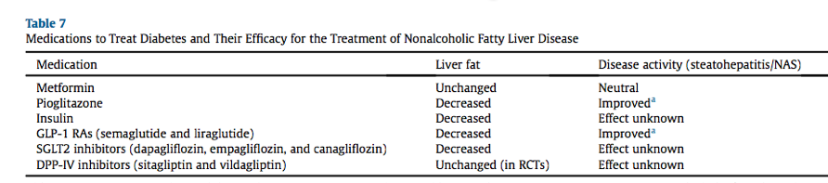
Endocrine Practice 28 (2022) 528e562

Slide 127
Biopsy proven NASH?
A liver biopsy is the optimal approach to confirm the diagnosis and stage of the severity of liver fibrosis.
This may not be feasible or acceptable to several individuals.
In high-risk populations (ie, those with obesity and T2D), pharmacologic therapy to treat obesity or diabetes may also be considered in the presence of
elevated plasma aminotransferase levels
and/or FIB-4 scores of >1.3
and confirmatory imaging (ie, TE and MRE)
or proprietary fibrosis biomarkers, such as the ELF test, when suggestive of clinically significant liver fibrosis, if imaging not available.
Endocrine Practice 28 (2022) 528e562

Slide 128
Pioglitazone
  A 2017 meta-analysis of available pioglitazone RCTs
  in persons with biopsy- proven NASH
  noted a significant improvement versus placebo for:
  NASH resolution (OR, 3.22; 95% CI, 2.17-4.79; P < 0.001)
  any stage of fibrosis (OR, 1.66; 95% CI, 1.12-2.47; P = 0.01),
  advanced fibrosis (OR, 3.15; 95% CI, 1.25-7.93; P =0.01),
  with similar results for those with and without T2D.
JAMA Intern Med. 2017;177(5):633e640.

Slide 129
pioglitazone
  The side effects of pioglitazone:
  dose-dependent weight gain (1% with pioglitazone 15 mg/ day up to 3%-5% with 45 mg/day),
  increased fracture risk,
  heart failure if used in persons with preexisting heart disease,
  bladder cancer
Endocrine Practice 28 (2022) 528e562

Slide 130
In a RCT, the progression of persons with obesity and prediabetes or T2D in the placebo arm of the study over 72 weeks was 26% compared with only 7% on pioglitazone.98
Ann Intern Med. 2016;165(5):305e315.

Slide 131
Semaglutide
In 2021, a phase 2 RCT
compared the doses of 0.1, 0.2, and 0.4 mg of semaglutide daily with placebo
in 320 persons with NASH for 72 weeks
Resolution of steatohepatitis was found in:
40% of those in the 0.1-mg group,
36% of those in the 0.2-mg group,
59% of those in the 0.4-mg group,
17% of those in the placebo group (P < .001 for semaglu- tide 0.4 mg vs placebo)
in the context of significant weight loss (13% in the 0.4-mg group vs 1% in the placebo group).99
There were no significant between-group differences in the percentage of individuals with an improvement in fibrosis stage, but progression of liver fibrosis was significantly less with the highest dose of the GLP-1 RA (4.9%) versus placebo (18.8%).
N Engl J Med. 2021;384(12):1113-1124.

Slide 132
Semaglutide
the semaglutide dose of 0.4 mg/ day employed is equivalent to the dose of semaglutide 2.4 mg/week shown in phase 3 trials to be highly effective for weight loss in persons with obesity.
Of the medications currently approved for chronic obesity therapy, semaglutide has shown the most efficacy in achieving 10%, 15%, and even >20% weight loss.
JAMA. 2021;325(14):1414-1425.

Slide 133
A 72-week, double-blind phase 2 trial involving patients with biopsy confirmed NASH and liver fibrosis of stage F1, F2, or F3
Patients were randomly assigned to receive once-daily subcutaneous semaglutide at a dose of 0.1, 0.2, or 0.4 mg or corresponding placebo.
The primary end point was resolution of NASH with no worsening of fibrosis.
The confirmatory secondary end point was an improvement of at least one fibrosis stage with no worsening of NASH
N Engl J Med. 2021 Mar 25;384(12):1113-1124

Slide 137
Key messages
This phase 2 trial involving patients with NASH showed that treatment with semaglutide resulted in a significantly higher percentage of patients with NASH resolution than placebo
However, the trial did not show a significant between-group difference in the percentage of patients with an improvement in fibrosis stage

Slide 138
Rubino D, Abrahamsson N, Davies M, et al. Effect of continued weekly sub- cutaneous semaglutide vs placebo on weight loss maintenance in adults with overweight or obesity: the STEP 4 randomized clinical trial. JAMA. 2021;325(14):1414e1425.

Slide 139
SGLT2 inhibitors
More recent RCTs have been performed showing
the potential benefit of these medications in NAFLD and NASH in persons with obesity and T2D
via imaging of hepatic steatosis using “gold standard” MRI-based techniques, but none yet has been performed with histologic evaluation
Diabetes Care. 2020;43(2):298e305.

Slide 140
Vitamin E
Among other agents, only vitamin E showed efficacy to ameliorate steatohepatitis (but not fibrosis) in individuals without T2D and biopsy-proven NASH in a 2-year RCT.97
Controversy re- mains about vitamin E being associated with a modest increased risk of cardiovascular disease and of prostate cancer,101
Endocr Pract. 2017;23(8):1006e1021.

Slide 141
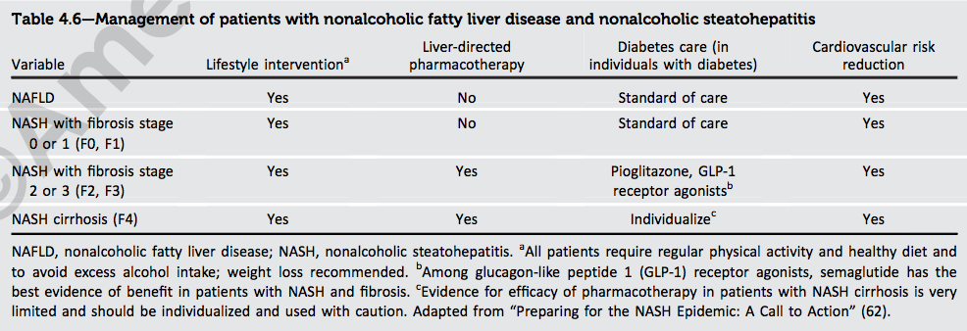
ADA 2022

Slide 142
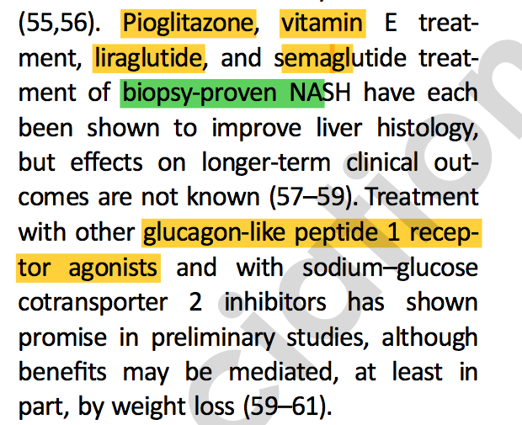
ADA 2022

Slide 143
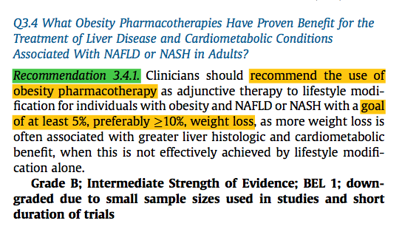
NAFLD or NASH and obesity
Endocrine Practice 28 (2022) 528e562

Slide 144
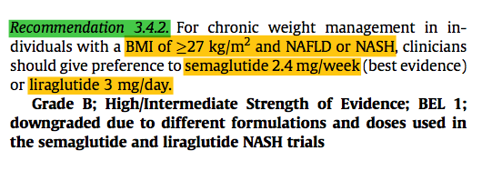
Endocrine Practice 28 (2022) 528e562

Slide 145
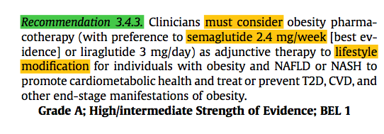
Endocrine Practice 28 (2022) 528e562

Slide 146
Obesity medications
  Medications approved for the chronic treatment of obesity include:
  the centrally acting oral combinations phentermine/topiramate ER
  naltrexone/bupropion ER,
  the oral lipase inhibitor orlistat,
  and subcutaneous GLP-1 receptor agonists liraglutide (titrated up to 3 mg daily) and semaglutide (titrated up to 2.4 mg weekly).
  Obesity medications are approved by the FDA for chronic weight management for individuals with a BMI of >30 kg/m2 or those with a BMI of 27 to 29.9 kg/m2 and at least 1 weight-related complication.
Gastroenterology. 2018;154(5):1309e1319.e7.

Slide 147
  Early response to therapy is a key predictor of long-term success,
  and the medications should be continued if 5% weight loss has been achieved within 3 months of using the full dose of medication.
  The amount of weight loss anticipated from obesity medications is greater than 10% or more of body weight and is associated with cardiometabolic and T2D risk reduction, if the early 3-month efficacy threshold is achieved
Obesity (Silver Spring). 2016;24(11):2278e2288.

Slide 148
GLP 1
Available data come from a 48-week pilot study (n 1⁄4 52) with liraglutide and a larger study (n 1⁄4 320) with semaglutide for 72 weeks,99 as discussed earlier, and recently summarized in 2 narrative reviews.286,287
J Clin Endocrinol Metab. 2022;107(1):29e38.

Slide 149
orlistat
A recent meta-analysis
including 3 RCTs and 4 single-arm trials
of 330 participants with NAFLD or NASH
concluded that orlistat reduced the aminotransferase levels in persons with NAFLD but failed to improve liver histology in NASH.
Biomed Rep. 2018;9(1):90e96.

Slide 150
Phentermine/topiramate ER
  Phentermine/topiramate ER has been shown to
  delay progression to T2D in those at high cardiometabolic risk (MetS or prediabetes),
  improve glycemic control with weight loss in T2D,
  and improve lipids and
  blood pressure
  with significant improvement in car- diometabolic parameters.
Diabetes Care. 2017;40(7):856e862.

Slide 151
Liraglutide
liraglutide reduced the HR for the composite major adverse cardiovascular event (MACE) outcome by 13%.319
A CV outcome trial has not been performed for liraglutide 3 mg in persons with obesity, although clinicians can be reassured by cardioprotection demonstrated in the Liraglutide Effect and Action in Diabetes: Evaluation of Cardiovascular Outcome Results trial for liraglutide 1.8 mg in those with T2D.319
N Engl J Med. 2016;375(4):311e322.

Slide 152
Semaglutide
Semaglutide reduces the risk of MACEs
supported by findings in the Trial to Evaluate Cardiovascular and Other Long- term Outcomes with Semaglutide in Subjects with Type 2 Diabetes CV outcome trial
that enrolled persons with T2D and established CVD and/or CKD,320
where it significantly reduced MACE by 26% compared with placebo.
N Engl J Med. 2017;376(9):891e892.

Slide 153
Bariatric surgery

Slide 154
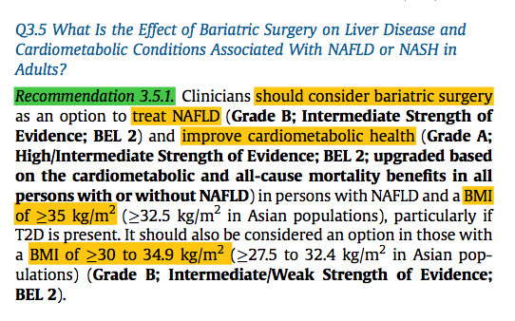
Endocrine Practice 28 (2022) 528e562

Slide 155

Endocrine Practice 28 (2022) 528e562

Slide 156
  A systematic review and meta-analysis of 32 studies
  of persons undergoing bariatric surgery,
  including 3093 liver biopsies obtained during and after bariatric surgery,
  66% had complete resolution of steatosis,
  resolution of inflammation 50%
  resolution of ballooning 76%
  fibrosis improved in 40% of individuals,
  fibrosis worsened in approximately 12%.
  Of note, the overall quality of the individual studies included was low.
Clin Gastroenterol Hepatol. 2019;17(6):1040e1060.e11.

Slide 157
  In a prospective study
  examining the impact of bariatric surgery,
  NASH resolution was observed in 85% after 1 year
  NASH resolution was observed in 90.5% at 5 years
  70% having fibrosis regression.
  In the subset with stage 3 fibrosis (precirrhosis) at baseline (n = 19), fibrosis improved in 68% and resolved in 45% after 5 years.
  This study only had paired biopsies for 3 persons with cirrhosis at baseline, of which 2 remained cirrhotic at the 5-year assessment. These results make it difficult to draw firm conclusions about the role of bariatric surgery in reversing cirrhosis.
Gastroenterology. 2020;159(4):1290e1301.e5.

Slide 158
  The investigators examined 25 828 liver biopsies
  performed at a U.S. health system
  between 2004 and 2016,
  where 1158 adults with obesity met enrollment criteria for bariatric surgery and had a confirmed histologic diagnosis of NASH with stage 1 to 3 liver fibrosis.
  The median follow-up was 7 years
  Bariatric surgery, compared with nonsurgical management, was associated with a 12.4% lower risk of incident major adverse liver outcomes (95% CI, 5.7%-19.7%), aHR of 0.12 (95% CI, 0.02-0.63; P = .01),
  a 13.9% decrease in MACE (95% CI, 5.9%-21.9%), aHR of 0.30 (95% CI, 0.12- 0.72; P = .007).323
JAMA. 2021;326(20):2031e2042.

Slide 159
Future Directions
mechanism | Example
Dual GLP-1 RA/gastric inhibitory polypeptide | tirzepatide
GLP-1 RA/glucagon agonists | cotadutide
pan-PPAR (PPAR-alpha, delta, and gamma activity) | lanifibranor | undergoing phase 3 testing | restore dysfunctional adipose in obesity to normal reverse IR | improving both steatohepatitis and fibrosis
FXR agonists | Tropifexor Cilofexor | phase 3 RCTs | having predominantly antifibrotic activity
thyroid hormone receptor agonists
Endocrine Practice 28 (2022) 528e562

Slide 160
Mechanism of Action of FXRs in Bile Acid Synthesis and Improvements in NASH-Related Fibrosis
Notes:
Non-invasive fibrosis tests should be used
to rule out rather than diagnose advanced fibrosis in low-prevalence populations
preferentially in patients at risk of advanced liver fibrosis* (not in unselected general populations)
ALT, AST and platelet count should be part of the routine investigations in primary care in patients with suspected liver disease
Calculation of simple non-invasive fibrosis tests such as FIB-4, in populations at risk of liver fibrosis* in primary care, is recommended

Slide 161
JAMA. 2020;323(12):1175-1183

Slide 162


Slide 163


Slide 164


Slide 165


Slide 166
Current challenges in management of NASH
Absence of clinical practice guidelines for screening of NASH
Poorly defined referral pathways
Lack of approved medical treatment for NASH
Lack of awareness concerning the diagnosis of NASH
Poor availability of diagnostic tests for NASH

Slide 167
Take home messages
Increased awareness about NASH and NASH related complications is warranted among diabetologists, especially with the prospective induction of NASH specific therapies
  endocrinologists and primary care physicians are in an ideal position to identify persons at risk on to prevent the development of cirrhosis and comorbidities.
The development of non-invasive, easily repeatable surrogate biomarkers and/or imaging tools is crucial to facilitate clinical studies and limit liver biopsy
Lifestyle intervention is the fundamental and, currently, the sole treatment of NAFLD, as long as no drugs are approved by regulatory agencies
Pioglitazone and GLP1 agonists have beneficial effect on NASH resolution and stability of fibrosis

Slide 168
  a
Endocrine Practice 28 (2022) 528e562

Slide 169
Rule out second causes
Prediabetes or T2D,
obesity or >= 2 cardiometabolic RF,
hepatic steatosis on imaging or AST or ALT>30
Low risk
Intermediate-high risk
(<1.30)
Fibrosis Risk Stratification
Calculate FIB-4 score
(Age, AST, ALT, platelet count)
(≥1.30)
Low risk
(<8 kPa)
Test liver stiffness by transient elastography*
No need for referral
Managed by primary care team or endocrinologist
Focus care on obesity and CVD prevention
Re-test in 2–3 years
Intermediate-high risk
(≥8 kPa)
Referral to liver specialist
EASL. J Hepatol. 2021;S0168–8278:00398–6.
Notes:
Non-invasive fibrosis tests should be used
to rule out rather than diagnose advanced fibrosis in low-prevalence populations
preferentially in patients at risk of advanced liver fibrosis* (not in unselected general populations)
ALT, AST and platelet count should be part of the routine investigations in primary care in patients with suspected liver disease
Calculation of simple non-invasive fibrosis tests such as FIB-4, in populations at risk of liver fibrosis* in primary care, is recommended

Slide 170
Endocrine Practice 28 (2022) 528e562

Slide 171
Treatment
Life style change
≥ 5-10% weight loss
Mediterranean diet
Medications
At present, there are no FDA-approved drugs for the treatment of NASH.
Physical activity
NAFLD and T2D: Pioglitazone, GLp-1 Ras, SGLt2 inh
NAFLD and Obesity: Semaglutide, Liraglutide, Bariatric surgery
NASH: Pioglitazone, Vit E
Endocrine Practice 28 (2022) 528e562

Slide 172


Slide 173
Diabetes Care 2017;40:419–430

Slide 174
Glucagon-Like Peptide-1 Receptor Agonists
Notes:
Non-invasive fibrosis tests should be used
to rule out rather than diagnose advanced fibrosis in low-prevalence populations
preferentially in patients at risk of advanced liver fibrosis* (not in unselected general populations)
ALT, AST and platelet count should be part of the routine investigations in primary care in patients with suspected liver disease
Calculation of simple non-invasive fibrosis tests such as FIB-4, in populations at risk of liver fibrosis* in primary care, is recommended

Slide 175
Mechanism of Action of FXRs in Bile Acid Synthesis and Improvements in NASH-Related Fibrosis
Notes:
Non-invasive fibrosis tests should be used
to rule out rather than diagnose advanced fibrosis in low-prevalence populations
preferentially in patients at risk of advanced liver fibrosis* (not in unselected general populations)
ALT, AST and platelet count should be part of the routine investigations in primary care in patients with suspected liver disease
Calculation of simple non-invasive fibrosis tests such as FIB-4, in populations at risk of liver fibrosis* in primary care, is recommended

Slide 176
Obeticholic Acid (OCA): Phase III REGENERATE Trial

Slide 180
Phase III REGENERATE Trial: Adverse Events

Slide 181
Lanifibranor: NATIV Trial
New Engl J Med. 2021;385:1547-1558
Notes:
Non-invasive fibrosis tests should be used
to rule out rather than diagnose advanced fibrosis in low-prevalence populations
preferentially in patients at risk of advanced liver fibrosis* (not in unselected general populations)
ALT, AST and platelet count should be part of the routine investigations in primary care in patients with suspected liver disease
Calculation of simple non-invasive fibrosis tests such as FIB-4, in populations at risk of liver fibrosis* in primary care, is recommended

Slide 182
Lanifibranor: NATIV Trial
Notes:
Non-invasive fibrosis tests should be used
to rule out rather than diagnose advanced fibrosis in low-prevalence populations
preferentially in patients at risk of advanced liver fibrosis* (not in unselected general populations)
ALT, AST and platelet count should be part of the routine investigations in primary care in patients with suspected liver disease
Calculation of simple non-invasive fibrosis tests such as FIB-4, in populations at risk of liver fibrosis* in primary care, is recommended

Slide 183
Lanifibranor: NATIV Trial
Notes:
Non-invasive fibrosis tests should be used
to rule out rather than diagnose advanced fibrosis in low-prevalence populations
preferentially in patients at risk of advanced liver fibrosis* (not in unselected general populations)
ALT, AST and platelet count should be part of the routine investigations in primary care in patients with suspected liver disease
Calculation of simple non-invasive fibrosis tests such as FIB-4, in populations at risk of liver fibrosis* in primary care, is recommended

Slide 184
Lanifibranor: Phase III Clinical Program
Notes:
Non-invasive fibrosis tests should be used
to rule out rather than diagnose advanced fibrosis in low-prevalence populations
preferentially in patients at risk of advanced liver fibrosis* (not in unselected general populations)
ALT, AST and platelet count should be part of the routine investigations in primary care in patients with suspected liver disease
Calculation of simple non-invasive fibrosis tests such as FIB-4, in populations at risk of liver fibrosis* in primary care, is recommended

Slide 185


Slide 186
NAFLD and T2D
The relationship between NAFLD and T2D is bidirectional, with visceral adiposity and IR being mediators in the causal pathway.
Visceral adipose tissue is known to increase de novo gluconeogenesis,
liver fat is associated with hepatic IR.
NAFLD, especially NASH, exacerbates hepatic and adipose tissue IR, which can contribute to the development of T2D
Gastaldelli A, Cusi K, Pettiti M, et al. Relationship between hepatic/visceral fat and hepatic insulin resistance in nondiabetic and type 2 diabetic subjects. Gastroenterology. 2007;133(2):496e506.
Gastaldelli A, Sabatini S, Carli F, et al. PPAR-g-induced changes in visceral fat and adiponectin levels are associated with improvement of steatohepatitis in patients with NASH. Liver Int. 2021;41(11):2659e2670.
Lomonaco R, Bril F, Portillo-Sanchez P, et al. Metabolic impact of nonalcoholic steatohepatitis in obese patients with type 2 diabetes. Diabetes Care. 2016;39(4):632e638.

Slide 187
Metabolic dysfunction-associated fatty liver disease
MAFLD
The NAFLD-to-MAFLD change would accommodate identification of metabolically complicated fatty liver superimposed on chronic liver disease or alcoholism and would exclude fatty liver unrelated to metabolic dysfunction

Slide 188
High-risk groups for NAFLD with liver fibrosis
High-risk groups for NAFLD with liver fibrosis are individuals who are:
50 years or older
and/or have moderate to severe obesity (BMI, >35 kg/m2), including those seeking consultation for bariatric surgery,
Prediabetes or T2D
and/or multiple components of MetS or IR.
Endocrine Practice 28 (2022) 528e562

Slide 189
Proposed algorithm to screen patients with type 2 diabetes for NAFLD
Clin Diabetes Endocrinol . 2020 Jun 5;6:9

Slide 190
Clin Diabetes Endocrinol . 2020 Jun 5;6:9

Slide 191
Aim: To determine the diagnostic accuracy of VCTE in detection of NAFLD in a multicenter cohort of patients.
393 adults with NAFLD who underwent VCTE within 1 year of liver histology analysis were enrolled
Clinical Gastroenterology and Hepatology 2019;17:156–163

Slide 192
Controlled attenuation parameter according to steatosis grade

Slide 194
Liver stiffness measurement according to fibrosis stage

