Slide 1
Treat to Target strategy in osteoporosis
Hashemipour.s MD
Endocrinologist
Qazvin university of medical science

Slide 2
Agenda
Definition
Potential Targets
Fracture
BMD
FRAX
Bone markers
Conclusion

Slide 3
What is treat to target strategy?

Slide 4
Definition
Setting a target (a surrogate) for the disease process and defining a level of that biomarker that should be reached for optimal protection against the detrimental effects of the disease

Slide 5
TTT is a feature of several fields of medicine
Diabetes mellitus
A1C < %7 : for preventing diabetes microvascular complications
Hypertension
BP<140/90: for preventing cardiovascular complications
Rheumatoid Arthritis Score of clinical and inflammatory laboratory parameters

Slide 6
Validity of surrogate endpoint
Correlation alone would not be enough
Proper justification requires that the effect of the intervention on the surrogate end point predicts the effect on the clinical outcome—a much stronger condition than correlation

Slide 7
Post setting goal
Selecting a drug or combination of drugs to reaching the target
Once the target for blood pressure, or A1C has been reached, the same treatment is usually continued unless an adverse effect is recognized
When the underlying disease becomes less severe, as might occur with changes in diet, weight, or physical fitness, the dose or type of medication may require adjustment
In the face of failure to reaching target , changing treatment

Slide 8
Treatment to target strategy in osteoporosis

Slide 9
Common scenario
Starting therapy: once a decision has been made to treat a patient with a pharmacologic agent, a “first-line” drug, usually an oral bisphosphonate, is prescribed
BMD is often repeated 1 to 2 years later to evaluate
Response to therapy :Stabilization or improvement of BMD is usually accepted as validation that the patient is responding appropriately to treatment

Slide 10
Common scenario (cont)
Follow up: The same treatment is then continued; after 3 to 5 years of oral or intravenous bisphosphonate therapy, a bisphosphonate “holiday” may be considered.
Treatment failure: If there is a statistically significant decline in BMD 1 to 2 years after starting therapy, clinicians evaluate for secondary causes and consider switching to a different agent

Slide 11
Treat to target strategy
A goal of treatment is established for a patient
the initial choice of treatment is based on the probability of reaching the goal
progress toward reaching the patient’s goal is reassessed periodically, with decisions to stop, continue, or change treatment based on achievement or progress toward goals
Cummings et al. JBMR. 2017,32: 3–10

Slide 12
Ideal surrogate (target)
Evidence-based
Simple
Widely available
Inexpensive
Understandable for physicians and patients
Applicable for men and women of all ethnicities worldwide

Slide 13
Potential targets
Fracture
BMD
FRAX probability
Bone turnover markers

Slide 14
Potential targets
Fracture
BMD
FRAX probability
Bone turnover markers

Slide 15
Occurrence of fracture as treatment failure?

Slide 16
Fracture
Available treatments reduce fracture incidence by 30 to 50 %, it is to be expected that fractures will occur on treatment
Treatment failure in osteoporosis. Osteoporos Int,2012, 23:2769–74

Slide 17
What about repeated fracture?

Slide 18
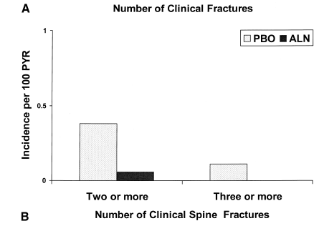
Multiple fractures in FIT trial
J Am Geriatr Soc, 2002. 50:409–415

Slide 19
Fracture
There is currently no widely used definition of treatment failure, though the occurrence of two or more incident fractures in a treated patient may be an indication that the patient is not responding to treatment (based on 70-90% fracture prevention in clinical trials)
Treatment failure in osteoporosis. Osteoporos Int,2012, 23:2769–74

Slide 20
Important note
Fractures of the hand, skull, digits, feet and ankle are not considered as fragility fractures
Falls are an important driver of fracture. Therefore this problem should be considered when analysing response to treatments
Treatment failure in osteoporosis. Osteoporos Int,2012, 23:2769–74

Slide 21
Fracture during treatment?
Residual risk
Changes in risk factors, for example, those not influenced by the current treatment, such as falls
problem with compliance
Suboptimal or failed treatment; indicating the need for a modification of the management strategy

Slide 22
Forget Fracture as a Target
It does not appear to be realistic to apply the occurrence of incident fracture in a treat-to-target strategy
Goal-directed treatment of osteoporosis in Europe. Osteoporos Int. 2014 Sep 9. [Epub ahead of prin.

Slide 23
Potential targets
Fracture
BMD
FRAX probability
Bone turnover markers
Indices of bone strength

Slide 24
RR of Fx for 1 SD decrease in BMD (age-matched)
Site | Hip Fx | vertebral Fx
Distal radius | 1.8 | 1.7
Proximal radius | 2.1 | 2.2
Calcaneous | 2.0 | 2.4
Spine | 1.6 | 2.3
Femoral neck | 2.6 | 1.8
(marshall D,et al,BMJ. 1996:,312:1254)

Slide 25
What about BMD in patients under anti-osteoporosis treatment?

Slide 26
Meta-analysis of all randomized, placebo-controlled trials of antiresorptive agents conducted in postmenopausal women with osteoporosis
To examine the extent to which increases in BMD and reductions in BCM during antiresorptive therapy are associated with reductions in risk of non vertebral fractures
J Clin Endocrinol Metab 87: 1586–1592, 2002
Notes:
مقاله دیده شود

Slide 27
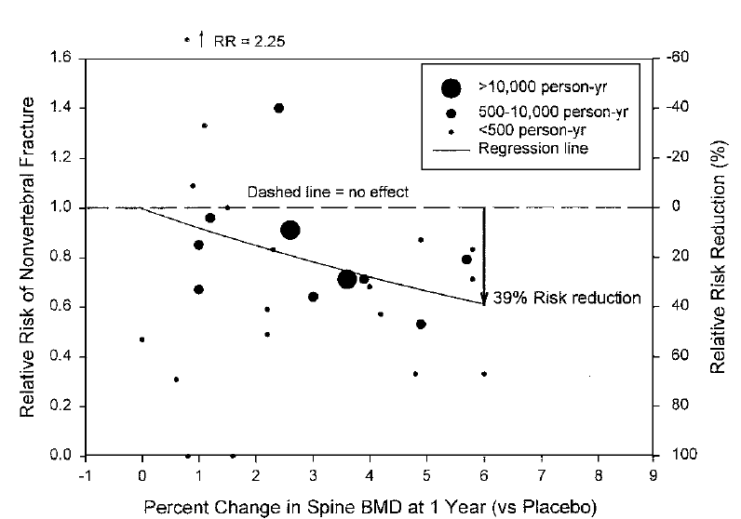
Treatments with the largest increases in lumbar spine BMD at 1 yearr, 6% vs. placebo, are associated with a 39% reduction in non vertebral fracture risk
Notes:
each 1% increase in spine BMD at 1 yr was associated with
an 8% reduction in nonvertebral fracture risk (P0.02)

Slide 28
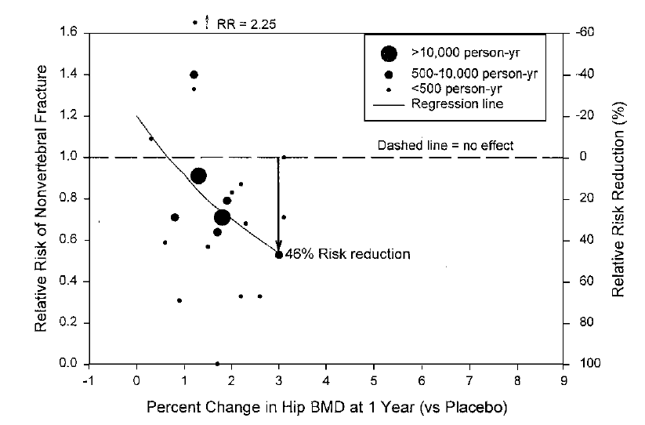
Treatments with the largest increases Hip BMD at 1 yr, 3% vs. placebo, are associated with a 46% reduction in non vertebral fracture risk

Slide 29
A post hoc analysis of FLEX trial
To determine whether the effect of long term ALN on fracture differs by vertebral fracture status and femoral neck (FN) T-score
Journal of Bone and Mineral Research, Vol. 25, No. 5, May 2010, pp 976–982

Slide 30
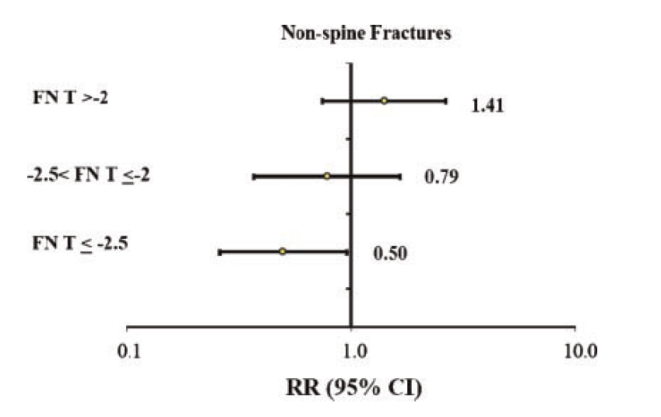
Continuing ALN for 10 years instead of stopping after 5 years reduces NVF risk in women without prevalent vertebral fracture whose FN T-scores, achieved after 5 years of ALN, are - 2.5 or less but does not reduce risk of NVF in women whose T-scores are greater than -2

Slide 31
A subgroup analysis of HORIZON PFT study (An extension RCT of the HORIZON study )
To determine if continuing ZOL reduces fracture risk in subgroups

Slide 32
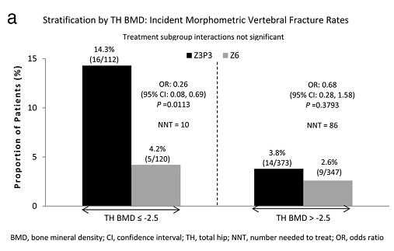
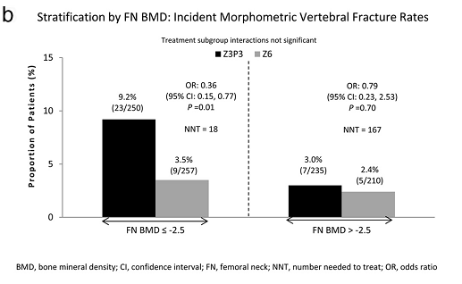
Difference of morphometric vertebral fracture rate based on total and neck femur BMD

Slide 33
Key message
In patients treated with bisphosphonates, femoral neck or total hip BMD at 3-5 years after treatment can predict fracture after drug discontinuation (as drug holiday)

Slide 34
Relationship of BMD changes and fracture rate is not consistent in different studies

Slide 35
Drug (Trial) | Increase in spine BMD | Decrease in vertebral Fx
Alendronate (FIT ll) | %8.3 | %44
Alendronate (FIT l) | %7.9 | %47
Residronate (RVE) | %7.1 | %49
Residronate (RVN | %5.4 | %41
Raloxifen (MORE) | %2.6 | %40
Calcitonin(PROOF) | %1.2 | %36

Slide 36
Fracture Intervention Trial : 6,459 women were randomly assigned to treatment with alendronate or placebo
To compared reductions in risk of spine fractures at end of follow-up (3 or 4 years) within various levels of change in total hip and spine BMD after 1 and 2 years of treatment
Osteoporos Int (2005) 16: 842–848

Slide 37
Risk of vertebral fracture as a function of total hip BMD loss at 1 year

Slide 38
A post hoc analysis, combined data from three pivotal risedronate fracture endpoint trials
Women received risedronate 2.5 , 5 mg (n=2561) or placebo (n=1418) daily for up to 3 years
BMD and non vertebral fractures confirmed by radiograph (hip, wrist, pelvis, humerus, clavicle, and leg) were assessed periodically over 3 years
J Bone Miner Res 2005;20:2097–2104.

Slide 39
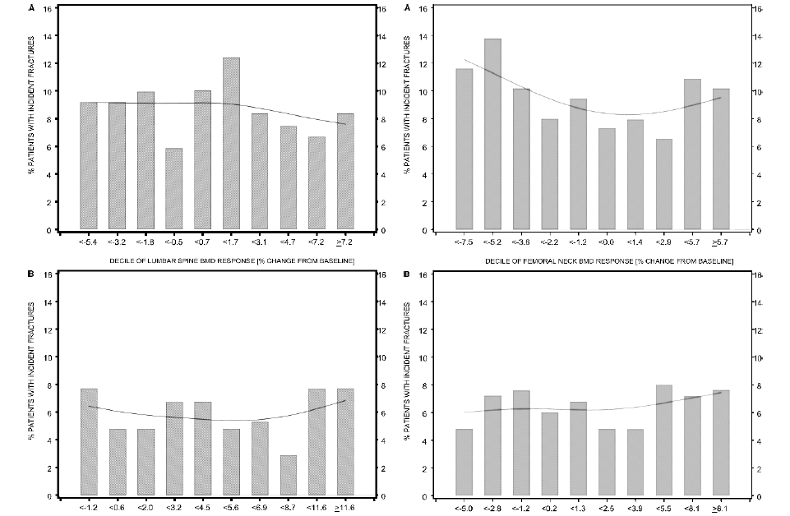
LS changes
FN changes

Slide 40
Changes in BMD as measured by DXA do not predict the
degree of reduction in non vertebral fractures
 | Incidence of non vertebral fracture | HR
LS Increase | 6.4% | 0.79; 95% CI, (0.50,1.25)
LS decrease | 7.8% | 1
FN Increase | 7.5% | 0.93; 95% CI,( 0.68, 1.28)
FN Decrease | 7.6% | 1

Slide 41
BMD as target

Slide 42
Advantages
T-scores are used for diagnostic classification and to determine when treatment is indicated
In most studies increase in BMD is associated with reduction in fracture risk
DXA is widely available and currently used to monitor therapy
Physicians and patients are already generally familiar with T-scores

Slide 43
Potential limitations
No change in BMD (or even loss of BMD in some studies) with therapy is also associated with reduction in fracture risk

Slide 44
Potential limitations
BMD values vary with different instruments and at different skeletal sites and changes with changed database
Even wit using the same instrument and same skeletal site, Precision error of BMD is higher than BMD attainment in many subjects. It is not clear to use 95% confidence interval or lower amounts(eg 80% CI) for detecting suboptimal response of BMD to treatment
An absolute target may not attainable when the baseline fracture risk is very high

Slide 45
Potential targets
Fracture
BMD
FRAX probability
Bone turnover markers

Slide 46
Can Change in FRAX score used as a target?

Slide 47
Validated Risk Factors
Advanced age
Previous fracture
Family history of hip fracture
Long-term glucocorticoid therapy
Low body weight (less than 58 kg [127 lb])
Cigarette smoking
Excess alcohol intake

Slide 48
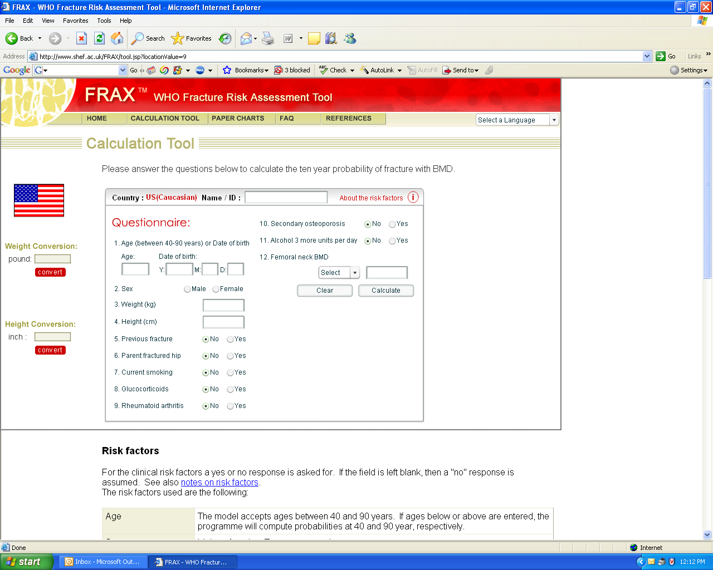

Slide 49
Objective: To confirm (or refute) the clinical utility of using change in FRAX scores over time as a surrogate measure that could be used to inform goal‐directed therapy and thus guide decisions around initiation and duration of osteoporosis treatment
11,049 untreated women aged 50 years undergoing baseline and follow‐up DXA examinations in Manitoba, Canada were evaluated
Median interval between two DXA was 4 years and for median of 4 years were followed for incident fracture
Journal of Bone and Mineral Research, Vol. 29, No. 5, May 2014, pp 1074–1080

Slide 50
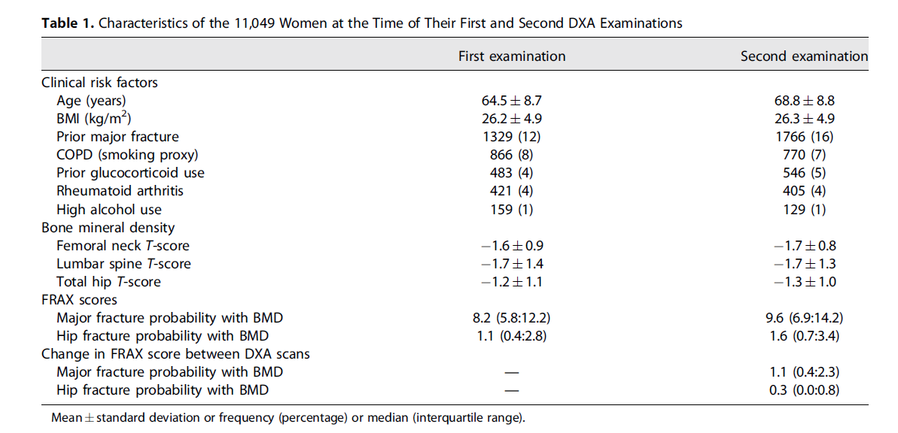

Slide 51
Results
In the subgroup of women highly adherent to osteoporosis treatment, 98% had the same or greater risk of major fracture according to FRAX as they did before therapy, and treatment only seemed to attenuate the universal increase in FRAX scores over time

Slide 52
Key messages
FRAX tended to increase over time and were not particularly responsive to changes in risk factors, BMD, or osteoporosis treatments
Thus, changes in FRAX score are a poor surrogate measure for treatment response and cannot be recommended as a target for goal‐directed therapy.

Slide 53
Potential targets
Fracture
BMD
FRAX probability
Bone turnover markers

Slide 54
Advantages
Evidence-based clinical practice guidelines have included BTMs as a method for monitoring the effects of therapy*
Measurement of BTMs is potentially useful in assessing the offset of effect after discontinuation of therapy and may provide insight on restarting therapy after a drug holiday**
*Evidence-based guidelines for the use of biochemical markers of bone turnover in the selection and monitoring of bisphosphonate treatment in osteoporosis: a consensus document of the Belgian Bone Club. Int J Clin Pract. 2009;63(1): 19–26
**J Bone Miner Res. 2012;27(5):963–974.

Slide 55
Practical point
Serum C- telopeptide of type I collagen (βCTX) and serum procollagen I N-propeptide (PINP) are considered as reference markers
Under clinical conditions, a precision error of approximately 10 % is estimated for both analytes
LSC estimates for serum βCTX and PINP are approximately 25 %
Treatment failure in osteoporosis. Osteoporos Int,2012, 23:2769–74

Slide 56
Potential limitations
Assay variability
lack of clarity regarding the optimal choice of BTM, which may differ for different drugs
Cost and availability

Slide 57
Conclusions
The main problem is lack of validated surrogate measures in osteoporosis
None of potential targets appears to be ready for use in a treat-to-target strategy

Slide 58
Treat to target strategy
1) A goal of treatment is established for a patient
2) the initial choice of treatment is based on the probability of reaching the goal
3) progress toward reaching the patient’s goal is reassessed periodically, with decisions to stop, continue, or change treatment based on achievement or progress toward goals
Cummings et al. JBMR. 2017,32: 3–10

Slide 59
Toward goal directed treatment in osteoporosis

Slide 60
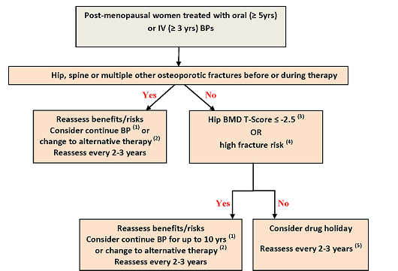
Bisphosphonates holiday in high vs low risk patients
Journal of Bone and Mineral Research, 2016,Vol. 31, pp 16–35
Notes:
The AACE agrees with the recently published
ASBMR algorithm for managements of patients on long-term bisphosphonate treatment that recommends that
patients who are initially at high risk and remain at high
risk receive a treatment duration of 10 years for an oral
bisphosphonate

Slide 61
Recommendations by Committee of Scientific Advisors of the IOF
Good response:
no new fractures
increased BMD
appropriate changes of bone markers
If response criteria are not fulfilled,:
A review of adherence, (the most likely reason for a poor response )
search for occult secondary causes of osteoporosis
Treatment failure in osteoporosis, Osteoporos Int 2012, 23:2769–2774

Slide 62
Recommendations by Committee of Scientific Advisors of the IOF
two or more incident fragility fractures
one incident fracture and a significant decrease in BMD
one incident fracture and elevated serumβCTX or PINP at baseline with no significant change during treatment
Both significant decrease in BMD and no significant decrease in serumβCTX or PINP
Treatment failure in osteoporosis, Osteoporos Int 2012, 23:2769–2774

Slide 63
Recommendations by Committee of Scientific Advisors of the IOF
Note the following:
Fractures of the hand, skull, digits, feet and ankle are not considered as fragility fractures.
The problem of falling
Treatment failure in osteoporosis, Osteoporos Int 2012, 23:2769–2774

Slide 64
Recommendations by Committee of Scientific Advisors of the IOF
The same assay should be used for repeated bone markers assay. A significant response is a decline of 25 % from baseline levels for anti-resorptive treatments, and 25 % increase for anabolic agents
Falls are an important driver of fracture. Therefore this problem should be considered when analysing for falure to treatment
Treatment failure in osteoporosis, Osteoporos Int 2012, 23:2769–2774

Slide 65
Issues for the research agenda
Further research about relationship between fracture( particularly hip fracture) and change of BMD
Integration of FRAX or other validated risk calculators in to new RCTs to link measurement of efficacy to fracture probability
Consensus to how to identify treatment failure
Investigation of whether switching therapy to further increase BMD is beneficial in term of fracture risk reduction
Goal-directed treatment of osteoporosis in Europe. Osteoporos Int.2014 Sep 9. [Epub ahead of print]

Slide 66
Issues for the research agenda
More studies focused on head to head comparison of anti-osteoporosis treatment in patients with more sever osteoporosis
Investigation of whether or not individuals with high remodelling rates may require more potent remodelling suppressants and patients with low remodelling require less potent anti-resorptive or anabolic agents

Slide 67
Thank you for your attention

