Slide 1

In the name of GOD
1
1

Slide 2
Obesity and cancer
F.Sarvghadi M.D
Associate prof. Research institute for endocrine sciences. Shahid Beheshti University of Medical Sciences.
1392/09/14

Slide 3
Agenda
Introduction
Epidemiologic studies
Pathophysiology of cancer in obesity
Cancer risk reduction
Conclusion

Slide 4
Adverse effect of obesity
Introduction:
Diabetes Mellitus Type 2
Cardiovascular Disease
Essential Hypertension
Stroke.
Cardiomyopathy
Reproductive Disorders
Gallbladder Disease
Respiratory Disease
Cancer
Other Comorbidities
Mortality

Slide 5
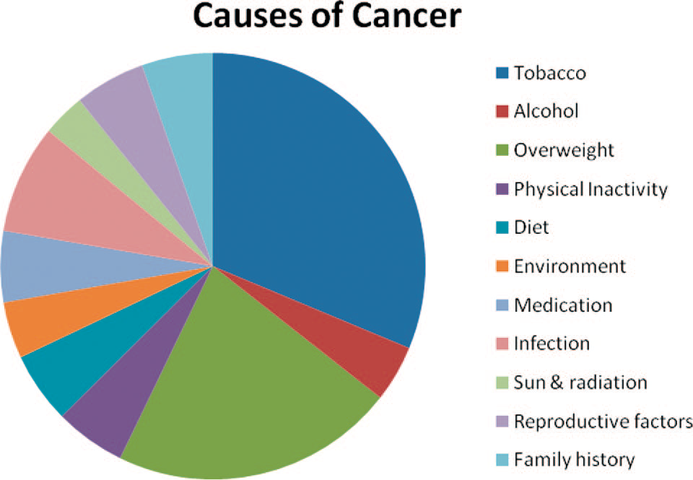
Nongenetic cancer causes.
.
Obesity account for approximately 20% of all cancer cases.
Wolin KY et al The Oncologist 2010;15:556–565

Slide 6
Epidemiologic studies of obesity and cancer

Slide 7
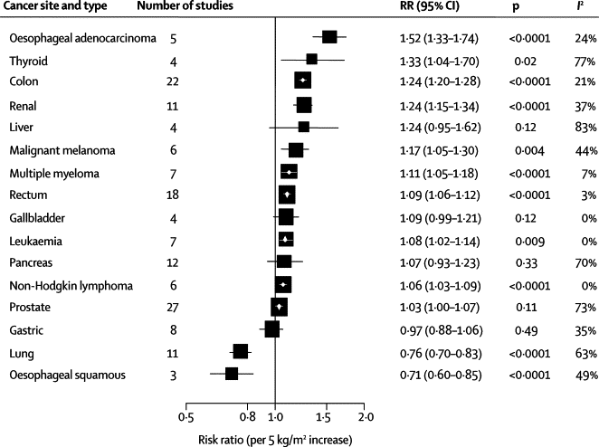
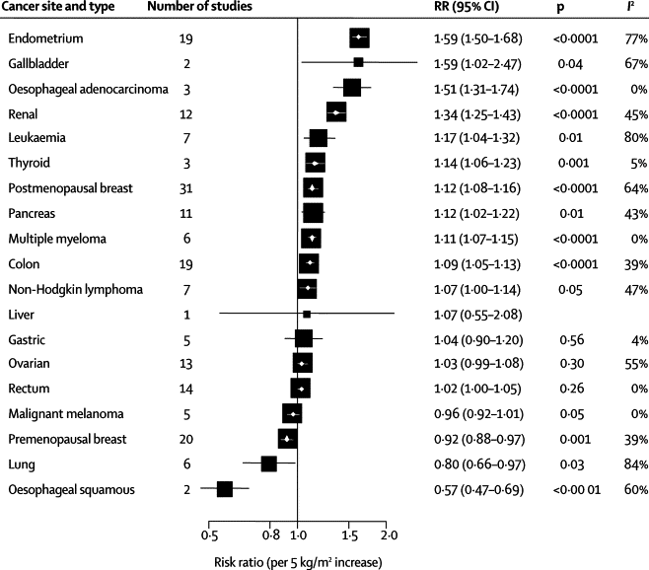
Body-mass index and incidence of cancer: a systematic review and meta-analysis of prospective observational studies.
1966 – 2007 , Incident cases of 20 cancer types , n= 282137
Risk estimates by cancer sites in men
Risk estimates by cancer sites in women
Renehan AG et al Lancet 2008 Feb 16;371(9612):569-78.

Slide 8
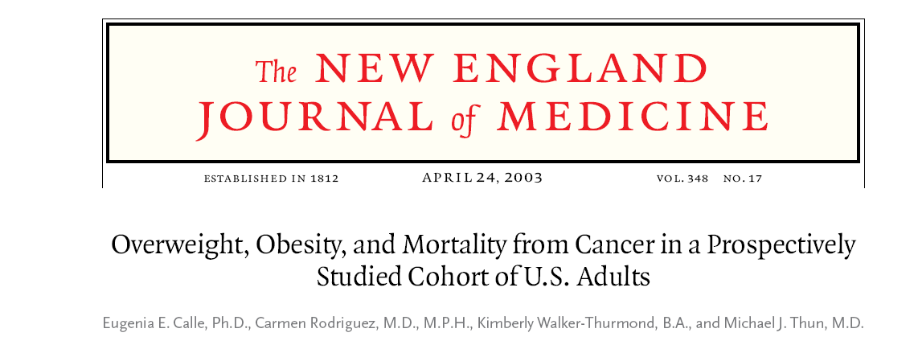
F/U 16 years , N= 900,000 U.S. adults (404,576 men and 495,477 women) , Outcome=Risk of death from all cancers and from cancers at individual sites, while controlling for other risk factors.
Calle EE, et al N Engl J Med. 2003;348:1625-1638.

Slide 9
In both sex BMI was significantly associated with higher rates of death due to cancers :
Esophagus
Colon
Rectum
Liver
Gallbladder
Pancreas
Kidney
Non-Hodgkin's lymphoma
Multiple myeloma
Calle EE, et al N Engl J Med. 2003;348:1625-1638

Slide 10
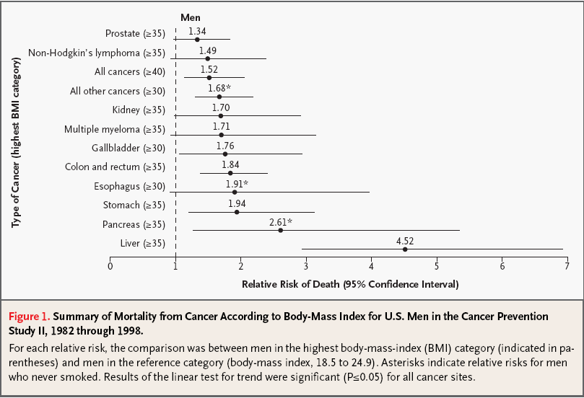

Slide 11
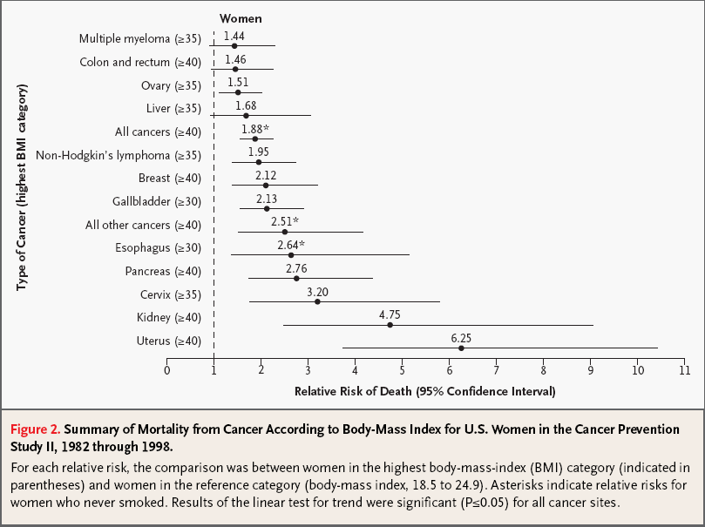

Slide 12
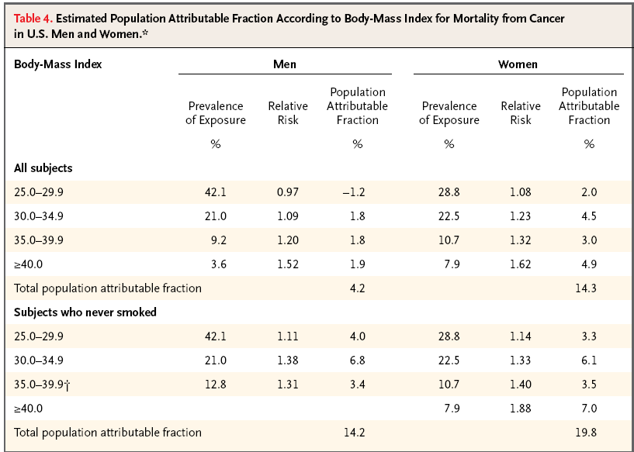
Overweight and obesity could account for 14% of all deaths from cancer in men and 20% of such deaths in women.
Calle EE, et al N Engl J Med. 2003;348:1625-1638

Slide 13
WCRF/AICR 2007
World Cancer Research Fund/International Agency for Research on Cancer
Excess body weight convincingly increases the risk of: Esophageal adenocarcinoma
Colorectal cancer
Pancreatic cancer
Postmenopausal breast cancer
Endometrial cancer
kidney cancer
Further, it probably increases the risk of gallbladder cancer, and possibly increases the risk of liver cancer.
Inoue M et al Endocrine-Related Cancer (2012) 19 F1–F8

Slide 14
Pathophysiology of obesity as a cause of cancer

Slide 15
Hyperinsulinaemia / Insulin-like growth factor-I
A chronic excess body weight condition increases production of free fatty acids, cytokines such as tumor necrosis factor-a and interleukin 6, and leptin from adipose tissue, while it decreases adiponectin production, which together lead to the development of insulin resistance and chronic hyperinsulinemia
Chronic hyperinsulinaemia has been linked to carcinogenesis and related to colon , endometrium ,pancreas and breast cancers
Insulin enhances the IGF-1 synthesis and its bioavailability and decreased production of IGFBPs-1 and -2.
Both, insulin and IGF-I are anabolic molecules that can promote tumor development by inhibiting apoptosis, and by stimulating cell proliferation .

Slide 16
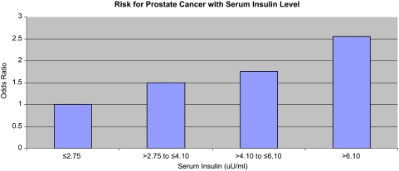
Serum insulin and risk for prostate cancer
Albanes DJ et alNatl Cancer Inst 2009;101:1272–1279.

Slide 17
Endogenous sex steroids
Insulin and IGF-I stimulate the synthesis of sex steroids in ovarian, testicular or adrenal tissue, and inhibit the hepatic synthesis of SHBG, increasing their free circulating levels and bioavailability to tissues.
Obese women show higher aromatization of androgenic precursors to estrogens.
Sex steroids are mitogens that can stimulate cell proliferation, inhibit apoptosis, and therefore potentially increase the chance of malignant cell transformation, particularly of endometrium and breast.

Slide 18
Inflammation and oxidative stress
Obesity is related to a condition of chronic inflammation characterized by abnormal production of inflammatory cytokines, TNFα- IL-6 and Leptin , affect both tumor initiation and tumor progression.
Decrease Adiponectin.
The process relating obesity to cancer development
is multifactorial and involves a network of
metabolic and immunological factors.
Inoue M et al Endocrine-Related Cancer (2012) 19 F1–F8

Slide 19
Cancer risk reduction

Slide 20
Weight and cancer risk reduction
Two large cohort studies suggests that large weight loss from bariatric surgery reduces the risk for cancer death.
U.S.-based study found a significant cancer risk reduction in bariatric surgery patients (HR, 0.76; 95% CI, 0.65– 0.89). That study found that this risk reduction was largely concentrated in obesity-related cancers.
Wolin KY et al The Oncologist 2010;15:556–565

Slide 21
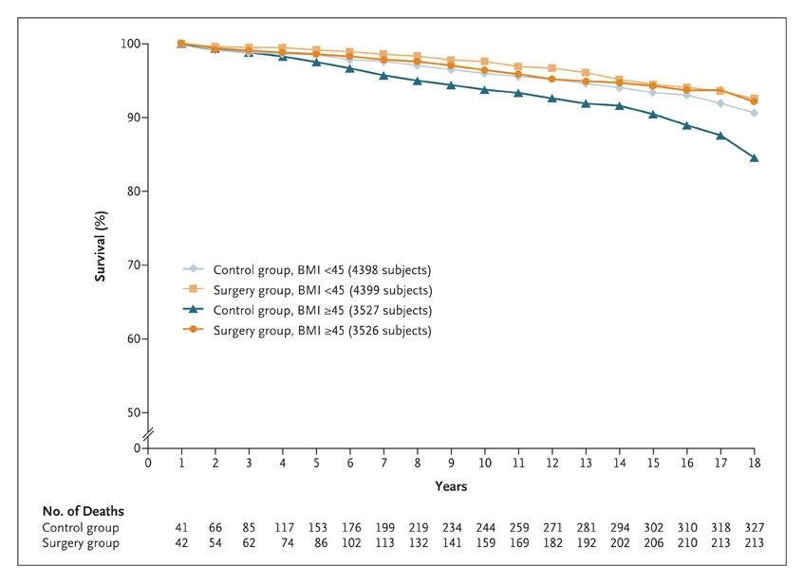
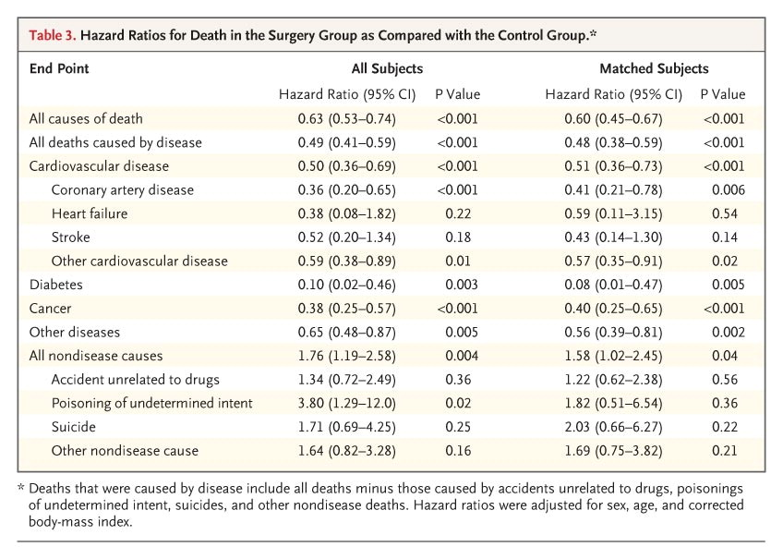
Long-term total mortality after gastric bypass surgery was significantly reduced, particularly deaths from diabetes, heart disease, and cancer
Adams TD et al N Engl J Med. 2007;357:753–761

Slide 22
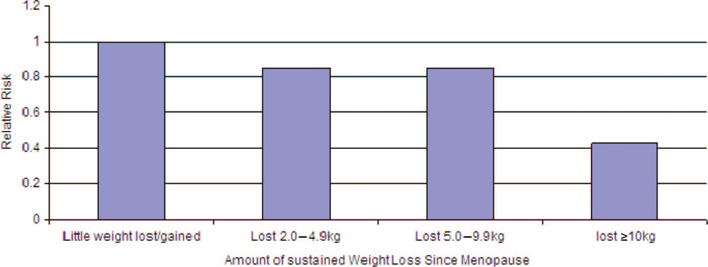
Adult weight change and risk of postmenopausal breast cancer.
Women who lost ≥ 10 kg after menopause
50% risk reduction for breast cancer
Eliassen AH et al JAMA 2006;296:193–201.

Slide 23
Physical activity and cancer risk reduction
WCRF/AICR report concluded that all types of physical activity convincingly decrease the risk of colon cancer, and probably also reduce the risk of postmenopausal breast cancer and endometrial cancer, either in association with excess body weight or independent of it.
Inoue M et al Endocrine-Related Cancer (2012) 19 F1–F8

Slide 24
Conclusion
Overweight and obesity could account for 14% of all deaths from cancer in men and 20% of such deaths in women.
Pathophysiology of cancers due to obesity is multifactorial and involves a network of metabolic and immunological factors.
Obesity follows cigarette consumption as a cause of avoidable cancer in western society.

Slide 25

Thank you

