Slide 1
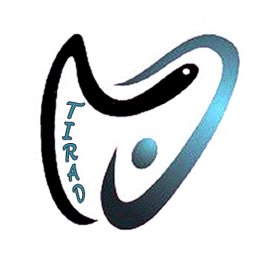
IN THE NAME OF GOD
Role of Radiofrequency ablation in recurrent thyroid cancer management
By Dr. H, Chegini
Interventional Radiologist
TIRAD Imaging Institute

Slide 2
Recurrent thyroid cancer:
Low risk: no local or distant metastasis; no local invasion or aggressive histology; R0 surgical resection; no ¹³¹I outside of the thyroid bed;
Intermediate risk: microinvasion, ¹³¹I or LNM present outside the thyroid bed; aggressive histology or vascular invasion could be present;
High risk: macroinvasion, incomplete resection—gross residual, or distant metastases were present

Slide 3
Recurrent DTC Management :
Recurrence rate :ranging from 20 to 59%.
Surgery followed by RIA +hormone therapy is the mainstay of treatment.
Increasing second neck surgery complications.
Alternative minimally invasive procedures: Laser A, Microwave A, RFA, Alcohol A,

Slide 4
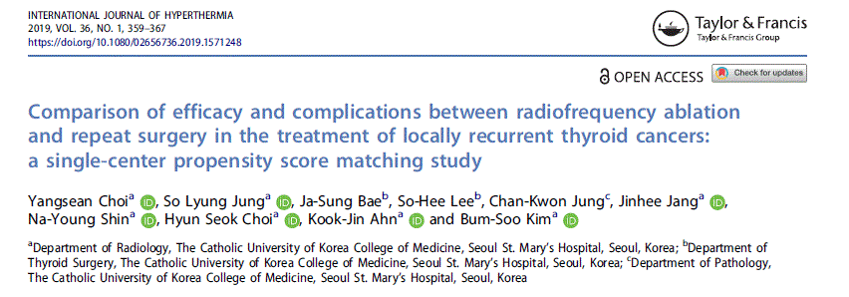
Review of previous Papers

Slide 5
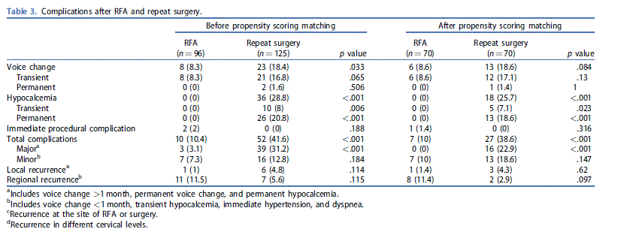
Review of previous Papers

Slide 6
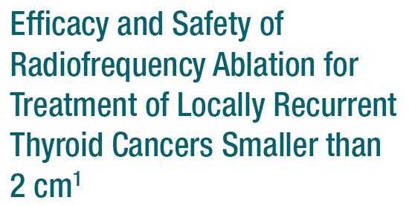
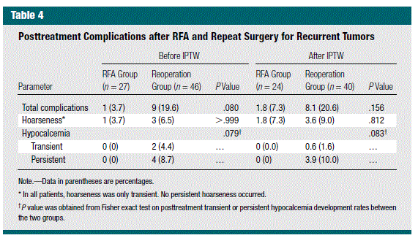
Review of previous Papers

Slide 7
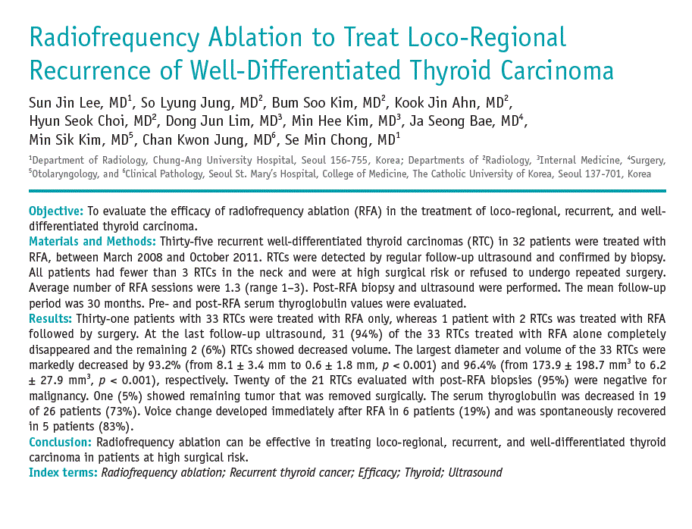
Review of previous Papers

Slide 8
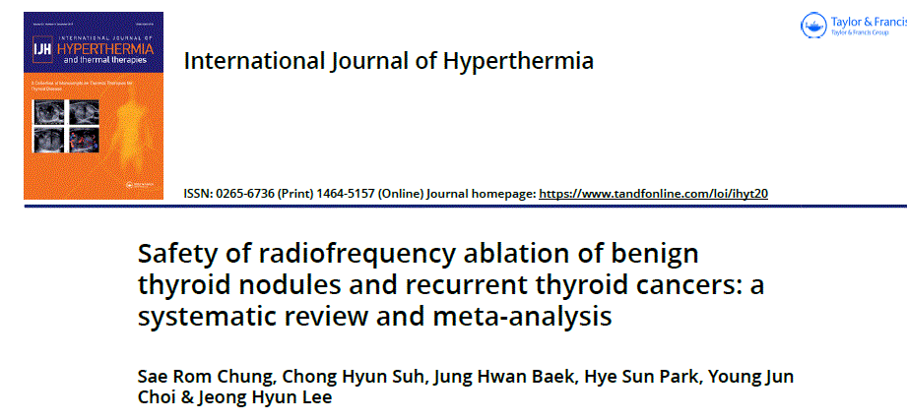
Review of previous Papers
24 studies
2786 nodules

Slide 9
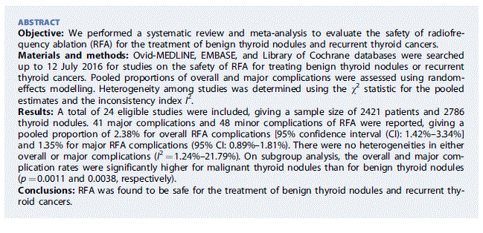
Review of previous Papers

Slide 10
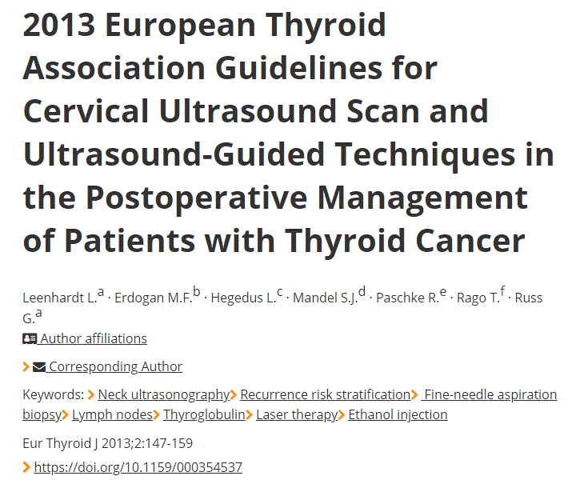
Guidelines Recommendations

Slide 11
Guidelines Recommendations

Slide 12
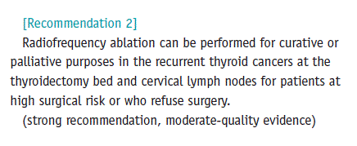
Guidelines Recommendations

Slide 13
Guidelines Recommendations

Slide 14
Other advantages of thermal ablation
Ablation of micro-PTC in special cases
Ablation of Parathyroid adenomas(failed surgery, medical conditions)
Palliative therapy for airway, GI obstructions
Mass volume reduction Before RAI

Slide 15
Challenging cases
73Y/F
Recurrent PTC, multiple surgery and RAI.
Laryngeal involvement, lower neck tracheal and esophagus involvement.
Tracheostomy
Two session RF ablation (palliative) done.
Tracheostomy is removed
No dyspnea no dysphagia
Followed 10 month.

Slide 16
Challenging cases
38Y/F
Recurrent PTC,
Thyroidectomy + twice neck dissection
Left VC complete paralysis + right paresis
Two low right Para tracheal 5 and 8 mm + 27x16 mm right Z2 mets.
Two session RF ablation
Complicated voice change (6 month permanent)
All lymph nodes are disappeared.
Dramatic decreasing TG
.

Slide 17
Challenging cases
54Y/F
Recurrent MTC,
Thyroidectomy + twice neck dissection
A 9x8 mm low right Para tracheal FNA proved MTC mets
Calcitonin 65
One session RF ablation done
Complicated voice change (2 month temporary)
All lymph nodes are disappeared.
Calcitonin 5.6
Fallowed 6 month

Slide 18
Challenging cases
45 Y/male
Parathyroid adenoma
Twice failed surgery
PTH : 302 , Ca :11.5 , Creat:1.45,
Kidney Sonography : suspected nephroncalcinosis + lithiasis
Patient refused surgery
US localized suspected left lower PTA (8*6 mm)
FNA: follicular cell + PTH wash out > 4000
One session RF done
No complications .
PTH two month later : 23
Fallowed 4 month .

Slide 19
Challenging cases
78 Y/M
Recurrent PTC,
Thyroidectomy + 6 times neck surgery
Multiple neck masses at both side central and laterl zones 6- 40 mm + lung mets ( 5-20 mm)
Two session RF ablation
No complications
All lymph nodes show decreasing size and avascular
Patient referred to RAI.

Slide 20
Other cases
54 patient with MTC and PTC
87 metastatic node
Fallowed 26-3 months
Complications : 4 voice change, one permanent ( 6 month)
One horner syndrome ( transient)
Regional recurrence: 4
Local recurrence : 5

