Slide 1
New Concepts in Thyroid Cancer Management
Thyroid Cancer Conference
Tehran
April 24, 2017
Hossein Gharib, MD, MACP, MACE Professor, Mayo Clinic College of Medicine Past President, American Thyroid Association Past President, American Association of Clinical Endocrinologists

Slide 2
Disclosure and Thanks
Nothing to disclose
My sincere thanks for the invitation to attend this meeting and for the honor of speaking to your group today

Slide 3
Objectives
Discuss the rising incidence of thyroid cancer
Review dynamic risk stratification
Outline optimal Rx for PTMC
Discuss Tx and CCND in thyroid cancer
RAI for remnant ablation
Options for management of suspicious micronodules
FVPTC

Slide 4
Epidemic of Thyroid Cancer

Slide 5
Incidence and Mortality in U.S.
Papillary Thyroid Cancer (PTC)
1975-2009
1988-2002
Ultrasound guided aspiration of thyroid nodules
Centimeters
Fine needle aspiration of thyroid nodules
0.0-1.0
1.1-2.0
2.1-5.0
>5.0
Widespread use of thyroid ultrasonography
Increase in use of CT and MRI
Rate per 100,000
Incidence
Mortality
Year
Year

Slide 6
PTC
Accounts for the recent rise in incidence of thyroid cancer
This rise is mostly due to small PTC; median tumor size 7 mm
Caused primarily by widespread, sensitive imaging, but also by more FNAs & more extensive thyroidectomies
Results in overdiagnosis and overtreatment

Slide 7
Risk Stratification

Slide 8
Standard Treatment of Thyroid Cancer
Total thyroidectomy
RAI ablation
TSH
Suppression therapy
Follow
US exam Tg assay

Slide 9
Dynamic Risk Classification
AJCC/UICC staging → predicts disease mortality
ATA initial risk stratification → predicts recurrence & persistence
ATA response to Rx → risk changes over time

Slide 10
Initial Risk Analysis
Former
Tumor size & type
Resection margins
LN involvement
Distant mets
Newer
Histologic variants
Vascular invasion
Multifocality
No. of lymph nodes examined & involved
Extranodal extension

Slide 11
Histologic Variants of PTC
Low Risk
Follicular variant
Classic or conventional
Minimally-invasive
High Risk
Tall-cell variant
Widely-invasive
Diffuse sclerosing type

Slide 12
Initial Risk Analysis
Postop risk classification |  | No evidence of disease po & after RRA
Low | Tumor <4 cm Intrathyroidal No ETE No lympho-vascular invasion FTC w CI only | ~85%
Intermediate | Everything else Higher risk PTC | ~60%
High | ETE Incomplete tumor resection DM | ~20%

Slide 13
Response to Rx Risk Analysis During Follow-Up
 | Suppressed Tg (ng/mL) | Stimulated Tg (ng/mL) | TgAb | Neck exam | Neck US
Excellent | <0.2 | <1 | Neg | Neg | Neg
Intermediate | <1 | <10 | Neg or ↓ | Neg | Indeterm- inate
Incomplete | >1 | >10 | Pos or ↑ | Pos | Pos

Slide 14
Papillary Thyroid Microcarcinoma (PTMC)

Slide 15
Papillary Thyroid Microcarcinoma (PTMC)
Almost always asymptomatic
Frequently found on imaging for nonthyroid reason
Currently accounts for 50% of all PTC
Prevalence is 10% in population (2-30%)
Accounts for the alarming rise in the incidence of thyroid cancer

Slide 16
22-Year-Old Woman
Found to have a left thyroid nodule on pre-employment exam. US showed a 9 mm solid left lobe nodule without suspicious adenopathy. FNA was suspicious for PTC. TSH is 2.8 mIU/L
What should you recommend?
Left lobectomy
TTX
TTX plus lateral neck dissection
Begin T4 suppressive Rx and follow

Slide 17
PTMC 22-Year-Old Woman
Lobectomy showed a solitary 0.9 cm PTC; no abnormal nodes were identified.
What further Rx do you recommend?
Rx with 30 mCi ¹³¹I
Rx with 100 mCi ¹³¹I
Start T4 and follow
Completion thyroidectomy followed with RRA

Slide 18
PTMC
Thyroid lobectomy alone may be sufficient Rx for small (<1 cm), low risk, unifocal, intrathyroid PTC in the absence of radiologically or clinically involved cervical nodal metastasis

Slide 19
PTMC Mayo Experience*
Between 1935-2015, 1,345 patients with average follow-up 15 yrs, 1-63 yrs
Tumors ≤1 cm, 27% multifocal, 30% node-positive, 1.3% invasive, 4 (0.3%) with DM, 0.3% deaths
Overall recurrence 7%; more common if node positive; 99% are not at risk of DM or death from cancer
Surgical complications are hypopara- and VC paralysis
Surgery included Lobx, BLR, TTx; 10% received RRA; no option affected great outcome
Best approach is lobectomy

Slide 20
PTMC Summary
“Let punishment fit the crime”…Mojazat barabareh jorm!
Lobectomy seems adequate for most pt
No CCND or RRA seems necessary
Target TSH suppression 0.5-1
Outcome is great with recurrence <5% & mortality <1%
Follow with TSH, Tg & US

Slide 21
Thyroidectomy (Tx)

Slide 22
36-Year-Old Woman
Evaluated for a thyroid nodule. US shows a 3.2 x 1.6 x 2.2 cm solid, right thyroid mass; no abnormal adenopathy. FNA → PTC
Which of the following is a recommended treatment?
Right lobectomy
Total thyroidectomy (TTx)
Total Tx plus CCND
A or B

Slide 23
Thyroidectomy
For PTC >1 cm and <4 cm, without extrathyroidal extension or clinical evidence of any lymph node metastases (cN0), the initial surgical procedure can be either a bilateral (near-total or total thyroidectomy) or a unilateral procedure (lobectomy)

Slide 24
When Less is More (kamtar behtareh)
Low risk PTC
Lobectomy or thyroidectomy is adequate
Prophylactic central neck dissection is not required
RAI remnant ablation is not necessary
Complete TSH suppression is not indicated
Excellent outcomes
Recurrence rates <5%
Disease-specific mortality <3%

Slide 25
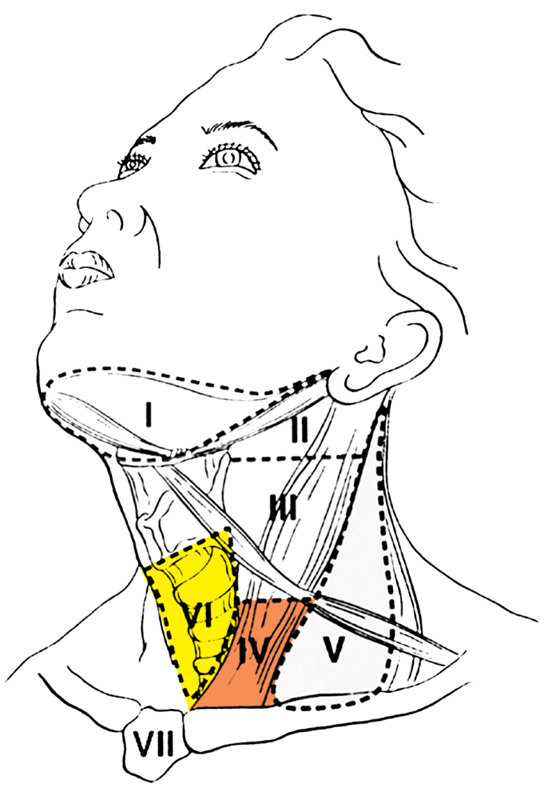
Lymph Node Metastasis in PTC
Most are ipsilateral
Central before lateral (usually but not always)
Levels III, IV, VI in 80% of pt
Level VI nodes not identified by preop US

Slide 26
pCLND
Debate continues; no RCTs
Pro: May improve survival, recurrence & po Tg levels; will detect some pN1 disease; can inform use of RAI
Cons: No improvement in long-term outcomes; increased likelihood of postop hypocalcemia

Slide 27
Central Compartment Neck Dissection
Consider prophylactic central compartment neck dissection for PTC with advanced primary tumors (T3 or T4) or cN1b of if the information will be used to plan further steps in therapy
No need for prophylactic central neck dissection for T1/T2 PTC and cN0 or for most FTC
Therapeutic CND with demonstration of disease by US, FNA or at surgery

Slide 28
When Less Isn’t More (kamtar bad tareh)
Surgeon volume is significantly associated with improved outcomes, shorter hospitalizations & lower costs
The threshold of total Tx cases for improved outcomes is 25 per year
The majority of pt undergo surgery by low volume surgeons

Slide 29
Micronodules

Slide 30
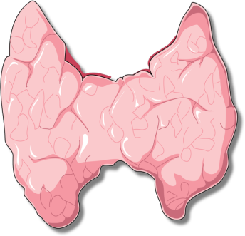
65-Year-Old Man
Diabetes, HTN, metastatic colon cancer
CT of chest finds incidental thyroid nodule
Thyroid US shows single 8 mm thyroid nodule
FNA confirms papillary thyroid cancer
What now?
Surgery vs observation

Slide 31
Surgery
If surgery is chosen for pt with thyroid cancer <1 cm without extrathyroidal extension and cN0, the initial surgical procedure should be a thyroid lobectomy unless there are clear indications to remove the contralateral lobe
If

Slide 32
Management Options for Small Thyroid Nodules Suspicious for PTC
Follow without FNA
Perform FNA, then decide
Proceed w surgery
Discuss risks/benefits with pt

Slide 33
Active Surveillance (Deferred Intervention)
Active observation approach
Patients with known or highly suspected disease
Therapeutic delay (deferred intervention) has no clinically significant impact
Therapy, when indicated, still effective
Not palliative care/watchful waiting (non-curative)
Classic example
Small volume prostate cancer

Slide 34
Outcomes after 10 years of observation
Young (<40 years)
Middle age (40-59 years)
Older (≥60 years)
%

Slide 35
Tumor/neck US Characteristics
Ideal
Solitary thyroid nodule
Well-defined margins
Surrounded by ≥2 mm normal thyroid parenchyma
No evidence of extrathyroidal extension
Previous US documenting stability
cN0
cM0
Age >60 years

Slide 36
Surgery vs Surveillance
Favor Tx
Lobectomy has minimal risk
Pt assurance that “ca is out”
Follow-up is easy
Favor Surveillance
Avoids immediate surgery
Disease not life-threatening
Surgery an option any time

Slide 37
Radioiodine (¹³¹I) Treatment (RAI)

Slide 38
56-Year-Old Man
6 weeks po TTX + CCND for PTC. Pathology showed 3.8 cm PTC; margins not free with mild ETE; 8/12 central neck nodes involved. T3N1aMx, stage III, intermediate risk on T4, TSH 0.2, Tg 1.8, TgAb neg
Optimal management includes
No further Rx
Diagnostic WBS
100 mCi ¹³¹I after rhTSH
100 mCi ¹³¹I after THW

Slide 39
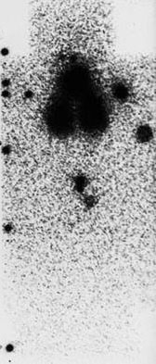
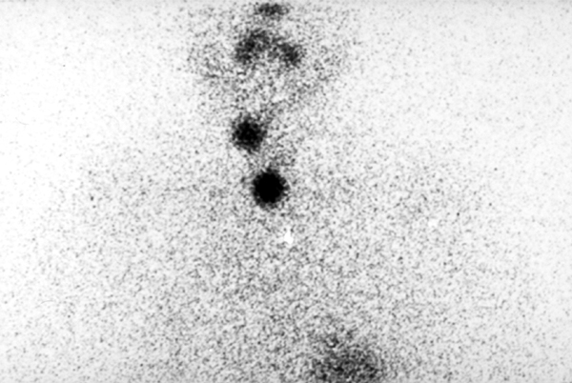
RAI Use in Thyroid Cancer
¹³¹I Rx
RRA
Adjuvant Rx
Remnant ablation
30-50 mCi
Residual, regional disease
50-150 mCi
Distant metastasis
150-200 mCi

Slide 40
RRA Lack of Influence on Recurrence or Mortality in LRPTC
Low risk | 20-yr mortality |  | 20-yr recurrence
1970-2000 | NT/TT alone | NT/TT and RRA | NT/TT alone | NT/TT and RRA
All patients (n=1,163) | 0.4% | 0.6% | 8.3% | 12.7%
Node negative (n=636) | 0% | 0% | 3.4% | 4.3%
Node positive (n=527) | 1.2% | 0.9% | 19.5% | 19.9%
P=0.64
P=0.008
P=NS
P=0.80
P=0.99
P=0.19

Slide 41
How to Achieve Ablation THW vs rhTSH
THW | LT4 withdrawal x 6 wks; administer T3 x 4 wks; stop T3 x 2 wks; measure TSH (≥30 mIU/L); perform WBS
rhTSH | Continue LT4 Rx; administer 0.9 mg rhTSH IM x 2; measure TSH & Tg & perform WBS

Slide 42
RAR
Not routinely recommended after Tx for low risk disease
In low- & intermediate-risk disease use either rhTSH or THW for RAR
rhTSH is not for hi-risk disease
Consider rhTSH in any risk level with significant comorbidity
An initial dose of 30 mCi RAI is preferred

Slide 43
Follow-Up for Low & Intermediate Risk PTC
Serum TSH & Tg at 6 & 12 months
TSH suppression based on risk analysis, usually 0.1 to 1.0 mIU/L
US exam at 12 & 24 months
For intermediate & high-risk disease consider WBS, neck & chest CT, PET, & stimulated Tg levels

Slide 44
Follicular Variant of PTC (FVPTC)

Slide 45
50-Year-Old Man
Presents with a thyroid nodule. US shows a solid 2 x 2 cm left nodule; right lobe is normal & no abnormal nodes are identified. Left lobectomy showed a 2 cm encapsulated FVPTC.
What additional Rx do you suggest?
Completion Tx
RRA with 100 mCi
T4 Rx with TSH <0.1
T4 Rx with TSH 1

Slide 46
Study: 109 patients with noninvasive EFVPTC observed for 10-26 years, and 101 patients with invasive EFVPTC observed for 1-18 years
Noninvasive group was disease-free at median 13 years follow-up
Invasive group showed 12% adverse effects, including DM

Slide 47
Study Conclusions
Noninvasive EFVPTC has low risk of adverse outcome
Can be treated with lobectomy alone
No RAI is necessary
Saves psychologic impact and cost

Slide 48
FVPTC
Pathologists disagree often on FVPTC
FVPTC is common & accounts for ~20% of all thyroid cancers
Two types recognized:
Encapsulated FVPTC with RAS mutations
Invasive FVPTC with BRAF mutations

Slide 49
Oncogenes in Thyroid Cancer
BRAF, in 30-90% of PTC
RAS, in 40% of FTC
RET/PTC, in 30% of PTC
PAX8/PPARγ in 30-40% of FTC
TERT in PTC

Slide 50
Diagnostic Criteria for NIFTP
Noninvasive follicular thyroid neoplasm with papillary-like nuclear features
Encapsulated
Follicular growth pattern with
<1% papilla
No psammoma bodies
30% solid growth pattern
No vascular/capsular invasion
RAS mutations in 30%

Slide 51
Conclusions
PTMC incidence is rising, accounting for most recent increase in thyroid cancers
New risk stratification for thyroid cancer improves management
Lobectomy alone seems sufficient for LRPTC
PTMC can be followed or excised
RRA is not routinely recommended for LRPTC
Encapsulated FVPTC is a nonthreatening malignancy and can be Rxd with lobectomy-only
NIFTP is not cancer

Slide 52
Thank you

Slide 53
Korean Story
Republic of Korea has a population of 50 million
1999 national screening program
Carotid screening with US
In 2011, thyroid cancer dx was 15 times that of 1999
In 2011, 40,000 new diagnosis, making PTC the most common cancer in Korea
Annual deaths due to Ca 300-400
PTMC increased from 14% in 1995 to 56% in 2005
Thyroid-cancer incidence and related
Mortality in South Korea, 1993-2011
Rate (per 100,000 population)
Thyroid-cancer
incidence
Incidence of papillary thyroid cancer
Thyroid-cancer mortality
Year

Slide 54
U.S. Story
Incidence rose 3.8% per year, faster than any other malignancy between 1992-2001
8th most common cancer in women
65,000 new cases in 2015 (52,000 w)
1,900 deaths
Median age of death 73 yr
Prevalence ~500,000

Slide 55
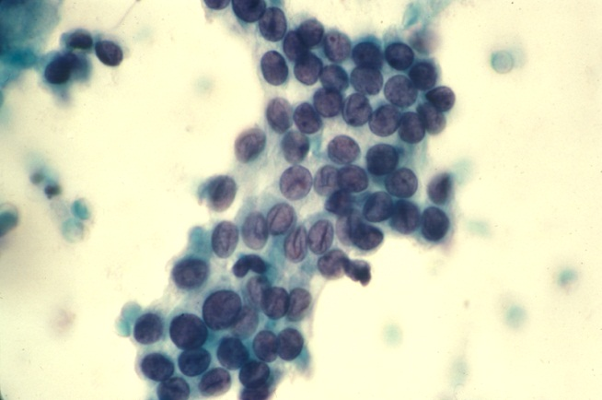
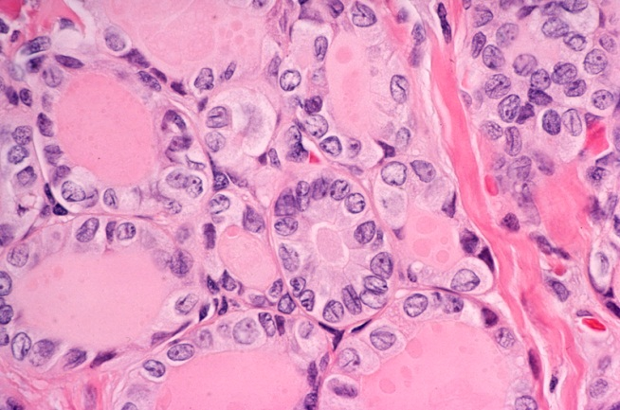
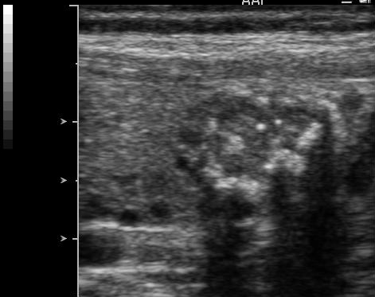
Typical Case
Papillary Thyroid Cancer (PTC)
Most common endocrine malignancy
80% of new cases worldwide
F:M 2:1, mean age at Dx 30-40 year

Slide 56
Why Favoring Surgical Treatment?
Lobectomy is sufficient unless multiple bilateral nodules
No CCND necessary
No RAI necessary
No TSH suppression needed
Risk is minimal in experienced centers
Mortality 0%; VC paralysis & hypoparathyroidism very low

Slide 57
Inappropriate
Evidence of aggressive cytology on FNA (rare)
Subcapsular locations adjacent to RLN
Evidence of extrathyroidal extension
Clinical evidence of invasion of RLN or trachea (rare)
N1 disease at initial evaluation or identified during follow-up
M1 disease (rare)
Documented increase in size of ≥3 mm in a confirmed papillary thyroid cancer tumor

Slide 58
When Observation Is Not Appropriate 26-Year-Old Woman
Discovered to have a single 8 mm thyroid nodule. FNA confirms PTC. She states that she wants to get pregnant & have children.
Observation
Surgery

Slide 59
RAI for LRPTC
Remnant ablation does not improve (favorable) outcome
Recurrences and deaths are both low
Most recurrences are locoregional, readily detected by US and best Rxd surgically
RAI is not effective Rx for neck recurrence
Consider alcohol ablation as a good alternative when recurrence is local & limited

Slide 60
Papillary Thyroid Microcarcinoma Might Progress During Pregnancy
Hisakazu Shindo¹, Nobuyuki Amino², Yasuhiro Ito¹, Minoru Kihara¹,
Kaoru Kobayashi¹, Akihiro Miya¹, Mitsuyoshi Hirokawa³, and Akira Miyauchi¹
4
Increased in Size
5
Remained Stable
Tumor size (mm)

Slide 61
BRAFV600E Mutation
Oncogenic protein, a member of the RAF family of protein kinases
Found in 30-90% of PTC
Reported in 60% of classic PTC; 77% of tall cell variant PTC
Correlated with more aggressive disease, ETE, recurrence and higher nodal metastasis
Not an independent risk for mortality

Slide 62
4 published studies; meta-analysis on 2,247 patients
PTMC recurrence of death ↑ with male sex, regional or distal mets, multifocality, ETE, vascular invasion or incomplete resection
BRAF correlates with recurrence of PTMC and can be used to identify and treat high-risk patients
BRAF mutation helps with risk stratification

Slide 63
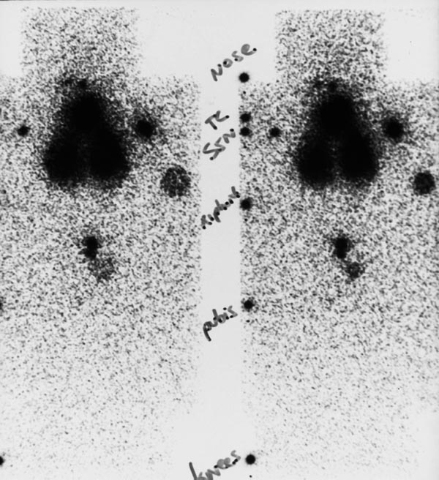
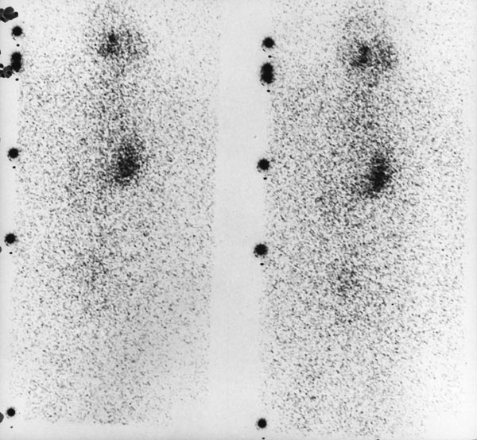
¹³¹I Therapy
Used for recurrent or metastatic disease when functioning mets present
Sometimes used for Tg pos/scan neg pt
Usual dose 150-200 mCi administered at 6-12 month intervals
Some centers use dosimetry for Rx

Slide 64
Low Risk DTC
PTC with the following
No local or distant mets
Total tumor resection
No tumor invasion of tissues or vessels
Clinical N0 or <5 micromets (<0.2 cm)
EFVPTC
FTC with CI only
PTMC

Slide 65
¹³¹I FAQs
Safe dose at one time? | ≤200 mCi
Total lifetime dose? | ~600 mCi
Side effects? | Dose dependent
Secondary primary malignancies? | Rare
Next pregnancy? | 6-9 mo
Subsequent pregnancies? | OK

