Slide 1
بسم الله الرحمن الرحیم

Slide 2
What does evidence tell us regarding Radioiodine therapy in patients with differentiated thyroid cancer?
Presenter:Farahnaz Salehinia MD
Endocrine Research institute
Shahid Beheshti Medical University
4 Khordad 94

Slide 3
Agenda
1-Introduction
2-Is radioiodine therapy prevent recurrence?
3-Is radioiodine therapy improve survival in these group?
4-When to use radioiodine and how to select the dose?
5-Rapid ATA recommendations review
6-Conclusion

Slide 4
Introduction
AJCC/UICC staging in DTC:
Majority (70–85%) of patients: at low-risk of mortality (T1–3, M0 patients)
Higher-risk: minority (T4 and M1 patients)
AJCC/IUCC staging :To predict risk for death, not recurrence.
For assessment of risk of recurrence: A three-level stratification can be used:
THYROID
Volume 19, Number 11, 2009
© Mary Ann Liebert, Inc.
DOI: 10.1089/thy.2009.0110

Slide 5
Introduction
Low-risk patients
1-No local or distant metastases.
2-All macroscopic tumor has been resected.
3- No tumor invasion of locoregional tissues or structures.
4-The tumor does not have aggressive histology (e.g., tall cell, insular, columnar cell carcinoma) or vascular invasion.
5-If ¹³¹ I is given, there is no ¹³¹ I uptake outside the thyroid bed on the first post treatment whole-body RAI scan (RxWBS).
THYROID
Volume 19, Number 11, 2009
© Mary Ann Liebert, Inc.
DOI: 10.1089/thy.2009.0110

Slide 6
Introduction
Intermediate-risk patients:
1-Microscopic invasion of tumor into the perithyroidal soft tissues at initial surgery.
2-Cervical lymph node metastases or ¹³¹I uptake outside the thyroid bed on the RxWBS done after thyroid remnant ablation .
3-Tumor with aggressive histology or vascular invasion .
High-risk patients :
1-Macroscopic tumor invasion
2-Incomplete tumor resection
3-Distant metastases, and possibly ;
4-Thyroglobulinemia out of proportion to what is seen on the posttreatment scan
However, depending on the clinical course of the disease and response to therapy, the risk of recurrence and the risk of death may change over time.
THYROID
Volume 19, Number 11, 2009
© Mary Ann Liebert, Inc.
DOI: 10.1089/thy.2009.0110

Slide 7
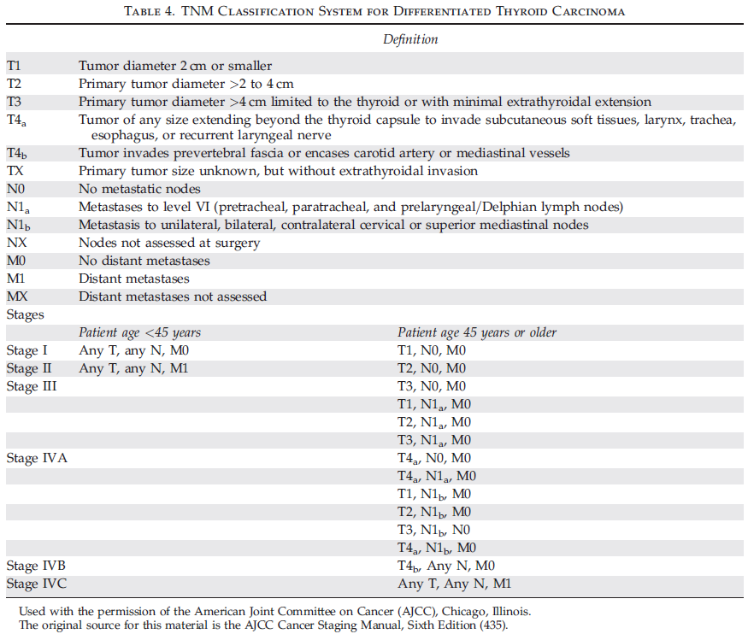

Slide 8
Introduction
Radioactive iodine in the form of 131-I sodium iodide is administered orally, usually 4 to 6 weeks after total thyroidectomy.
b- and g-emitting radionuclide with a physical half-life 8.1 days.
The principal g-ray of 364 keV is used for imaging.
The principal b-particle emission has therapeutic effect with a maximum energy of 0.61 MeV, an average energy of 0.192 MeV, and a mean range in tissue of 0.4 mm
Endocrinol Metab Clin N Am 43 (2014) 385–400

Slide 9
Introduction
3 Main categories depending on the patients’ estimated risk:
(1)Remnant ablation,
(2) Adjuvant therapy,
(3) Therapy for known persistent disease
Endocrinol Metab Clin N Am 43 (2014) 385–400

Slide 10
Introduction
1-Remnant ablation refers to the elimination of residual macroscopic normal thyroid tissue:
Better Tg accuracy to detect recurrent disease
Better scan accuracy to detect recurrent disease and facilitate initial staging.
Minimize risk of new cancers in at-risk patients
2-Adjuvant therapy has the objective of destroying possible but unproven residual or metastatic disease with the ultimate goal of decreasing the risk of Disease Recurrence (DR)and Disease Specific Mortality(DSM)
Endocrinol Metab Clin N Am 43 (2014) 385–400

Slide 11
Introduction
3-Therapy for known residual or metastatic disease has the objective of decreasing the:
Risk of DRand of DSM.
Would be used in patients with known macroscopic tumor invasion, incomplete tumor resection, thyroid metastases, and thyroglobulin levels out of proportion to what is seen on postoperative pretreatment imaging.
Endocrinol Metab Clin N Am 43 (2014) 385–400

Slide 12
Introduction
For microscopic multifocal papillary cancer, when all foci are <1 cm, RAI is of no benefit in preventing Recurrence .
Non papillary histologies (such as follicular thyroid cancer and Hurthle cell cancer) :::higher risk tumors.
Expert opinion the use of RAI in almost all of these cases.
Minimally invasive follicular cancer (ONLY capsular invasion) surgical resection alone..
RAI ablation may not be required for all patients with this histological diagnosis .
THYROID
Volume 19, Number 11, 2009
© Mary Ann Liebert, Inc.
DOI: 10.1089/thy.2009.0110

Slide 13
Introduction
AND……
There have been continuing controversies surrounding radioiodine use in DTC patients , now we are going to discuss some of them.

Slide 14
Agenda
1-Introduction
2-Is radioiodine therapy prevent recurrence?
3-Is radioiodine therapy improve survival in these group?
4-when to use radioiodine and how to select the dose?
5-Rapid ATA recommendations review
6-Conclusion

Slide 16
Design: Systematic Review
Main Aim: To examine the evidence of RRA benefit in staging, follow up (F/U), and DR prevention in LR and IR DTC patients.
Method: Pub med search from 2008/01/01 until 2014/03/01, 26 Original Article

Slide 17
Inclusion criteria
1-DTC (either follicular or papillary)
2-LR and IR patients
3-Non RRA treated patients or RRA vs. non-RRA treated groups
4-Reporting of the outcome of cancer recurrence (local relapse, regional or metastasis).

Slide 18
What are the rationales for radioiodine remnant ablation?
1) To facilitate a patient’s staging by revealing possible metastatic disease on the post-treatment scan and thereby detect early disease persistence;
2) To destroy thyroid remnants in order to facilitate F/U by enabling stimulated thyroglobulin (Tg) testing;
3) To treat microscopic or “occult” persistent disease fulfilling the role of adjuvant therapy.
There is little evidence for benefit among LR patients.

Slide 19
Goal 1. To facilitate a patient’s staging by revealing possible metastatic disease on the post-treatment scan and detect early disease persistence
The risk of persistent disease : 2.5% in low risk ,11% in intermediate risk( Ranging from < 1% to 20% according to the different pathological features).
10 year distant DR rate: 1.3% in DTC patients
The main target in LR and IR patients is the early detection of loco regional disease.
The post therapy whole body scan (RxWBS) more sensitive
than the diagnostic WBS (DxWBS) , but low specificity.

Slide 20
RxWBS :lesions of < 0.2g (few millimeters)
DxWBS: lesions of > 0.2g
Post RRA Rx WBS suspicious for cervical lymph node metastasis:
From 36% to 2%(frequency)
Spect CT?(20-50%)

Slide 21
The most sensitive technique for N1 detection: NECK US
Global accuracy of US +FNAB=100%
Negative predictive value (NPV) of an undetectable Tg and negative neck US =100%
All patients with metastases detected by RxWBS but not by US had stimulated Tg levels of > 10 ng/mL
Elevated levels of Tg typically above 5 ng/mL
Suspicion of precence of METASTASIS.

Slide 22
Neck US and serum Tg measurement are equivalent or superior in detecting and localizing residual disease compared to Rx-WBS.
It is doubtful that early detection of microscopic loco regional metastases will impact on patient’s OUTCOME.

Slide 23
Goal 2. To destroy thyroid remnants in order to facilitate F/U by enabling stimulated Tg testing
Tg measurment :To indentify persistent or recurrent tumor(the minority) and those without evidence of disease(the vast majority).
{detectable and undetectable Tg}
Radioiodine :Increase Tg sensitivity and specificity by eliminating any residual normal thyriod tissue.
Undetectable TSH-stimulated Tg Levels have the highest sensitivity to accurately detect disease-free patients, with a NPV of almost 100% .
The need for TSH stimulation is expected to decline following the increasing use of ultrasensitive Tg assays

Slide 24
Goal 2.1. Which diagnostic tools can be used in non RRA ablated patients?
For those who have not received RRA, the clinical significance of Tg assay positivity is unclear(remnants of normal thyroid cell) No reliable cut off
BUT
Initial serum Tg measurement less specific marker in non ablated patients,
Serial Tg determinations informative during long-term surveillance.
Durante C et al. A Cohort study .JCEM 2012
.

Slide 25
The temporal trend of serial Tg: an excellent negative (declining values) or positive (rising values) predictive value for thyroid cancer DR.

Slide 26
Miyauchi and coworkers a postoperative serum Tg doubling time less than 1 year as a reliable predictive marker of loco-regional and distant DR, irrespective of radioiodine administration.
2004-2010 data from National Cancer Institute: The vast majority of DTC metastases are confined to the neck (86.7%) .
Neck US a highly sensitive tool in detecting cervical node involvement, regardless of whether patients had or had not received RRA , and irrespective of Tg values.

Slide 27
Early neck US (within 6 months form initial treatment) is accurate and is an independent predictor of DR.
Neck US is becoming the main tool of the early postoperative follow up, when Tg assay results are difficult to interpret.
The diagnostic value of serum Tg determination increases with time, as serial measurements accumulate and allow reliable predictions of disease status.

Slide 28
Goal 3.Radioiodine benefit for treating microscopic persistent disease :radioiodine adjuvant therapy (RAT)D3.1 RAT benefit in LR patients
There are no OP or systematic reviews that demonstrate a benefit from RAT in DR prevention in LR patients published since 2008.
Selection Bias
Low disease recurrence rate

Slide 29
LR microcarcinomas
Only one study on micropapillary PTC (mPTC)(Durante et al.JCEM 2010) :
Retrospective series
312 patients with unifocal mPTC, without aggressive histology, extrathyroidal invasion, or N1 or M1.
Patients received or did not receive RAT based on of their physicians’ preferences .
No clinical or radiologic recurrences were found in either the RAT or non-RAT group.

Slide 30
F/U: Basal Tg In the RAT group : ≤1 All patients
In the non RAT group: ≤1 in 93%
BUT stable or decreasing over time.
In this setting the clinical significance of detectable Tg is uncertain.
Only rising Tg is a reliable marker of persistent/recuurent disease.

Slide 31
LR macrocarcinomas
Similar lack of evidence
A series: 965 LR DTC patients (Schvartz et all JCEM 2012)
Median F/U: 10.3 years
No impact of RAT on overall survival and on DFS was found after stratification by propensity score.
The only independent risk factors for overall survival and DFS :Age and gender.

Slide 32
RAT Benefit in IR Patients and Patients with other possible “risk modifiers”
One or more of the following features:
1-minimal extrathyroidal extension
2-aggressive histology (eg, tall cell, columnar, or diffuse sclerosing variants) OR vascular invasion
3-N1
4-Uptake outside thyroid bed on DxWBS or RxWBS
Other potential higher risk features, such as multifocality or the V600EBRAFmutation, may also play a role in the decision to recommend RRA.

Slide 33
10OP some benefit in reducing DR rates with RAT in IR patients
14 OP failed to show benefit from RRA in similar groups of patients.

Slide 34
IR microcarcinoma
Series of 704mPTC ,Kim HJ et all (Clin Endocrinol 2013)
IR:480
DR cases :6
All had received RAT
DFS rate difference between 2 groups: NOT SEEN
TNM stage: significantly higher in RAT treated patients.
Other pathologic or demographic features: NO DIFFERENCE

Slide 35
Specific Risk Modifiers that are used to support RAT in IR microcarcinoma patients
1- multifocality
2-minimal extrathyroidal invasion
3- presence of N1
4- BRAF status
No difference was found in RAT and non-RAT treated BRAF V600E patients.

Slide 36
IR macrocarcinomas
In nonrandomized studies:
RAT achieved it’s goal :
Reducing the number of recurrences that would have occurred had it not been given to these higher risk patients.

Slide 37
Specific Risk Modifiers that are used to support RAT in IR macrocarcinoma patients:
1- Minimal extrathyroidal invasion(2 paper found no difference)
2- Aggressive histology
3- Presence of N1
4- BRAF status
5-Other primary malignancy before DTC diagnosis

Slide 38
RAT was found effective in preventing DR in aggressive variants of PTC .
RAT was recommended for angioinvasive minimally invasive FTC and widely invasive FTC
RAT was considered of some benefit in N1 patients in 1 OP ( 2 OP found no benefit).
BRAF V600E was proposed as a tool for RAT decision making.
DTC developing in the setting of a prior malignancy :
Worse overall survival RAT : Better overalI survival

Slide 39
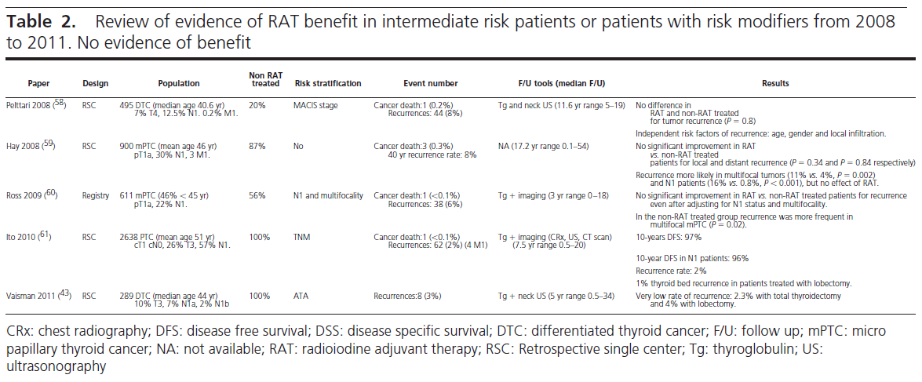

Slide 40
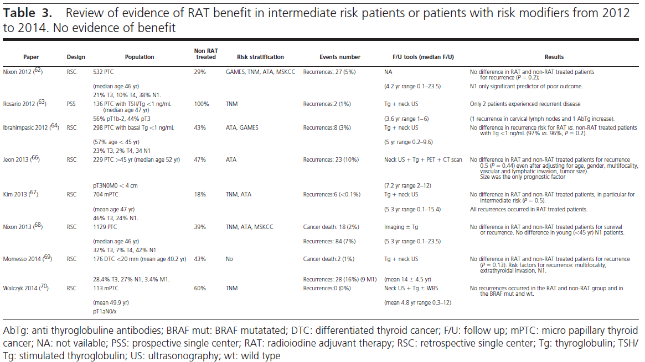

Slide 41
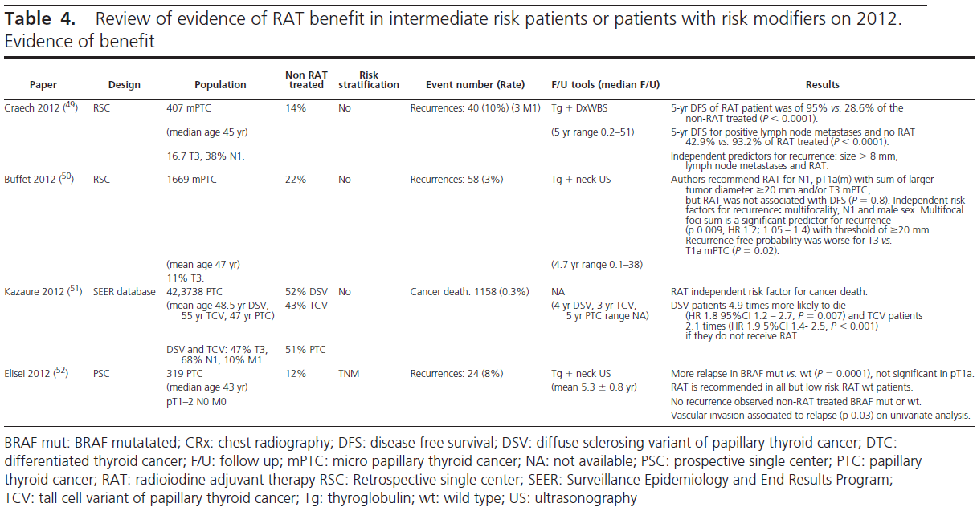

Slide 42
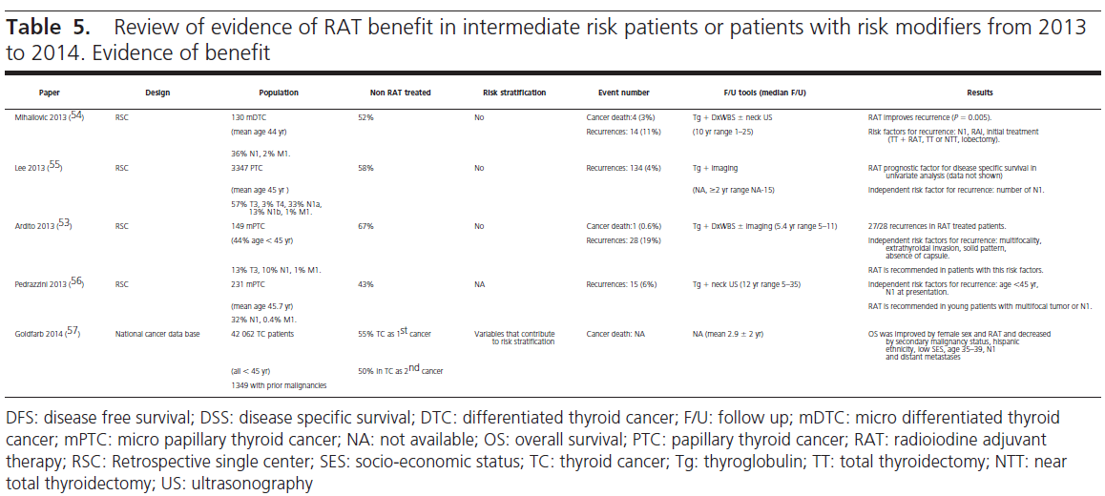

Slide 43
Side Effects of Radioiodine
Since the benefits of RRA are unproven in LR and some IR patients, the risk of adverse effects should play an important role in the decision making process.
A linear correlation was found for the risk of a second malignancy and the administered radioiodine activity; it was estimated that 100 mCi (3.7 GBq) of radioiodine will cause an excess of 53 solid malignancies and 3 leukemias in 10 000 patients over 10 years of follow-up.
The period of highest risk for a second malignancy In the first five years after radioiodine exposure
Younger patients particularly Susceptible.
ESPECIALLY with high cumulative activities ( 500–600 mCi)
Unfortunately relatively large administered activities are still being used for RRA, with no
evidence of benefit beyond that achieved with 30–50 mCi.

Slide 44
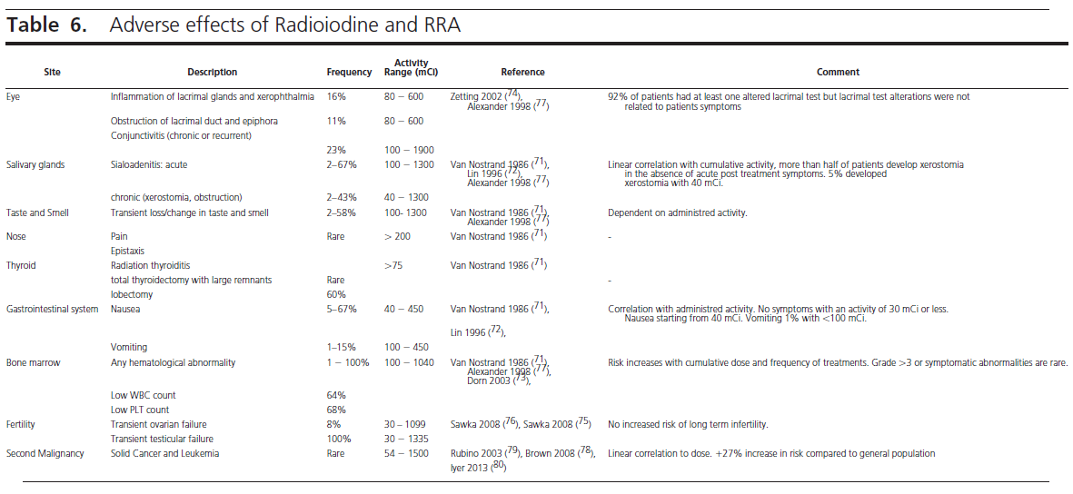

Slide 45
Effects of RRA on Quality of Life
Some topic of concerns:
1-Thyroid hormone withdrawal for remnant ablation was associated with a transient worsening of HRQoL compared to the use of recombinant human (rh)TSH.
2-There was a statistically significant correlation between the number of radioiodine therapies and the perception of illness, but not with the number of surgeries!!
4- The lower educational achievement worse perception of their disease.

Slide 46
Increased use of RRA
Increase in LR DTC incidence

Slide 47
Factors that currently influence RRA usage
Patient
Young age
Physician
Multiple tumor foci
worry
Higher socioeconomic status

Slide 48
is not much worse in many IR
Death rate in LR is close to zero
A significant knowledge gap

Slide 49
Patients recommendations for physician counseling about RRA(a qualitative study)
Explanation of rationale for or against RRA
In plain language the risk and benefits of RRA and the possibility of DR
Multidisciplinary team based approach and individualized care
Information pertinent to their care that is present in current clinical practice guidelines

Slide 50
Key messages
Non stimulated undetectable Tg (Tg ≤1 ng/ml ):
Very low rate of DR despite not receiving RRA

Slide 51
Key messages
1-With regard to early staging:
RxWBS discloses few metastatic foci in cervical nodes, whereas neck US has shown excellent NPV and accuracy .
M1 is rare and high or rising levels of Tg :further investigation
2-With regard to DR:
No benefit from RAT has been shown for LR patients in prevention of DR.
In IR patients, or in the presence of risk modifiers such as multifocality or an adverse genetic profile, the benefit of RRA in DR prevention remains controversial.
Microscopic extrathyroidal invasion, alone are not a sufficient argument for RRA.

Slide 52
Key messages
3-With regard to N1 status:
The location, number, size and the presence of extrathyroidal extension of metastatic lymph nodes, rather than the presence or absence of N1, are key features for DR risk estimates.
4-The presence of BRAF mutation in PTC has been associated with a worse outcome, but the association is not independent from other tumor features.
5-No advantage of RRA in LR patients, but
unable to provide conclusive data for or against RRA DR prevention in IR patients.
for IR patients, no defined recommendation for or against RRA is made.

Slide 53
Key messages
6- A careful evaluation of the whole range of “aggressive” features of the tumor and patient characteristics (eg, age) and not a single element should guide RRA decision making.
Patients should be properly informed and share in the decision to use RRA.
7-When RRA is considered, low activities (eg, 30 mCi) and rhTSH preparation should be preferred in order to minimize side effects and QoL impairment.
8-The use of high radioiodine activities in order to reduce disease specific death rates in LR patients are at odds with the current literature and the tendency of the international evidence based guidelines towards selective use of RRA with low activities. NO improve DFS or DSM in patients <45 years BUT
In low risk patients > 45 years of age, there were no differences in recurrence rates, but DSM was higher in those patients who initially received <54 mCi (2000 MBq) vs. those who received >54 mCi, patient age remains an important factor in the decision making process.

Slide 54
Key messages
US and basal Tg measurement as areliable alternative to RRA:
If Tg levels rise or suspicious findings on physical examination or neck US appear, restaging is warranted and RRA could be considered.
An undetectable serum Tg especially in a high sensitivity Tg assay and negative neck US 6–12 months after surgery should enable many LR and IR patients to be categorized as being “free of disease”, despite not having undergone RRA.

Slide 55
Key messages: Ongoing studies
Low OR very low DR rates; then only
Prospective randomized trials can provide a reliable answer
Estimabl2/IoN STUDY

Slide 56
Agenda
1-Introduction
2-Is radioactive iodine therapy prevent recurrence?
3-Is radioactive iodine therapy improve survival in these group?
4-when to use radioiodine and how to select the dose?
5-Rapid ATA recommendations review
6-Conclusion

Slide 57
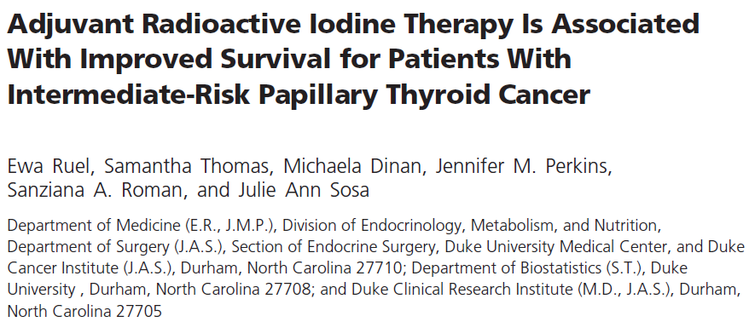

Slide 58
Objective: To examine the impact of RAI on overall survival in patients with intermediate-risk PTC.
Design: Adult aged 18 years or older with intermediate -risk PTC who underwent total thyroidectomy with/without RAI 1998-2006
Follow up time: 6.8 years
Primary Outcome measures: Overall Survival(OS) for patients treated with and without RAI using univariate and multivariate regression analysis.
Secondary Outcome: Evaluation of impact of RAI on survival differently among intermediate-risk patients who are younger (< 45 y) vs. older (≥ 65 y).

Slide 59
Data
The National Cancer Database (NCDB) is maintained jointly by the National Cancer Society and the American College of Surgeons Commission on Cancer.

Slide 60
The intermediate risk group was defined according to ATA risk criteria and American Joint Commission on Cancer (AJCC)
Inclusion:
Tumor size greater than 4 cm or any size tumor with a minimal extrathyroidal extension and with no evidence of cervical lymph node metastases (T3, N0, M0, or Mx) .
Tumor size 4 cm or less who had metastatic cervical lymph nodes (T1–3, N1,M0,orMx).
Exclusion:
1-Aggressive variants of papillary thyroid cancer, such as tall cell, columnar, sclerosing and insular variants, Hürthle cell, and medullary and other poorly differentiated thyroid cancers.
2-Patients with more than one primary cancer .
3- Missing data for some variables in the NCDB.

Slide 61
Study variables
Patient demographic and clinical variables:
Age, gender, race, education, insurance status, and year of diagnosis.
Provider variables :Hospital type and location.
Pathological and clinical characteristics :
Tumor size, lymph node status, RAI administration (yes/no), and margin status.

Slide 62
Results
PTC patients: n=71 222
Intermediate risk : n=21 870 (31%)
Received RAI: n= 15 418 (70.5%)
Did not receive RAI :n=6452 (29.5%)
Proportion of multifocal tumors in Patients who received RAI vs those who did not : (51% vs 47%, respectively),
Lymph node involvement (74% vs 68%),
Positive surgical margin status (19% vs 15%),
(all P<.01).

Slide 63
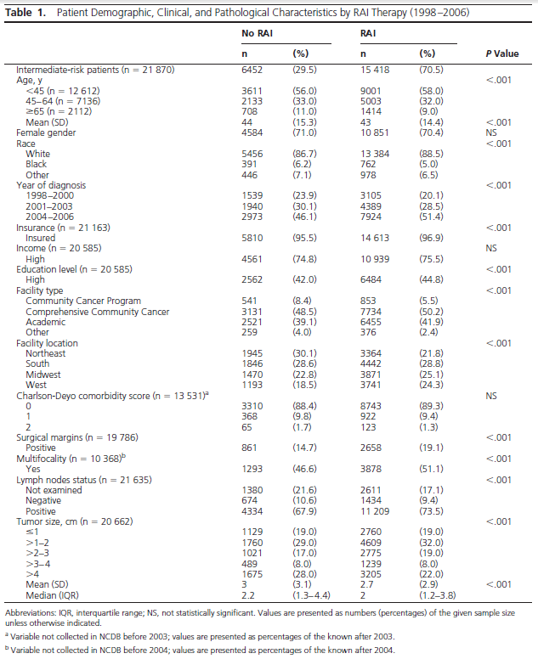

Slide 64
Deaths in the RAI group 730 (5%)
In the no RAI group 424 (7%) (P < .001).
RAI administration was associated with improved OS in all patients

Slide 65
12 612 patients subgroup analysis by age ( yonger than 45 years).
9001 (71.4%) received RAI.
109(1%) deaths in the RAI group
66 (2%) deaths in the no RAI group (P = .007).
RAI was associated with improved OS in patients younger than 45 years, as demonstrated by Kaplan-Meier survival curves
(log-rank P =.002)
censor rate 99%

Slide 66
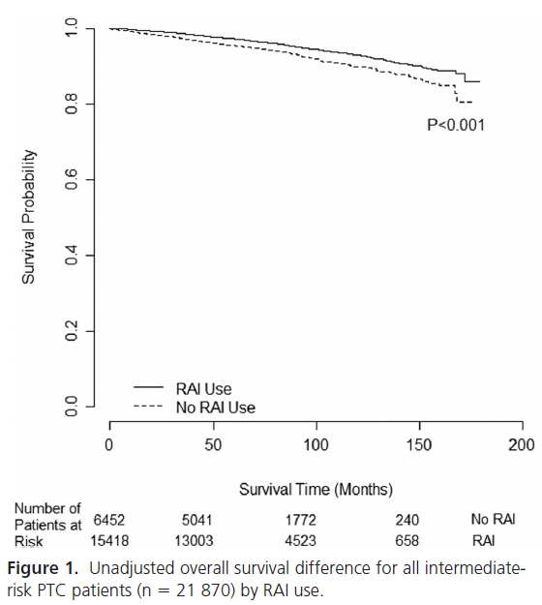
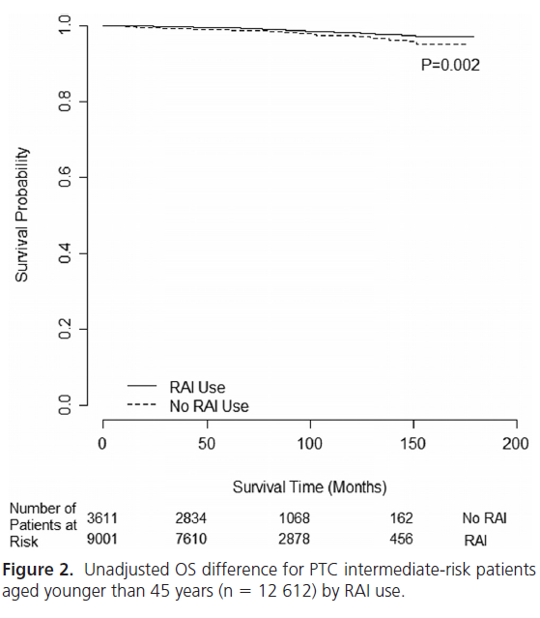

Slide 67
2122 patients subgroup analysis by age ( 65 years or older).
1414 (66.6%) received RAI.
379 (27%) deaths in the RAI group
222 (31%) deaths in the no RAI group (P = .028)
RAI was associated with improved OS in patients 65 years old or older as demonstrated by Kaplan- Meier survival curves.

Slide 68
65 years or older patients
Sencor rate
73%
Median OS with RAI
140 months
Median OS
Without RAI
128 months
log-rank P
0.008

Slide 69
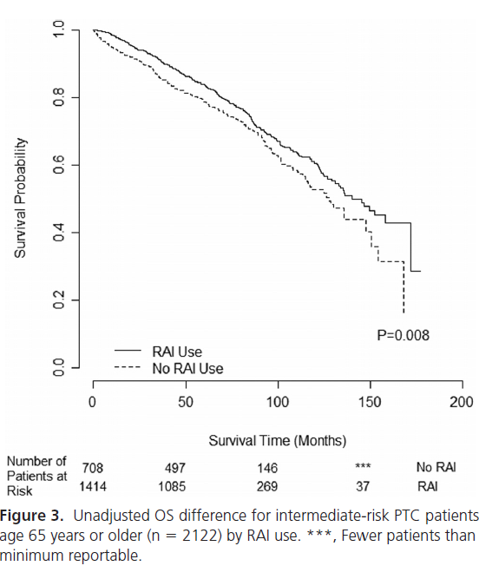

Slide 70
Multivariate adjustment for patient demographic and clinical factors
RAI was associated with a 29% reduced risk of death {HR) 0.71, (CI) 0.62–0.82, P < .001}.
Patient factors associated with compromised
OS:
Older patient age, male gender, and black race .

Slide 71
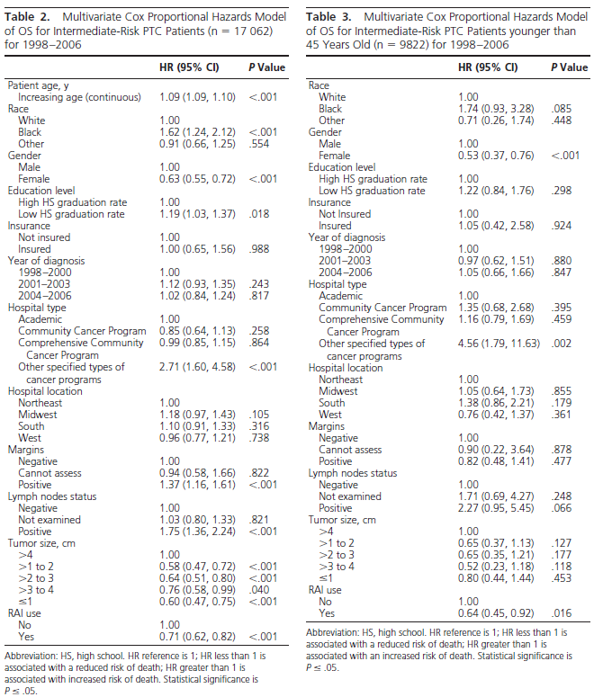

Slide 72
The pathological and clinical factors associated with compromised OS:
1- Larger tumor size
2-Lymph node metastases
3 -Positive surgical margins
4- Lack of RAI therapy (all P≤.01).
Subanalysis for patients age younger than 45 years RAI was associated with a 36% reduced risk of death [HR 0.64 (CI 0.45–0.92), P = .016].
Patient factor associated with compromised OS for patients younger than 45 years included male gender .

Slide 74
Key Messages
The decision to treat is based on clinical judgment, with particular weight placed on:
1- Patient age
2-Histology
3-Size of tumor
4- Status of lymph node metastases
In combination with other potential risk factors, such as the presence of vascular invasion and tumor multifocality .
Patients with larger tumors and those who are older may benefit from RAI, although specific tumor size and clinical cutoffs differ.

Slide 75
Key Messages
A 29% reduced risk of death in multivariate analyses when RAI was administered in the postoperative setting.
Subanalysis of those patients aged younger than 45 years revealed a 36% reduced risk of death on multivariate analysis.
RAI is associated with improved OS in intermediate-risk patients with papillary thyroid cancer.

Slide 76
Key messages
36% reduced risk of death for patients aged younger than 45 years
29% reduced risk of death with RAI therapy [HR 0.71 (CI 0.62–0.82)] in an adjusted analysis for all intermediaterisk patients

Slide 77
Agenda
1-Introduction
2-Is radioactive iodine therapy prevent recurrence?
3-Is radioactive iodine therapy improve survival in these group?
4-when to use radioiodine and how to select the dose?
5-Rapid ATA recommendations review
6-Conclusion

Slide 78
Initial Radioiodine Administration ,When to Use It and How to Select the Dose Giuseppe Esposito, MD
Department of Radiology, Medstar Georgetown University Hospital, 3800 Reservoir Road NW,
Washington, DC 20007, USA
Endocrinol Metab Clin N Am 43 (2014) 385–400

Slide 79
Reviews the current clinical guidelines, with the intent to provide a reference framework for an individualized use of radioactive iodine in the management of well-differentiated thyroid cancer.
Endocrinol Metab Clin N Am 43 (2014) 385–400

Slide 80
Up to 30% of the patients with well-differentiated thyroid cancer may develop recurrence over several decades from diagnosis according Mazzaferri and Jhiang.
More than 66% of the recurrences occur within the first decade.
More frequently in cervical lymph nodes (74%), in thyroid remnants(20%), and in distant metastases (21% of the recurrences, mostly in the lungs).
50% of the patients with distant metastases died of thyroid cancer.
Endocrinol Metab Clin N Am 43 (2014) 385–400

Slide 81
What’s the role of pretreatment WBS?
Whole-body planar or tomographic (single-photon emission computed tomography[SPECT])
Verify the presence of uptake in the thyroid bed and to quantify the amount of uptake as a measure of the amount of postoperative residual functioning thyroid tissue.
To look for the presence of local cervical lymph node or distant functioning metastases.
Using low doses of either 131-I or 123-I (typically between 2 and 5 mCi
Endocrinol Metab Clin N Am 43 (2014) 385–400

Slide 82
Discordant opinions in the literature as to whether a diagnostic scan is needed before radioiodine treatment.
Omitting the pretreatment diagnostic scan:
1-Undertreating patients with metastases recognizable only with the diagnostic scan.
2- sometimes surgeons are able to remove all thyroid tissue with no residual uptake identified on the diagnostic scan; these patients can be safely spared a 131-I treatment dose.
May alter management.
In patients with very low risk for metastatic disease whereby remnant ablation is the goal of 131-I treatment, it might be reasonable to omit the pretreatment scan.
Endocrinol Metab Clin N Am 43 (2014) 385–400

Slide 83
Diagnostic SPECT/CT scans :
Detected regional metastases in 35% of patients
Distant metastases in 8% of patients.
pre-ablation scans with SPECT/CT contribute to staging of thyroid cancer.
Endocrinol Metab Clin N Am 43 (2014) 385–400

Slide 84
rTSH-rhTSH
There was no difference in the ablation effectiveness between the rhTSH approach and hormone withdrawal at an ablation dose of 100 mCi (3.7 GBq), and a similar results for 50-mCi (1.85 GBq) ablation doses.
But
rhTSH stimulation showed a favorable 33% lower whole-body radiation dose.
In contraindications to induced hypothyroidism(eg, the elderly, depression, congestive heart failure), rTSH may be administered.
Endocrinol Metab Clin N Am 43 (2014) 385–400

Slide 85
Low-Iodine Diet
Patients should follow a low-iodine diet for 1 to 2 weeks
before and for at least 1 day after 131-I is administered, as also recommended by the ATA’s guidelines.
Endocrinol Metab Clin N Am 43 (2014) 385–400

Slide 86
Minimization of side effects
Hydration with large volumes of fluids facilitates the rapid renal excretion of the radioactive iodine
Antiemetics before treatment administration.
The use of sialagogues, such as lemon juice or lemon candies, is controversial .
The radioprotectant amifostine administered before 131-I administration seems to decrease symptoms and can be useful particularly for repeated treatments.
Temporary oligospermia
Brief amenorrhea
Hydration with large amount of fluids and frequent voiding of the bladder is helpful to minimize radiation dose to the gonads.
Endocrinol Metab Clin N Am 43 (2014) 385–400

Slide 87
A large epidemiologic study conducted in the United States by the National Cancer Institute reported an excess of 6.39 cases every 10,000 person-years in the absolute risk for secondary malignancies .
Endocrinol Metab Clin N Am 43 (2014) 385–400

Slide 88
A second large epidemiologic study conducted in Europe:
Developing secondary malignancies of the soft tissues, bones, female genital organs, leukemia, and central nervous system among 6840 patients treated for thyroid cancer with a mean cumulative administered activity of 162 mCi (6 GBq).
A meta analysis of these 2 large studies confirmed a 1.19 excess risk of secondary malignancies in patients treated with radioactive iodine.
Endocrinol Metab Clin N Am 43 (2014) 385–400

Slide 89
There is a dose-related incidence of side effects; therefore, for each individual patient, a careful assessment of the benefits versus risks of radioactive iodine treatment must be conducted.
Endocrinol Metab Clin N Am 43 (2014) 385–400

Slide 90
How to select the dose?
The equivalence in successfully ablating thyroid tissue of 30 and 100 mCi doses (1.1 and 3.7 GBq,respectively).
30 to 50 mCi (1.1–1.8 GBq) of 131-I for lower-risk patients. (patients younger than 45 years with tumors between 1 and 2 cm confined to the thyroid gland).
For Intermediate-Risk Patients:
Adjuvant Treatment
Higher activities of 75 to 100 mCi (2.8–3.7 GBq) 131-I for patients at an intermediate risk (microscopic capsular invasion, aggressive histology, T >2 cm with no capsular invasion).
Endocrinol Metab Clin N Am 43 (2014) 385–400

Slide 91
For High-Risk Patients: Treatment of Residual or Metastatic Disease
Patients at higher risk for local disease recurrence or those that have macroscopic residual disease or distant metastases 150 and 200 mCi (5.6–7.4 GBq).
These patients will receive a pretreatment scan, typically with rhTSH or hormone withdrawal. For those patients with scan evidence of residual postoperative disease in the thyroid bed or in cervical lymph nodes, approximately 150 mCi 131-I (5.550 GBq).
Endocrinol Metab Clin N Am 43 (2014) 385–400

Slide 92
Patients that demonstrate a large amount of lymph node disease should be referred back to the surgeon for possible completion of neck dissection.
Radioiodine treatment would then follow 6 to 8 weeks after surgery.
Pulmonary metastases and/or skeletal metastases: don’t exceed 150 mCi (5.5 GBq) unless specifically guided by dosimetry and particularly for elderly patients.
Endocrinol Metab Clin N Am 43 (2014) 385–400

Slide 93
Key message
Successfully abltion doesn’t need too much dose of radioiodine.
30-50 mci for lower risk patients
75-100mci for patients at an intermediate risk
150-200 for patients at higher risk
Endocrinol Metab Clin N Am 43 (2014) 385–400

Slide 94
Key messages
There is no difference in ablation effectiveness between the rhTSH and hormon withdrawal.
The side effects of Radioactive iodine are dose related then for each individual patients a careful assessment of the benefits versus risks of radioactive iodine treatment must be conducted.
Endocrinol Metab Clin N Am 43 (2014) 385–400

Slide 95
Agenda
1-Introduction
2-Is radioactive iodine therapy prevent recurrence?
3-Is radioactive iodine therapy improve survival in these group?
4-when to use radioiodine and how to select the dose?
5-Rapid ATA recommendations review
6-Conclusion

Slide 96
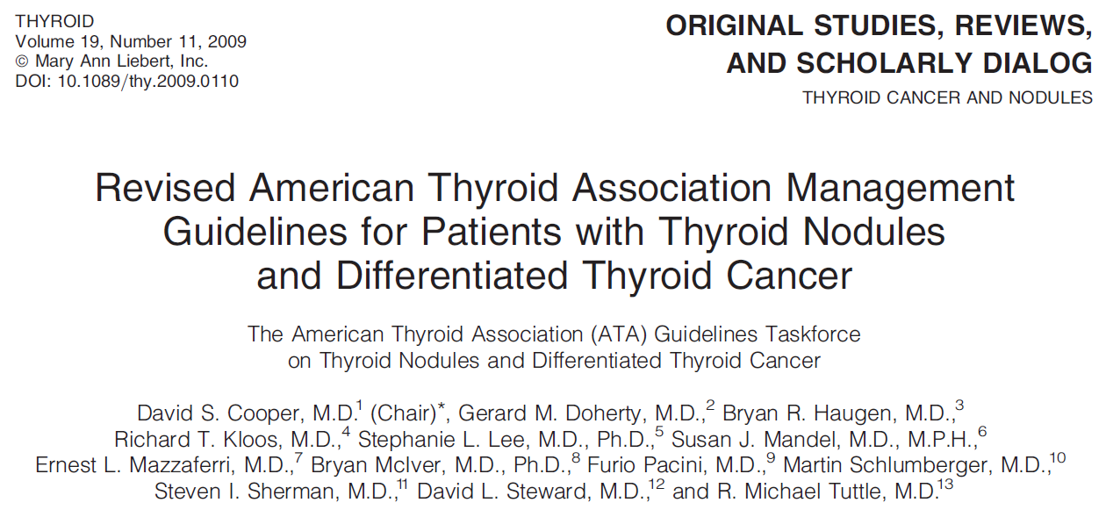
rv

Slide 97
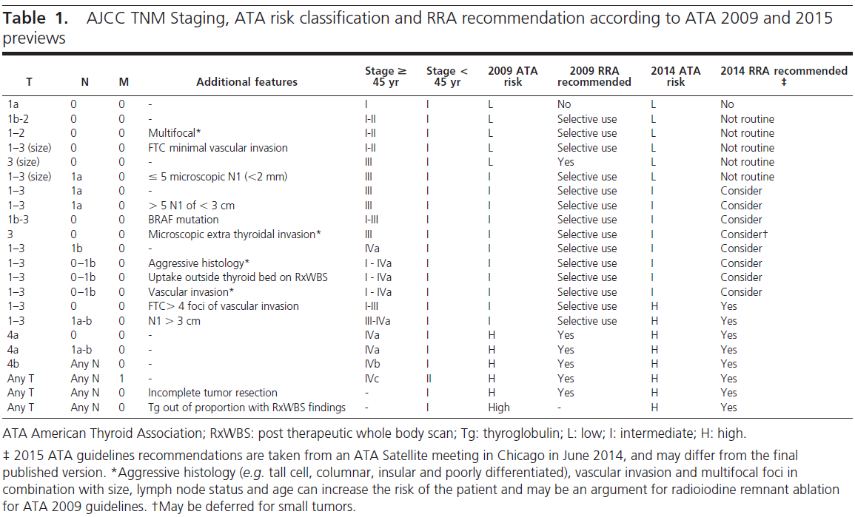

Slide 98
AJCC/UICC staging is recommended for all patients with DTC.
The use of postoperative clinico-pathologic staging systems is also recommended to improve prognostication and to plan follow-up for patients with DTC. Recommendation rating:B
THYROID
Volume 19, Number 11, 2009
© Mary Ann Liebert, Inc.
DOI: 10.1089/thy.2009.0110

Slide 99
1-Worrisome histologic subtypes (tall cell, columnar, insular, solid variants, poorly differentiated thyroid cancer),
2-Intrathyroidal vascular invasion
3-Gross or microscopic multifocal disease
RAI ablation is not recommended for all patients with these higher risk histologic features.
The presence of these features in combination with size of the tumor, lymph node status, and patient age may increase the risk of recurrence or metastatic spread .
RAI ablation in selected patients.
THYROID
Volume 19, Number 11, 2009
© Mary Ann Liebert, Inc.
DOI: 10.1089/thy.2009.0110

Slide 100
RAI ablation is recommended for all patients with
1-Known distant metastases.
2-Gross extrathyroidal extension of the tumor regardless of tumor size.
3- Primary tumor size >4 cm even in the absence of other higher risk features .
4- Selected patients with 1–4cm thyroid cancers confined to the thyroid, who have documented lymph node metastases, or other higher risk features when the combination of age, tumor size, lymph node status, and individual histology predicts an intermediate to high risk of recurrence or death from thyroid cancer.
Recommendation rating: C (for selective use in higher risk patients).
THYROID
Volume 19, Number 11, 2009
© Mary Ann Liebert, Inc.
DOI: 10.1089/thy.2009.0110

Slide 101
RAI ablation is not recommended for patients with unifocal cancer <1 cm without other higher risk features . Recommendation rating: E
RAI ablation is not recommended for patients with multifocal cancer when all foci are <1 cm in the absence other higher risk features. Recommendation rating: E
THYROID
Volume 19, Number 11, 2009
© Mary Ann Liebert, Inc.
DOI: 10.1089/thy.2009.0110

Slide 102
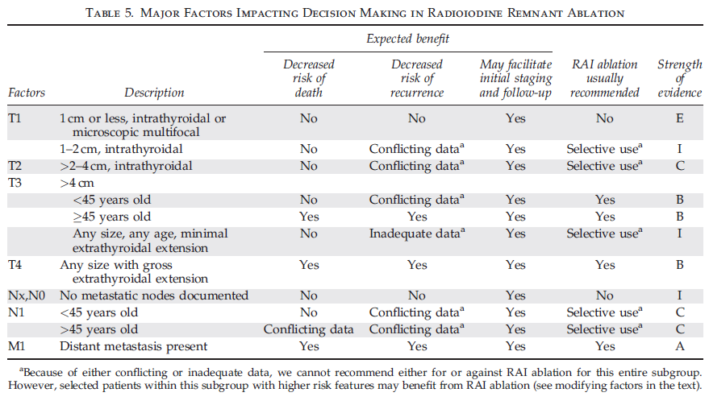
THYROID
Volume 19, Number 11, 2009
© Mary Ann Liebert, Inc.
DOI: 10.1089/thy.2009.0110

Slide 103
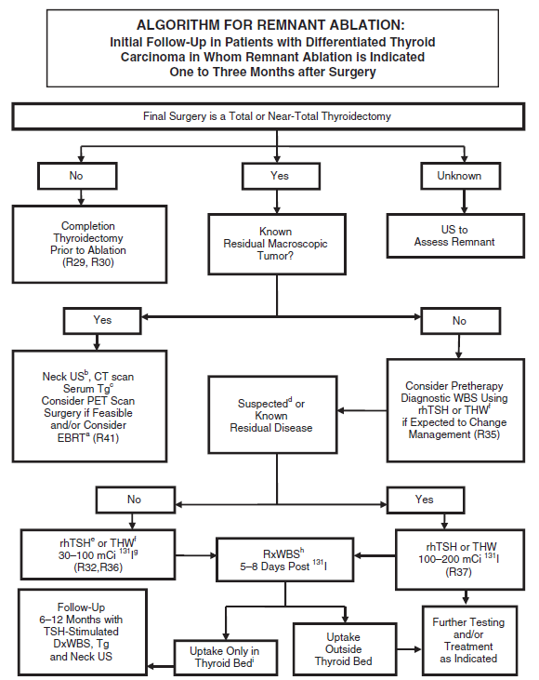

Slide 104
What activity of I should be used?
Activities between 30 and 100 mCi of ¹³¹I generally show similar rates of successful remnant ablation and recurrence rates.
The minimum activity (30–100 mCi) necessary to achieve successful remnant ablation should be utilized, particularly for low-risk patients. Recommendation rating: B
If residual microscopic disease is suspected or documented, or if there is a more aggressive tumor histology (e.g., tall cell, insular, columnar cell carcinoma), then higher activities (100–200 mCi) may be appropriate. Recommendation rating: C
A post therapy scan is recommended following RAI remnant ablation. This is typically done 2–10 days after the therapeutic dose is administered, although published data supporting this time interval are lacking. Recommendation rating: B
THYROID
Volume 19, Number 11, 2009
© Mary Ann Liebert, Inc.
DOI: 10.1089/thy.2009.0110

Slide 105
TSH suppression to below 0.1mU/L may improve outcomes in high-risk thyroid cancer patients , though no such evidence of benefit has been documented in low-risk patients.
Suppression of TSH was not beneficial in patients with stage I disease.
Initial TSH suppression to below 0.1mU/L is recommended for high-risk and intermediate-risk thyroid cancer patients, while maintenance of the TSH at or slightly below the lower limit of normal (0.1–0.5mU/L) is appropriate for low-risk patients.
Similar recommendations apply to low-risk patients who have not undergone remnant ablation, i.e., serum TSH 0.1–0.5mU/L. Recommendation rating: B
THYROID
Volume 19, Number 11, 2009
© Mary Ann Liebert, Inc.
DOI: 10.1089/thy.2009.0110

Slide 106
Agenda
1-Introduction
2-Is radioactive iodine therapy prevent recurrence?
3-Is radioactive iodine therapy improve survival in these group?
4-when to use radioiodine and how to select the dose?
5-Rapid ATA recommendations review
6-Conclusion

Slide 107
Conclusions
An undetectable serum Tg especially and negative neck US 6–12 months after surgery should enable many LR and IR patients to be categorized as being “free of disease”, despite not having undergone RRA.
RAI is associated with improved OS in intermediate-risk patients with papillary thyroid cancer.

Slide 108
Conclusions
For microscopic multifocal papillary cancer, when all foci are <1 cm ,RAI is of no benefit in preventing Recurrence .
RAI ablation may not be required for all patients with poor histological diagnosis .
Neck US has shown excellent NPV and accuracy in detecting the nodes.
No benefit from RAT has been shown for LR patients in prevention of DR.
In IR patients, or in the presence of risk modifiers such as multifocality or an adverse genetic profile, the benefit of RRA in DR prevention remains controversial.

Slide 109
Conclusions
No advantage of RRA in LR patients, but
unable to provide conclusive data for or against RRA DR prevention in IR patients.
For IR patients, no defined recommendation for or against RRA is made.

