Slide 1
Mixed Insulins
A Amouzegar MD
Research Institute For Endocrine Sciences , Shahid Beheshti University

Slide 2
Agenda
Introduction
Human Vs. analouges premixed
Premix vs. basal insulin
Premix Vs. Basal bolus
conclusion

Slide 3
“patient-centered” approach
Individualizing therapy and goals for pts With T2DM
The individualized targets should take into account not only clinical conditions, such as relevant comorbid conditions, age, duration of diabetes, and history of severe hypoglycemia, but also the patient-specific psycho-socioeconomic context

Slide 4
Which regimen will be the best for the patient?

Slide 5
Which Insulin
Studies comparing initiation of basal insulin analogs versus premix insulin analogs did not help to define which pts are better suited to each treatment arm
The results of the presence studies are not conclusive in demonstrating that one insulin regimen is better than the other
Owing to their design and size, most studies are not able to define which subgroups of patient will benefit more from the premix or basal insulin regimen

Slide 6
Cont
Pts despite high HbA1c, the FBS is relatively low (150 mg/dl), PP glucose is relatively high, premix insulin might demonstrate better efficacy and safety
HbA1c > 8.5% the stronger effect of premix over basal insulin in HbA1c reduction
Pts with lower compliance benefits

Slide 7
The ADA/EASD for choosing or adjusting insulin regimens:
The number of injections
The complexity
The flexibility
Individuals specific therapy goal
Is not a single step or one - way direction

Slide 8
To normalise blood glucose both FPG and PPG must be reduced
Most insulin is initiated when HbA_{1c} >8.5%
100
PPG
80
40%
30%
FPG
% contribution to HbA_{1c}
50%
45%
60
70%
40
70%
50%
55%
60%
20
30%
0
<7.3
7.3–8.4
8.5–9.2
9.3–10.2
>10.2
HbA_{1c} range (%)
Adapted from Monnier L et al. Diabetes Care 2003;26:881–5
Notes:
In order to normalise blood glucose, there is a need to address both fasting and post prandial glucose abnormalities. As patients get closer to HbA1c targets, the relative importance of PPG increases.

Slide 9
Insulin therapy options Primary care physicians are often puzzled by the many options available
Prandial insulin supplementation
Basal insulin administration
Premixed formulations
Basal-plus /bolus regimen

Slide 10
Premix insulins
Biphasic Human insulin (Regular + same attached to protamine )
Insulin analogues (Insulin Aspart 70/30, Lispro 75/25 and 50/50)

Slide 11
NovoMix® 30
Biphasic insulin aspart 30 (NovoMix® 30) comprises:
30% soluble, rapid-acting insulin aspart
70% protaminated insulin aspart, which is intermediate-acting
Notes:
In NovoMix 30, insulin aspart is given as a mix of 30% soluble (free) molecules and 70% protaminated (crystallised) molecules.
The transfer of protamine groups between insulin molecules does not matter as the ratio of free and protaminated insulin aspart molecules remains constant.
NovoMix 30 allows the provision of both prandial and basal insulin in a single injection.

Slide 12
Pros and Cons : Premix insulins
No need for self mixing
Minimizing dosing error
Less injections (attractive alternative to basal bolus)
Fixed ratio (Less flexibility)

Slide 13
The dual-release insulin concept
Physiological insulin profile:
- meal-related peak
- basal component
Profiles are schematic
Rapid-acting insulin analogue together with a basal insulin analogue provide physiological insulin replacement
Premix analogues such as NovoMix® 30 mimic physiological insulin secretion
Physiological insulin profile
Soluble insulin aspart
Protamine crystallised insulin aspart
NovoMix® 30

Slide 14
Outcomes
All trials reported intermediate outcomes
FBS, postprandial glucose, HbA1c
The adverse outcome of weight gain, hypoglycemia
No studies that were specifically designed to evaluate clinical outcomes such as microvascular and macrovascular complications and death

Slide 15
Ann Intern Med. 2008;149:549-559

Slide 16
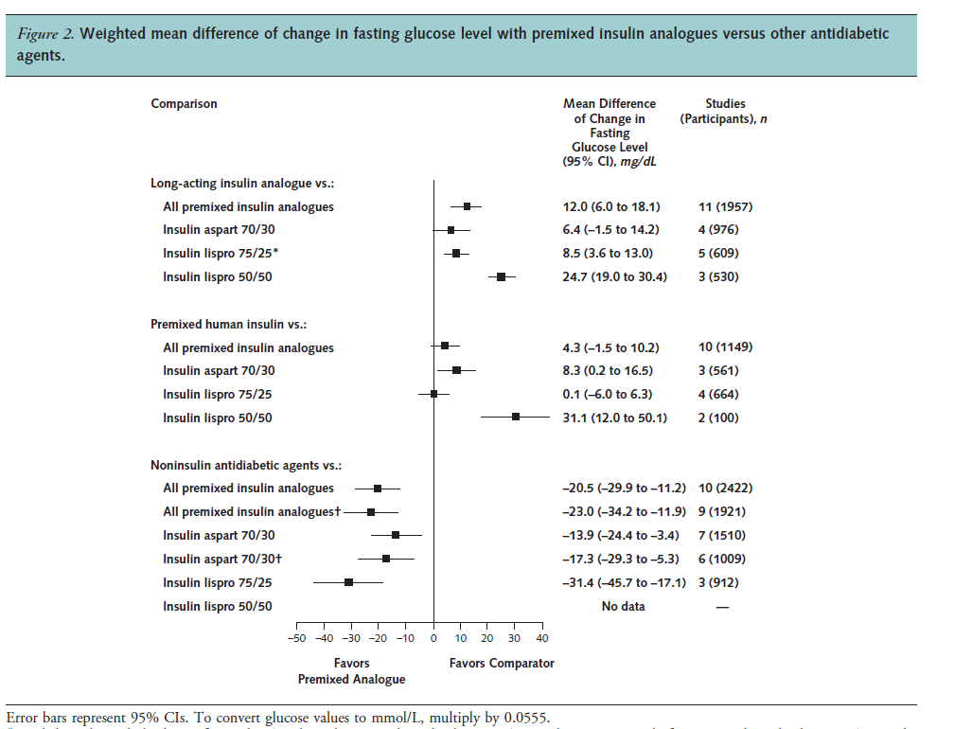
Long- acting Insulin
Premix human Insulin

Slide 17
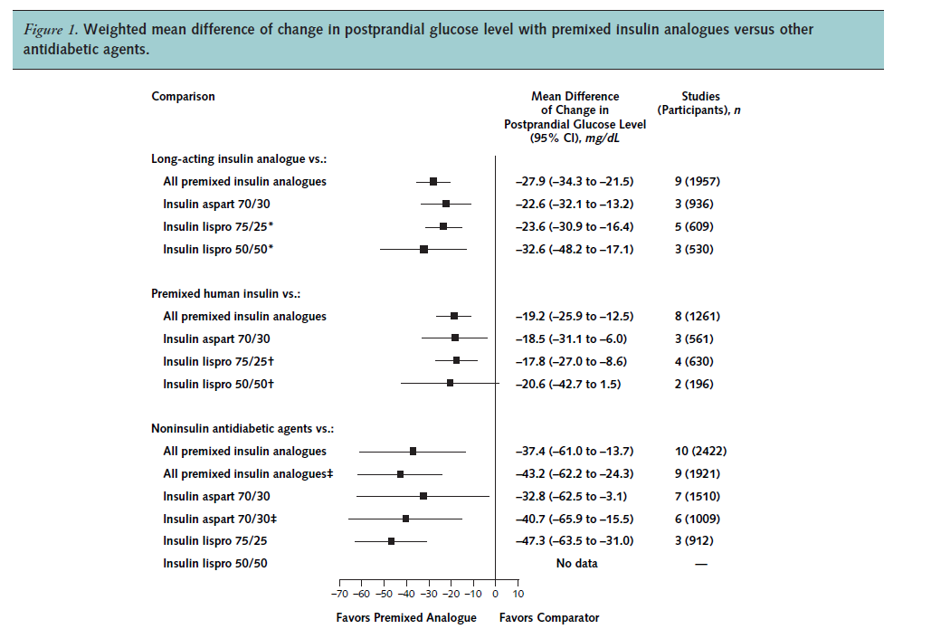
Premix human Insulin

Slide 18
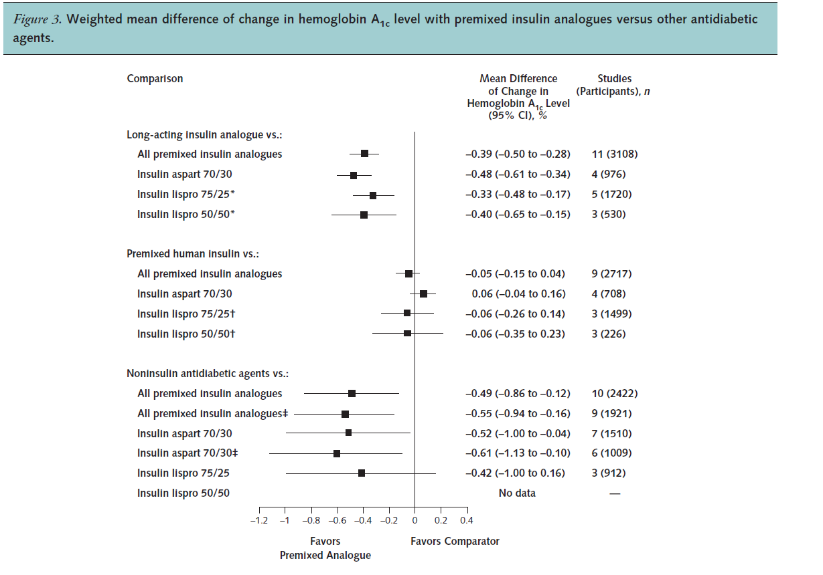
Premix human Insulin

Slide 19
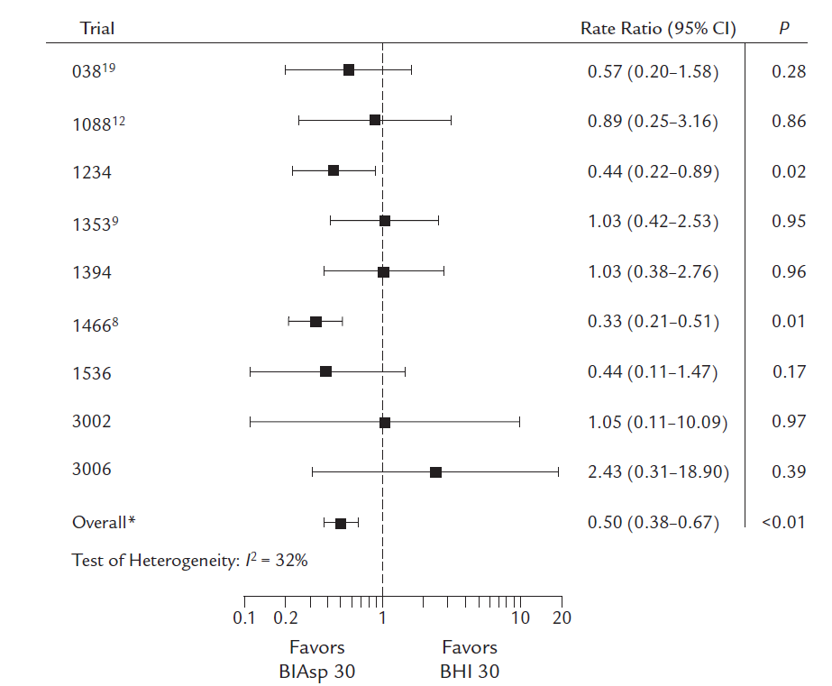
Meta-analysis of nocturnal hypoglycemia in patients with T2DM treated with biphasic insulin BIAsp 30 or BHI 30
BIASP 30 had 50% lower rate of nocturnal hypoglycemia
Clin Ther 2009 Aug;31(8):1641-51.

Slide 20
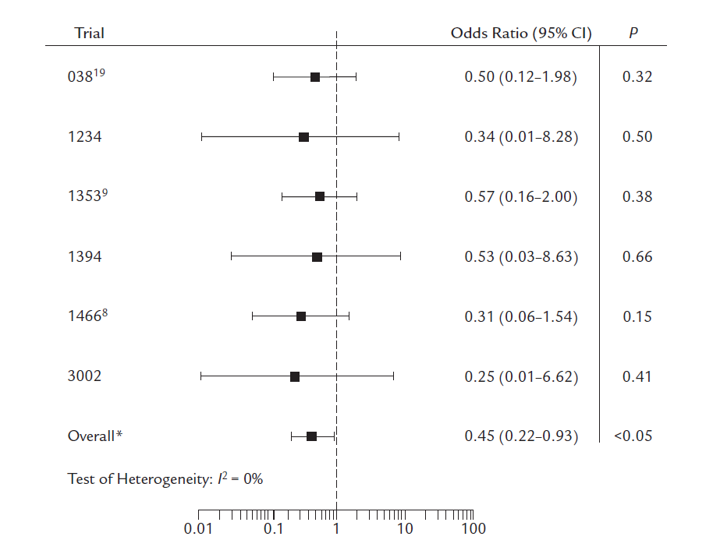
Meta-analysis of major hypoglycemia in patients with type 2 diabetes mellitus treated with BIAsp 30 or BHI 30
BIASP 30 had 55% lower rate of majorl hypoglycemia
Clin Ther 2009 Aug;31(8):1641-51.

Slide 21
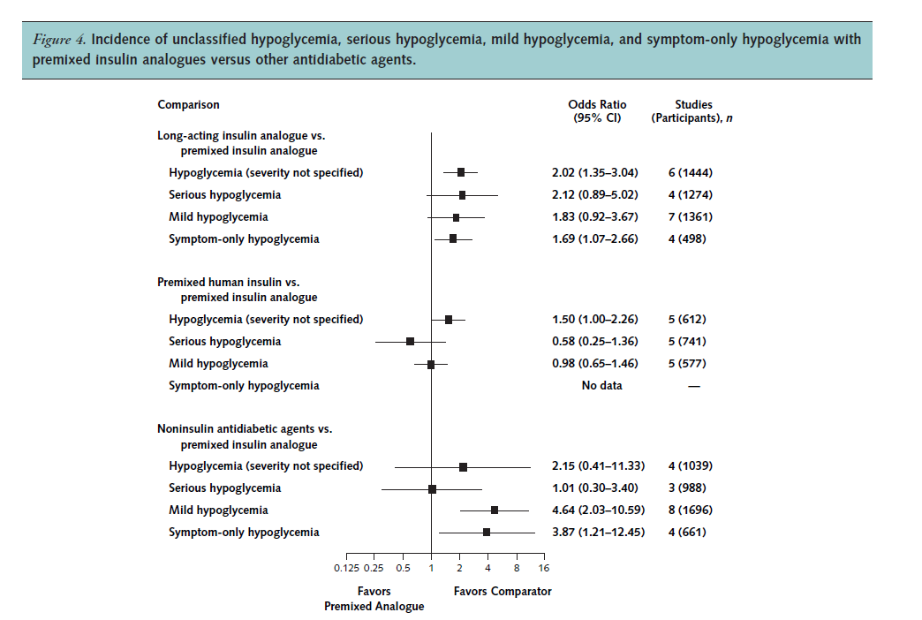

Slide 23
Key massage
Premixed insulin analogues provide glycemic control similar to that of premixed human insulin
It may provide better glycemic control than long-acting insulin analogues
No difference in overall hypoglycemia but less noctyrnal and major hypoglycemia in insulin analogues

Slide 24
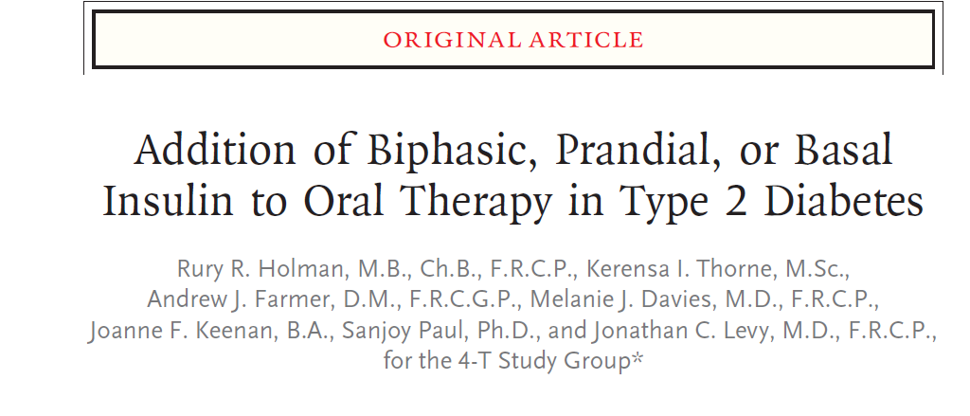

Slide 25
Methods
Open-label, controlled, randomly assigned 708 pts with a HbA1C level (7.0 to 10.0%) who were receiving maximally tolerated doses of Met+SU
Biphasic insulin aspart twice daily, prandial insulin aspart 3 times daily, or detemir once daily
Outcome measures at 1 year were HbA1C level,, the rate of hypoglycemia, and weight gain

Slide 26
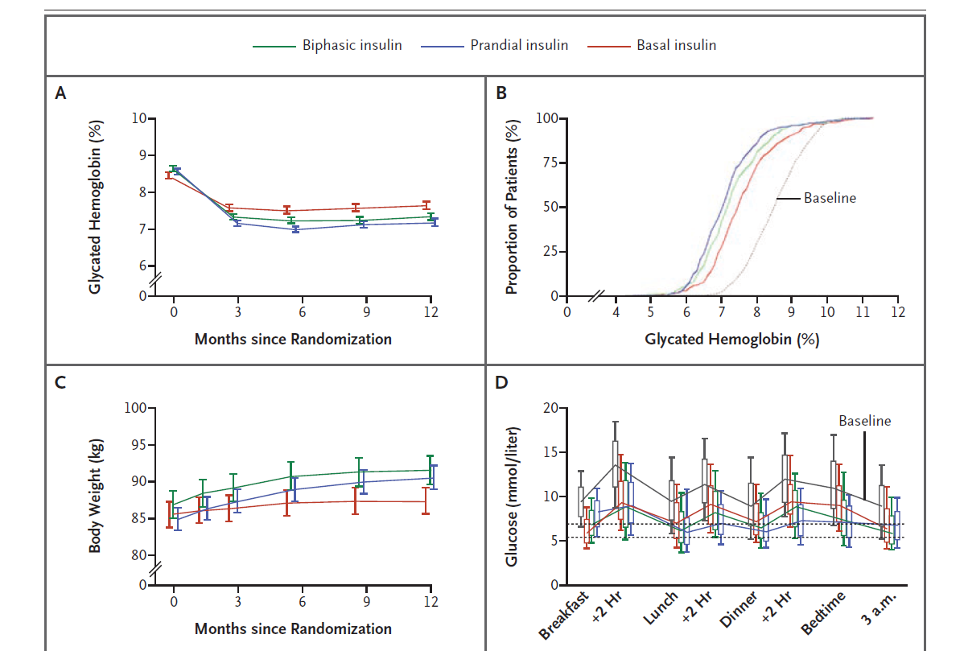
Reduction from baseline
1.3% in the biphasic
1.4% in the prandial
0.8% in the basal
HbA1C≤ 6.5%
biphasic group17.0%
prandial group 23.9%
Basal 8.1%
prandial > biphasic> basal

Slide 27
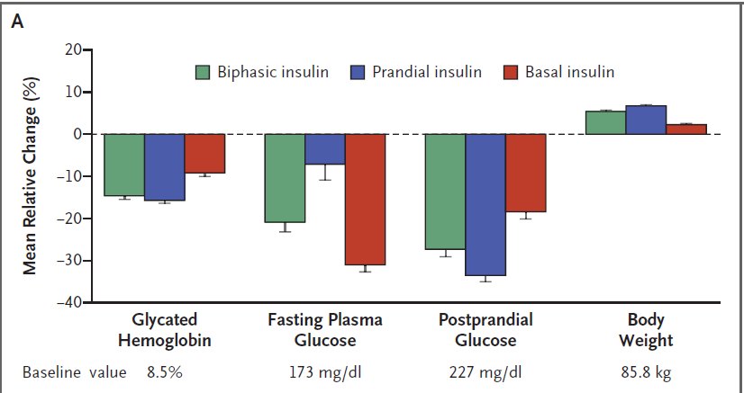
Mean (±SE) Percentage Change from Baseline to 1 Year in HbA1C, Fasting Plasma Glucose, Postprandial Glucose, and Body Weight

Slide 28
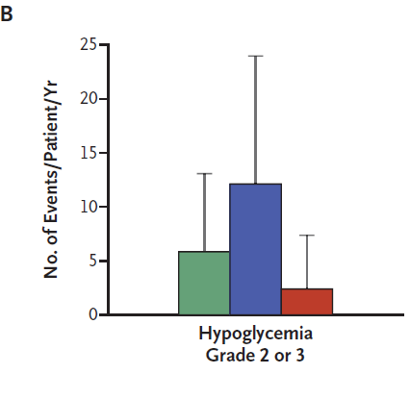
Mean (+SD) Hypoglycemic-Event Rate
prandial > biphasic>basal

Slide 29
Key massage
Biphasic and prandial regimens lowered HbA1C to the same extent and to a greater degree than the basal regimen
No significant differences were seen among the groups for pts with a baseline HbA1C level of≤ 8.5%
Increased risk of hypoglycemia, particularly with the biphasic and prandial

Slide 30
premix insulin analogs versus basal plus and basal-bolus regimens

Slide 31
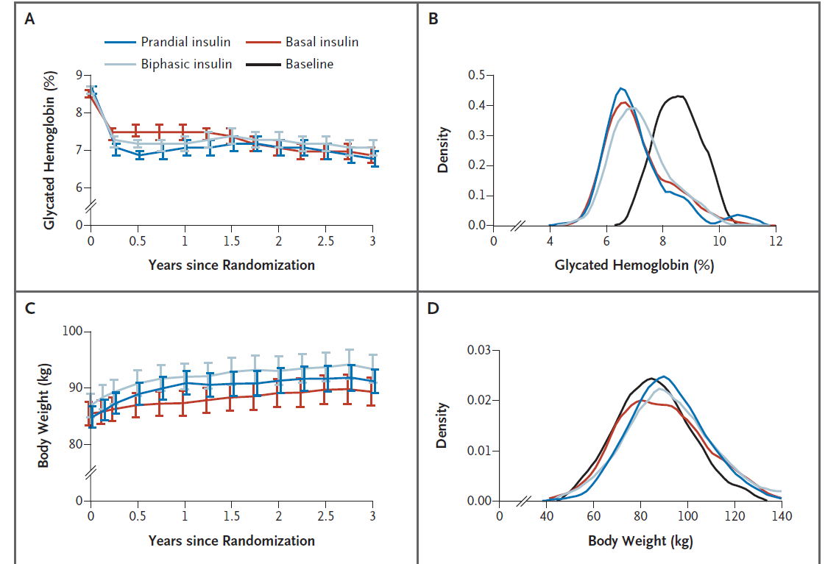
All gained
Biphasic=prandial>basal

Slide 32
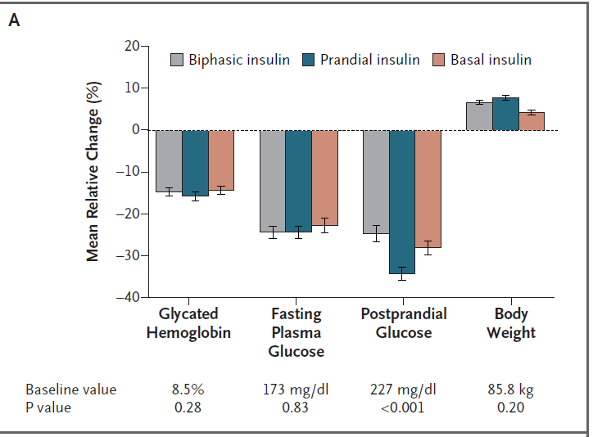
Changes from Baseline to 3 Years in Glycated Hemoglobin, Fasting
*

Slide 33
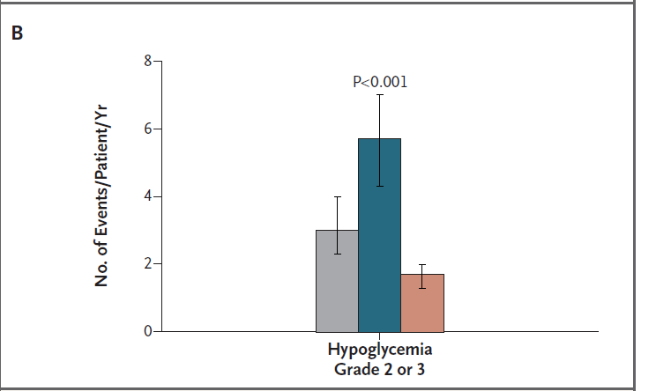
Rate of Hypoglycemia

Slide 34
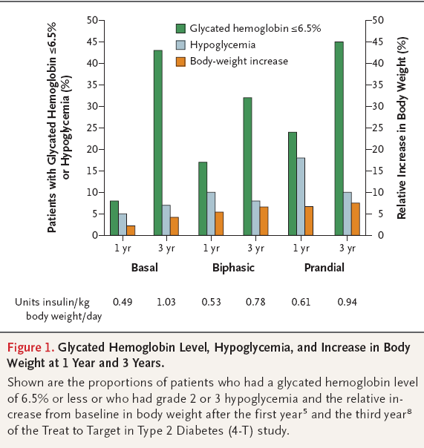

Slide 35
Conclusion
Achieved HbA1C was similar in all three groups, with fewer pts achieving glycemic targets in the biphasic group than in either the prandial group or the basal group

Slide 36
Intensification of insulin therapy with basal-bolus or premixed insulin regimens in type 2 diabetes: a systematic review and meta-analysis of randomized controlled trials
Giugliano D, Chiodini P, Maiorino MI, Bellastella G, Esposito K. Endocrine 2016;51:417–428
Only RCTs,13 ,T2DM,,
Giugliano et al. Endocrine 2016;51:417–428

Slide 37
Outcomes measurements
Examine whether there is an advantage, in terms of glycemic control, hypoglycemia, weight gain, or insulin dose, of using BB compared with premixed insulin regimens in patients with T2DM
Primary outcome:
The difference in mean decrease in the HbA1c level at the endpoint
Secondary outcomes:
The percentage of patients achieving HbA1c target ≤7 %

Slide 38
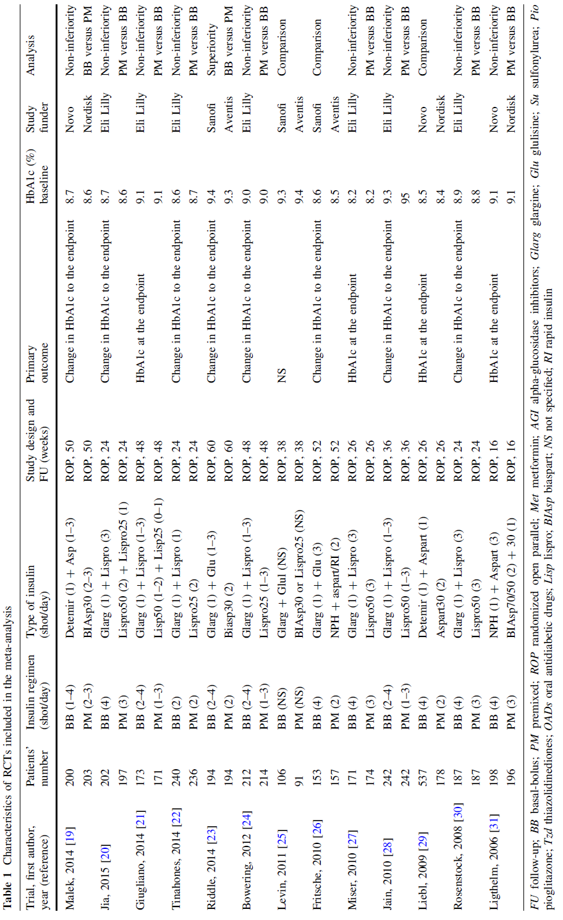

Slide 39
Primary End point: mean decrease in HbA1C
Similar HbA1c Control
0.01% difference in HbA1C
HbA1c decrease at the endpoint was -1.56 % (2.0 to -1.15) in the BB group and -1.47 % (-1.8 to -1.16) in the premix group.
A cut point of 0.3% HBA1C is used as the margin for non-inferiority
Giugliano et al. Endocrine 2016;51:417–428

Slide 40
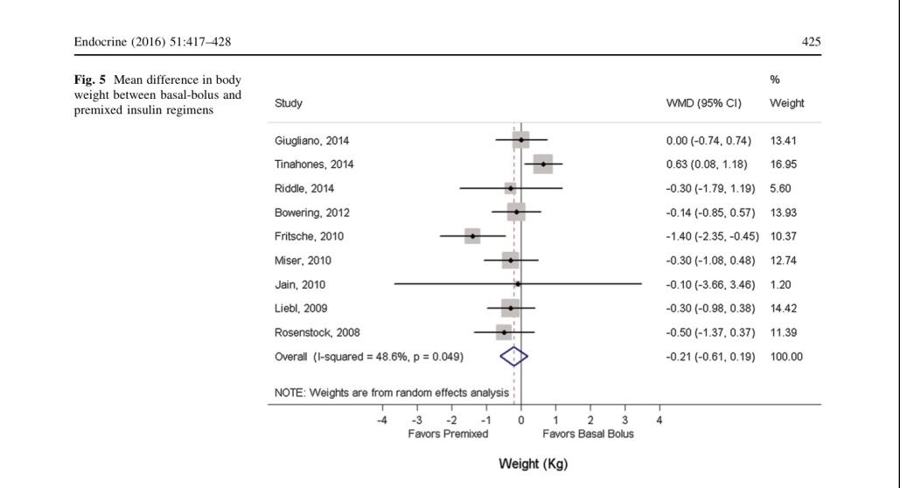
Mean difference in the incidence of hypoglycemia & body weight
Overall
Similar Hypoglycemia
Similar weight gain
1 single more hypoglycemic episode every 6.25 year in a one pt using premix
Giugliano et al. Endocrine 2016;51:417–428

Slide 41
Conclusion
BIAsp 30 in comparison with Basal-Bolus
Similar HbA1 reduction
Similar hypoglycemia
Similar weight gain
Giugliano et al. Endocrine 2016;51:417–428

Slide 42
How to begin: Premix

Slide 43
Start and stay with NovoMix® 30
NovoMix® 30 Summary of Product Characteristics.
Garber A et al. The 1-2-3 study. Diabetes, Obesity and Metabolism 2006; 0: 1–10.
Raskin P et al. On behalf of the INITIATE Study Group. Basal insulin or premix analogue therapy in type 2 diabetes patients. Euro J Int Med 2007; 18: 56–62.

Slide 44
BIAsp 30: dosage regimen
Dose to titrate | Timing of blood glucose measurements used for dose titration
 | BIAsp 30 OD | BIAsp 30 BID | BIAsp 30 TID
Breakfast | – | Pre-dinner | Pre-lunch
Lunch | – | – | Pre-dinner
Dinner | Pre-breakfast | Pre-breakfast | Pre-breakfast
BIAsp, biphasic insulin aspart; BID, twice daily; OD, once daily; TID, three-times daily
Garber et al. Diabetes Obes Metab 2006;8:58–66; Raskin et al. Diabetes Care 2005;28:260–5
Notes:
Dosage regimen of BIAsp 30:
For once daily, the evening dose titration is done based on pre-breakfast blood glucose level.
For twice-daily BIAsp 30, the morning dose is to be titrated based on pre-dinner blood glucose level and evening dose is to be titrated based on pre-breakfast blood glucose level.
If a patient needs further intensification for three-times-a-day BIAsp 30: the morning dose can be titrated based on the pre-lunch blood glucose, midday dose is titrated on pre-dinner blood glucose and evening dose is titrated on pre-breakfast blood glucose.
This algorithm was adapted from a 48-week, open-label, observational study. Enrolled patients (n=100, HbA_{1c} ≥7.5 and ≤10%) were ≥18 years of age, had diabetes ≥12 months and had received a stable antidiabetic regimen for at least 3 months. Patients discontinued prior basal insulin and added one injection of BIAsp 30 (12 U or 70–100% of prior basal insulin dose within 15 min of dinner initiation). Patients self-titrated their BIAsp 30 dose with investigator guidance every 3 or 4 days to achieve pre-breakfast fasting blood glucose (FBG) of 4.4–6.1 mmol/L. At 16 weeks, a pre-breakfast injection of 6 U of BIAsp 30 was added if week 15 HbA_{1c} exceeded 6.5%; the added dose was titrated to achieve pre-dinner BG of 4.4–6.1 mmol/L. After an additional 16 weeks, 3 U of pre-lunch BIAsp 30 was added if HbA_{1c} exceeded 6.5%. This added dose was adjusted based on 2-h post-lunch BG to achieve PPG of 5.6–7.8 mmol/L. Subjects achieving HbA_{1c} ≤6.5 at 15 and 31 weeks completed the study at weeks 16 and 32, respectively.

Slide 45
BIAsp 30: titration algorithm
FBG or pre-dinner SMBG |  | BIAsp 30 dose adjustment
(mg/dL)
<80 |  | –2 U
80–110 |  | –
111–140 |  | +2 U
141–180 |  | +4 U
>180 |  | +6 U
BIAsp, biphasic insulin aspart; FBG, fasting blood glucose; SMBG, self-measured blood glucose
Adapted from Raskin et al. Diabetes Care 2005;28:2811
Notes:
BIAsp 30 offers a simple dose titration based on FBG or pre-dinner SMBG.
This example of the BIAsp 30 titration algorithm is taken from Raskin et al. (2005). This was a 28-week parallel-group study that randomised 233 insulin-naïve patients with HbA_{1c} values ≥8.0% on >1000 mg/day metformin alone or in combination with other OADs. Metformin was adjusted up to 2550 mg/day before insulin therapy was initiated with 5–6 units BIAsp 70/30 twice daily or 10–12 units glargine at bedtime and titrated to target blood glucose (80–110 mg/dL) by algorithm-directed titration.

Slide 46
Conclusion:
Individualizing therapy and goals for pts
Premixed insulin analogues provide glycemic control similar to that of premixed human insulin
Rates of overall hypoglycemia the same between treatments
BIAsp 30 lower rate of nocturnal hypoglycemia and major hypoglycemia

Slide 47
Cont
Premix insulins may provide better glycemic control than long-acting insulin analogues with more hypoglycemic events
It seems there is no clinically relevant difference in the efficacy of BB versus premixed insulin regimens for HbA1c decrease

