Slide 2
Type 2 DM treatment Intensification
H. Delshad M.D
Endocrinologist
Research Institute for Endocrine Sciences

Slide 3
Case Discussion
A 64-year-old man was diagnosed with type 2 diabetes
9 years ago, which is currently being treated with:
Metformin (1000 mg twice daily)
Gliclazide (160 mg twice daily)
Sitagliptin (100 mg once daily)
He is overweight, with a BMI of 29 kg/m²
He does not have any diabetic complications.
He has hypertension, which is being treated with 10 mg
Lisinopril once daily, and dyslipidemia , which is being treated
with 5 mg Rosuvastatin once daily.
He has no history of cardiovascular disease or hypoglycemia.

Slide 4
SMBG
6
7
2
4
1
5
3

Slide 5
According to the latest recommendations from
the ADA / EASD , what is the most appropriate
HbA1c target for this patient?
A- ≤ 7.5
B- ≤ 7.0%
C- ≤ 6.5%
D- ≤ 6.0%

Slide 6
You tell him that you would like to intensify his anti-hyperglycemic treatment so that he can reduce his HbA1c to the target.
He does not think his current HbA1c level of 7.8% is particularly high, so
he doesn't see the need for a lower target.

Slide 7
What is the most appropriate reply to him?
A- Agree to an HbA1c target of 7.0% rather than ≤ 6.5% over
the next 3 months
B- Agree to focus initially on reducing his blood pressure and
body weight and delay intensification therapy for 3 months later.
C- Tell him that his HbA1c needs to be reduced as soon as possible
in order to minimize the risk for microvascular and macrovascular
complications associated with T2D
D- Agree to maintain his current treatment regimen for the time being
and review his HbA1c, blood pressure, and body weight in 3 months.

Slide 8
What is the most appropriate intensification regimen
for the patient at this stage?
a- A once-daily basal insulin regimen
b- A once-daily premix insulin regimen
c- A twice-daily premix insulin regimen
d- A once-daily GLP1 agonist regimen

Slide 9
Specific Goals in Management of Diabetes
Fasting plasma glucose = 80 -130 mg/dL
Post-meal plasma glucose < 180 mg/dL
A1C < 7%
Blood Pressure < 130 -140/80 – 90 mmHg
LDL < 100 mg/dL; HDL > 45-50 mg/dL
Triglycerides < 150 mg/dL
Notes:
9
Title
Subtitle

Slide 10
Relative Risk of Progression of Diabetes Complications (DCCT)
Relative Risk
Mean A1C
DCCT Research Group, N Engl J Med 1993, 329:977-986.
Notes:
10
Title
Subtitle

Slide 11
Effect of A1C On Complications in the UKPDS Study
%60
A1C
50
HbA1C
5.5%
40
6.5%
7.5%
30
8.5%
20
9.5%
10.5%
10
0
Myocardial Infarction
Microvasc Disease

Slide 12
Risk of complications
Correlation between a 1% A_{1C} decrease and reduced risk of complication
14%
14%
21%
37%
43%
Cardiovascular complications
Amputations or death from peripheral vascular disease (p < 0.0001)
Microvascular complications (p < 0.0001)
Diabetes-related death (p < 0.0001)
Myocardial infarction (p < 0.0001)
All-cause mortality (p < 0.0001)
Stratton IM, et al. BMJ. 2000:321:405-412.
Notes:
The UKPDS trial involved ~4000 patients with newly diagnosed T2D who received either conventional glucose control (diet; n=1138) or intensive glucose control.
Patients were treated for 10 years with standard or intensive glucose control (sulfonylurea/insulin n=2729; or metformin n=342). 3277 UKPDS patients were followed for an additional 10 years (without their original trial therapy).
In 2008, the additional 10 year follow-up data was published showing that, compared with conventional therapy:
relative risk was reduced in the sulfonylurea/insulin group by 9% for any diabetes-related end point (p=0.04) and 24% for microvascular disease (p=0.001)
post-trial risk reductions emerged for diabetes-related death (17%; p=0.01), myocardial infarction (15%; p=0.01) and death from any cause (13%; p=0.007).
Long-term follow-up data show that intensive BG control reduces the risk of long-term complications, compared with conventional therapy.
Holman RR, et al. N Engl J Med 2008;359:1577–89

Slide 13
Uncontrolled hyperglycaemia is a global problem
Prevalence data
80
HbA_{1c} <7.5%
60
67
HbA_{1c} ≤7.0%*
Proportion of patients achieving target HbA_{1c} (%)
51
HbA_{1c} <7.0%*
40
HbA_{1c} ≤6.5%*
37
31
20
0
CHINA
(CODIC-2)¹
CANADA
(DICE)²
USA
(NHANES)³
EUROPE
(CODE-2)⁴
*National guidelines target HbA_{1c}
¹Chen Xingbao, Chinese Health Economics 2003; Tang Ling, China Diabetic Journal 2003; ²Harris SB, et al. Diabetes Res Clin Pract 2005;70:90–7; ³Saydah SH, et al. JAMA 2004;291:335–42; ⁴Liebl A, et al. Diabetologia 2002;45:S23–8
Notes:
National and international diabetes management guidelines recommend targets for glycemic control.
Studies have looked at the proportion of patients who meet recommended HbA_{1c} targets:
Cost Of Diabetes In China Type 2 (CODIC-2; >5,000 T2D patients): 68% had HbA_{1c} <7.5%.¹
Diabetes in Canada Evaluation (DICE; 2,473 T2D patients): 51% had HbA_{1c} ≤7%.²
US National Health and Examination Survey (NHANES 1999–2000): 37% had HbA_{1c} <7%.³
Cost of Diabetes in Europe (CODE-2; 7,000 T2D patients): 31% had HbA_{1c} ≤6.5%.⁴
Around the world, many diabetes patients do not achieve HbA_{1c} targets.
In addition, when targets are more stringent, smaller proportions of patients achieve them.
1. Chen Xingbao, Chinese Health Economics 2003; Tang Ling, China Diabetic Journal 2003.
2. Harris SB et al. Diabetes Res Clin Pract 2005; 70: 90-7.
3. Saydah SH, et al. JAMA 2004; 291: 335-42.
4. Liebl A, et al. Diabetologia 2002; 45: S23-8.

Slide 14
Type 2 DM treatment
Intensification
why
?

Slide 15
Diabetes is a progressive condition
Beta-cell function continues to decline
100
75
Clinical
Diagnosis
β-Cell Function (%)
50
IGT
Postprandial Hyperglycemia
Type 2 Diabetes Phase I
Type 2 Diabetes Phase III
25
Type 2 Diabetes Phase II
0
-12
-10
-6
-2
0
2
6
10
14
Onset of
Diabetes
Years From Diagnosis
Notes:
Slide 1-24
Stages of Type 2 Diabetes
Epidemiological studies suggest that the onset of diabetes occurs 10 to 12 years before a clinical diagnosis is made. (Harris 1997) In the UKPDS study of type 2 diabetics, at least 50% of the patients had evidence of diabetic tissue damage when diabetes was first diagnosed. (UKPDS Study 16, 1995)
In the earliest phase, when beta-cell function is not impaired, the ability of the beta-cells to hypersecrete insulin masks the impaired glucose tolerance, often for years. During the IGT phase, the FPG will be higher than the normal 110 mg/dL but lower than the 126 mg/dL that is indicative of diabetes.
As beta-cell function continues to decline, mild postprandial hyperglycemia develops, reflecting the inability of the beta-cell to hypersecrete enough insulin to overcome insulin resistance. At the end of this prediabetic phase, the first phase of type 2 diabetes typically produces symptoms that lead to a diagnosis.
During phase I, in the first 2 years after diagnosis of diabetes, beta-cell function decreases to between 70% and 40% of normal function.
CORE

Slide 16
Progressive Loss of β-Cell Function in T2DM: UKPDS
100
Nonobese Patients
Obese Patients
100
80
80
60
60
β-Cell Function, %
β-Cell Function, %
40
40
20
20
0
0
0
1
2
3
4
5
6
7
0
1
2
3
4
5
6
7
Years From Randomization
Conventional
Sulphonylurea
Metformin
Notes:
16
The U.K. Prospective Diabetes Study Group (UKPDS) evaluated the efficacy of antidiabetic therapy over 6 years of follow-up and the overall incidence of diabetic complications. The study included 4209 patients newly diagnosed with type 2 diabetes who after 3 months' diet were asymptomatic and had fasting plasma glucose (FPG) levels from 6.0 to 15.0 mmol/L. The study consisted of a randomized controlled trial with 2 main comparisons: 1) 3867 patients with 1138 allocated to conventional therapy, primarily with diet, and 2729 allocated to intensive therapy with additional sulfonylurea or insulin, which increase insulin supply, aiming for FPG <6 mmol/L; and 2) 753 obese patients with 411 allocated to conventional therapy and 342 allocated to intensive therapy with metformin, which enhances insulin sensitivity.
β-Cell function deteriorated over 6 years in the 37% of patients allocated to and remaining on diet therapy at 0, 1, and 6 years, geometric means 51, 53, and 28 %β, respectively, with a significant decrease from 1 to 6 years (P<.0001). In the 50% of patients continuing on their allocated sulfonylurea therapy, geometric mean β-cell function increased in the first year from 46 to 78 %β (P<.0001), but subsequently the β-cell function decreased to 52 %β (P<.0001) at 6 years, the decrease being similar to that in those treated by diet over the same time period. In the obese patients allocated to conventional therapy and remaining on diet therapy, β-cell function also decreased, the geometric mean values at 0, 1, and 6 years being 60, 62, and 33 %β, respectively, with a significant decrease from 1 to 6 years (P<.0001). In the 56% of patients who remained on their allocated metformin therapy, the β-cell function in the first year increased from 51 to 66 %β (P<.0003), with a subsequent decrease to 38 %β at 6 years (P<.0001), similar to that in the 36% of patients treated by diet.
U.K. Prospective Diabetes Study Group. Overview of 6 years' therapy of type II diabetes: a progressive disease. U.K. Prospective Diabetes Study Group. Diabetes. 1995;44:1249-1258.

Slide 17
Type 2 DM treatment
Intensification
how
?

Slide 18
6 – 7%
7 – 8%
HbA1c
Patient /Disease Features
Risks potentially associated with hypoglycemia
Low
High
Newly
diagnosed
Disease duration
Long
standing
Life expectancy
Long
Short
More Stringent
Important
co-morbidities
Less Stringent
Absent
Sever
Absent
Established vascular complications
Sever
Motivation
Self-care capacities
Low
High
Resources and
Support system
Limited
Available
Inzucchi et al. Diabetes Care 2015;38:140-149

Slide 19
Anti-Hyperglycemic Agents
SU
GLP-1
Metformin
TZD
DPP-4-i
Insulin
SGLT-2-i

Slide 20
Choice of pharmacologic agents
●Considerations include:
Efficacy
Hypoglycemia risk
History of ASCVD
Impact on weight
Potential side effects
Renal effects
Delivery method (oral versus subcutaneous)
Cost
Patient preferences

Slide 21
Expected HbA_{1c} reduction according to intervention
Intervention | Expected ↓ in HbA_{1c} (%)
Lifestyle interventions | 1 | to | 2%
Metformin | 1 | to | 2%
Sulfonylureas | 1 | to | 2%
Insulin | Unlimited
Glinides | 1 | to | 1.5%¹
Thiazolidinediones | 0.5 | to | 1.4%
α-Glucosidase inhibitors | 0.5 | to | 0.8%
GLP-1 agonist | 0.5 | to | 1.0%
Pramlintide | 0.5 | to | 1.0%
DPP-IV inhibitors | 0.5 | to | 0.8%
Nathan DM, et al. Diabetes Care 2009;32:193-203.
Notes:
21

Slide 22
 | Efficacy | Hypoglycemia | Weight change | CV ASCVD | Effects CHF
Metformin | High | No | Neutral | Potential benefit | Neutral
SU | High | Yes | Gain | Neutral | Neutral
TZD | High | No | Gain | Potential benefit | Increased Risk
GLP-1 RAs | High | No | Loss | Neutral Benefit : Liraglutide | Neutral
DDP-4 Inh. | Intermediate | No | Neutral | Neutral | Potential Risk: Saxagliptin Alogliptin
SGLT-2 Inh. | Intermediate | No | Loss | Benefit : Canaglifluzin empaglifluzin | Benefit : Canaglifluzin empaglifluzin
Insulin | Highest | Yes | Gain | Neutral | Neutral

Slide 23
Types of Insulin
More than 20 types of insulin
Different time of onset and duration of action.
Among the criteria considered in choosing insulin are:
○ How soon it starts working (onset)
○ When it works the hardest (peak time)
○ How long it lasts in the body (duration)

Slide 24
Available insulin injections
Insulin Type | Product | Onset |  | Peak | Duration
Rapid-Acting
Aspart Glulisine Lispro | Novolog Apidra Humalog |  | 10-30 min. 10-30 min. 10-30 min. | 1 - 3 h. 1 - 3 h. 1 - 3 h. | 3-5 h. 3-5 h. 3-5 h.
Short-Acting
Regular | Humulin R Novolin R |  | 0.5-1 h. | 2-5 h. | 6 – 8 h.
Intermediate-Acting
NPH insulin | Humulin N Novolin N |  | 1 -2 h. | 4-8 h. | 8 – 12 h.
Long-Acting
Detemir Glargine Degludec (ultra- ) Premixed | Levemir Lantus Teresiba Novomix-30 |  | 30 – 60 min. 30 – 60 min. 30 – 60 min. | Minimal peak Minimal peak No peak | 16 to 24 h. 16 to 24 h. 24 to 40 h.

Slide 25
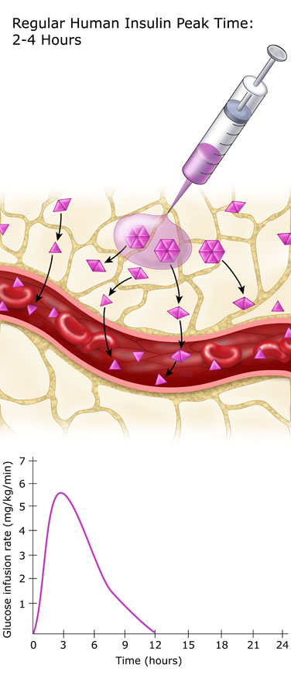
Regular Insulin
Exist in solution in hexameric form
Onset of action : 0.5 – 1 hour after SC
It peaks 2 – 4 hours after SC
The duration of action range 8 – 10 hours
It peaks much later than the blood glucose rise
Exerts its effect for too long
Risk of hyperglycemia in the first 30 minutes and hypoglycemia many hours after meals

Slide 26
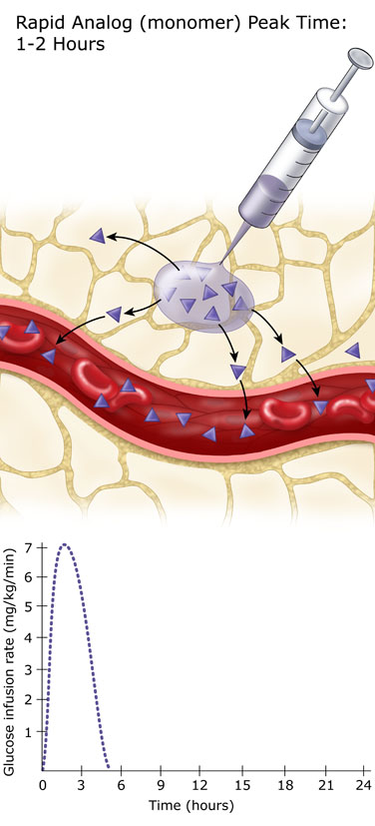
Rapid Analogs
○ Lispro
○ Aspart
○ Glulysine
Exist in solution in monomeric form
Onset of action : up to 30 min. after SC
Peaks 1– 3 hours after SC
The duration of action up to 6 - 8 hours
Peak when the blood glucose rise
No risk of hyper- or hypoglycemia
Dose given immediately pre-meal

Slide 27
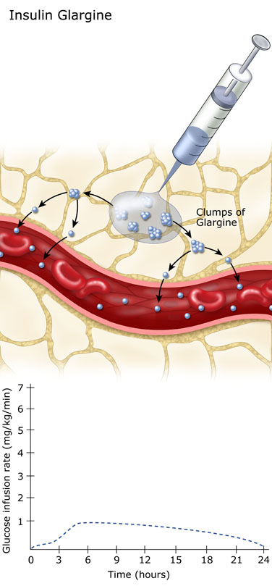
PHARMACOKINETICS :
Slow dissolution of the Glargine
hexamers at the injection site
results in a relatively constant
release with no pronounced
peak over a period of up to
24 hours.
Onset of action = 30-60 min.
Peak = minimal peak
Duration = 16-24 hours

Slide 28
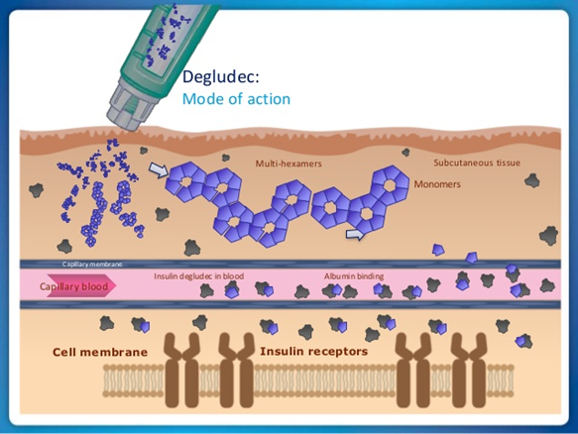
Insulin Degludec
● Newest long acting basal insulin with longer
half life (25 -40 h.)
● Following S.C injection it forms multi-hexamers
which form S.C depots
Onset of action = 30-60 min.
Peak = flat ( no peak)
Duration = 24 - 40 hours

Slide 29
Insulin Time Action Curves
Rapid (Lispro, Aspart , Glulysine)
Short (Regular)
Relative Insulin Effect
Intermediate (NPH)
Long (Glargine)
Degludec
0
2
4
6
8
10
12
14
16
18
20
Time (Hours)

Slide 30
Treatment intensification routes as the diabetes progresses (ADA 2018)
Basal-bolus
3 times Premix Ins.
A logical stepwise approuch
Basal-plus
Basal+GLP-1-RA
BID Premix Ins.
5
Basal Insulin
+OHA
4
Additional
OADs
Lifestyle
+
Metformin
3
2
1

Slide 31
T2DM Treatment: ADA/EASD position statement 2018
Healthy eating, weight control, increased physical activity
Initial monotherapy
MET
Not at target HbA_{1c} after ~3 months
SU
TZD
DPP-4i
SGLT-2i
GLP-1 RA
Insulin
Basal
Two-drug combinations*
Not at target HbA_{1c} after ~3 months
Three-drug combinations
TZD DPP-4i GLP-1RA Insulin
SGLT-2i
SU DPP-4i GLP-1RA Insulin
SGLT-2i
SU TZD Insulin
SGLT-2i
SU TZD
GLP-1RA Insulin
SU TZD
SGLT-2i Insulin
TZD DPP-4i GLP-1RA
SGLT-2i
Not at target HbA_{1c} after 3-6 months combination therapy with insulin
More complex strategies
Combination Injectable Therapy
*For patients with ASCVD, add a second agent with evidence of cardiovascular risk reduction
Liraglutide , Canagliflozin , Empagliflozin
Notes:
ADA/EASD position statement now recommends GLP-1RAs as second line agents

Slide 32
T2DM Treatment: ADA/EASD position statement 2018
Initial therapy
A1c is≥9%
Consider Dual therapy
*A1c≥10%
*BS > 300 mg
*Markedly symptomatic
Consider
Combination injectable therapy

Slide 33
Initiate Basal Insulin
Usually with Metformin +/- other noninsulin agent
Start: 0.1 – 0.2 U/kg/day
Adjust : 2 – 4 U once or twice weekly to reach FBG target
If A1c not controlled
Add 1 rapid-acting insulin before largest meal
Change to premixed insulin twice daily
Start: 0.1 U/kg or 4 units
Adjust : 1– 2 U once or twice weekly until SMBG target reached
Start: divide current basal dose into 2/3 AM, 1/3 PM or 1/2 + 1/2
Adjust : 1– 2 U once or twice weekly until SMBG target reached
Liraglutide
Start: 0.6 mg for 1st week
1.2 mg for 2nd week
1.8 mg from 3rd week
If A1c not controlled
If A1c not controlled
Add ≥ 2 rapid-acting insulin before meal
If goals not met
Change to premixed insulin 3 times daily

Slide 34
Once Daily Basal Insuline Maintains HbA1c Target for at least 2.5 Years
10
Reduced Hypoglycaemia
9
-1.6
-1.6
8
8.6
HbA_{1C} (%)
7
7.0
7.0
6
0
9
30
Time (months)
Schreiber S et al. . Curr Med Res Opin 2007 Dec;23(12):3131-6.

Slide 35
Which patient should be offered a premix versus basal- bolus/basal plus regimen?
Premix insulin analogs | Basal plus/basal bolus
Patient preference | Type 1 diabetes (any age)
Older age | Younger age
Need assistance with injections | Highly motivated and compliant
Organized lifestyle | Active lifestyle
Two meals a day or evening main meal | High variability in eating habits
Mosenzon O, et al. Diabetes Care 2013; 36(2):S212-S218.

Slide 36
Basal bolus / Prandial Insulin
Prandial
Before meals
Aspart
Glulisine
Lisporo
Basal
At bedtime or in the morning
Glargine
Detemir
Degludec

Slide 37
Fewer Nocturnal Hypoglycemic Events With Aspart vs Regular Human Insulin

Slide 38
Determining initial insulin
dosages for basal-bolus

Slide 39
How is insulin normally secreted ?
Bolus
Bolus
Bolus
Basal
Bolus (60%)
Serves to control postprandial
hyperglycemia in response to
food intake.
Basal ( 40%)
Serves to balance the rate
of hepatic glucose production
and peripheral uptake during
overnight and prolonged
periods between meals.

Slide 40
Determining initial insulin dosages for basal-bolus
Total Daily Dose (TDD) : 0.3 – 0.5 U/kg/day
Bedtime Glargine : 40% TDD
Meal Boluses Rapid-acting 60 % of TDD
- Breakfast = 20 %
- Lunch = 20 %
- Dinner = 20 %

Slide 41
Determining initial insulin dosages for basal-bolus
35-y old man, BW:90 kg
Total Daily Dose: 0.5 x 90 = 45 IU
Bedtime Glargine: 45 X 40% = 18 IU
Meal Boluses Rapidacting:
- Breakfast = 45 X 20% = 9 IU
- Lunch = 45 X 20% = 9 IU
- Dinner = 45 X 20% = 9 IU

Slide 42
Initial Dosing Guidelines for Insulin Glargine
Type of Patient
Appropriate Glargine Dosage
Initiate at 10 IU once daily , titrate appropriately
Initiate at same dosage; titrate appropriately
Reduced total daily dose by 20%-30% compared to NPH; titrate appropriately
Insulin-naïve
Switched from NPH
once daily
Switched from NPH
twice daily
Titration of Glargine to a final dose range of 2 to 100 IU is suggested
Notes:
When initiating Lantus® (insulin glargine) therapy in insulin-naïve patients with type 2 diabetes, an average dose of 10 IU once daily should be administered. Titration of Lantus to a final dose range of 2 to 100 IU is suggested¹
Patients switching from NPH once daily to Lantus should initiate Lantus therapy at the same dose and titrate the dose based on patient response¹
For patients switching from NPH twice daily, the initial dose of Lantus should be reduced by 20% to 30% to decrease the risk of hypoglycaemia. The Lantus dose should be titrated according to patient response¹
1. Lantus® (insulin glargine) EMEA Summary of Product Characteristics. Bridgewater, NJ: Aventis Pharmaceuticals; 2002.

Slide 43
Initial Dosing Guidelines for Premix Insulin
High FBS &PPG
Particularly for elevated PPG and HbA1c>8.5%
FBS & pre-dinner BG
80 – 110 mg/dl
Premix OD
6-10 IU before bedtime
HbA1c > 7 %
Premix TDS
6-10 IU before Lunch
HbA1c > 7 %
FBS > 110 mg/dl
HbA1c > 7 %
Premix BD
Total daily dose = BW/2 2/3 morning, 1/3 evening
Basal – Bolus Insulin

Slide 44
Making adjustment in insulin dosage
►Insulin Sensitivity Factor (ISF)
●ISF (For human insulin)= 1500 ÷ TDD
●ISF (For analogue insulin)= 1800 ÷ TDD
Example:
TDD= 50 (human insulin), ISF = 1500 ÷ 50 = 30
(It means that each unit of bolus decreases blood glucose by 30 mg/dl)
►Based on food intake :
- 1.0 U of Regular Insulin for every 10 gr. CAH

Slide 45
Supplemental Insulin for Correction of Hyperglycemia
Prandial insulin dosing depends upon:
• Pre-meal plasma glucose
• Meal size ( CAH contents)
Target plasma glucose:
• Fasting=80-120 mg/dl
• 2-h. post-prandial= 140-180 mg/dl
• Pre-meal = 100-150 mg/dl

Slide 46
Supplemental Insulin for Correction of Hyperglycemia
Regular insulin, insulin Aspart /Glulisine / Lispro
can be used to correct for hyperglycemia:
• Pre-meal plasma glucose = 160 mg/dl
• Meal CAH = 30 gr.
• Pre-meal target = 100 mg/dl
Bolus ( pre-prandial) insulin: 2 IU + 3 IU = 5 IU

Slide 47
Adjustments for Exercise
Exercise improves insulin sensitivity
• For morning exercise :
Reduce pre-breakfast insulin (~25%)
• For early-afternoon exercise :
Reduce the pre-lunch insulin
• For evening exercise
Reduce pre-dinner insulin

Slide 48
Case 2
56 years old man
T2DM for 15 years
BMI= 28
Med. : Metformin 1000 mg/BD, Gliben. 15 mg/daily
HbA1c = 8.5%, FBS=130 mg/dl
Post MI
What is the next step ?

Slide 49
Case 3
49 years old woman
T2DM for 9 years
BMI= 26
Med. : Metformin 1000 mg/BD, Gliclazide 240 mg/day
HbA1c = 9.5%, FBS=115 mg/dl, BS= 242 mg/dl
What is the next step ?

