Slide 1
In The Name Of GOD
Association between RS266729 polymorphism of adiponectin gene with type 2 diabet in diabetic patients in jahrom city
Saeideh Erfanian¹, kavus solhju², maryam khallashi³
1. Master of science biochemistry, Jahrom University of Medical Sciences, Jahrom, Iran
2. Department of microbiology, Jahrom University of Medical Sciences, Jahrom, Iran
3. Medical student, Jahrom University of Medical Sciences, Jahrom, Iran

Slide 2
INTRODUCTION

Slide 3
What is Adiponectin??
A signaling molecule that is secreted from white and brown adipose tissue.
Composed of 247 amino acids.
Accounts for 0.05 % of total serum protein.
Concentration: 2~20 μg/mL in the blood
Adiponectin is one such adipokine
that has recently attracted much attention.
Notes:
Some studies have shown that women have 40% higher levels of adiponectin than men. Reasons are unknown. Something to do with horomones.

Slide 4
Genetic Factors
The gene for adiponectin is located on chromosome 3q27.
This region of the chromosome has also been linked to type 2 diabetes.
A SNP located 276 base pairs downstream of the start site of the adiponectin gene was associated with increased insulin resistance and risk of developing type 2 diabetes.
Notes:
single nucleotide polymorphism (SNP) Definition: a single nucleotide differs between members of a species.
For instance, SNP 276 in white German and North American subjects was associated with increased obesity and insulin resistance

Slide 5
Structure of adiponectin
3 domains: Collagen-like domain, globular domain, and a signal sequence.
Taken from Kadowaki and Yamauchi, 2004
Notes:
Adiponectin consists of three domains—a collagen-like domain, a globular domain near the C terminus, and a signal sequence at the N terminus

Slide 6
Adiponectin
Reduced adiponectin levels are seen in patients with
cardiovascular diseases
hypertension,
metabolic syndrome

Slide 7
Why is it important to study adiponectin?
Evidence strongly suggests that adiponectin plays a role in the pathophysiology of type 2 diabetes and other metabolic syndrome diseases!!
Notes:
adiponectin directly sensitizes the body to insulin and therefore, decreased levels of adiponectin lead to insulin resistance and corresponding diseases

Slide 8
Correlation between adiponectin and insulin resistance
Obesity and type 2 diabetes are associated with decreased adiponectin levels
Reduced plasma adiponectin is also seen in people with conditions such as cardiovascular disease and hypertension, diseases that are often associated with insulin resistance.

Slide 9
IRAN consist of a multiethnic population, with different lifestyle habit and genetic backgrounds. Therefore, it is very important to investigate the association of adiponectin gene with ethnicity, dietary intake and physical activity among T2DM patients, in order to manage the overwhelming prevalence of T2DM.
objective

Slide 10
Patients & methods
Inclusion criteria: •iranian(fars) •Diabetic Type 2 with no insulin injection •Not pregnant •From 35 years old onwards | Recruitment Criteria
demographic, medical history Anthropometry Biochemical profile: glocuse, triglyceride, cholesterol, HDL and LDL | Data collection
300 T2D patients and 300 controls | Sample Size
DNA extraction PCR RFLP | Genotyping
Spss 15 | Statistical analysis

Slide 11
results

Slide 12
Clinical characteristics of the study population
P | Type 2 diabetic subjects | NGT subjects
.000 | 150/150 (%50/50) | 150/150(%50/50) | n (males/females)
0.079 | 10.8 ±52.5 | 9.5 ±51.1 | Age (y)
0.433 | 4.7±27.2 | 9.4±26.7 | BMI (kg/m2)
0.00 | 65.7±172.1 | 12.2±91.9 | Fasting plasma glucose (mmol/L)
0.00 | 53.7±202.2 | 48.1±187.4 | Total cholesterol (mmol/L)
0.417 | 29.3±48.7 | 25.1±46.9 | HDL cholesterol (mmol/L)
0.018 | 43.2±123.3 | 33.6±115.8 | LDL cholesterol (mmol/L)
0.001 | 95.5±180.4 | 78.7±155.5 | TG

Slide 13
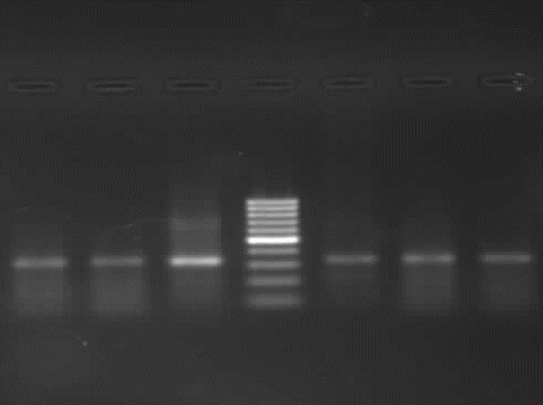
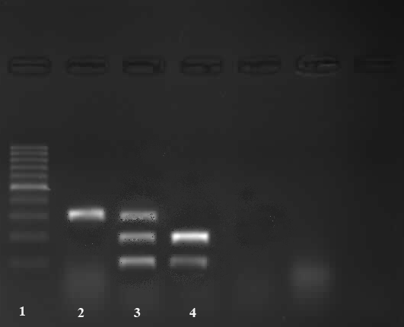
pcr
334bp
digestion
212, 122bp
212, 122bp و334 bp

Slide 14
The genotype and allele frequencies of the ADIPOQ gene
polymorphism
P | OR | Type 2 diabetic subjects (n =200) | NGT subjects (n =200) | Genotype
 |  | rs266729
0.038 | 1.88(1.037-3.420) | 36(%12) | 19(%6.3) | GG
0.327 | 0.842(0.597-10187) | 100(%33.3) | 118(%39.3) | GC
Refrence | Refrence | 164(%54.7) | 163(%54.4) | CC
0.300 | 1.144(0.887-1.475) | 172(%28.7) | (%26) 156 | Frequency of G allele
Refrence | Refrence | 428(%71.3) | 444(%74) | Frequency of C allele
0.935 | 1.014(0.735-1.398) | 164(%54.7) | 163(%54.3) | CC
 |  | 136(%45.3) | 137(%45.7) | CG+ GG

Slide 16
Sex and genotype and allele frequencies of the ADIPOQ
Genotype | SEX |  | OR | P
 | male | female
GG | 27(9%) | 28(9.3%) | 1.209(0.682-2.141) | 0.516
GC | 97(32.3%) | 121(40.3%) | 1.454(1.030-2.052) | 0.030
CC | 176(%58.7) | 151(%50.3)
GG+GC | 124(41.3%) | 149(49.7%) | 0.714(0.517-0.986) | 0.09
CC | 176(58.7%) | 151(50.3%)
Frequency of G allele | %25.2 | %29.5 | 1.244(0.965-1.605) | 0.092

Slide 17
Discussion
In this study, the frequency of G allele in polymorphism RS266729 among non-diabetic and type 2 diabetic subjects, respectively, was 26% and 28.7% .
in spite of higher frequency of this allele in diabetic patients was not statistically significant observed. (P ≥ 0.05).
However, the mutant GG genotype distribution was significantly different between the two groups (P ≤ 0.05).
these results show that the mutant GG genotype of RS266729 polymorphism in adiponectin gene are related with higher levels of FBS and is likely to propel people to be involved in type 2 diabetes.
Future studies in larger populations are required to confirm our findings and may indicate the presence of yet to be defined genetic risk factors for T2D.

Slide 18
Thanks for your attention

